Slide 1




15th Annual AUVSI RoboSub Competition – The Ides of TRANSDEC
ME Team Members: Eric Sloan, Kashief Moody, Tra Hunter
ECE Team Members: Antony Jepson, Hang Zhang, Ryan Kopinsky

Slide 2
Presentation Overview
Introduction
Functional System Diagram
Concept Descriptions
Final AUV Design + Test Results
  Complete System
  Mechanical Subsystems
  Electrical System
  Guidance System
Engineering Economics – Budget/Expenditures
Concluding Remarks

Slide 3


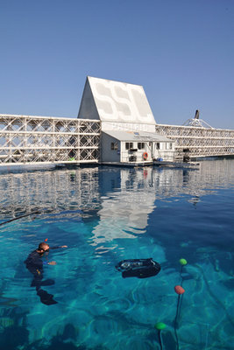
SSC Pacific TRANSDEC Anechoic Saltwater Pool

Slide 4
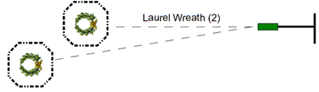
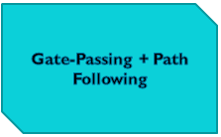
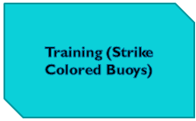

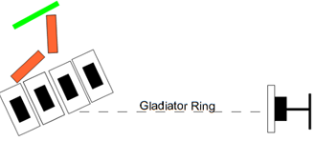
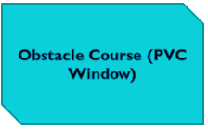
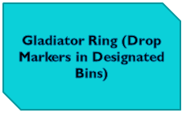
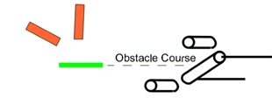
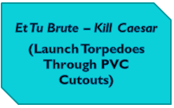
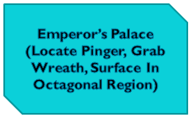
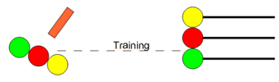

Mission Tasks
Notes:
Content is here but needs reformatting to look better. This breaks the master-slide format.
Application due 15 Dec for $100 off = $400.

Slide 5
Needs Assessment – AUV Design
Constraints
[1] Maximum AUV Dimensions – 6 ft. x 3 ft. x 3 ft.
[2] Maximum AUV Weight – 110 lbs. (85 lbs. – 110 lbs. Earns Minor Point Deduction)
[3] Time to Complete Mission Tasks – 15 min.
[4] Total Available Budget - $7,433 (Build Costs) + $4,000 (Competition/Travel Costs)
[5] Maximum Marker and Torpedo Dimensions – 2.0 in. x 2.0 in. x 6.0 in.
[6] Maximum Marker and Torpedo Weight – 2.0 lbs.
[7] Torpedoes Must Travel At “Safe Speed” (i.e. Must Not Induce Bruise Upon Impact)
[8] Maximum Open Source Power Supply Voltage – 60 VDC
[9] AUV Must Contain Remote Kill Switch to Shut Off Electronics

Slide 6
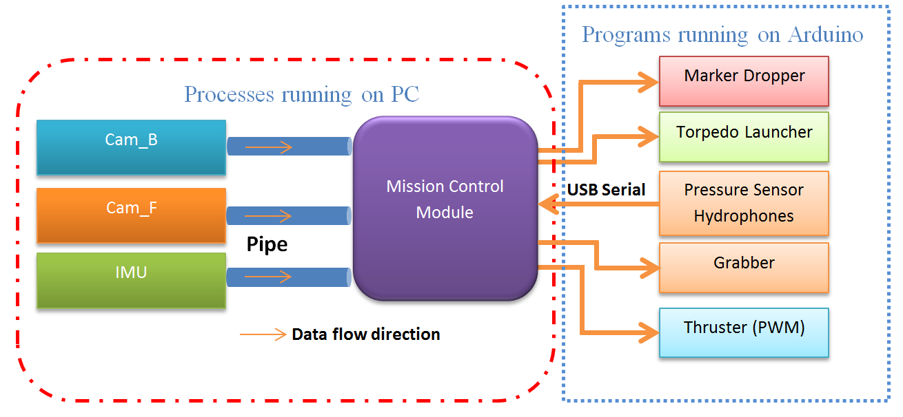
Functional System Diagram
Inertial Measurement
Unit (IMU)

Slide 7
Concept Descriptions
Hull/Frame Decision Matrix
Design Criteria | Ease of Manufacture |  | Waterproof Reliability |  | Hydrodynamics (Drag Force) |  | Weight |  | Versatility/Ease of Peripheral Subsystem Attachment |  | Cost |  | Sum
Weighting Factor | 0.25 |  | 0.20 |  | 0.10 |  | 0.15 |  | 0.20 |  | 0.10 |  | 1.00
Single Solid Enclosure | 6 | 1.50 | 5 | 1.00 | 8 | 0.80 | 5 | 0.75 | 7 | 1.40 | 7 | 0.70 | 6.15
Open External Frame + Internal Enclosure | 7 | 1.75 | 8 | 1.60 | 6 | 0.60 | 7 | 1.05 | 9 | 1.80 | 6 | 0.60 | 7.40
Biomimetic Shape (e.g. Sting Ray) | 2 | 0.50 | 6 | 1.20 | 10 | 1.00 | 9 | 1.35 | 1 | 0.20 | 4 | 0.30 | 4.65

Slide 8
Concept Descriptions
AUV Subsystem | Concept 1 | Concept 2 | Concept 3
Vehicle Propulsion | Thrusters – 6 | Pneumatic System
Grasp/Release Mechanism | Array of Claws – Scoop Object | Two Claws – Linear Translation to Actively Grab Object | Single Claw – Pneumatic Actuation to Induce Rotation of Jaws
Marker Dropper | Electromagnets | Servo Motor (i.e. Modify Original Design) | Pneumatic System
Torpedo Launchers | Self-Propelled | Pneumatic System | Spring-Loaded
Main Control Unit | Zotac Mini-PC (Intel i5 Processor) | Original BeagleBoard | BeagleBoard-xM
Camera Enclosures | Cylindrical Shape | Spherical Shape | Box Shape
Pressure Transducer | Gauge | Absolute | Sealed Gauge
 | 4 mA – 20 mA Output | 0 – 5 VDC Output
 | Stainless Steel Housing | Duplex Stainless Steel Housing | Marine Bronze Housing
Compressed Gas Distribution System | CO₂ | Air
 | Compression Fit Adapters + PVC Gas Lines | Push-to-Connect Adapters + Nylon Gas Lines | Barbed Adapters + PVC Gas Lines

Slide 9
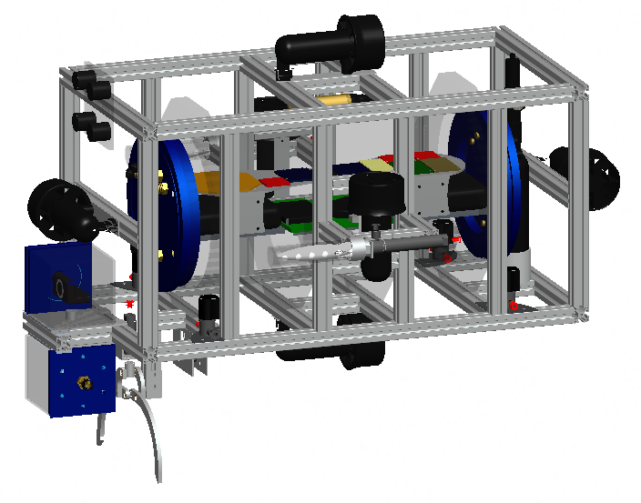
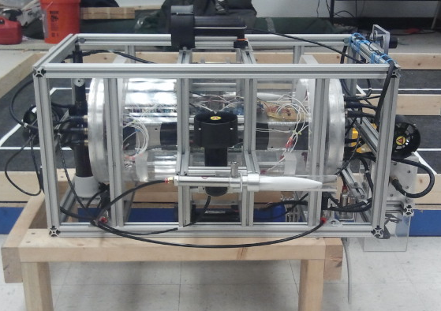
Final AUV Design
Pro/Engineer Model
Actual Photograph

Slide 10
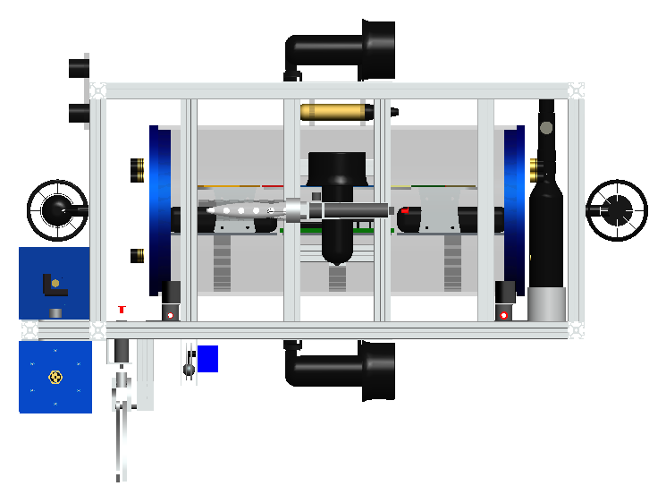
Side View
2 x 2 Hydrophone Array
IMCL Submersible
Pressure Transducer
Compressed Air Tank
+ Regulators/Gauges
Grasp/Release
Mechanism
Marker Dropper

Slide 11
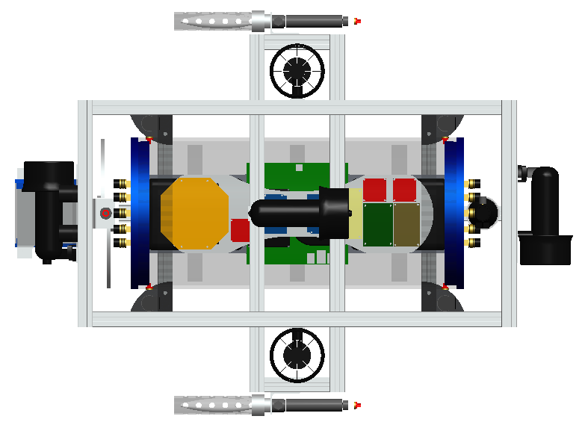
Top View
Cast Acrylic Main Hull
(Houses Electronics)
Right Torpedo Launcher
Left Torpedo Launcher

Slide 12
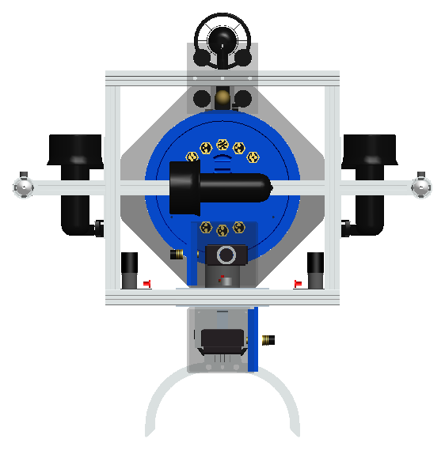
Front View
80/20 Inch Solid Extruded
Aluminum Frame
SeaBotix BTD150 Thrusters
Submersible Solenoid
Valves (Right)
Submersible Solenoid
Valves (Left)
Camera Enclosures
+ Web Cameras
Grasp/Release Mechanism

Slide 13
Tests – AUV System
Test Description | Outcome
Vehicle Weight | Pass (87.7 lbs)
Vehicle Density | Pass (0.0360 lb/in³)
Vehicle Balance | Pass
Vehicle Dimensions | Pass (37” L x 27” W x 27” H)
Watertight Hull | Pass

Slide 14
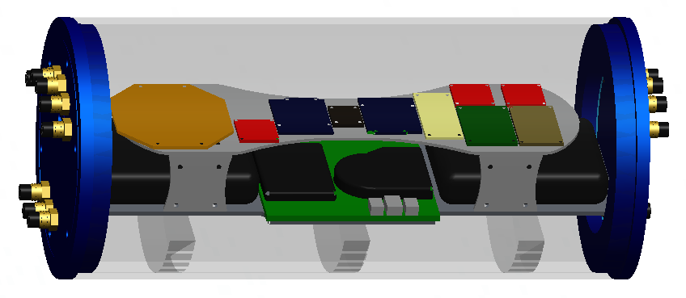
Interior Hull Layout
Hydrophone
Interface PCB
Arduino
Uno Board
Solenoid Valve
Interface Circuit
L298 Dual H-Bridge
Motor Driver
IMU
Lithium-Ion
Battery Packs
Voltage Regulator
Boards
Electronics Platform
Zotac PC

Slide 15
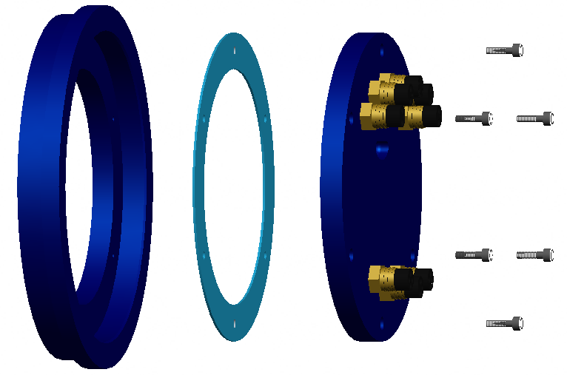
End Cap Design
Fixed Outer
End Cap
1/16” Thick EPDM Rubber Gasket
10-24 Stainless Steel Bolts
Embedded Handle for
Easier Removal
SEACON™ Underwater
Wet-Mate Connectors
Mounting Lip
Removable Inner End Cap

Slide 16
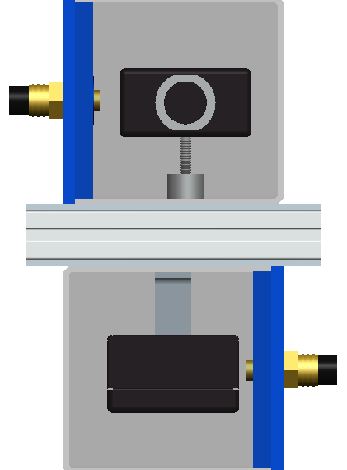
Camera Enclosures
SEACON™ Connector
C615 Logitech Web
Camera (Front-Facing)
80/20 Inch Solid Extruded
Aluminum Support
Threaded Support Rod
1/8” Thick Aluminum
Base Plate
Angle Bracket
C615 Logitech Web
Camera (Down-Facing)
4.25” x 4.25” x 4.25”
1/8” Thick
Acrylic Display Case

Slide 17
Tests – Camera Enclosures/Web Cameras
Test Description | Outcome
Watertight Camera Enclosures | Pass
Computer Vision – Gate Detection | Pass
Computer Vision – Path Detection | Pass
Computer Vision – Buoy Detection | In Progress
Computer Vision – Drop-In Bin Detection | In Progress
Computer Vision – Torpedo PVC Cut-Out Detection | In Progress

Slide 18

Compressed Air Tank and Regulators
Adjustable Outlet Pressure Knob
Secondary / Low Pressure Regulator
Pressure Gauge
1/8” NPT – ¼” OD Tube Adapter
3000 psi Rated Compressed Air Tank
Tank / High Pressure Regulator
Delrin™ Mount

Slide 19
Compressed Air Distribution System Diagram
Compressed Air Tank
Storage/Regulation
3000 psi
Distribution
High Pressure Regulator
850 psi
Low pressure Regulator
100 psi
Solenoid Valves
Grasp/Release
Exhaust
Torpedo Launcher 1
Torpedo Launcher 2
Notes:
(1st) Okay here is a look at the system level design of the CO₂ Distribution System. As you can see the Blue boxes corresponds to storage and regulation of CO₂ and the Red ones corresponds to its distribution.
(2nd) The direction arrows represents the network of tubing guiding the carbon dioxide through various stages in system to its appropriate destination

Slide 20
Tests
Test Description | Outcome
Proper Regulated Output Pressure | Pass (~100 psi)
Watertight Gas Lines (No Air Leakage) | Pass
Solenoid Valve Actuation/Integration | Pass
One-Way Check Valve Purging System | Pass

Slide 21
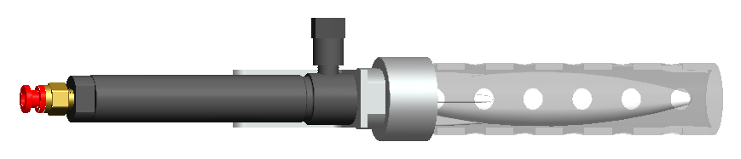
Torpedo Launcher Design
One-Way Check Valve
1/8” NPT – ¼” OD Tube Adapter
1.25” OD, 1.00” ID Cast Acrylic Barrel
(Pattern of Holes Reduces Drag During Launch)
Custom Attachment
Double-Acting Air Cylinder
Torpedo (ABS Plastic Embedded with 3/16” Diameter
Stainless Steel Rod and Neodymium Disk Magnet)

Slide 22
Tests – Torpedo Launchers
Test Description | Outcome
Torpedo Density | Pass (0.037 lb/in³)
Torpedo Balance | Pass
Torpedo Hydrodynamics | Pass
Torpedo Dimensions | Pass (0.95” L x 0.95” W x 5.00” H)
Torpedo Launch – Air | Pass
Torpedo Launch – Water | Pass

Slide 23
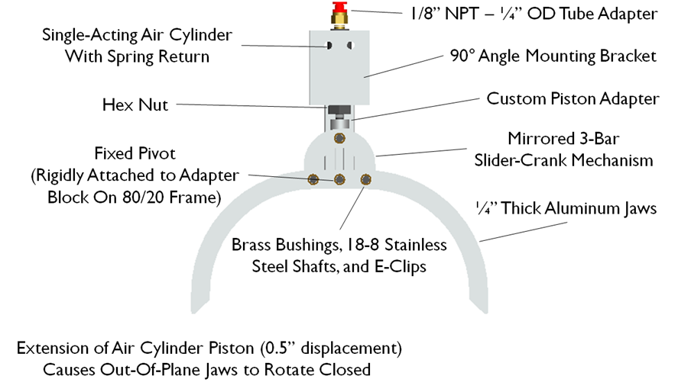
Grasp/Release Mechanism Design
1/8” NPT – ¼” OD Tube Adapter
Single-Acting Air Cylinder With Spring Return
90° Angle Mounting Bracket
Hex Nut
Custom Piston Adapter
Mirrored 3-Bar
Slider-Crank Mechanism
Fixed Pivot
¼” Thick Aluminum Jaws
Brass Bushings, Stainless Steel Shafts, and E-Clips
Design Specifications:
35 lb Linear Actuation Force @ 100 psi
3 lb Restoring Spring Force @ Maximum Piston Displacement of 0.5 in

Slide 24
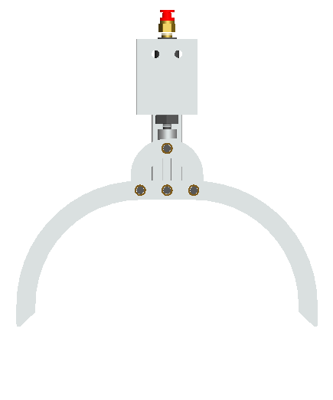
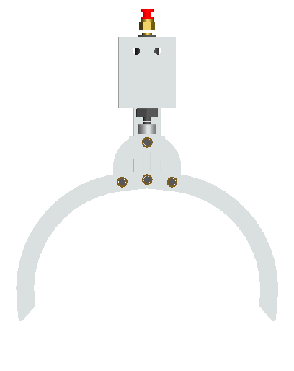
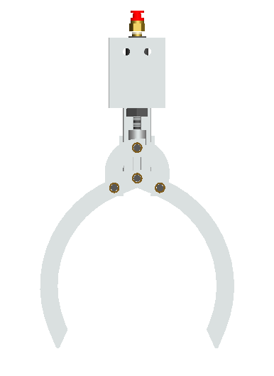
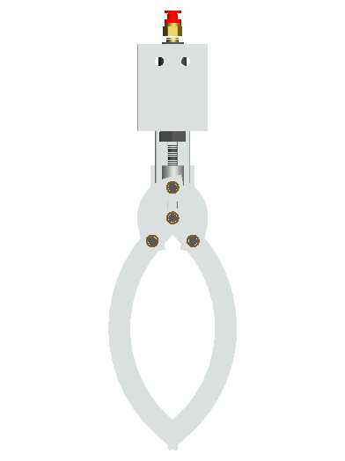
Grasp/Release Mechanism Simulation
Stage 1
Stage 2
Stage 3
Stage 4

Slide 25
Tests – Grasp/Release Mechanism
Test Description | Outcome
Simulation (Pro/E Mechanism + Adams) | Pass
Grasp/Release Test – Air | Pass
Grasp/Release Test – Water | Pass

Slide 26
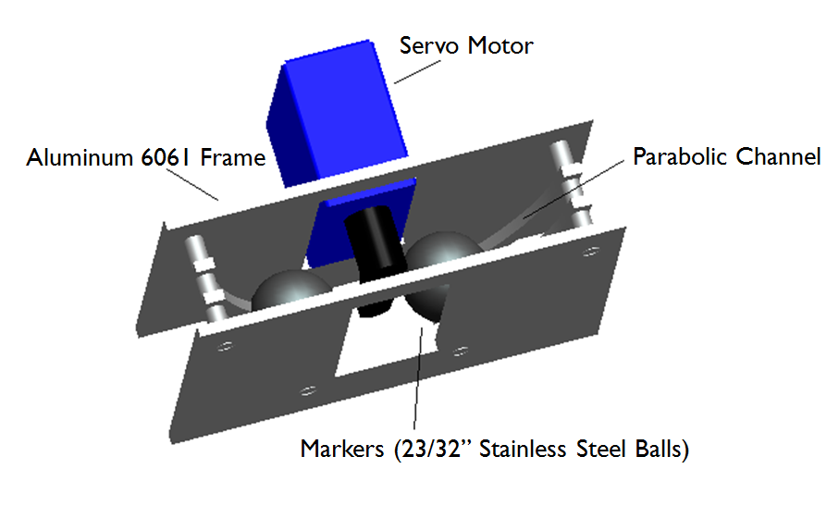
Marker Dropper Design

Slide 27
Tests – Marker Dropper
Test Description | Outcome
Servo Motor Actuation/Control (Using Dragon Board) | Pass
Marker Dropper Test – Air (Using Dragon Board) | Pass
Marker Dropper Test – Water | Pass

Slide 28
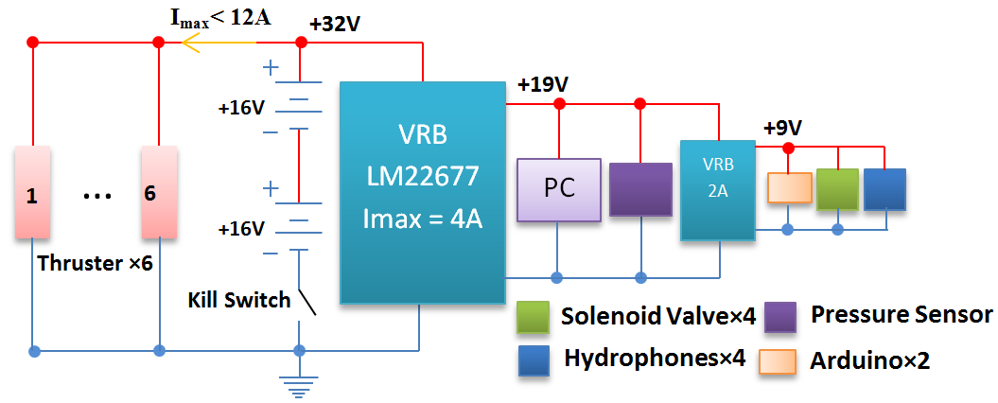
Electrical System

Slide 29
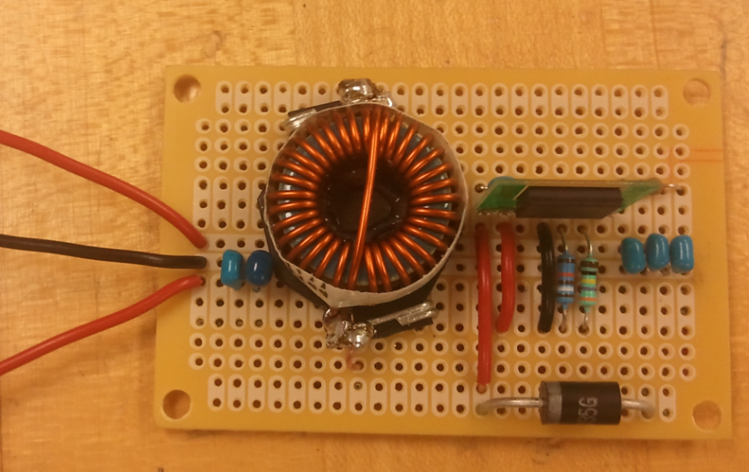
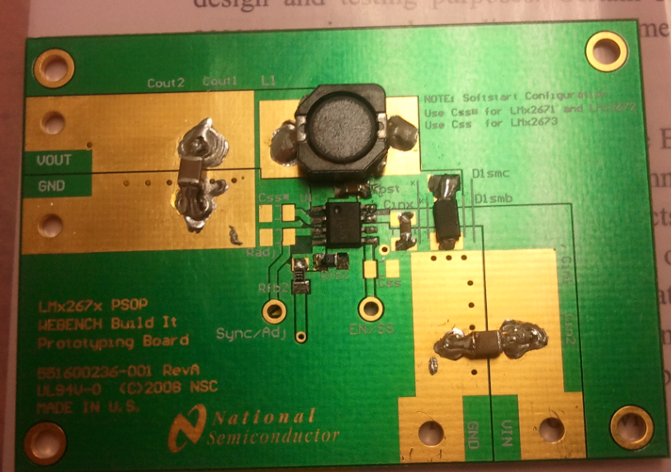
Voltage Regulator Boards
LM22677 For Zotac PC and Pressure Transducer
(Input: 32 V – Output: 19 V)
LM22676 For Arduino Uno Boards and Hydrophone Interface PCB
(Input: 19V – Output: 9 V)

Slide 30
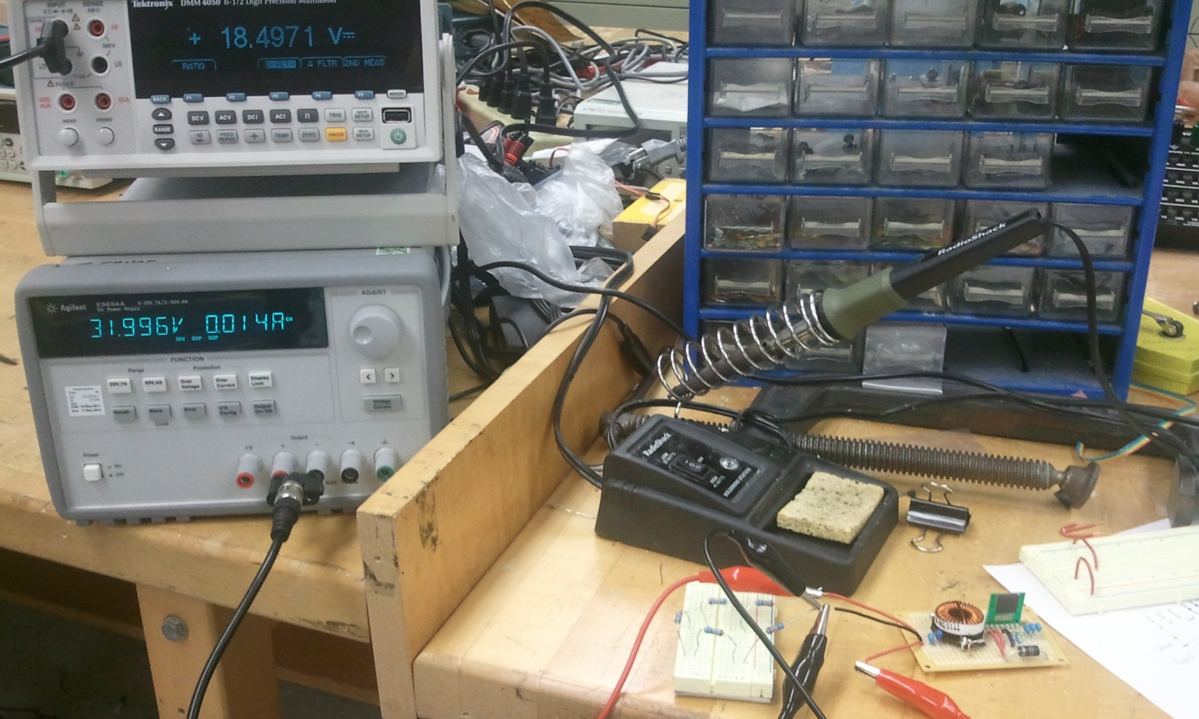
Tests – Voltage Regulator Boards
Input
Output

Slide 31
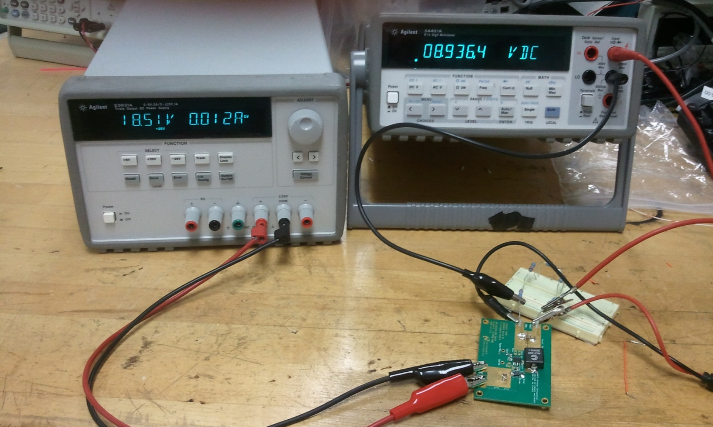
Tests – Voltage Regulator Boards
Input
Input
Output
Output

Slide 32
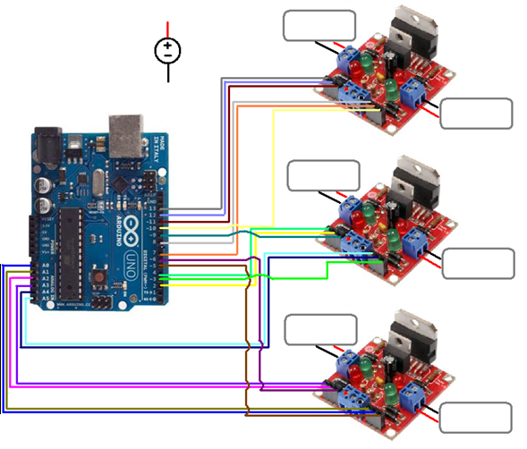
Propulsion System – Wiring Scheme
Top
32 VDC Supply
(Lithium-Ion Batteries)
Bottom
Left
Right
Front
Back

Slide 33
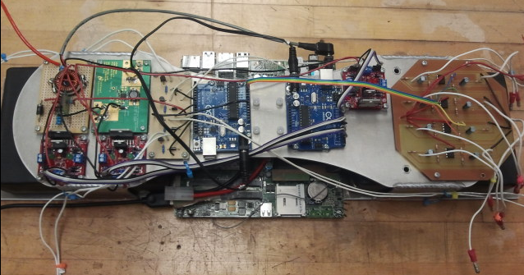
Electronics Platform

Slide 34
Mission Control

Slide 35
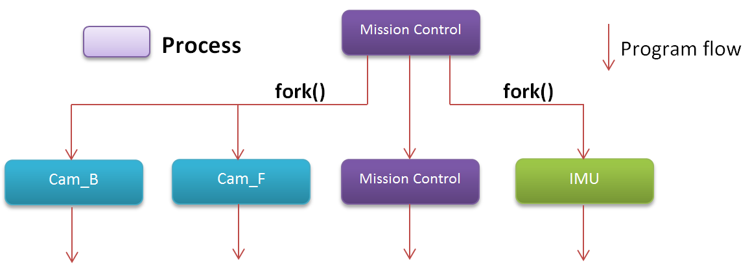
Mission Control

Slide 36
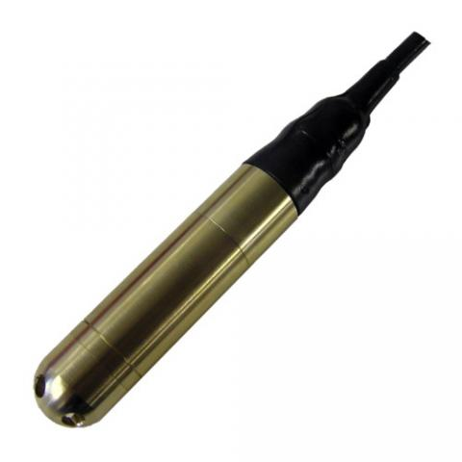
Guidance System – IMCL Submersible Pressure Transducer
Key Features:
Sealed Gauge
0 – 10 mWG Range
0 – 5 V Output
Marine Bronze Housing
PUR Cable
Ceramic Piezoelectric Sensor
Function:
Accurately Measure Depth of the AUV Underwater

Slide 37
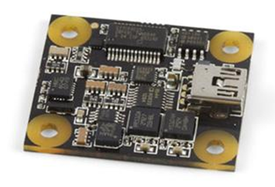
Guidance System – Inertial Measurement Unit (IMU)
Key Features:
3-Axis Gyro
3-Axis Accelerometer
Compact 1.2” x 1.4” Footprint
Micro-USB Input
Built-In System Clock/Timer
Function:
Accurately Measure Orientation, Acceleration, and Relative Position of AUV Underwater

Slide 38
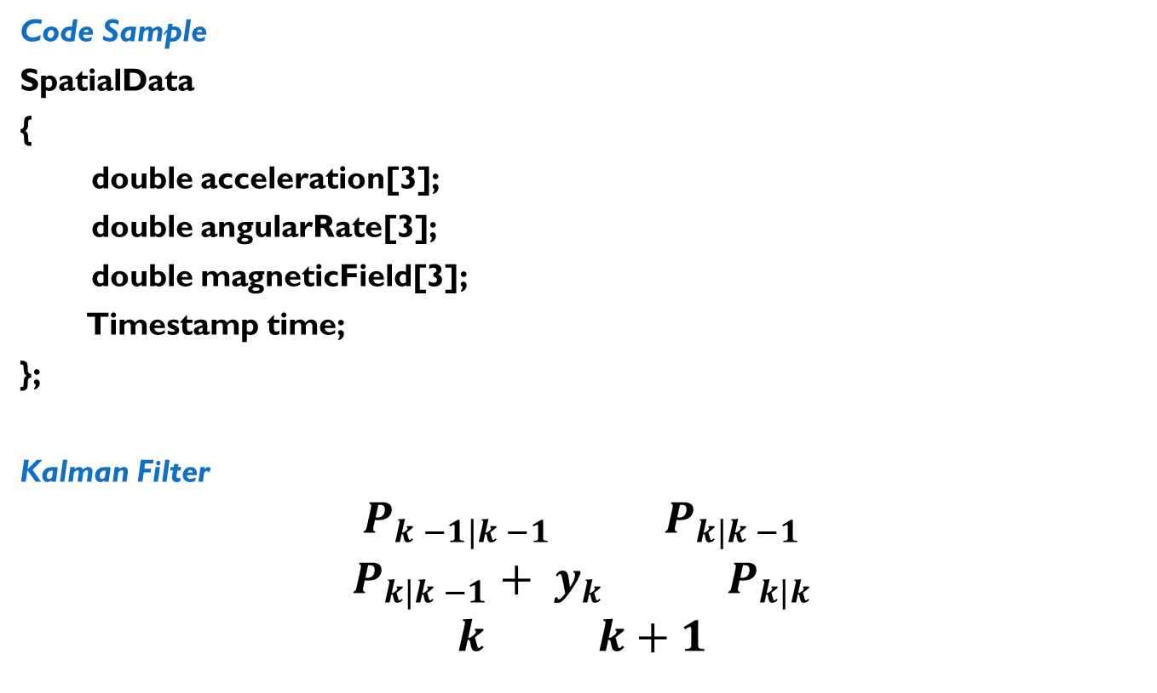
Guidance System – Inertial Measurement Unit (IMU)
Code Sample
SpatialData
{
double acceleration[3];
double angularRate[3];
double magneticField[3];
Timestamp time;
};
Kalman Filter
$$P_{k −1|k −1} P_{k|k −1}$$
$$P_{k|k −1}+ y_{k} { P}_{k|k}$$
$$k k+1$$

Slide 39
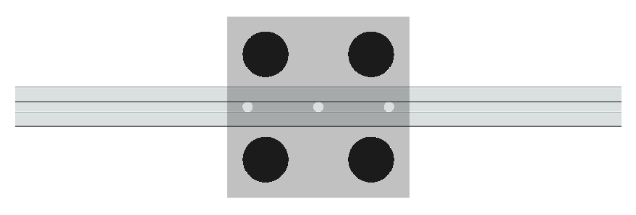
Guidance System – Hydrophone Array
Key Features:
Omnidirectional Sensitivity
Compact Size (1.13” x 1.13” x 1.2”)
High Impedance Cable Sheathing
SQ26-01 Towed Array Hydrophone
80/20 Inch Solid Aluminum
Support Bar
Function:
Detect the Acoustic Pinger Signals in Order to Triangulate the Location of the Laurel Wreath

Slide 40
Guidance System – Acoustic Pinger Detection and Triangulation Process
Hydrophones Sense Pinger Signals
Interface PCB Amplifies Signal to 0 – 5 V Range
A/D Converter Outputs Digital Value from 0 – 1023
Software Program Relates Time Delays to Pinger Location
AUV Target Direction (i.e. Thruster Commands) Set

Slide 41
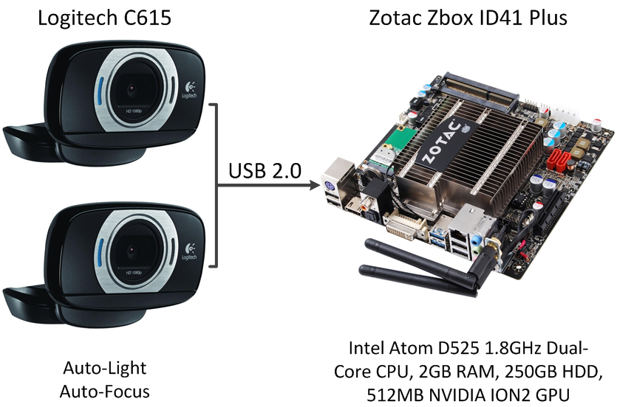
Guidance System – Computer Vision

Slide 42
Computer Vision Framework
Features
Modules can be reused
Optimized for performance/ efficiency
Modules
Find FPS
Save Images
Color Filter
Find Task
  Find Gate
  Find Path
  Find Buoy
Send To Mission Control

Slide 43
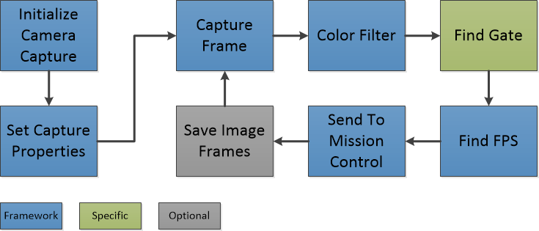
Computer Vision Framework
Structure

Slide 44
Computer Vision Framework – Color Filter
Mat colorFilter(const Mat& src)
{
//-- Type: 8bit image, 3 channels, unsigned char
assert(src.type() == CV_8UC3);
Mat hsv, thresholded;
//-- cvtColor(source, destination, color_space, destination_#channels)
cvtColor(src, hsv, CV_BGR2HSV,0);
//-- inRange(hsv, hsv_min , hsv_max, thresholded)
inRange(hsv, Scalar(hue_min,sat_min,val_min), Scalar(hue_max,sat_max,val_max), thresholded);
return thresholded;
}
Electronics → Computer Vision

Slide 45
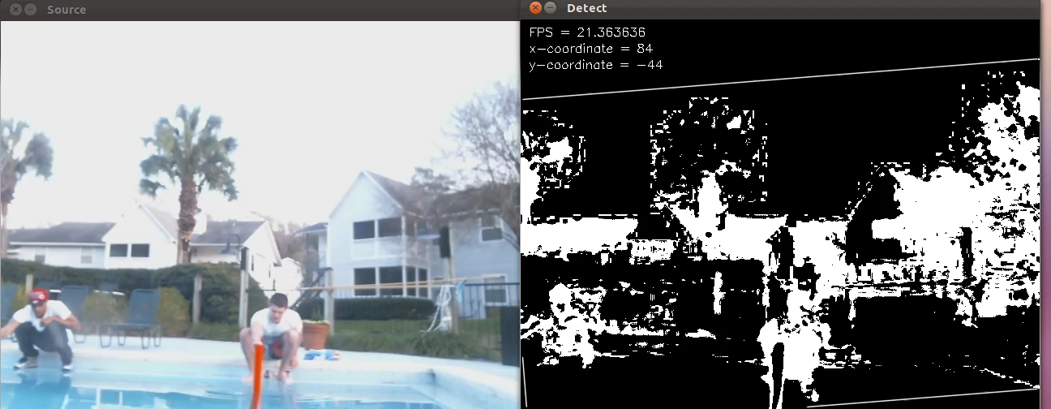
Computer Vision Framework – Find Gate

Slide 46
Tests
Test Description | Outcome | Notes
Color Filter | Pass | N/A
Find FPS | Pass | 17 - 22 FPS Per Web Camera
Send to Mission Control | Pass | Center Coordinates + Timestamp Sent to Mission Control
Save Image Frames | Pass | N/A
Find Gate | Pass | Center + Corner Coordinates, FPS, Height, Width, Angle Displayed

Slide 47
Budget – Project Expenditures
Fall Expenditures | Item Description | Price
 | 80/20 Framing + Fasteners | $359.88
 | Cast Acrylic Hull + Torpedo Cannons | $340.19
 | SeaBotix BTD150 Thrusters | $1005.18
 | SEACON Underwater Micro Wet-Mate Connectors | $1191.14
 | Raw Materials (Aluminum/Acrylic) | $974.52
 | Miscellaneous | $883.44
Spring Expenditures | Compressed Air Distribution System | $443.56
 | SQ26-01 Hydrophones (2) | $410.75
 | SEACON Underwater Micro Wet-Mate Connectors | $183.33
 | IMCL Submersible Pressure Transducer | $401.87
 | Zotac PC | $293.98
 | Microcontrollers, Interface Circuits, Motor Drivers | $578.52
 | C615 Logitech Web Cameras | $108.49
 | Miscellaneous | $733.06
Summary | Build Total | $7,907.91

Slide 48
Budget – Competition Expenditures/Summary
Competition Expenditures | Item Description | Price
 | Travel/Shipping/Lodging Expenditures | $6,700.00
 | Competition Fee | $500.00
Summary | Project Total | $15,107.91
 | Current Budget | $11,433.00
 | Remaining Balance | -$3,674.91

Slide 49
Conclusion
Completed Objectives
  Vehicle Mechanically Complete
    Watertight Enclosures
    Proper Weight, Density, and Balance Obtained
    General Maneuverability Via Thrusters Achieved
    Conductive Heat Dissipation Network Inside Main Hull
    Functioning Mechanical Subsystems Integrated with Electronics
  Computer Vision
    C615 Logitech Web Cameras Installed Inside Enclosures
    Gate Detection Completed (Software)
    Path Detection Completed (Software)

Slide 50
Conclusion
Remaining Goals
  Integrate Inertial Measurement Unit (IMU) and Sealed Gauge Pressure Transducer
  Establish PID Controllers in Navigation/Stability Control Algorithms
  Progress/Refine Computer Vision and Mission Control to Enable the Successful AUV Completion of the Following Mission Tasks:
    Gate-Passing
    Training
    Obstacle Course
    Gladiator Ring
    Et Tu Brute (“Kill Caesar”)
      Laurel Wreath and Emperor’s Palace Task Will Likely Not Be Attempted

Slide 51
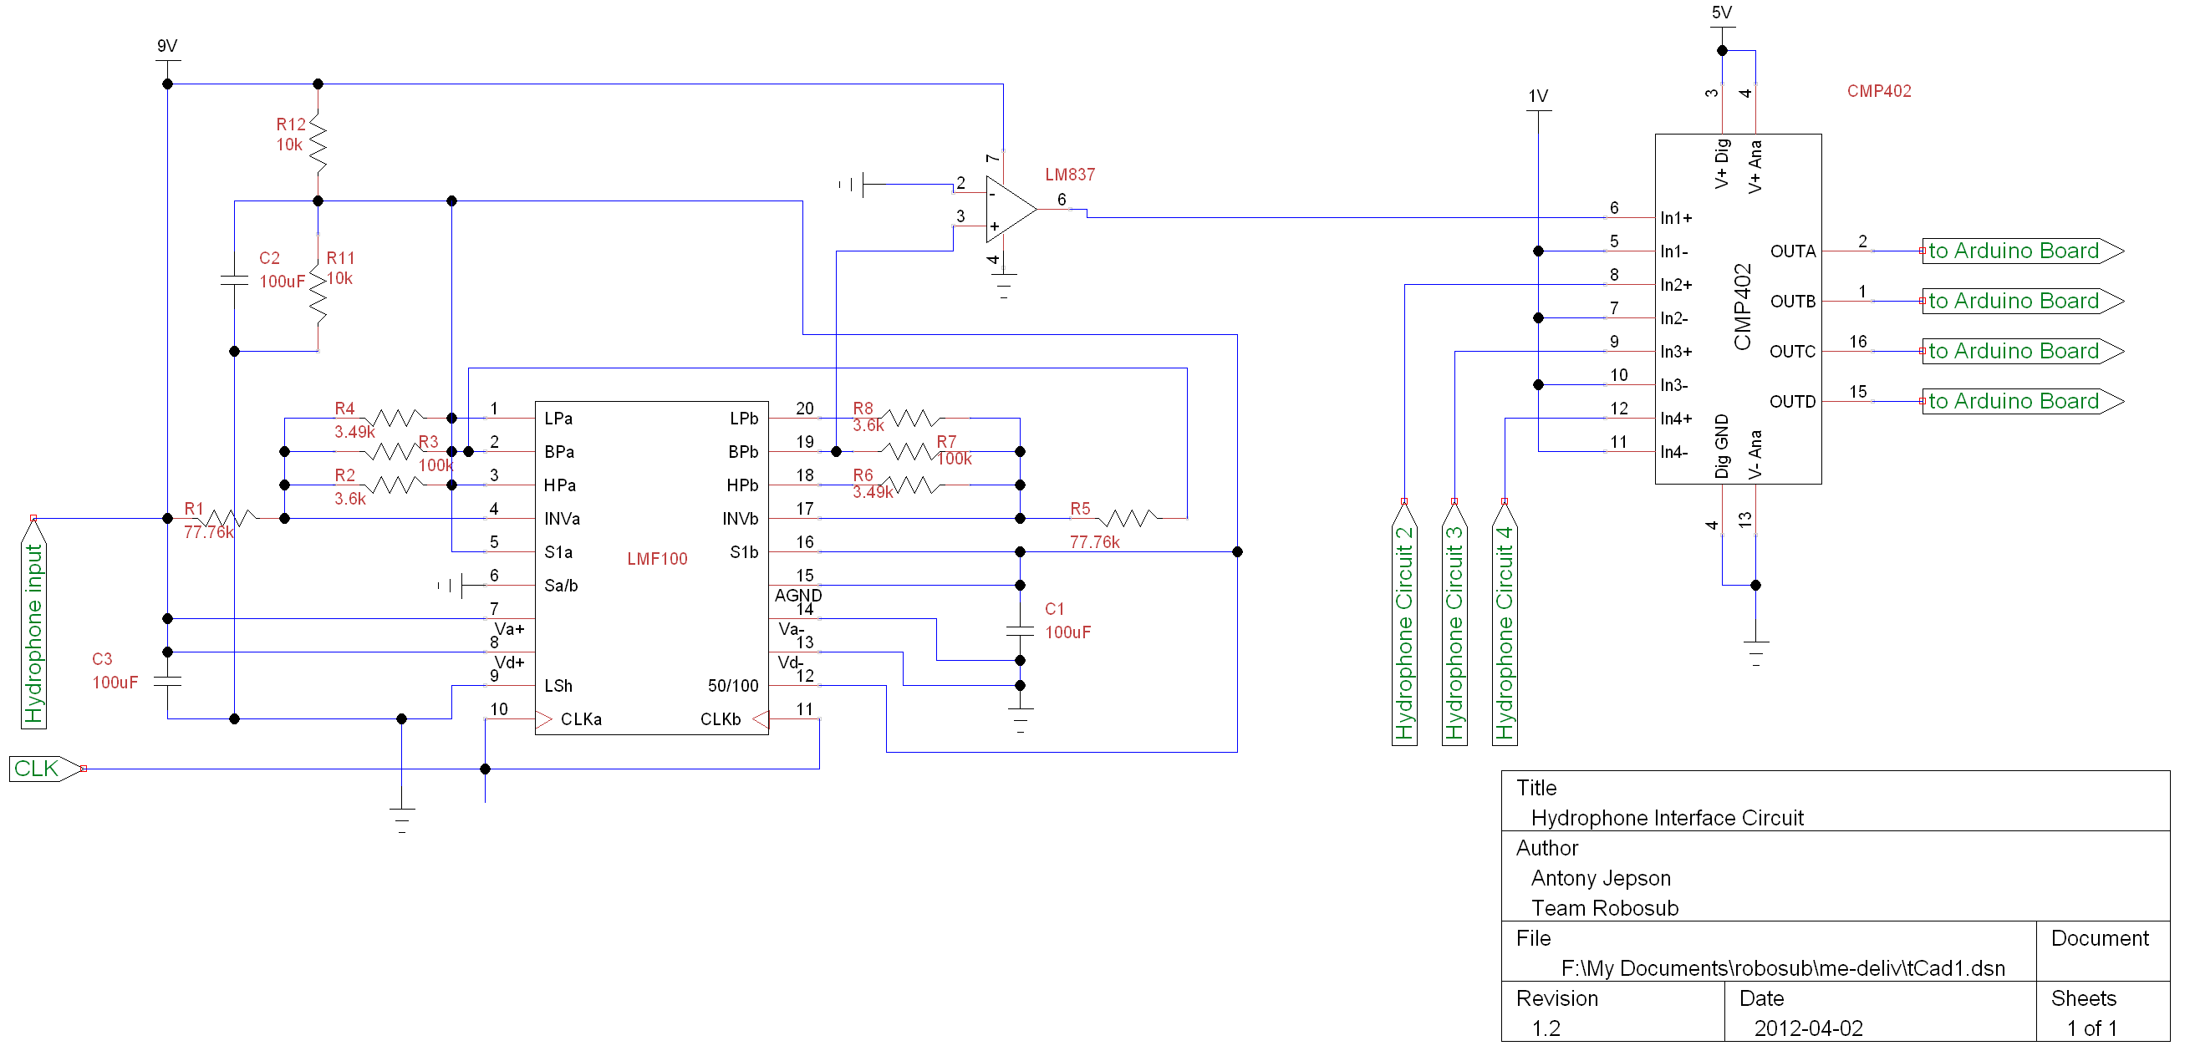
Hydrophone Amplification Circuit
Antony
Electronics → Guidance System
Notes:
TODO Change to software architecture diagram.

Slide 52
Hydrophone Amplification Circuit
Antony
Electronics → Guidance System
Notes:
TODO Change to software architecture diagram.

Slide 53
Hydrophone Amplification Circuit
Antony
Electronics → Guidance System
Notes:
TODO Change to software architecture diagram.

