Slide 1
Progress Report 1
Team 25 COSMICi
Mechanical Engineers
George Chakhtoura
Brian Kirkland
Electrical/Computer Engineers
Aarmondas Walker
Samad Nurideen
Juan Calderin Michael Dean

Slide 2
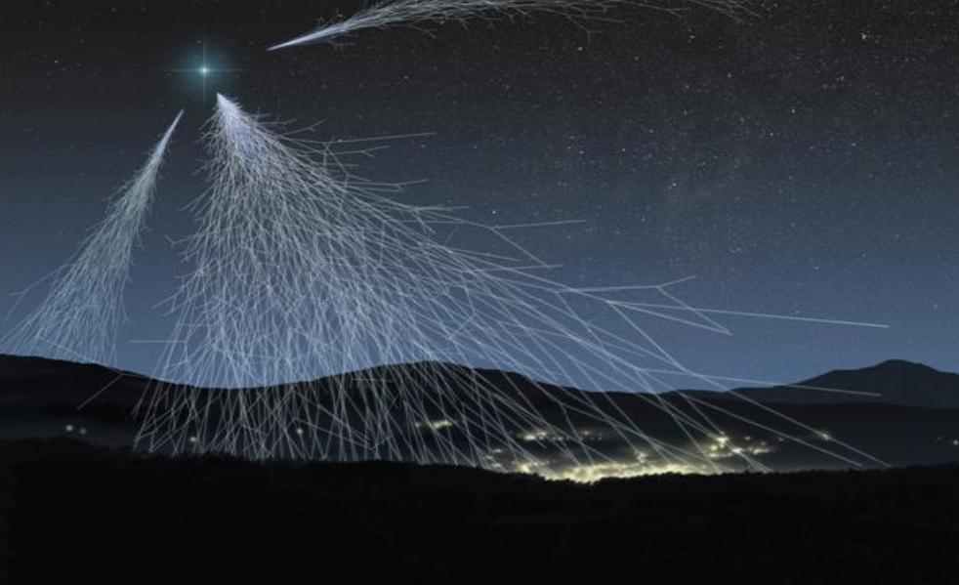
Project Goal
Install and implement a network of Cosmic Ray detectors that will triangulate the origins of UHECR (Ultra High Energy Cosmic Rays) shower events
•Cosmic Ray Showers enter earth from outer space. •Showers are detected by Scintillators and Photomultiplier Tubes (PMT) setup. •Emits light when excited by radiation.
•Light is detected by Photo Multiplier Tube and amplified.
•Signal is sent to the electronics board.
•FPGA board analyzes pulses from PMT and records the data on a server.
•Apply data along with Google Sky maps to Triangulate Cosmic Ray origin.

Slide 3
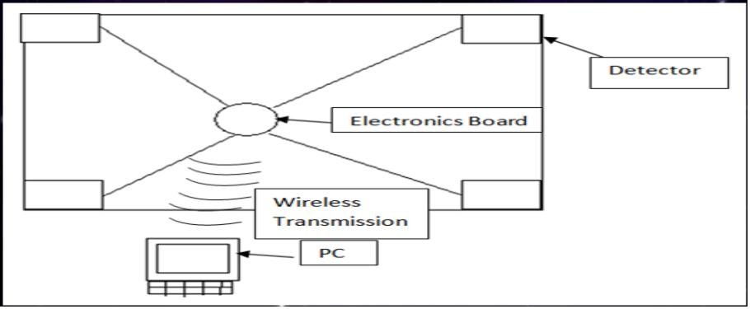
Approach
Simple Design due to limited space and low budget.
A redesign of current cooling system to prevent water damage on circuit board and obtain lower operation temperature.
Create necessary enclosure to protect all electronic components.
Main components need to be visible for learning experience of viewers and users. i.e All three detectors and the electronics enclosure.
Data needs to be sent to a server for logging and processing i.e. a visual representation.

Slide 4
Problems Encountered
Structural Support Design.
Challenger Learning Center Structural Regulations.
Three structural design plans.
Detectors and Enclosure placement issues due to CLC room layout.
Loss of team member at critical design point left significant work load of structure analysis and testing to be redistributed among remaining members.

Slide 5
High-Speed Components and Bit-Width Reduction
System was tested at FAMU lab with successful data retrieval.
Approaching the conclusion of software coding using Python.
Currently creating increase for the FPGA board operational frequency from 200MHz to 500MHz.
Brings time precision into +/- 1ns
Waiting for arrival of power and coaxial cables for CLC wiring.

Slide 6
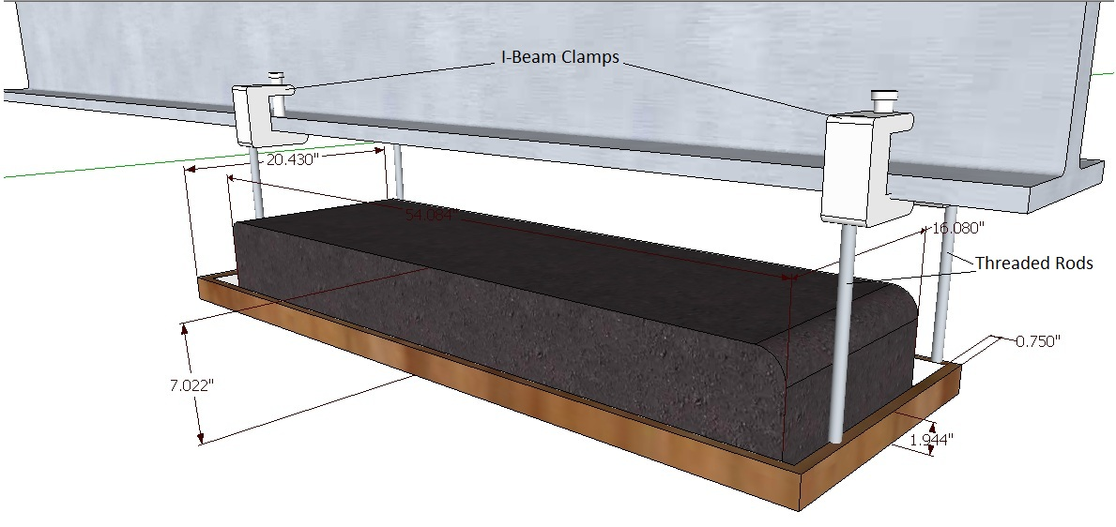
Structural Support
Support Structure analysis had been concluded.
Most necessary components will be ordered Monday Jan 22nd.
Detector shelving design still underway.

Slide 7
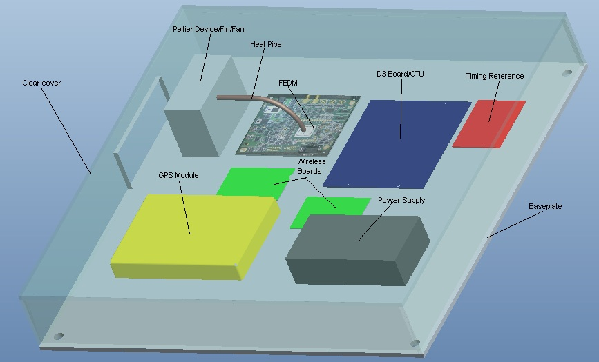
Component Enclosure & Cooling System

Slide 8
Component Enclosure & Cooling System Cont…
Copper rod and thermoelectric cooler have been obtained.
Awaiting arrival of copper fin/fan heat sink component.
Heat transfer testing will begin upon component arrival between Wed Jan 25th and Friday Jan 27th.
All circuit board placement has been finalized and will begin fitment upon arrival of all enclosure components. (Anticipated arrival date for enclosure components Jan. 27th. )

Slide 9
Summary
Close to software coding finalization.
All parts excluding shelving have been ordered.
Next step’s
Copper rod testing.
Circuit board placement and fastening on enclosure.
Determine Structural support shelving design.
Testing system supports.

