Slide 1
Semi Autonomous Palm Pruner
Analyze Phase
Presented by Group 26:
Obie Abakporo
Bill Carpenter
William Craig
Juan Antonio Rojas
Christopher Xavier Smith
Sarah Trayner

Slide 2
Introduction
The Palm Pruning project is focused on providing an efficient, economical, and effective means of harvesting fruit from oil palms
Oil Palms grow 40-60 feet
Palm oil is worth 50$ a barrel
Reduce the dangers associated with harvesting oil palm tree fruit
Accomplished task by designing a Computer Integrated Robot

Slide 3
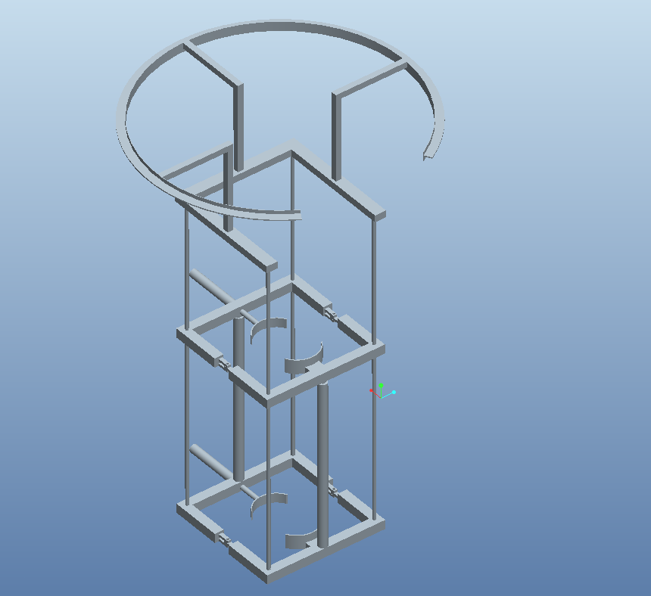
King Climber Design
Robot Components
Frame
Actuators
Guiding Rails
Cutting Track
Manipulator Arm
Camera
Ground Based
Components
Generator
Remote Control
Display Screen
Operator

Slide 4
Spring Scheduling Tools
Gannt chart
Mechanical Timeline Goals
Major Report Due Dates
Staff Meetings
Shop Times
Critical Path Analysis
Avoids bottleneck stops in construction
Gives earlier start times for longer portions
Provides a continuous flow of production

Slide 5
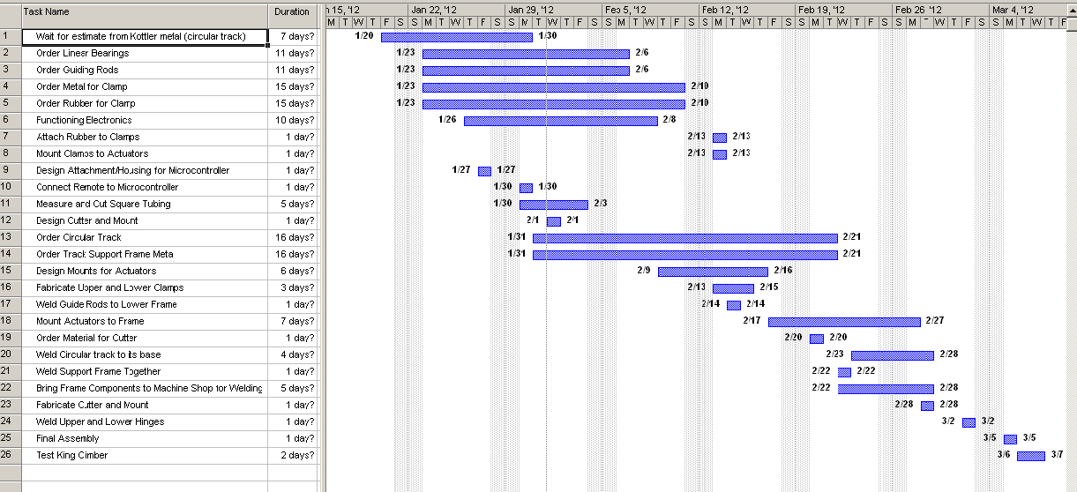
Gannt Chart

Slide 6
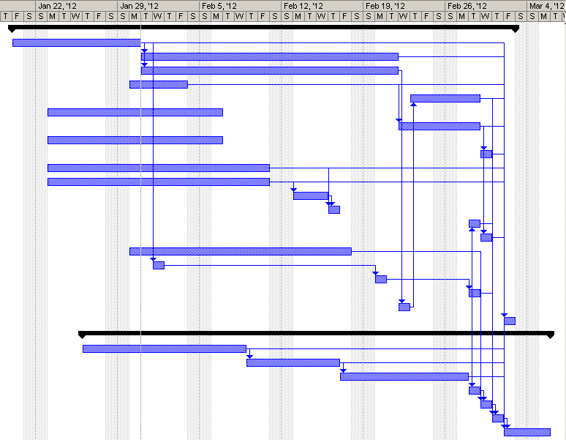
Critical Path Analysis

Slide 7
Diminishing Labor
The current labor force is shrinking.
Local seasonal workers are finding safer income elsewhere.
In 3 to 5 years there will be a shortage of labor willing to climb trees.
Project focus is not to compete with current climbing workforce but to replace this dangerous position.

Slide 8
Processing Times
Comparison of robotic processing with current labor methods of harvesting in terms of time.
Time (in minutes)` | Process
 | Machine | Human
Climb | 13.5 | 10
Cut | < 5 per bunch | 1 per bunch
Descend | 13.5 | 10
Unhook | 5 | 10
Transport | 2 | < 1
Setup | 5 | 10

Slide 9
Venn Diagram

Slide 10
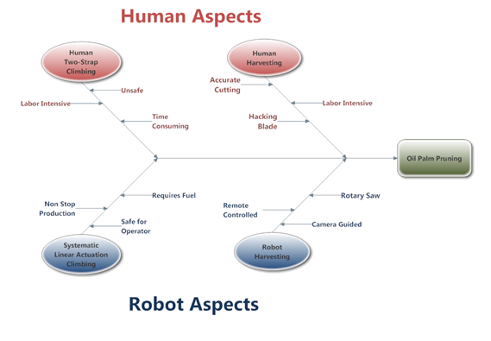
Fishbone Diagram

Slide 11
Cost Analysis
Create a working design while staying economical
The view point of our project sponsor
The view point of a potential investor
Determined Future Worth Projection
Predict the increasing cost of labor
Various tools and formulas used for these conclusions

Slide 12
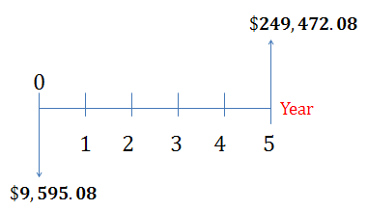
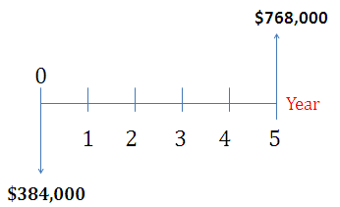
Cost Analysis
Calculated selling cost
Selling Price = Total Cost (1 + Mark-Up Percent)
Return of investment
ROI= (Final Cost – Intial Cost) / Final Cost
Future Worth Projection
Projected Cost of Labor (20 Workers)

Slide 13
Sponsor Questionnaire
-What is the average time for a worker to climb up a tree?
10 mins
-What is the average time for a worker to cut a palm oil’s fruit bunches?
1.0 min per bunch
- What is the average time it takes to walk from oil palm to oil palm?
Depends on population density, average less than 1 min
-What is the average setup time before going up a tree?
10 mins
- What is the average number of workers working in a 1 hr?
Depends on population density, average of 20
- What is the average number trees that can be cut in 1hr?
Depends on number of bunches
-What is the average distance between trees?
10 ft.
-What is the number of hours that workers work?
~ 6 hrs
-What is the average salary for a palm pruner?
$2 per bunch cut
-What is the physical stress on the body of a palm pruner from climbing up a tree?
Just imagine!

Slide 14
Next Phase
The next phase according to DMADV is Design.
Being that we have already designed our product for the fall semester will use this time for building and fabrication.
Next presentation we will have actual data and pictures from our design

Slide 15
Questions?

