Slide 1
Semi-Autonomous Palm Pruner
By
Department of Industrial Engineering:
Bill Carpenter
Juan Rojas
Sarah Trayner
&
Department of Mechanical Engineering:
Obie Apakporo
William Craig
Xavier Smith
Project Sponsor
Dr. Okenwa Okoli, Associate Professor
FAMU-FSU College of Engineering
Department of Industrial Engineering
Department of Mechanical Engineering

Slide 2
Overview
Introduction
Project Challenges
Conceptual Designs
Design Selection
Design Analysis
Engineering Economics
Conclusion

Slide 3
Introduction
The Palm Harvester project is based on providing an efficient, effective, economical, means of harvesting oil palms
Current methods are primitive
Senior design group is developing a computer-integrated robot that can climb and harvest the oil palm fruits

Slide 4
Palm Oil Output
Products: coconut oil, margarine, shortening, cosmetics, cleaning supplies
Business appeal: Creation of innovative method could lead to profit
Country/Region | Palm Oil Output (million metric tons) | World Share
Malaysia | 14,962,000 | 44%
Indonesia | 14,000,000 | 42%
Nigeria | 800,000 | 2%
Thailand | 685,000 | 2%
Columbia | 661,000 | 2%
Papua New Guinea | 310,000 | 1%
Cote D’Ivoire | 260,000 | 1%
Brazil | 160,000 | 0%

Slide 5
Challenges
Main constraints include:
Safety factors (palm tree and harvester)
Optimizing Design
Maintain low skill level for harvester
Semi-autonomous
$2000 budget
Milestones
Innovate and Develop:
Two-piece robot with clamps that secure an upward and downward movement along the trunk

Slide 6
Diminishing Labor
The current labor force is shrinking
Local seasonal workers are finding safer income elsewhere
In 3 to 5 years there will be a shortage of labor willing to climb trees
Project focus is not to compete with current climbing workforce but to replace this dangerous position.

Slide 7
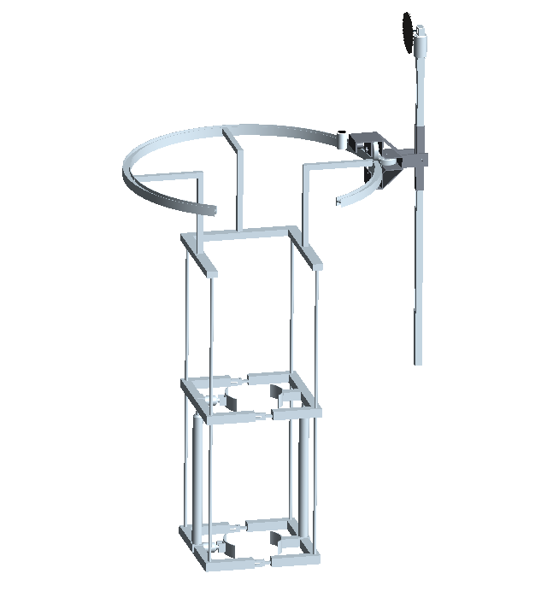
Concept 1 – King Climber
Components
Frame
Actuators
Guiding Rails
Cutting Track

Slide 8
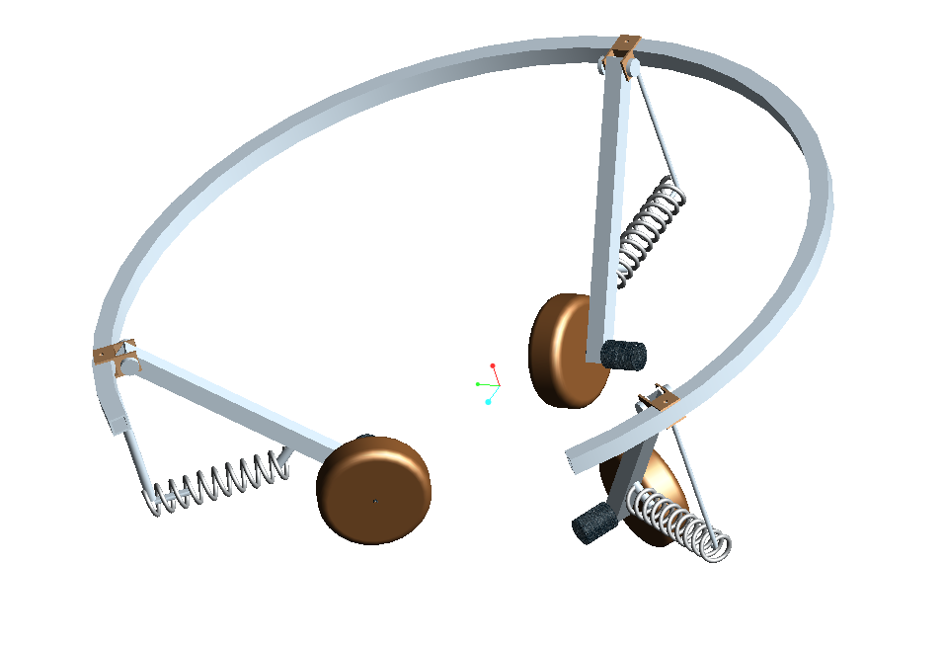
Concept 2 – Rolling Thunder
Components
Circular Frame
Legs
Wheels
Motors
Springs

Slide 9
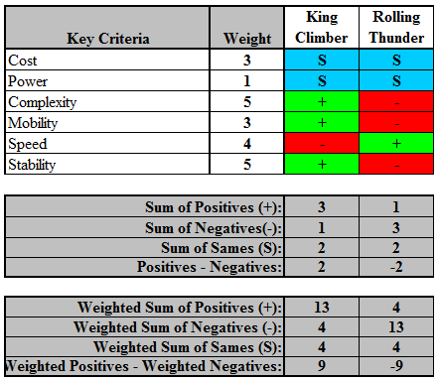
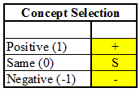
Pugh Selection Method
Matrix Key

Slide 10
Final Selection
KING CLIMBER WINS!
More stable
Best user safety
More effective

Slide 11
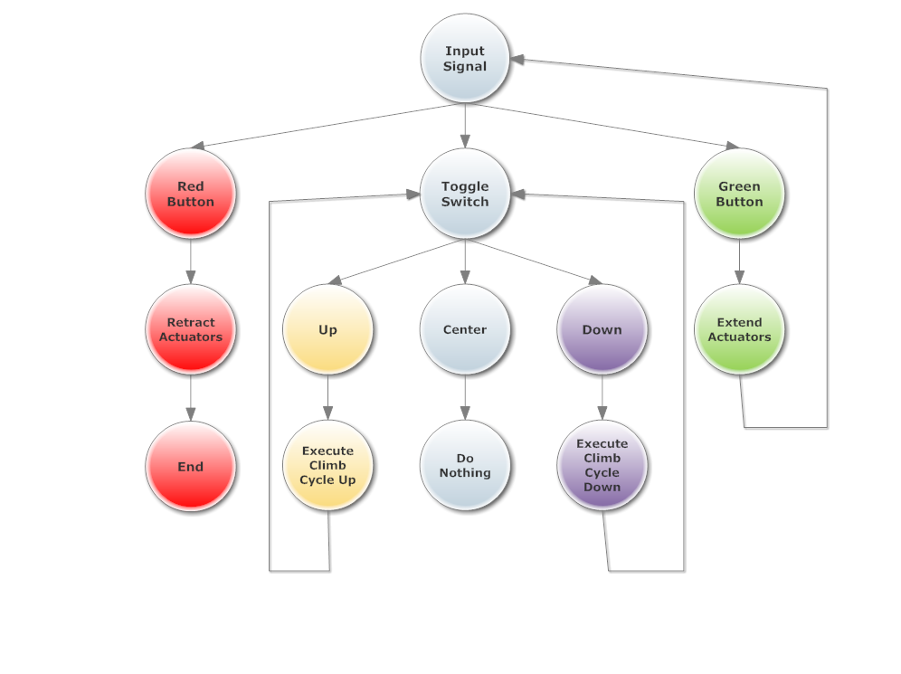
Functional Diagram

Slide 12
King Climber Design
Manipulator Arm
Ground Based
Components
Generator
Remote Control
Display Screen
Operator
Camera
Cutting Track
Actuators
Frame
Guiding Rails

Slide 13
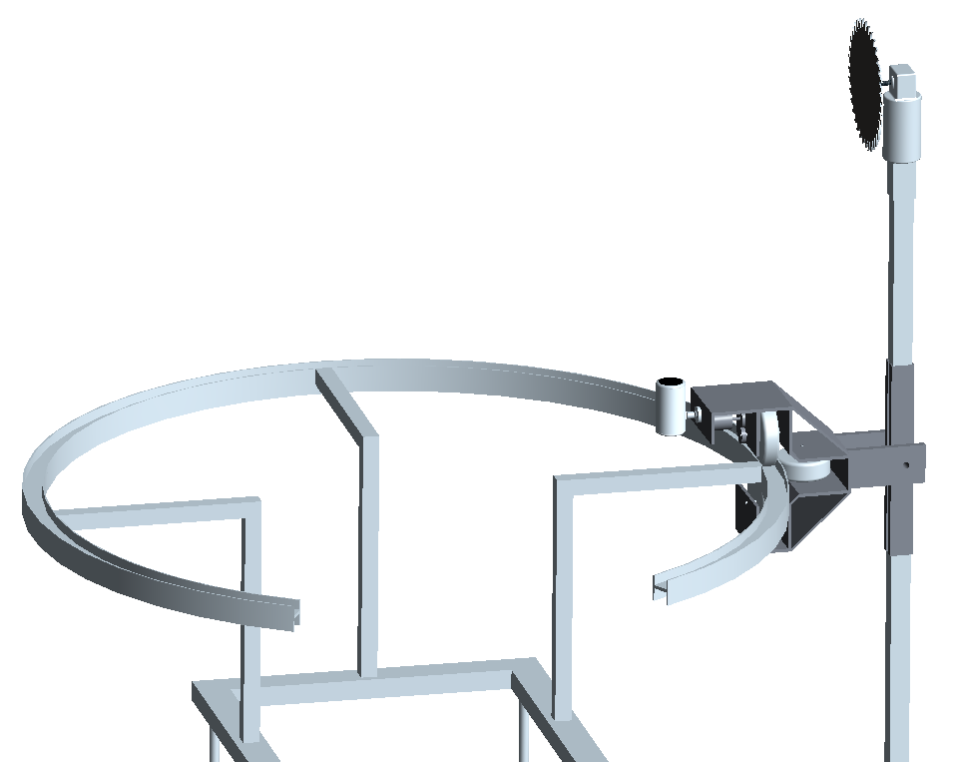
King Climber Cutting Design
8.25” Saw Blade
DC Saw Motor
Al. Shaft
Geared DC Motor
Camera
Al. Housing
Castor Wheels

Slide 14
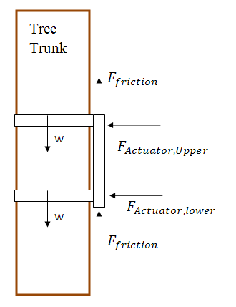
King Climber - Force Analysis

Slide 15
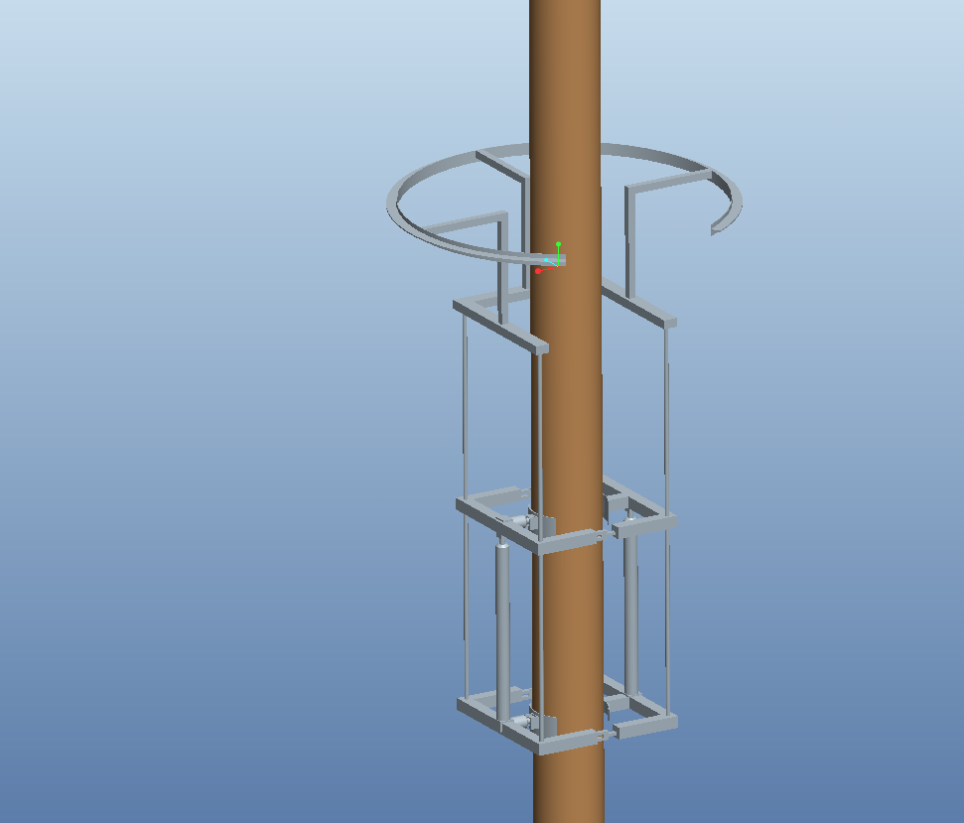
King Climber Speed, Power, and Cost Analysis
Velocity (robot) = 0.075 ft/sec
Power required = 71 Watts
Material | Weight (lbs) | Quantity (unit) | Cost ($) | Total Cost ($)
AL6061 | 51.9 | 36 ft (Ordered extra) | 5.59 per ft | 201.30
Supports | * | 4 | * | *
Cutter | 50 | 1 | * | *
H Actuator | 5 | 2 | 159.00 | 318.00
V Actuator | 7 | 2 | 169.00 | 338.00
Total | 125.9 |  |  | 857.30

Slide 16
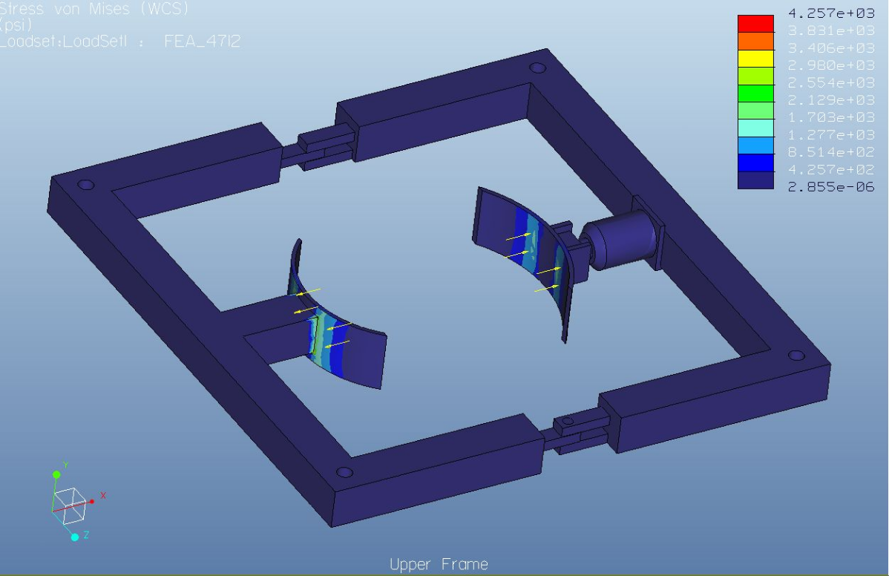
Further Analysis Stress Concentrations: Upper and Lower Frame
Max=4.257x10³ psi
Min=2.855x10⁻⁶ psi

Slide 17
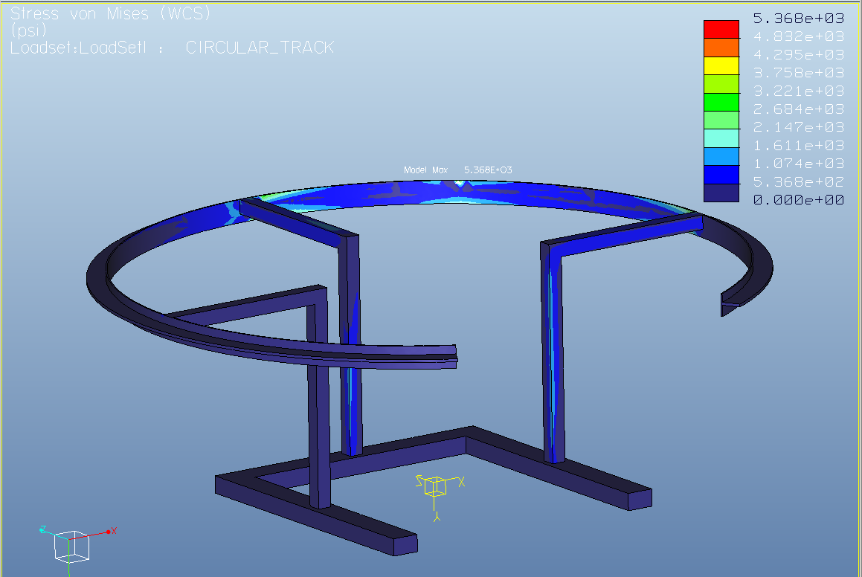
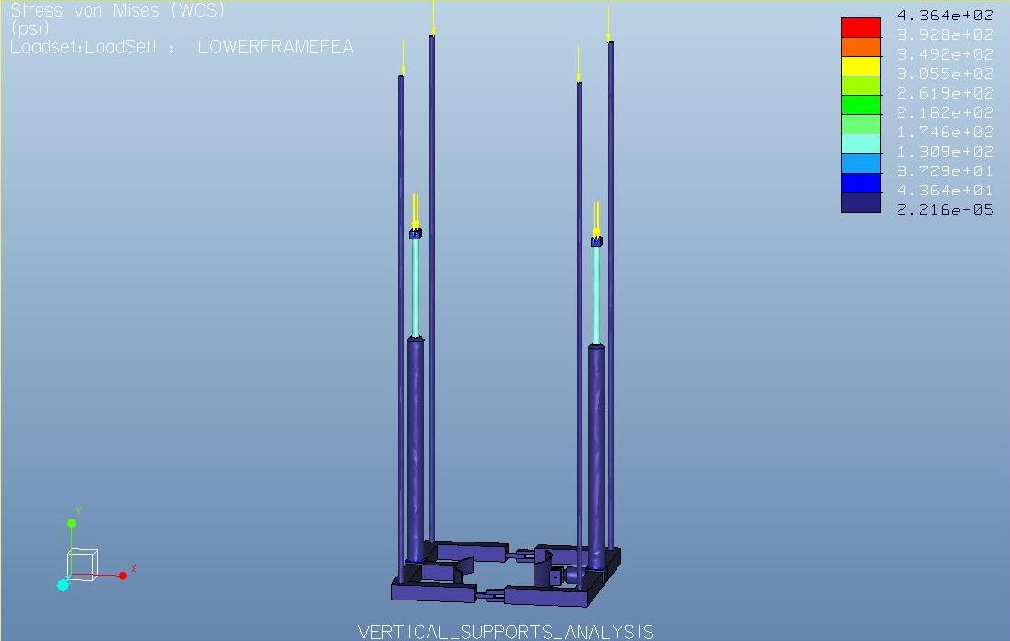
Stress Concentrations: Cutting Track and Actuators
Max=5.368x10³ psi
Min=0 psi
Max=4.364x10³ psi
Min=0 psi

Slide 18
Testing and Results
Mechanical Test
The frame can with withstand internal stresses
Linear bearings originally tested carved grooves into aluminum guide rods
Linear bearings now slide smoothly over steel guide rods
All other equipment as be test fit and geometry is correct.

Slide 19
Testing and Results
Power
Generator needed a 3 hour run cycle for start up.
A 3 hour test used approximately half gallon of gasoline.
Communications
Test signals from the remote box to the micro controller have been sent and received across the 40’ shielded multi conductor cable
Test signals from the micro controller to the relay switches have not triggered the relay

Slide 20
Testing and Results
Electronics
DC output from generator insufficient
2 -12VDC 25Amp power supplies were implemented
Motor drivers do not accept Pulse Width Modulation
Electromechanical relays currently being implemented
Motor driver test showed the actuators only drawing 9 amps unloaded

Slide 21
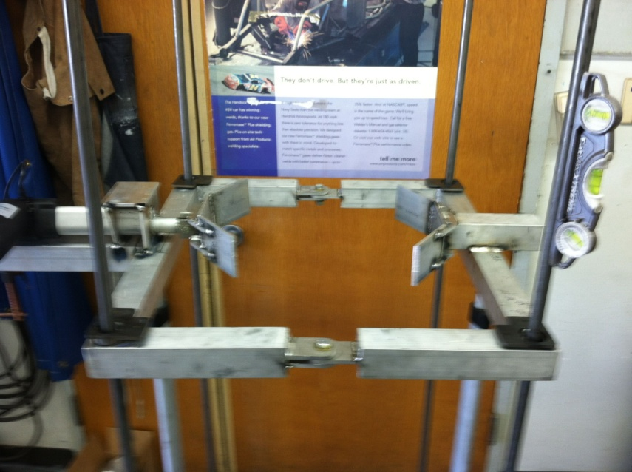
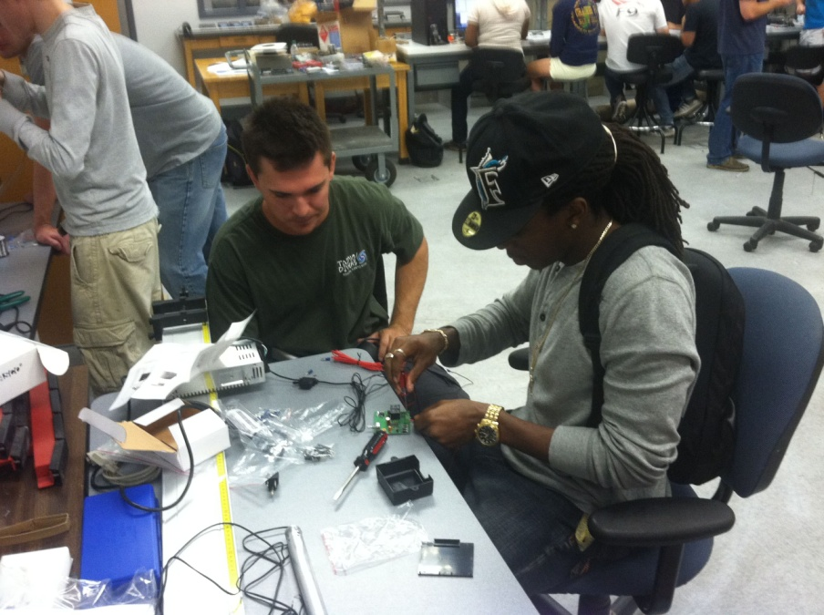
Construction Photos

Slide 22
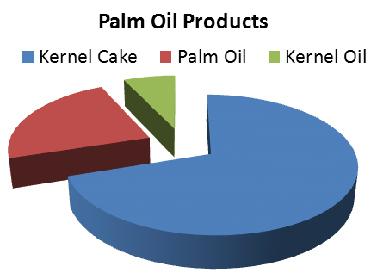
Market Analysis
Target Market:
Oil Palm Plantations
Manufacturing Companies
7%
23%
70%

Slide 23
Bill of Materials
Type | Product | Quantity | Total Cost ($)
Structural | Square Tube, AL, 1.75'' Inside Sq, 6ft | 6 | 201.30
 | Ball Bushing Bearing | 4 | 82.48
 | Aluminum 1/4" Thick, 3" Width, 3' Length | 4 | 80.70
 | Aluminum Rods 6’,3/4” OD | 4 | 96.35
Power | 1000W Power Generator | 1 | 180.63
 | 30" Stroke 100lb Fast Force Actuator | 2 | 339.98
 | 6" Stroke 100lb Fast Force Actuator | 2 | 319.98
Electronics | Dragon12P-USB-SM Microcontroller | 1 | 159.99
 | Motor Drivers | 4 | 156.39
 | Electromechanical Relays | 8 | 68.51
Project Total: $2,173.72
* Not all expenses shown

Slide 24
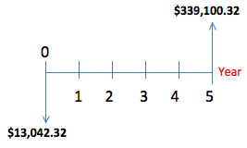
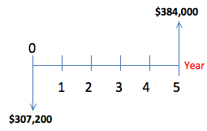
Cost Analysis
Calculated selling cost
Selling Price = Total Cost (1 + Mark-Up Percent)
Return of investment
ROI= (Final Cost – Initial Cost) / Final Cost
Future Worth Projection
Projected Cost of Labor (20 Workers)

Slide 25
Breaking Even for Plantation Owners
Using 8 King Climbers
Break even at approximately 0.4 months

Slide 26
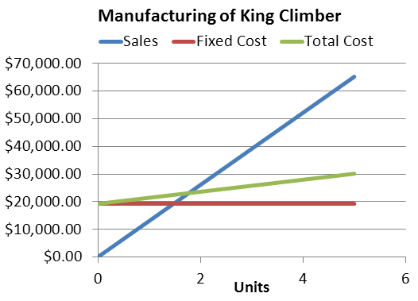
Breaking Even for Manufacturers
Break even at 2 units
500% markup

Slide 27
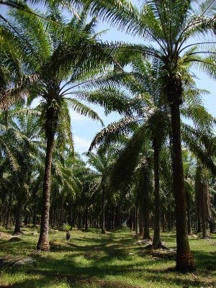
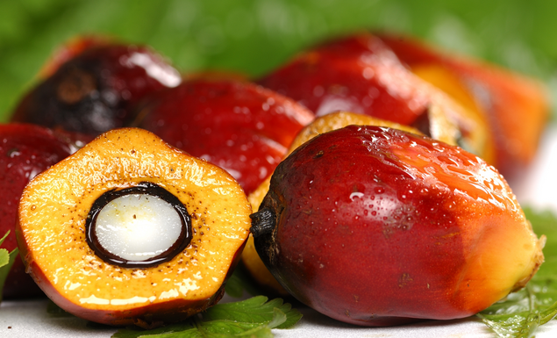
Considerations
Environmental Aspect
Minimal damage to tree in the form of circular indentation/scars from clamping
Ethical
Labor
Replaced by machine
Oil Palm Farms
Limited amount of oil palms
King Climber Manufacturers
Established protocol
Social and Political
Improve productivity and efficiency, provides solution to decreasing work force
Reduction in safety hazards will benefit worker

Slide 28
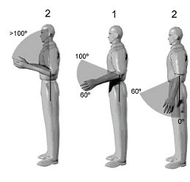
Considerations
Health and Safety
Minimum of two people to move King Climber
Safety satisfied by NIOSH and RULA
Sustainability
Become main method for harvesting oil palms
Design for manufacturing
Symmetrical
Reduce number of parts
Standardize number of parts

Slide 29
Conclusion
Meets safety requirements
Reduces risk of injury
Passes NIOSH and RULA tests
User-friendly
Profitable for manufacturers
Break even after two units sold
Profitable for plantation owners
Break even in less than one month

Slide 30
Questions?

