Slide 1
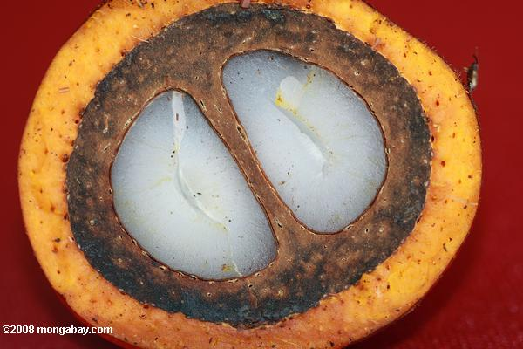
Define Phase
Group 26 – Palm Harvester
Members:
Obie Abakporo
Bill Carpenter
William Craig
Juan Antonio Rojas
Christopher Xavier Smith
Sarah Trayner

Slide 2
Team Organization
Christopher Xavier Smith, ME
Coordinator, Engineering and Design Team
William Craig, ME
ME Lead, Engineering and Design Team
Obiechina Abakporo, ME
Secretary, Commercialization Engineering Team
Sarah Trayner, IE
IE Lead, Engineering and Design Team
Juan Antonio Rojas, IE
Treasurer, Commercialization Engineering Team
Bill Carpenter, IE
Engineering and Design Team
Mentor: David Olawale

Slide 3
Project Sponsor
The sponsor of our project is Dr. Okenwa Okoli, Associate Professor of the FAMU-FSU College of Industrial and Manufacturing Engineering.
Research interests include the characterization of polymer composites and the development of liquid molding techniques for the cost-effective production of composites.
His research led to the development of a composite manufacturing technique known as Resin Infusion between Double Flexible Tooling (RIDFT).

Slide 4
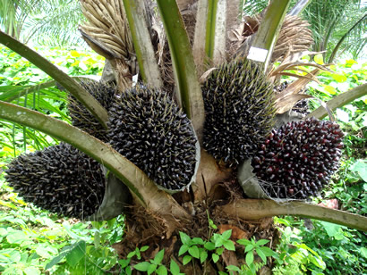
Introduction
The Palm Harvester project is based on providing an efficient, economical, effective means of harvesting fruit palms in subtropical regions
Methods of harvesting the oil palm are primitive.
Our group will develop a Computer-integrated robot that can climb the oil palm and harvest the fruits as efficient as possible.

Slide 5
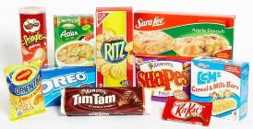
Palm Oil Output
Country/Region | Palm Oil Output (million metric tonnes) | World Share
Malaysia | 14,962,000 | 44%
Indonesia | 14,000,000 | 42%
Nigeria | 800,000 | 2%
Thailand | 685,000 | 2%
Columbia | 661,000 | 2%
Papua New Guinea | 310,000 | 1%
Cote D’Ivoire | 260,000 | 1%
Brazil | 160,000 | 0%
Products: coconut oil, margarine, shortening, cosmetics, cleaning supplies
Business appeal: creation of innovative method could lead to profit

Slide 6
Challenges
Main restraints include:
$2000 budget
Safety factors (palm tree and harvester)
Maintain low skill level for harvester
Semiautonomous (minimize work for harvestor)
Optimum way for efficiency (hydraulic vs electric)
Milestones
Concept to innovate and develop: two-piece retractable robot with clamps that secure an upward and downward movement along the base of the palm

Slide 7
Project Definition
Critical route: conduct research, create assumptions, set milestones, use tools for analysis (fishbone, voice of customer, house of quality), select concept design, select materials, assemble and test prototype, create instruction protocol
Scope: development of minimal requirements for semi-autonomous robot specifications for cost efficiency and effective palm pruning
Minimize: work done by palm harvester and time to prune palms
Increase: amount of palm fruits harvested and safety factors
Assumptions: spacing between palms, average palm base diameter, safe for palm

Slide 8
Project Charter
Goal: make the most efficient and reliable oil palm harvester in the market today
Palm oil promises to be an attractive business for entrepreneurial enterprises (not limited to foods and cleaning supplies)
Open door for new jobs
Reduce injuries and fatalities
Whenever there is a surplus of palm oil, different refineries can evolve to balance the market

Slide 9
Business Significance
 | Helpful to Objective | Harmful to Objective
Internal Origin (Team Attributes) | Strengths: Diverse group Member’s personal experiences and skills Advisor owns oil palm farm (familiarity with trees) Number of team members Multiple advisors | Weaknesses: No physical contact with oil palm tree Time conflicts Lack of programming experience Advisor owns oil palm farm (narrow thinking)
External Origin (Environmental Attributes) | Opportunities: High demand Growing industry Lack of effective methods Durable fruit Valuable to import Nutritional value exceeds other oil sources | Threats: $2000 budget Tree texture Plantation location Movement of mechanism Material acquisition Customer satisfaction/approval

Slide 10
Analysis of Customer
Customer
Voice of the Customer
Key Customer Issues
Critical Requirements
Dr. Okenwa Okoli
Efficient Quantity? Cost effective? Minimal man power? Time efficient?
Close Proximity of Trees, Not Damaging Fruit, Height of the Trees, Expenses, Labor, Difficulty, Not Damaging the Tree
Cut Down Fruit, $2,000 Maximum, Robot to Climb Tree, Easy and Safe to Use, Light Weight, Portable

Slide 11
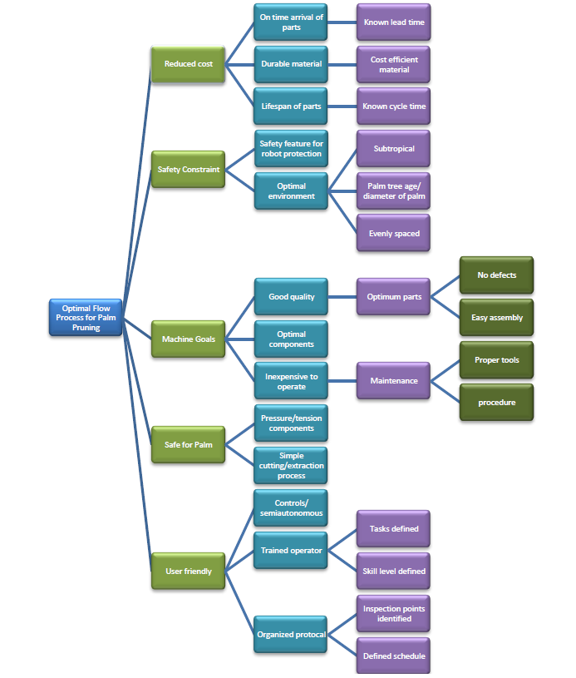
Voice of Customer Tree

Slide 12
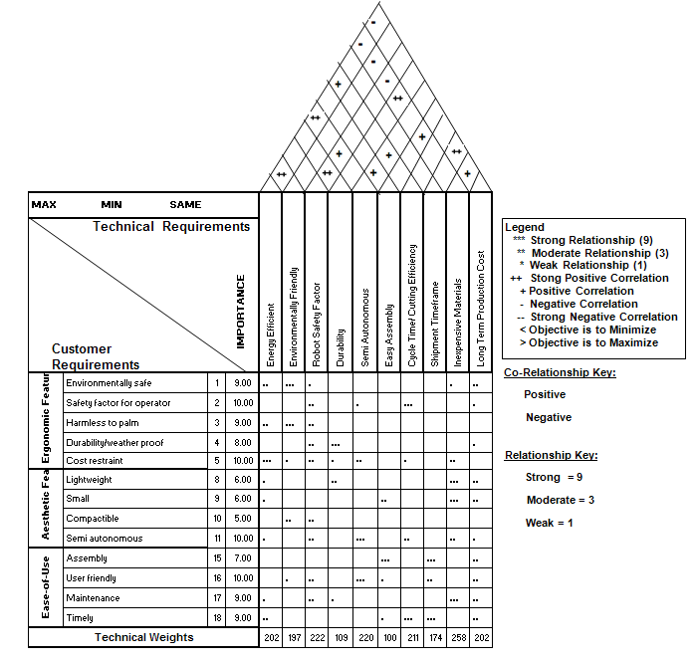
House of Quality

Slide 13
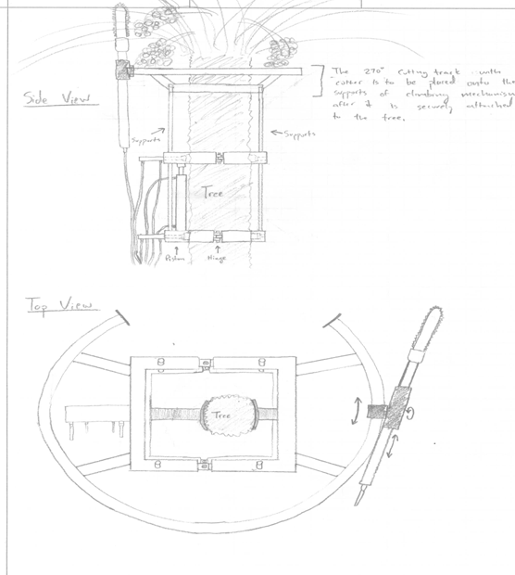
Potential Concept Designs
Design 1:

Slide 14
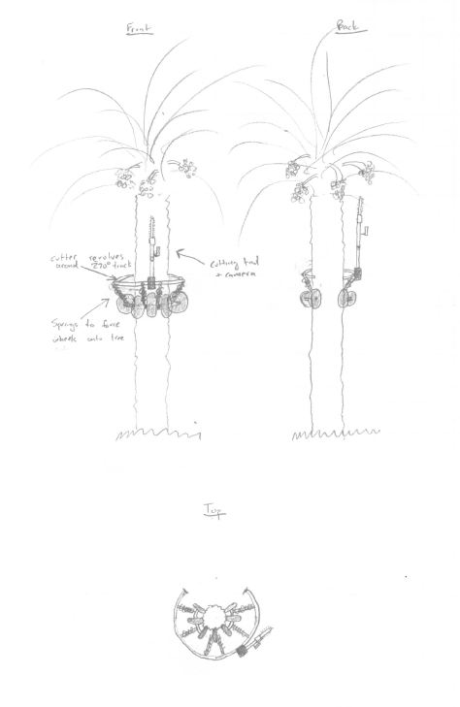
Design 2:

Slide 15
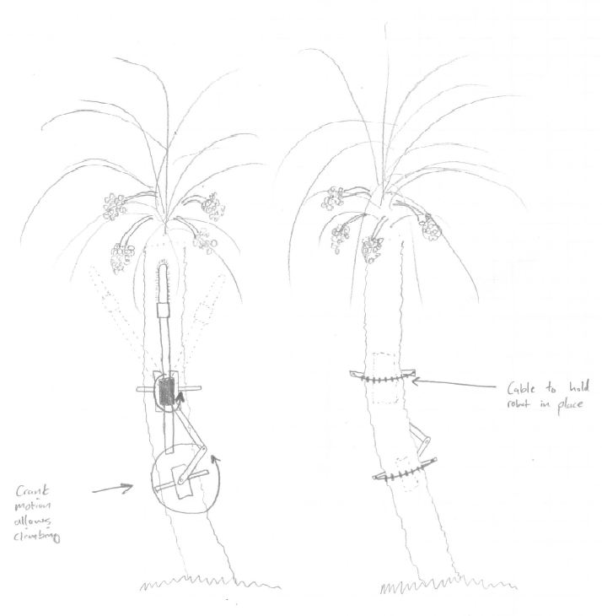
Design 3:

Slide 16
Project Goals
Semi-Autonomous device
Improve harvesting methods
Improve cost efficiency
Faster ascent/descent
Infrastructure development
Safer environment
Immediate/Long term economical advantages
Customer satisfaction

Slide 17
Questions?

