Slide 1
Semi Autonomous Palm Pruner
Verify Phase
Presented by Group 26:
Obie Abakporo
Bill Carpenter
William Craig
Juan Antonio Rojas
Christopher Xavier Smith
Sarah Trayner

Slide 2
Introduction
The Palm Pruning project is focused on providing an efficient, economical, and effective means of harvesting fruit from oil palms.
We designed, developed, and chose the best cutting arm for the King Climber by implementing the critical customer requirements chart, the Pugh Matrix, as well as the Evaluation Matrix.
The main goal of this phase is to analyze and verify all aspects of the King Climber design in order to ensure that the production process and the design are completely compatible.
This phase is most crucial in that it could make or break a project.

Slide 3
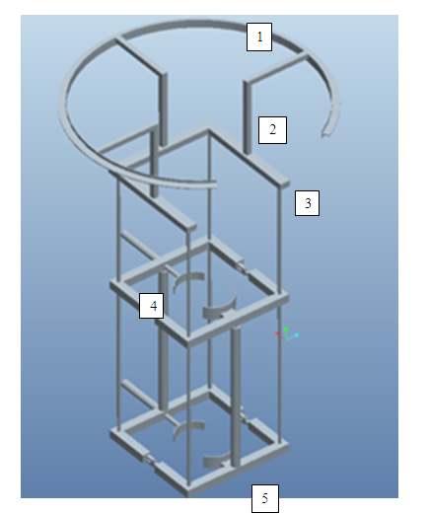
King Climber Design
Circular Track
Guiding Rods
Upper Frame
Vertical Actuators
Square Frame

Slide 4
King Climber Cutting Design
8.25” Saw Blade
DC Saw Motor
Al. Shaft
Geared DC Motor
Castor Wheels
Al. Housing
Camera

Slide 5
Interactions
King Climber’s Response to Human Command:
Establish all Connections.
User Presses “Climb up” Button.
Ascension.
Fruits of our Labor
Cutting the Fruit.
Descent.
Turn off Power.
Detach King Climber.

Slide 6
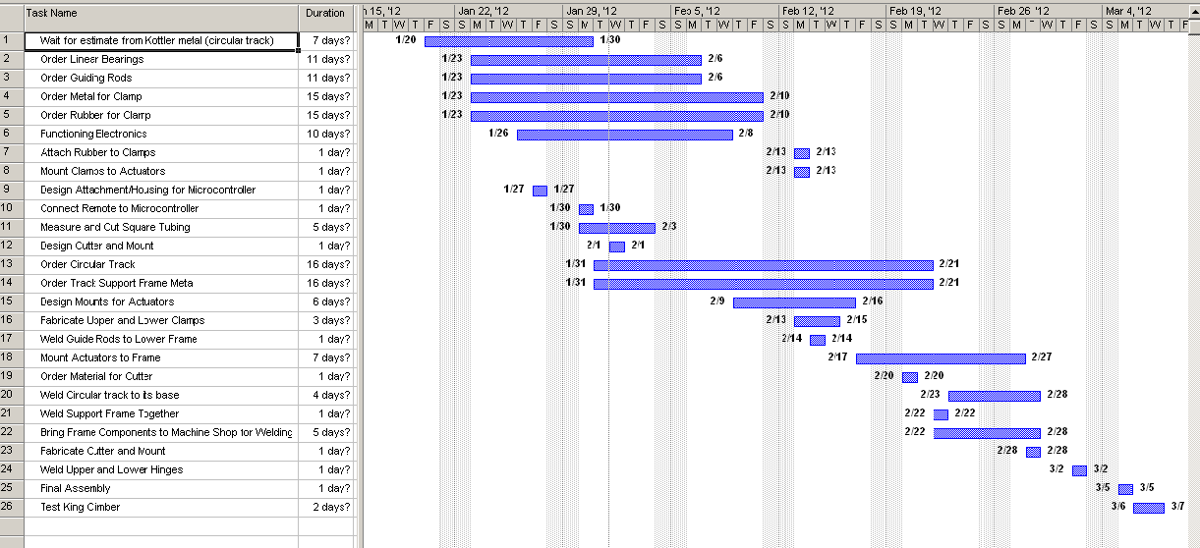
Tool Selection
Gantt Chart

Slide 7
Tool Selection
Parts and Assembly
Part | Testing Process
Actuators | Brought to electrical lab and connected to a variable power source to verify proper functionality
Frame | Performed the proper stress calculations and verified material properties
Circular Cutting Track | N/A
Microcontrollers | Created circuit schematics and wiring diagrams with assistance from Dr. Chuy in ME mechatronics lab
Cutting Mechanism | N/A

Slide 8
External Obstacles Encountered
Kottler Metal Company
  Only company to do H track bending
  Multiply attempts to contact with little response
  Failure to give us a solid quote and timeline required us to use alternative method
College of Engineering Machine Shop
  Completed work correctly but always 1-2 weeks after expected completion date

Slide 9
Internal Obstacles Encountered
Gap in knowledge
  3 ME team members, responsible for design analysis, construction, materials research
  3 IE team members, responsible for budgeting, work flow, process analysis
  Electrical expertise is comprised of EE intro classes and one class in mechatronics
  Underestimated the scale and complexity of the electronics from the project start

Slide 10
Electrical Obstacles Encountered
Power Supply
  Bought a AC/DC generator that did not output enough DC power to run actuators
    New generator
    AC to DC converter
    Specific 12VDC 25Amp power supply- Not in PO system
Motor Drivers
  Bought motor drivers that used PWM, internal PWM with no micro-controller input
    New motor drivers – Not in PO system
    8 Electromechanical switches – Rushed in with PO system
    The switches now need diodes and transistors

Slide 11
Cost Analysis
Use of an updated Bill of Materials
Expand on the comparison between human labor cost and machine cost
Use of Break Even Chart for:
1) Situation where a oil palm farm uses King Climbers
2) Situation where a company builds King Climbers
New Future Worth Projection

Slide 12
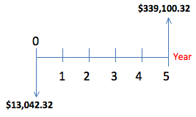
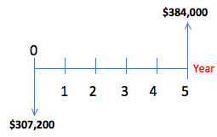
Cost Analysis
Selling Price = Total Cost (1 + Mark-Up Percent)
= $13,042.32
Future Worth Projection
Projected Cost of Labor (16 Workers)

Slide 13
Cost Analysis
Situation where a oil palm farm uses 8 King Climbers:
-Break Even before 2 months of usage
-Fixed Cost of $25,600 , based only on labor cost.
-Collection of: 39.744 metric ton of palm oil ($1,020.54), 12.096 metric ton of kernel oil ($1,366.00), and 120.96 metric ton of kernel cake ($175.00).

Slide 14
Cost Analysis
Situation where a Company X builds King Climbers:
-Break Even after 2 machines are sold at $13,042.32 each
-Fixed Cost of $19,270, based on: $11,250.00 on rent, $350 the electricity,
$100 phone plan, $200 cellphone plan, $70 water usage, $400 gas usage, $600
per employee, $600 per secretary, and $1,500 for the company’s administrator.

Slide 15
Assumptions
The prototype will function
The parts work properly with cutting arm
The time it takes for the cutting arm to harvest
Business aspect complies with customer needs
Cutting arm will work properly and will cut fruit bunches in less than 5 minutes

Slide 16
Final Stages
Pilot testing
Create a well rounded business approach into selling this new, innovative product
Hand over to product sponsor

Slide 17

Questions?

