Slide 1
Smart Material Museum Exhibit Spring Design Review #2
Senior Design Group 13
Glen Ashworth
Daniel Roque
Isaac Piersall
Laura Wainikainen

Slide 2
Overview
Problem/Intro
Recap/Update of Design
Accomplishments
Update on Current Testing
Remaining Tasks
Gantt Chart
References

Slide 3
Problem/Intro
The goal of this senior design project is to design, build, and test a museum exhibit
Exhibit must utilize and demonstrate the behavior of a smart material and its applications
Smart material chosen for this project is the piezoelectric type
Exhibit must be interactive and entertaining for students
Final product should be delivered to the museum ready for display

Slide 4
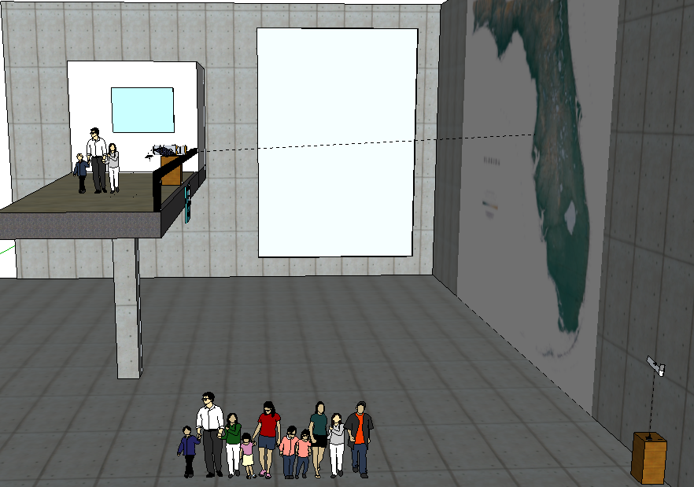
View of Exhibit: Original

Slide 5
View of Exhibit: Updated

Slide 6
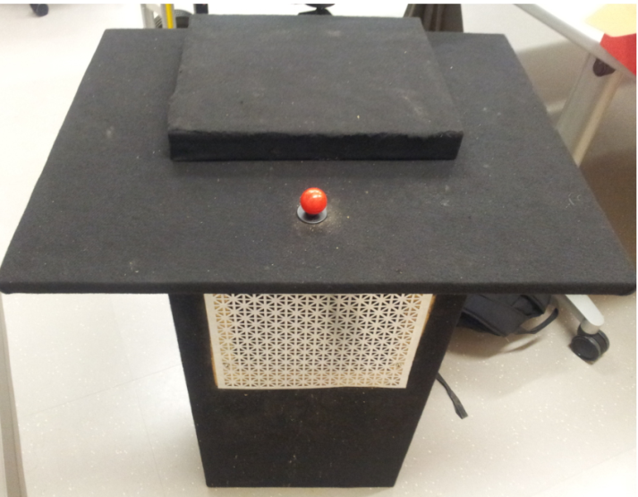
Accomplishments
Exhibit stand built out of ¾” MDF wood and covered with black carpet
Elevated stage to be enclosed by plexiglass
Equipped with chamber for electrical components

Slide 7
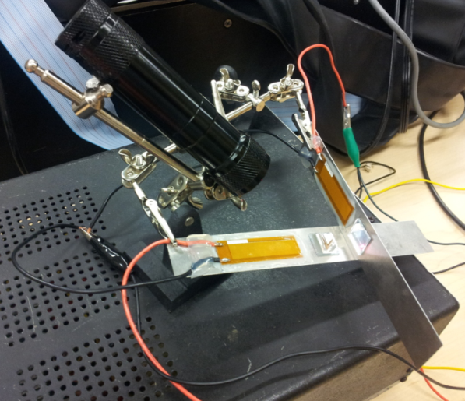
Piezoelectric Accomplishments
Piezoelectric material and mirrors glued to metal strips
Wires soldered and attached to piezos
Positioned via adjustable “helping hands” with alligator clips
Oriented 90 degrees from each other
Controlled via Arduino and laptop computer
Will be placed on the stage, shielded from children via plexiglass

Slide 8
2-D Laser Movement Controlled via Arduino

Slide 9
Experimental Resolution
Linear disp. = 3.6”
~ 0.012” per tick
Angular disp. = 3.8 °
~0.015° per tick
Initial Position
Direction of motion
Laser Path
37 in
63 in

Slide 10
View of Exhibit
Location of pan/tilt kit with a separate laser mounted on top
Target with photoresistors for each direction of motion

Slide 11
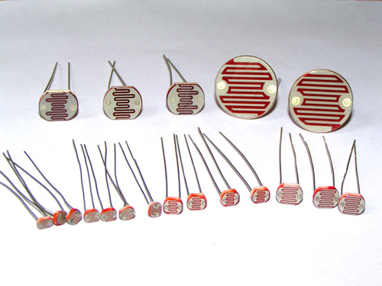
Photoresistor Circuit Data
Light Conditions | Resistance |  | Vout
Laser (6 in) | 120 | ohm | 1.21
Laser (15 ft) | 300 | ohm | 1.78
Ambient Light | 1500 | ohm | 5.59
Total change | 1380 | ohm | 4.37
Total Resolution with Arduino: 10 bits or 1024 increments
Usable Resolution: 802 Increments

Slide 12
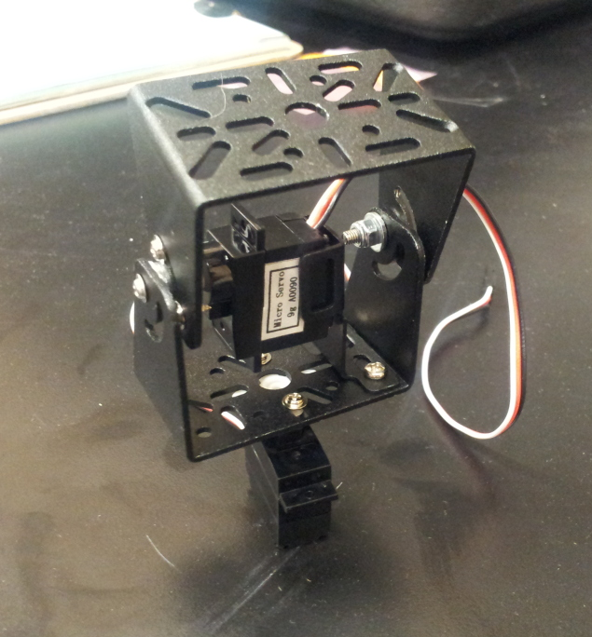
Pan/Tilt kit
Received mounting kit and two motors
Assembled pieces, tested for functionality
170 degrees of motion in both pan and tilt directions
Sufficient range to aim at any part of map

Slide 13
Piezo Code
Current
gets values through serial monitor
able to control piezos via filtering of PWM signal
Started interface with joystick
Needs
Finish interface with joystick
Oscillation/vibration demonstration
Laser power control

Slide 14
Servo Code
Current
Controls both servo motors
Started interface with photoresistors
Needs
Photoresistor circuit
Finish interface with photoresistors
Laser power control (same as in piezo code)

Slide 15
Remaining Tasks
User Interface
Connection of joystick to arduino
Placement/alignment of peizos and laser on exhibit stand
Satellite Station
Connection of photoresistors with arduino
Placement of photoresistors on target
Possible adjustments of laser reflections on map

Slide 16
Schedule
January |  |  |  | February |  |  |  | March |  |  |  | April
6-Jan | 13-Jan | 20-Jan | 27-Jan | 3-Feb | 10-Feb | 17-Feb | 24-Feb | 3-Mar | 10-Mar | 17-Mar | 24-Mar | 31-Mar | 7-Apr | 14-Apr | 21-Apr
 |  | Restated Scopes and Plans Review
 |  |  |  |  | Initial Purchasing
 |  |  |  |  |  | Initial Testing
 |  |  |  |  |  | Design Review Presentation #1
 |  |  |  |  |  |  |  | Continued Testing
 |  |  |  |  |  |  |  |  |  | Prototype Building
 |  |  |  |  |  |  |  |  |  | Installation
 |  |  |  |  |  |  |  |  |  |  | Design Review Presentation #2
 |  |  |  |  |  |  |  |  |  |  |  |  | Testing/Analysis
 |  |  |  |  |  |  |  |  |  |  |  |  | Open House
24-Mar | 31-Mar | 7-Apr | 14-Apr
Testing and Analysis
 | Joystick/Arduino Connection
 | Exhibit Assembly
 |  | Photoresistor Connection
 |  | Assembly of Target/Satellite

Slide 17
Questions?

Slide 18
References
"Performance High Voltage Power Supply Manufacturer." EMCO High Voltage Power Supply Manufacturer. N.p., n.d. Web. 25 Oct. 2012. <http://www.emcohighvoltage.com/>.
"MFC." Macrofiber Composite. Smart Material, n.d. Web. 22 Oct. 2012. <http://www.smart-material.com/MFC-product-main.html>.
"Piezo Actuators to Enable High-resolution Cosmic Dust Analysis." SME Achievements. European Space Agency, n.d. Web. 22 Oct. 2012. <http://www.esa.int/SPECIALS/SME_Achievements/SEMAADO7BTE_0.html>.
"From the Satellite to the Ground." Imagine the Universe. NASA, n.d. Web. 22 Oct. 2012. <http://imagine.gsfc.nasa.gov/docs/sats_n_data/sat_to_grnd.html>.

