Slide 1
CanSat Concept Generation
Group Members: Yasmin Belhaj, Andrew Grant, Andrew Guerr, Maxwell Sandler, Samuel Rustan
Faculty Advisor: Dr. Kamal Amin, Dr. Michael Frank
Senior Design Team #18
10/25/2012

Slide 2
Overview
CanSat Competition Background
Mechanical Systems
Phase 1 Braking
Phase 2 Braking
Phase 3 How to Secure Sensor
Electronics
Selectable Objective
Component Selection

Slide 3
Competition Background
Simulate satellite entering planet atmosphere
Gathers flight data and safely delivers a sensor payload to the planet’s surface
Main Components of CanSat
Payload that secures the sensor (a hen egg)
Container that encloses the payload from ascent to initial descent

Slide 5
Passive Braking, at 670 m, uses streamer or parachute to reduce velocity to 20 m/s
Active Braking autonomously engages at 400 m when payload is released from container
Additional requirements
Weight, mass, shape of CanSat
Limitations on methods of braking
Selectable objective (camera v force sensor)
Telemetry and communication specifications

Slide 6
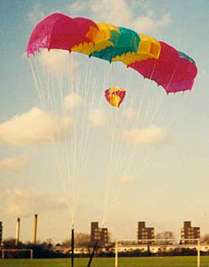
Streamer
Pros
Low Wind Drift
Cons
Requires more material
Low Drag Coefficient
Square Parachute
Pros
High drag coefficient
High Control
Cons
High wind drift

Slide 7
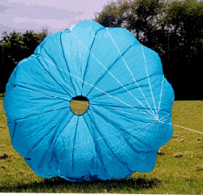
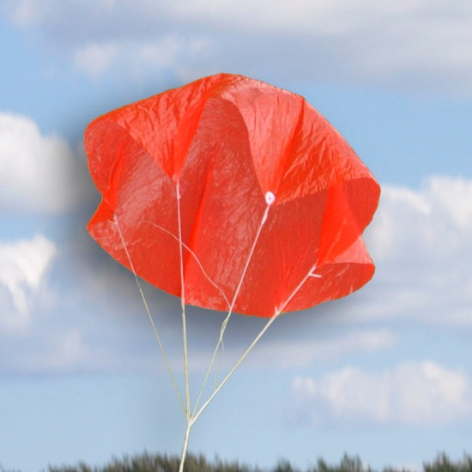
Round Parachute
Pros
High drag coefficient
More compactable than parasheet
Cons
Wind drift is still a factor
Complex Fabrication
Parasheet
Pros
High drag Coefficient
Simple Fabrication
Cons
High Wind Drift

Slide 8
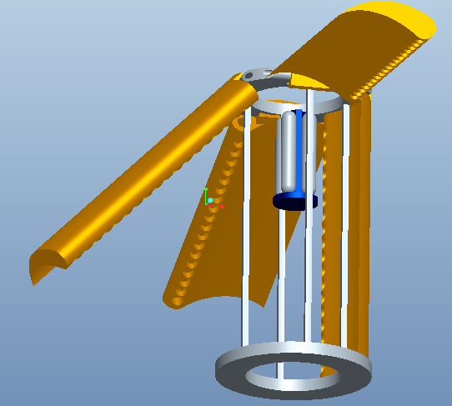
Fixed, Rigid Aero-foils
Upon deployment, The flaps will extend outwards creating drag along with a stabilizing spin. Nozzles mounted to the edges of the flaps will be used to give control to the payload.
Pros
Effective
Small electrical power consumption
Cons
Heavy
Components take up space
High cost
Complex
Difficult to manufacture

Slide 9
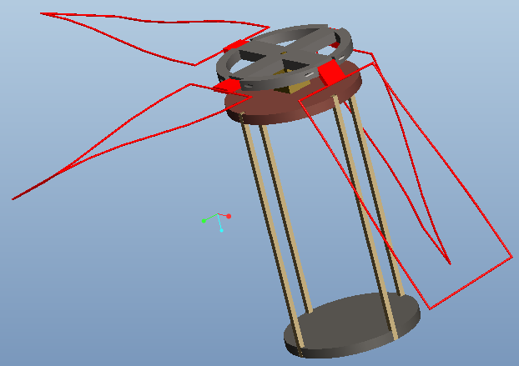
Rotational, Semi-rigid Aero-foil
Semi rigid wings will be deployed and under motor control, the payload will reach the ground as a helicopter would.
The semi rigidity of the wings will aid in their compartmentalization as well be able to absorb impact and shock, in case of a rough landing.
Pros
Easy to manufacture
Cheap
Compact
Low Weight
Cons
Deformable
Power consumption

Slide 10
Phase 3: How to secure sensor
Dough
Minimal Cost
High density, significant weight contriubution
Can fully enclose egg
Memory Foam
Costly
Lightweight , low density
Can also fully enclose egg
Flexible Membrane Clamp
Low cost
Easy to implement
Light weight with minimal volume
Will not enclose egg

Slide 11
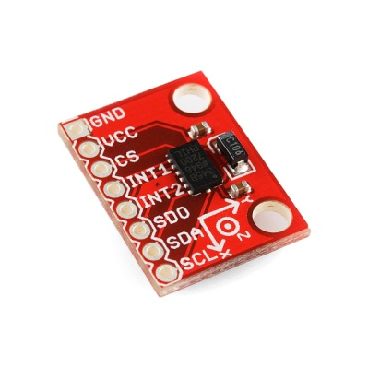
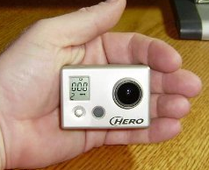
Selectable Objective
Camera to record descent or sensor to measure force of impact.
Force sensor is cheaper and easier to implement.
Option | Base Cost | Battery Life | Weight (no case) | Weight (with case)
HD Hero Go Pro Camera | $130 | 2.5 h | 94 g | 167 g
Impact Sensor (Implemented with accelerometer) | $30 | Negligible power use | Negligible | Negligible

Slide 12
Flight Software, Telemetry and Communications
Flight Software (FS) will use data from sensors, format that data and output telemetric data to transmitter.
- GPS data, Altimetry, Temperature, Battery Voltage
FS will be used to provide control any actuator or electromechanical device. (latch relay, motor, etc.)
FS will operate on the onboard micro-controller (MC) and will be stored in memory on the chip.
FS will employ the C/C++ programming language and be compiled for the Arduino development environment.
FS will be able to maintain flight stage in the event of a loss of power.

Slide 13
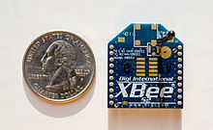
Flight Software, Telemetry and Communications
All communications will be via an XBEE radio.
XBEE will be a "series 1" operating on the IEEE 802.15.4 protocol standard.
XBEE shall communicate (transmit and receive) with a ground station. The ground station will be a laptop with a version of the FS providing an output to a "csv" file.
The ground station will receive and transmit via an antenna placed at a height so that line of sight with the CANSAT shall be maintained
13

Slide 14
Conclusions and Future Plans
Further testing will be done to finalize pending considerations:
Parachute vs. Streamer
Deploy from building top
Fixed vs. Rotational aero-foils
Dropping from various heights.
“Egg drop” tests for sensor protection
Drop from various heights.
Radio tests
Distance, Power consumption, Bit-error rates
Battery life
Power/energy requirements
Amp-hour rating of batteries
14

Slide 15
Conclusions and Preliminary Design
Next steps:
Perform tests
Finalize component selections
Bench testing electrical and computer devices
Questions?

Slide 16
References
Culp, Randy. "Parachute Decent Calculations."rocetmime.com. 24 Aug 2008. Web. 10 Oct 2012. <http://www.rocketmime.com/rockets/descent.html>.
"Parachutes." Parafauna.com. Web. 10 Oct 2012. <http://www.parafauna.co.uk/para_shapes.php>.
Harvey, Hal. "Council on Jobs and Competitiveness Report." http://energyinnovation.org. Energy Innovation, 18 Jan 2012. Web. 10 Oct 2012. <http://energyinnovation.org/2012/01/council-on-jobs-and-competitiveness-report/>.
Cooke, Bill. "How to Calculate Streamer Size."www.sunward1.com. Sunward. Web. 10 Oct 2012. <http://www.sunward1.com/images-tarc/Streamer Calculations (Cooke) (Jun 09).pdf>.
Sources for ECE (used to source datasheets)
http://www.digi.com/xbee/
http://www.digikey.com
http://www.adafruit.com
http://sparkfun.com

