Slide 1
CanSat Fall Final Presentation
Group Members: Samuel Rustan,Yasmin Belhaj, Andrew Grant,
Andrew Guerr, Maxwell Sandler
Technical Advisors: Dr. David Cartes, Dr. Victor DeBrunner
Faculty Advisors: Dr. Kamal Amin, Dr. Michael Frank
ME Senior Design Team #18
ECE Senior Design Team #10
12/06/2012

Slide 2
CanSat Project Overview
Designed for AIAA sponsored competition
Competition is in central Texas in June 2013
CanSat is a container with a deployable payload
CanSat is housed in Rocket (supplied by AIAA)
Main objective
Deliver the payload safely to the ground
Secondary objective
Telemetry data & impact force calculation

Slide 3
CanSat Project Overview
~670 m
Initiate Phase 1
Launch and
Ascent to ~670 m
400 m
Initiate Phase 2
Ground Control
0 m
Phase 3
06-DEC-2012
3

Slide 4
CanSat Physical Overview
130mm
Container
250mm
Payload

Slide 5
CanSat Physical Overview
Container
Payload
Parachute
Separation Mechanism
Electronics
Envelope
Aero Braking
Egg Compartment

Slide 6
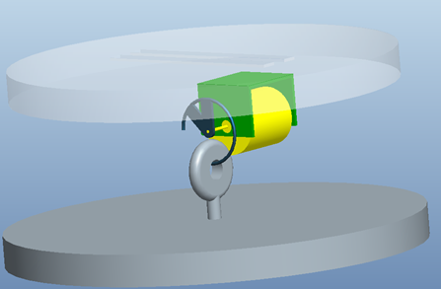
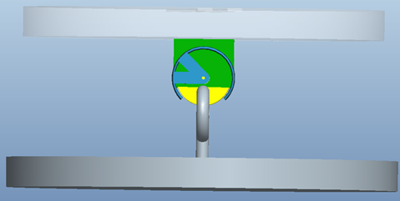
Separation Mechanism
• Container
DC Motor
Motor Bracket
Open Ring
Eye Bolt
• Payload

Slide 7
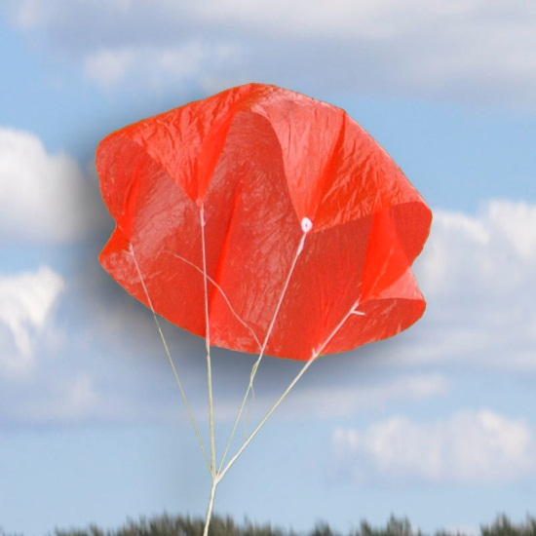
Phase 1: Parachute
Effective means of limiting
descent velocity of the CanSat
Determined most reliable by
experiment
Size determined by model
Diameter is 7.5 inches
Notes:
Shroud length,
Experiments were done
Figure Reference:

Slide 8
Phase 2: Descent Mechanism
120mm
450mm
175mm
Notes:
How we narrowed decision
Possible materials
Remind when it engages during descent
Put translucent image of cansat
Place hook mechanism

Slide 9
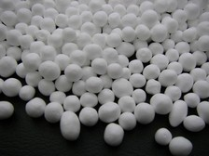
Phase 3: Egg Protection
Material | Density | Cost | Details | Pros | Cons
Memory Foam | 48-80 kg/m^3 | $20-150/ mattress topper | Rectangular foam 1.5 in thick | Soft, light | Susceptible to heat
Dough | unknown | $2-10 | Organic material with air pockets | cheap | Difficult to obtain consistent properties
Polystyrene Beads | 1050-1120 kg/m^3 | 12-15¢/ liter | Expanded soft beads | Cheap, light | May get loose in container
Experiment
Drop from standard height
Multiple substances protect the egg
Notes:
Pictures of the Polysterene beads, memory foam
Figure Reference: http://www.cushionsandmore.com/polystyrene-beads.html

Slide 10
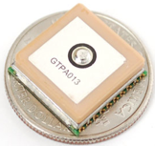
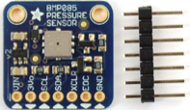
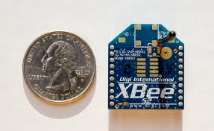
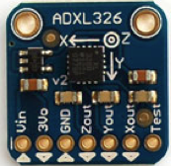
Sensor Subsystem, Telemetry
Altimeter (Pressure & Temp )
Force Sensor (Accelerometer)
GPS Module
XBEE Radio
Photo courtesy of www.adafruit.com
Photo courtesy of www.adafruit.com
Photo courtesy of www.adafruit.com
Photo courtesy of www.digistream.com
10

Slide 11
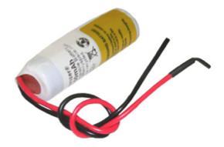
Electrical Power, Batteries
Estimated total energy consumption
Approx less than 300 mWh
Energy deliverable by “Li14500” shown
At least 850 mWh
Meets voltage requirement
20 g mass doesn’t tax mass budget
photo courtesty of www.batteryspace.com
photo courtesty of www.batteryspace.com

Slide 12
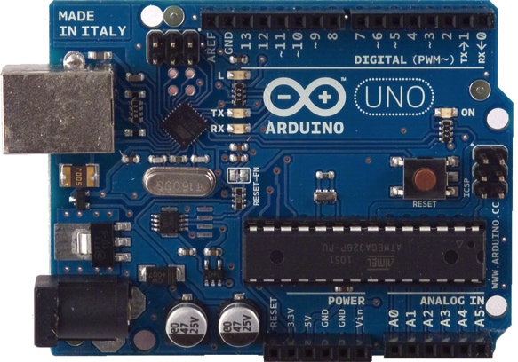
Communications and Data Processing
Arduino Uno
Able to handle data
and sampling rates
Within size contraints (2.7”x 2.1”)
Low cost, rapid development
Photo courtesy of www.arduino.cc
Arduino Uno Interface
 | Component | Interface/Protocol | Pins
Radio | XBEE Series 1 | Serial, TTL | 0, 1
Altimeter | BMP085 | I²C | A4, A5
Accelerometer | ADXL326 | I²C | 10 - 13
Voltmeter | Onboard | Analog to Digital | A0

Slide 13
Flight Software

Slide 14
Funding
Income and Expenses
Sponsor Name | Funds Received | Funds Pending | Equipment Purchased | Cost
ECE Department | 200.00 | 0.00 | 2 xbee radios | 84.81
Private Donation | 750.00 | 0.00 | 2 rocket parachutes | 4.28
Dr. Shih | 1000.00 | 0.00 | Can of Oats, Fishing Line, Ribbon | 8.75
State Farm | 250.00 | 0.00 | Can of Oats | 3.39
Total Funding | 2200.00 | 0.00 | Total Expenses | 101.23
Total Available Funds | 2098.77

Slide 15
Budget
Category | Budget | Type
Electrical | 300.00 | Estimated
Mechanical | 300.00 | Estimated
Travel | 1424.00 | Estimated
Total | 2024.00 | Estimated
This leaves an adequate amount of cushion in the funding for any unexpected costs.

Slide 16
Future work
Begin ordering selected ECE components
Procure parachute and related phase 1 materials
ECE Testing and Integration
Flight Software, Communications
Ground Control
Phase 2 descent control initiation
Phase 3 Impact testing

Slide 17
Thank you, Questions?
Group Members: Samuel Rustan,Yasmin Belhaj, Andrew Grant,
Andrew Guerr, Maxwell Sandler
Technical Advisors: Dr. David Cartes, Dr. Victor DeBrunner
Faculty Advisors: Dr. Kamal Amin, Dr. Michael Frank
ME Senior Design Team #18
ECE Senior Design Team #10
12/06/2012

