Slide 1
CanSat Interim Presentation
Group Members: Samuel Rustan,Yasmin Belhaj, Andrew Grant, Andrew Guerr, Maxwell Sandler
Faculty Advisor: Dr. Kamal Amin, Dr. Michael Frank
Technical Advisors: Dr. David Cartes, Dr. Victor DeBrunner
Senior Design Team #18
11/14/2012

Slide 2
Competition Background
American Institute of Aeronautics and Astronautics (AIAA) organize design-build-launch competition
Simulate satellite entering planet atmosphere
Gathers flight data and safely delivers a sensor payload to the planet’s surface
Main Components of CanSat
Payload that secures the sensor (a hen egg)
Container that encloses the payload from ascent to initial descent

Slide 4
Phase 1: Passive Braking, at 670 m, uses streamer or parachute to reduce velocity to 20 m/s
Phase 2: Active Braking autonomously engages at 400 m when payload is released from container
Phase 3: How to secure the “sensor”
Telemetry and communication specifications
Additional requirements
Weight, mass, shape of CanSat
Limitations on methods of braking
Selectable objective (camera v force sensor)

Slide 5
Previous Gantt Chart

Slide 6
Concept Generation Review
Phase 1
Phase 2
Phase 3
Round Parachute
Square Parachute
Parasheet
Streamer
Fixed, Rigid
Rotational, Rigid
Rotational, Semi-rigid
Compressed Gas
Electric Motor
Buoyant Neutral Fluid
Dough/Foam Enclosure
Flexible Membrane Clamp
Expense

Slide 7
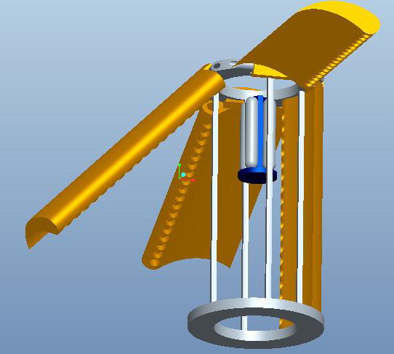
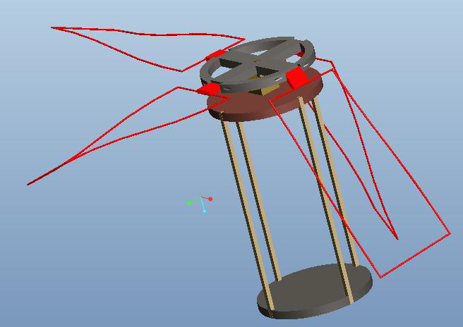
Phase 2 Generated Concepts

Slide 8
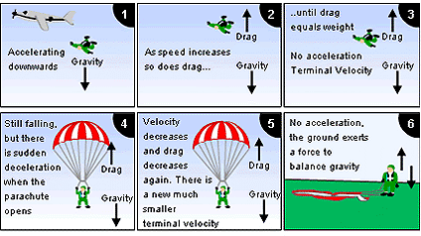
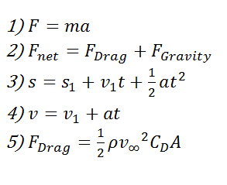
Model Concept Development
Image 2

Slide 9
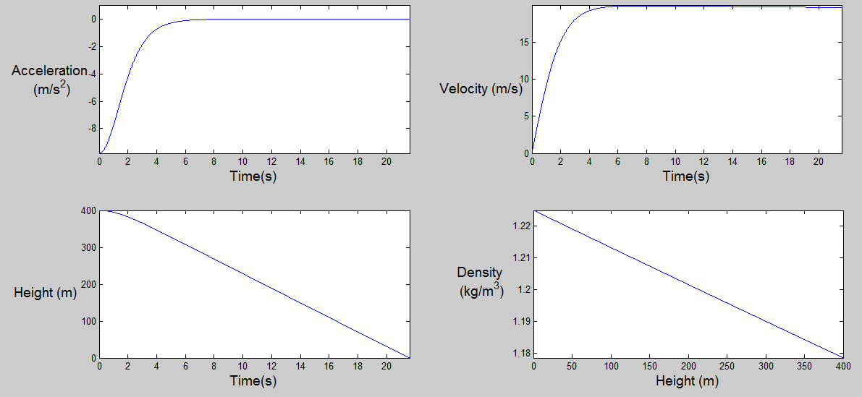
Model Application
Decent Prediction
Figure 1
Outputs:
Accurate prediction of the objects decent
Verified by experiment
Determines parachute or streamer size, given terminal velocity
Core code will be applied to subsequent phases

Slide 10
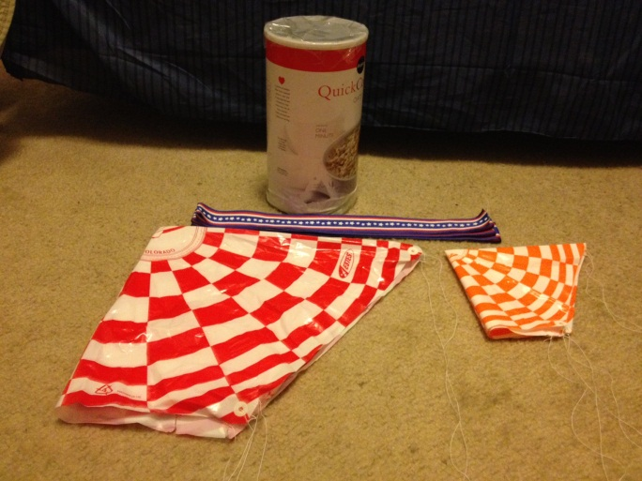
Phase 1 Experiment “Parachute vs. Streamer”
Phase 1 Decision Matrix
 | Drag Coefficient (0.2) | Small Size (0.1) | Low Wind Drift (0.3) | Low Complexity (0.2) | Low Cost (0.2) | Total
Flat Streamer | 1 | 1 | 5 | 5 | 3 | 3.4
Folded Streamer | 2 | 2 | 4 | 4 | 4 | 3.4
Parasheet | 3 | 3 | 3 | 3 | 5 | 3.4
Round Parachute | 5 | 5 | 1 | 1 | 1 | 2.2
Square Parachute | 4 | 4 | 2 | 2 | 2 | 2.6
Purpose
Test Model
Aid in Phase 1 decision

Slide 11
Phase 1 Experiment “Parachute vs. Streamer”
Independent Variables
Mass
Height
Chute/Streamer
Dependent Variables
Time
Required Number of People
Iterations

Slide 12
Parachute Vs. Streamer Results
Model Accuracy
Parachute: experimental data fit model
Expected more drag for streamer
Difficult to determine drag coefficient
Using the model to determine size
A streamer would be over 5 times larger.
Decision

Slide 13
ECE Systems Design
Microcontroller
Flight Software
XBEE
Tx/Rx
Altimeter
Force Sensor/Accel.
GPS
Audible Locator
Battery
Ground Station
Laptop
Flight Software
XBEE
Rx/Tx

Slide 14
ECE Component Selection
Description | Range (km) | Power Req. (mW) | Cost ($US) | Configuration
Pro-802.15.4 Series 1 (S1) | 1.6 | 63 | 32 | Point-to-point (easily configured)
DigiMesh Series 2 | 3.2 | 63 | 36 | Mesh Network (more difficult)
ZigBee SMT Series 2 | 3.2 | 100 | 48 | Point-to-point (configuration more complex than S1)
802.15.4 Series 1 meets requirements
Range requirement
Ease of implementation/configuration

Slide 15
ECE Component Selection
XBEE Series 1, Decision Matrix
Description Priority Factor | Range 4 | Power Req. 3 | Cost 2 | Configuration 1 | Weighted Total
Pro-802.15.4 Series 1 (S1) | 1 | 3 | 3 | 3 | 10
DigiMesh Series 2 | 3 | 3 | 2 | 1 | 6.3
ZigBee SMT Series 2 | 3 | 1 | 1 | 2 | 4.2

Slide 16
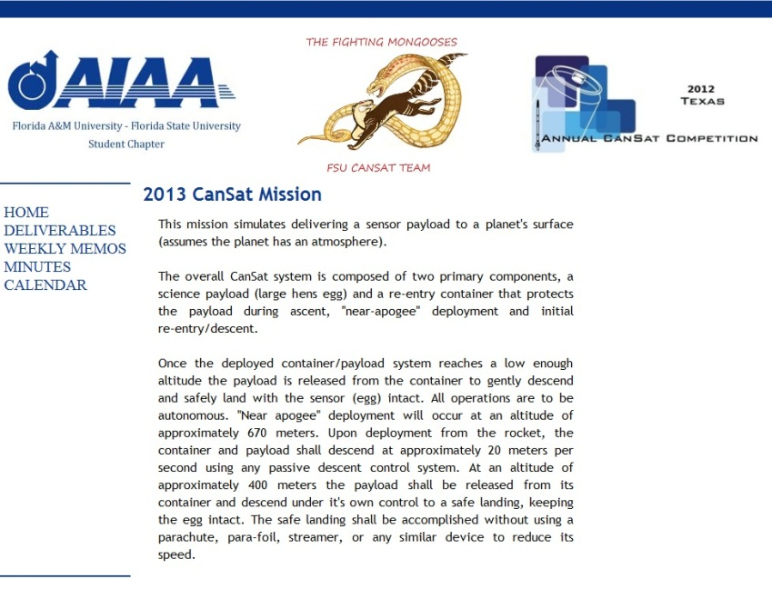
Website & File Management
Website available
Contains meeting minutes,
calendar
deliverables, other information
http://eng.fsu.edu/me/senior_design/2013/team18/
Group email address set up at fsucansat13@gmail.com
Emails to this address are forwarded to each team member
Google docs folder used as central repository for documents
Google calendar used to keep track of meeting times and deadlines

Slide 18
Funding
Income and Expenses
Sponsor Name | Funds Received | Funds Pending | Equipment Purchased | Cost
ECE Department | 200 | 0 | 2 xbee radios | 84.81
Private Donation | 0 | 750 | 2 rocket parachutes | 4.28
Dr. Shih | 200 | 800 | Can of Oats, Fishing Line, Ribbon | 8.75
State Farm | 0 | 250 | Can of Oats | 3.39
Total Funding | 400 | 1800 | Total Expenses | 101.23
Total Available Funds | 298.77

Slide 19
References & Acknowledgements
This source
That source
This person/org
That person/org

