Slide 1
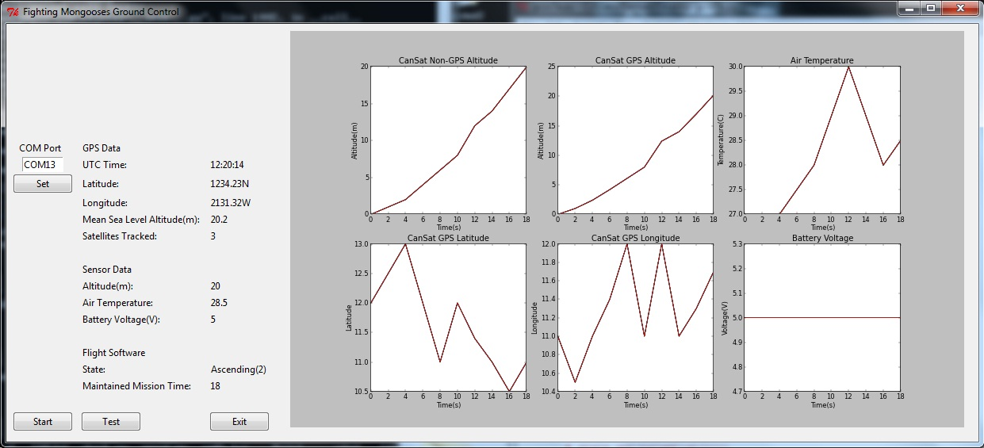
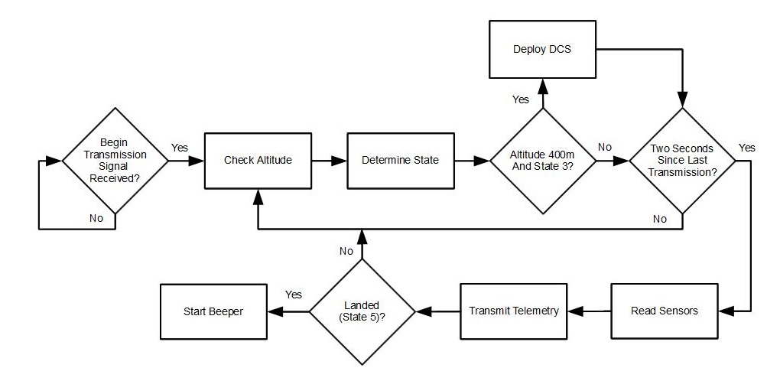
CanSat Competition
AIAA/NASA Competition
Yasmin Belhaj¹ Maxwell Sandler¹ Andrew Grant¹ Samuel E. Rustan² Andrew J. Guerr²
Faculty Advisors: Dr. David Cartes¹ and Dr. Victor DeBruner²
¹Department of Mechanical Engineering ²Department of Computer and Electrical Engineering
Competition Objectives
Design a canister satellite to protect a sensor payload
Must weigh 700 g with a tolerance of 10 g
Must fit inside the cylindrical rocket compartment with diameter 130 mm and height 250 mm
Deployed From apogee to 400 m, the CanSat must fall at 20 m/s with a tolerance of 1 m/s
From 400 m onward the CanSat must deploy an aero-braking structure that will limit the descent velocity to below 20 m/s
During the descent, the CanSat must telemeter NMEA GPS data and Non-GPS data including altitude, pressure, temperature, battery voltage, flight state and time
Upon ground impact, an impact force measurement is taken and stored for later retrieval.
Budegt for competition design must be under $1000
Flight Software / GCS Software
Launch Configuration
Telemetry Sensor System
Flight Software Flow Diagram
Payload connected to container via separation mechanism
Designed with proper clearance for rocket payload compartment.
Bosch™ BMP085 : Press/Temp.
GlobalTop™ FGPMMOPA6C : GPS Module
Analog Devices ADXL326 : Accelerometer
Impact force calculated from the mass and acceleration upon impact (F=ma)
Aero-Braking Structure
GPS Module
Microcontroller
Data
Power
Press/Temp
RF Data
ADC
Accelerometer
XBEE RF Transmitter
(CanSat)
Battery
Gound Control Software Flow Diagram
2.4 [GHz]
XBEE RF
Receiver (Ground Station)
USB/FTDI
Ground Control Station (Laptop)
Increases effective area by 8 times
Torsion springs open the structure

