Slide 1
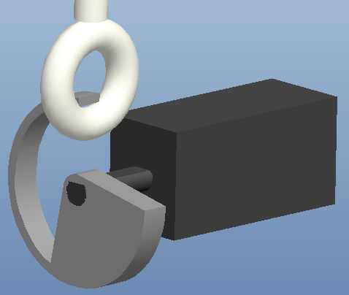
CanSat Competition
Belhaj, Y., Grant, A., Rustan, S., Sandler, M., Guerr, A.
Dr. David Cartes and Dr. Victor DeBrunner
Competition Objectives
Mission Sequence of Events
Flight Software Flow Diagram
Design a canister satellite to protect a sensor payload
Must weigh 700 g with a tolerance of 10 g
Fit inside the cylindrical rocket compartment with diameter 130 mm and height 250 mm
From deployment at apogee to 400 m, the CanSat must fall at 20 m/s using a parachute
From 400 m, the CanSat deploys an aero-braking structure that will limit the velocity to below 20 m/s
CanSat must telemeter GPS data, altitude, pressure, temperature, battery voltage, flight state and time
Upon ground impact, an impact force measurement is taken and stored for later retrieval
Total cost of final product must be under $1000
Pre-Launch
Preflight Briefing
Final Systems Check & Power On
Integrate CanSat into Rocket
Deploy DCS
YES
Launch
CanSat Deployment & Initiate Telemetry
Parachute Deployment & Container-Payload Separation
Ground Impact, End Telemetry
Begin Signal Transmission
Received?
Check Altitude
Determine State
Altitude 400m And State 3?
NO
2s Since Last Transmission?
YES
YES
NO
NO
NO
Post-Launch
CanSat Recovery
Data Retrieval
Post Flight Analysis
Start Beeper
YES
Landed
(State 5)?
Transmit Telemetry
Read Sensors
Launch Configuration
Separation Mechanism
Aero-Braking Structure
Telemetry Sensor System
Motor
Separation Mechanism
Bosch™ BMP085 : Press/Temp.
GlobalTop™ FGPMMOPA6C : GPS Module
Analog Devices ADXL326 : Accelerometer
Impact force calculated from the mass and acceleration upon impact (F=ma)
Eye-Bolt
GPS Module
Microcontroller
Data
Egg
Released Aero-Brake
Power
Open Ring
Supports
Press/Temp
RF Data
ADC
Separation Mechanism connects container to payload
Consists of a motor, open ring attached to the top of the payload and an eyebolt attached to the inside of the container
At 400m the separation mechanism will activate
Payload will drop out of container
Accelerometer
XBEE RF Transmitter
(CanSat)
Battery
Once activated, will increase effective area by 5 times
The aero-braking structure holds the supports that will absorb most of the impact force
Sensor (egg) protected using polystyrene beads
Payload connected to container via separation mechanism
Designed with proper clearance for rocket payload compartment
Container protects payload during launch and release
2.4 [GHz]
XBEE RF
Receiver (Ground Station)
USB/FTDI
Ground Control Station (Laptop)

