Slide 1
CanSat Mid-Term Presentation
Group Members: Samuel Rustan,Yasmin Belhaj, Andrew Grant,
Andrew Guerr, Maxwell Sandler
Technical Advisors: Dr. David Cartes, Dr. Victor DeBrunner
Course Instructors: Dr. Kamal Amin, Dr. Michael Frank
ME Senior Design Team #18
ECE Senior Design Team #10
02/14/2013

Slide 2
CanSat Project Overview
Designed for AIAA sponsored competition
Registered and Mentor assigned
1st Deliverable (Prelim. Design Review) submitted
Competition is in central Texas in June 2013
CanSat is a container with a deployable payload
CanSat is housed in Rocket (supplied by AIAA)
Main objective
Deliver the payload safely to the ground
Secondary objective
Telemetry data & impact force calculation

Slide 3
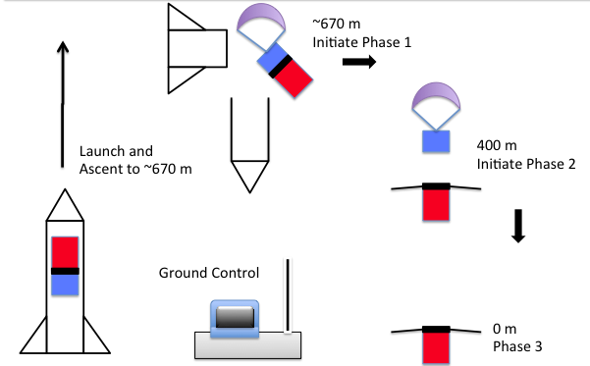
CanSat Overview

Slide 4
Launch Configuration
Parachute
Separation
Mechanism
Container
Electronic
Components
Aero-braking
Structure
Payload
Egg Compartment

Slide 5
Dimensioned Layout
50 mm
Allow clearance in the rocket section of
130 mm x 250 mm
Overcome sizing issues of micro-controller, motor, and payload
Materials selected to meet mass budget of 700 g
45 mm
220 mm
100 mm
73 mm
120 mm

Slide 6
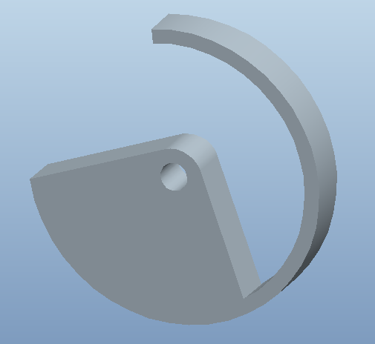
Separation Mechanism
Detachment Ring
Materials
Prototype in Aluminum
Nylon, other Plastics if feasible
Manufacturability
WaterJet followed by processing for smooth action.
Progress in prototyping
Submitted to Machine shop
Eye Bolt
Material: Nylon
Lightweight
Low Friction Coefficient

Slide 7
Aero-braking Structure
400 mm
Fabric wings purchased
ABS plastic for 3-D printing of top and bottom
Aluminum, Plastic, and Wooden dowels considered for rods
Torsional Springs for release ordered (size and torque limit)
Connecting Pins for pivot points ordered
More to be done on securing rods pre-deployment

Slide 8
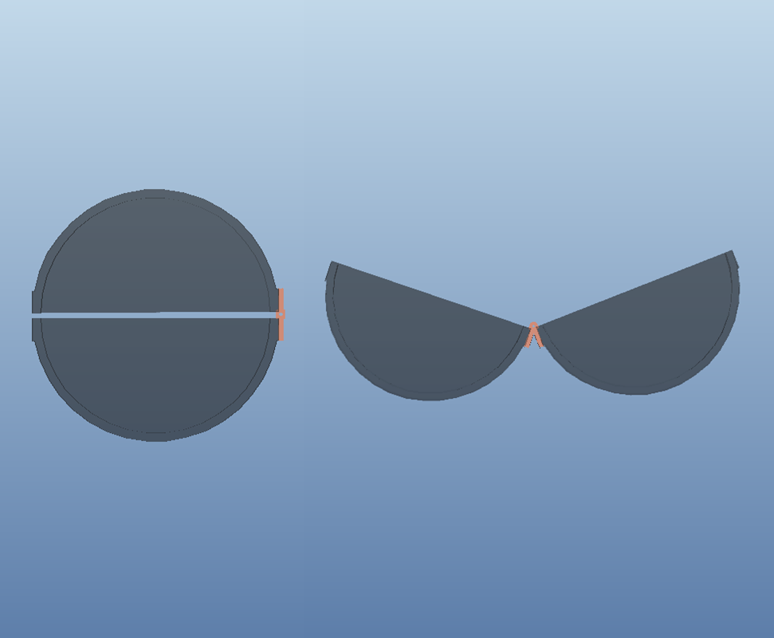
Payload Layout and access
High Density Polyethylene
HDPE can easily be cut
Prototype
Copper Hinge

Slide 9
Egg (Payload) Protection
Polystyrene beads
Based on iterative tests of several materials
Separate container
Materials ordered

Slide 10
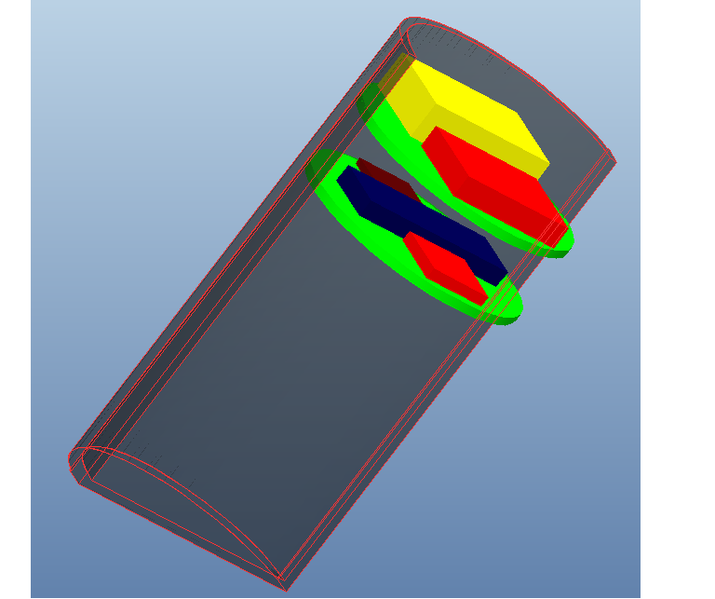
Integration of Electrical Components with Physical Structure
Multi-Level Electronics Arrangement
Permanently Affixed to Payload Half
Thin, Rigid Wafers
Material: ABS Plastic

Slide 11
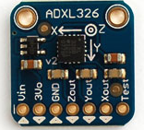
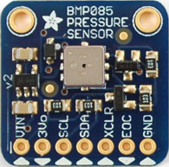
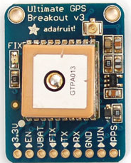
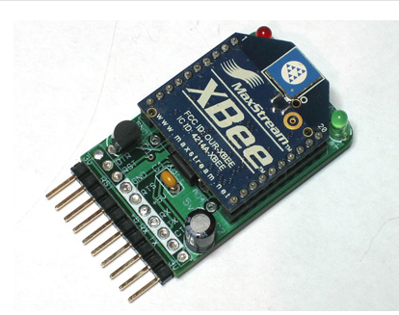
Telemetry component tests
Test: Verified read sensor data over I²C
Test Result:
OK
Test: Verified read sensor data over I²C
Test Result:
OK
Test: Verified read GPS data
Test Result:
OK
Test: XBEE Verification sent over FTDI
Test Result:
Incomplete

Slide 12
Software Development and Microcontroller
Flight Software
Basic framework coded
Needs to be integrated with sensor input and radio
Ground Station Software
In planning stages.
Input from XBEE radio and display and graph the information in a GUI
Microcontroller reselection
Arduino Platform, different configuration
Smaller profile as well as smaller area

Slide 13
Funding / Project Budget
Revenue |  | Expenses
Funding Source | Funds Received | Procured | Expense Amount
ECE Department | $200.00 | ECE Components (Telemetry) | $200.00
Private Donation | $750.00 | Mechanical & Structural | $70.00
Dr. Shih | $1000.00 | Shipping | $15.00
State Farm | $250.00
Total Funds Generated | $2200.00 | Total Procurement Expenditures | $285.00
Total Available Funds Remaining | $1915.00

Slide 14
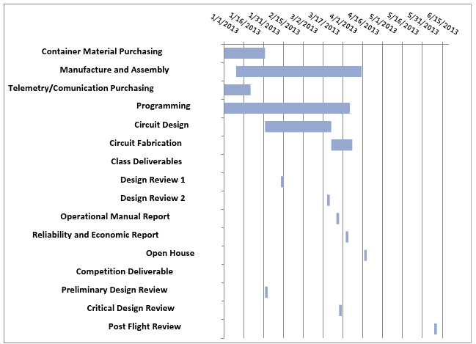
Updated Gantt

Slide 15
Other Challenges and Future Work
Parachute attachment
Test ring release mechanism
Adjust constraints to require least possible torque
XBEE Radio Range Testing
Find clear line of sight for 1.6 km
Motor selection and trade
Separation mechanism
Prototype Structure and integrate electronics
Including battery

