Slide 1
CanSat Presentation
Yasmin Belhaj (ME)
Andrew Grant (ME)
Andrew Guerr (CE)
Samuel Rustan (EE)
Maxwell Sandler (ME)
Technical Advisors: Dr. David Cartes, Dr. Victor DeBrunner
Course Instructors: Dr. Kamal Amin, Dr. Michael Frank
ME Senior Design Team #18
April 18, 2013

Slide 2
Outline
Competition Overview
Design Specifications
Concept Generation and Selection
Final Design
Manufacturing and Assembly
Operation and Reliability
Testing and Results
Conclusion

Slide 3
Competition Overview and Design Specifications
Belhaj

Slide 4
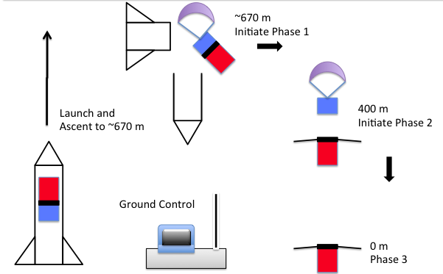
Competition Overview
Design a container/payload system to be launched via rocket and develop autonomous descent control strategy to safely land CanSat
Main objective
Deliver the payload safely to the ground
Secondary objective
Collect telemetry data & impact force calculation

Slide 5
Mission Sequence of Events
Pre-Launch
Final Systems Check & Power On
Integrate CanSat into Rocket
Preflight Briefing
Launch
CanSat Deployment & Initiate Telemetry
Parachute Deployment & Container-Payload Separation
Ground Impact, End Telemetry
Post-Launch
CanSat Recovery
Data Retrieval
Post Flight Analysis

Slide 6
CanSat Sample Specifications
Mass must be 700 g
Material limitations
Geometric constraints due to rocket bay size
Descent Control Strategies limited
Telemetry
GPS data
Altitude
Air temperature
Battery voltage
Flight software state
Deliver detailed presentations to NASA/AIAA representatives

Slide 7
Concept Generation and Selection
Passive Braking Method
Separation Mechanism
Aero-braking Structure
Sensor Protection
Microcontroller
GPS, Sensors, Radio
Battery
Grant and Rustan

Slide 8
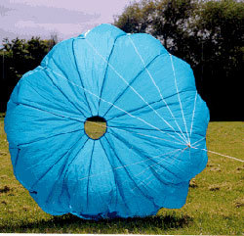
Descent Control Strategies
Round Parachute
Spring Loaded Rods (Concept Selected)
Parasheet (Concept Selected)
Diameter: 7.5in
Deployable Exterior Panels
Streamer
Telescoping Arms
Passive Braking Criteria
Drag coefficient Wind Drift Potential Stability
Aero-braking Structure Criteria
Reaction time Number of Moving Parts Structural Integrity
Notes:
Round Parachute
Pros: Drag coefficient 1.5 High stability, Compact
Cons: High wind drift potential
Parasheet (Concept Selected)
Pros: Simple, Compact, Drag Coefficient 0.75
Cons: High wind drift potential, less stable
Streamer
Pros: Low Wind Drift Potential, Simple
Cons: Drag Coefficient 0.14 – 0.4
Spring Loaded Rods (Concept Selected)
Torsional springs open rods/fabric fastened at base.
Pros: Lightweight, Easy deployment
Cons: Structural Integrity
Deployable Exterior Panels
Rigid panels open using motor.
Pros: Durable
Cons: Weight, Power requirement
Telescoping Arms
Fabric connected at center and tips will extend using linear actuator.
Pros: Large area, Max drag
Cons: Complex, Lengthy deployment time

Slide 9
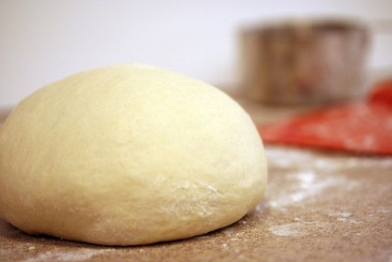
Container-Payload Separation and Sensor Protection
Linear Release
Rotational Release (Concept Selected)
Trap Door
Memory Foam
Polystyrene Beads (Concept Selected)
Dough
Separation Mechanism Criteria
Reaction time Number of Moving Parts Structural Integrity
Sensor Protection Criteria
Cost Density Efficacy
Notes:
Linear Release
Pros: Few parts, easy manufacturability
Cons: Slow reaction time
Rotational Release (Concept Selected)
Pros: Proven technique, Inexpensive
Cons: Slow reaction time, Fabrication considerations
Trap Door
Pros: Provides structural support
Cons: Multiple moving parts, heavy
Memory Foam: costly, high volume, light, poor under heat
Dough: Variable density, cheap, Inconsistent properties
Polystyrene Beads: relatively high density 1050-1120kg/m3, Cheap, light

Slide 10
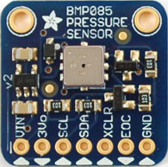
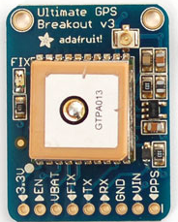
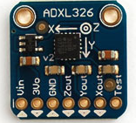
Sensor Selection
Telemetry Sensors
Bosch™ BMP085, Pressure/Temperature Sensor Selection criterion:
Precision: ± 0.25m, ± 2.0 ºC
Reliability: vetted by many users
Cost: $20
GlobalTop™ FGPMMOPA6C, NMEA GPS Module Selection criterion:
Reliability: -165 dBi sensitivity
Low power: 20 mA current draw
Cost: $40
Analog Devices™ ADXL-326, Accelerometer
Selection criterion:
Range of measurement: ±16g
5v logic ready, via onboard regulator
cost: $18

Slide 11
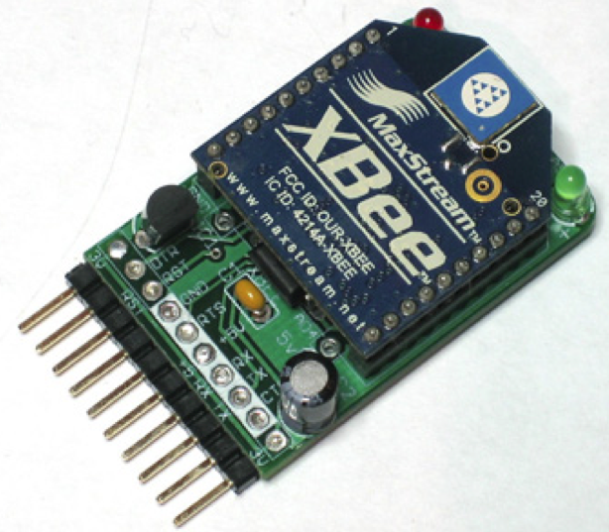
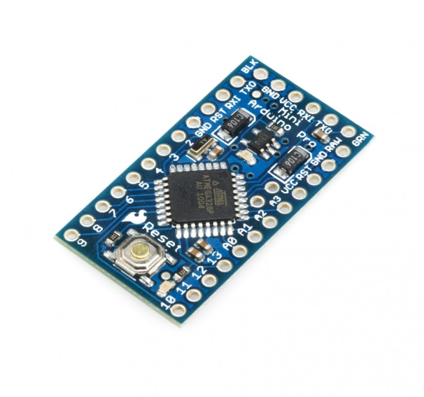
Communication Selection
Data Handling and RF Communications
Xbee Pro™ Series 1, 802.15.4 (Digi Int’l)
Selection criterion:
Selection restricted by competition
Series 1 point-to-point communication
Compatible with Adafruit™ breakout kit
Advantageous for breadboard proto-typing
Arduino Pro Mini™ Microcontroller
Selection criterion:
Size: 18x33mm, essential due to size limits
Handles power demand of all connected devices, ADC, I²C, Serial, Analog, Digital
Open source platform
Code is easily migrated from other Arduino environments (Uno, Duo, etc)

Slide 12
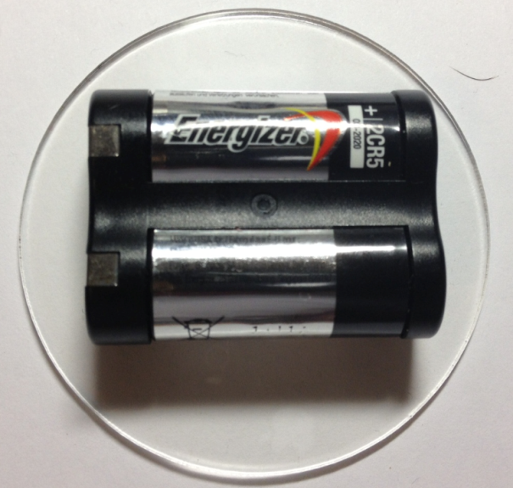
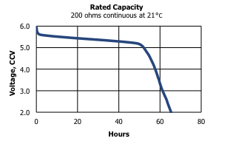
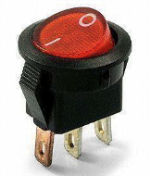
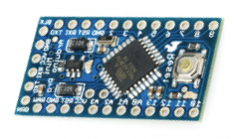
Battery/Voltmeter Selection
Electrical Power System
Energizer 2CR5, 5v, Li/MnO₂
Selection criterion:
High energy density, low weight
High discharge current current (1500 mA)
Capacity exceeds need by factor of 3
Rated voltage output ensures power delivery
1.5 MΩ

Slide 13
Final Design Configuration
Sandler

Slide 14
Launch Configuration
Parachute
Separation
Mechanism
Electronic
Components
Shelving
Container
Aero-braking
Structure
Payload
Egg Compartment
Notes:
Explain selection of each subsystem:
Container is the entire length of structure. Made of plastic, it is open on the bottom.
Payload is the portion inside that houses the electronic components and the raw egg.
Parachute was selected by conducting an experiment on the braking efficacy and ease of implementation of parachutes and streamers for this application. The diameter of the parachute was calculated to achieve the desired 20 m/s at 400m.
While under descent of parachute, the payload will detach from the container via this separation mechanism. A motor will provide the rotation of this ring to allow the payload to fall from out from the bottom.
The aero-braking structure is secured in its launch configuration, surrounding the payload. Support rods connect the top and bottom portions of the aero-braking structure to the payload.
Electronic components are in the top portion of the payload, and the egg is housed near the bottom.

Slide 15
Deployed Configuration
Aero-Braking Structure
Specifications
Mass: 700 g
Height: 220 mm
Width: 110 mm
Parachute: D = 175 mm
Aero-Structure: D = 500 mm
Support rods
Tension Wires
Notes:
Rocket bay dimensions: 130mmx250mm
Based on diameter of wings: Velocity at ground:

Slide 16
Manufacturing and Operation
Sandler and Rustan

Slide 17
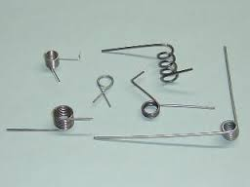
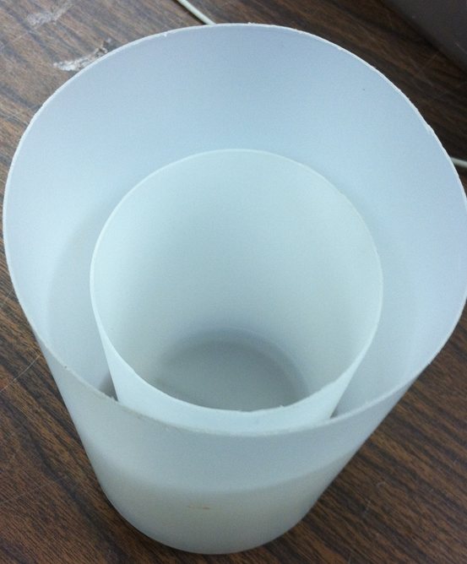
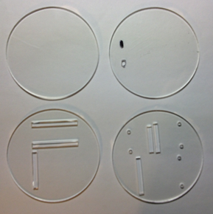
CanSat Fabrication
Mechanical Design Criteria
Material/Part Acquisition Lightweight Low Radio Interference Inexpensive

Slide 18
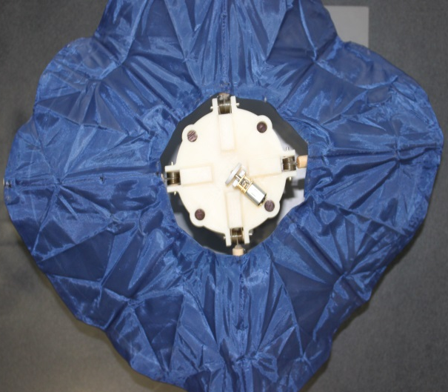
Payload Fabrication
Aero-braking top and bottom – 3D printed ABS
Payload Envelope – Modified polyethylene bottle
Torsion springs allow quick and reliable opening
Deployed via heating element at 400 m
Structural rods made of wood
Structural rods attached to aero-braking top and bottom with screws
Separation mechanism on top of aero-braking structure

Slide 19
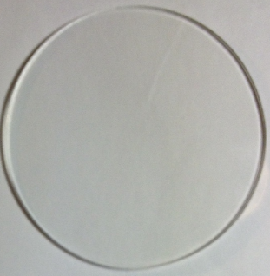
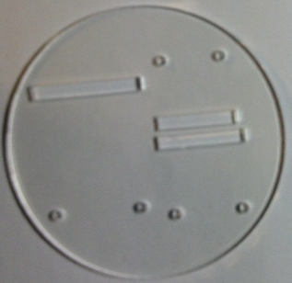
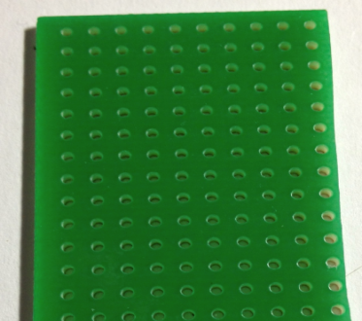
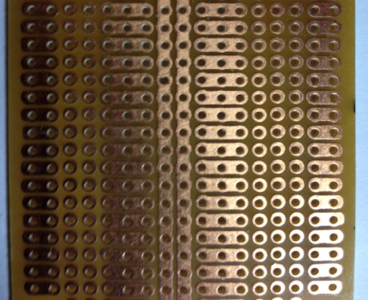
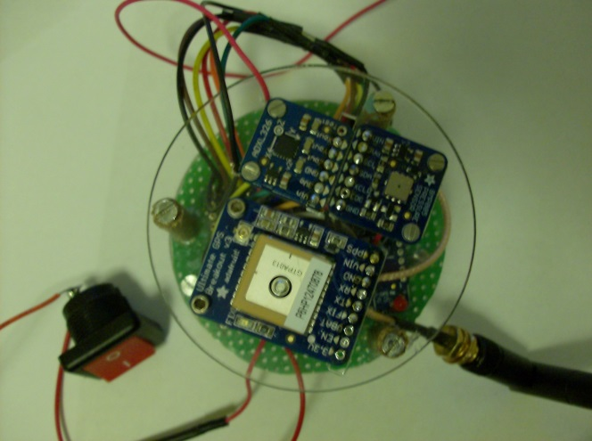
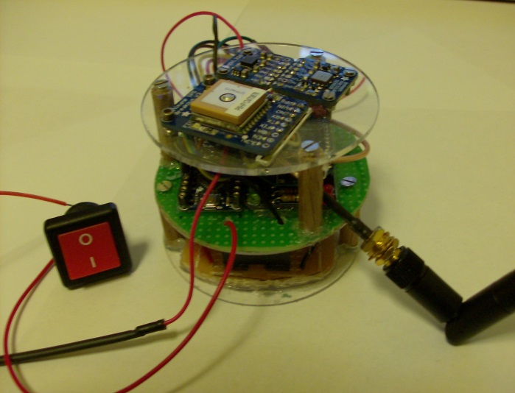
Electronic Component Fabrication
Components mounted on laser cut acrylic disks using perf-boards
Pressure/Temperature Sensor and Accelerometer
GPS Module
Microcontroller and XBEE
Battery
Antenna

Slide 20
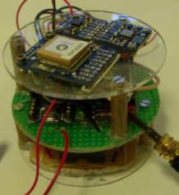
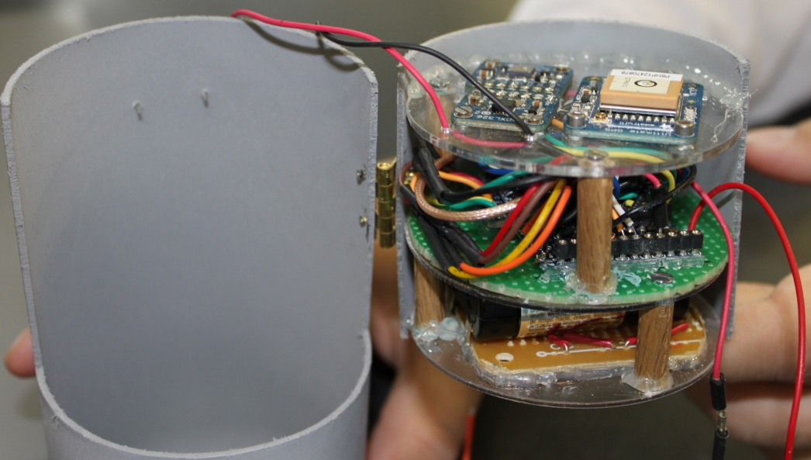
Integration of Electrical Components
Level 1
Telemetry Sensors
Level 2
Data Handling & Communications
Level 3
Electrical Power System
Notes:
-Multi-Level Electronics Arrangement
-Permanently Affixed to Payload Half
-Rigid shelves made of plastic

Slide 21
System of Operation
Secure Egg Inside Payload Envelope and Assemble Payload
Place in Launch Configuration. Telemetry Data Transfer to Ground Station.
Launch and Eject at Apogee.
Parachute Deployment. 20m/s Decent from 670m.
Altimeter Reads 400m
Separate from Container, Engage Aero-Braking.
Decent Until Impact in which Force of Impact is Recorded.
Retrieve Payload and Force of Impact Data.
Locate Payload through Visual Sight and Audible Noise.

Slide 22
Subsystems Operation
GPS Module
Microcontroller
Data
Power
RF Data
Press/Temp
ADC
Accelerometer
XBEE RF Transmitter
(CanSat)
Battery
Audible Locator
2.4 [GHz]
XBEE RF
Receiver (Ground Station)
Ground Control Station (Laptop)
USB/FTDI
Telemetry Sensor System
Telemetry Sensor System
Telemetry Sensor System
Telemetry Sensor System
Bosch™ BMP085 : Press/Temp.
GlobalTop™ FGPMMOPA6C : GPS Module
Analog Devices ADXL326 : Accelerometer
Impact force calculated from the mass and acceleration upon impact (F=ma)
Bosch™ BMP085 : Press/Temp.
GlobalTop™ FGPMMOPA6C : GPS Module
Analog Devices ADXL326 : Accelerometer
Impact force calculated from the mass and acceleration upon impact (F=ma)
Bosch™ BMP085 : Press/Temp.
GlobalTop™ FGPMMOPA6C : GPS Module
Analog Devices ADXL326 : Accelerometer
Impact force calculated from the mass and acceleration upon impact (F=ma)
Bosch™ BMP085 : Press/Temp.
GlobalTop™ FGPMMOPA6C : GPS Module
Analog Devices ADXL326 : Accelerometer
Impact force calculated from the mass and acceleration upon impact (F=ma)
GPS Module
Microcontroller
Data
GPS Module
Microcontroller
Data
GPS Module
Microcontroller
Data
GPS Module
Microcontroller
Data
Power
Power
Power
Power
RF Data
RF Data
Press/Temp
RF Data
Press/Temp
RF Data
Press/Temp
Press/Temp
ADC
ADC
ADC
ADC
Accelerometer
Accelerometer
XBEE RF Transmitter
(CanSat)
Battery
Accelerometer
XBEE RF Transmitter
(CanSat)
Battery
Accelerometer
XBEE RF Transmitter
(CanSat)
Battery
XBEE RF Transmitter
(CanSat)
Battery
2.4 [GHz]
2.4 [GHz]
2.4 [GHz]
2.4 [GHz]
XBEE RF
Receiver (Ground Station)
Ground Control Station (Laptop)
XBEE RF
Receiver (Ground Station)
Ground Control Station (Laptop)
XBEE RF
Receiver (Ground Station)
Ground Control Station (Laptop)
XBEE RF
Receiver (Ground Station)
USB/FTDI
Ground Control Station (Laptop)
USB/FTDI
USB/FTDI
USB/FTDI

Slide 23
Testing, Results, Reliability
Aero-braking Deployment
Separation Mechanism
Telemetry and Electronics
Flight and Ground Control Software
Rustan and Guerr

Slide 24
Separation and Deployment
Unable to test in operation conditions
Test individual components
Parachute
Test confirmed validity of model
Separation Mechanism
Successfully detached payload from container
Aero-braking
Manually deployed structure

Slide 25
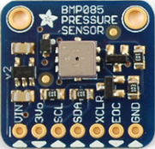
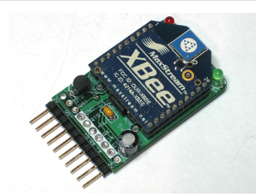
Telemetry Testing and Results
Competition Req
Force Sensor
100 Hz sample rate
Test Result:
OK
Accelerometer
Competition Req
Altitude Sensor
0.25 m precision
Test Result:
OK
Press./Temp.
Competition Req
GPS NMEA Data
NMEA std. output
Test Result:
OK
GPS Module
Competition Req
XBEE Series 1 or 2
2.4 GHz
RF LOS ~1km
Test Result:
Inconclusive
XBEE Pro Series 1

Slide 26
Reliability
Digital Communications (XBEE, RF), Link Margin
Cable
Transmission in Air
-100 dB
Transmitter
18 dBm
Antenna
2.1 dB
-0.5 dB
Receiver
-100 dBm
Cable
Antenna
2.1 dB
XBEE Receiver
Sensitivity: -100 dBm
Received Power: -72.5 dBm
Link Margin: -28 dBm
-1 dB
Data Reliability
Graphical Display
Received Signal
Software Error Handling
Output to File

Slide 27
Software Testing and Results
CanSat Flight Software
Serial
Telemetry Packet
Telemetry Sensors
Flight Software
XBEE RF Transmitter
(CanSat)
I²C
Analog
Altitude
System Ran for over 1 hour
FSW State
Telemetry Packet
Ground Control Software
Telemetry Packet
Graphical Display
Parsed
Telemetry Data
XBEE RF
Receiver
Ground Station Software
USB/FTDI
Output to File
System Ran for over 1 hour

Slide 28
Discussion and Conclusions
Belhaj

Slide 29
Project Budget
Revenue |  | Expenses
Funding Source | Funds Received | Procured | Expense Amount
ECE Department | $200.00 | ECE Components (Telemetry) | $300.00
Private Donation | $750.00 | Mechanical & Structural | $175.00
Dr. Shih | $1000.00 | Shipping | $25.00
State Farm | $250.00
Total Funds Generated | $2200.00 | Total Procurement Expenditures | $500.00
Total Available Funds Remaining | $1700.00

Slide 30
Competition Benchmarks
Delivered Preliminary Design Review (PDR)
Feedback: Scored 92% from AIAA/NASA Panel
Scheduled Delivery for Critical Design Review (CDR)
Competition Date: June 8, 2013
Post-Flight Review: June 9, 2013
Notes:
It may be smart to set this up so each checklist or check box “Appears” with a separate mouse click. Otherwise big lists like these can be overwhelming to look at.

Slide 31
Conclusions
Physical prototype manufactured within competition specifications
Telemetry sensors tested and integrated
Flight Software and Ground Station Software completed
Electrical power system and RF communications are operational
Total budget under $600
All competition requirements have been met.

