Slide 1
Senior Design Team 20 Solar Powered Phase-Change Compressor
Spring Midterm Presentation
February 14th, 2013
Addison Bender
Jesse Diaz
Emmanuel Ferdinand
Sponsor: Grant Peacock
Faculty Advisor: Dr. Ordonez

Slide 2
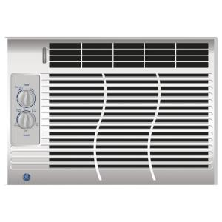
Project Scope
Refrigerant Compressor for a small A/C unit.
Heat removal: 5000 BTU/hr
Driven by steam
Potential steam source: concentrating solar collector

Slide 3
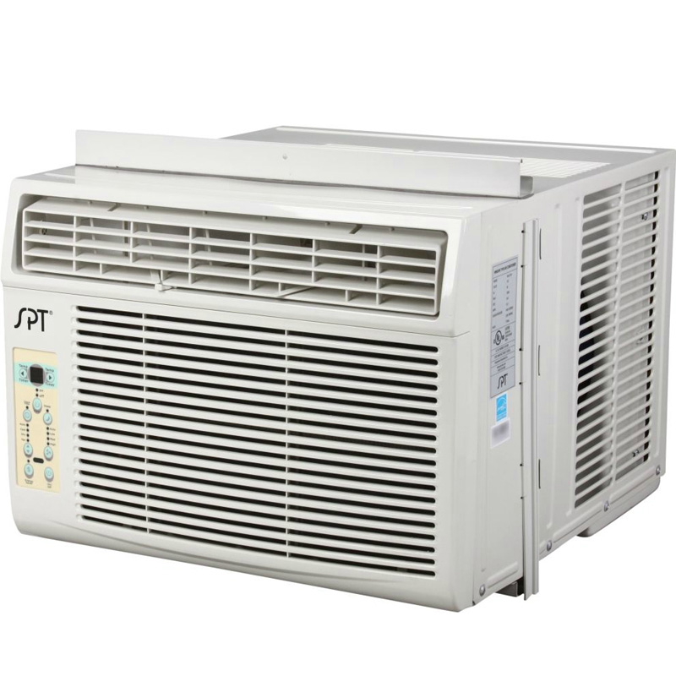
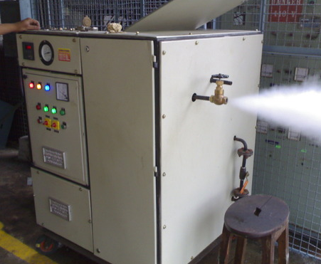
Overview
Designing Compressor Unit
Use electric boiler steam supply
Interface with closed loop refrigerant cycle.

Slide 4
Pressure Vessel Design
Machined from cylindrical billet.
Simpler process than welding multiple pieces together.
Steel chosen over aluminum
Less thermal expansion
Comparable cost
Disadvantage: longer machining time

Slide 5
Prototype Testing
Simulates solar powered steam generation system
Easily controlled
Adjusts to multiple fittings
Supervision under John Dascomb
Testing will take place at the Florida State University ESC

Slide 6
Prototype Testing
5000 BTU a/c window unit
Standard a/c refrigerant maintenance
Flushing refrigerant
Replace compressor (fittings)
Recharge refrigerant
Calibration

Slide 7
Valve Overview
Solenoid Valve:
Controls the flow of steam
Operates at 1 Hz
Check Valve:
Control the flow of R-134a
One directional flow

Slide 8
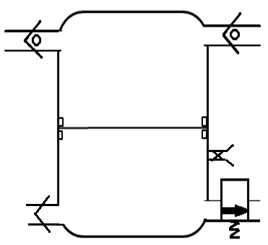
Design Revision
Release valve will be implemented
High temperature tubing will be attached
Decreases cost and complexity of design
Old Design
New Design

Slide 9
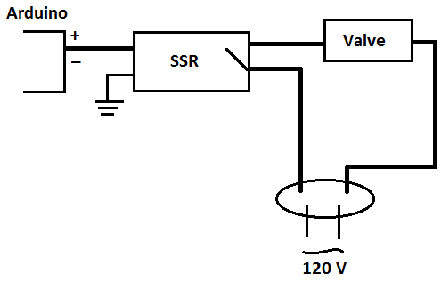
Control Circuit
Electronic Components:
Arduino R3 Uno Microcontroller
5V Solid State Relay issue
Solenoid Valve
120 V AC Power Supply

Slide 10
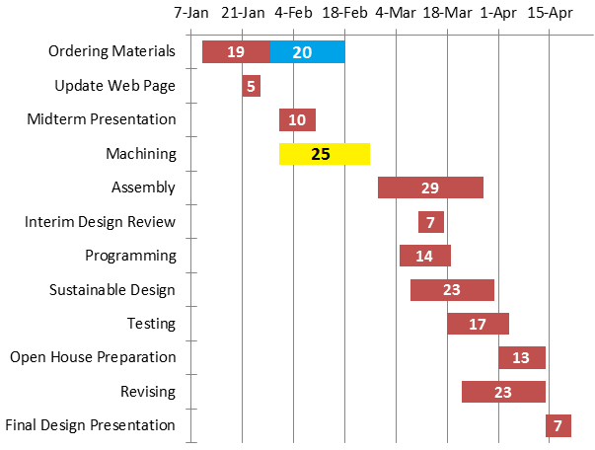
Scheduling Update

Slide 11
Future Plans
Work on control circuit with the advisement of Dr. Chuy
Select a suitable data acquisition system for determining pressure readings
Acquire A/C unit to determine fittings for connection

Slide 12
Expenditures
Microcontroller | $ 35
Solenoid Valve | $ 312
Silicone Elastomer | $ 114
Steel Billet | $ 156
Check Valves | $ 106
Globe Valve | $ 12
Relief Valve | $144
------------------------------- | -------------------------------
Expenditures to date: | $ 879

Slide 13
Projected Expenditures
Pressure Transducers | $ 330
R134a Cylinder | $ 125
R134a Manifold | $ 175
DAQ | $ 200
AC Unit | $ 50
------------------------------- | ----------------------------
Projected Future Expenditures: | $ 880
Remaining: $241

Slide 14
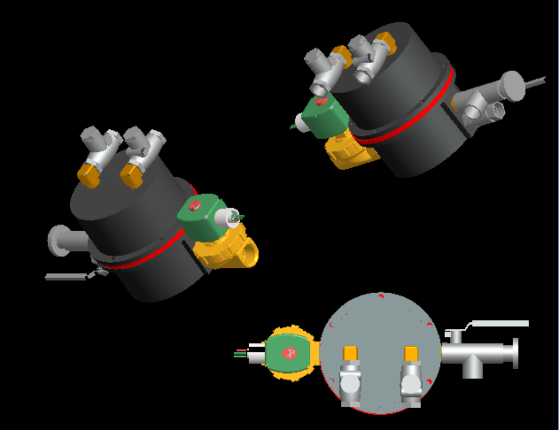
Questions?

Slide 15
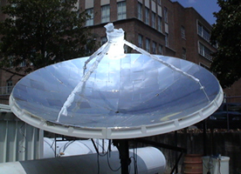
Steam Generation
Based on John Dascomb’s concentrating solar collector
Solar collector must have an Area = 17.75$m^{2}$
System will generate the required > 770 kPa

