Slide 1

Senior Design Team 20
Solar Powered Phase-Change Compressor
Final Design Presentation
April 18, 2013
Addison Bender
Jesse Diaz
Emmanuel Ferdinand
Sponsor: Grant Peacock
Faculty Advisor: Dr. Juan Ordonez
and John Dascomb
Notes:
Jesse

Slide 2
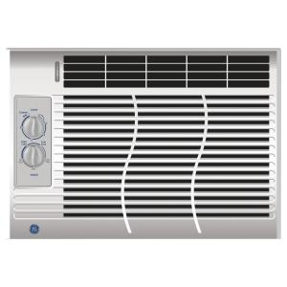
Project Definition
Need Statement:
  Design a compressor for a refrigeration system that can be powered by solar energy.
Objective: 5,000 BTU/hr (1465 W)
Solar-Thermal Driven
Budget: $2000
Notes:
Jesse

Slide 3
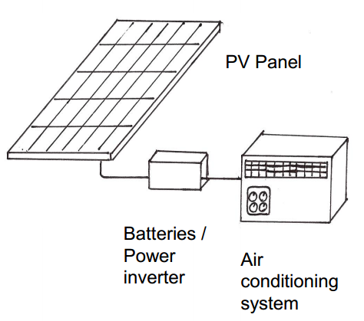
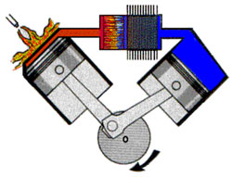
Concept Development
Solar energy → electricity → mechanical power
Solar energy → mechanical power
Notes:
Emmanuel

Slide 4
Concept Development
Piston
Pros:
  High stress & high cycling
  High temperature
  Large displacement
Cons:
  Precision machining
  Possibility of refrigerant escaping
Notes:
Emmanuel

Slide 5
Concept Development
Elastic Membrane
Pros:
  Larger tolerances
  Sealed by non-permeable material
Cons:
  High temperature
  Fatigue effects
  Smaller displacement
Notes:
Emmanuel

Slide 6
System Diagram
Compressor
Air Conditioner
Refrigerant Loop
Condenser
/
Steam Source
Capillary
Steam Flow
Evaporator
Control Circuit
Fan Control
Fan
Microcontroller
Solenoid Valve
Power Supply (120V AC)
Relay
Steam vent
Notes:
Jesse

Slide 7
Design Concept
Vent is closed
  Steam pressure compresses refrigerant
Vent is opened
  Steam chamber pressure drops below refrigerant chamber pressure.
Vent is closed, cycle repeats.
R134a From evaporator
R134a to condenser
High Pressure Steam from solar boiler
Vented steam
Notes:
Jesse

Slide 8
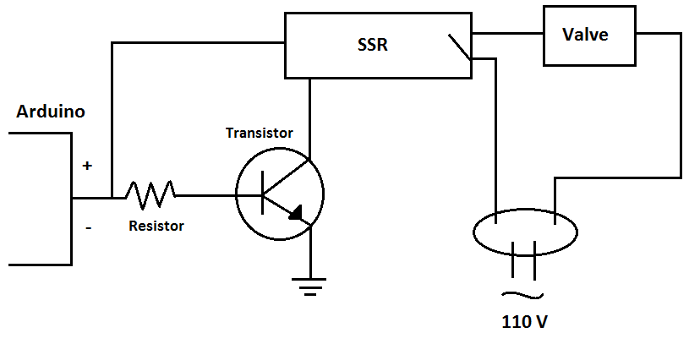
Control Circuit for Solenoid
Arduino R3 Uno Microcontroller
  Open and closed valve at 1 Hz
  2N222 Transistor and 5.6 kΩ Resistor
Solid State Relay
  Control voltage (5 – 24 VDC)
  Load Voltage (19-264 VAC)
  Load Current (10 A)
Notes:
Addison

Slide 9
Thermodynamic Model: Refrigeration Cycle
T
T₂ = 32.9°C
Isentropic compression
Isobaric heat rejection
Adiabatic expansion
Isobaric heat absorption
∆P = 433 kPa
m = 0.009 kg/s
T₃ = 30°C
P₂ = 771 kPa
P₃ = 771 kPa
2
3
1
T₁ = 4°C
4
P₁ = 338 kPa
T₄ = 4°C
P₄ = 338 kPa
s
R134a Ideal Vapor-Compression Refrigeration Cycle
Notes:
Jesse
talk about refrigerant selection: vapor pressure

Slide 10
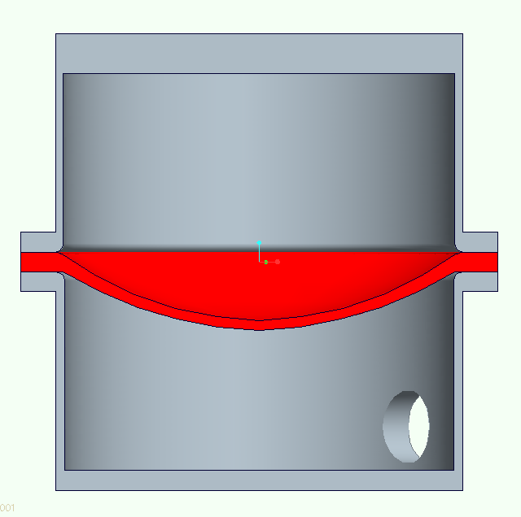
Modeling Diaphragm Deflection
Elasticity of material is used to predict deflection
V = 1.67 x 10⁻⁴ m³
f = 2Hz
D = 12cm, δ = 2.7 cm, t = 1.3 cm
t
D
δ
Notes:
Jesse
Mention material chosen and why

Slide 11
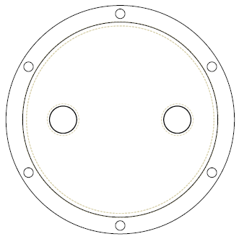
Sealing
Bolt material: steel
  Yield strength = 45,000 psi
  Tensile stress area = 0.025 in²
Max chamber pressure = 150 psi
  Load on bolts = P*A = 707 lb.
  Load on 1 bolt =707N/6 = 117.8 lb.
  Stress on 1 bolt = F/A = 4,713 psi
Notes:
Emmanuel
Note:
I think I should mention the statements below in some way
Bolt spacing around a bolt circle should not exceed about 6 bolt diameters for good force distribution
Bolts should not be less than 1.5 diameter to edge

Slide 12
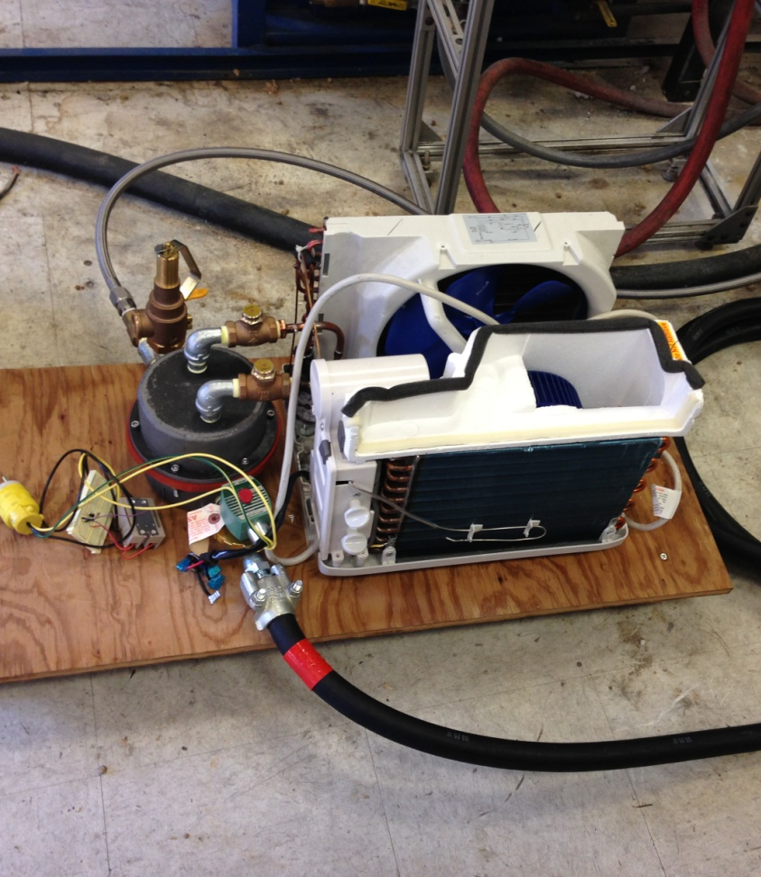
Testing Procedure
Static pressure test: 800kPa
Steam Test: membrane rupture
Connect to compressed air supply
Add refrigerant to selected pressure
Run solenoid at preset duty cycle
Increment air flow and monitor refrigerant pressure
Increase refrigerant pressure and repeat
Notes:
Emmanuel

Slide 13
Results
Notes:
Jesse

Slide 14
Results
Notes:
Jesse

Slide 15
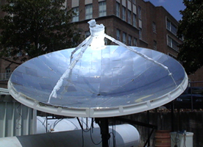
Desired Solar Power
Thermal efficiency based on a dish size of 6.47 m²
Theoretical solar concentrator would generate ~6,900 W
 | Theoretical | Actual
Compression Power | 145 W | 70 W
Dish Size Required | 6.47 m² | 13.39m²
Thermal Energy Needed | 970 W | 2,007 W
Overall Efficiency | 2.1% | 1.0%
$/Watt | 9.63 | 19.93
Notes:
Addison

Slide 16
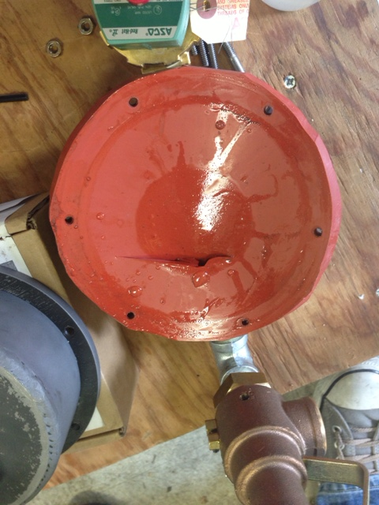
Failure Modes of Diaphragm Compressor
Failure Mode | Failure Cause | Failure Effect
Loss of Gas Output | Cracked/ Damaged Gasket Leak | Compressor Failure
Cracking of Diaphragm | Contaminants | Decreased Performance
Diaphragm Rupture | Inadequate Strength Characteristics | Loss of Output Gas
 | Insufficient Material Plasticity
Notes:
Addison
contaminants cause diaphragm to crack?
plasticity or elasticity?
compressor failure is too broad

Slide 17
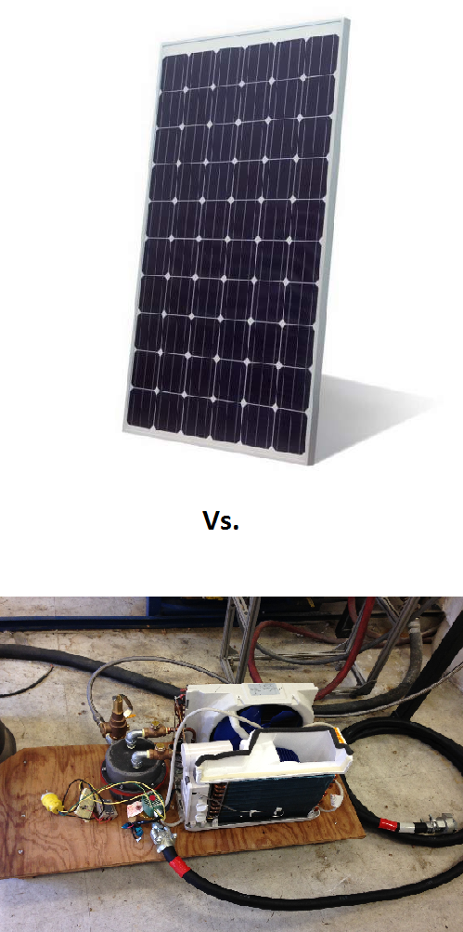

Feasibility of PCC
Duty cycle too high
  5 cycles/hour is considered HIGH for membrane
  Design requires 3600 cycles/hour
Too much steam needed to generate 145 Watts
($1-$3)/Watt for PV
$19.93/Watt for Actual
Conversion Mechanism | Efficiency
Micro Steam Turbine | 15%
Phase Change Compressor | 3.5%
Notes:
Addison

Slide 18
Summary
Compression was achieved, though less than target.
Membrane concept is much less stable than piston.
System is more prone to failure than solar-electric generation due to high use components.
Notes:
Emmanuel

Slide 19
Recommendations
Include a control valve to control steam in
Implement feedback control based on low and high pressure sensors
Test membrane component
  Property degradation with high cycle loading
  Performance at high temperature
Incorporate solar generated steam source
Notes:
Emmanuel

