Slide 1

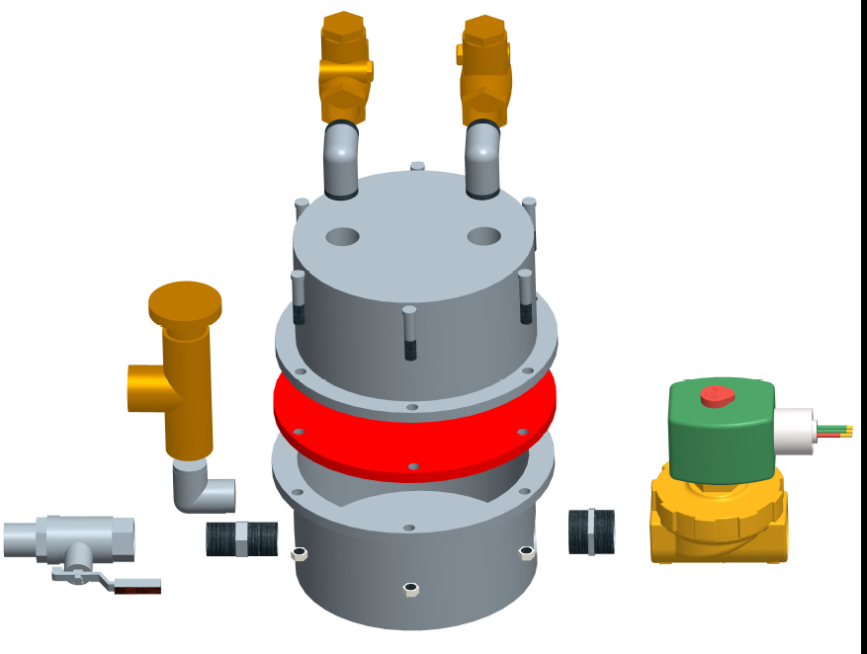
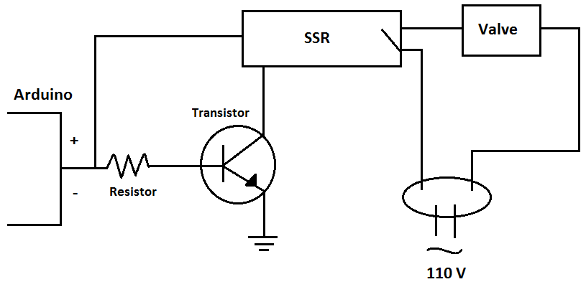
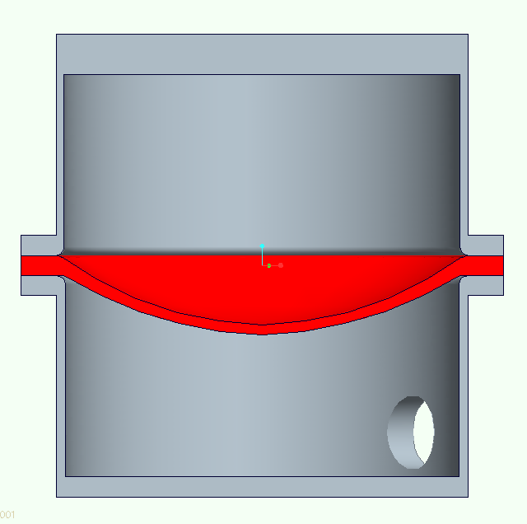
Solar-Powered Phase Change Compressor
Addison Bender Jesse Diaz Emmanuel Ferdinand
Sponsor: Grant Peacock Advisors: Dr. Juan Ordoñez, John Dascomb
Project Need
Design a refrigerant compressor that can be driven by solar-generated steam.
Energy Analysis
 | Theoretical | Actual
Compression Power | 145 W | 70 W
Insolation Required | 6,891 W | 14,260 W
Thermal Energy Input Needed | 970 W | 2,007 W
Overall Efficiency | 2.10% | 1.02%
$/Watt | 9.63 | 19.93
Low pressure refrigerant from evaporator.
Concept
Vent is closed. Pressure from boiler raises the membrane and compresses refrigerant.
Vent is opened. Steam is released and refrigerant is drawn into the upper chamber as the pressure in the lower chamber drops.
Vent is closed, cycle repeats.
High pressure refrigerant to condenser
Pressure relief valve prevents membrane blow-out if pressure builds up in steam chamber.
High-use check valves constrain flow to one direction through the refrigerant loop as membrane oscillates.
Results
T
T₂ = 32.9°C
T₃ = 30°C
P₂ = 771 kPa
P₃ = 771 kPa
2
3
High temperature silicon elastomer membrane
(rated for 316ºC)
4
1
T₁ = 4°C
T₄ = 4°C
P₁ = 338 kPa
P₄ = 338 kPa
s
R134a Ideal Vapor-Compression Refrigeration Cycle
Compressor Specification
Flow Required (1465W heat removal)
m = 0.009 kg/s
Material: Silicone Elastomer
E = 20 MPa, ν = 0.5
Membrane Dimensions:
t = 1.1 cm, R = 6 cm
Displacement:
V = 330 cm³ , f = 1 Hz
Steam shut-off valve
Steam supply from boiler (175ºC < T < 225ºC)
Steam vent to atmosphere
Conclusions
Membrane failed when steam was used. Successful test used compressed air.
Compression of refrigerant was achieved, though less than target.
Energy is lost when membrane is deformed and steam is vented.
High-use components diminish system reliability.
Fast-response solenoid valve controls steam pressure in the lower compressor chamber. (open: 0.5 s, closed: 0.5s)
t
D
δ
Solenoid Control Circuit

