Slide 1
Cosmic Cube
Team Lead/Programmer: Kenneth Spradley
Lead ECE: Matthew Gibson
ECE Assistant: Don Lundi
Lead ME: Cole Gray
Financial Advisor: Crystal Hill

Slide 2
Presentation Outline
Overview of the Design
Needs Analysis – Crystal Hill
Overall Description – Don Lundi
Requirement Specification – Matt Gibson
Functional Requirement – Kenneth Spradley
Non-Functional Requirement – Cole Gray
Constraints

Slide 3
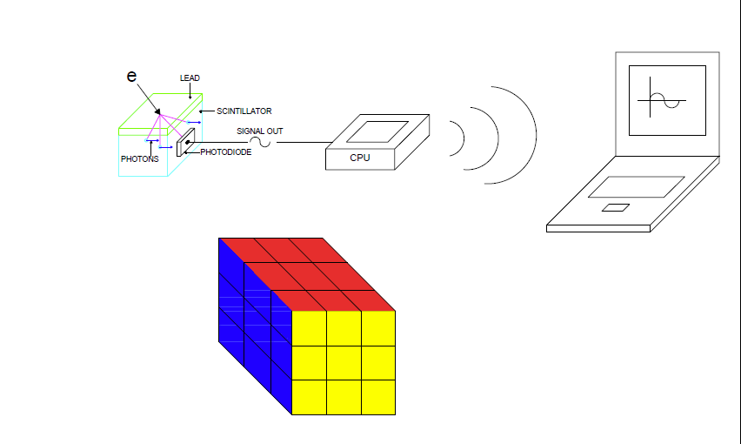
Overview of the Design

Slide 4
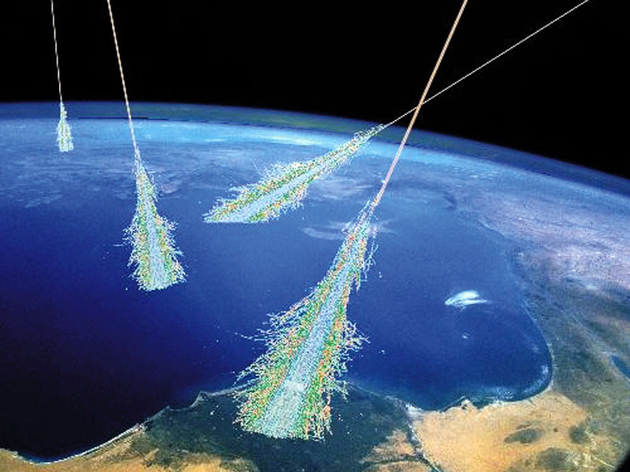
Needs Analysis
Overview of the Cosmic Cube Project (Purpose)
Statement of the Problem

Slide 5
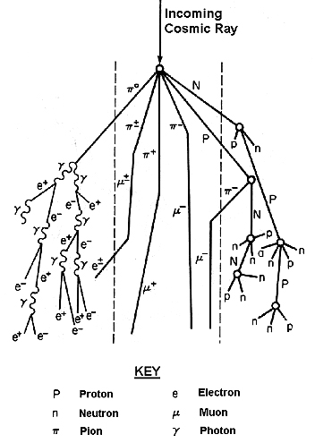
Overall Description
Self Contained Cosmic Ray Detector
Product Functions
Detect Cosmic Ray
Record time of event (GPS)
Differentiate Between Particle Species
Provide Raw data to user
- Open Source
- Simple Interface

Slide 6
Overall Description
User Classes and Characteristics
Researchers: Universities, High Schools, Scientists.
Backyard Astronomers/General Public: Individuals who have interest in space and particle astronomy.
Special Application Groups: Gamma Ray Detection

Slide 7
Requirement Specifications
External Interface Requirements
User Interfaces
Visual (LED)
Data Display (Computer)
Hardware Interfaces
Scintillator
Solid State Detection
A/D Conversion
Upload to Computer
Software Interfaces
Pulse Detection
Communication Protocols and Interfaces
GPS Time Synchronization
USB
ZIGBEE

Slide 8
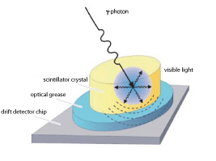
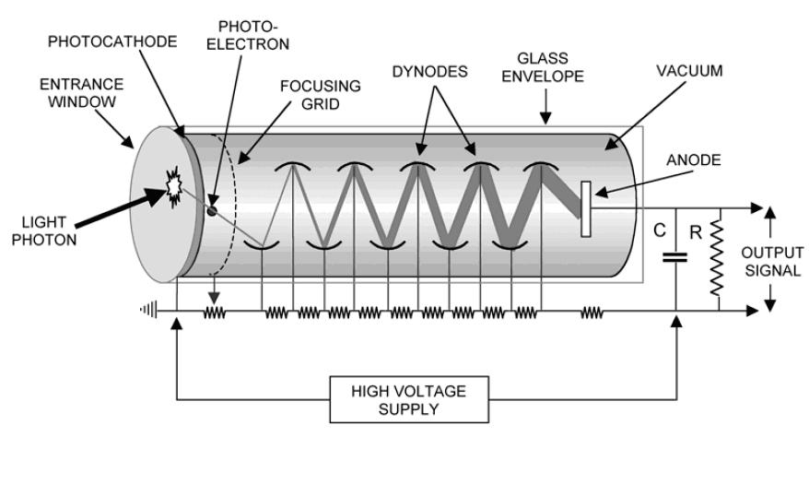
Functional Requirements
REQD-001: The system must be able to continuously detect high-energy muons, protons, and electrons from energy levels in the magnitude of 1 GeV.

Slide 9
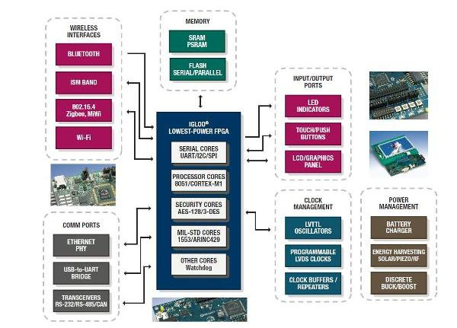
Functional Requirements
REQDa-001 The system should be able to output the raw data in a readily available software format found on most personal computers, i.e. a Text file or Microsoft Excel file.

Slide 10
Non-Functional Requirements
Structural Requirements
REQSt-001 – The cube encasing should be no smaller than 15 cubic cm and no larger than 30 cubic cm.
REQSt-002 – The cube should be designed so it can be reproduced and connected securely to other cubes.

Slide 11
Non-Functional Requirements
Structural Requirements
REQSt-003 – The portion of the cube that contains the sensor must be have no light entering it.
REQSt-004 – The portion of the cube containing the sensor must have exchangeable panels so different radiation particles can be detected.

Slide 12
Non-Functional Requirements
Structural Requirements
REQSt-005 – The cube should be water resistant.
REQSt-006 – The system should be strong enough to have some impact resistance.

Slide 13
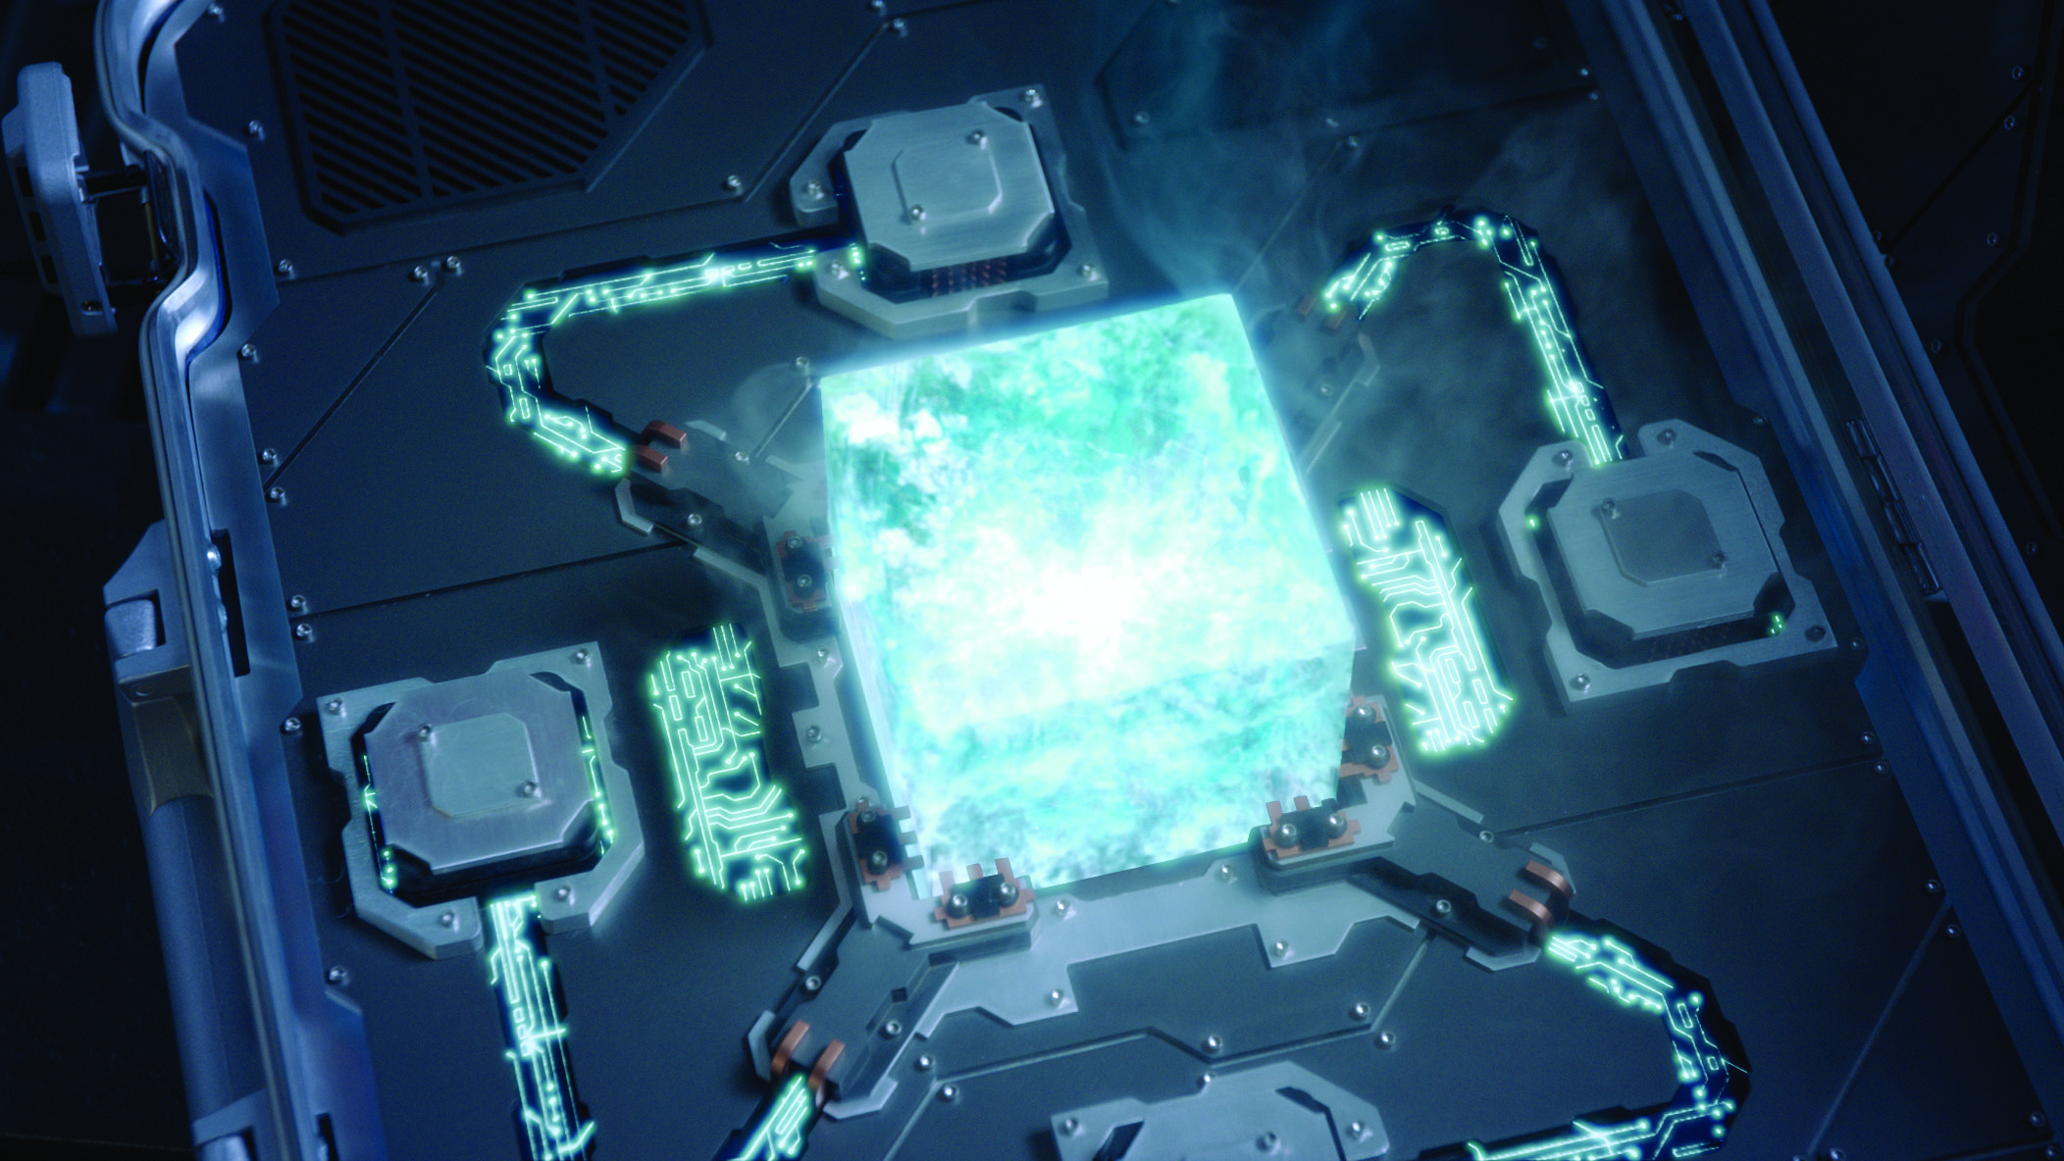
Constraints
The initial budget for the prototype is $750. This is subject to change if additional funding is provided or raised. The prototype cube should be designed and at a functional state by April, 2013.

Slide 14
Questions?

Slide 15
References

