Slide 1



Cosmic Cube
Team Lead/Programmer: Kenneth Spradley
Lead ECE: Matthew Gibson
ECE Assistant: Don Lundi
Lead ME: Cole Gray
Financial Advisor: Crystal Hill

Slide 2
Cosmic Cube
Financial Advisor: Crystal Hill

Slide 3
Current Status
  Arduino, Wi-Fi, De0 Nano, GPS, and polycarbonate have all been ordered
  Programming has been started for the Arduino as well as the Wi-Fi and GPS systems
  The scintillator and photo detector have been prepared and tests will shortly begin after optical grease arrives

Slide 4
Budget
Scintillator Material (EJ-208) | $0.00 | 1 | $0.00
Photo Detector (S10362-11-025U) | $0.00 | 1 | $0.00
Wi-Fi Shield (Arduino DEV - 11287) | $84.95 | 1 | $84.95
GPS Shield (FASTRAX UP501) | $76.66 | 1 | $76.66
LEDs | $6.58 | 1 | $6.58
Polycarbonate | $93.98 | 1 | $93.98
Angle Aluminum (1/8"X4') | $9.69 | 1 | $9.69
DE0 Nano (Altera) | $86.25 | 1 | $86.25
Microcontroller (Arudino Mega 2560 R3) | $69.06 | 1 | $69.06
LED - RGB Diffused Common Cathode (COM-09264) | $1.95 | 5 | $9.75
Jumper Wire F/F (PRT-08430) - Pack of 10 | $3.95 | 2 | $7.90
Jumper Wire M/M (PRT-08431) - Pack of 10 | $3.95 | 2 | $7.90
Optical Grease | $105.00 | 1 | $105.00
 |  | Total Expenses: | $557.72
 |  | Budget: | $192.28

Slide 5
Risks
Going over budget is the biggest risk we have right now. Additional glue will push us over budget
  Fix: In mass production the parts will become less expensive
Completion of the programming for the Arduino is not on schedule
  Fix: Allot more members to assist on programming
Bolts not strong enough to hold the cube structure together
  Fix: Glue sides together

Slide 6
Schedule
On schedule with all parts being ordered and testing and programming being done
The presentation at the end of February will include demos on units currently working but not all integrated together.

Slide 7
Cosmic Cube
Lead ECE: Matthew Gibson

Slide 8
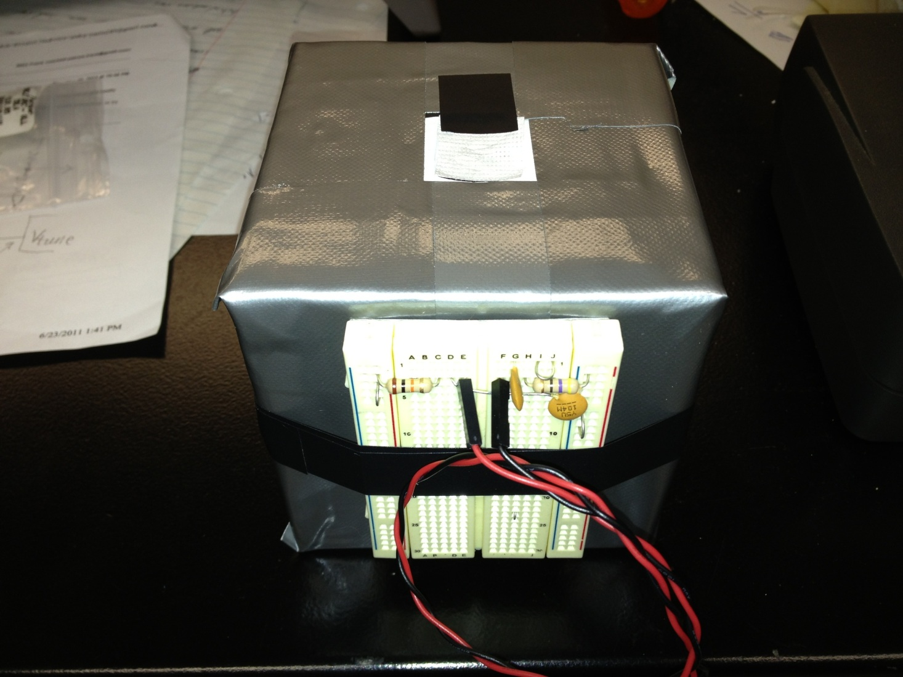
SCINTILLATOR

Slide 9
TESTING
Need Optical Grease
Measure Amplitude and Pulse Width
Half cube for testing

Slide 10
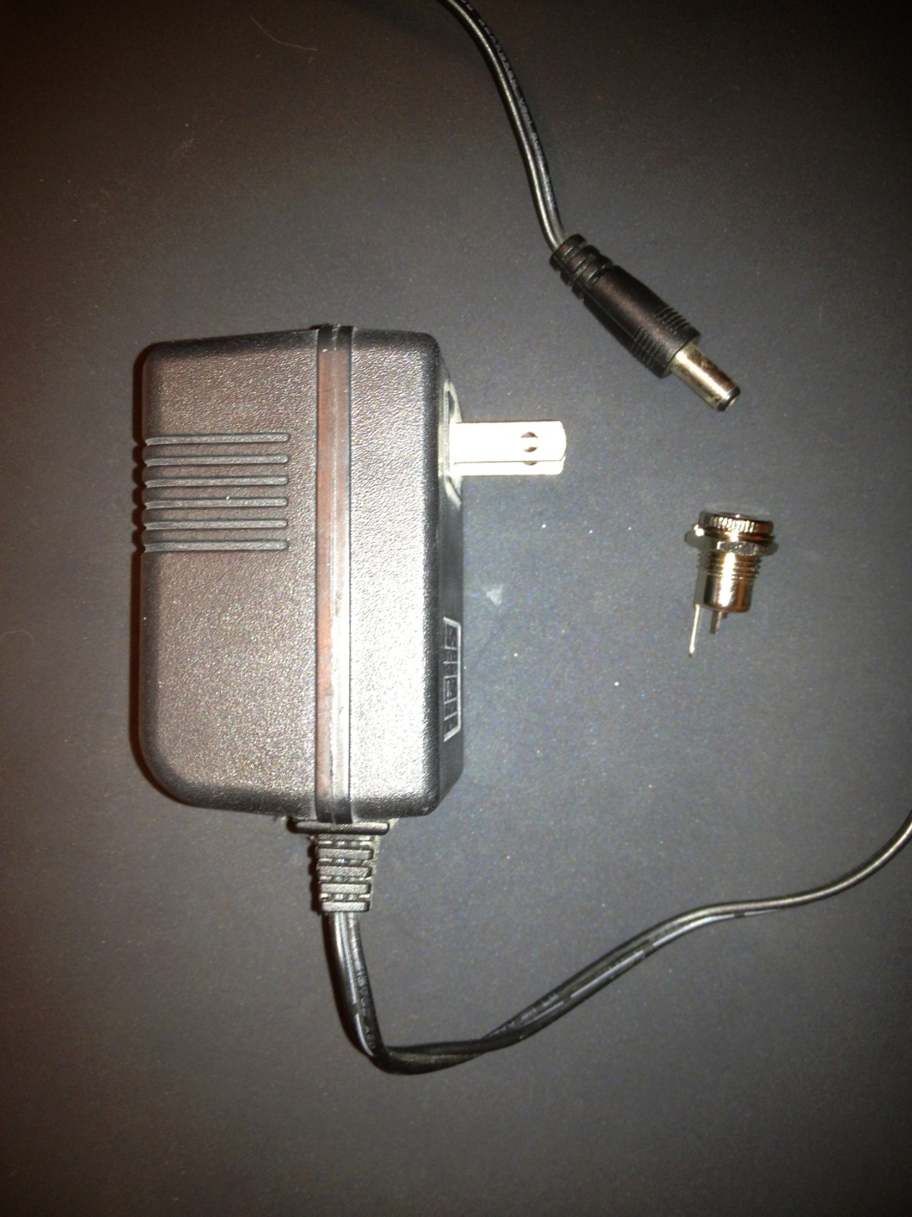
MAIN PSU

Slide 11
TESTING
Rated voltage : 15VDC
Actual voltage : 22.5VDC
Arduino maximum voltage : 12VDC
LM7812 Linear

Slide 12
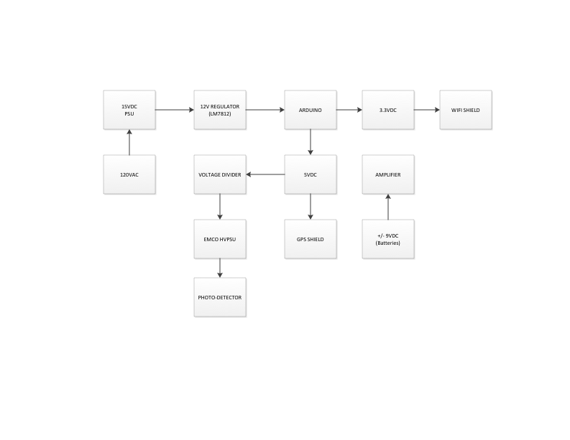
POWER

Slide 13
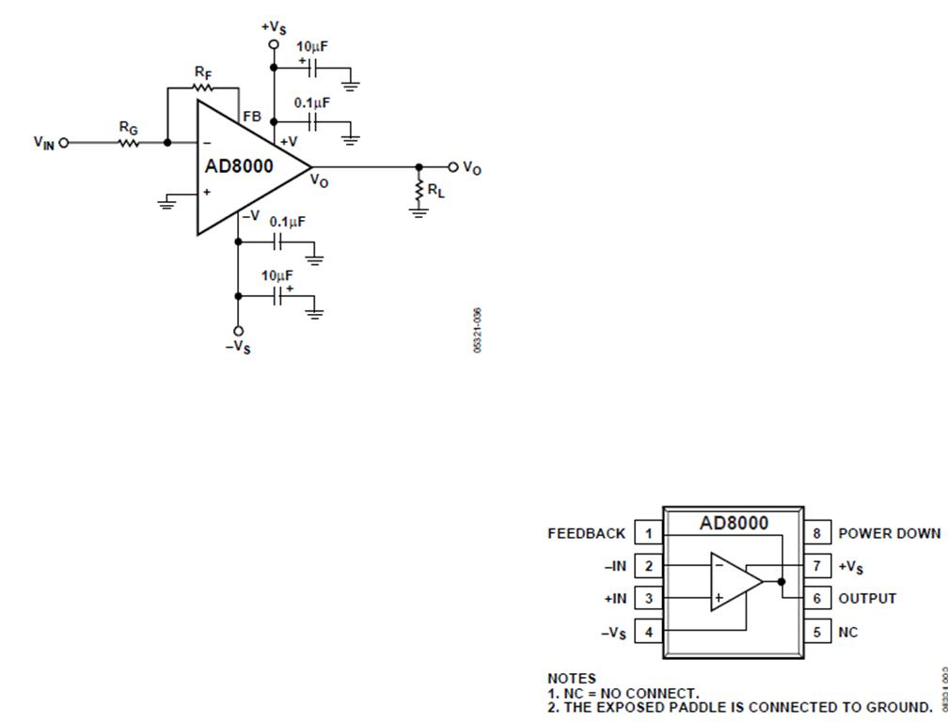
AMPLIFIER(AD8000)

Slide 14
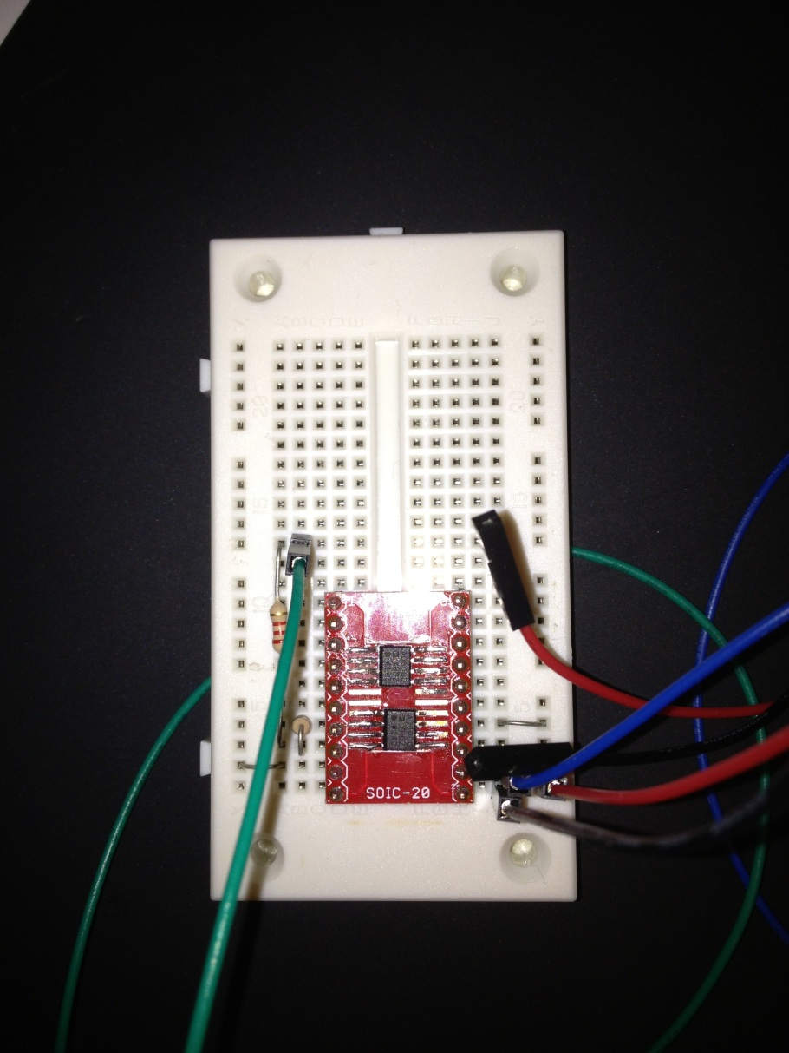
AMPLIFIER(AD8000)

Slide 15
Cosmic Cube
ECE Programmer/Assistant: Don Lundi

Slide 16
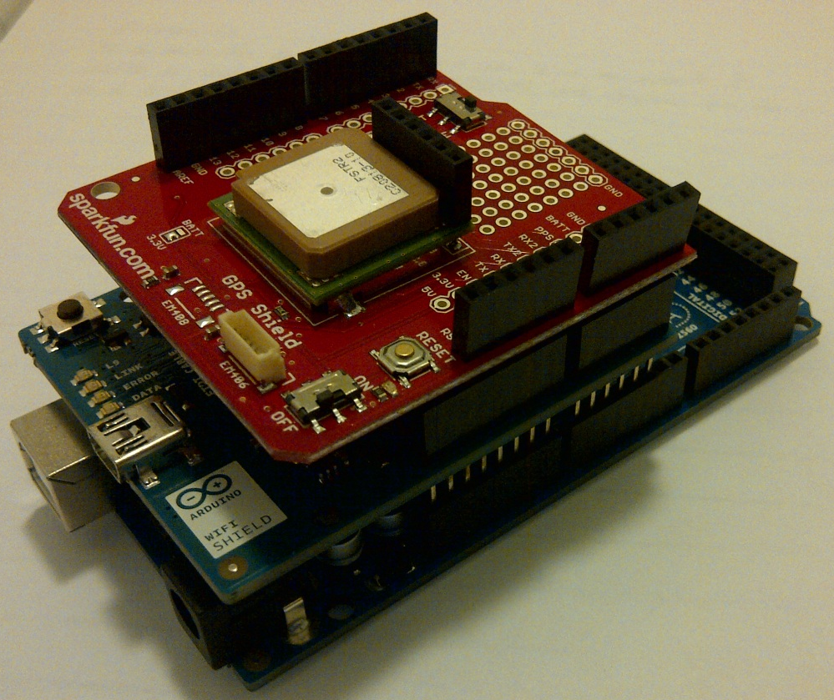
GPS and Wi-Fi Shields

Slide 17
Current Structure of Shields
GPS receiver is mounted to GPS Shield
The two shields will stack on top of one another
  The Wi-Fi integrates with Arduino and uses no pin space
  The GPS will stack on the Wi-Fi and any circuitry require will be soldered to prototyping space

Slide 18
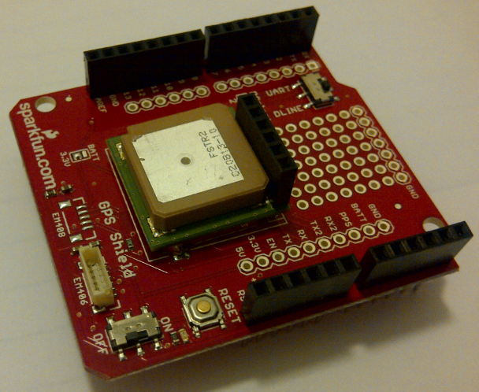
GPS Shield
Test Plan: Integrate GPS shield with DE0 Nano microcontroller and test that PPS signal is being received.
Current Status: GPS shield can detect location and send PPS signal to Arduino Mega 2560

Slide 19
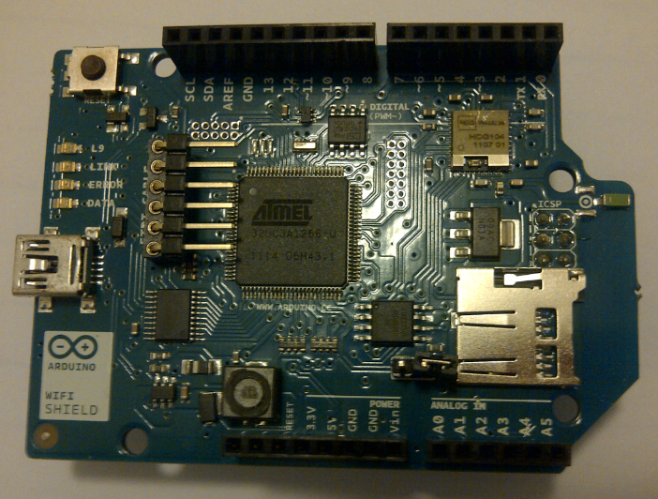
Wi-Fi Shield
Test Plan: Integrate Wi-Fi Shield with DE0 and photo-detector. Transmit data from photo-detector and GPS to user computer wirelessly.
Current Status: Shield can connect to local internet access points, both with no encryption and those encrypted with WPA2 Personal.

Slide 20
Cosmic Cube
Team Lead/Programmer: Kenneth Spradley

Slide 21
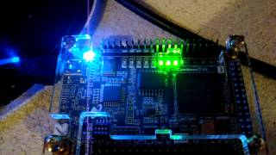
Time Processing Unit
Test Plans:
Continual Testing of Programs/Functions
Make sure can receive PPS signal from GPS
Detect Event from Sensor (Pre Amplification)
Ability to send data via 8 bit bus.
Current Status:
Current programs and functions within the TPU are currently being updated and developed as well as retested.

Slide 22
Current Architecture

Slide 23
Current Functions/Programs
wave_detection.vhd
  This file will be responsible for the detection of a cosmic particle event incoming via an incoming analog connection.
time_stamp.vhd
  This file will be responsible count the nanoseconds in between each GPS PPS (pulse per second) signal and store in a std_logic_vector until CPU is ready for transmission of the data.
board_comm.vhd
  This file will be responsible for signaling the CPU when data is ready for transmission as well as waiting for the CPU to send signals to show that CPU is ready for the transmission of data.

Slide 24
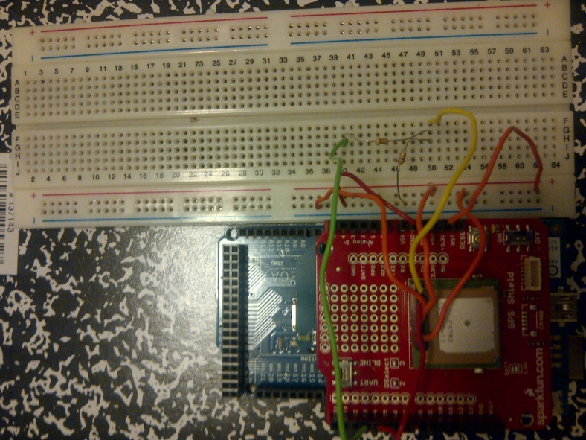
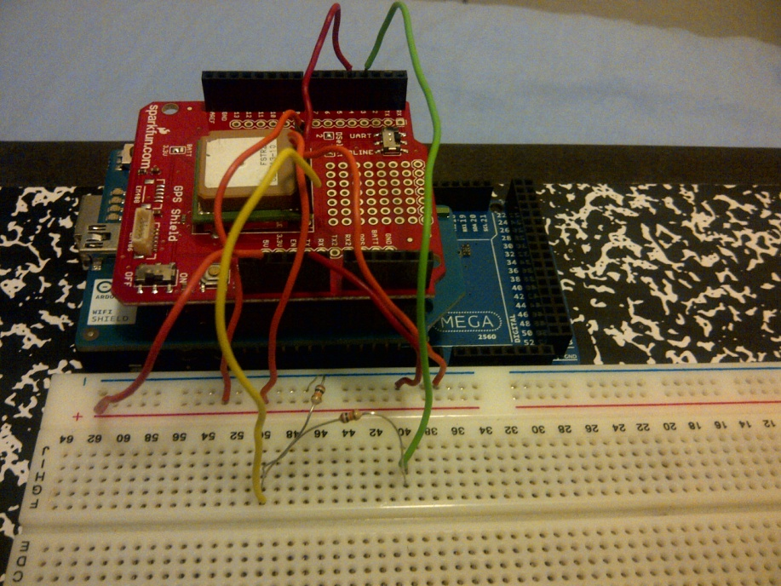
Central Processing Unit
Test Plans:
Continual Testing of Programs/Functions
Make sure can receive data from TPU
Detect Event from Sensor (Post-Amplification)
Can send data via Wi-Fi Connection
Current Status:
Initial Integration has been successful with WI-FI and GPS Shields.
The development of software is behind however more man power is being allocated to this aspect of the project.

Slide 25
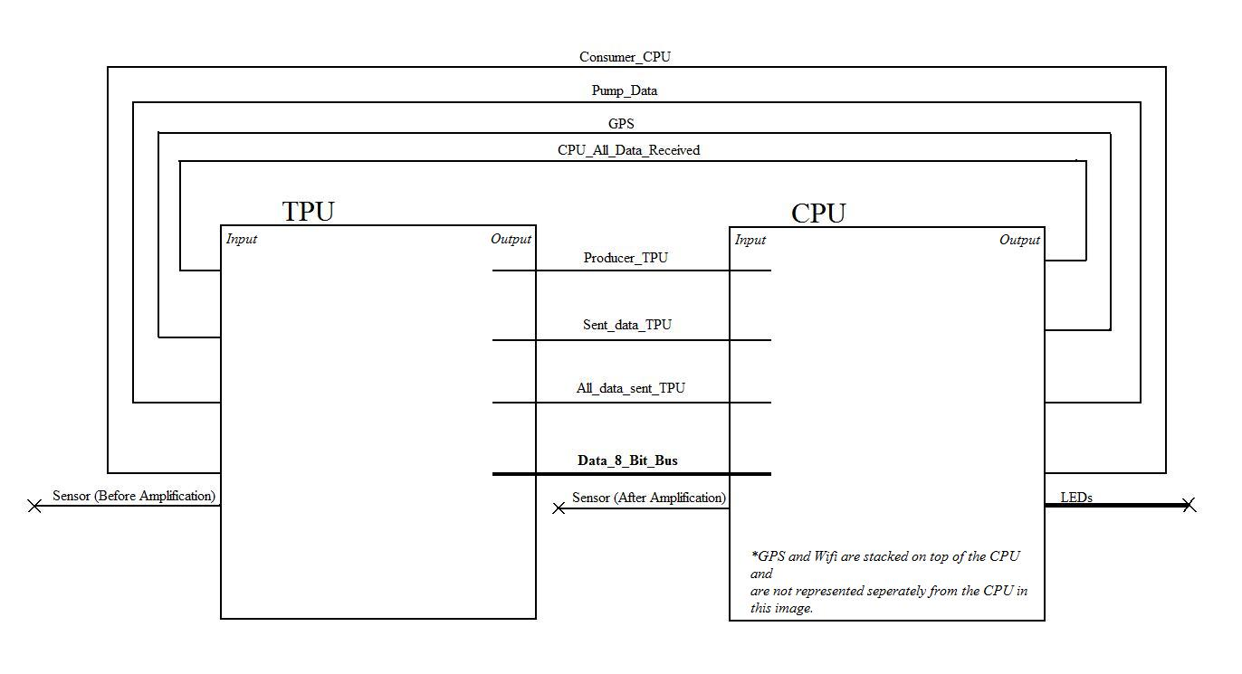
CPU & TPU Integration

Slide 26
CPU & TPU Pin Connections
Interfacing Pin Connections
Signal Name | Component 1 | Input/Output | Component 2 | Input/Output | Pin Name (Component 1) | Pin Name (Component 2)
Sensor_TPU | Sensor | Output | TPU | Input | N/A | GPIO_00
Consumer_CPU | CPU | Output | TPU | Input | PE1 (Digital Pin 1) | GPIO_09
GPS | GPS | Output | TPU | Input | PE0 (Digital Pin 0) | GPIO_14
Pump_data | CPU | Output | TPU | Input | PH0 (Digital Pin 17) | GPIO_10
CPU_all_data_received | CPU | Output | TPU | Input | PH1 (Digital Pin 16) | GPIO_13
Sent_data_TPU | TPU | Output | CPU | Input | GPIO_15 | PE5 (Digital Pin 3)
Producer_TPU | TPU | Output | CPU | Input | GPIO_11 | PE4 (Digital Pin 2)
All_data_sent_TPU | TPU | Output | CPU | Input | GPIO_12 | PE3 (Digital Pin 5)
Data_8_Bit_Bus | TPU | Output | CPU | Input | GPIO_[0108] | PC[0..7] : (Digital Pin 37..30)
Sensor_CPU | Sensor | Output | CPU | Input | N/A | PF0 (ADC0) (Analog Pin 0)
LEDs_out | CPU | Output | LEDs | Input | PA[3..6] : (Digital Pins 25..28) | N/A

Slide 27
Producer/Consumer Communication Protocol
When the TPU has seen an event and has recorded the time, the TPU will send a signal to the CPU to signify that the TPU has data ready to be sent.
  Producer_TPU = ”1”
Once the CPU has recognized that the TPU has data, the CPU will then send a signal to the TPU signifying that it is making preparations to receive the first 8 bits of data.
  Consumer_CPU = “1”
As soon as the CPU is absolutely ready for a set of 8 bits of data it will send a signal to the TPU, giving it the permission to send its first set 8 bits (or 1 byte) of data.
  Pump_data_CPU = “1”
Once the TPU has sent a byte (8 bits) of data it will send a signal signifying it.
  Sent_data_TPU = “1”
Upon receiving this set of data, the CPU then proceeds to store it in its memory and then prepares for next byte of data to be sent.
  Pump_data_CPU = “0”

Slide 28
Communication (Part 2)
6. Once pump_data_CPU has gone to a low value, then so will sent_data_TPU. This is when the TPU will make preparations to send the next byte of data to the CPU.
  Sent_data_TPU = “0”
7. Steps 3 through 6 will be repeated until all 40 bits (or 5 bytes) have been sent in increments of 8 bit sets.
8. Once all the bits have been sent the TPU will signify that all the bits have been sent.
  All_data_sent_TPU = “1”
9. Once all the bits have been received by the CPU it will send a signal to the TPU indicating that all the bits have been received.
  All_data_received_CPU = “1”
10. Once both of the signals, All_data_received_CPU and All_data_sent_TPU, have high values, both processors will reset themselves and prepare for the time data for the next cosmic particle event.
  Consumer_CPU = “0”
  Producer_TPU = “0”
  Pump_data_CPU = “0”
  Sent_data_TPU = “0”

Slide 29
Cosmic Cube
Lead ME: Cole Gray

Slide 30
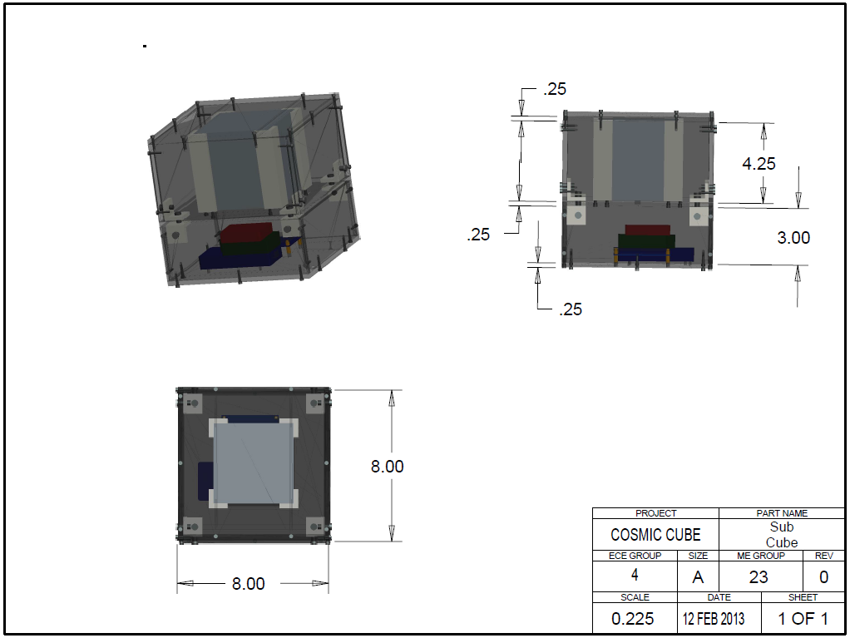
Sub-Cube Structure
The Single Unit Sub-Cube

Slide 31
Sub-Cube Structure
The sub-cube will be 8” on a side
There will be two compartments within the sub-cube
  The top compartment will house the scintillator
  The bottom compartment will contain the electronics of the system.
The electronics will be bolted to the bottom side of the sub-cube rather than having shelving units hold the electronics. This allows for a reduction in cost and complexity in the sub-cube.

Slide 32
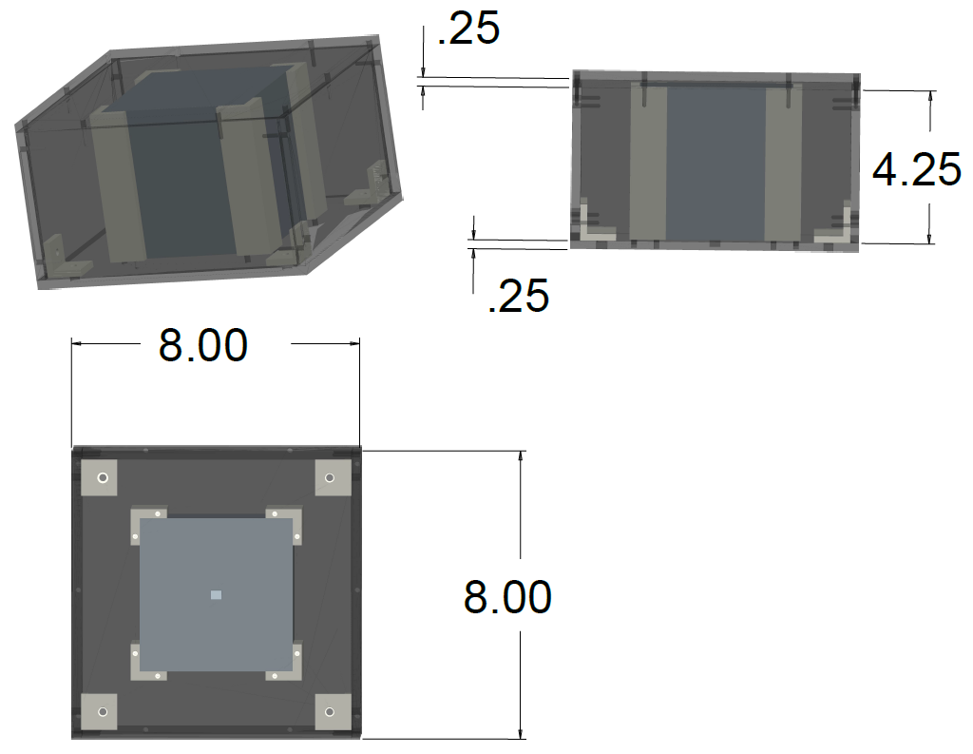
Top Compartment
Test Plan: Make a scintillator block in ProE and place it in the brackets to make sure there is room, and make sure the sensor hole is big enough for the MPPC
Current Status: Plans and materials are ready to be dropped off to the machine shop

Slide 33
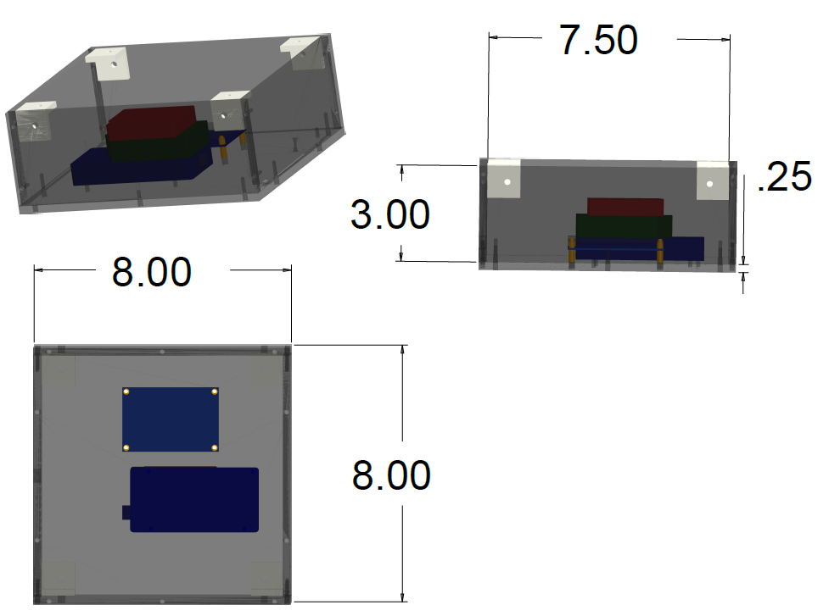
Bottom Compartment
Test Plan: Make a model of the electronics being used for the sub-cube in ProE and add them to the assembly to make sure there is ample room for wiring and electronics
Current Status: Plans and materials are ready to be dropped off at the machine shop

Slide 34
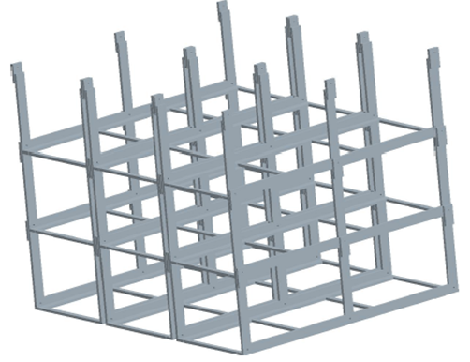
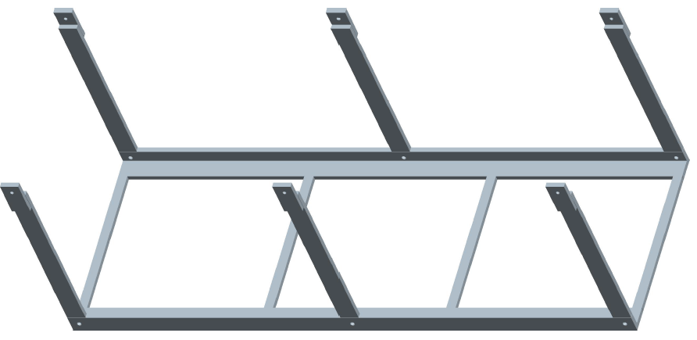
Cube Structure
Test Plan: Make sure the structure is sturdy, and the multi-unit sub-cube fits
Current Status: Needs to be resized, and materials need to be obtained

Slide 35
Questions?

