Slide 1
Cosmic Cube
Team Lead/Programmer: Kenneth Spradley
Lead ECE: Matthew Gibson
ECE Assistant: Don Lundi
Lead ME: Cole Gray
Financial Advisor: Crystal Hill

Slide 2
Cosmic Cube
Financial Advisor: Crystal Hill

Slide 3
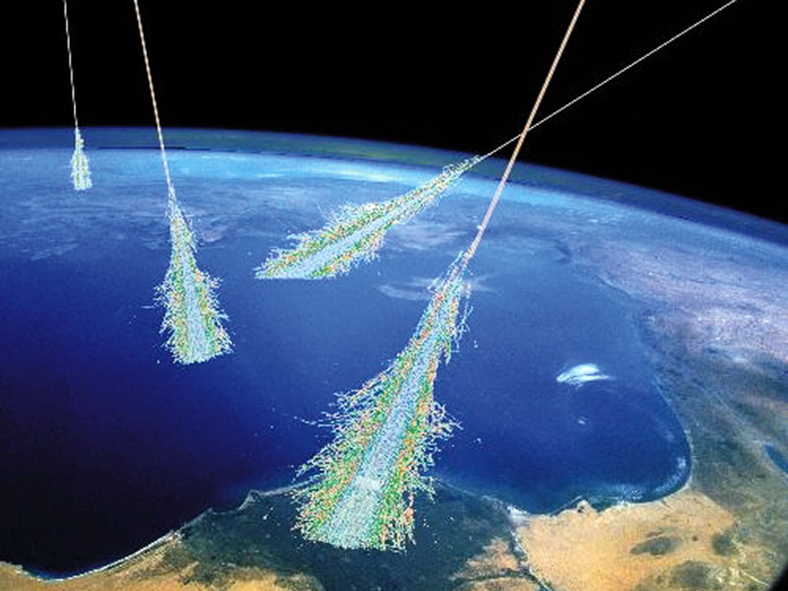
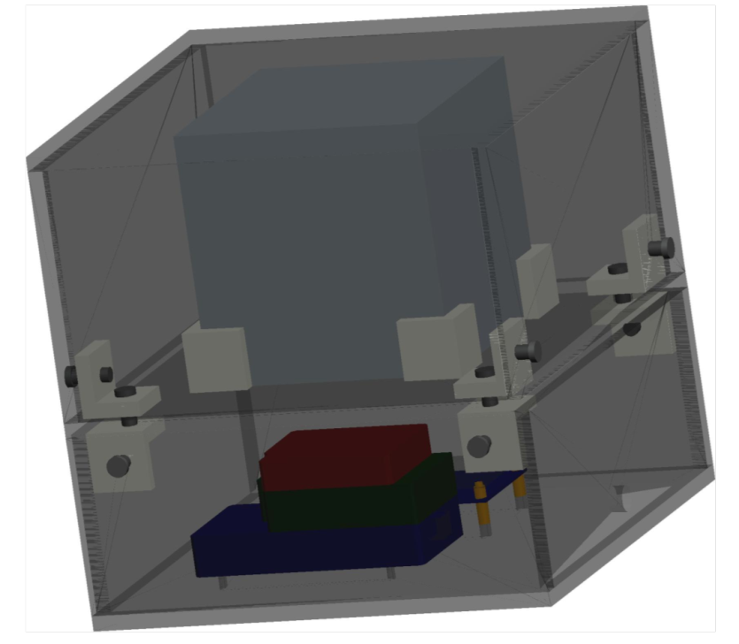
Overview

Slide 4
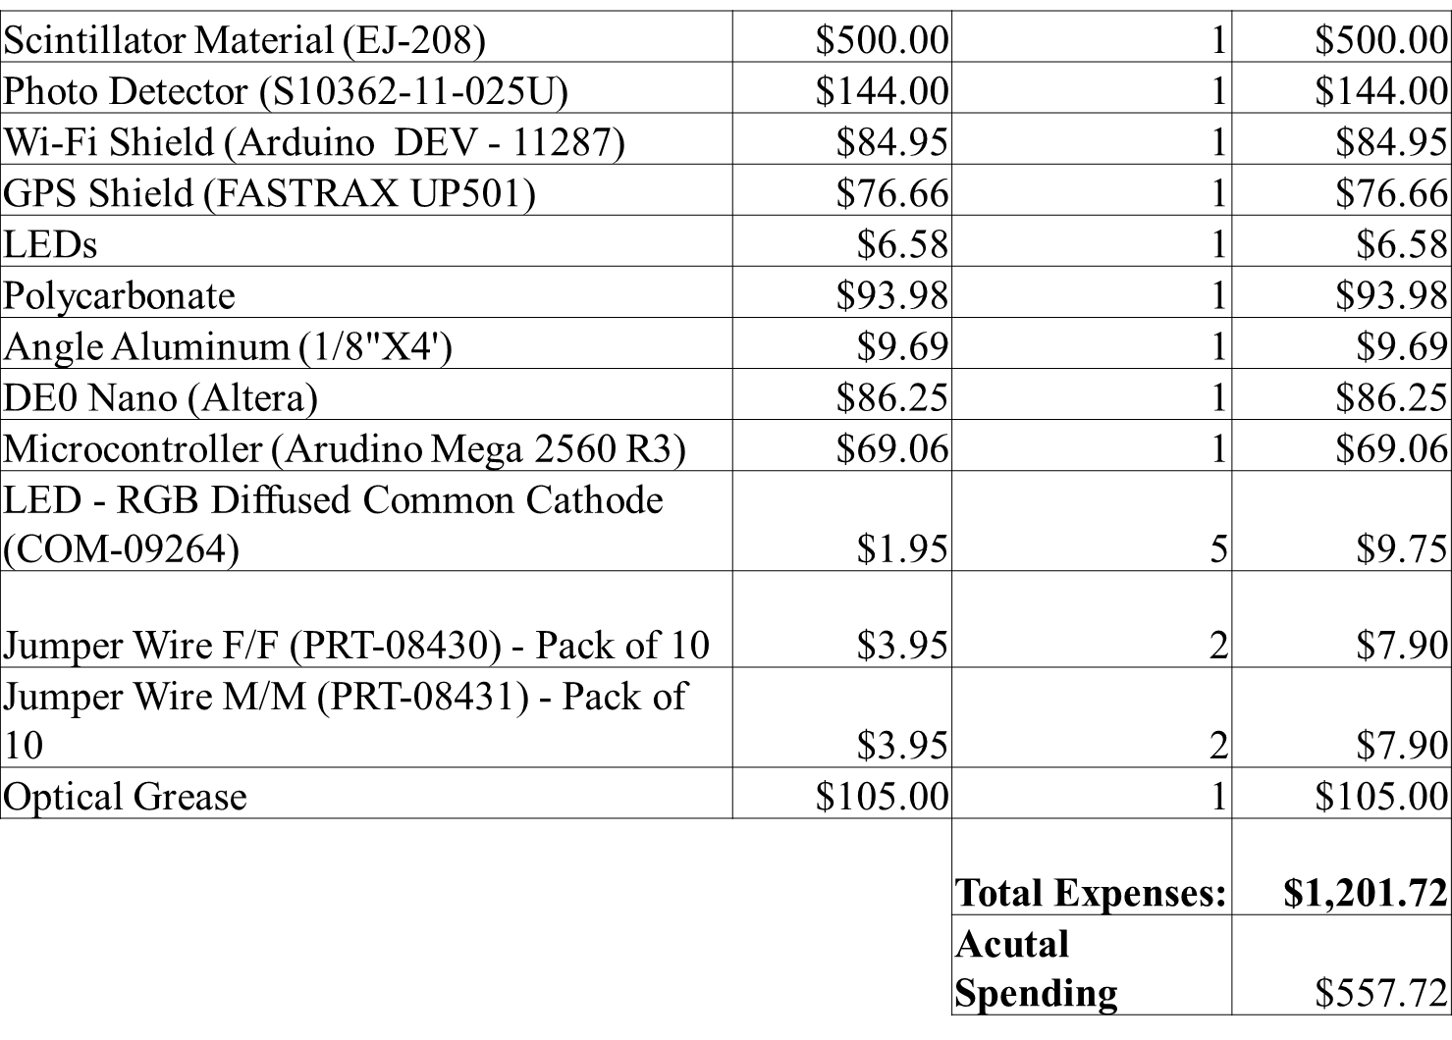
Budget

Slide 5
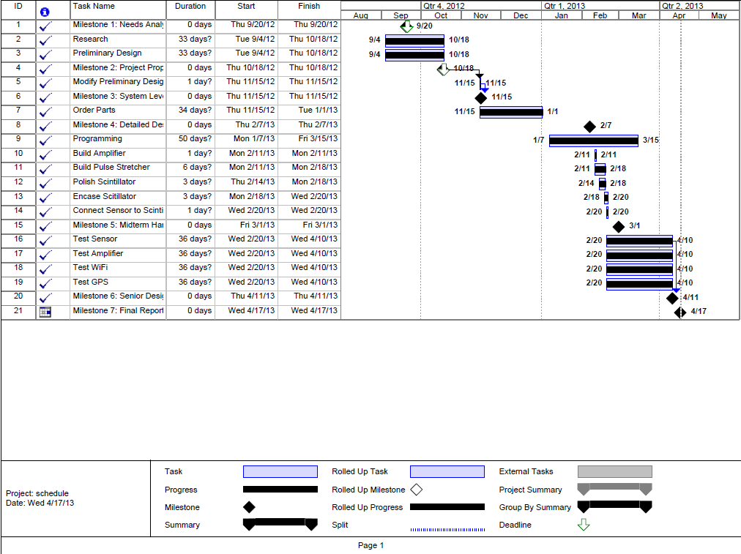
Schedule

Slide 6
Cosmic Cube
Lead ECE: Matthew Gibson

Slide 7
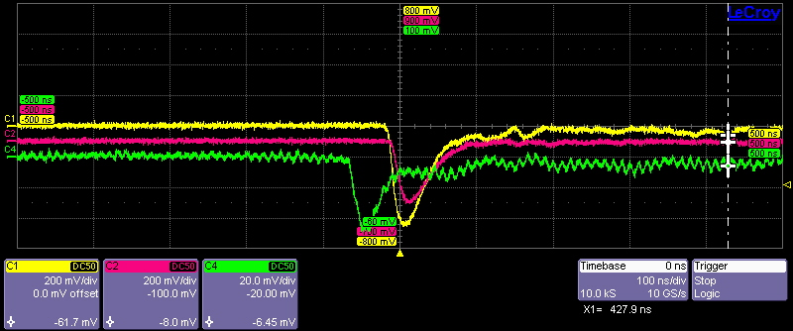
COSMIC RAYS
OUTPUT PULSE
PULSE WIDTH: 50nS
AMPLITUDE: 50mV

Slide 8
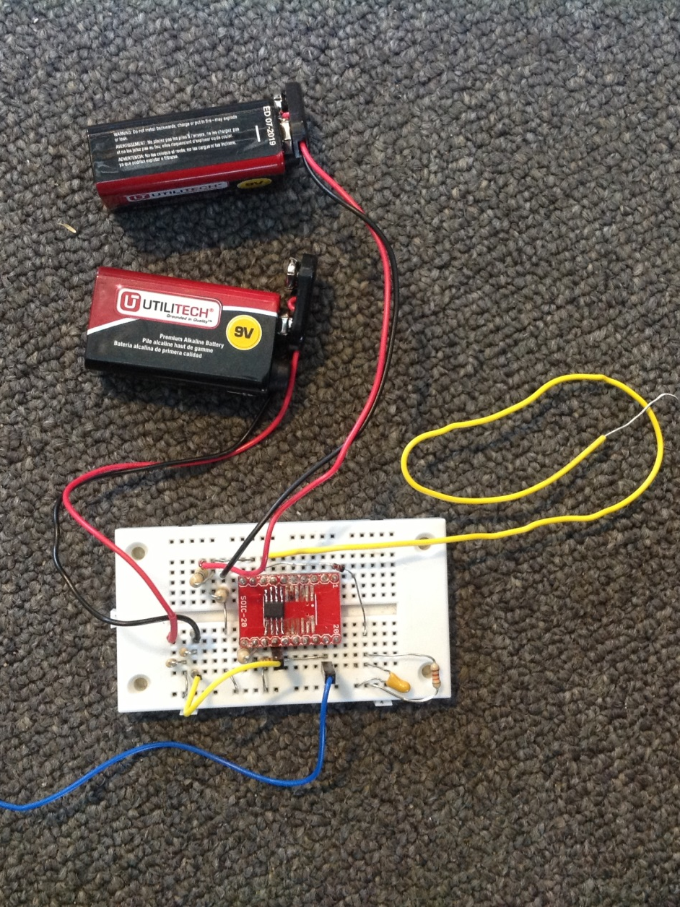
AMPLIFIER(AD8000)
PARAMETERS
GAIN: 36
PSU: 4.5v, -4.5v
INVERTING

Slide 9
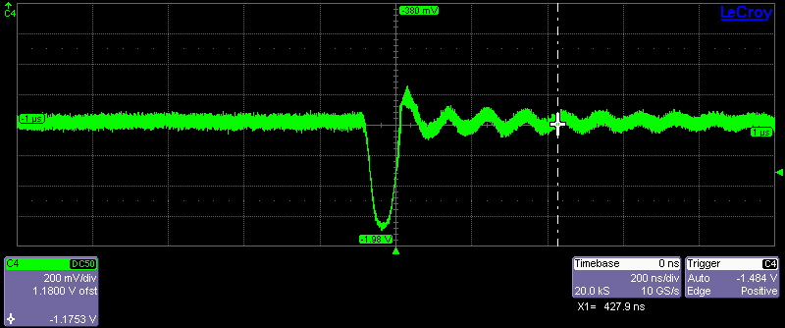
AMPLIFICATION
INPUT PULSE
OUTPUT PULSE
PULSE WIDTH: 50nS
AMPLITUDE: 50mV
PULSE WIDTH: 100nS
AMPLITUDE: -1.18V

Slide 10
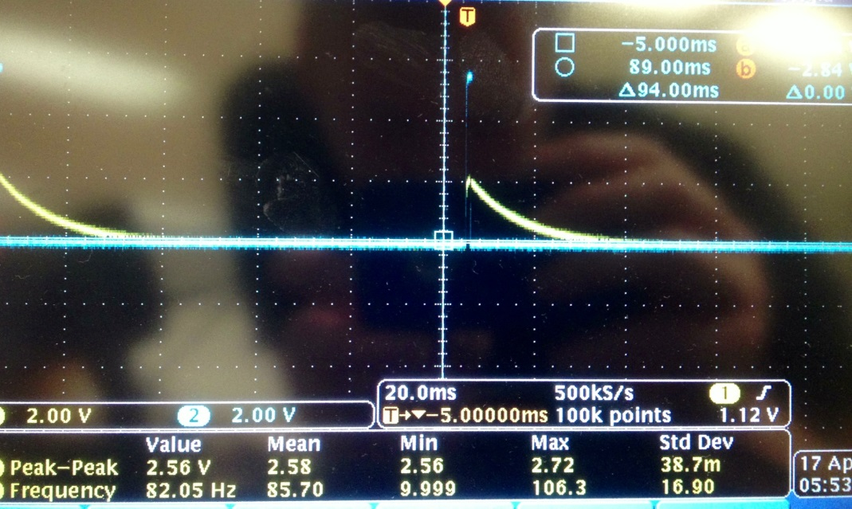
PULSE STRETCH
COMPONENTS
EQUATIONS
CAPACITOR: 0.001uF
RESISTOR: 10Mohm
DIODE: 1N4148
Vc = Vs(1 - exp(-(t/RC)))
T(Discharge) = RC
INPUT PULSE
OUTPUT PULSE
PULSE WIDTH: 50nS
AMPLITUDE: 50mV
PULSE WIDTH:20mS
AMPLITUDE: 2v

Slide 11
Cosmic Cube
ECE Programmer/Assistant: Don Lundi

Slide 12
GPS
Progress:
Connect to Satellites
Send/Receiver data
Interfaced with TPU to send PPS
Provides Time, Date, Position

Slide 13
Obtain GPS Data

Slide 14
Wi-Fi
Progress:
Able to search for local networks
Can connect to local networks
Able to receive network status

Slide 15
Access Local Networks

Slide 16
Access Local Networks

Slide 17
Cosmic Cube
Team Lead/Programmer: Kenneth Spradley

Slide 18
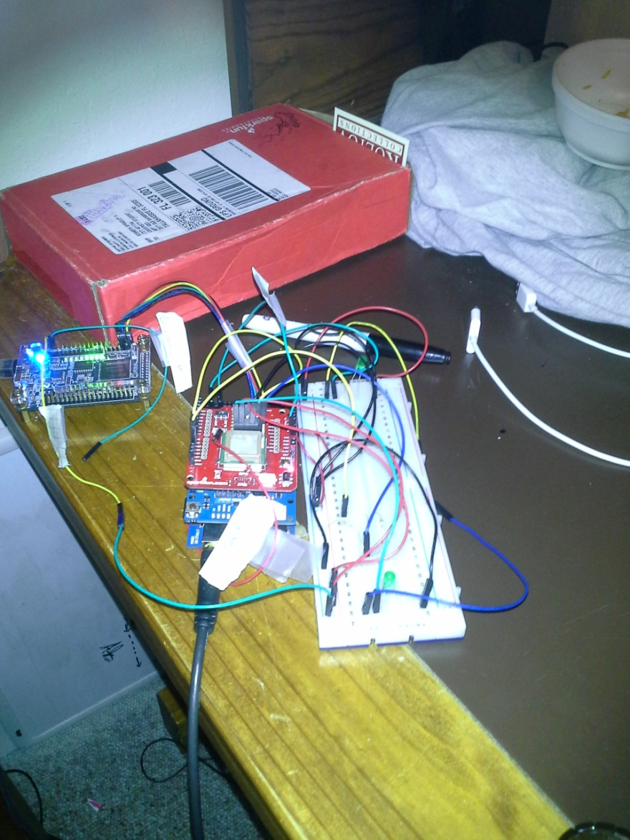
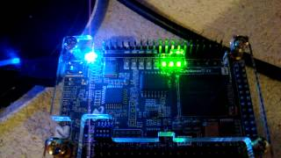
Time Processing Unit (TPU)
Successful Systems:
Detect Incoming Signal
Count GPS PPS
Count Nanosecond
Signal Incoming Event Interrupt Routine (Arduino)
Debugging Issues:
8 bit bridge (Transferring time data precision)

Slide 19
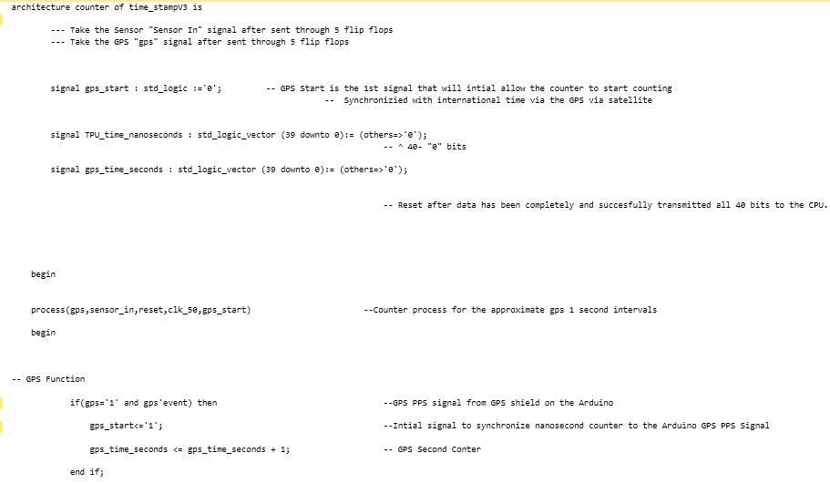
Time Stamp

Slide 20
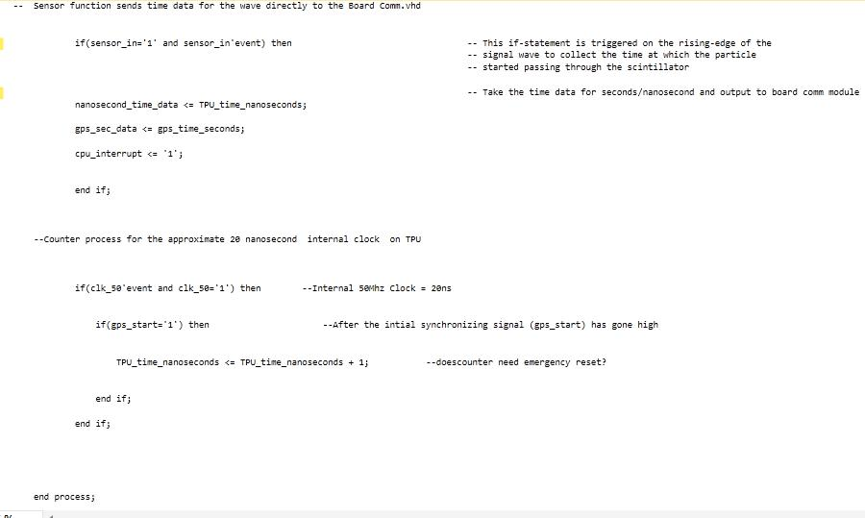
Time Stamp

Slide 21
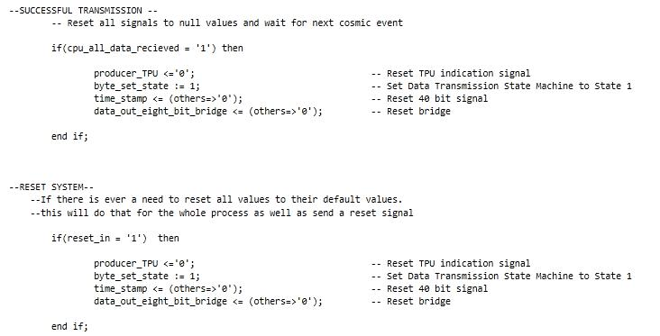
Board Communication

Slide 22
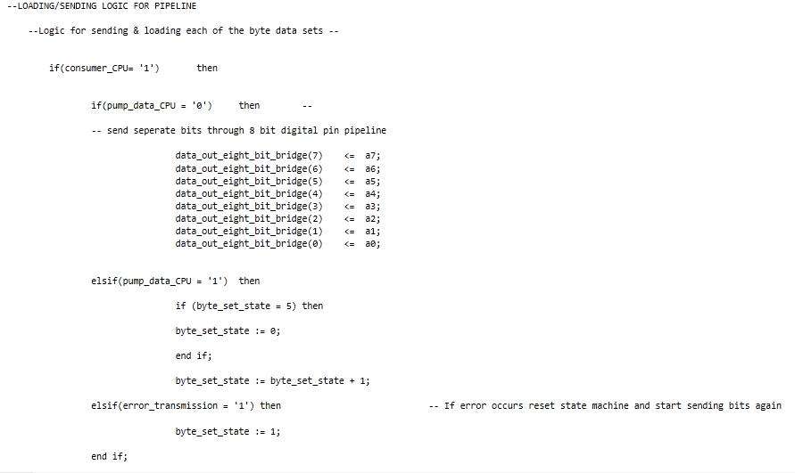
Board Communication

Slide 23
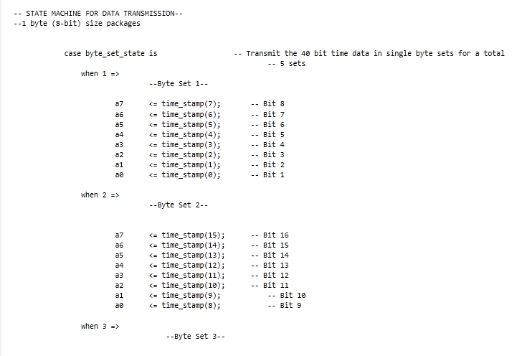
Board Communication

Slide 24
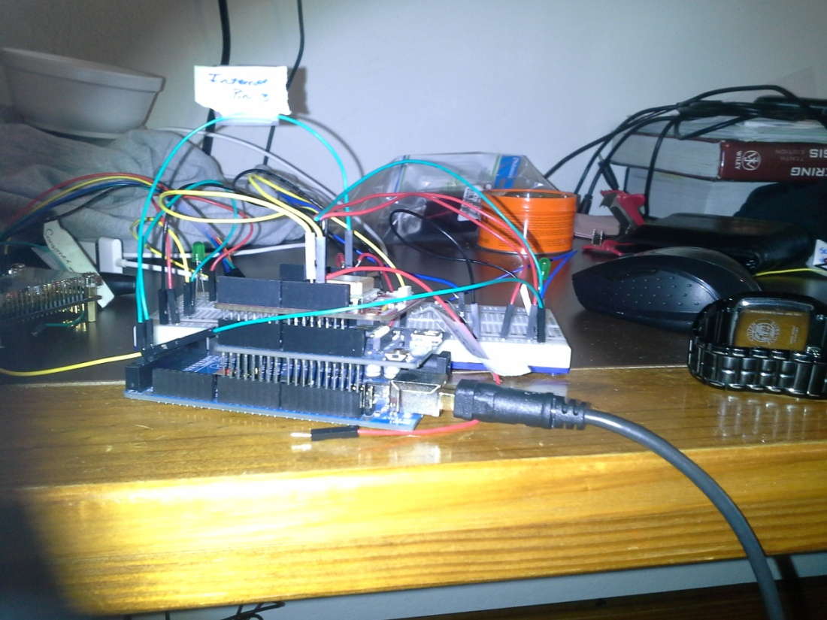
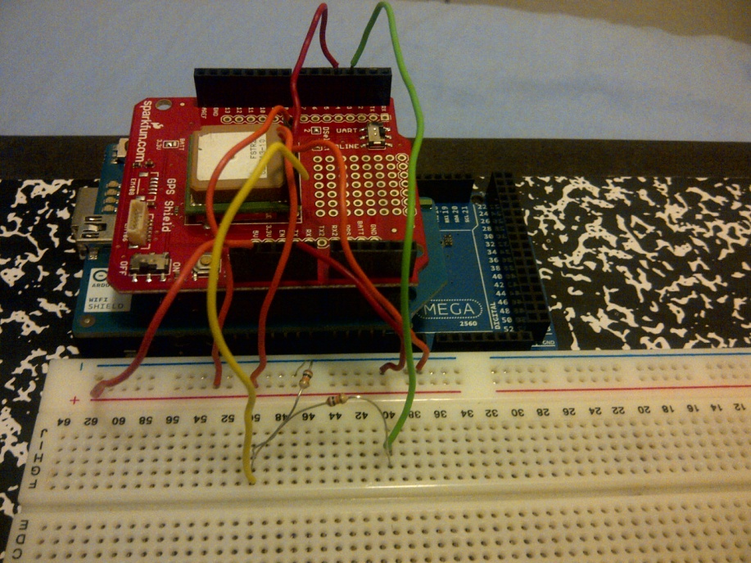
Central Processing Unit
Successful Systems:
Obtain Current Time/Position from GPS
ISR Magnitude of Incoming Pulse
Debugging Issues:
8 bit bridge (Transferring time data precision)

Slide 25
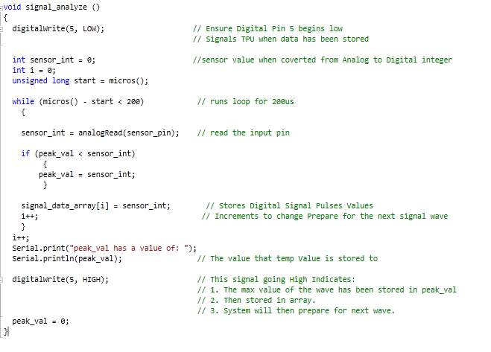
Interrupt Service Routine

Slide 26
Cosmic Cube
Lead ME: Cole Gray

Slide 27
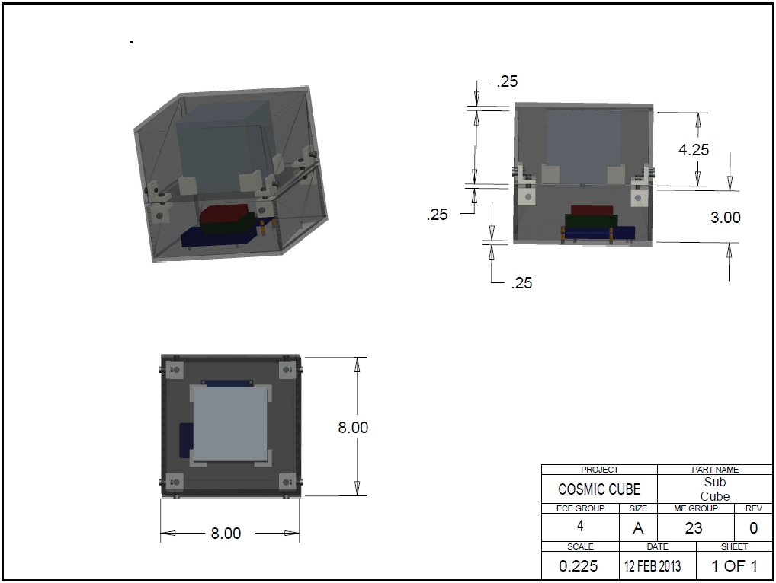
Single-Unit Cube Structure

Slide 28
Sub-Cube Structure
The sub-cube will be 8” on a side
There will be two compartments within the sub-cube
The top compartment will house the scintillator
The bottom compartment will contain the electronics of the system.
The electronics will be attached to the cube using velcro dots, this allows the electronics to be configured in any way necessary and easily moved

Slide 29
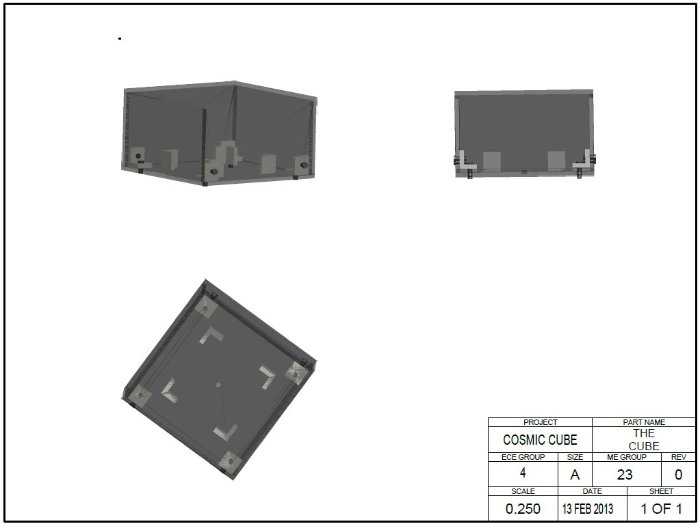
Top Compartment

Slide 30
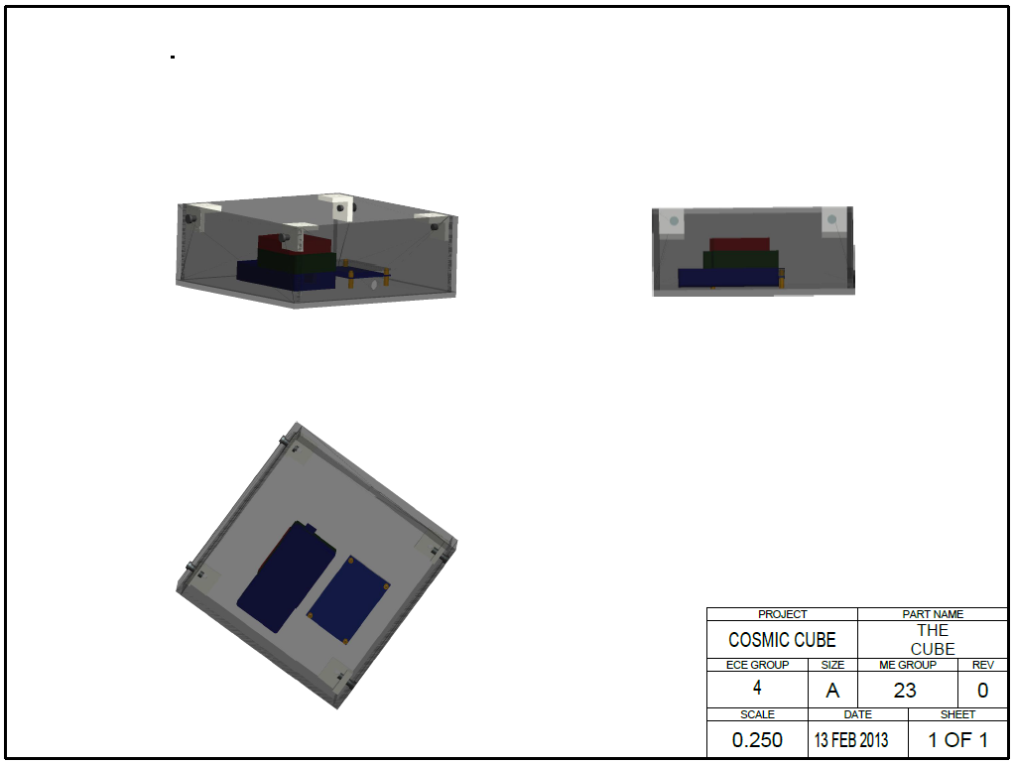
Bottom Compartment

Slide 31
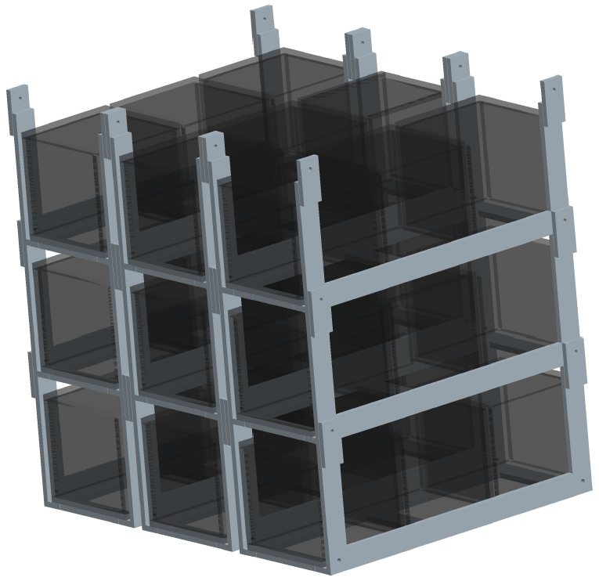
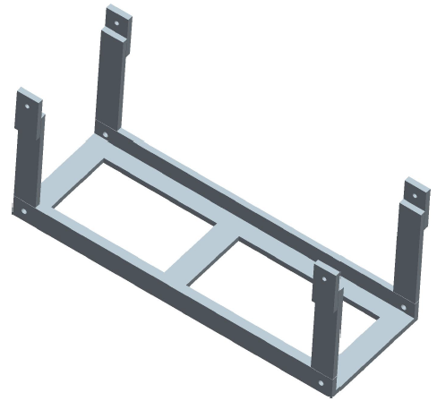
Multi-Unit Cube Structure

Slide 32
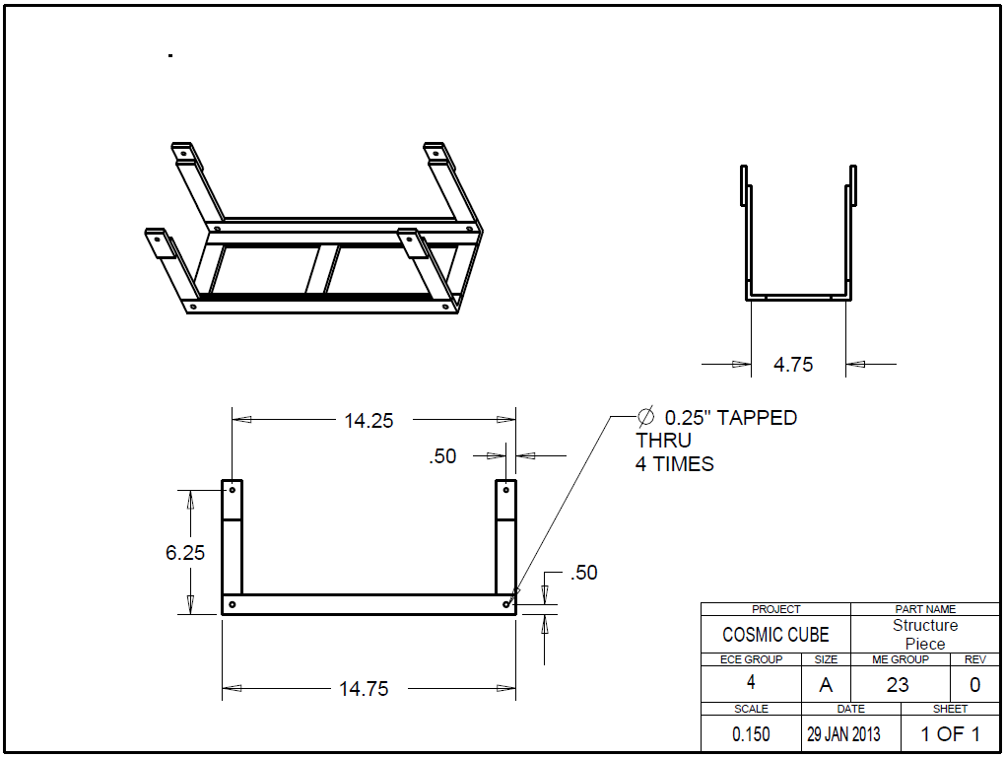
Multi-Unit Cube Structure

Slide 33
Questions?

