Slide 1
Cosmic Cube
Team Lead/Programmer: Kenneth Spradley
Lead ECE: Matthew Gibson
ECE Assistant: Don Lundi
Lead ME: Cole Gray
Financial Advisor: Crystal Hill

Slide 2
Presentation Outline
Crystal Hill
Project Executive Summary
Risk Assessment
Schedule
Budget
Deliverables
Don Lundi
Statement of the Problem
Assumptions and Limitations
Global Position System (GPS)
Light Emitting Diodes (LEDs)
Cole Gray
Overview of Cube
Structure of Cube
Matthew Gibson
Scintillator
Photo-detector
Radioactive Isotope
Kenneth Spradley
Microcontroller/CPU
WI-FI

Slide 3
Crystal Hill
Project Executive Summary
Risk Assessment
Schedule
Budget
Deliverables

Slide 4
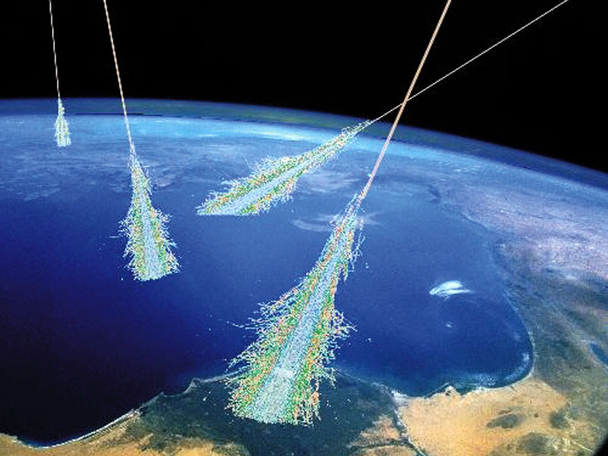
Executive Summary
Project Description
The Team
Target Market
Funding

Slide 5
Risk Assessment

Slide 6
Schedule

Slide 7
Budget

Slide 8
Budget

Slide 9
Budget

Slide 10
Deliverables
User’s Manual
1 cube segment complete with
Enclosure
Scintillator
Solid-state Photodiode
GPS Module
DAC board
Wi-Fi Module
Power Supply
Design schematics
All code files developed for microcontrollers

Slide 11
Don Lundi
Statement of the Problem
Assumptions and Limitations
Global Position Systems (GPS)
Light Emitting Diodes (LEDs)

Slide 12
Statement of Problem
There is a need for detectors that can measure high-energy cosmic rays
Research is being done in particle astronomy
Finding the exact origins of the Cosmic Events
Discovering the frequency at which these events occur

Slide 13
Why the Cosmic Cube?
Compact
Visually Stimulating
Fully Functioning Detector
Detect the presence a cosmic shower
Record the time
Measure the energy levels of the incoming particles
Track the trajectory of the particles

Slide 14
Assumptions and Limitations
Assumptions
The particles that strike the scintillator will be in the range of 1-4GeV range.
Limitations
No greater than 30 cm on a given side of a cube segment.
The time resolution of the device will be no slower than 100 nanoseconds.
A cosmic cube segment along with a master cube should cost the user approximately $1000 to purchase

Slide 15
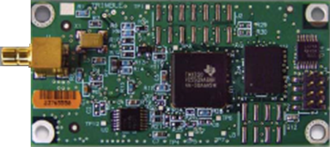
GPS Module
The GPS will be used as a “real time” timing reference
The GPS Module Chosen:
The Resolution T GPS Timing Receiver
15ns
10MHz output from the on board oscillator
Easy integration with in the circuit

Slide 16
Test/Verification Plan
To test the accuracy of the GPS the GPS module will be connected to a computer via USB cable.
The software provided with the GPS module can determine how many satellites the GPS is currently communicating with and within how many nanoseconds of accuracy the GPS time is with real time.

Slide 17
Light Emitting Diode (LED)
The cosmic cube will have a visual indicator that will light whenever a cosmic event is detected.
A multicolor LED will be used that will flash a different color depending on the type of particle detected.
Since the Cosmic Cube is to be commercial product using LEDs provides a cheap and entertaining method of engaging the audience.

Slide 18
Cole Gray
Overview of the Cube
Structure of Cube

Slide 19
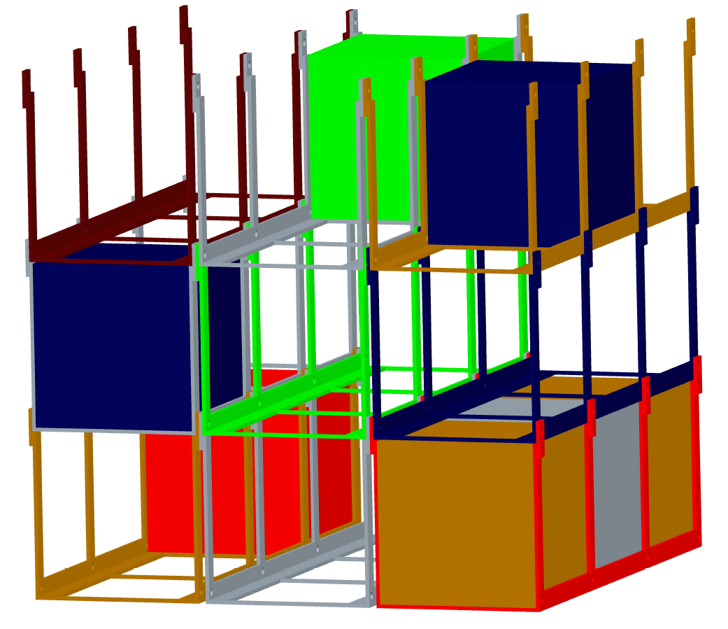
Structure
Cole Gray: Lead Mechanical Engineer

Slide 20
The Sub-Cube
The sub-cube will have two compartments
The top compartment will contain the scintillator and the deflector material
Sides are made out of Aluminum to help block out all light
Deflector material often used is lead, but a possible safer substitute is bismuth
The bottom compartment will contain the electronics, including the sensor
Made out of clear Plexiglas to give an appealing look to consumers

Slide 21
Sub-Cube Structure

Slide 22
Top Compartment
All six sides will be made out of 3/16” Aluminum
Each edge will have a gasket in place to improve water resistance and ensure that no light can enter
The bottom side will have a small hole in the center, that allows the sensor lens to slightly fit through.
Angle Aluminum will be used to securely hold the scintillator and deflector material in place.

Slide 23
Bottom Compartment
The bottom compartment will contain a small cylinder in the top center of it for the sensor to securely fit in, as well as all of the electronics required to run the sub-cube
The four walls, and the bottom side will be made out of 3/16” Plexiglas
This will allow light through, but will allow the consumer to see the “brains” of the cube, and will be more appealing.
A rubber gasket will also be added to all edges to improve water resistance

Slide 24
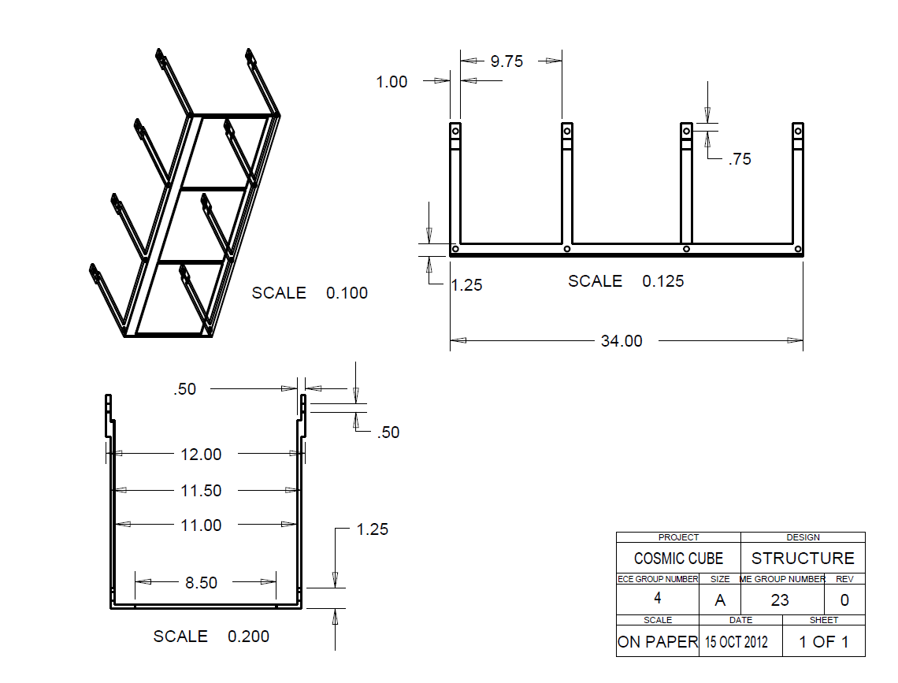
Cube Structure

Slide 25
Cube Structure
The current design is for up to 27 cubes
More sections can be added, but will not form a “cubic” structure
Each section can hold up to three cubes
The sections can be added side to side or top to bottom
The sections are bolted together
The bolts help hold the cubes in place from sliding around

Slide 26
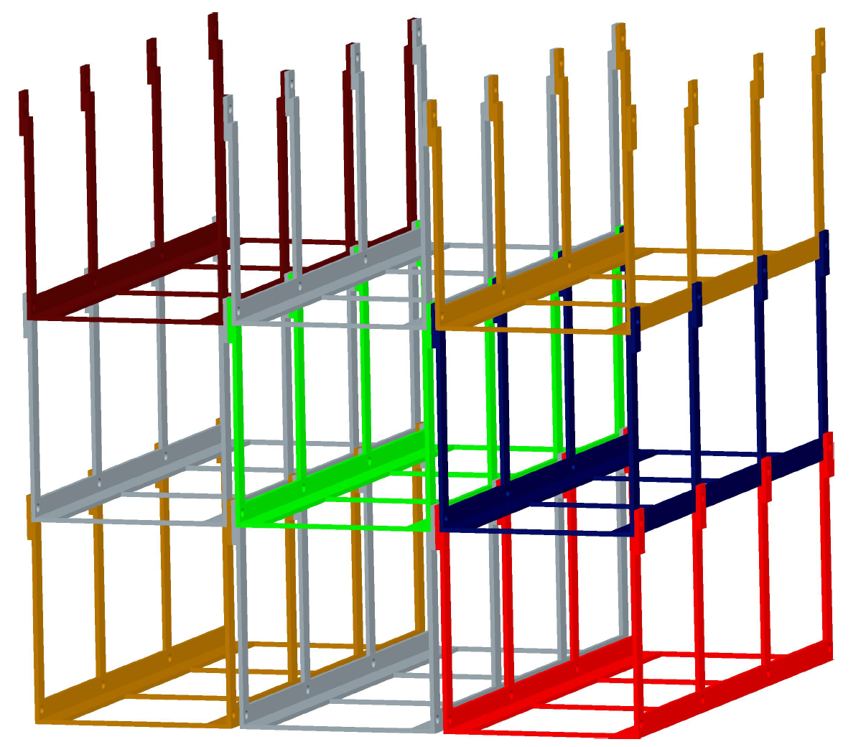
Structure Assembly

Slide 27
Matthew Gibson
Scintillator
Photo-Detector
Radioactive Isotope

Slide 28
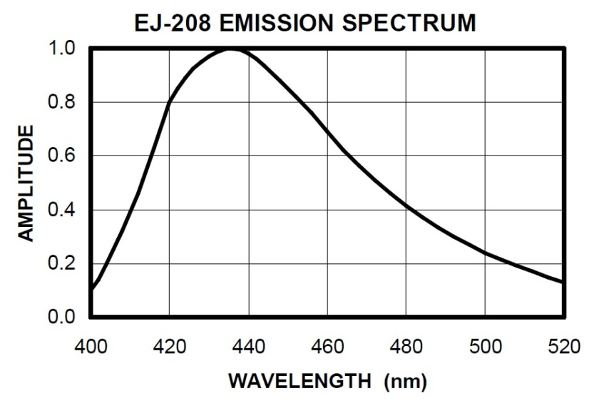
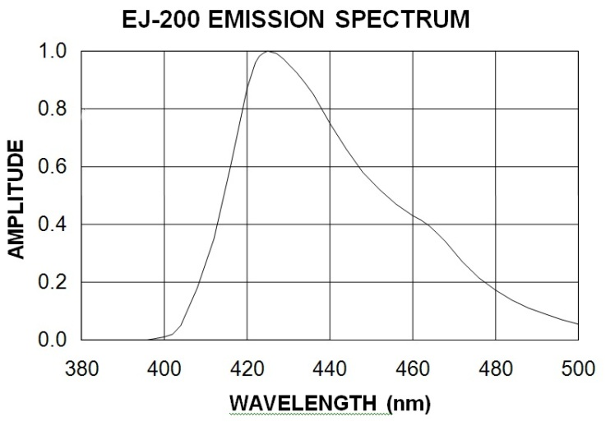
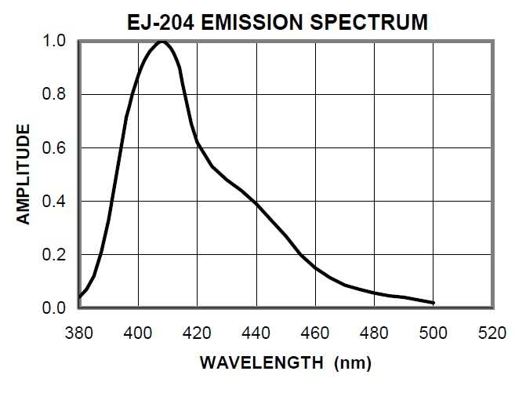
SCINTILLATORS

Slide 29
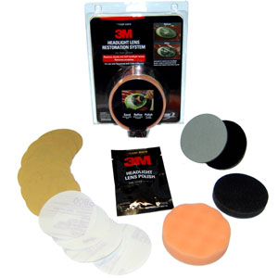
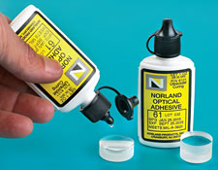
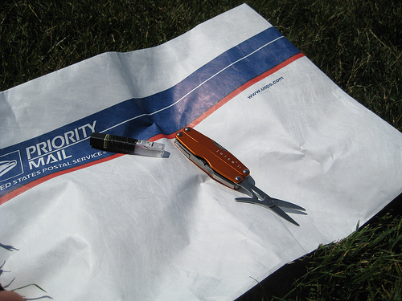
Preparing the Scintillator
STEP 1: Sanding (Coarse, Medium, Fine)
STEP 2: Polishing (Buffing compound)
STEP 3: Light shielding (Tyvek)
STEP 4: Attach Photo-Detector (Optical grease/glue)

Slide 30
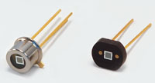
SOLID STATE DETECTION
PART # | AREA (mm^2) | PEAK WL (nm) | PIXELS | PIXEL (um) | PRICE (usd)
S10362-33-025c | 9 | 440 | 14400 | 25x25 | 323.00
S10362-11-100u | 1 | 440 | 100 | 100x100 | 144.00
S10362-33-025u | 1 | 440 | 1600 | 25x25 | 144.00
Hamamatsu

Slide 31
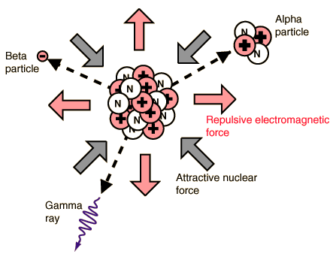
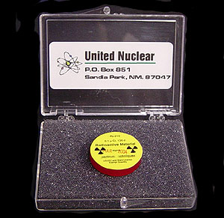
RADIOACTIVE ISOTOPES
(Calibration)
ISOTOPE | GAMMA (MeV) | Half-Life (years) | Cost ($)
Co-60 | 1.2, 1.3 | 5.27 | 79.00
Cs-137 | .6 | 30.1 | 79.00
Eu-152 | 1.4 | 13.5 | 145.00

Slide 32
Power Supply
Component | Voltage (volts) | Power (Watts)
WIFI | 3.3 | 0.165
MEGA2560 | 7-12
GPS | 5 | 0.35
PHOTO-DETECTOR | 60-80
LED | 3.3 | .06

Slide 33
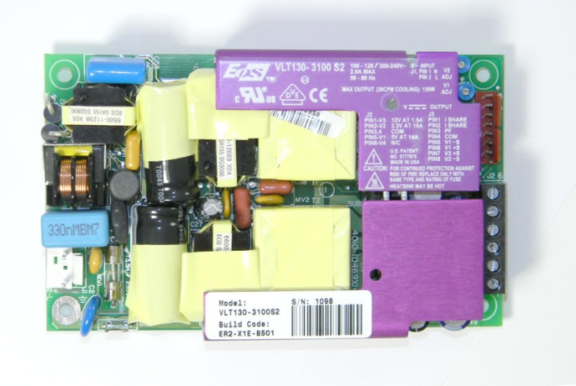
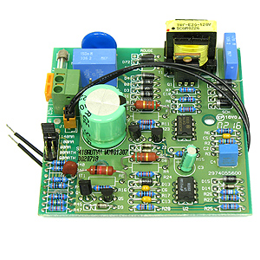
Power Supply
PSU | Voltage (Volts) | Power (Watts) | Price ($)
VLT130-3100-S2 | 12,5,3.3 | 80 | 10.95
OS40-302 | -12,+12, 5 | 40 | 6.95
UPN65-31 | 12,5,3.3 | 65 | 4.95
E.G. G19092 | 60 | 8.4 | 8.00

Slide 34
Kenneth Spradley
Microcontroller/CPU
WIFI

Slide 35
Topics
Microcontroller/CPU
Objective
Evaluation of Characteristics
Possible Component Choice
Approach
Test Plan
WI-FI
Objective
Evaluation of Characteristics
Possible Component Choice
Approach
Test Plan

Slide 36
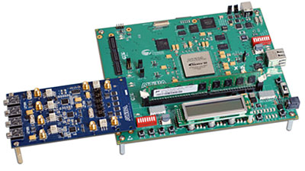
Microcontroller
Objective
Analysis the incoming analog signal
Time stamp using GPS Chip to 100 ns precision
Send data via WI-FI to user’s PC
Record the data in a format that easy for the user to acquire

Slide 37
Microcontroller
Evaluation of Characteristics
Clock Speed
Operating Voltage
Input Voltage Limits
# of Channel
Memory
Price/Quantity

Slide 38
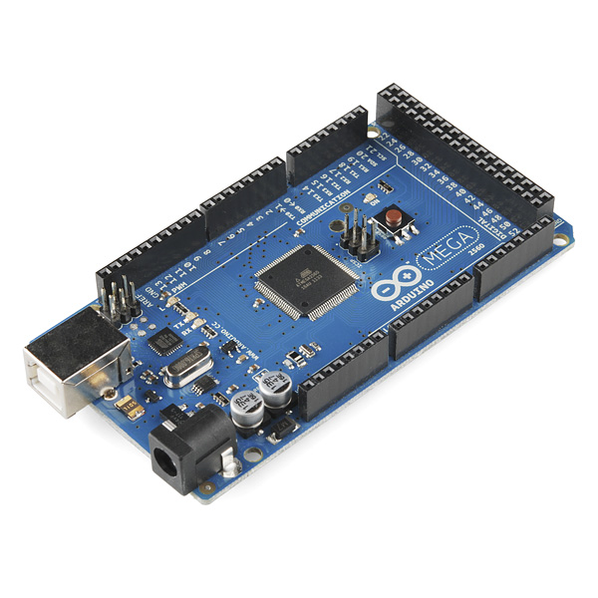
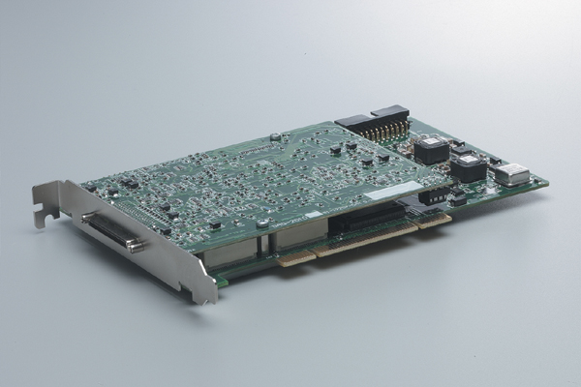
Microcontroller
Possible Component Choices
Stratix III
Arduino Mega 2560 R3
DAQ-2000

Slide 39
Startix III (Altera)
Characteristics
Clock Speed: 500MHz= 2ns
Operating Voltages: 4.0
Input Voltage Limits: 1.2-3.3V
Flash Memory: 144KB
Channels :
272 I/O
Interrupts? Yes
$2895.00

Slide 40
Arduino Mega 2560 R3 (Arduino)
Characteristics
Clock Speed: 16MHz = 63ns
Operating Voltages: 5V
Input Voltage Limits (6-20V)
Flash Memory: 256KB
Channels :
16-Analog Input
54 -Digital I/O
Interrupts? Yes
$58.95

Slide 41
DAQ-2000 (ADLINK)
Characteristics
Clock Speed: 40MHz = 25ns
Operating Voltages: 5V
Input Voltage Limits: 0-10 PCI Bus
Flash Memory: -
Channels :
24 D-I/O
4 A-I
Interrupts? Yes
$595.00

Slide 42
Selection of Component
Part | Clock Speed (ns) | # of Channels | Memory | Interrupts | Price ($)
Stratix III | 2 | 272 I/O | 144KB | Y | 2,895.00
Arduino Mega 2560 R3 | 63 | 54-D-I/O 16 A-I | 256KB | Y-External | 58.95
DAQ-2000 | 25 | 24-D-I/O 4 A-I | - | Y | 595.00

Slide 43
Microcontroller
Approach
Program Libraries as the order of hierarchy part significance
Photo-Detector
GPS
WI-FI
LED’s
Test Plan
Test each library, class or program via Graphical User Interface (GUI)

Slide 44
WI-FI
Objective
Interface with Microcontroller
Connect with user’s PC
Transmit data via WI-FI

Slide 45
WI-FI
Evaluation of Characteristics
Range
Protocol
Operating Voltage
Band Frequency
Data Rate
Price
Ease of Interface with Microcontroller

Slide 46
WI-FI
Possible Component Choices
XB24-Z7WIT-004
DEV-112877
WRL-08665

Slide 47
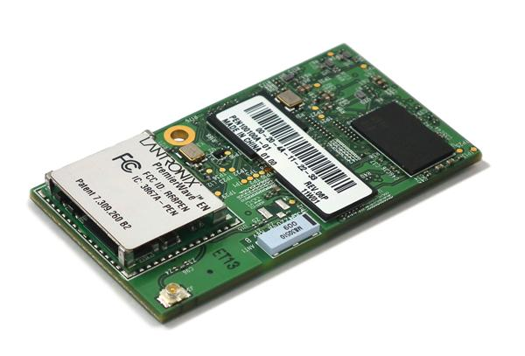
PEN10010NA-01 (Lantronix)
Characteristics
Protocol: 802.11a/b/g/n
Frequency Band: 2.4, 5GHz
Operating Voltages: 3.3
Data Rate: 1Mbps, 54 Mbps, 65Mbps
Dimension: 55mm x 30mm x 8mm
Interface Type: Ethernet, I2C, SPI, Serial, U
Ease of Interface: Moderate Programming Required

Slide 48
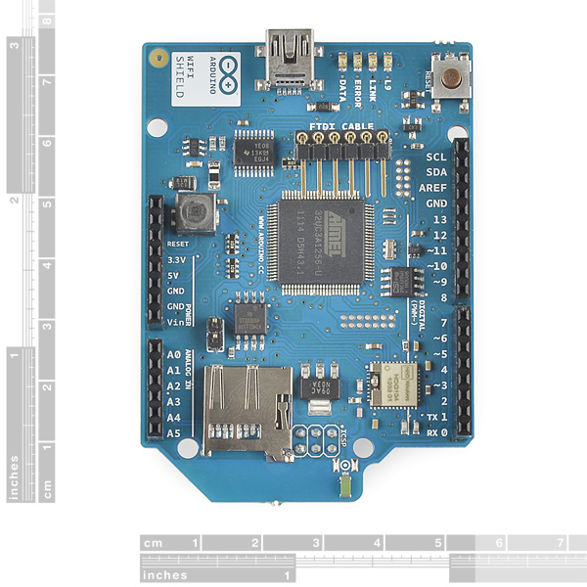
Arduino WI-FI Shield (Arduino)
Characteristics
Protocol: 802.11b/g
Clock Speed: 16MHz = 63ns
Frequency Band: 2.4, 5GHz
Operating Voltages: 3.3
Data Rate: 1Mbps, 54 Mbps, 65Mbps
Dimension: 55mm x 30mm x 8mm
Interface Type: Ethernet, I2C, SPI, Serial, U
Ease of Interface: Minimal Programming Required

Slide 49
Selection of Component
Part # | Range (ft) | Data Rate (Mbps) | ($)
XB24-Z7WIT-004 | 200 | 35 | 25.95
PEN10010NA-01 (Lantronix) | 150 | 65 | 35.45
WRL-08665 (Altera Wi-Fi Shield ) | 150 | 65 | 22.95

Slide 50
WI-FI
Approach
Program libraries to allow WI-FI chip to complete the following task
Connect with Microcontroller
Transmit data via WI-FI
Test Plan
Test each library, class or program via Graphical User Interface (GUI)

Slide 51
Questions?

