Slide 1
Shear Stress Sensor with Cholesteric Crystals
Group #3
Group Members
Matthew Carmichael, FSU
Tyler Elsey, FSU
Luiz Paes, UNIFEI
Sponsor
Dr. Dickinson , Eglin AFRL
Advisors
Dr. Oates, FAMU & FSU COE
Matthew Worden
4/18/2013
eng.fsu.edu/me/senior_design/2013/team3

Slide 2
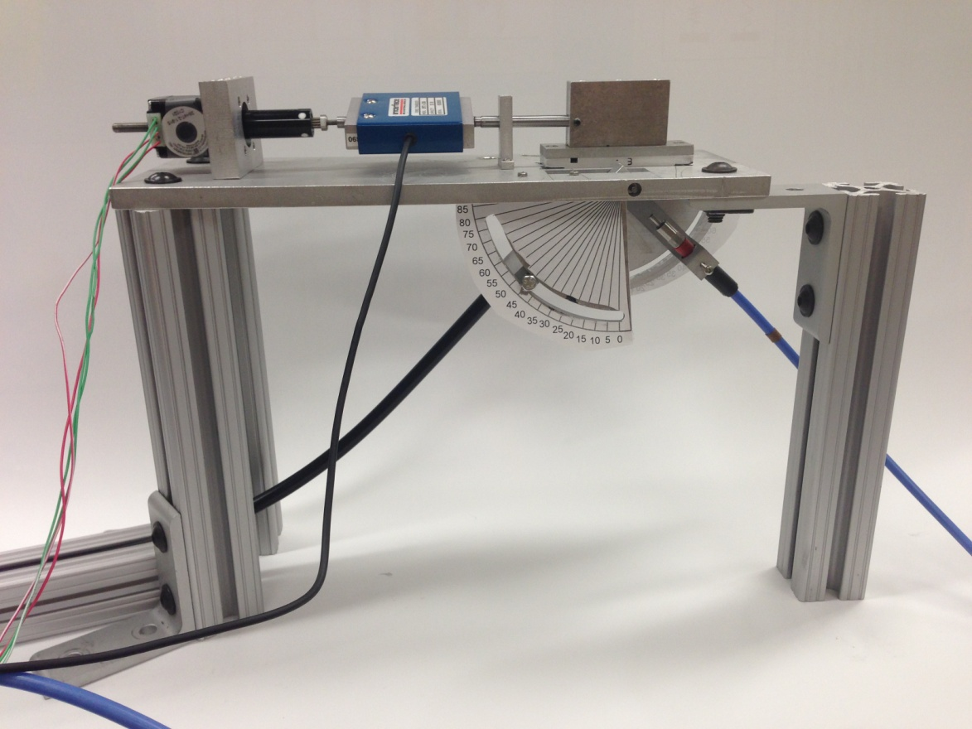
OVERVIEW
Project Scope
Cholesteric Crystals
Theory
Final Design
Programming
Results
Unit Cells

Slide 3
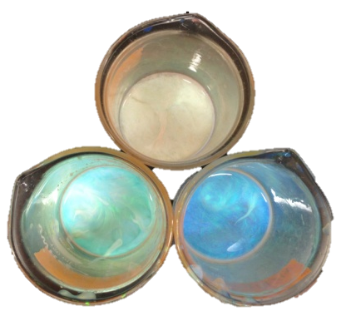
Project Scope
Create Testing Apparatus
Create Testing Method
Create Data Acquisition & Analysis Software
Characterize cholesteric crystals
Liquid
Polymer

Slide 4
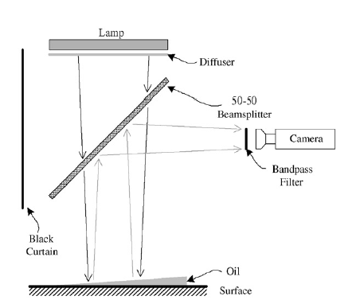
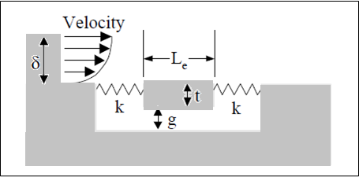
Existing Technology
Micro-electrical-mechanical Systems (MEMS)
Thin-Oil Film

Slide 5
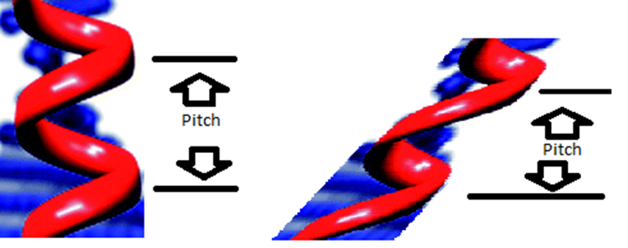
Cholesteric Crystals
Originally discovered in cholesterol
Pitch varies with the boundary conditions
Visible Light Spectrum

Slide 6
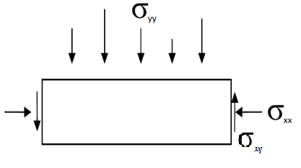
Theory – Hooke’s Law
-Decouple Analysis – Uniform Shear
y
x
$$σ_{xy}$$
Plane Strain
Strain
Strain Ratio
Uniform Shear
$ε_{xx}$= $0$
$$\frac{ε_{xy}}{ε_{xx}}→∞$$
$ε_{yy}$=$0$
Hooke’s Law
$$\frac{ε_{xy}}{ε_{yy}}→∞$$
$ε_{xy}$= $\frac{1}{G}σ_{xy}$

Slide 7
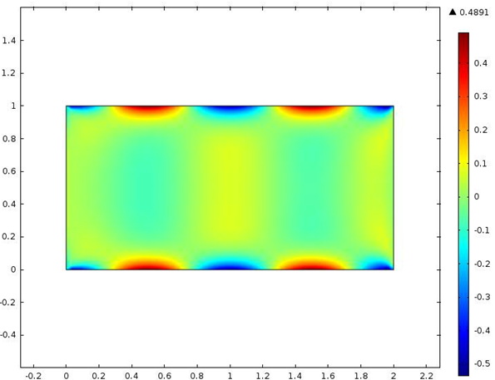
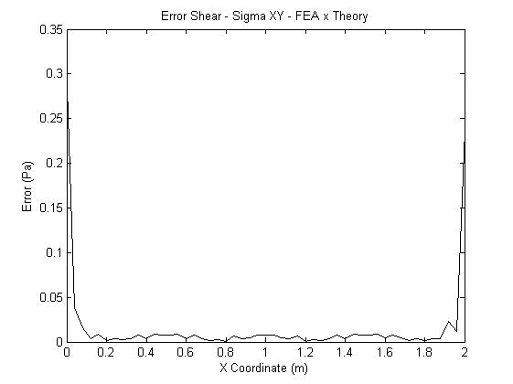
Simulation
– FEM Plane Strain
y
x
$$−0.5 cos⁡((4π/L)∗x) Pa − top$$
$$0.5 cos⁡((4π/L)∗x) Pa − bottom$$
Stress XY (Pa)
Pressure Error – Sigma XY
Error (Pa)
Y Coordinate (m)
X Coordinate (m)
X Coordinate (m)

Slide 8
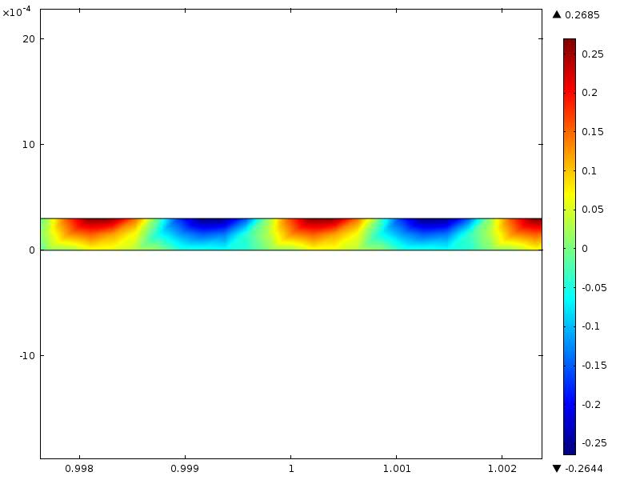
Simulation
– FEM Plane Strain
y
Thin film – c<<L
x
$$−0.5 cos⁡((4π/c)∗x) Pa − top$$
Stress XY (Pa)
Y Coordinate (m)
X Coordinate (m)

Slide 9
Simulation – FEM Plane Strain
-Decouple Analysis – Oscillating Shear
High Periods – Approximate oscillating load to a constant
Shear
c
L
y
x
Decouple is possible for constant load approximation and small c

Slide 10
Concepts

Slide 11
Final Design

Slide 12
Light Sources

Slide 13
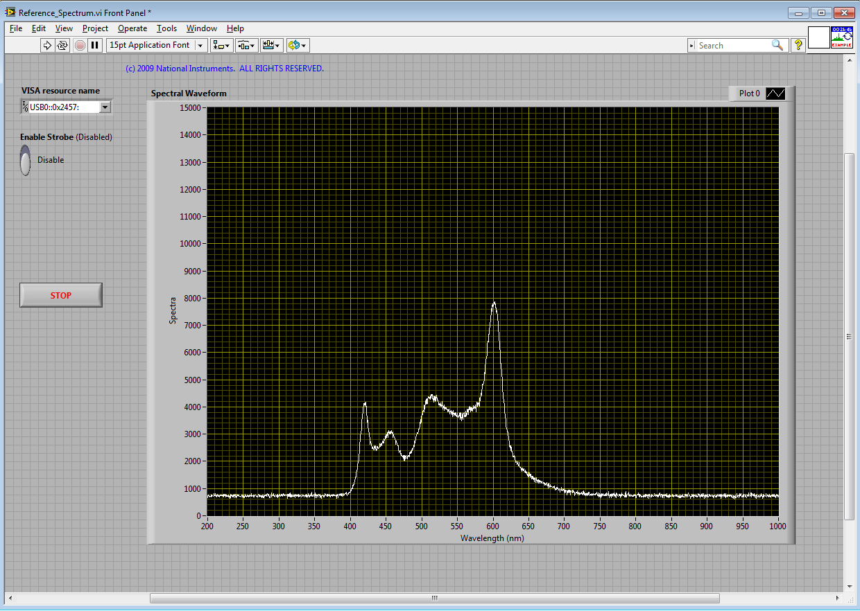
LabView
Record Force, Spectrum and Experiment Conditions

Slide 14
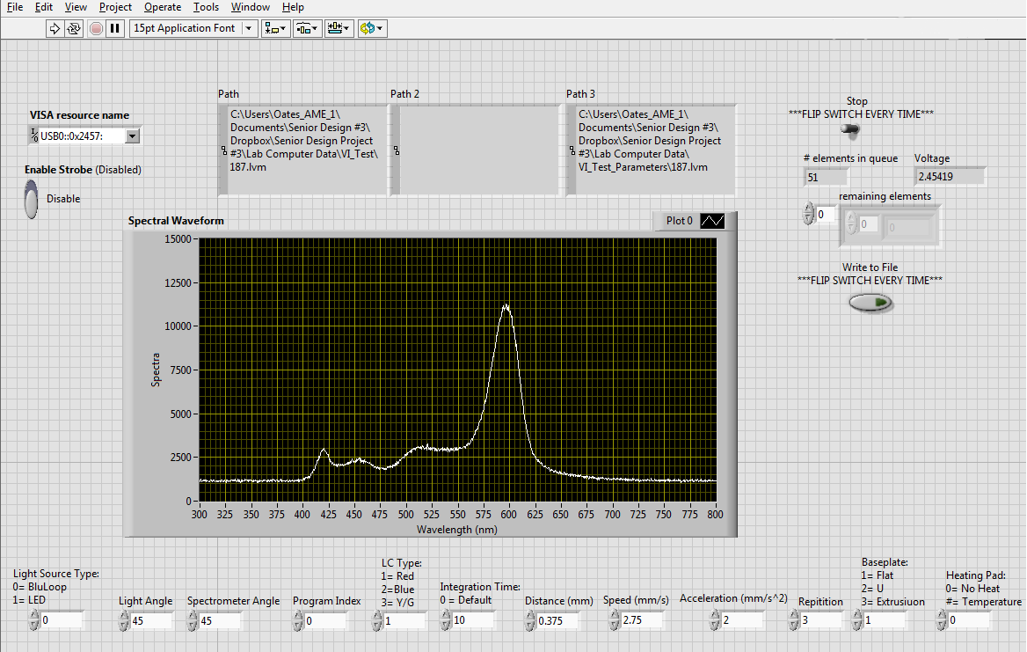
LabView

Slide 15
MATLAB
Systematize experimental data
Filter experiment spectrum from reference spectrum
Analyze data set

Slide 16
MATLAB

Slide 17
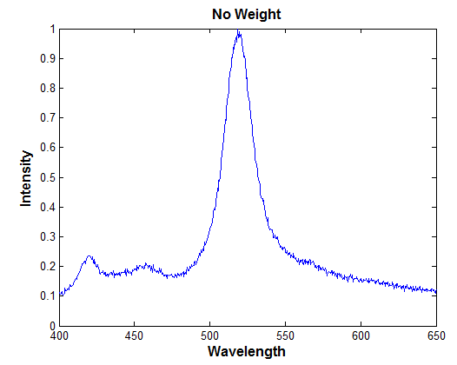
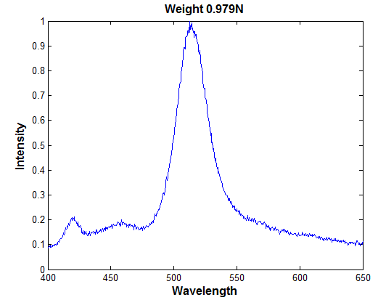
Results-Normal Force
 | Color
 | Red | Blue | Yellow |  | Red | Blue | Yellow
 | No Weight |  |  |  | Weight (0.979 N)
Average Wavelength (nm) | 600.3 | 469.1 | 512.0 | Average Wavelength (nm) | 597.5 | 469.7 | 519.7
Difference
Color | Red
Red | 2.8
Blue | 0.6
Yellow | 7.7

Slide 18
Results- Liquid Crystals

Slide 19
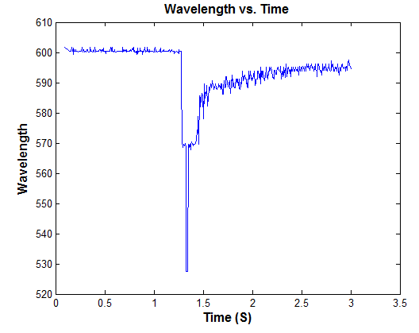
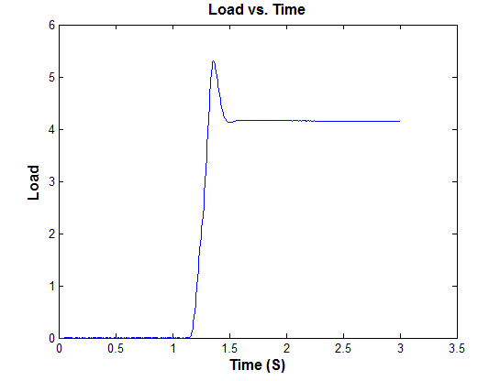
Results- Liquid Crystals

Slide 20
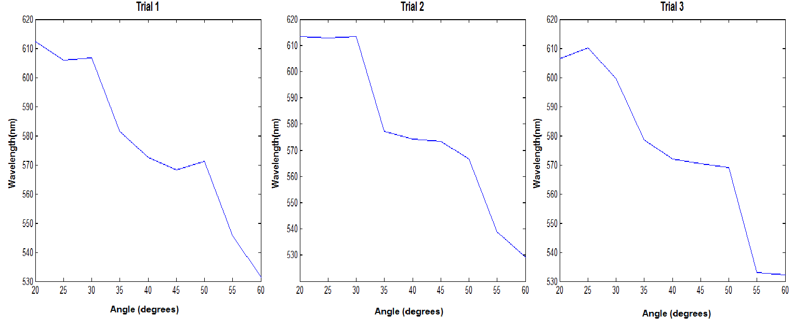
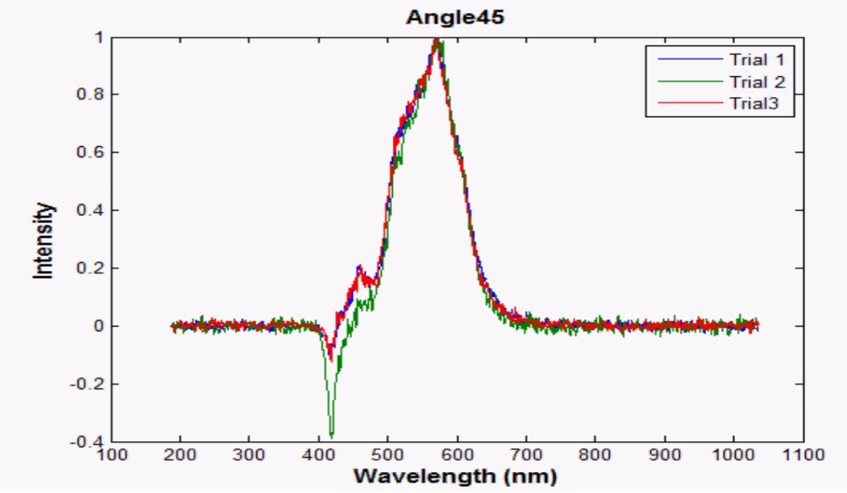
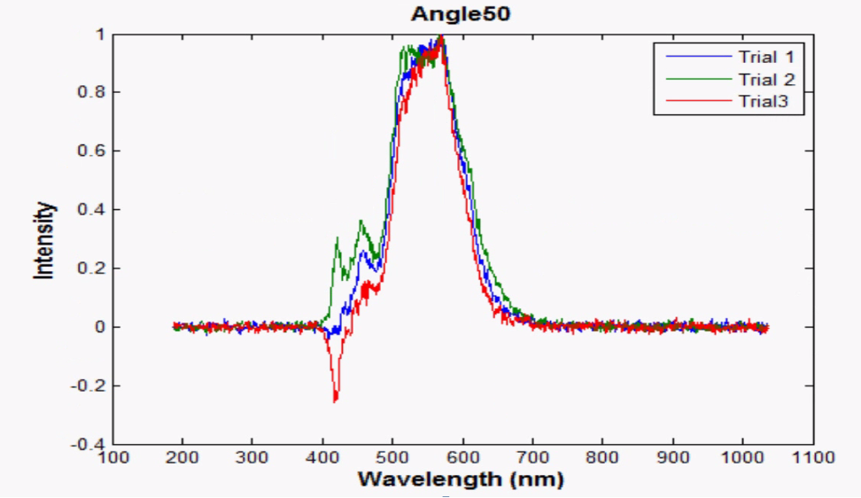
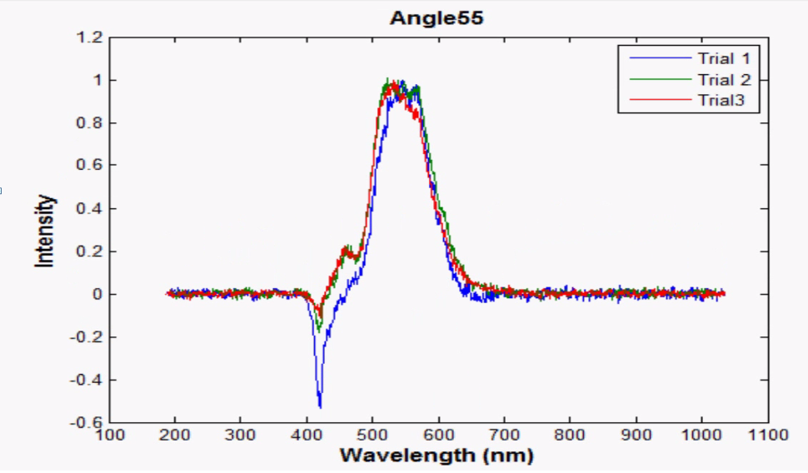
Results- Polymer crystals

Slide 21
Results
Variables
Distance
Velocity
Acceleration
Settling Time
Quantity of Liquid Crystals
Angles/Distance of Fiber Optic Cables
Type of Light source

Slide 22
Unit Cells
Purpose is to have a manufacturable product for distribution in a sensor ready form
VHB with Liquid Crystals
Side View
Zero Force Applied
Force Applied
Top View
Zero Force Applied
Force Applied

Slide 23
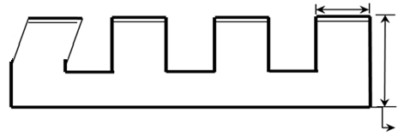
Unit Cells
Top View
Angle Θ
Pressure
b
Shear
c
Fixed
Decouple Analysis
Side View
Shear and Pressure
Zero Force Applied
Maximize Angle θ
Force Applied

Slide 24
Cost
Part | Unit Price | Quantity | Price
Teflon Bearing | $3.11 | 3 | $ 9
Insulation | $9.03 | 1 | $9
Heat sheet | $38.90 | 1 | $38
Fasteners | - - | - - | $22
LED | $23.74 | 1 | $24
Thermocouple | $19.00 | 2 | $38
Load Cell- 10N | $485.00 | 1 | $485
Liquid Crystals | $75.00 | 3 | $225
VHB Tape | $18.44 | 1 | $19
Total |  |  | $870

Slide 25
Summary
COMSOL analysis
Designed a testing apparatus
Created programs to process data
Cholesteric crystals are angle dependent
Basic unit cell design

Slide 26
Recommendations
Analysis of Unit Cells
More testing on Liquid Crystals
Adapt apparatus for Polymer Crystals
Test Polymer Concept

Slide 27
Questions/Comments

Slide 28
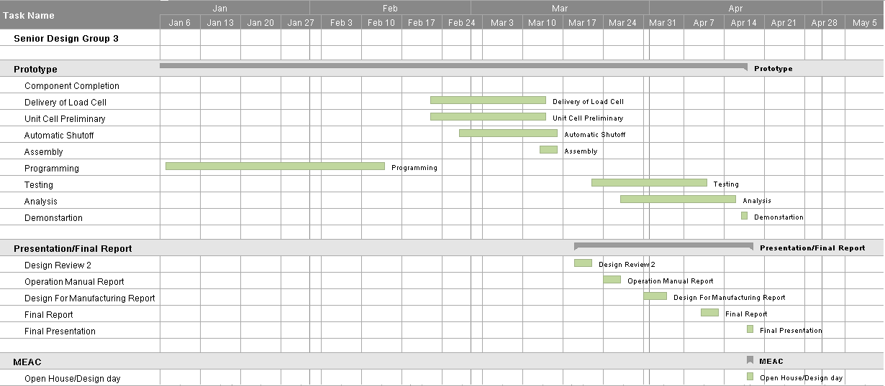
Schedule

Slide 29
Budget (Supplied Parts)
Part | Unit Price | Quantity | Price
Machine Shop | $150.00 | 30 | $4,500.00
Aluminum | $64.00 | -- | $ 64.00
Fiber-Optic Spectrometer | $2,775.00 | 1 | $2,775.00
Linear Servo Motor | $75.00 | 1 | $75.00
BluLoop Light Source | $1,575.00 | 1 | $1,575.00
Software | $2,669.00 | -- | $2,669.00
Multimeter | $15.00 | 1 | $15.00
DAQ Board | $369.00 | 1 | $369.00
Amplifier- SGA power signal converter | $345.00 | 1 | $345.00
Motor Driver | $395.52 | 1 | $395.52
Power Supply | $130 | 1 | $130
Total |  |  | $13,013

Slide 30
MEMS
Devices that have been fabricated using silicon micromachining technology
High-resolution, time-resolved, quantitative fluctuating turbulence measurements in a controlled wind tunnel environment
Open nature of these sensors is not well suited for dirty environments in which debris may be trapped in the sensor gaps

Slide 31
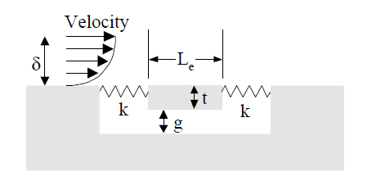
MEMS
Types – Direct sensors, thermal sensors and laser based sensors
Direct sensors – Measure integrated force produced by the wall shear-stress on a flush movable “floating” element
Displacement of the floating element – function of wall shear stress

Slide 32
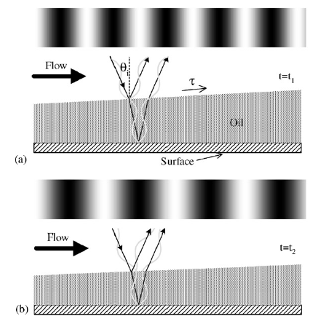
Thin-Oil Film
Quasi direct means of measuring skin-friction
The motion of oil film is sensitive to shear-stress, gravity, pressure gradients, surface curvature of the oil and surface tension
Oil thickness is measured via interferometry – function of the local skin-friction

Slide 33
Thin-Oil Film
Types - Single points, line and image techniques (1D and 2D)
-Image techniques 2D analysis
Surface imaging skin-friction - SISF
-Advantages
Range of 4% of uncertainty – two images during a single run
Method is only sensitive to shear stress
-Limitations
It requires at least two images acquired during a test
Complexity

Slide 34
Liquid Crystal Coating
-Advantages
Exhibit chemical stability so that they perform well over a reasonable interval
Can be used in dirty environments as it is not dependent on electricity
-Limitations
Optical access, calibration and accuracy
The color observed is dependent on illumination and observation angles
The coating degrades with time, and, due to the exposure of shear sensitive liquid crystals to the flow, reapplication is often necessary

Slide 35
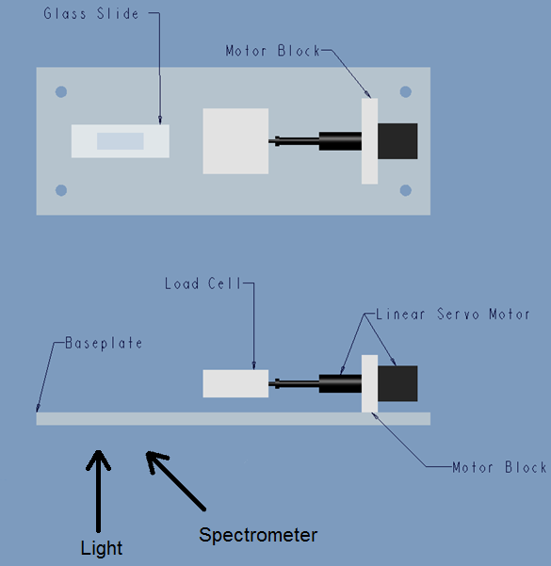
Given Parts and Design

Slide 36
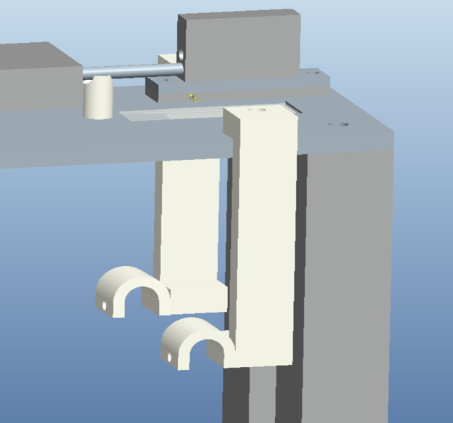
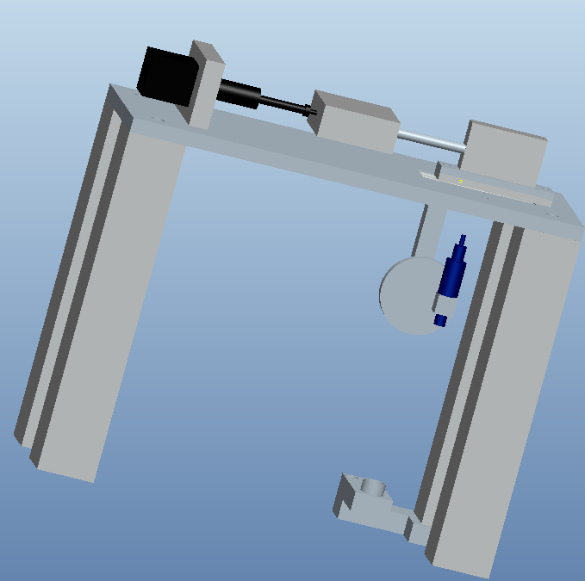
Concepts
Concept #1
Concept #2
Concept #3

Slide 37
Decision Matrix
Final Design Selection: Concept 2

Slide 38
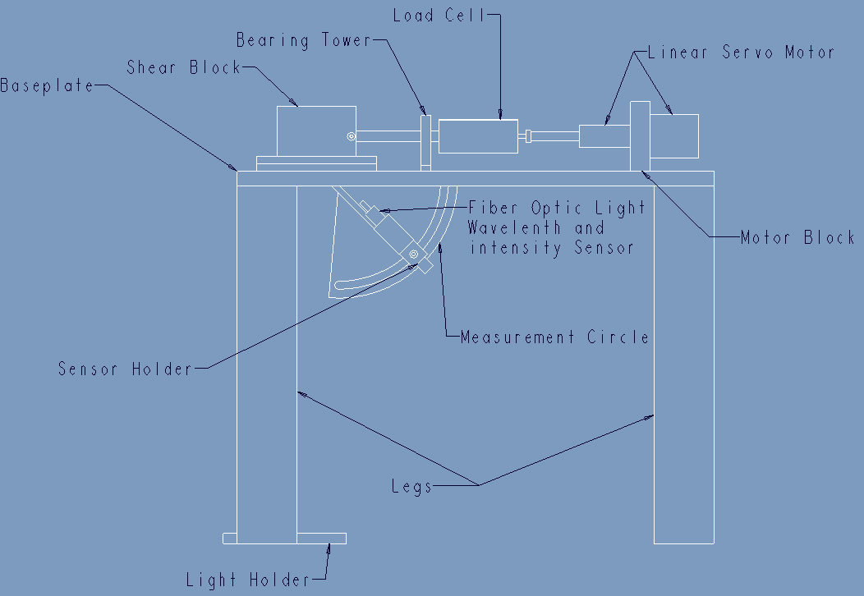
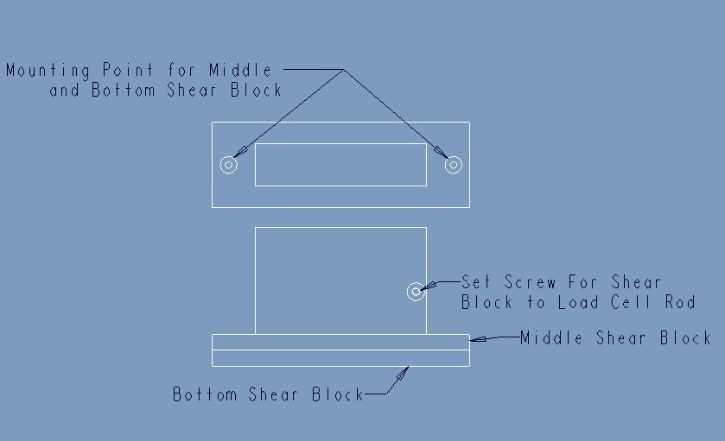
Final Design
Bottom Shear Block holds the heat pad and is modular so different block types can be tested

Slide 39
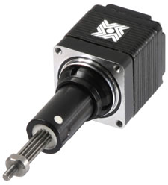
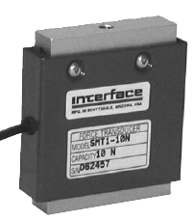
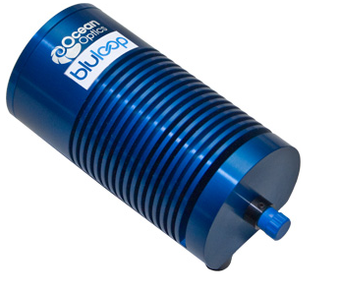
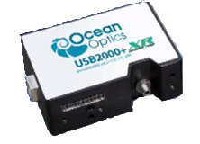
Components
Load Cell
Linear Servo Motor
BluLoop Light
Spectrometer

Slide 40
Polymers from Wright-Patterson AFRL

Slide 41
Oscillating Load
Oscillating Load – can approximate any function based on Fourier Series
Wind Speed - FAA
$w=−p_{1}Asin\left[π\frac{x−x_{r}}{q_{1}}\right]$ [m/s]
Shear - Cosine Load - Timoshenko
$$σ_{xy}=−0.5 cos⁡((4π/c)∗x) Pa$$

Slide 42
Theory – Hooke’s Law
-Decouple Analysis – Uniform Shear
y
x
$$σ_{xy}$$
Plane Strain
$$ε_{zz}=ε_{xz}=ε_{yz}=0$$
$$σ_{xz}=σ_{yz }=0$$
Strain
Strain Ratio
Uniform Shear
$ε_{xx}$= $0$
$$\frac{ε_{xy}}{ε_{xx}}→∞$$
$ε_{xx}$= $\frac{1}{E}(σ_{xx}−νσ_{y})$
$ε_{yy}$=$0$
$$\frac{ε_{xy}}{ε_{yy}}→∞$$
$ε_{yy}$= $\frac{1}{E}(σ_{yy}−νσ_{xx})$
$ε_{xy}$= $\frac{1}{G}σ_{xy}$
$ε_{xy}$= $\frac{1}{G}σ_{xy}$

Slide 43
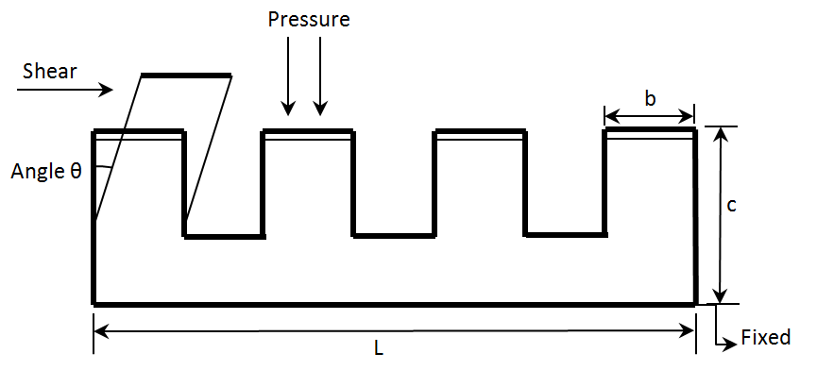
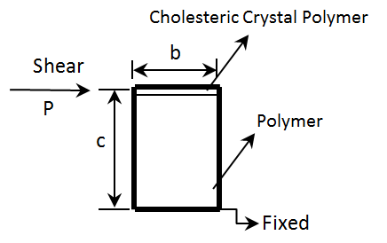
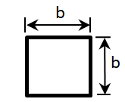
Theory – Euler Bernoulli Beam
-Decouple Analysis
Shear – deflection θ – relate to wavelength
Pressure – No change in angle
Maximize θ
Cantilever Beam
Θ $=\frac{Pc^{2}}{2EI}=\frac{6Pc^{2}}{Eb^{4}}$
Θ $=6 \frac{ σ_{xy α^{2}}}{E}$
$$σ_{xy}=\frac{P}{b^{2}}$$
$$α=\frac{c^{2}}{b^{2}}$$
Sensibility $α$ – maximize c and minimize b
Find thickness c that satisfies both approaches

Slide 44
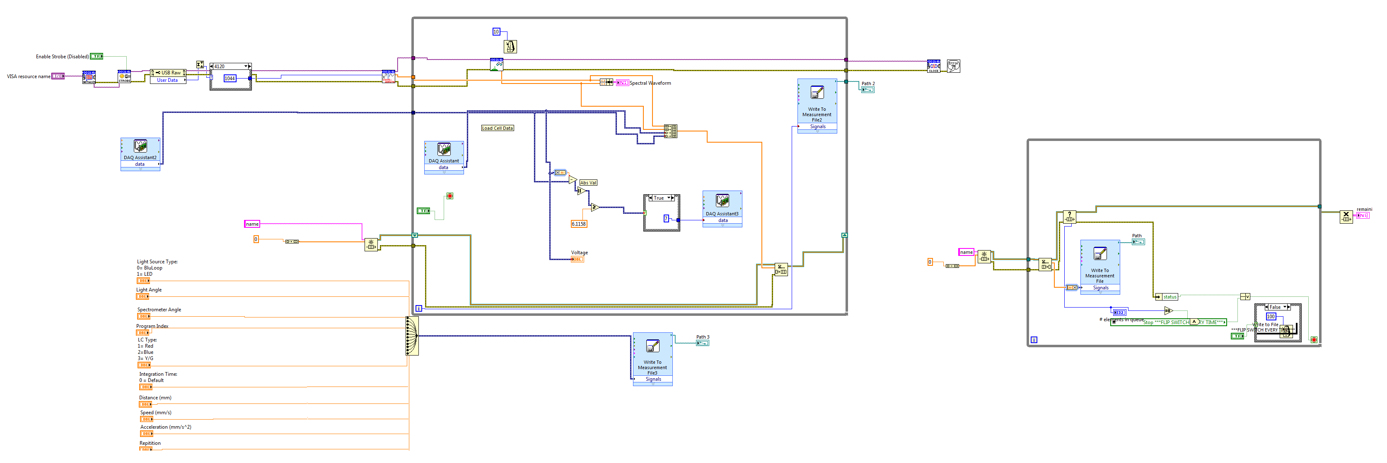
LabVIEW Block Diagram

Slide 45
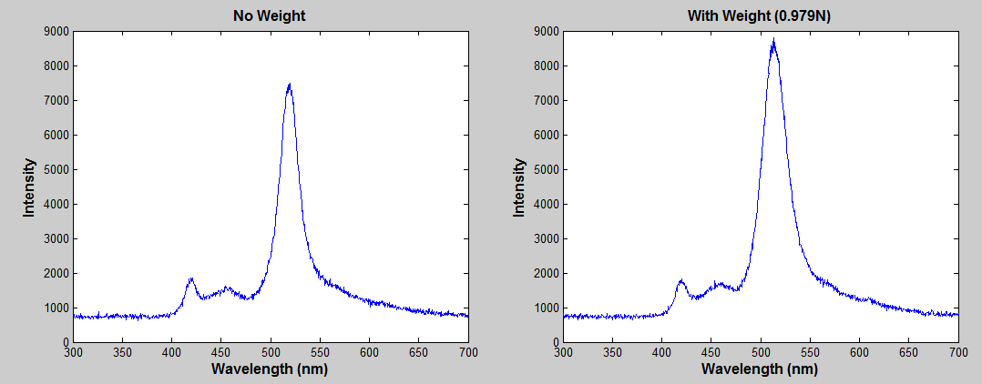
Results-Normal Force
Yellow Liquid Crystal
5 Trials for each condition
 | Color
 | Red | Blue | Yellow |  | Red | Blue | Yellow
 | No Weight |  |  |  | Weight (0.979 N)
Range (nm) | 600.3 | 469.1 | 512.0 | Average Wavelength (nm) | 597.5 | 469.7 | 519.7
Range (nm) | 5.9 | 3.1 | 3 | Range (nm) | 7.2 | 2.2 | 3.1
Differences
Color | Red
Red | 2.8
Blue | 0.6
Yellow | 7.7

