Slide 1
Shear Stress Sensor Using Cholesteric Crystals
Group #3
Group Members
Matthew Carmichael, FSU
Tyler Elsey, FSU
Luiz Paes, UNIFEI
Graduate Assistant
Matthew Worden
Sponsors
Dr. Dickinson , Eglin AFRL
Dr. Oates, FAMU & FSU COE
2/20/2013
eng.fsu.edu/me/senior_design/2013/team3

Slide 2
OVERVIEW
Project Scope and Objectives
Theory
Technical Approach
Final Design
Programming Needed
Schedule

Slide 3
Need Statement & Project Scope
Need Statement
Need in the market for a shear stress sensor that can be used outside the lab
Project Scope
Create Testing Apparatus
Determine if cholesteric crystals are able to measure shear stress

Slide 4
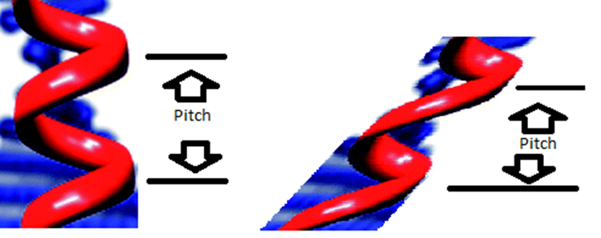
Cholesteric Crystals
Originally discovered in cholesterol
Helical Structure
Pitch varies with the boundary conditions
i.e. electricity or forces
Liquid Crystals made easily from 3 powders
Polymer form made through many time intensive processes

Slide 5
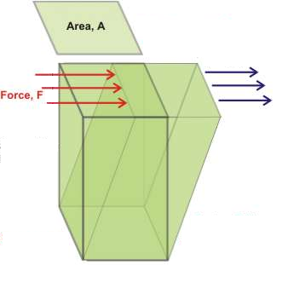
Technical Approach
$$τ=\frac{F}{A}$$
Assume no slip condition for liquid crystal testing
BluLoop Fiber Optic Light
Spectrometer:
200-1100 nm
2048 pixels
Linear Servo Motor:
1 step = 1/64”
Load cell:
10N

Slide 6
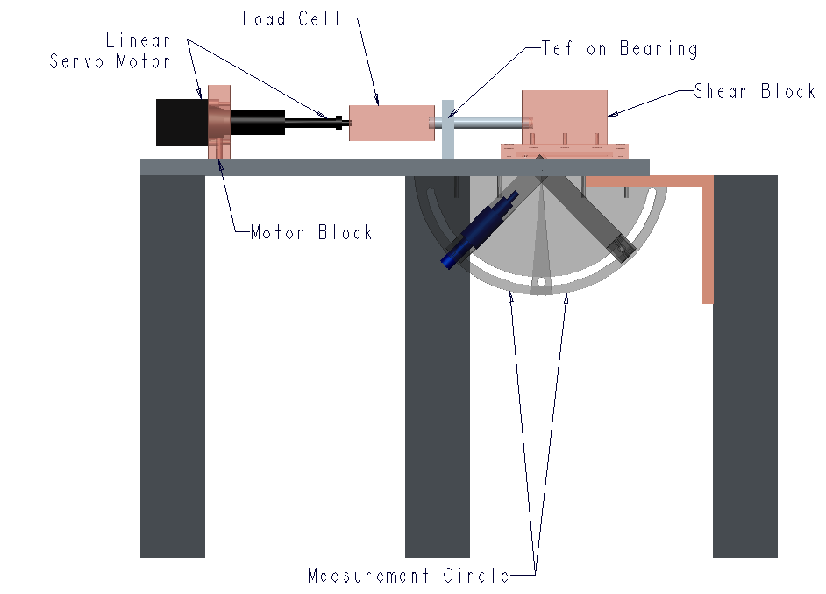
Final Design

Slide 7
Programming
LabView
Correlation between load and voltage with load cell
Load cell, spectrometer need to start at the same time – record information
MATLAB
Create method to review time resolved data
Filter spectrum from reference spectrum
Find equation that relates load to wavelength

Slide 8
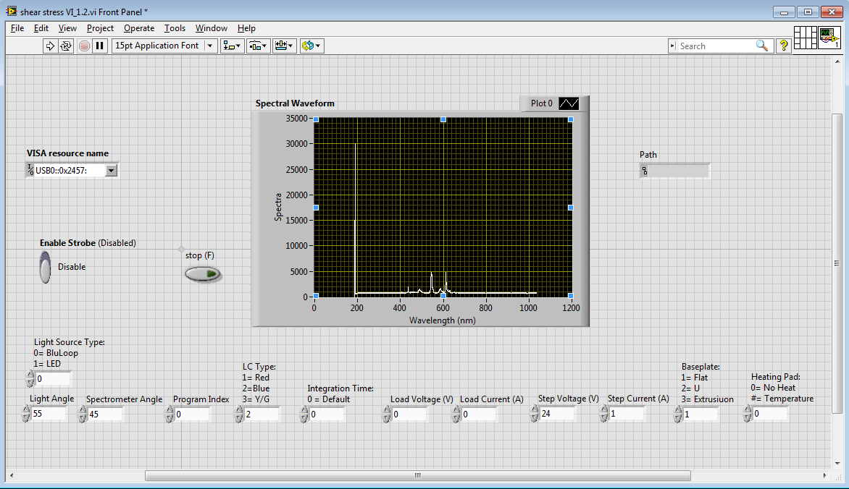
Labview

Slide 9
Matlab

Slide 10
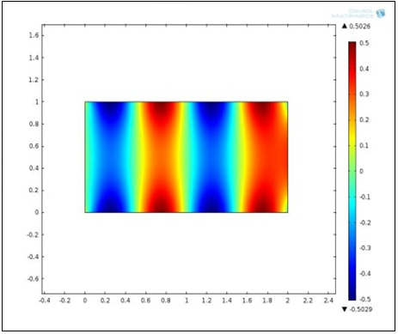
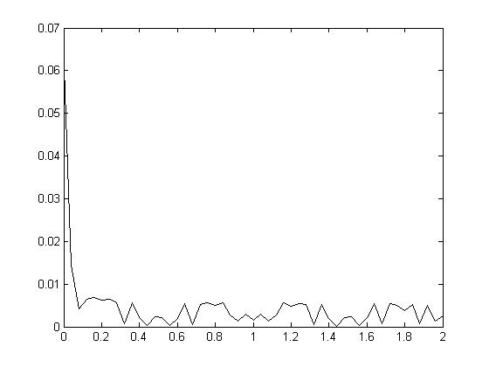
Simulation
– FEM (Finite Element Method)
y
Pressure - Sine Load
-0.5 sin ((4π/L)*x) Pa - top
0.5 sin ((4π/L)*x) Pa - bottom
x
Stress YY (Pa)
Pressure Error – Sigma YY
Error (Pa)
Y Coordinate (m)
X Coordinate (m)
X Coordinate (m)

Slide 11
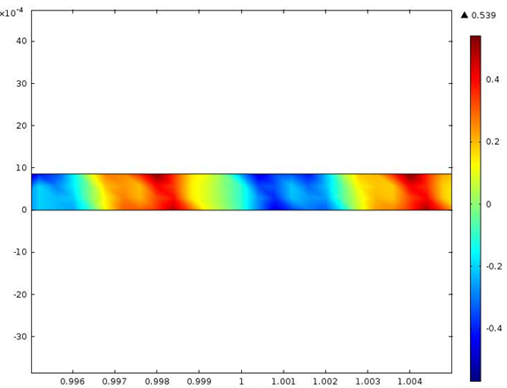
Simulation
– FEM (Finite Element Method)
y
Thin film - L=2000 (c)
x
Pressure - Sine Load
-0.5 sin ((4π/c)*x) Pa - top
Stress YY (Pa)
Y Coordinate (m)
X Coordinate (m)

Slide 12
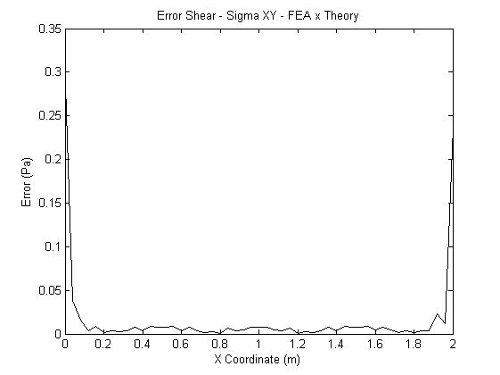
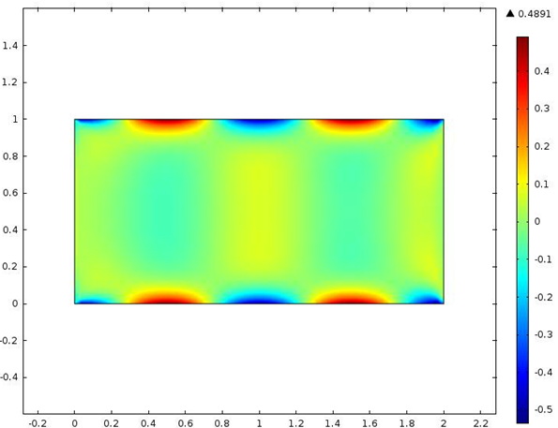
Simulation
– FEM (Finite Element Method)
y
Shear - Cosine Load
-0.5 cos ((4π/L)*x) Pa - top
0.5 cos ((4π/L)*x) Pa - bottom
x
Stress XY (Pa)
Pressure Error – Sigma XY
Error (Pa)
Y Coordinate (m)
X Coordinate (m)
X Coordinate (m)

Slide 13
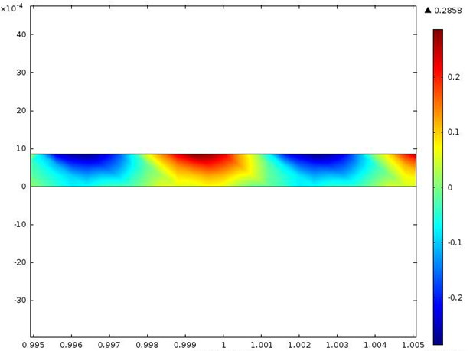
Simulation
– FEM (Finite Element Method)
y
Thin film - L=2000 (c)
x
Shear - Cosine Load
-0.5 cos ((4π/c)*x) Pa - top
Stress XY (Pa)
Y Coordinate (m)
X Coordinate (m)

Slide 14
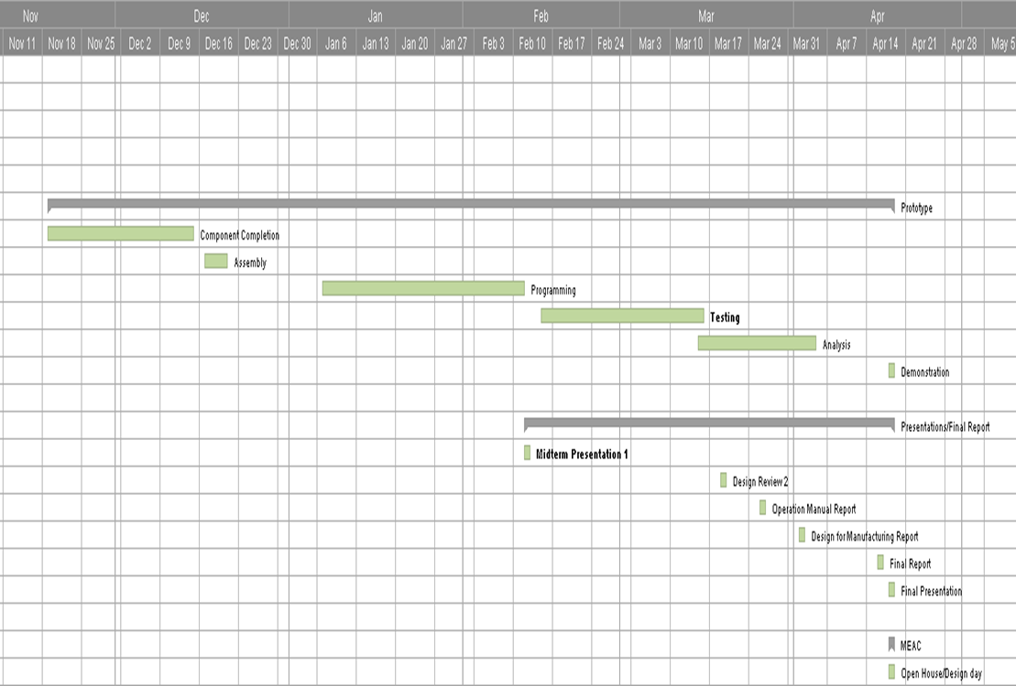
Schedule

Slide 15
Summary
-Shear stress device measurement was fabricated
-Labview and MATLAB interface is ready for experiments
-Testing samples have been made
-Next steps
Testing and analysis
Vary testing conditions and test polymer form of Cholesteric Crystals

Slide 16
Questions/Comments

