Slide 1
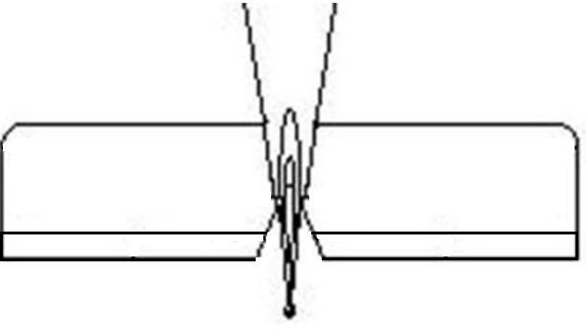
Team 6: Autonomous Aerial Vehicle
Imaging Processing
Power System
Image Processing Hardware
Asus Laptop Computer
Intel core i5 dual core processors
4 GB ram memory
Sony KX700-SHQ Camera
700 TVL resolution
Total Pixels: 1020x508
Image Processing Software
OpenCV – Computer Vision Libraries
C++ Language
MS Visual Studio Design Environment
Wireless Video Communication
TX-V584 Transmitter – 5.8GHz
R5800DX Receiver – 5.8 GHz
Composite-to-USB converter
4.8 V Battery
Supplies power to APM and autopilot servos
Rechargeable
NiMH
11.1 V Battery
Supplies power to image processing hardware
Rechargeable
Lithium Polymer (Li-Po)
Camera
Gimbal Servo
Throttle Servo
Navigation System
GPS
Ardupilot Mega 2.5
3 axis gyro
Accelerometer
Magnetometer
Barometer
Arduino compatible
3DR Radio Telemetry Kit
915 MHz
20dBm transmit power
250 kbps air data rate
Adaptive time division multiplexing
Built in error correcting code
Approx. 1 mile range
3DR GPS uBlox LEA-6
5Hz update rate
3.3V regulator
I2C EEPROM for configuration storage
11.1 Voltage DC Battery
Autopilot System
Voltage Regulator
Mechanical System
Radio Transmitter
Motor/Propeller
4 Stroke/Single Cylinder Magnum XL Fuel Engine
15x6” APC Propeller
16 OZ Fuel Tank + 6 OZ Additional Tank
1 Damping Square Pad (Firewall Insulation)
Gimbal System
2 Futaba 180° Standard Servos
3 Machined and Bended Aluminum Parts (2 U Shape, 1 L Shape, Designed in Pro/e)
1 Damping Square Pad
1 Small U Bracket (Holds Camera)
2 Servo Control Horns
1 Aluminum Screw Hub
Flight Controllers
2 Futaba Servos (Elevators Control)
2 Futaba Servos (Ailerons Control)
1 Futaba 180° Servo (Throttle Control)
Video Transmitter
Aileron Servo
Elevator Servo
Rudder Servo
Communications Interface
Camera
Transmitter
Transmitter
Receiver
Radio
USB Encoder

