Slide 1

Shape Conformable Battery Pack (Team #15)
Sponsor: Dr.Zheng
Advisor: Dr.Shih
Team Members:
David Goss
Roberto moutran
Jenna Pine
Brian rainbeau
Niraj Thakker
Jianchen Yu
04/17/2014

Slide 2
Executive Summary
Brief Overview
Manufacture of Lithium Cobalt Cells
Prototypes
Testing
Prototype Demos
Hazards
Conclusion
Future Recommendations
David Goss 1

Slide 3
Brief Overview
Design a shape conformable battery pack to fly a Remote-Controlled (RC) Plane
David Goss 2

Slide 4
Objectives and Goals
Build proof-of-concept prototype to justify design.
Design should be modular.
Sustain flight for 5 minutes.
Design should be safe.
David Goss 3

Slide 5
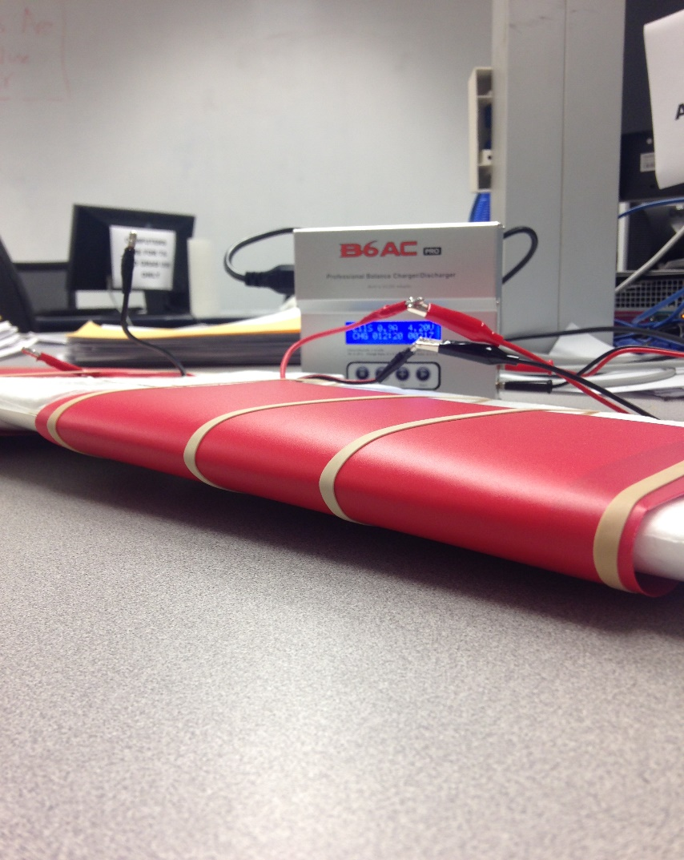
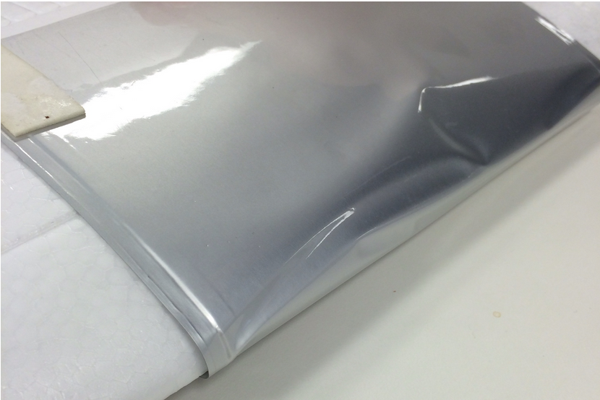
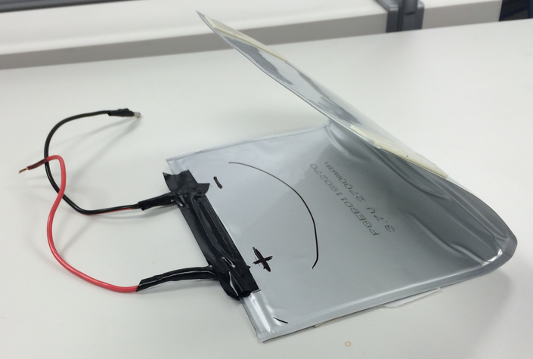
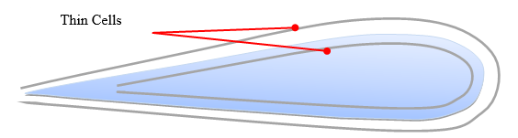
Design Concept 1
Large thin cells.
Bend around the wing.
Protective casing needed.
David Goss 4

Slide 6
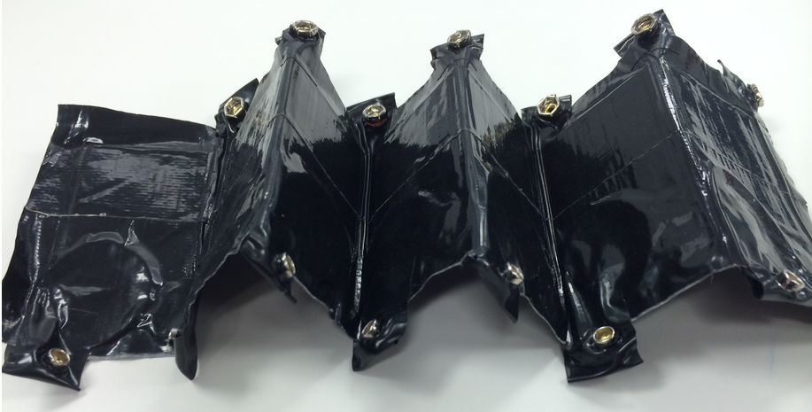
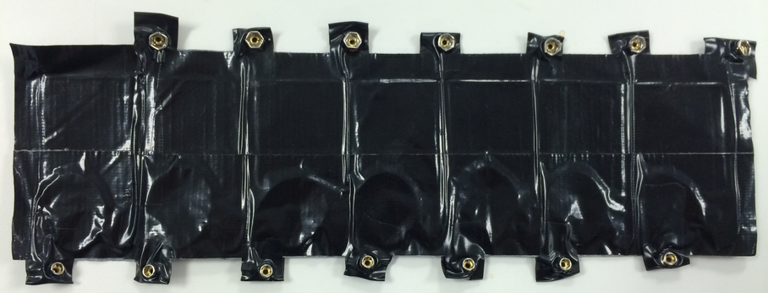
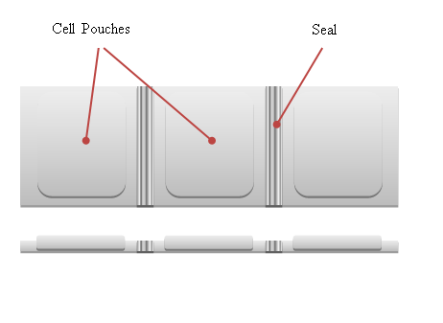
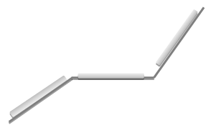
Design Concept 2
Multiple cells embedded in origami sheet.
David Goss 5

Slide 7
Manufacture of Lithium Cobalt Cells (LiCo)
Single layer cell (1 cathode, 1 anode)
Raw Materials:
  Aluminum foil coated by LiCoO₂ cathode sheet
  Double-sided copper foil coated by CMS graphite anode sheet
  Lithium Hexafluorophosphate (LiPF₆) liquid electrolyte
  Celgard separator film
Roberto Moutran 6

Slide 8


Manufacture of LiCo Cells
Electrode preparation:
Dimensions:
8.5cm x 5cm
Thickness:
0.2 mm Cathode
0.1 mm Anode
Roberto Moutran 7

Slide 9
Manufacture of LiCo Cells
Electrode preparation:
Good Electrodes
Overcut
Undercut
Roberto Moutran 7

Slide 10
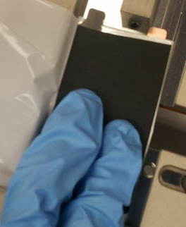
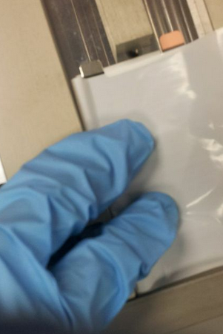
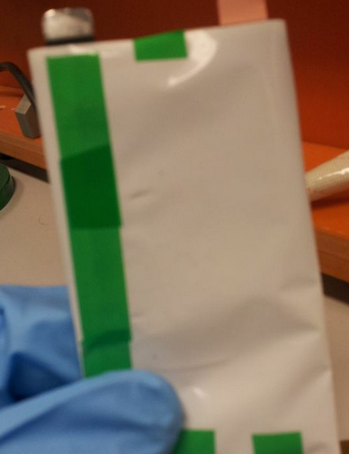
Manufacture of LiCo Cells
Cell folding:
Roberto Moutran 8

Slide 11

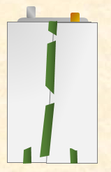
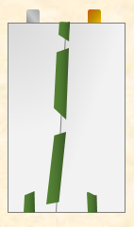
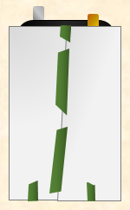
Manufacture of LiCo Cells
Cell folding:
A good pouch keeps the electrodes close but fully isolated from each other
Contact between electrodes in bad pouch – short circuit
Good Pouch
Bad Pouch
Roberto Moutran 8

Slide 12


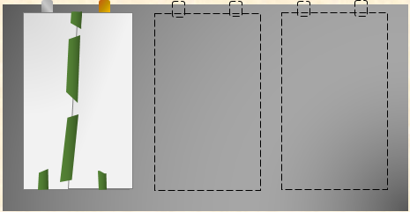
Manufacture of LiCo Cells
Aluminum casing:
Aluminum laminated film for pouch cell casing
Roberto Moutran 9

Slide 13
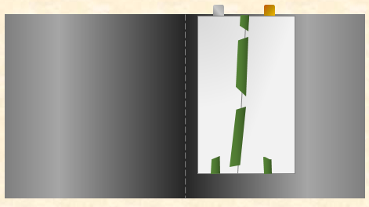
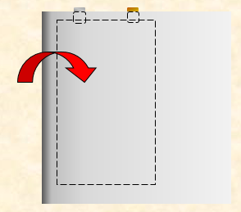
Manufacture of LiCo Cells
Aluminum casing:
Additional space left for formation process
Roberto Moutran 9

Slide 14
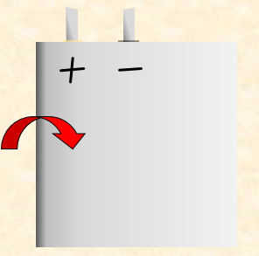
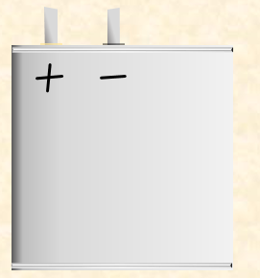
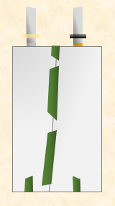
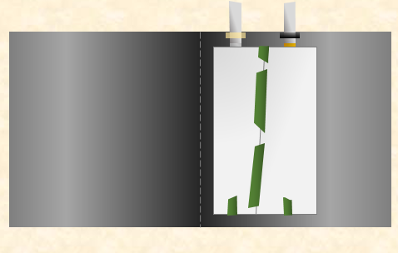
Manufacture of LiCo Cells
First Sealing Pass:
Glue strips lined up over sealing spot
Seals
Roberto Moutran 10

Slide 15
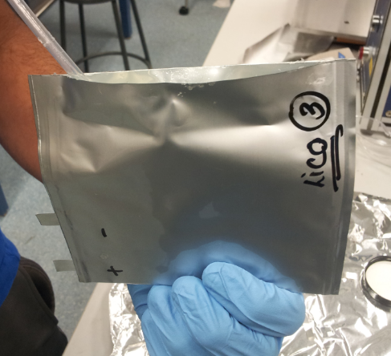
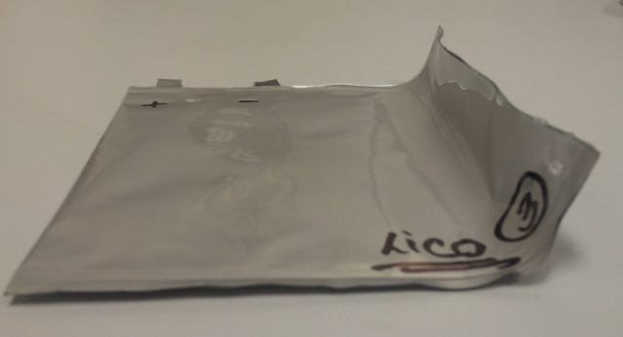
Manufacture of LiCo Cells
Electrolyte and Rest Period:
Two hour rest period to allow cell to fully soak
3 pipettes of LiPF₆ liquid electrolyte
Enough electrolyte to cover cell inside without leaking
Roberto Moutran 12

Slide 16
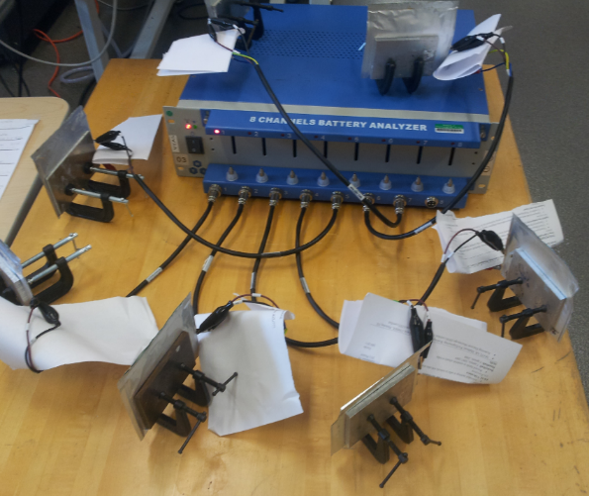
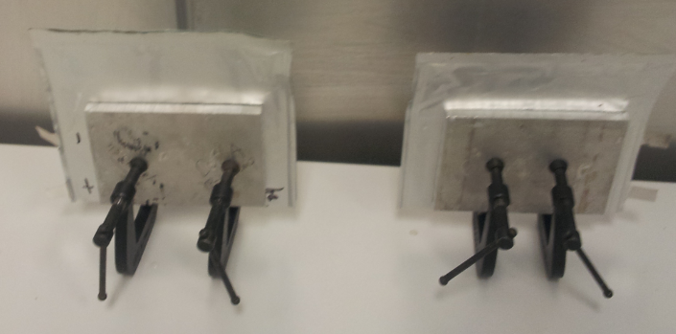
Manufacture of LiCo Cells
Clamping, Top Seal and Formation:
Clamping:
Keeps electrodes in contact with electrolyte
Pushes out air and excess fluid
Formation: Charge/discharge cycling with battery analyzer.
Roberto Moutran 13

Slide 17
Manufacture of LiCo Cells
Formation Process:
  Three cycles at slow discharge rate, ~24 hours
  Cycle time will depend on battery quality
  Charge/discharge cycle increases temperature in battery
  Extra gas and excess electrolyte is pushed away from the cell into the long end of the aluminum foil
Roberto Moutran 14

Slide 18
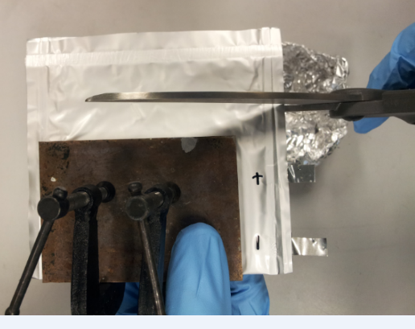
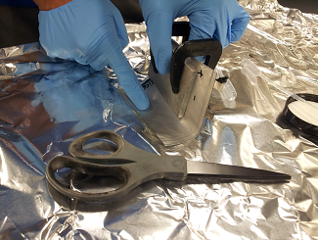
Manufacture of LiCo Cells
Cut and Final Vacuum Seal
Final LiCo Battery
Roberto Moutran 15

Slide 19
Manufacture of LiCo Cells
Additional Problems:
  Machinery issues
  Humidity
  Time
  Channel limitation on analyzer
  Variability
Roberto Moutran 16

Slide 20
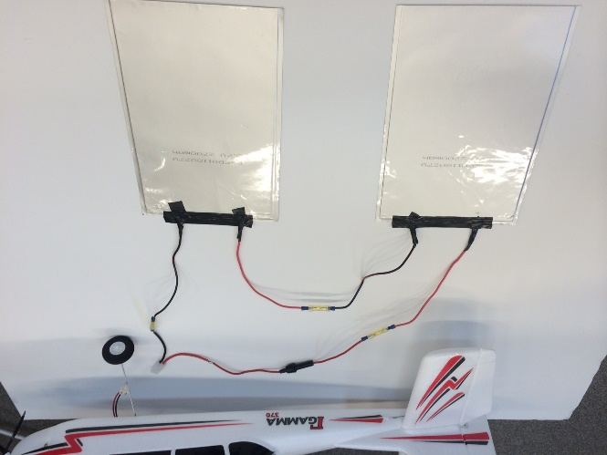
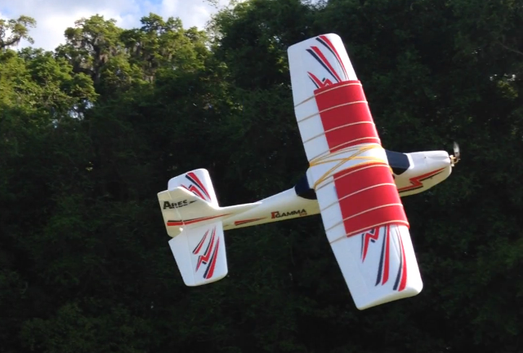
Prototype
Large Bent Batteries
  Connect two packs in series with bullet connectors to increase voltage.
  Put battery packs in nylon sheets in order to protect and reinforce the batteries.
  Wrap the battery packs around the airfoil and fix them with rubber bands.
Jianchen Yu 17

Slide 21
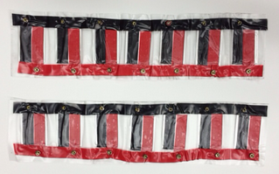
Prototype
Origami Battery Pack
  Connect 7 single batteries in parallel to supply enough capacity and two packs in series to supply enough voltage.
  Insolate the terminals with electrical tape and mark anodes with red tape while cathodes with black tape.
Jianchen Yu 18

Slide 22
Prototype
Origami Battery Pack
  Place batteries in set of 7 at a certain interval to a sheet of contact paper to guarantee the bendability.
  Solder connectors in an array to connect anode terminals and cathode terminals relatively and strengthening the master connectors with electrical tape.
Jianchen Yu 19

Slide 23
Prototype
LiCo Battery Packs
  Connect 2 single batteries in parallel and two packs in series following the same process as origami design.
  Wrap them around both sides of the airfoil and clamp them with plastic plates.
Jianchen Yu 20

Slide 24
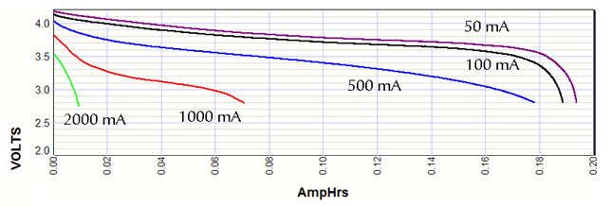
Testing Batteries
Discharge Rate Matters!!
In order to run, the plane requires high instantaneous discharge rate.
Single Layer Lithium Liquid Electrolyte cell can not discharge at a high rate for a long periods of time.
Niraj Thakker 21

Slide 25

Testing Batteries
Static Thrust
  Static thrust is a function of propeller R.P.M, diameter and pitch.
  $\frac{Static Thrust}{Weight}= \frac{1}{3}$ (To Sustain Flight)
  $\frac{Static Thrust}{Weight}= \frac{2}{5}$ (To Take off)
Green Line : 8 x 6 inch propeller
Yellow Line : 9 x 7 inch propeller
Find minimum R.P.M for a given Static Thrust and hence for a given weight of the plane
Niraj Thakker 22

Slide 26
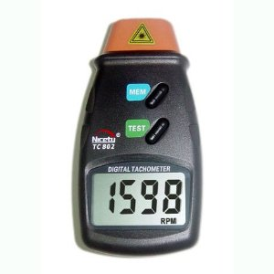
Testing Batteries
Different battery designs were attached to the motor and the propeller R.P.M was measured.
Tachometer readings were taken every 5 seconds for 6 minutes.
Data for Origami, Large Bent and Stock batteries was obtained.
Niraj Thakker 23

Slide 27
Testing Batteries
 | Diameter (in) | Pitch (in) | Plane Weight (g) | Minimum Thrust (g) | Minimum R.P.M
Original Battery | 8 | 6 | 485 | 161.67 | 3907.6
 | 9 | 7 |  |  | 3645.1
Origami Cell | 8 | 6 | 606 | 202 | 4388.3
 | 9 | 7 |  |  | 4072.1
Large Bent Cell | 8 | 6 | 753 | 376.5 | 6246.7
 | 9 | 7 |  |  | 5754.8
For Large Bent Cell, the plane will sustain flight for at least 6 minutes
For Origami Cell, the plane will sustain flight for close to 50 seconds
Niraj Thakker 24

Slide 28
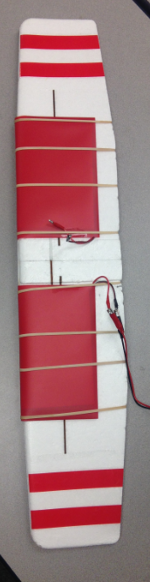
Large Thin Cells Demo
For the RC plane application, bending around the wing does not disrupt center of gravity.
Packs connected in series.
Design allows for surface conformability.
Jenna Pine 25

Slide 29

Large Thin Cells Test Flight
Jenna Pine 26

Slide 30
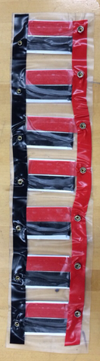
Origami Prototype Demo
To give shape conformability smaller cells were connected in parallel to make each pack.
Packs would then be connected in series.
Allows for many different shapes including folding and wrapping.
Jenna Pine 27

Slide 31


Environmental Hazards
Proper disposal of used materials.
Harmful if electrolyte comes in contact with your skin.
Not good for the ground.
Jenna Pine 28

Slide 32
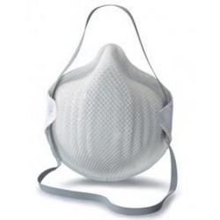

Safety Hazards
Electrolyte material is extremely flammable and toxic if inhaled.
Can be extremely dangerous if a Lithium Polymer battery is cut open.
Batteries can combust due to improper charging/discharging.
Jenna Pine 29

Slide 33
Conclusion
Two directions: focused on building cells, while building packs from pre-made cells to validate our design.
Built working thin cells, and integrated others into usable conformable battery packs.
Brian Rainbeau 30

Slide 34
Future Recommendations
Learn to walk before you run.
Learn to build good ordinary batteries before you attempt to build unique and innovative ones.
Even before the design process, learn the limitations of the technique, facility, and equipment.
Brian Rainbeau 31

Slide 35
Future Recommendations
Essentially 4 Challenges to overcome
  Build Reliable cells
  Batteries must be light
  Batteries must be powerful
  Accommodate an odd shape
Brian Rainbeau 32

Slide 36

Questions ?

Slide 37
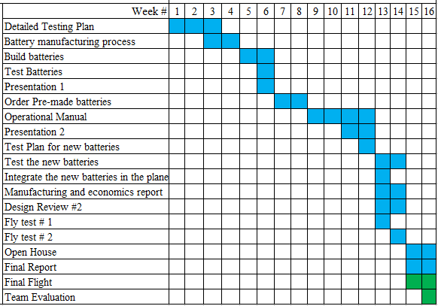
Gantt Chart

Slide 38
Description | Quantity | Unit Price ($) | Total ($)
Ares Gamma 370 RTF plane | 1 | 129.99 | 129.99
Wing Set | 2 | 39.98 | 79.96
Large EPP foam glue | 2 | 9.98 | 19.96
Li-Ion Battery Cathode - Aluminum foil double coated LiFePO4 | 2 | 79.95 | 159.90
Li-Ion Battery Anode - Copper foil double side coated Graphite | 2 | 59.95 | 119.90
FALL TOTAL |  |  | $509.71
Li-Ion Battery Cathode - Aluminum foil double coated LiFePO4 | 1 | 79.95 | 79.95
Li-Ion Battery Anode - Copper foil double side coated Graphite | 1 | 59.95 | 59.95
Polymer Lithium-ion battery (small) 200 mA | 30 | 10.00 | 300.00
Polymer Lithium-ion battery (large) 2800 mA | 6 | 28.00 | 168.00
Battery Charger | 1 | 35.50 | 35.50
Replacement parts and supplies | 1 | 80.96 | 80.96
SPRING TOTAL |  |  | $724.36
GRAND TOTAL |  |  | $1234.07
REMAINING BUDGET |  |  | $765.93
Budget Status

Slide 39
Why can we not use LiCO cells to fly the plane?
  Handcrafted LiCO cells only provide 8.5mAh capacity per gram of battery. For the battery to supply enough capacity to support its weight and the weight of the plane, the minimum required weight to capacity ratio is 1g to 15 mAh

Slide 40

Static Thrust Equation
$T_{S}=1.225∗\frac{{π\left(0.254∗d\right)}^{2}}{4}\left[{\left(RPM∗0.0254∗p∗\frac{1min}{60sec}\right)}^{2}\right]∗{(\frac{d}{3.29546∗p})}^{1.5}$

