Slide 1
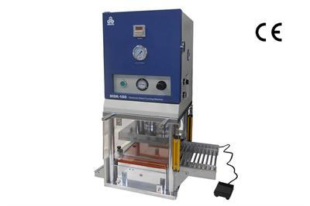
Senior Design : Shape Conformable Battery Pack
Sponsor: Dr.Zheng
Advisor: Dr.Shih
Team Members:
Jenna Pine
Niraj Thakker
Jianchen Yu
David Goss
Roberto Moutran
Brian Rainbeau

Slide 2
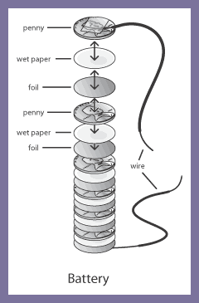
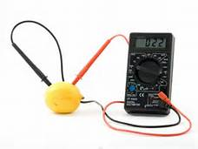
Battery CRASH COURSE

Slide 3
Project Description
What’s the project about?
Objective | Constraints
Build a battery that can be integrated into the wing of a UAV system Develop uniquely shaped battery or formable battery The battery must satisfy the power need of the RC plane Battery is to be detachable for charging | Limited project Budget Limited research or experience available Battery must not explode or catch fire Enough power must be supplied for at least a 5 minute flight without switching batteries or recharging

Slide 4
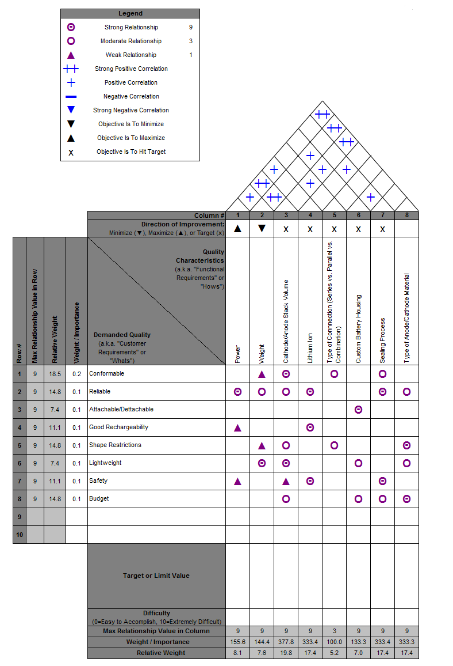
House of Quality

Slide 5
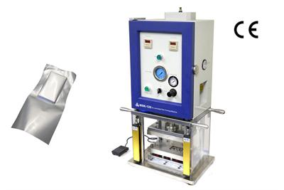
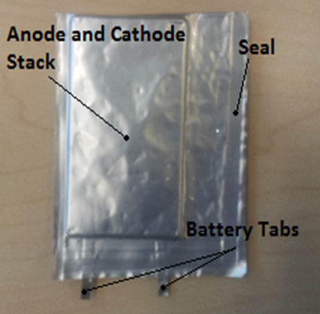
Introduction
What is a lithium pouch cell battery?
Cathode sheets consist of Lithium Iron Phosphate (${\text{LiFePO} }_{4}$) spread over an Aluminum Sheet
Anode Sheets consist of graphite spread over a copper sheet

Slide 6
Design Concept for battery
Concept 1: Thin C-Shaped Pouches
Create many thin layered batteries and seal them independently
Pros
Easy to seal
Making the batteries thin increases their bendability
Cons
Bending pouches may result in loss of electrolyte conductivity
Sharp bending angle may impair electrolyte flow

Slide 7
Design Concept for battery
Concept 2: Single Pouch
Require different size anode and cathode sheets
Pros
True conformability
Cons
High risk of shorting the battery
Vacuum sealing will be difficult due to the shape of the pack.

Slide 8
Design Concept for battery
Concept 3: Individual Cell Pouches
Make individual batteries and connect them in series/parallel
Pros
Easiest to manufacture
No loss of electrolyte conductivity from bending
Cons
Longer manufacturing time
Not the most creative design

Slide 9
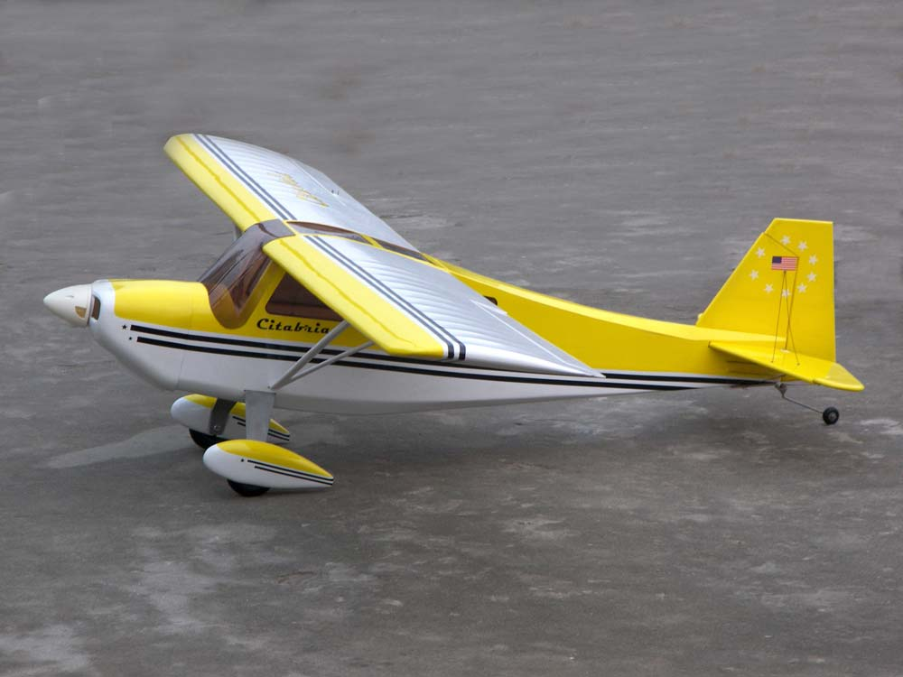
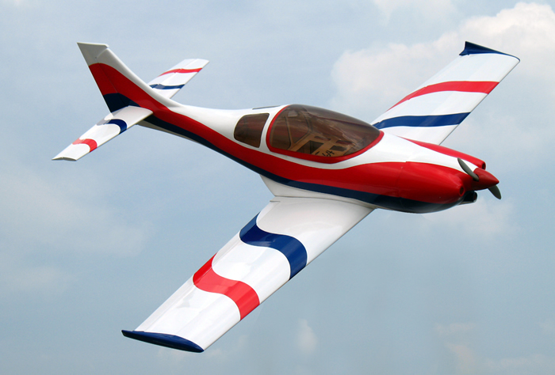
Design Concept for Plane
Wing over Body | Wings to the side
Pros More Support for the heavy wings Having a single wing makes the attachment and detachment process easier Conformable battery placement is more flexible Cons Support rods add additional weight, which increase the power requirement Rods will also increase the induced drag | Pros Less induced drag Weigh’s less, since there are no additional support components Cons Attachable/detachable wing will be unstable Less flexibility for placing the conformable battery

Slide 10
Analysis of the airfoil
How are we going to analyze Lift on the airfoil?
Assumptions
Thin Air Foil (To use Kutta-Condition for coefficient of Lift)
Laminar Flow
Experimental Analysis
Placing the airfoil in the wind tunnel
Computing lift at different angles of attack
Theoretical Analysis
Use 2-D Finite Element Model for a flow over an airfoil
Use natural boundary condition to set up the model

Slide 11
Selection of battery Material
What kind of Lithium Battery are we going to choose?
Two choices : Lithium Ion and Lithium Solid Polymer.
Light-weight, Rechargeable and High capacity
Lithium Ion | Lithium Polymer
Pros Commercially available materials Access to battery lab Cons Lower specific energy Less shape conformable | Pros High specific energy Shape conformable Cons Materials are harder to find No production facility available
Since Lithium Ions materials are readily available, Lithium Ion will be selected

Slide 12
Selection of battery Material
Types of Lithium Ion Batteries
Three Prevalent types of Lithium Ion Battery cathode.
Lithium-cobalt dioxide (LiCoO₂)
Lithium-manganese oxide (LiMn2O₄)
Lithium iron phosphate (LiFePO₄)
Of these three LiCoO₂ and LiFePO₄ offer higher specific energy, but LiFePO₄ is roughly half the cost of LiCoO₂ (Iron is more common than cobalt)
Choices for ready made Anode and Electrolyte materials were limited to Graphite and Lithium Salt (Lithium hexafluorophosphate)

Slide 13
Analysis of battery material
How much material is needed to produce the required power?
The plane is equipped with a 11.1V, 3200mAh battery which weights 309 g
Electrode | Volts | Capacity (mAh/cm²) | material to achieve 3200mAh (cm²) | material to achieve 3200mAh, 11.1V (cm²) | anode + substrate weight per cm² (g) | cathode + substrate weight per cm² (g) | Electrode weight needed total(g) | Electrolyte needed total(g) | 3200mAh 11.1V cell weight no package (g)
LiFePO₄ | 3.45 | 2.42 | 1322.31 | 4254.40 | 0.03 | 0.02 | 205.63 | 102.81 | 308.44
We need 4254cm² of each electrode and 102.81g of electrolyte

Slide 14
Summary
What designs did we choose?
Based on house of quality we choose
For battery housing
Concept 1: Thin-C shaped Pouches
Concept 3: Individual Cell Pouches
For plane
Concept 1: Wing over the body
For battery material(Cathode)
LiFePo₄

Slide 15
Future Works
What’s next?
Analyzing the power output of each of the battery shape concepts
Analyzing the placement of the battery in the wing
Designing various concepts to attach and detach the wing from the plane
Analyzing different combinations of series and parallel connection to obtain the required output

Slide 16
References
¹Amin, D. (2013, August). EML4551C-Senior Design Project 1 . Retrieved September 22, 2013, from Blackboard: https://campus.fsu.edu/webapps/portal/frameset.jsp?url=%2Fwebapps%2Fblackboard%2Fexecut e%2Flauncher%3Ftype%3DCourse%26id%3D_6389491_1%26url%3D
²Ismail, M. H. (2003). Designing lithium ion batteries for high power applications. PECon 2003 National Proceedings, (pp. 289 – 291).
³Kam, K. C. (2012). Electrode Materials for Lithium Ion Batteries. Material Matters.
⁴Linden, D. (2002). Handbook of Batteries. New York: McGraw-Hill.
⁵Server Experts. (2011). LiPo Batteries and Charging for your Model RC Airplane. Retrieved September 21, 2013, from L.I. Foam Flyers: http://www.longislandelectricrcairplanes.com/learnbatteries.php
⁶Unknown. (2010, October). Learn about Batteries. Retrieved September 21, 2013, from Battery University: http://batteryuniversity.com/learn/article/is_lithium_ion_the_ideal_battery
⁷Unknown. (2012). BYD Company Limited. Retrieved 10 19, 2013, from http://bydit.com/doce/products/Li-EnergyProducts/
⁸Unknown. (2013, 10 20). Apprentice S 15e RTF. Retrieved from HobbyZone: http://secure.hobbyzone.com/EFL3100.html
⁹Zheng, H., Liu, G., Crawford, S., & Battaglia, V. S. (2010). Fabrication Procedure for Lithium-ion Rechargeable Coin Cells. Berkeley: Lawrence Berkeley National Laboratory.

Slide 17
Questions??

