Slide 1
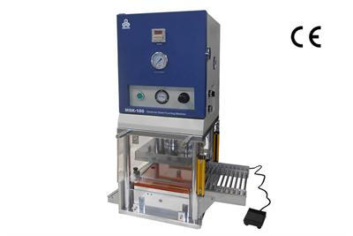
Senior Design : Shape Conformable Battery Pack
Sponsor: Dr.Zheng
Advisor: Dr.Shih
Team Members:
Jenna Pine
Niraj Thakker
Jianchen Yu
David Goss
Roberto Moutran
Brian Rainbeau

Slide 2
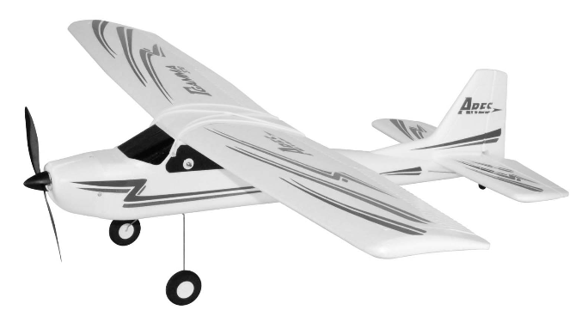
RECAP
Decided to go with the over the
body style wing design
Give us most stability
Keep weight centered
Using lithium ion battery material
Not able to pursue lithium solid polymer
Using liquid electrolyte battery

Slide 3
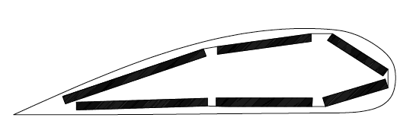
Battery shape
C-shape battery pouch
Give conformability to wing
shape
Foldable battery
Allow battery to fold into different shapes

Slide 4
Battery information
Wingspan: 38.6 in (980mm)
Battery: 1000mAh 7.4V Li-Po (included with RTF)
Li-Ion Battery Cathode - Aluminum foil double coated LiFePO₄
Li-Ion Battery Anode -Copper foil double side coated CMS Graphite
Electrolyte LiPF₆ for LiMn₂O₄/LiFePO₄ Lithium-ion battery

Slide 5
General process
Primary Inputs
Outputs
Secondary Inputs
Function
Primary Inputs: power requirements of the device
Secondary Inputs: material-specific properties
Outputs: total material required to meet power requirements and overall battery weight

Slide 6
Excel function
Primary Inputs: desired current (mAh) and voltage (V)
Secondary Inputs: material-specific properties
Outputs: total area, total battery weight, number of cells

Slide 7
Excel function
Assumptions:
Weight of separator paper is negligible
Electrolyte weight is cathode plus anode weight divided by 2
Limitations:
Cells have to be of the same size
Cells are connected in series

Slide 8
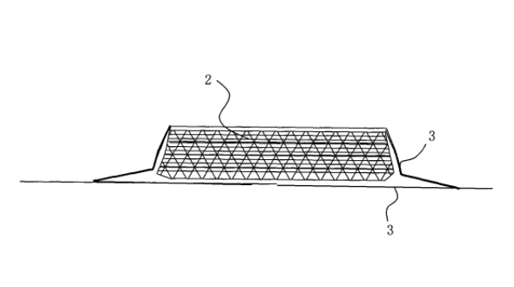
Sealing process
Existing sealing process
The flexible packaging is a five-layer film
Before sealing flexible packaging films, the films will be punched into a groove with certain depth to put the lithium battery.
When sealing, The PE and PP layers of two sides of the film will be melted into one.

Slide 9
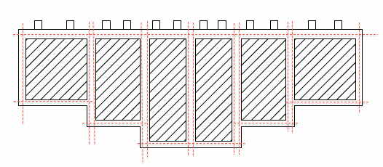
Sealing process
With different combinations of batteries, they can fit into different spaces.
Seal along the red dashed lines.

Slide 10
Battery Properties
Voltage requirement for Plane = 7.4V
LiFePO₄ provides 3.45 V
Connect cells in series.
Voltage output = 10.35 V
Will use a resistor to reduce the voltage to 7.4V
Value of resistor can only be found experimentally
V
V
V
R
Load

Slide 11
Conclusion
Currently waiting for materials
Conformable battery building process
Exploring additional ideas to enhance conformability

Slide 12
Future Works
Build Battery!
Test battery performance (flat and bent)
Test internal resistance of battery
Learn to fly RC plane
Fly the plane!

