Slide 1


Pedibus Development
Sponsored by Capital City Pedicab Company
In affiliation with the FSU and FAMU College of Engineering
Team 18
Andrew Galan
John Hassler
James McCord
Onyewuchi Ebere
Sponsor Instructors
Ron Goldstein Dr. Kamal Amin
Faculty Advisor Dr. Chiang Shih
Dr. Patrick Hollis

Slide 2
Brief Overview
Quick background information
Objective statement
Vehicle design and components
Potential challenges/risk
Future plans
Relevant questions
James McCord

Slide 3

Background
The pedibus is a pedal-powered vehicle used for transportation that seats a variety number of passengers depending on size.
The idea was developed to provide as an eco-friendly traveling entertainment center to attract people of all ages and professions.
        Some models contain alcohol distribution consoles in the center.
Also referred to as the pedal crawler, pubcrawler, and party bike.
The pedibus has grown in popularity over the last five years.

Slide 4
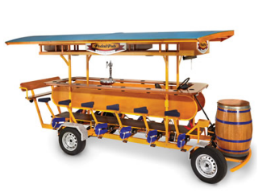
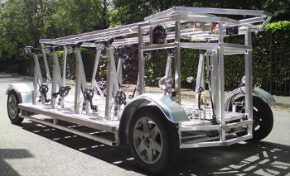
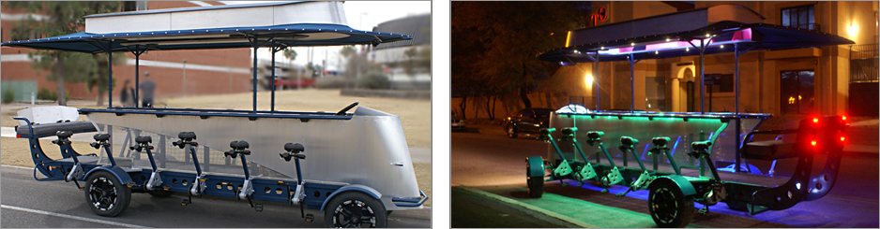
Existing Models
James McCord

Slide 5
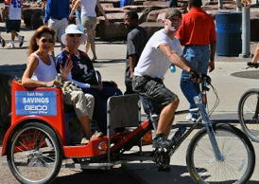
Sponsor
Ron Goldstein
Tallahassee Native
Owner of Capitol City Pedicabs
Wants to manufacture the Pedibus for sale
James McCord

Slide 6
Project Statement
Develop and build a fully functional pedibus prototype that will be able to transport passengers in a safe and eco-friendly manner.
      The prototype is to be light weight, yet sturdy, with smooth transition of power from the passenger pedals to the wheels.
      The prototype must be able to be powered by two peddlers.
      The main purpose of the prototype is that it will be able to be used as a guideline structure for future local manufacturing, as appointed by the sponsor.
James McCord

Slide 7
Design Concepts
The Pedibus is broken down into five main components
        Structural frame
        Power transmission
        Peddling stations
        Braking system
        Steering control
James McCord

Slide 8
Structural Frame
Requirements:
  Must be strong enough to support passengers weight
  Must be as light weight as possible
  Must be low cost
  Must be reliable with low maintenance
James McCord

Slide 9
Structural Frame Materials
Steel
Caron Fiber
Bamboo
Aluminum
James McCord

Slide 10
Structural Frame Materials
Steel
Pros
Most well-known
Easy to weld and repair
Very good material properties
Cons
Relatively heavy
Expensive
May rust depending on type
Carbon Fiber
Pros
Extremely stiff, strong, and light
High toughness
Aesthetically nice finish
Cons
Brittle
Extremely expensive
Requires high skill level
Aluminum
Pros
Very strong
Light weight
Impact resistant
Less expensive than steel
Cons
Difficult to repair and reshape
Difficult to weld
Bamboo
Pros
Durable
Extremely light weight
Cheap renewable resource
Cons
Too flexible
Unclear fastening methods
James McCord

Slide 11
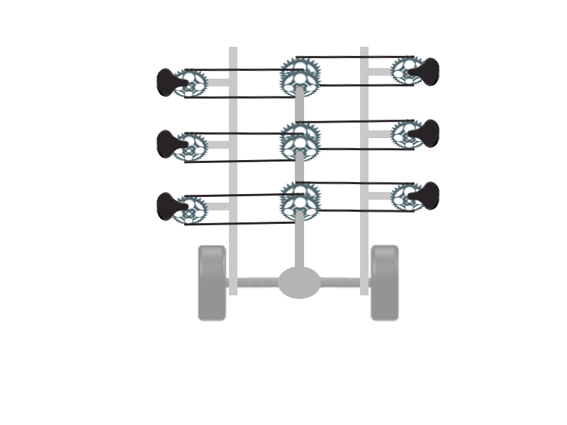
Drive Train Design
Existing models use:
Cold rolled steel drive shaft
Rear axle from automobile
Differential from automobile
Question
How to connect pedals to drive shaft?
John Hassler

Slide 12
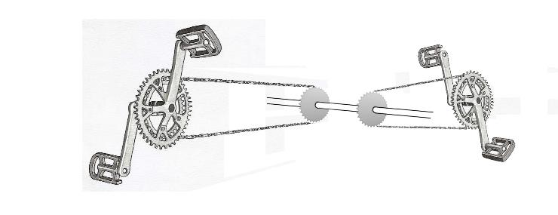
Bike Chain Layout
Problem: one side of the bike can be tied directly to drive shaft but the other side is reversed
John Hassler

Slide 13
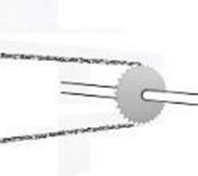
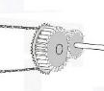
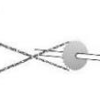
Bike Chain Designs
Design 1
One side peddles backwards
Design 2
One side geared to the drive shaft
Design 3
One side consist of a flipped chain
John Hassler

Slide 14

Bike Chain Layout
Option #1
One side peddles backwards
Pros:
Simplest design
Easy to implement
Cons:
Uncomfortable to peddle backwards all day
One side becomes more desirable than the other
John Hassler

Slide 15

Bike Chain Layout
Option #2
One side has the bike chain attached to a gear that is attached to the drive shaft
Pros:
All passengers peddle forward
Cons:
More complex design
More expensive to implement
John Hassler

Slide 16
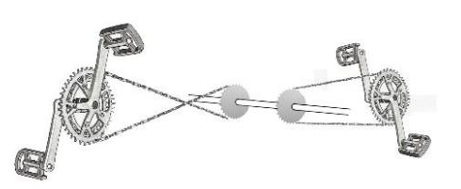
Bike Chain Layout
Option #3:
One side has the chain flipped
Pros:
All passengers peddle forward
Simple and effective solution
Easy to implement
Cons:
Requires more maintenance and parts to keep the chains from rubbing
John Hassler

Slide 17
Peddling Stations
Important properties of the peddling station:
Comfortable to ride for extended period of time
Must be able to sit and peddle at the same time
Needs to be stable seating for turns or stops
John Hassler

Slide 18
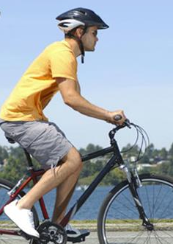
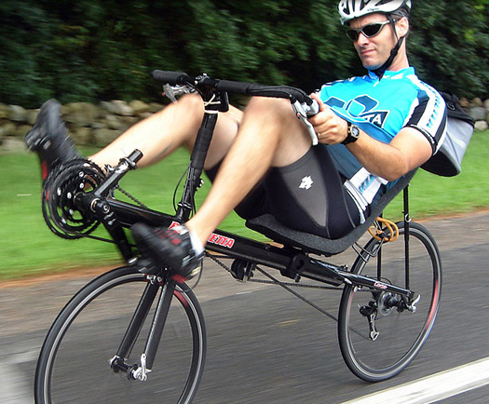
Peddling station Designs
Design 1
Standard bicycle peddling station
Design 2
Low seated peddling station
John Hassler

Slide 19
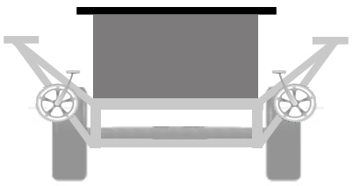
Peddling station Design
Design # 1 – Standard bicycle peddling station
Pros:
Higher viewing angle better for scenic tours
Seated at a table (more social, able to drink or eat)
Peddling is similar to traditional bike orientation
Cons:
Capable of generating less total power
less comfort on long rides due to lack of back support
John Hassler

Slide 20
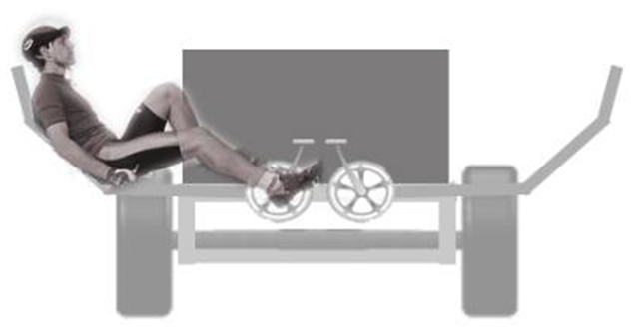
Peddling station Design
Design # 2 – Recumbent peddling station
Pros:
Capable of generating more power per peddling station
Seating is comfortable for long periods of time
Cons:
Lower viewing angle
Seating is less conducive to social interaction
Smaller populace capable of powering the peddling station
Head is in unsafe position
John Hassler

Slide 21
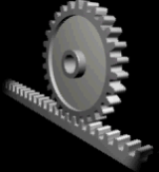
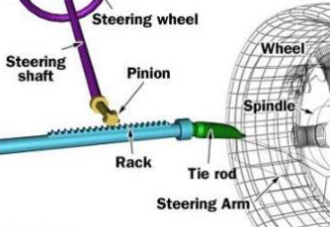
Steering Control
Rack and Pinion Steering
Consist of a rack-and-pinion gearset that is enclosed in a metal tube
    At the end of each rack, is attached a tie rod that connects to a steering rod, located on the spindle.
The pinion gear is attached to the steering shaft
    This allows the rack to transition horizontally as the steering wheel turns/rolls the pinion gear.
It converts the rotational motion of the steering wheel into the linear motion needed to turn the wheels.
It provides a gear reduction, making it easier to turn the wheels.
Andrew Galan

Slide 22
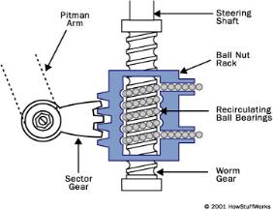
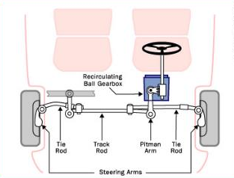
Steering Control
Recirculating-ball Steering
Consists of a metal gear box that has a threaded hole in it that allows transition along a worm gear.
  A worm gear is used when large gear reduction is needed.
This box has gear teeth cut into the outside, which engages a gear that moves the pitman arm.
The steering wheel connect to a threaded rod, which is inserted into the gear box.
  When turned, the box moves, instead of the fixed rod, which moves the gear that turns the wheels.
All of the threads in the box are filled with ball bearings, so there is no direct thread contact.
  These bearings reduce friction, wear and slop in the gear.
Andrew Galan
Notes:
Slop would be felt when you change the direction of the steering wheel -- without the balls in the steering gear, the teeth would come out of contact with each other for a moment, making the steering wheel feel loose.

Slide 23
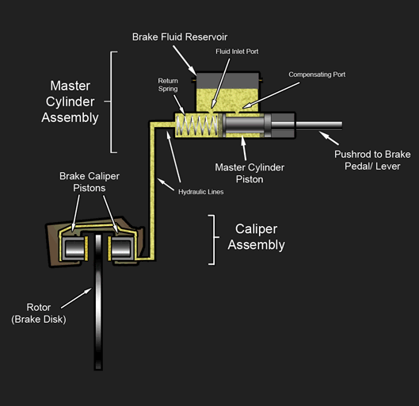
Braking System
Hydraulic Disc Brakes
The main components of a disc brake:
  Brake pads
  Caliper
  Rotor
System Operations
The brake pads squeeze the rotor and force is transmitted hydraulically.
Friction between the pads and the disc slows the disc down.
The brakes convert the kinetic energy to heat generated by the friction between the pads and the disc.
Andrew Galan

Slide 24
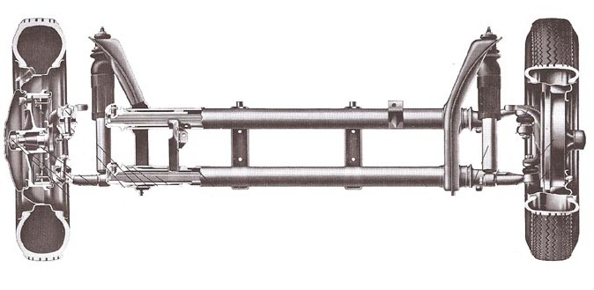
Alternative Solution
Front Beam Axle of VW Beetle
The front axle is a rigid beam providing:
  Suspension, steering, and rotational movement
Already mounted steering gearbox and linkage.
The axle beam tubes contain the torsion bars and their bearings and mounts.
Shock absorbers are mounted as well, that will add a suspension unit to the pedibus.
By using an already constructed front axle frame, the handling will be that more of a car and less like a bicycle.
Andrew Galan

Slide 25
Future Plans
Andrew Galan

Slide 26
Challenges & Potential Problems
Our current design is well over our budget of $2,000.00 but don’t yet know by how much.
At full capacity the bus weighs ~2500lb. It will be difficult to peddle up hills without electric motor assist.
Andrew Galan

Slide 27
References
Pedal Crawler | Custom Party Bike Manufacturer. 2013. Pedal Crawler | Custom Party Bike Manufacturer. http://www.pedalcrawler.com/.
The Party bike http://www.thepartybike.com/index.php/the-party-bike/.
PedalPub. The Bike with the Barrel. 2013. PedalPub. The Bike with the Barrel. http://www.pedalpub.com/.
http://www.capitalcitypedicabs.com/CCPedicabs/home.html
Pedibus - Beer bike, pubcrawler, pedibus, bike bar, cycle pub, cycling pub, cycling bar, bike pub, bike car. http://www.pedibus.co.uk/.
Grainger Industrial Supply - MRO Supplies, MRO Equipment, Tools & Solutions. Grainger Industrial Supply - MRO Supplies, MRO Equipment, Tools & Solutionshttp://www.grainger.com/Grainger/wwg/start.shtml.
http://elementaluminum.tripod.com/id8.html
http://www.totallybamboo.com/c27/About-Bamboo.htm

