Slide 1
Self-Stabilizing Pool Table
Team 19 Group Members:
Norman Gross & Alexander York
Advisor: Keith Larson
2/13/2014

Slide 2
Project
Notes:
Beyond Innovation has the solution to this problem. A prototype is being developed to reduce the footprint of the pool table by up to 75%. This will give the table a capability of vertically stowing itself in a discrete housing in case the additional space is needed. Along with its storage ability, the table will also have a self-stabilization feature that levels the slate-top to have a perfectly horizontal playing field. The design of this table will have both the look and the feel of a standard slate pool table.

Slide 3
Project Scope
Reduce the footprint by 75%
Vertically Stowable
Self-Stabilizing
Notes:
Beyond Innovation has the solution to this problem. A prototype is being developed to reduce the footprint of the pool table by up to 75%. This will give the table a capability of vertically stowing itself in a discrete housing in case the additional space is needed. Along with its storage ability, the table will also have a self-stabilization feature that levels the slate-top to have a perfectly horizontal playing field. The design of this table will have both the look and the feel of a standard slate pool table.

Slide 4
Housing Concept
Housing
Internal Frame
Steel
External Frame
Wood
Potential Challenges

Slide 5
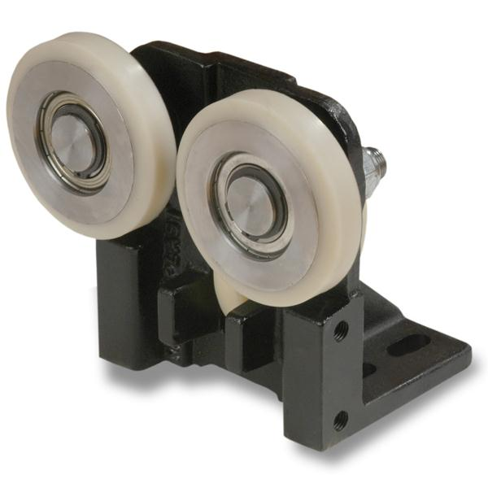
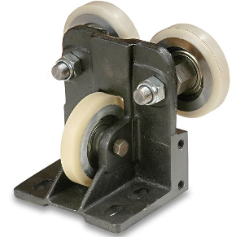
Lifting Concept
Lifting Mechanism
Linear Guides
Seen on elevators
Guide Rails
Minimize moments
Hooking arms

Slide 6
Transition Concept
Notes:
Show all angles of transition

Slide 7
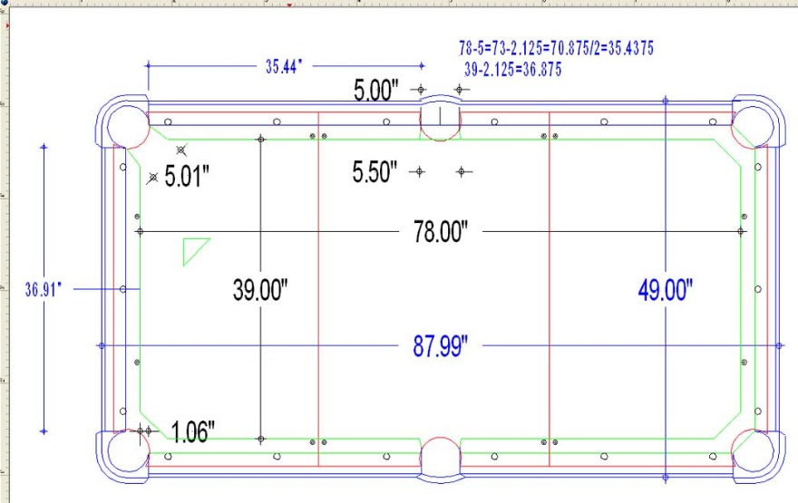
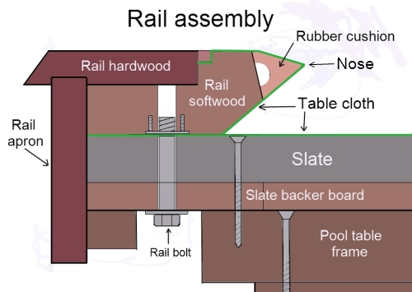
Prototype Specs
Engineering Specs
750lb max weight
7ft x 3.5ft

Slide 8
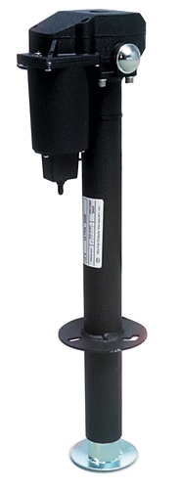
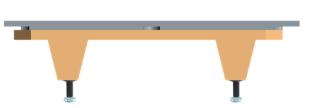
Table Concept
Table
4 linear actuators
4 XY Inclinometer sensors
Microcontroller

Slide 9
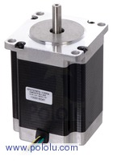
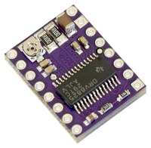
Linear Actuators
Original Setup:
4 DC Motors
No encoders
Limited accuracy during leveling
Corrected Setup:
4 “Four Phase NEMA 23” Stepper Motors
Increased accuracy
Smaller power consumption
Higher Hold Torque rating
Each phase draws 1 A at 8.6 V
Holding torque of 14 kg-cm (190 oz-in)
Can be used as a unipolar or bipolar stepper motor
Has a 1.8° step angle 200 steps/rev

Slide 10
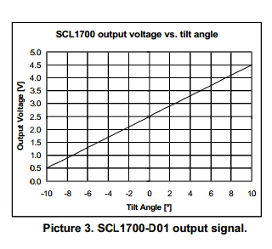
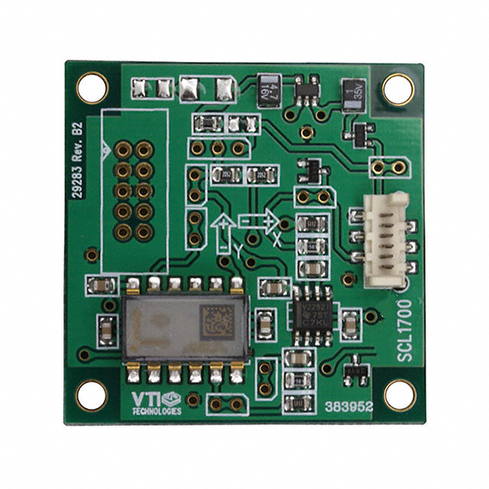
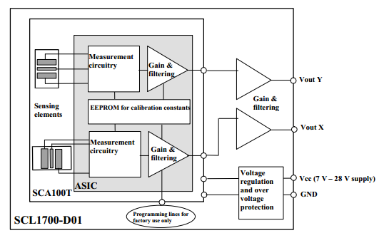
XY Inclinometer
4 XY Inclinometer sensors
2 pairs each identically oriented on opposite sides of the table; using each other and gravity as reference points
Resistive Sensors
Operates on 5V Logic
Analog Output

Slide 11
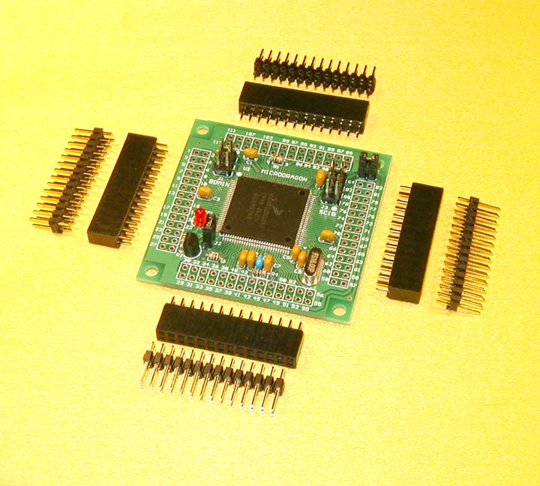
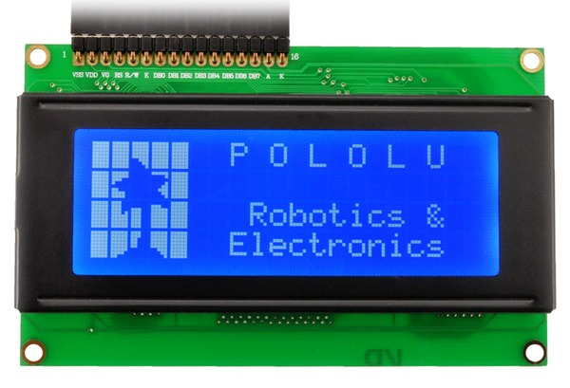
Microcontroller
Micro Dragon Microcontroller
Processing:
16 MHz crystal, 8 MHz default bus speed and up to 25MHz bus speed via PLL
Pre-installed with Serial Monitor for CodeWarrior
91 of MC9S12DG256 I/O pins are accessible on male header connectors for user applications
MCU also includes the following peripherals:
3 SPIs
2 SCIs
2 CANs
I²C interface
8 16-bit timers
8 PWMs
16-channel 10-bit A/D converter

Slide 12
Leveling Control

Slide 13
Current Progress

Slide 14
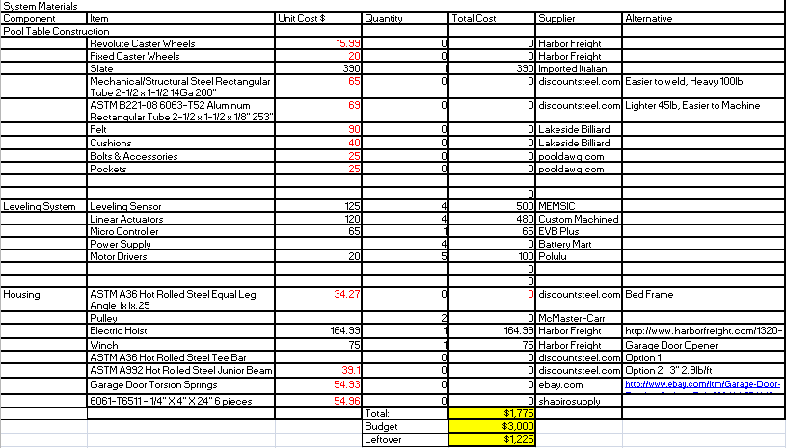
Procurement

Slide 15
Future Plans
Develop leveling system
Testing
Create table frame
Construct housing and lift assembly
Finalize system controls

Slide 16
Project Timeline

Slide 17
Questions

Slide 18
Citation
http://muller.lbl.gov/teaching/H7B/pages/ElasticModuliTable.htm
http://www.pianoworld.com/faq.htm

