Slide 1

Self-Stabilizing Pool Table
Team 19 Group Members:
Norman Gross & Alexander York
Advisor: Keith Larson
3/20/2014

Slide 2

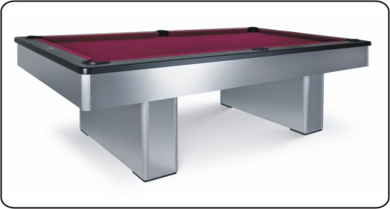
Motivation
Notes:
Beyond Innovation has the solution to this problem. A prototype is being developed to reduce the footprint of the pool table by up to 75%. This will give the table a capability of vertically stowing itself in a discrete housing in case the additional space is needed. Along with its storage ability, the table will also have a self-stabilization feature that levels the slate-top to have a perfectly horizontal playing field. The design of this table will have both the look and the feel of a standard slate pool table.

Slide 3
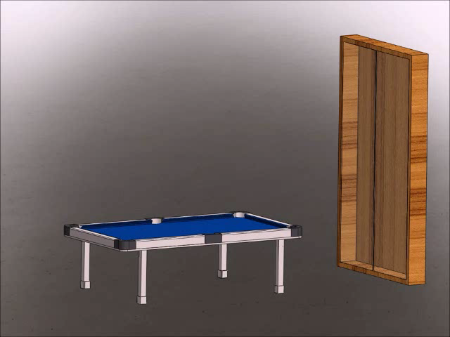
Project Scope
Reduce the footprint by 75%
Vertically Stowable
Self-Leveling
Notes:
Beyond Innovation has the solution to this problem. A prototype is being developed to reduce the footprint of the pool table by up to 75%. This will give the table a capability of vertically stowing itself in a discrete housing in case the additional space is needed. Along with its storage ability, the table will also have a self-stabilization feature that levels the slate-top to have a perfectly horizontal playing field. The design of this table will have both the look and the feel of a standard slate pool table.

Slide 4
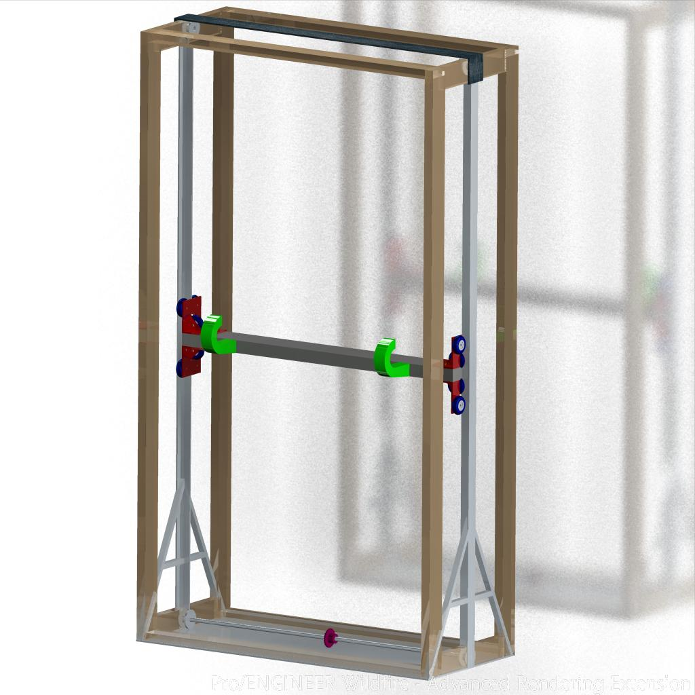
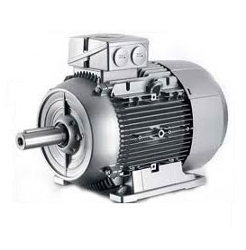
Stowing
Housing
Internal Frame
  Steel
External Frame
  Wood
AC Motor
  Waterjet Sprockets
  Chain Driven
Notes:
Discuss Motor selection for lifting mechanism

Slide 5
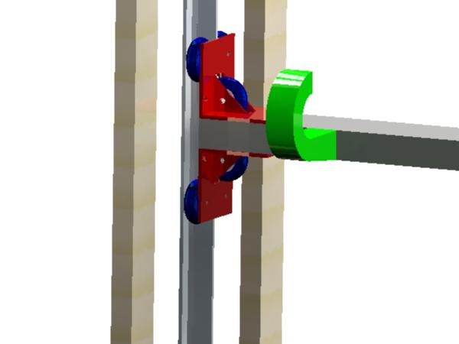
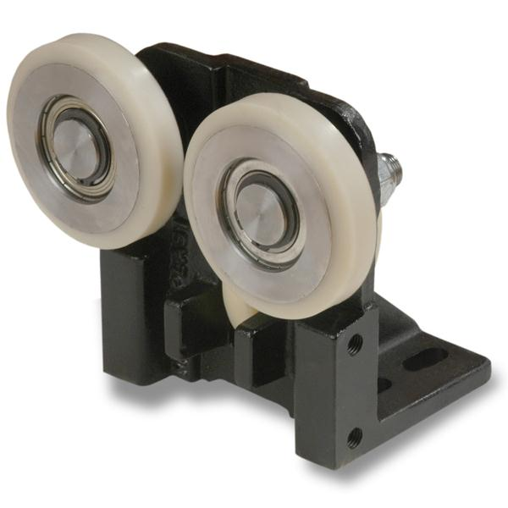
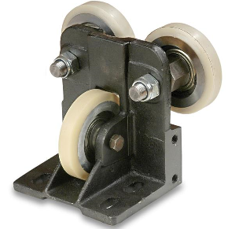
Stowing
Lifting Mechanism
Linear Guides
  Seen on elevators
Guide Rails
  Minimize moments
Hooking arms

Slide 6
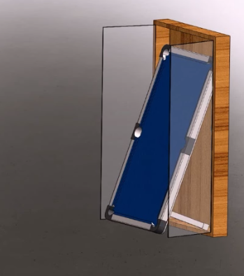
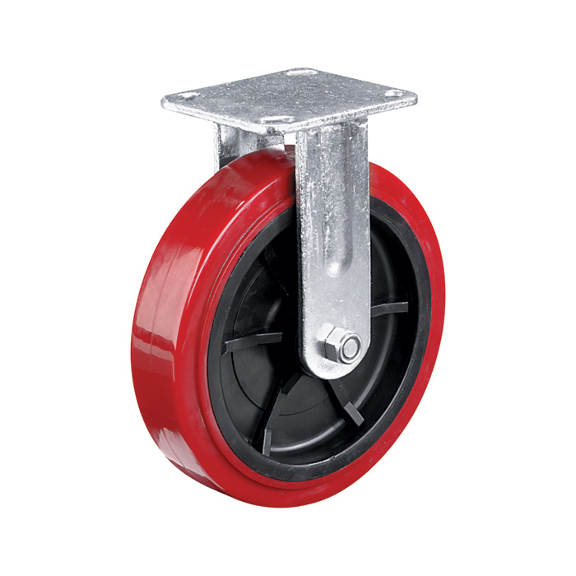
Transition
Notes:
Show all angles of transition

Slide 7
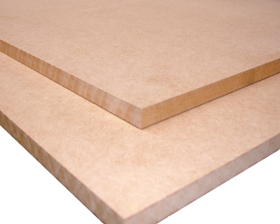
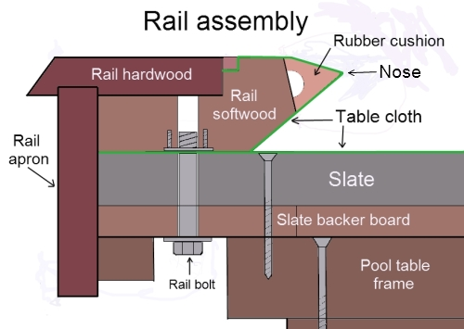
Prototype Specs
Engineering Specs
  750lb max weight
  7ft x 3.5ft
Notes:
MDF is a uniform density panel with a fine and smooth surface ideal for shaping and routing. MDF can be easily painted, cut, machined and cleanly drilled without splintering or chipping.

Slide 8
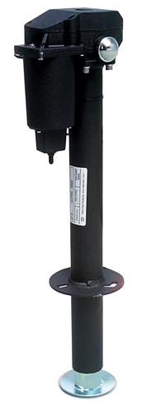
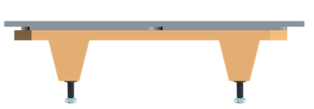
Table
Table
4 linear actuators
4 XY Inclinometer sensors
Microcontroller

Slide 9
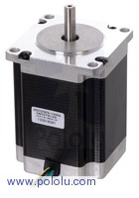
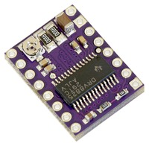
Linear Actuators
Original Setup:
4 DC Motors
  No encoders
  Limited accuracy during leveling
Corrected Setup:
4 “Four Phase NEMA 23” Stepper Motors
  Increased accuracy
  Smaller power consumption
  Higher Hold Torque rating
Each phase draws 1 A at 8.6 V
Holding torque of 14 kg-cm (190 oz-in)
Can be used as a unipolar or bipolar stepper motor
Has a 1.8° step angle 200 steps/rev

Slide 10
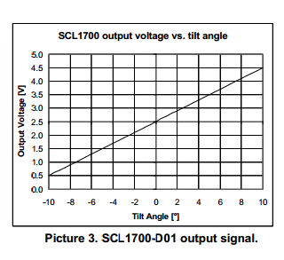
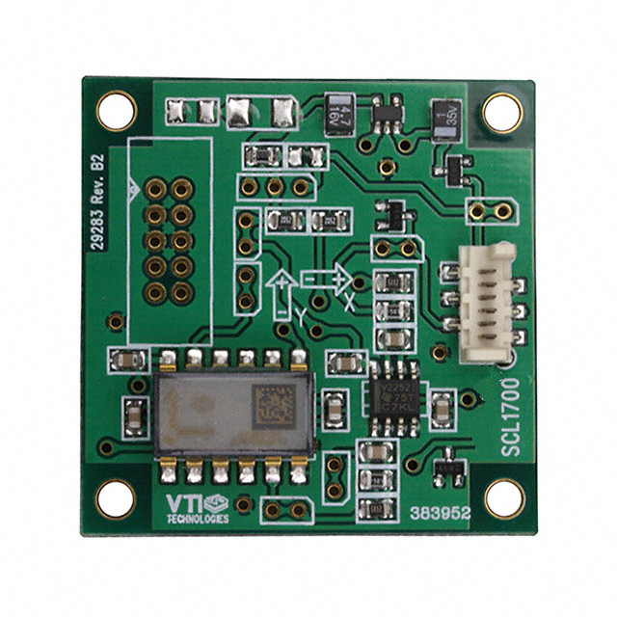
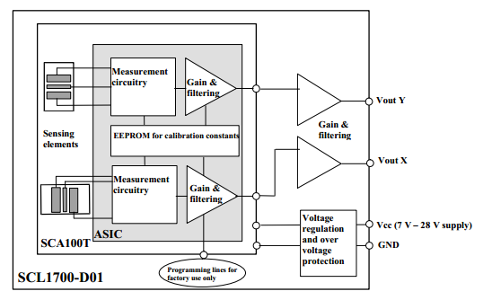
XY Inclinometer
4 XY Inclinometer sensors
  2 pairs each identically oriented on opposite sides of the table; using each other and gravity as reference points
Resistive Sensors
Operates on 5V Logic
Analog Output

Slide 11
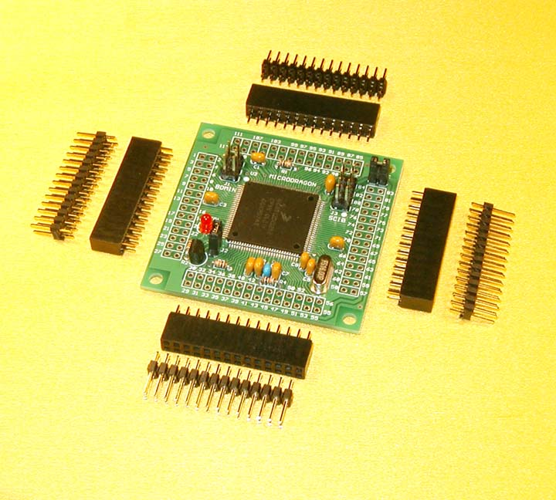
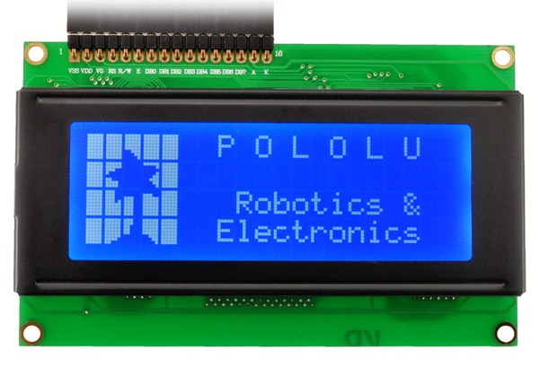
Microcontroller
Micro Dragon Microcontroller
Processing:
16 MHz crystal, 8 MHz default bus speed and up to 25MHz bus speed via PLL
Pre-installed with Serial Monitor for CodeWarrior
91 of MC9S12DG256 I/O pins are accessible on male header connectors for user applications
MCU also includes the following peripherals:
  3 SPIs
  2 SCIs
  2 CANs
  I²C interface
  8 16-bit timers
  8 PWMs
  16-channel 10-bit A/D converter

Slide 12
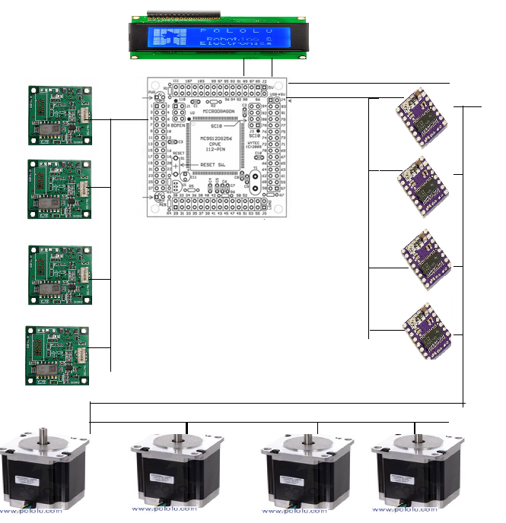
Leveling Control

Slide 13
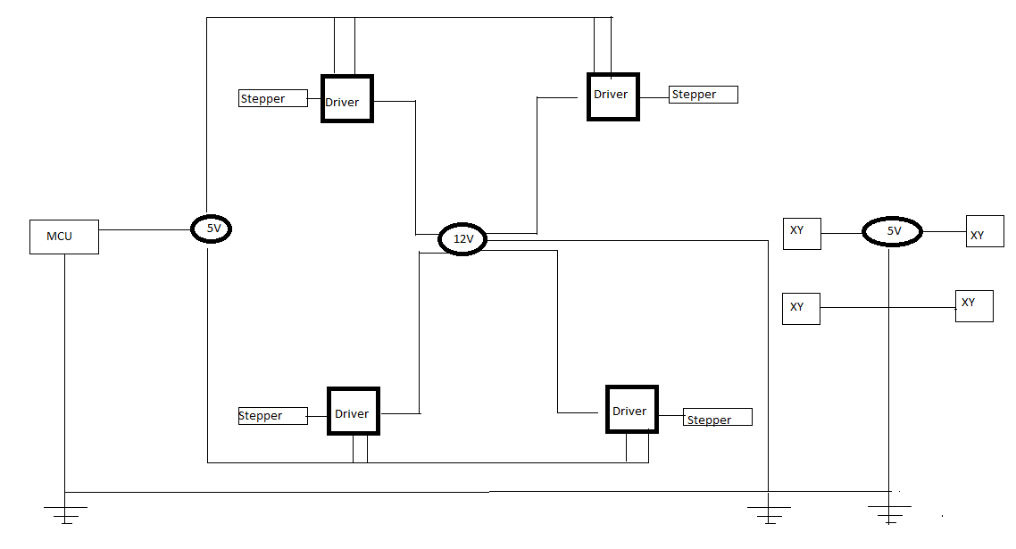
Power Consumption

Slide 14
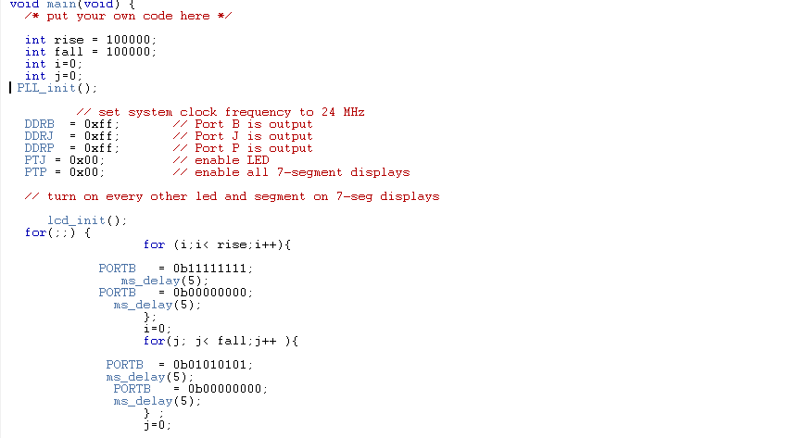
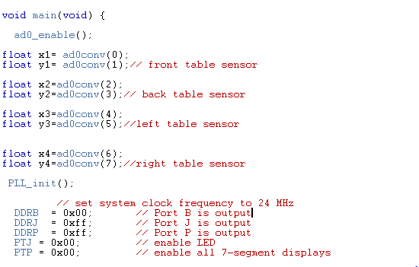
Current Progress
Motor Control
Sensor Control

Slide 15
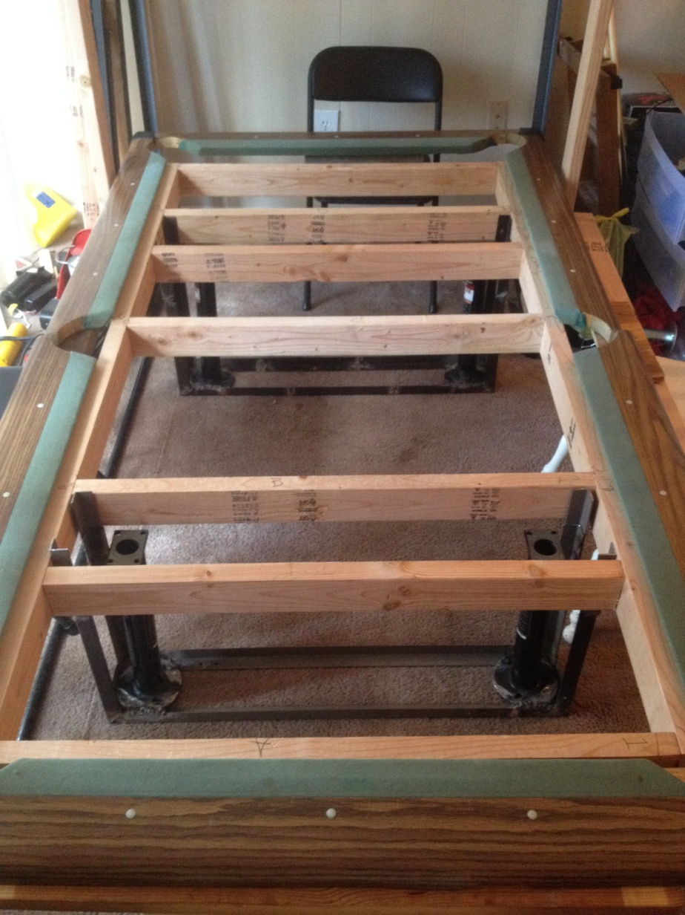
Current Progress

Slide 16
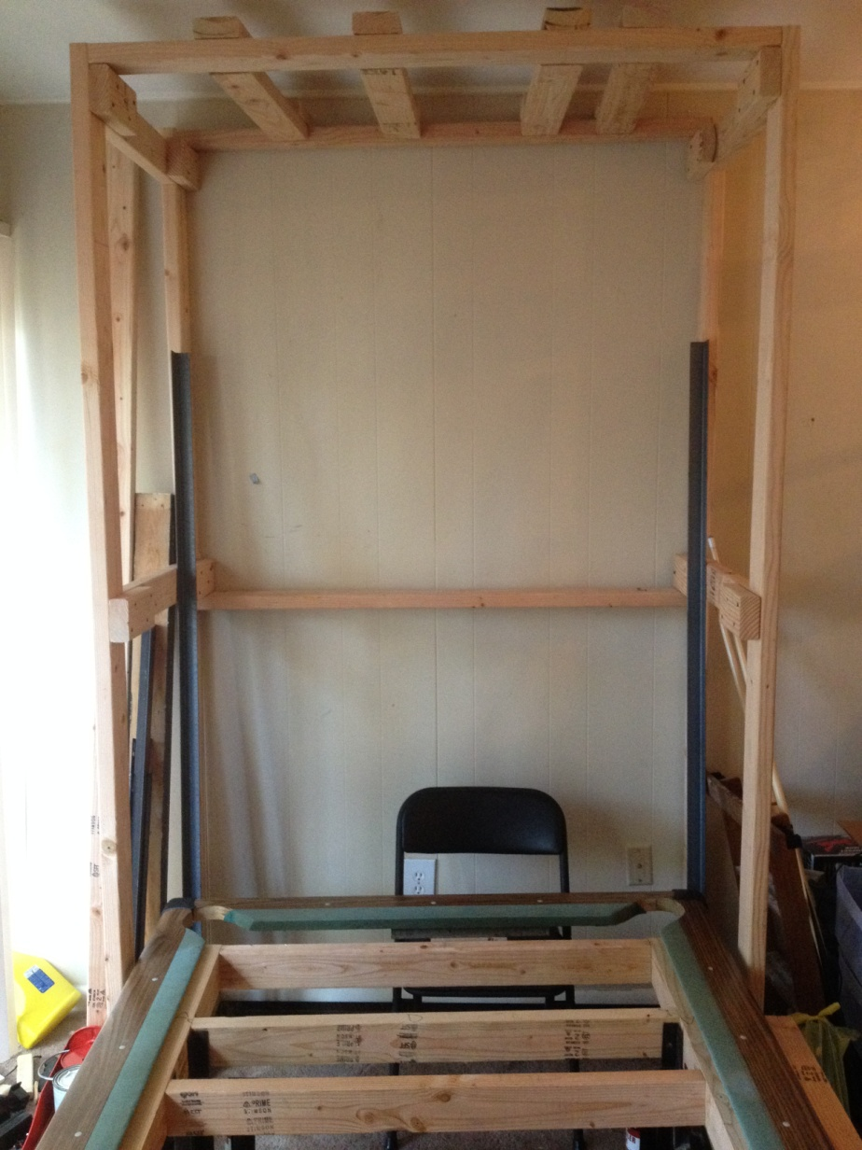
Current Progress

Slide 17
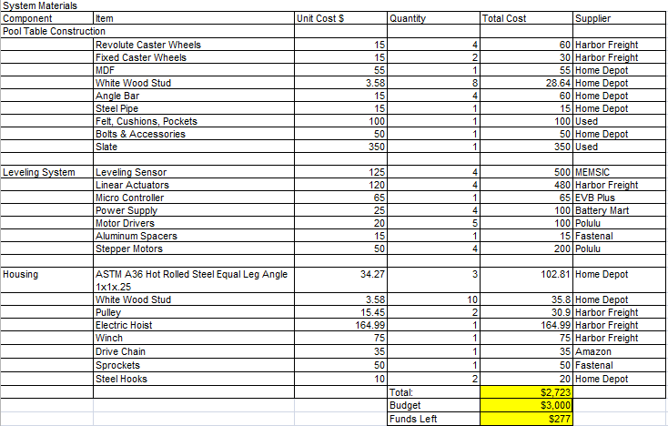
Procurement

Slide 18
Future Plans
Develop leveling system
  Testing
Finish table frame
Finish housing and lift assembly
Finalize system controls

Slide 19
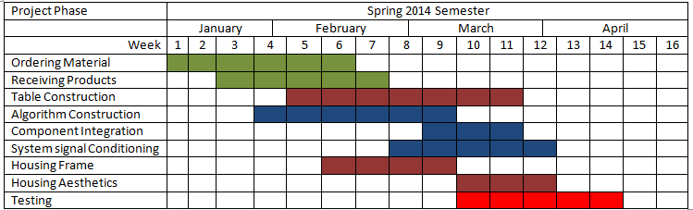
Project Timeline

Slide 20
Questions

Slide 21
Citation
http://muller.lbl.gov/teaching/H7B/pages/ElasticModuliTable.htm
http://www.pianoworld.com/faq.htm

