Slide 1


#20 - Direct Drive Solar Powered Arcjet Thruster
Sponsor – NASa, marshall space flight center, Huntsville al
Advisors – dr. guo, dr. kwan, dr. Andrei
Senior design coordinators – Dr. amin, dr. frank
Team Members
Date – 3/18/14
Chris Brolin - ME
Cory Gainus - ME
Gerard Melanson - ECE
Tara Newton - ME
Griffin Valentich - ME
Shane Warner - ECE
Griffin Valentich

Slide 2
Agenda
    Background
    Sponsor Requirements/Objectives
    Final Design
      Mechanical
      Electrical
    Testing Overview
    Procurement
    Future Plans
    Gantt Chart
Griffin Valentich

Slide 3
Background
Propulsion Systems
Chemical Propulsion
Electrical Propulsion
Ion Thrusters
Electrodynamic Tethers
Solid Fuel
Cold Gas
Liquid Fuel
Arc Jet
MPD
Griffin Valentich

Slide 4
Background
Electrical Propulsion Systems
    High specific impulse – low thrust
  Electro-thermal thruster– arcjet
    Produce thrust by heating gas propellant (Ar) and expelling through C-D Nozzle
  Electromagnetic thruster – MPD
    Accelerates particles with applied magnetic force
Purpose of Electric Propulsion Systems
  Station keeping – lower overall lifetime costs
  Satellite altitude and attitude adjustment
  Potential for deep space applications
Power Processing Unit (PPU)
    Expensive and complex
  Largest prohibitive component to electronic propulsion systems
  Converts input power to correct current and voltage
Griffin Valentich

Slide 5
Sponsor Requirements / Objectives
Eliminate the PPU
  Enable thruster to operate in Direct-Drive Mode
  Obtain power directly from solar panels
Design, manufacture, and test an arcjet thruster
  Utilize permanent magnets to confine focus ion stream to increase thrust
  Independently control propellant flow
  Design mounting apparatus and a workable vacuum chamber
  Measure thrust produced
Quantify the range of operating conditions over which thruster is effective at operating continuously
Griffin Valentich

Slide 6
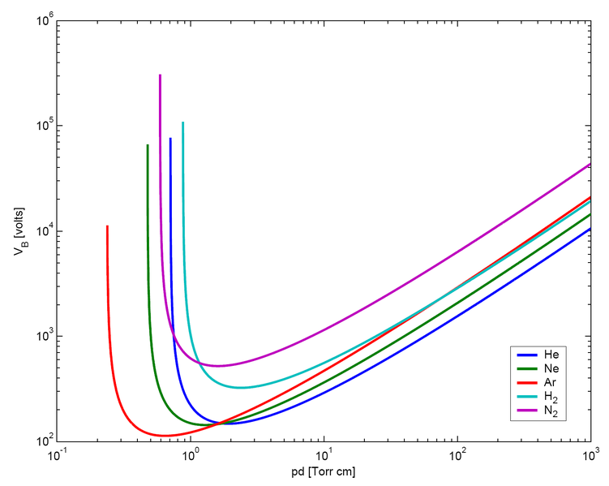
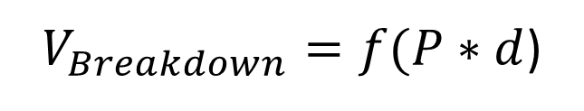

Paschen’s Law
Relates the product of pressure and distance between anode and cathode to the voltage necessary to initiate breakdown
$V_{Breakdown}=f(P∗d$)
Argon had lowest breakdown voltage
$$\sim 137 V$$
Good starting point, but values will be different due to complex geometry
Griffin Valentich

Slide 7
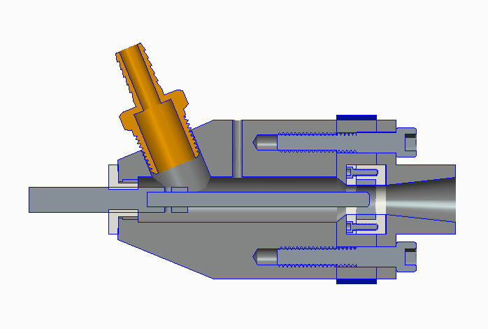
Final Thruster Design
Characteristics
3 part nozzle construction
  Easier machinability
  Designed for Mach 2.65 - A/A* = 3.15
Magnet placed at throat of nozzle to protect nozzle walls
Stagnation Pressure – 550 Pa
Static Pressure at throat – 267 Pa
  Pressures from Bernoulli’s Eq with const. mass flow rate
  P/P₀ = 0.4867, at throat M = 1
Anode/Cathode Spacing – 0.15”
Product of pressure and distance gives breakdown voltage of 137 V
  Well within circuit’s capabilities
Argon Inlet
Cathode Holster
Magnet
Converging Nozzle
Anode Insulation
Cathode Insulation
Chamber
Diverging Nozzle
Cathode
Anode
Cory Gainus

Slide 8
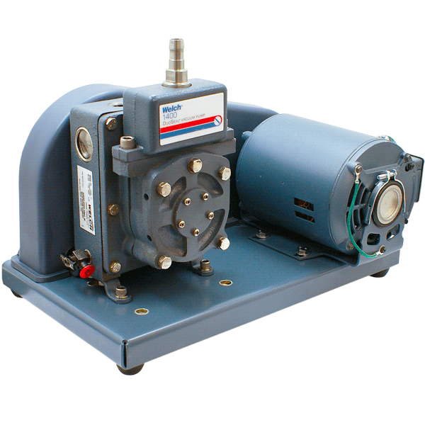
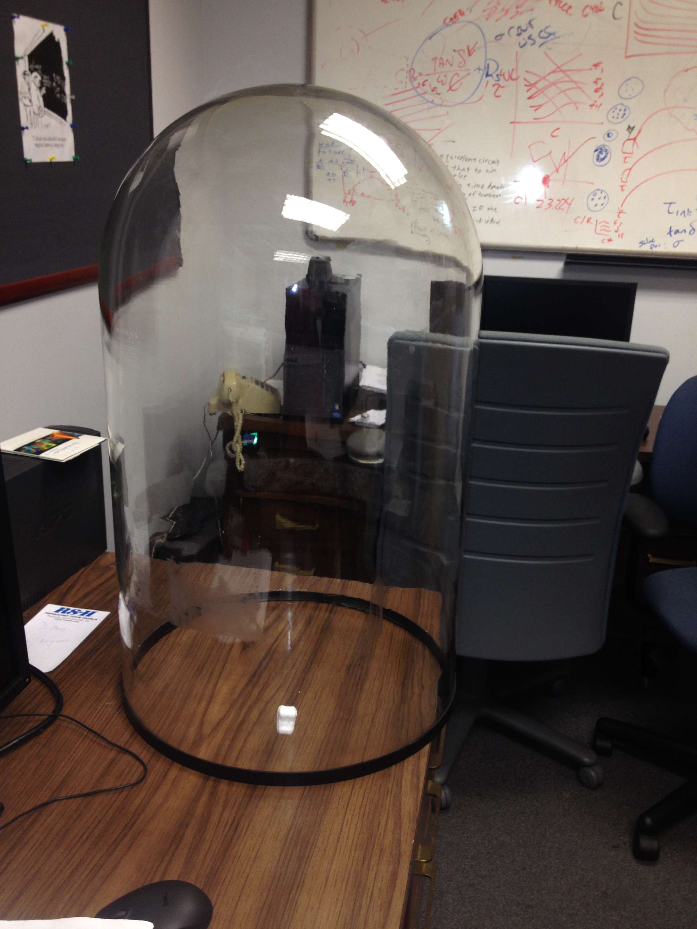
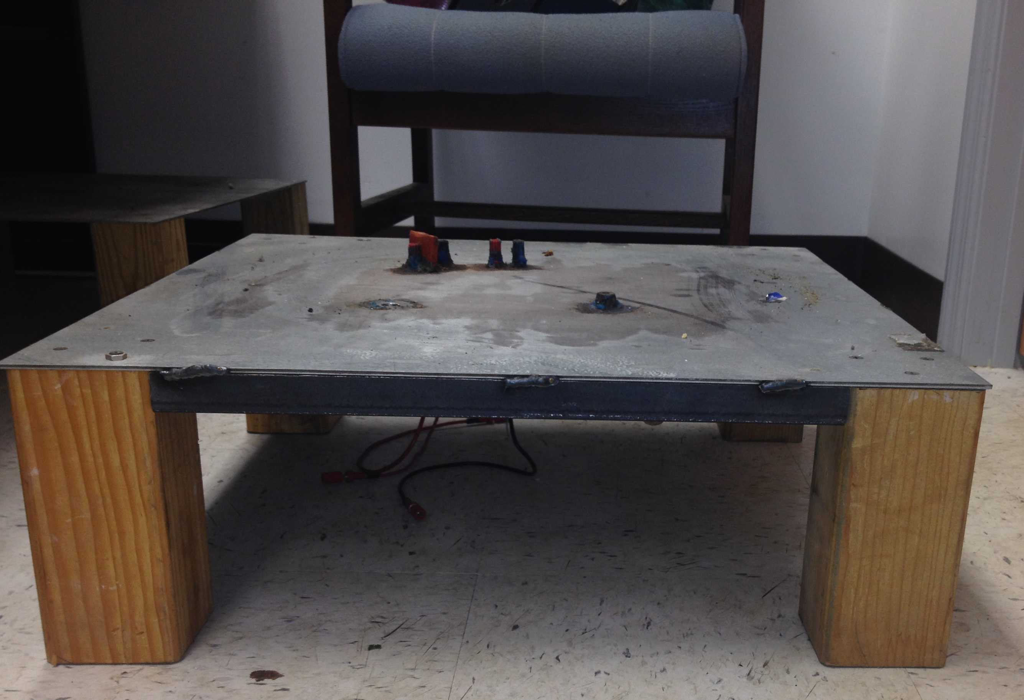
Testing Apparatus
Vacuum Pump
Welch 1400
Vacuum to 1x10⁻⁴ Torr
Baseplate
Borrowed from Dr. Weatherspoon
  Argon and electrical connection input through baseplate
Vacuum Chamber
  Bell Jar
  Borrowed from Dr. Weatherspoon
  Chamber will be evacuated to 1x10⁻⁴ Torr
Cory Gainus

Slide 9
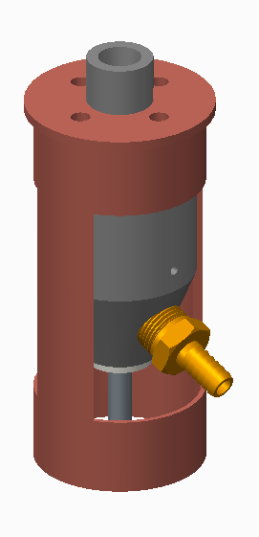
Test Stand
Standard Pipe with cap
  Separate Pieces
Easy to machine
Easily attached to thruster and detached for any required adjustments
Lightweight
Easy to access argon and pressure ports
Adaptable for whatever force measurement equipment is used
Cory Gainus

Slide 10
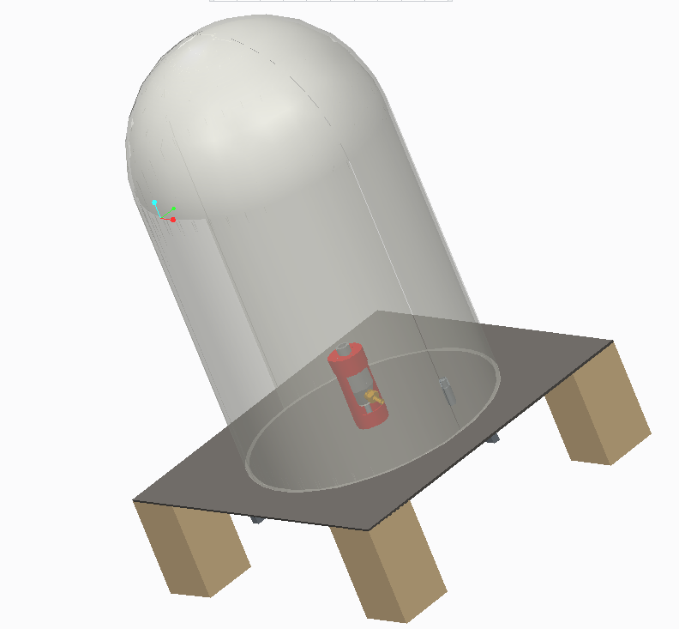
Final Testing Set Up
Square steel tubing reinforced baseplate
Pipes welded for
  Vacuum hose
  Vacuum gauge
  Argon inlet
Wires throughput with stycast epoxy
  Supplied by Dr. Guo
Edges of chamber sealed with vacuum grease
Cory Gainus

Slide 11
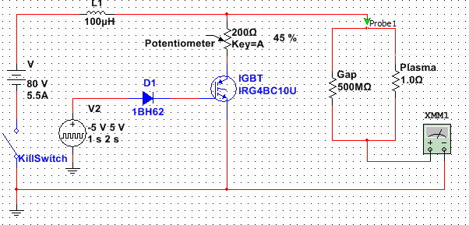
Circuit Alterations
Gerard Melanson

Slide 12
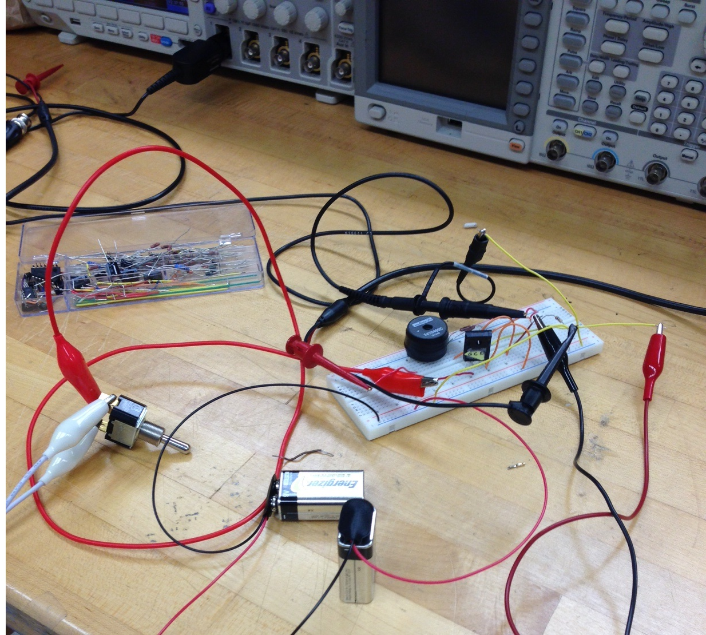
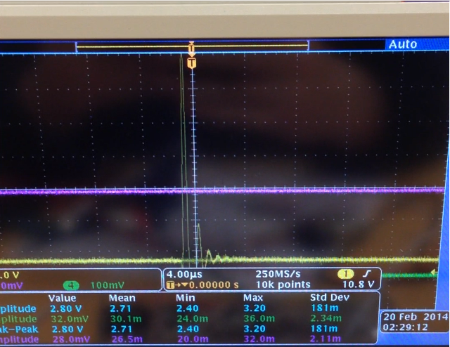
Testing and Results
Approximately 150 V spike at Vsource = 20 V and
Rtop = 50 ohm
Full Circuit Testing
Theoretical max spike
2 kV
Gerard Melanson

Slide 13
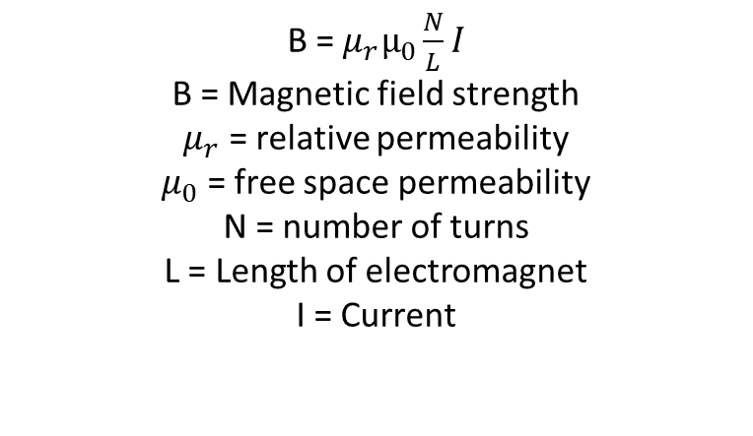
Final Magnet Design
Magnet
B = ${μ_{r}μ}_{0}\frac{N}{L}I$
B = Magnetic field strength
$μ_{r}$ = relative permeability
$μ_{0}$ = free space permeability
N = number of turns
L = Length of electromagnet
I = Current
Gerard Melanson

Slide 14

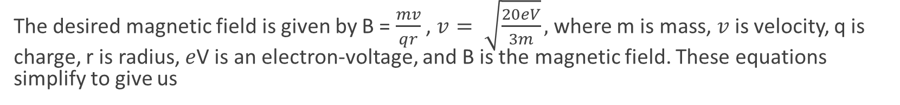

Maximum Magnetic Field
The desired magnetic field is given by B = $\frac{mv}{qr}$ , $v= \sqrt{\frac{20eV}{3m}},$where m is mass, $v$ is velocity, q is charge, r is radius, $e$V is an electron-voltage, and B is the magnetic field. These equations simplify to give us
$$B=0.316 T$$
Now the current and number of turns we need is given by:
$$NI=\frac{LB}{μ_{r}μ_{0}}=4790 (A−turns)$$
Gerard Melanson

Slide 15
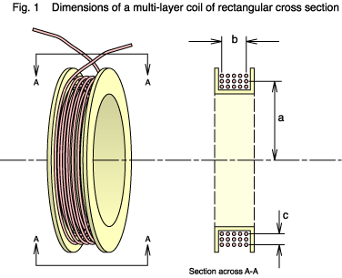
Magnet Design
Max Current = 5 A
Length = 0.01905 m
Diameter of 22 gauge wire =0.0017 m
Number of loops per layer = 11
Absolute max field = 0.316 T = 4790 A-turns
Typical ideal field = 0.050 T = 758 A- turns
At least 14 layers needed
Coat with layer of insulation between wire layers
Gerard Melanson

Slide 16
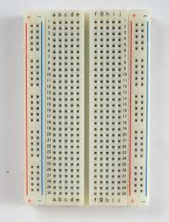
Circuit Testing and Finalization
We are currently designing the PCB on Eagle now that the design has been finalized
Gerard Melanson

Slide 17

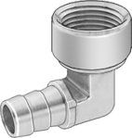

Procurement
Through baseplate hardware
Component | Part # | Quantity | Cost
Threaded Pipe Nipple | 44615K462 | 2 | $3.24
Vacuum Hose Fitting 90 deg | 5346K125 | 1 | $10.20
Coupling for Vacuum Gauge | 4429K111 | 1 | $5.70
 |  | Total | $19.14
Remaining hose fitting and poly flow hose will be supplied by sponsor
Remaining Budget – $130.74
Griffin Valentich

Slide 18
Future Plans
Machining baseplate
  Mounting apparatus completed
  Weld tubes and attach appropriate fittings
Test vacuum chamber and leak proof connections and through holes
Measure resistance of plasma
  Determine whether to insert additional resistor or transconductance amplifier
Determine thrust output and range of operating conditions
Acquire Printed Circuit Board
Griffin Valentich

Slide 19
Gantt Chart
Griffin Valentich

Slide 20
Questions?

