Slide 1


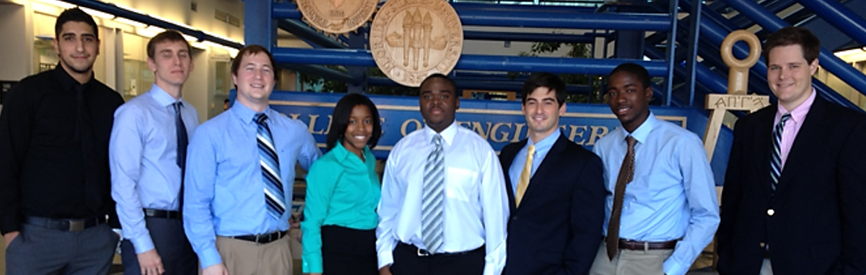
Shell Eco-Marathon
FAMU-FSU 2014 Solar Car
Milestone #3 Presentation
Team #2

Slide 2

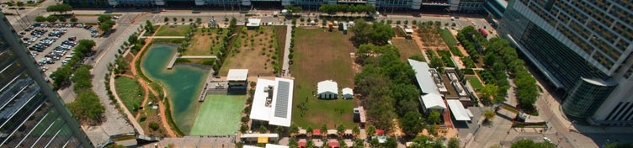
Introduction
Registration Update
General Problem Statement
General Solution Approach
Operating Environment
Intended Use(s)/User(s)
Shell Stock Image Database
Race Track (Operating Environment)
Francois Wolmarans

Slide 3
Presentation Overview
Scheduling and Progress
Comparison Matrix
Mechanical Overview
  Mechanical Components
Electrical Overview
  Electrical components
Budgeting

Slide 4
Scheduling & Progress
Components Completed on Schedule
Additional Components Completed
Incomplete Components
Removed Components
Phases
Scheduling Risks
  Ordered Parts
  Required Equipment

Slide 5
Presentation Overview
Introduction and Registration Update
Scheduling and Progress
Comparison Matrix
Mechanical Overview
  Mechanical Components
Electrical Overview
  Electrical components
Budgeting

Slide 6
Comparison Matrix
Design Options | Safety (0.432) | Cost (0.208) | Component Weight (0.187) | Implementation (0.173) | Total
Design 1 | 2 | 1 | 1 | 2 | 1.605
Design 2 | 1 | 2 | 2 | 1 | 1.395
Weight Legend:
Safety = 0.432
Cost = 0.208
Weight = 0.187
Implementation = 0.173
Optimization Legend:
1 least optimal
Higher values correspond to a relatively more optimal solution
Jose Cardenal

Slide 7
Presentation Overview
Introduction and Registration Update
Scheduling and Progress
Comparison Matrix
Mechanical Overview
  Mechanical Components
Electrical Overview
  Electrical components
Budgeting

Slide 8
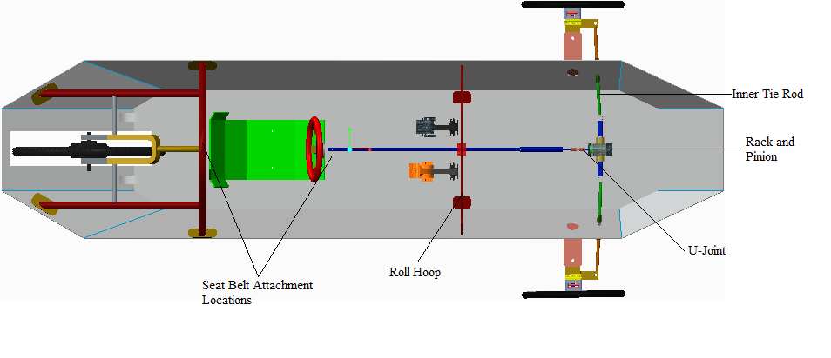
Mechanical Overview
James Croasmun

Slide 9
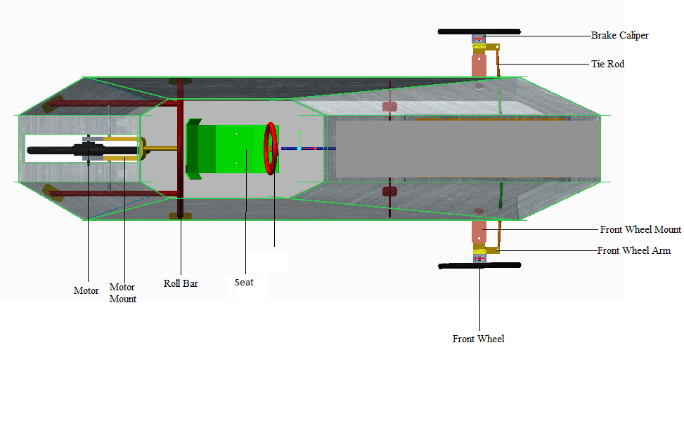
Mechanical Overview

Slide 10
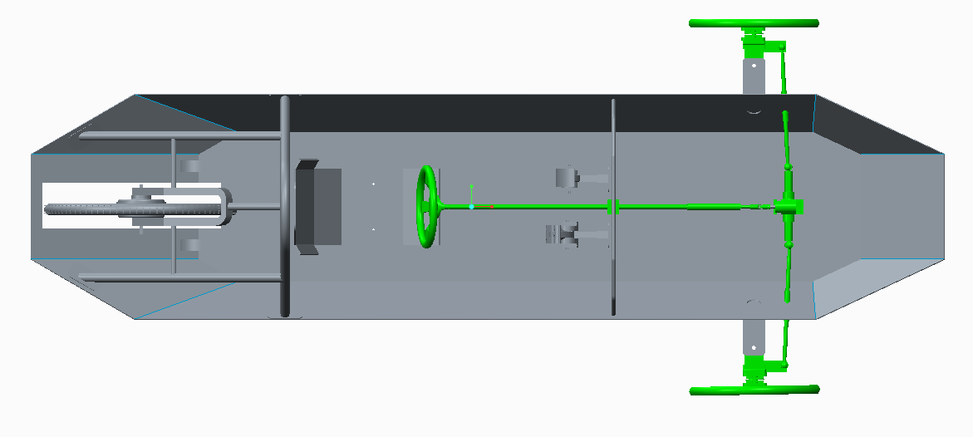
Steering System
James Croasmun

Slide 11
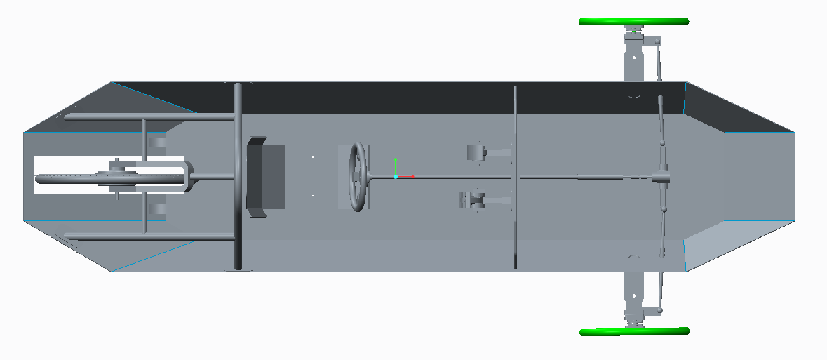
Front Wheels
James Croasmun

Slide 12
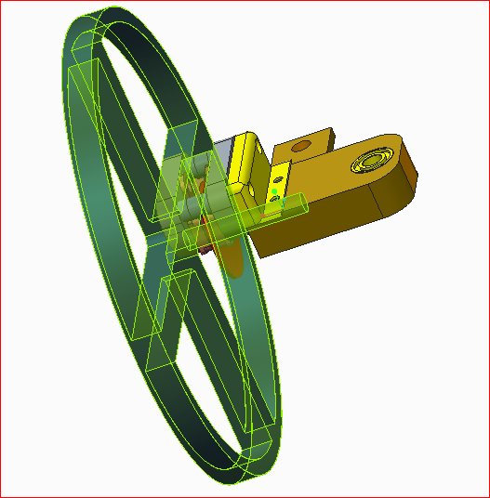
Front Wheels
Bicycle Tires
Wheel Hubs have preinstalled bearings
Connects easily to steering assembly
0.5” hub bolt can handle all applied forces
Safety Factor of 20.2 for aluminum 0.5” diameter hub bolt
Front Wheels
James Croasmun

Slide 13
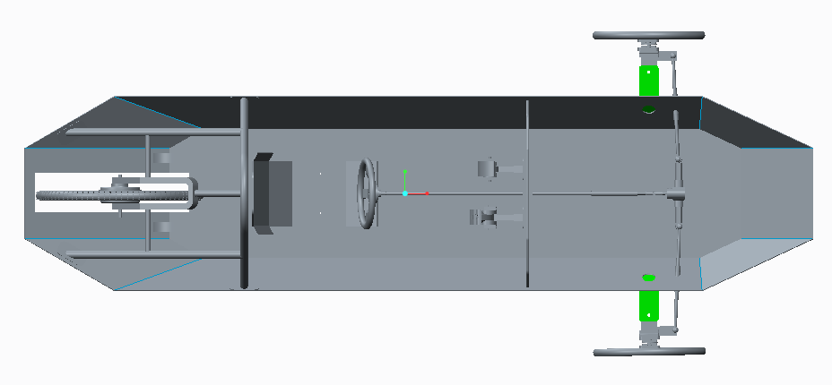
Front Wheel Mounts
James Croasmun

Slide 14
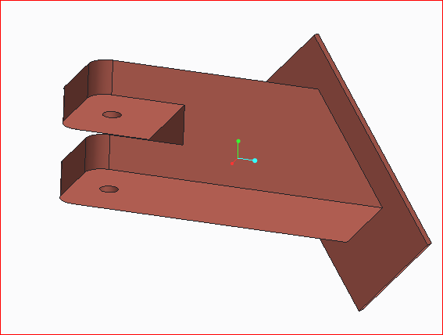
Front Wheel Mounts
Simple design can be machined in house
Can handle all applied forces with a factor of safety of 30.49
Dimensions: 1.5”x1.5”x0.25”
Front Wheel Mounts
James Croasmun

Slide 15
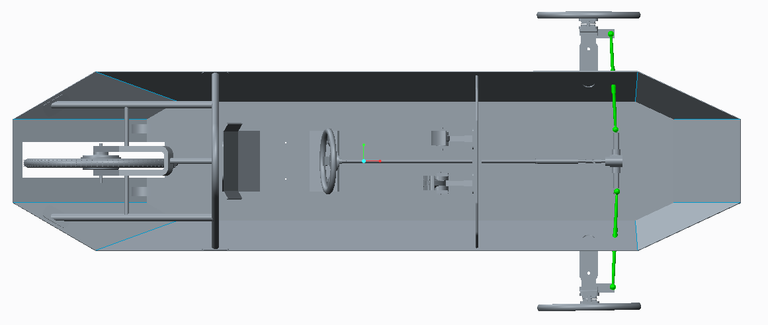
Tie Rods
Wael Nabulsi

Slide 16
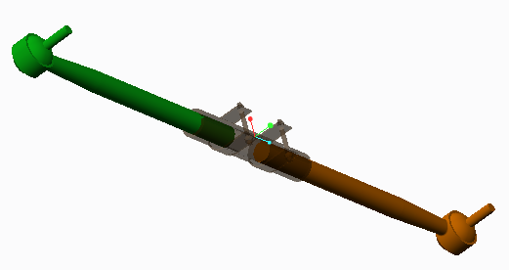
Tie Rods
Adjustable length
Easy to install
Low cost
Light weight
Adjustable Tie Rods
Wael Nabulsi

Slide 17
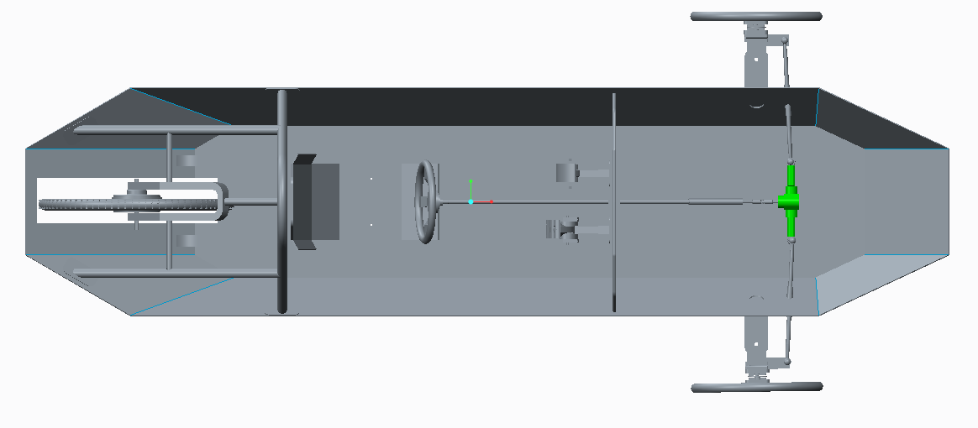
Rack and Pinion
Wael Nabulsi

Slide 18
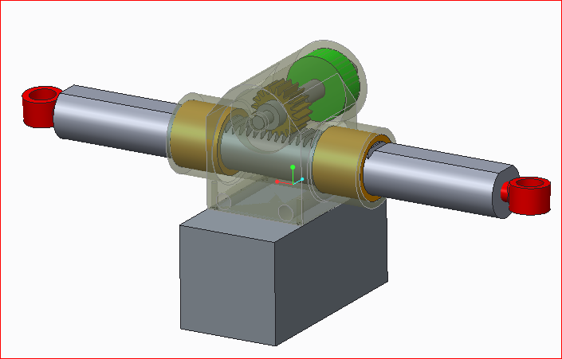

Rack and Pinion
Required rack travel distance of 4.87 in
Decreases input force to steer the vehicle
Increased vehicle safety
$Sin\left(αη\right)=$(Track length) /
(wheel arm length)
Rack and Pinion
Wael Nabulsi

Slide 19
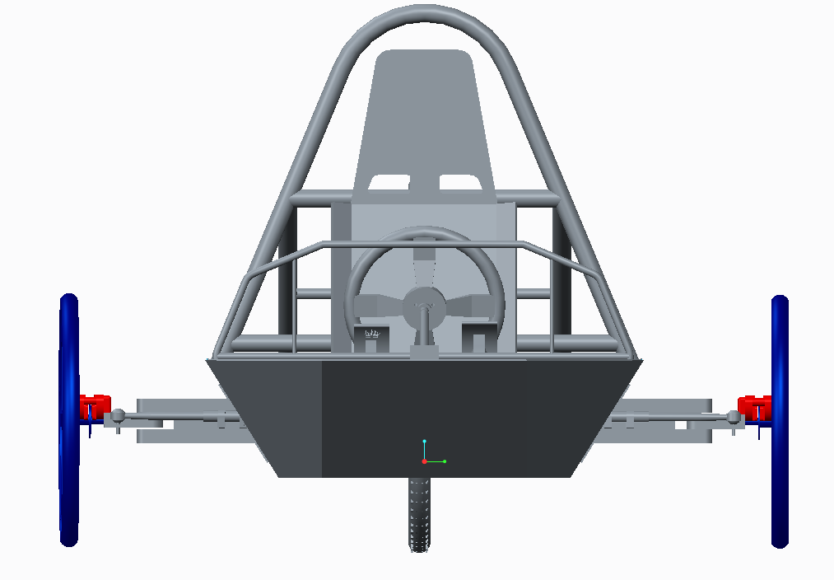
Front Braking System
Wael Nabulsi

Slide 20
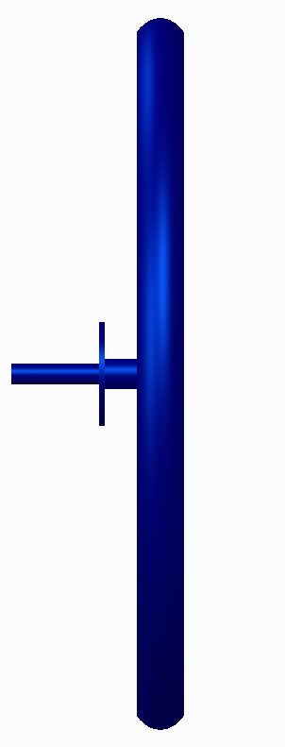
Front Wheel Rotor
Enables the use of calipers
Front wheel rotor width, determined by braking caliper
Secured to front wheel
Allows for higher braking forces
Can be built in house or come attached to front wheel hub
Front Wheel Rotor
Wael Nabulsi

Slide 21
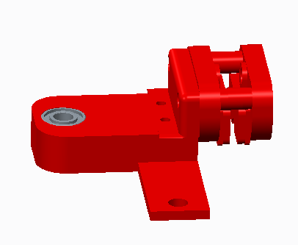
Calipers
Higher stopping forces than bicycle brakes
Utilizes a simple mounting system
Requires balancing for stopping forces on each front wheel
Calipers
Wael Nabulsi

Slide 22
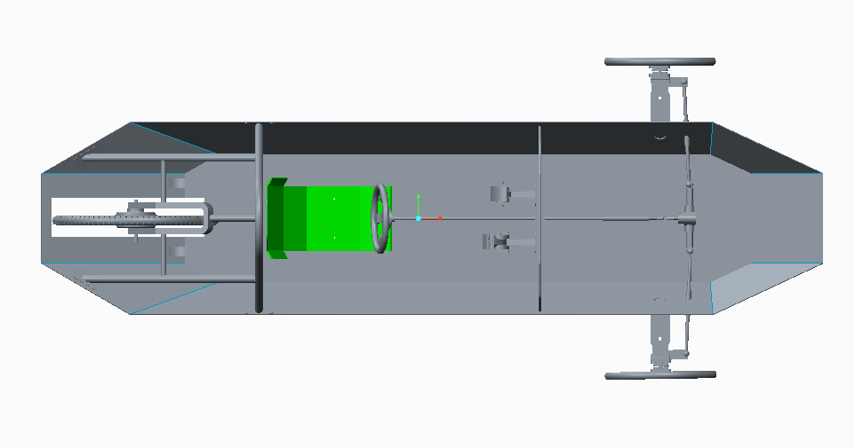
Solar Car Seat
David Jolicoeur

Slide 23
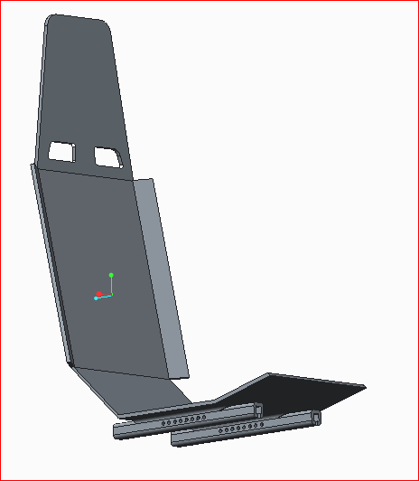
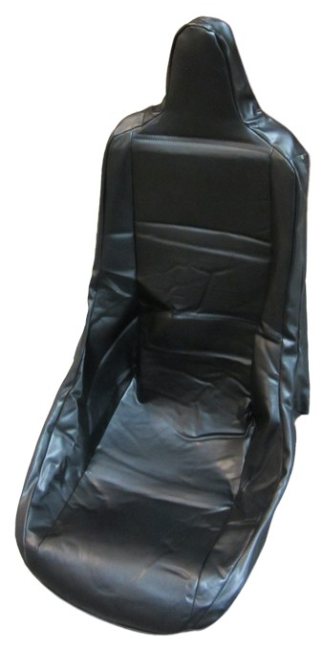
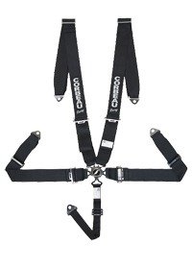
Solar Car Seat
Standard 20 ° layback position
Design will be mounted on rails
All team members will be capable of driving the vehicle
5-Point Harness
Padding
Seat Design
http://www.bmikarts.com/Seat-Cover-for-Yerf-Dog-Spiderbox-_p_1258.html
http://corbeau.com/products/harness_belts/3-inch_5-point_harness_belts/
David Jolicoeur

Slide 24
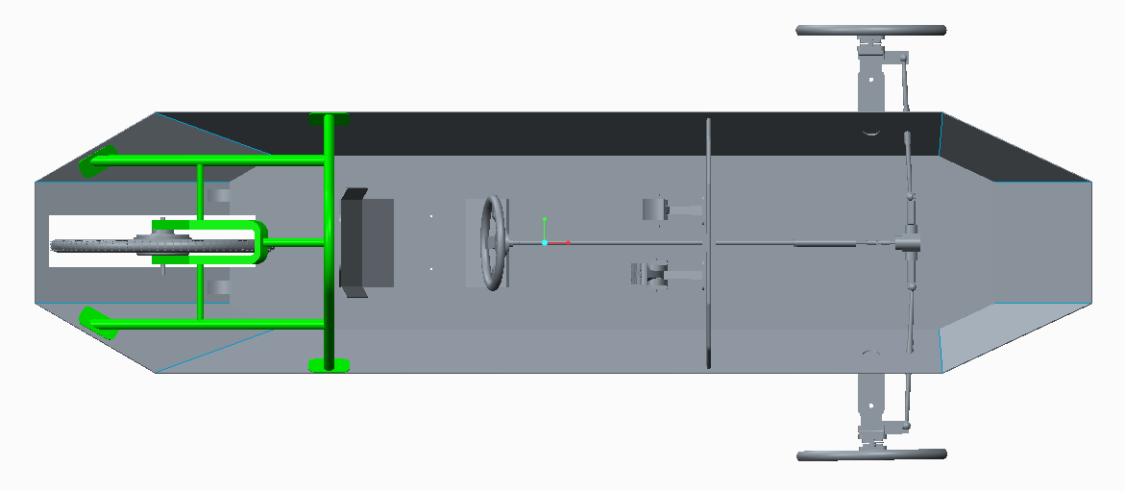
Roll Bar & Motor Mount
David Jolicoeur

Slide 25
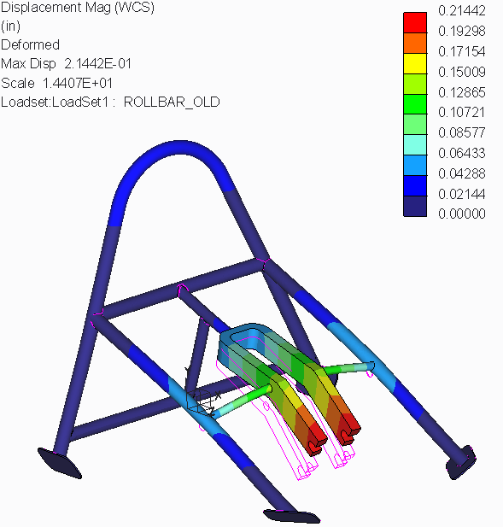
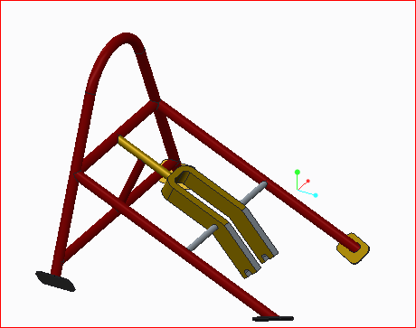
Roll Bar & Motor Mount
Meets all requirements for the competition
Strong enough to handle forces imposed by the rear wheel and load of the car
Allows for easy motor mounting
Roll Bar & Motor Mount
David Jolicoeur

Slide 26
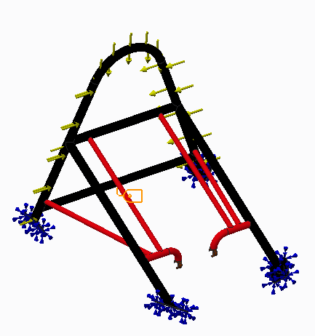
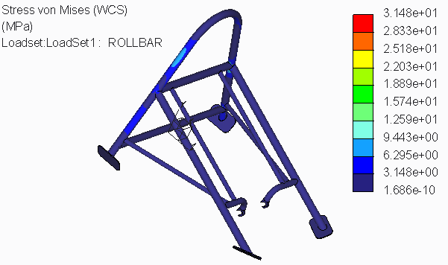
Static Load Analysis: Stress
Stress Analysis and Modified Roll Bar
David Jolicoeur

Slide 27
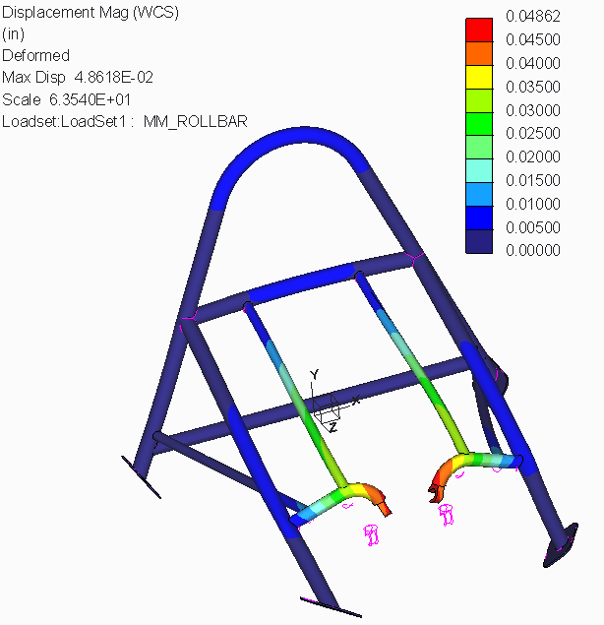
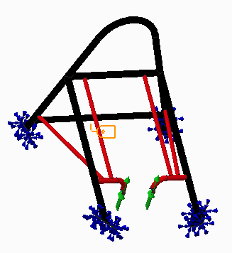
Static Load Analysis: Displacement
Displacement Analysis
David Joliceour

Slide 28
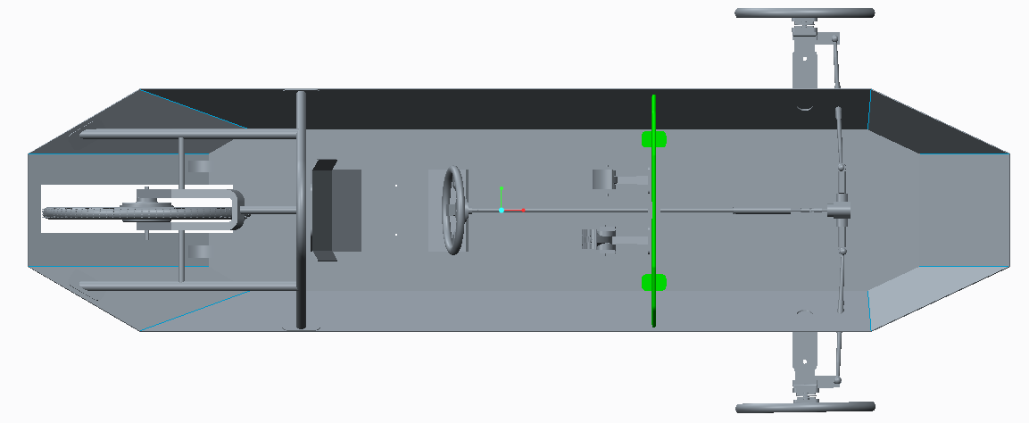
Roll Hoop
David Jolicoeur

Slide 29
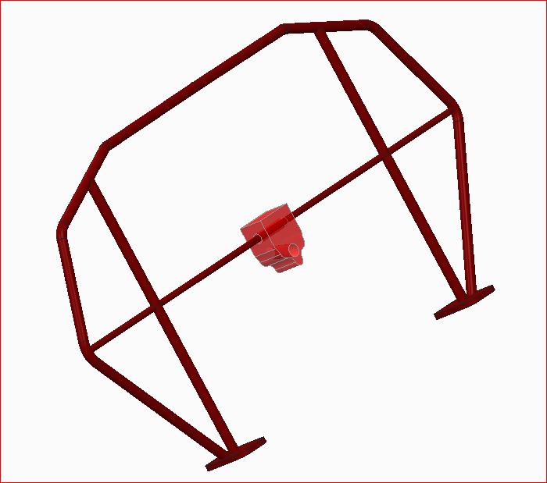
Roll Hoop
Increases the safety of the vehicle and integrity of the chassis
Allows support for the steering column and wheel
Can be used to support solar panel encapsulation
Incorporate the front bulk head
Roll Hoop
David Jolicoeur

Slide 30
Presentation Overview
Introduction and Registration Update
Scheduling and Progress
Comparison Matrix
Mechanical Overview
  Mechanical Components
Electrical Overview
  Electrical components
Budgeting

Slide 31
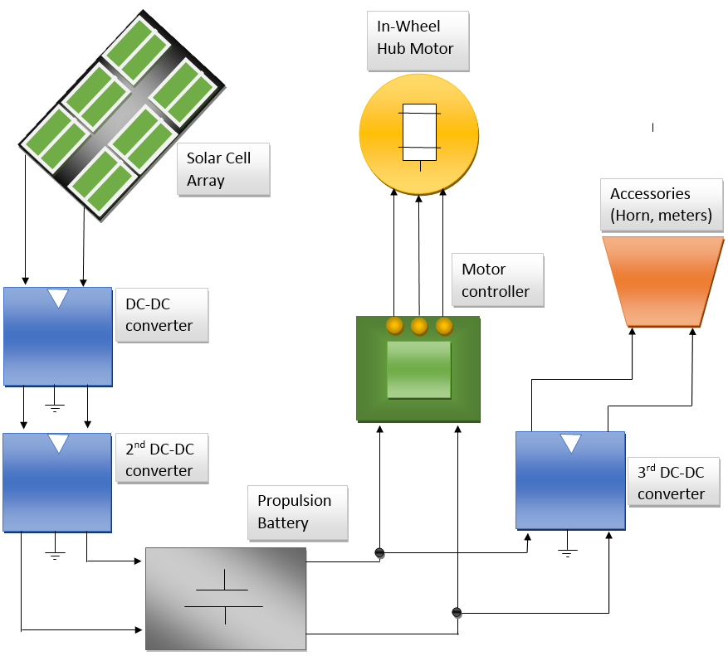
Overview of Electrical System
Fritz Jeanty

Slide 32
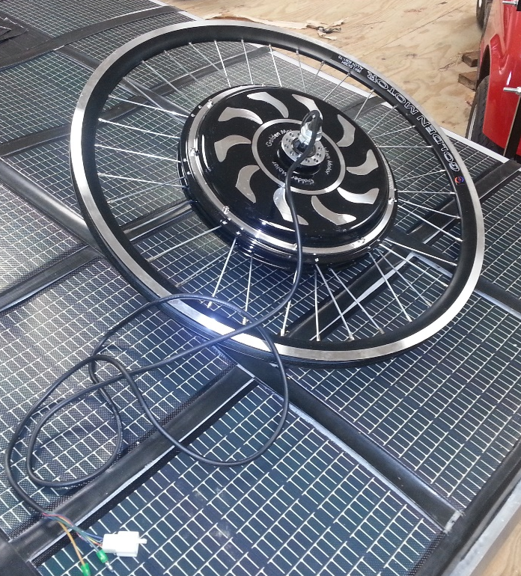
Motor’s Maximum Parameters
Sustain max torque of 22.63Nm
Max Output of 308.88W
Max Current of 19.18A
Motor
Fritz Jeanty

Slide 33
Overview of Electrical System

Slide 34
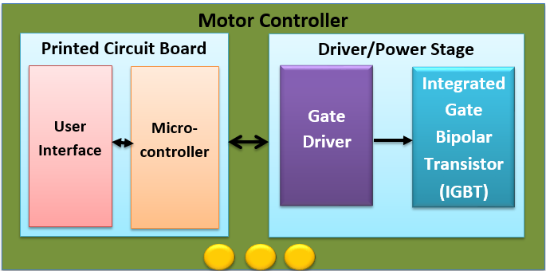
Motor Controller Block Diagram
Fritz Jeanty

Slide 35
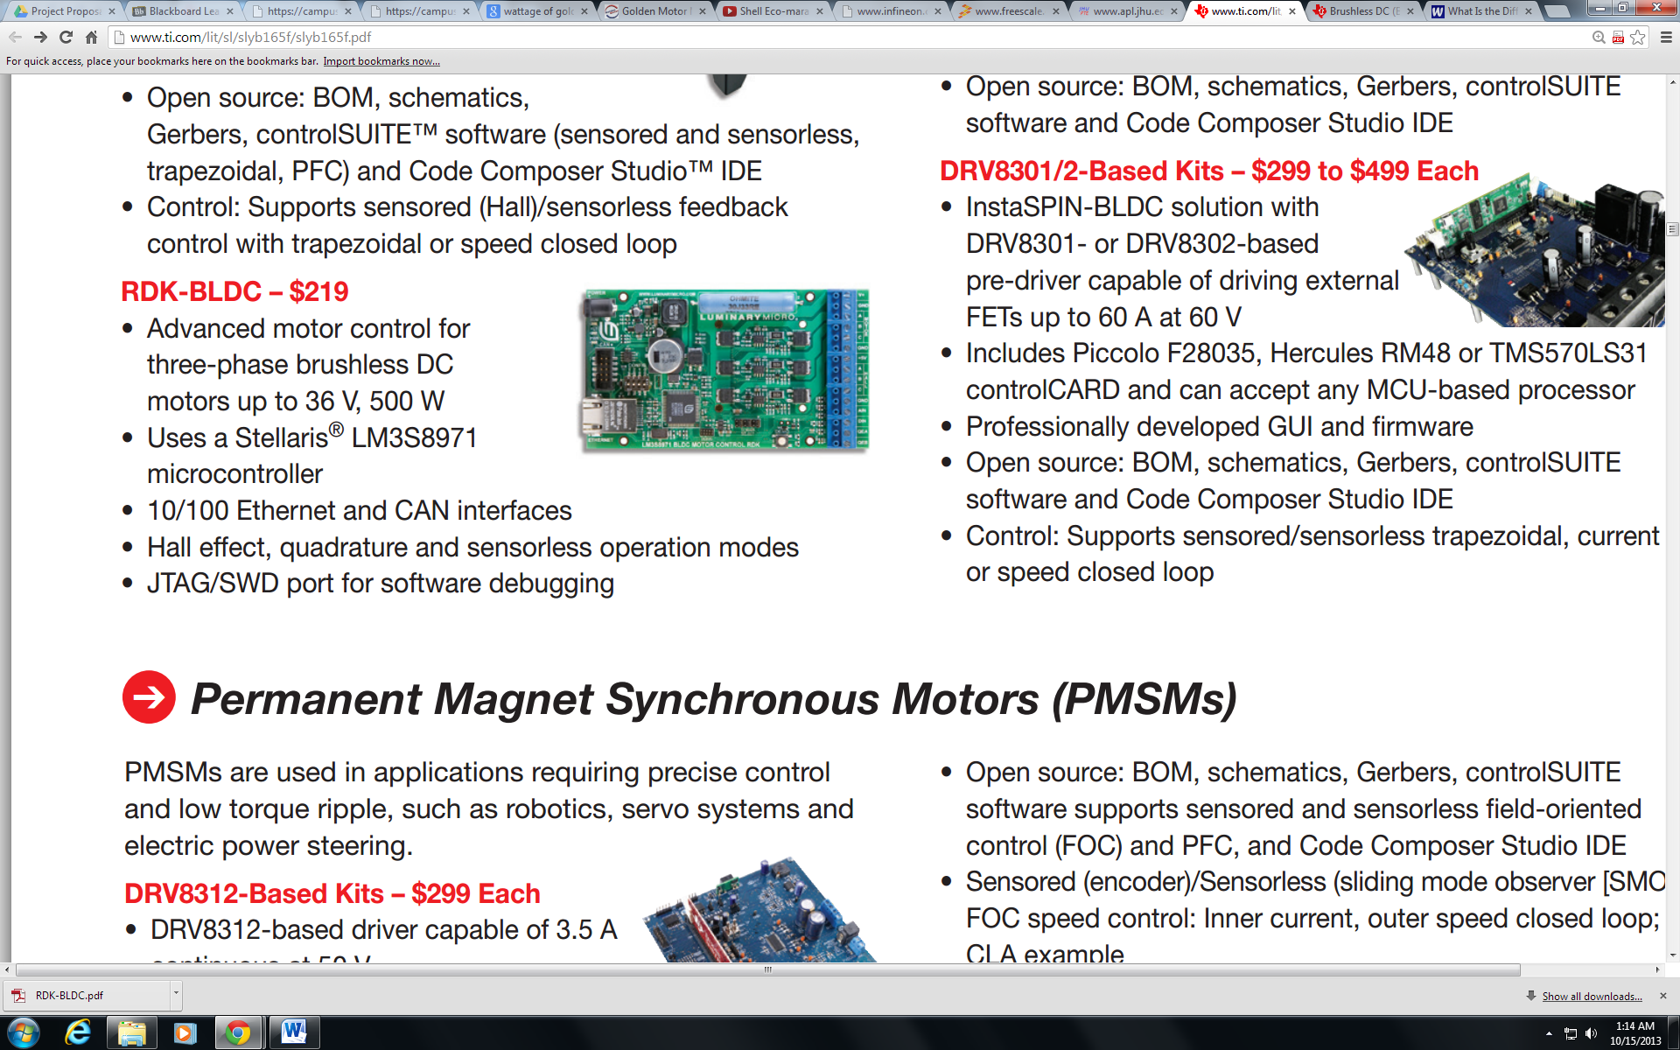
Board
Initially, TI RDK board Controller
  Does not comply with competition rules (Disqualification)
    “Yes. The team does not need to purchase components from different suppliers. They must, however, integrate the components together into a MC system. This includes doing both hardware and software ”
  Preset Power and Driver Stage
Board Controller
“RDK-BLDC." Data Sheet. Texas Instruments, n.d. Web. 14 Nov. 2013.
Fritz Jeanty

Slide 36
Board
Initially, TI RDK board Controller
  Does not comply with competition rules (Disqualification)
  Preset Power and Driver Stage
“RDK-BLDC." Data Sheet. Texas Instruments, n.d. Web. 14 Nov. 2013.
Fritz Jeanty

Slide 37
Printed Circuit Board
Advantages
  Custom build for motor being used
  Avoid wire wrapping
    Avoid using multiple Board controllers
  Cost efficient
    Can be built in house
    Order PCB design through University
  Implementation
  Eliminate possibility of competition disqualification
Fritz Jeanty

Slide 38
Overview of Electrical System

Slide 39

Isolated DC-DC Converter
DC-DC Converter Implementation Plan
Previously an accessory battery was going to be used instead of an isolated DC-DC converter
  Built in safety
  Cheaper
  Less weight
Julia Clarke

Slide 40
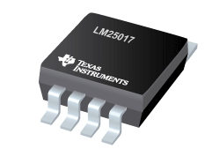
Isolated DC-DC Converter
Converter chosen was the Texas Instruments LM25017
The converter specifications aligned with the specifications of the battery.
Minimum input voltage 9V and maximum input voltage is 48V
The minimum output voltage is 1.25V with a maximum output voltage of 40V and a maximum output current of 0.65A
Isolated DC-DC Converter
"LM25017(ACTIVE)48V, 650mA Wide Vin Synchronous Step-down Regulator with Integrated MOSFETs." Converter (Integrated Switch). N.p., n.d. Web. 14 Nov. 2013.
Julia Clarke

Slide 41
Overview of Electrical System
Fritz Jeanty

Slide 42
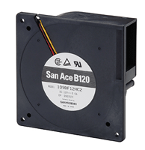
Ventilation System
The ventilation system chosen is the Sanyo Denki fan
  Fairly cheap
  Met specifications of isolated DC-DC converter
Ventilation Fan
"SANYO DENKI - SANACE FANS - 109BF12HC2 - DC BLOWER, 120 X 32MM, 12V." 109BF12HC2. N.p., n.d. Web. 14 Nov. 2013.
Julia Clarke

Slide 43
Overview of Electrical System
Fritz Jeanty

Slide 44
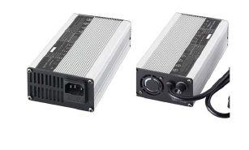
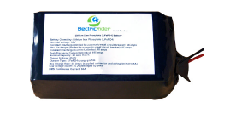
Battery System
The battery chosen by the previous years solar car team was a 24V lithium ion battery from Electric Rider
  Small size
  Low weight
  Cost under $500 including shipping
Battery and Battery Management System
FAMU-FSU 2012 Solar Car Final System Design Review Report, Bosworth et al, April 2013.
Julia Clarke

Slide 45
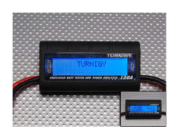

Battery System
In addition to the battery the team purchased a Turnigy Watt-Meter and Power Analyzer to measures:
  batteries performance
  health while in use
Watt meter and Power Analyzer
FAMU-FSU 2012 Solar Car Final System Design Review Report, Bosworth et al, April 2013.
Julia Clarke

Slide 46
Overview of Electrical System

Slide 47
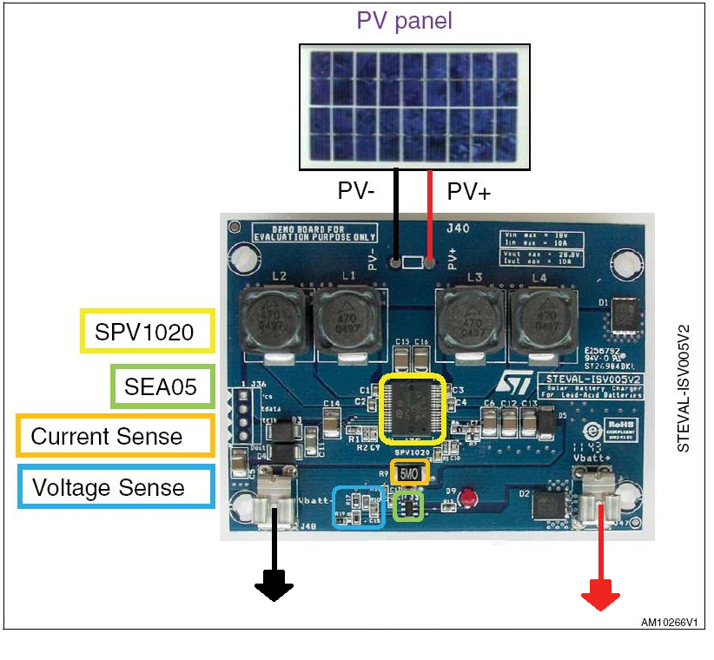
Stage 1
Stage 1 DC-DC Converter
Zachary Barr
"ISV005V2." Data Sheet for ISV005V2. Steval Microelectronics, n.d. Web. 14 Nov. 2013. <http://www.st.com/st-web-
Steval ISV005V2 Board
SPV1020
  MPPT Algorithm
Worst Case Scenario
  Vout=10V

Slide 48
Overview of Electrical System

Slide 49
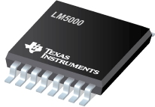
Stage 2
Stage 2 DC-DC Converter
LM5000. Digital image. Www.ti.com. Texas Instruments, n.d. Web. 14 Nov. 2013. (<http://www.ti.com/lit/ds/symlink/lm5000.pdf>.)
Zachary Barr
Texas Instruments LM5000
Surface mounted
Range of Input
  3.1V– 40V
Range of Output
  1.259V – 75V

Slide 50
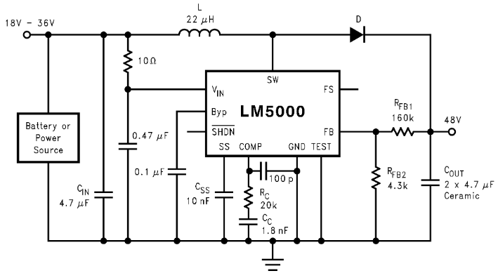
Stage 2
In order to set the output voltage:
Zachary Barr
LM5000. Digital image. Www.ti.com. Texas Instruments, n.d. Web. 14 Nov. 2013. (<http://www.ti.com/lit/ds/symlink/lm5000.pdf>.)

Slide 51
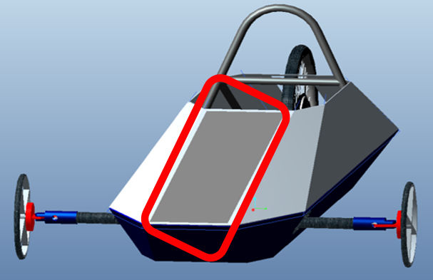
Solar Panels
Competition Limitations
Design Selection
Solution
Implementation
Risks
Solar Panel Implementation
FAMU-FSU 2012 Solar Car Final System Design Review Report, Bosworth et al, April 2013.
Francois Wolmarans

Slide 52
Presentation Overview
Introduction and Registration Update
Scheduling and Progress
Comparison Matrix
Mechanical Overview
  Mechanical Components
Electrical Overview
  Electrical components
Budgeting and Estimates

Slide 53
Budget Update
Expenditure | Cost
Personnel | $92,160.00
Fringe Benefits | $26,726.40
Expenses | $597.00
Equipment¹ | $0.00
Sub-Total | $119,483.40
Personnel & Misc. Recap
Materials Selection
Materials Estimates
Overhead Costs | $53,767.53
Total Estimated Project Cost | $173,250.93
Francois Wolmarans

Slide 54
Estimating
Material Volumes per Part
Materials Pricing
Materials Estimates
Part: | Quantity: | Volume (in³) | Total Volume (in³) | Desired Material:
Front Brake Base | 2 | 1.651 | 3.303 | Aluminum
Front Wheel Mount | 2 | 9.819 | 19.6395 | Aluminum
Aluminum Plate Price per 1 in³
Grade | 2011-T3 | 2024-T3 | 6061-T6 | 6262-T6511
Price Estimate | $1.47 | 1.84 | $0.96 | $0.96
Francois Wolmarans

Slide 55

Questions

Slide 56
Center of Gravity
$$Moment \left(lbs∗in\right)=Weight∗Length from roll bar$$
$$Car^{′}s COG from roll bar \left(in\right)=\frac{Sum of the moments \left(lbs∗in\right)}{sum of weights\left(lbs\right)}$$
Calculating Weight Ratio
$$Front Weight Ratio=\frac{Distance from the Car^{′}s COG to motor mount}{The measured wheel base}$$
$$Rear Weight Ratio=\frac{Distance from the car^{′}s COG to the front wheel mounts}{The measured wheel base}$$

Slide 57


Static Vertical Wheel Load Calculations
$$Front Static Vertical Wheel Loads \left(lbs\right)=$$
$$\frac{Maximum load\left(lbs\right)∗Distance from motor to COG_{car}\left(in\right)}{Wheel base \left(in\right)}$$
$$Rear Static Vertical Wheel Load\left(lbs\right)=$$
$$\frac{Maximum load\left(lbs\right)∗Distance from mounts to COG_{car}\left(in\right)}{Wheel base \left(in\right)}$$

Slide 58






Calculating Stresses
$$σ_{1,2}=(\frac{σ_{x}+σ_{y}}{2})±{\left({\left(\frac{σ_{x}−σ_{y}}{2}\right)}^{2}+τ_{xy}^{2}\right)}^{0.5}$$
$$σ_{y}=\frac{M∗y}{I}$$
$$τ_{\max{in plane}}={\left({\left(\frac{σ_{x}−σ_{y}}{2}\right)}^{2}+τ_{xy}^{2}\right)}^{0.5}$$
$$σ_{x}=Lateral Braking force$$
$$τ_{xy}=\frac{P}{A_{shear}}$$
$$Factor of Safety=\frac{Yield Shear Strength}{τ_{\max{in plane}}}$$

Slide 59




Lateral Braking Force
Assumptions:
Stopping Distance from 15mph: 32 ft
Center of Gravity Height: 8 in
Starting Velocity: 15 mph = 22 ft/s
Calculated Variables:
Curb Weight: 470 lbs
Front Weight Ratio: 35%
Rear Weight Ratio: 65%
Front Static Load: 164.5 lbs
Rear Static Load: 305.5 lbs
Wheel Base: 82 in
$$a=Rear weight ratio∗Wheel base$$
$$b=Front weight ratio∗Wheel base$$
$$a_{x}=\frac{V_{0}^{2}}{2∗Stopping distance}$$
$$W_{f}^{′}=\left(\frac{b∗Curb weight}{Wheel base}\right)+(\frac{COG∗\left(\frac{Curb weight}{g}\right)∗a_{x}}{Wheel base})$$

Slide 60
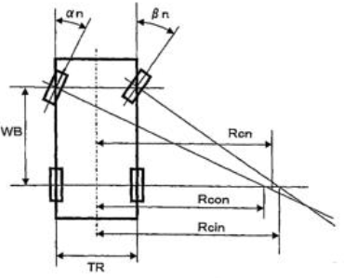
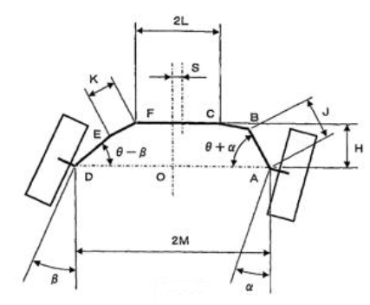




Calculating Turning Radius
$$R_{cin}=\frac{WB}{\tan\left(βη\right)+M}$$
$$R_{con}=\frac{WB}{\tan\left(αη\right)−M}$$
$$Turning Radius R_{cn}=\frac{R_{cin}+R_{con}}{2}$$
$$Tie rod travel distance=Sin\left(αη\right)∗(L)$$

Slide 61
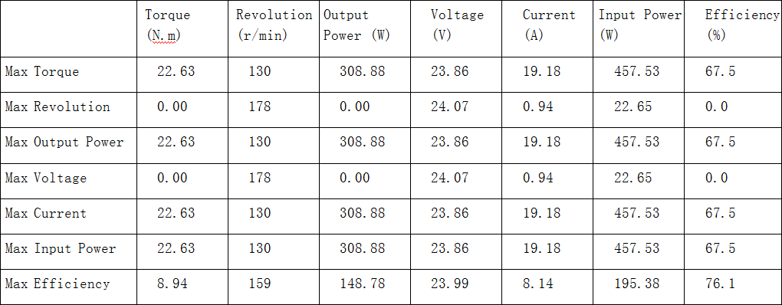
Motor’s Max Parameters Performance Data
“Magic Pie Motor." Performance Data. Golden Motor, n.d. Web. 14 Nov. 2013.
<http://www.goldenmotor.com/magicpie/MP-performance%20data%2024V.pdf>.
Fritz Jeanty

