Slide 1



Shell Eco-Marathon
FAMU-FSU 2014 Solar Car
Milestone #1 Presentation
Team #2

Slide 2
Leadership Roles
Project Leader – Fritz Jeanty
  Micro Controller Design and Programming
Lead Mechanical Engineer – James Croasmun
  Braking, Steering, and Suspension Systems Technician
Lead Electrical Engineer – Zachary Barr
  Micro Soldering Technician
Lead Industrial Engineer – Jose Cardenal
  Safety Testing Supervisor
Financial Advisor – Francois Wolmarans
  Ergonomics
Secretary/Web Master – Julia Clarke
  Accessory Battery and System Shutdown
Rules Requirements Advisor/CREO-2.0 Manager – David Jolicoeur
  Seat, Roll Bar, and Bulk Head Designer
Installations Manager – Wael Nabulsi
  Machinist and Installation Advisor
Julia Clarke

Slide 3
Overview
This year’s team focus is completing the car and ensuring compliance with the requirements of the “2014 Shell Eco- Marathon Challenge’s.”
Using mechanical, electrical, and ergonomic design the group will build, test and improve last year’s design for a finalized product that’s competition ready.
The group will add the necessary components that will get the car up to par with the requirements for the “Shell Eco- Marathon Challenge.”
Julia Clarke

Slide 4
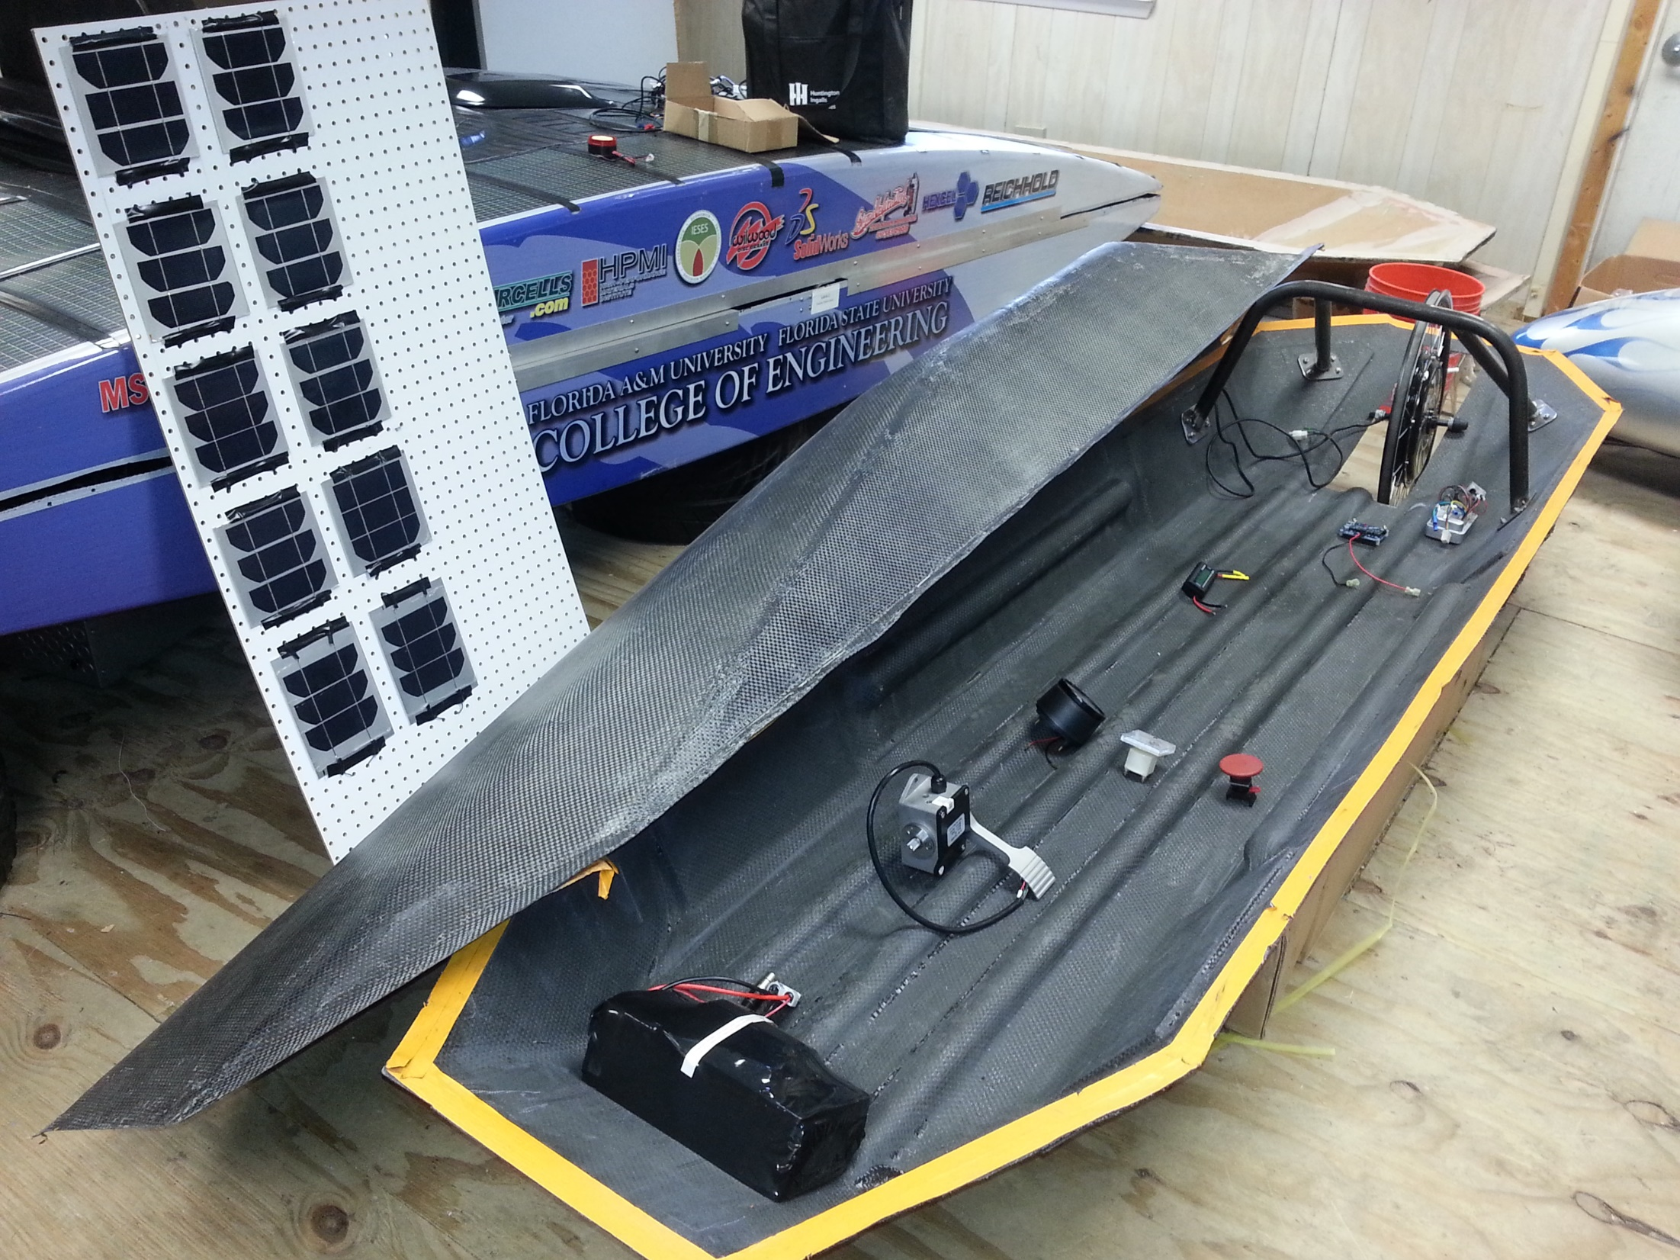
Left Behind
David Jolicoeur

Slide 5
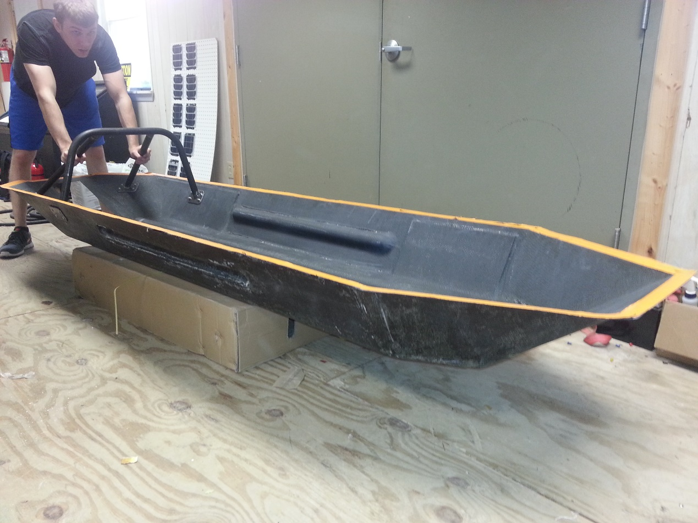
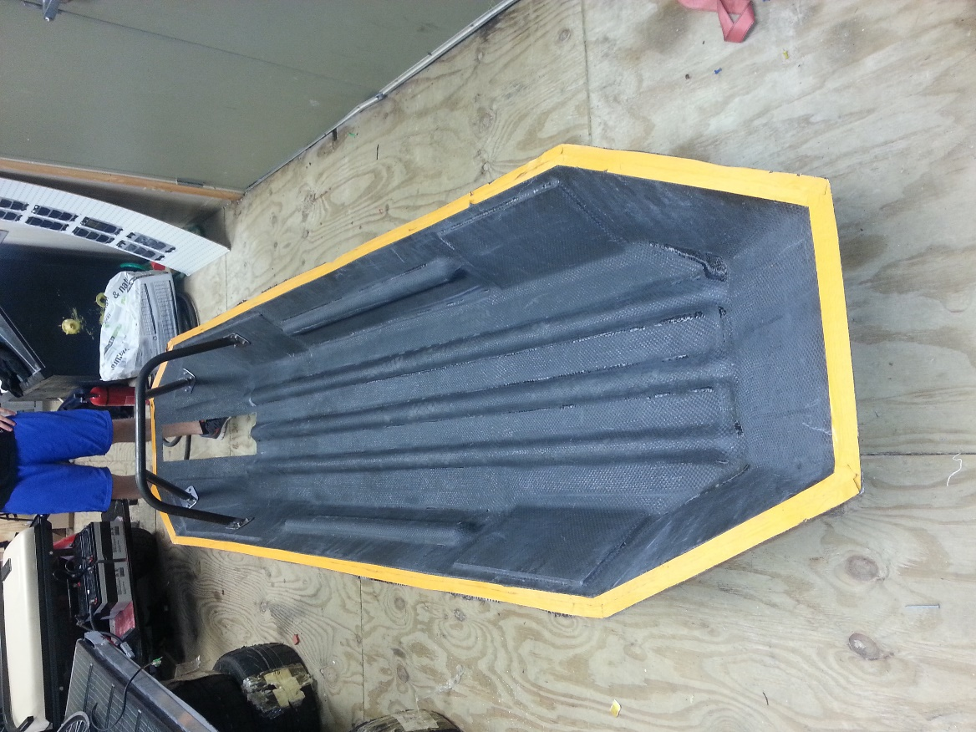
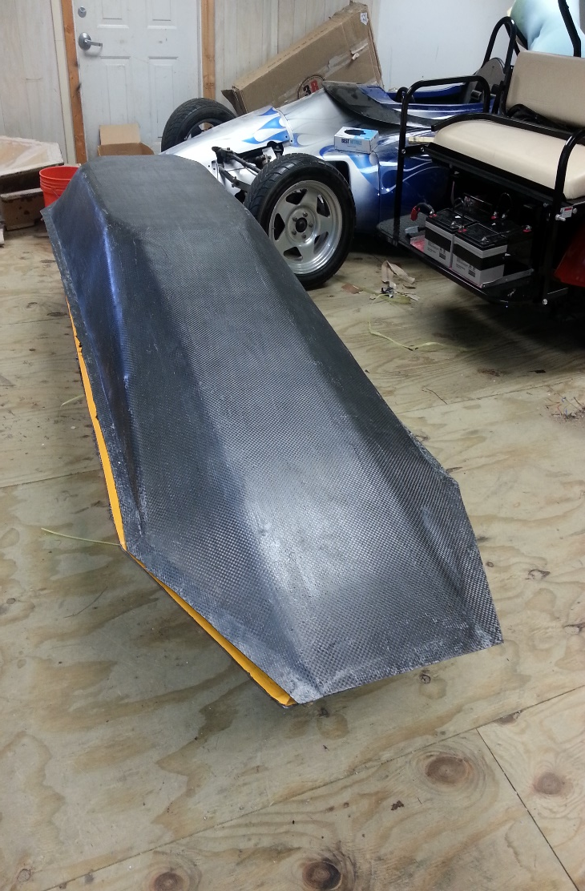
Balsa Wood
Chassis
PVC Half Pipes
Roll Bar
Carbon Fiber
Designed for Aerodynamics
  Coefficient of Drag: C_{d} = 0.155
David Jolicoeur

Slide 6
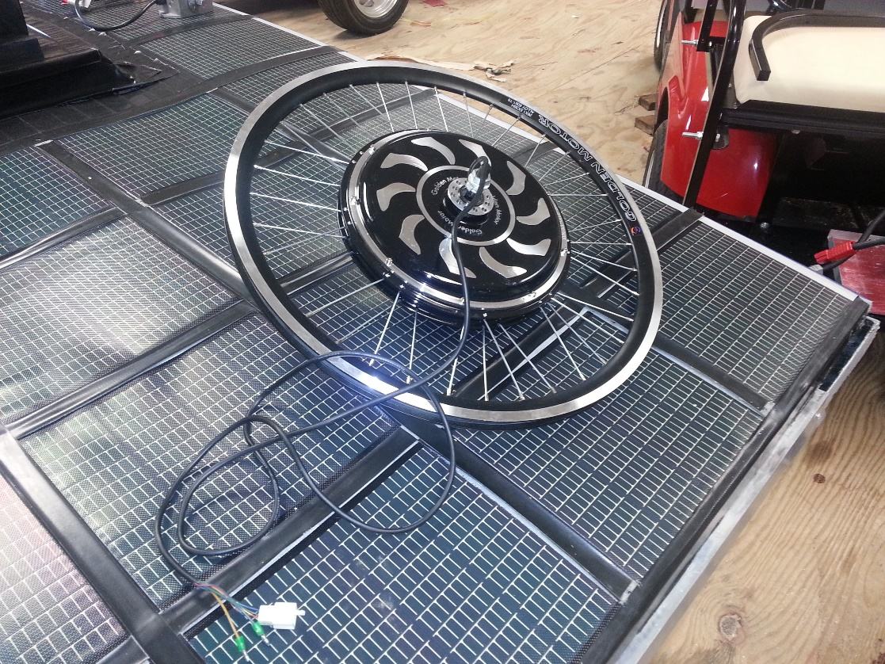
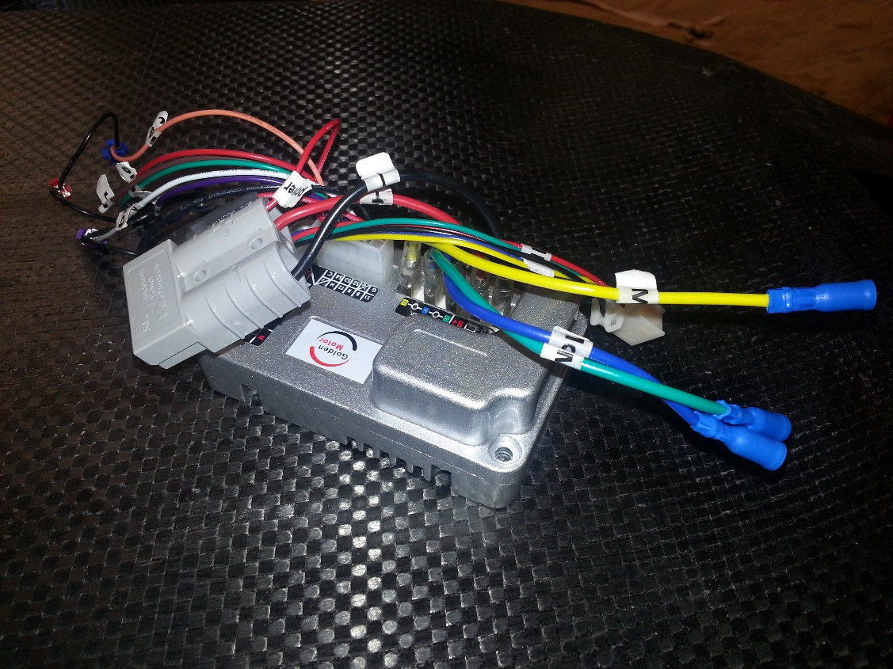
Motor
It is a 24V, 750W rated motor from Golden Motors
Unfortunately, Article 67 states that the motor controller must be custom built.
David Jolicoeur

Slide 7
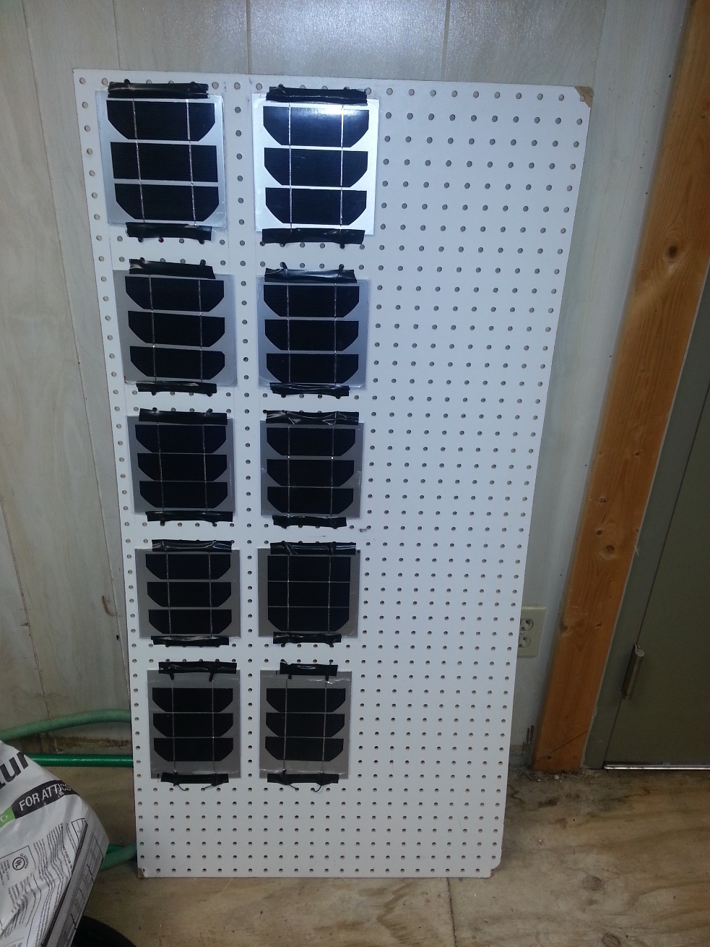
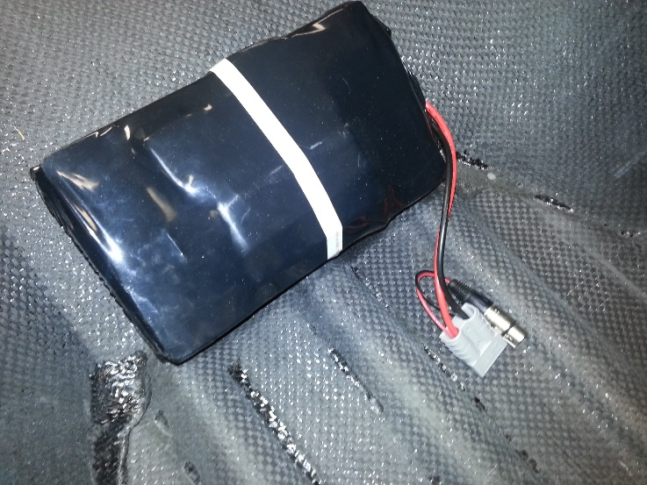
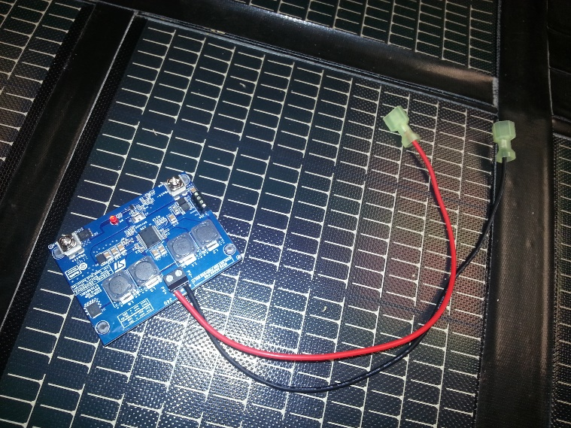
Solar Panels
Maximum Surface area of 0.17 m²
Mono-Crystalline Solar Cells
Electric Rider LiFePO4
Battery Pack
DC-DC Converter 24V
David Jolicoeur

Slide 8
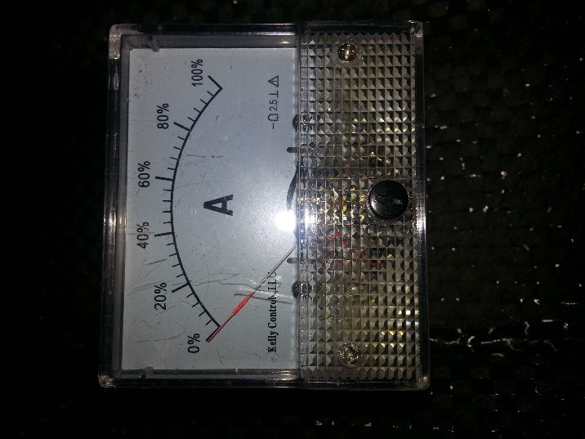
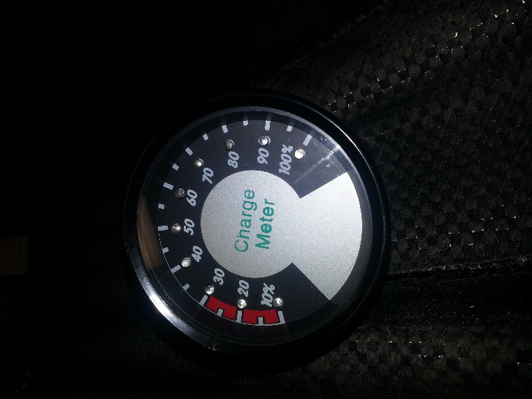
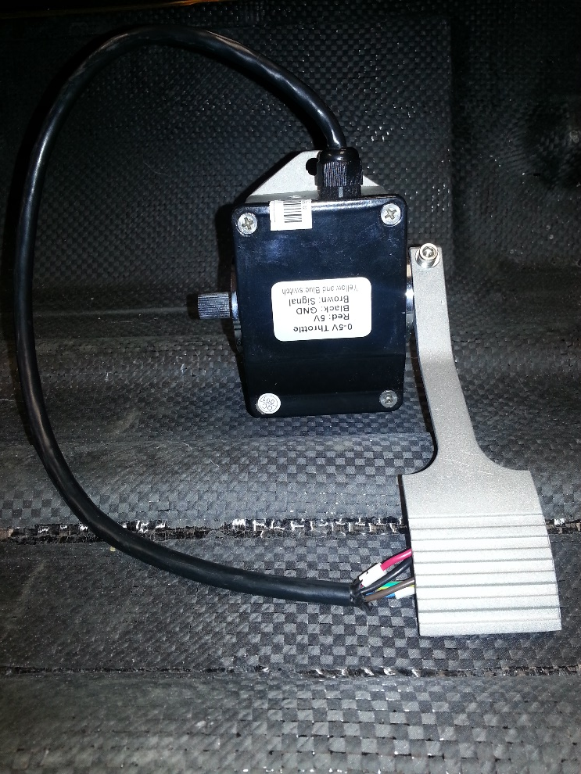
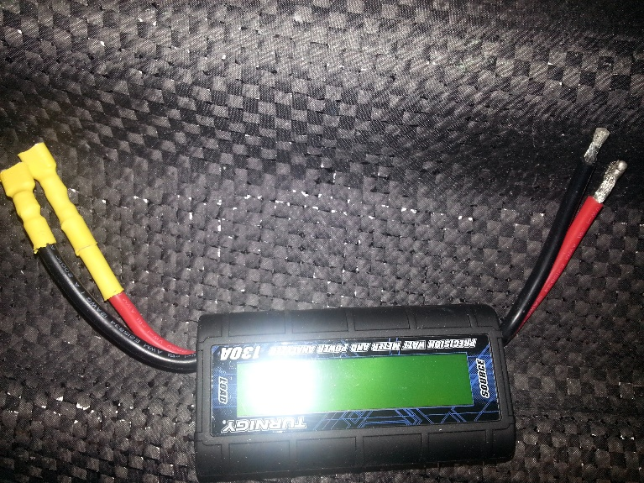
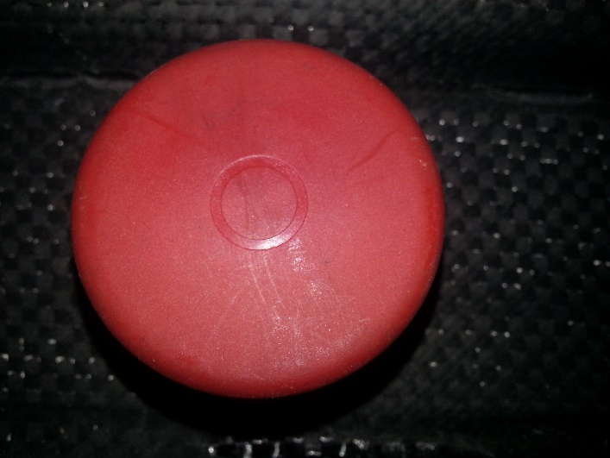
Additional
Components
David Jolicoeur

Slide 9
General Requirements
Dual Braking System
Required Safety Features
Emergency Procedure
Visibility Requirements
Prototype Dimensions & Specifications
Separated Fire-proof Compartments
Required Indicators & Switches
Electrical Horn
Li-ion Battery & Battery Management System (BMS)
Efficacy
Jose Cardenal

Slide 10
House of Quality
House of Quality: (HOQ) A planning matrix which helps to establish the relationship between a customer’s wants, and the ability to fulfill that want with a good or service.
Customer wants versus product features
Competitor comparison
Correlation matrix
Prioritization of components/processes
Jose Cardenal

Slide 11
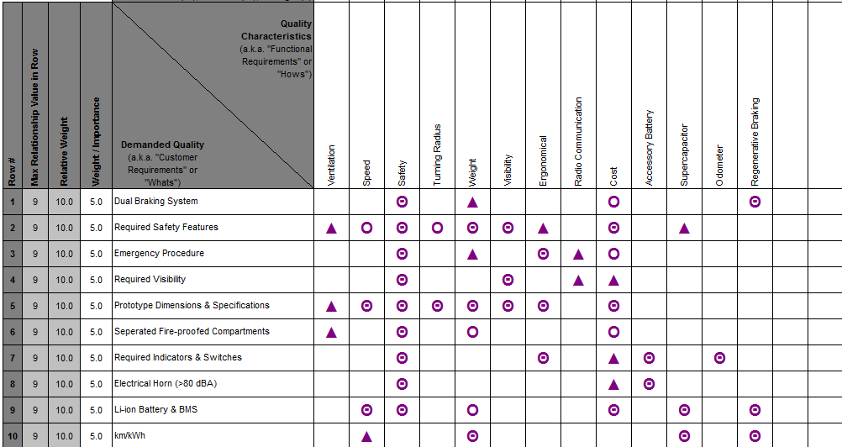
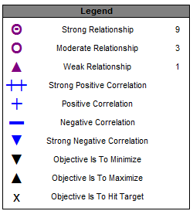
Evaluating Relationship Strengths
Francois Wolmarans

Slide 12
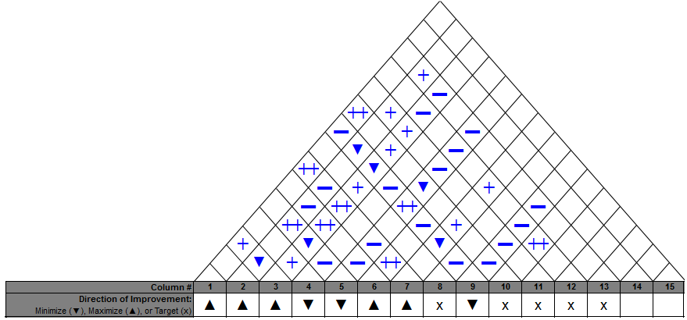
HOQ Correlation Matrix
Francois Wolmarans

Slide 13
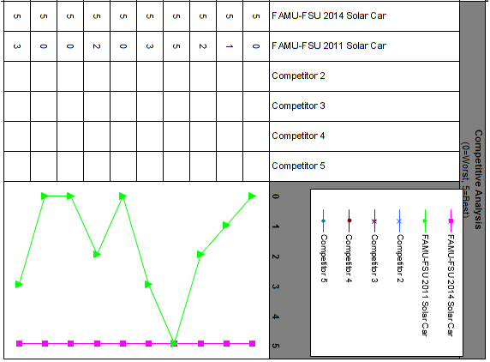
Competitor Analysis
Francois Wolmarans

Slide 14
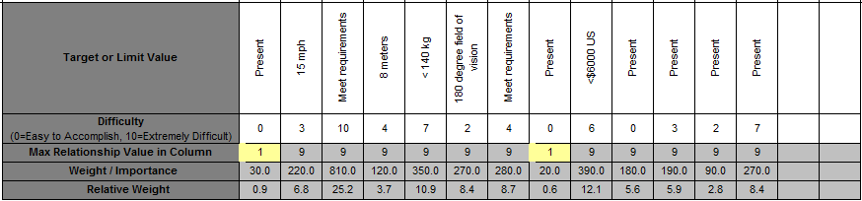
Interpreting the House of Quality
Allows us to determine the desired and required capabilities
Ranks the quality characteristics in order of priority based on the customers needs and wants.
Francois Wolmarans

Slide 15
Gantt Chart
Estimated Times:
Estimated Manufacturing rate for in-shop products: 21 days
Estimated Manufacturing rate for ordered products: 30 day
Estimated Installation for major components: 2 days
Estimated Completion Date: (excludes Christmas Break)
  February 26, 2012
Jose Cardenal

Slide 16
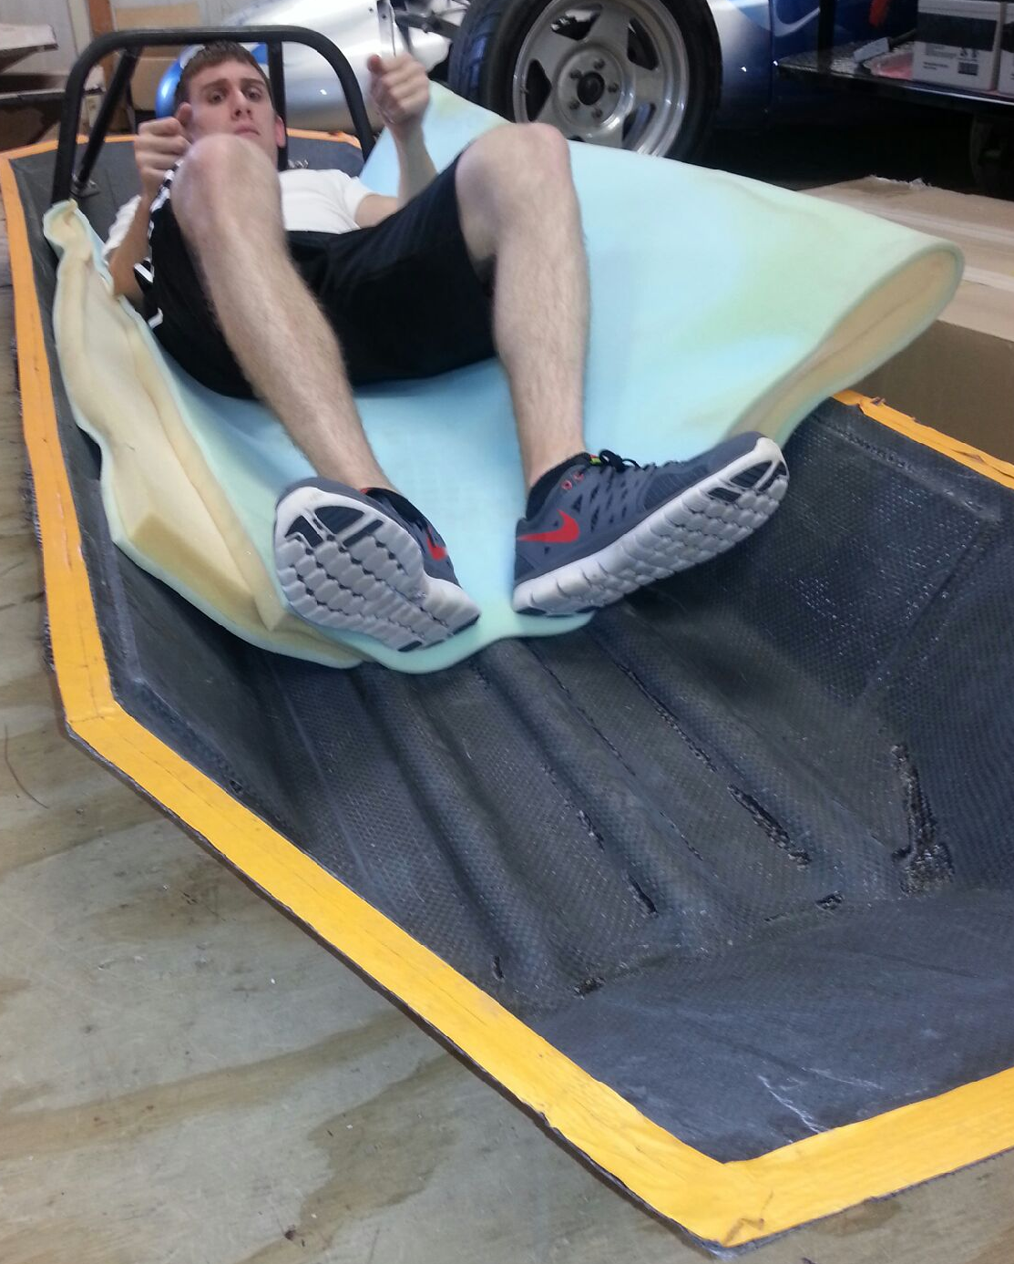
Gantt Chart
Lead Design and Analysis Tasks:
  Seat Design and Analysis
  Front Wheel Mount Design and Analysis
  Motor Controller Design
  Resistor Replacement Mathematics/Test
Lead Installation Tasks (Major Milestones):
Roll Bar: First major mechanical component to be installed in the chassis.
Battery/Battery Compartment: First major electrical component to be installed in the chassis.
James Croasmun

Slide 17

Gantt Chart
Longest Task Duration:
  Motor Controller Manufacture and Programing:
    A board may need to be ordered and then programmed.
Shortest Task Duration:
  General Installation:
    Estimated 1-2 days per installation
    Some parts require predecessor installation
James Croasmun

Slide 18

Preliminary Cost Analysis
Total Budget: $6000
Preliminary Costs: $1867
Remaining Budget: $4133
Most, if not all installations will be done by design team
  Total installation cost summed to be $0
Fritz Jeanty

Slide 19
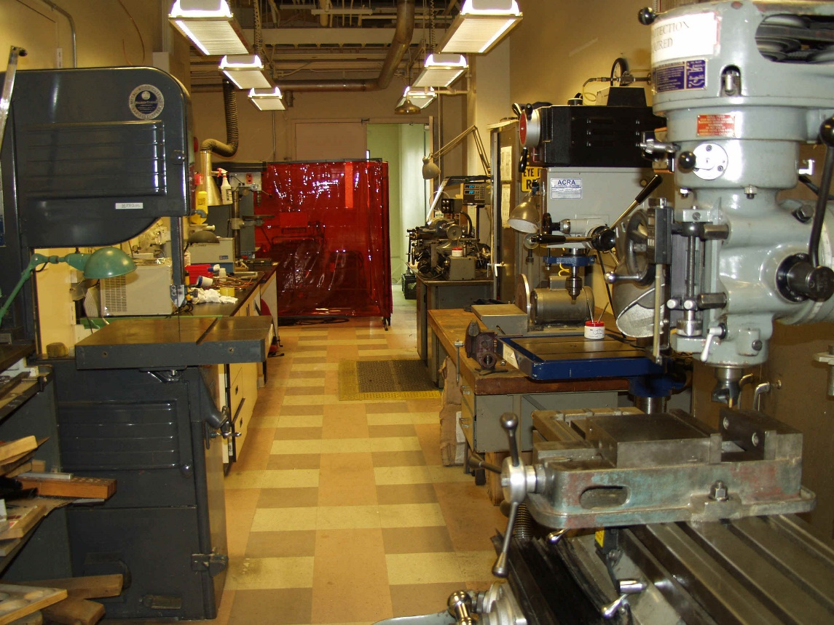
Parts Expected to be Built In-House
Raw material such as Aluminum and Carbon Fiber will be donated
The following parts can be built in-house to minimize total cost:
  Front Wheel Mount
  Steering Wheel
  Seat
  Seat Mount Rail
  Pedal
  Front Bulk Head
  Rear Bulk Head
Additional Material Costs:
  Aluminum= $0.80/lbs
  Carbon Fiber = $8.50-$10/m^2
Fritz Jeanty

Slide 20
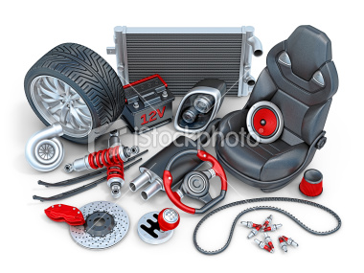
Major Parts That Will Be Purchased
Front Wheel
Front Wheel Brake System
Steering Column
Roll Bar/Rear Motor Mount
Accessory Battery
Motor Controller Components
  DE0 Board or DE2 Board
  Gate Drivers
Fritz Jeanty

Slide 21
Testing Plans
Capabilities Tests:
  Dimensions Examination
  Electrical Horn
  Total Weight
  Avg. Speed
  Odometer integration
Functionality Tests:
  Travel Distance
  Operation in All types of Weather
  Fit Driver
  Steering Capabilities
Structural Tests:
  Weight of Driver
  Roll Bar Height
  Roll Bar Width
  Roll Bar Strength
  Steering Independence
  Car & Ground Clearance
  Braking System
  Brake Test for Incline
  90° Visibility
Zachary Barr

Slide 22
Testing Plans
Electrical Tests:
  Extra Diode
  Mono-crystalline Solar Cell Implementation
  Battery Management System
  High voltage threshold
  DC converter
Safety Tests:
  Fire Retardant Bulkheads
  Driver Harness
  10 Second Evacuation
  Fire Extinguisher
Zachary Barr

Slide 23
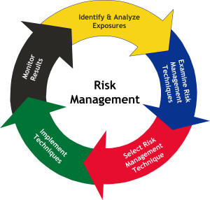
Risk Assessment
How can risks be avoided?
Risks:
  Circuit Overload
    Solar Cell Encapsulation
    Improper Motor Wiring
    Motor Controller
    Batteries
  Structural/Functional Failures
    Chassis and Wheel Mounting
    Braking
    Steering and Rollovers
    Roll Bar Stiffness
Wael Nabulsi

Slide 24
Risk Assessment
High | 5 Point Seat Belt Test | Proper Wiring of Motor Motor Controller Batteries | Braking Chassis Wheel Mounting
Medium |  | Steering Rollovers | Roll Bar Stiffness
Low |  | Solar Cell Encapsulation
 | High | Medium | Low
Consequence
Probability
Wael Nabulsi

Slide 25

Questions

