Slide 1
Shell Eco-Marathon FAMU-FSU 2014 Solar Car Milestone #4 Presentation Team #2

Slide 2
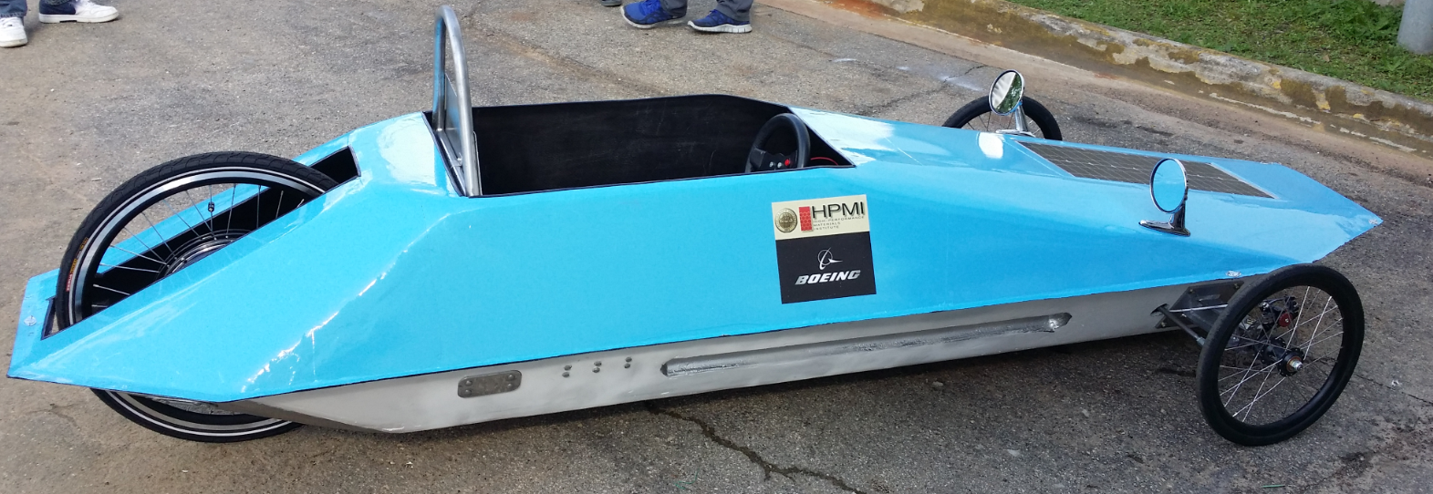
Presentation Overview
Francois Wolmarans
Introduction
Progress
Concept Generation
Mechanical Overview
Electrical Overview
Budget
Introduction
Progress
Concept Generation
ME Overview
EE Overview
Budget

Slide 3
Introduction
Francois Wolmarans
General Problem Statement
General Solution Approach
Operating Environment
Intended Use(s)/User(s)
Shell Registration
Eco-Marathon Competition
Race Track (Operating Environment)
Introduction
Progress
Concept Generation
ME Overview
EE Overview
Budget

Slide 4
Progress
Jose Cardenal
Next:
Testing
Competition (April 25-27)
Completed:
Shell Registration
Shell Design Level Review
Shell Final Review
Design Phase
Manufacturing
Stock Parts
Custom Parts
Installation
Design
Manufacture
Installation
Testing
Introduction
Progress
Concept Generation
ME Overview
EE Overview
Budget

Slide 5
Concept Generation
Jose Cardenal
Step 1: House of Quality
Step 2: Comparison Matrix
Design Options | Safety (0.432) | Cost (0.208) | Component Weight (0.187) | Implementation (0.173) | Total
Mount 1 | 2 | 1 | 1 | 2 | 1.605
Mount 2 | 1 | 2 | 2 | 1 | 1.395
Step 3: Professional Opinion
Step 4: Final Selection
Introduction
Progress
Concept Generation
ME Overview
EE Overview
Budget

Slide 6
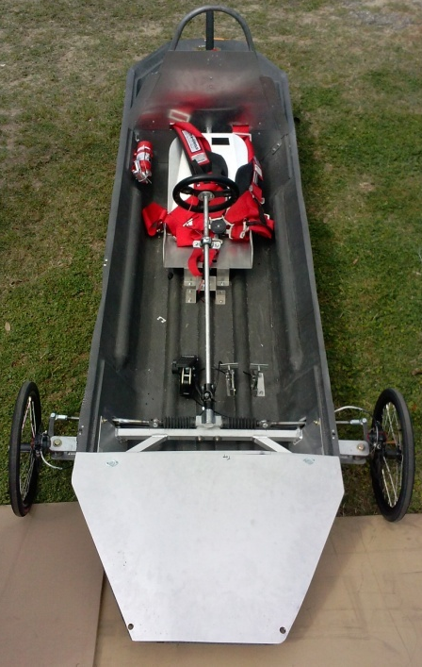
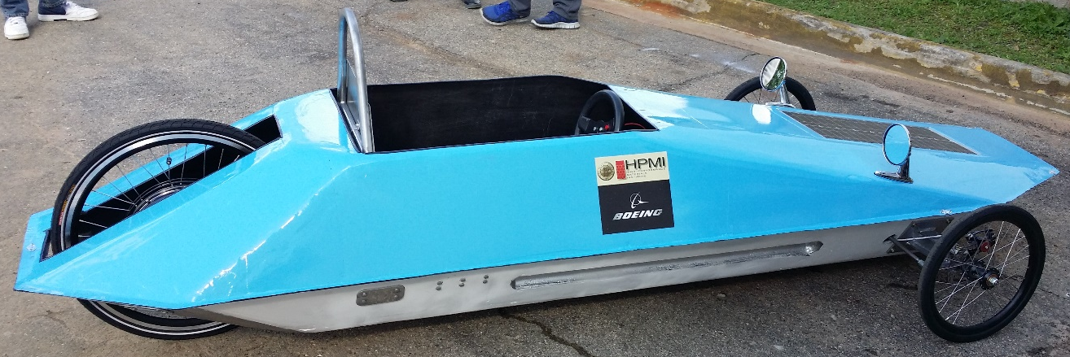
Vehicle Overview
Wael Nabulsi
Introduction
Progress
Concept Generation
ME Overview
EE Overview
Budget

Slide 7
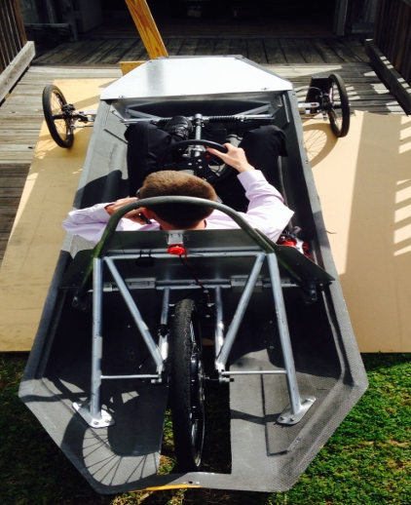
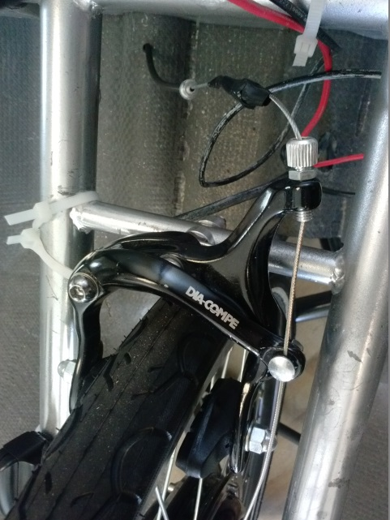
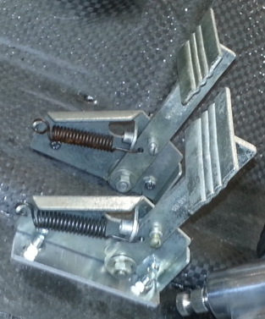
Braking Systems
Wael Nabulsi
Requirements
Dual Independent Braking Systems
Independently capable of holding car static at 20 degree incline
Engage without removing hands from Steering Wheel
Braking Test
Front Brakes
Rear Brakes
Pedals
Pedals

Slide 8
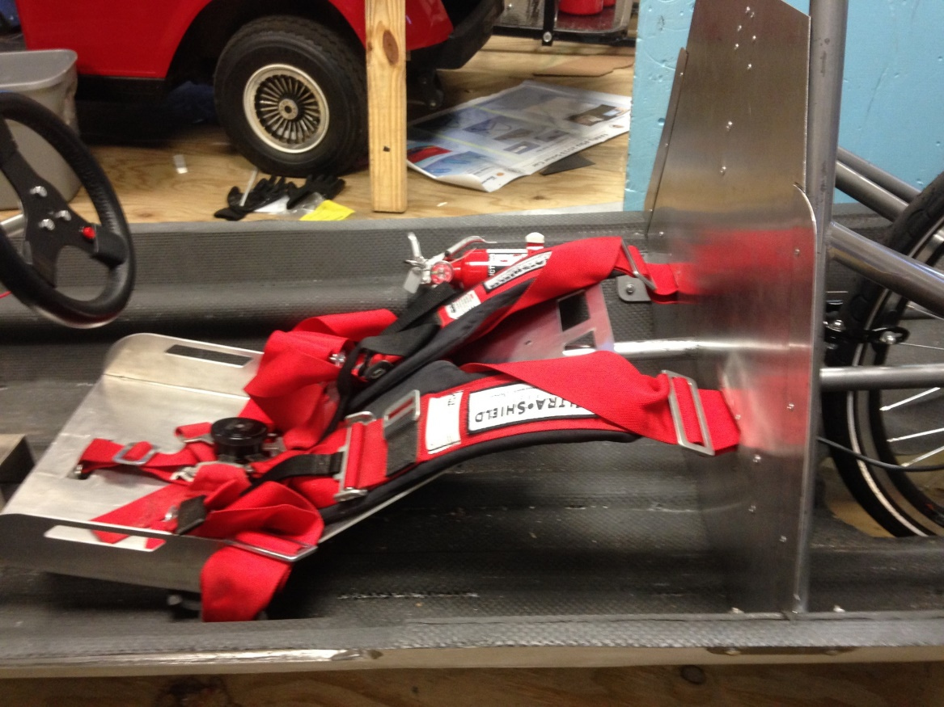
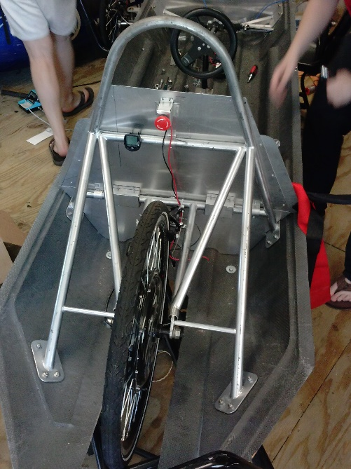
Roll Bar & Seat
David Jolicoeur
Requirements:
Withstand 700N of force from all directions
5 cm above drivers head
Peak less than 39 in. from ground
Seatbelt must be able to hold 1.5 times the drivers weight
Seat & Seat Belt
Roll Bar (Initial)
Roll Bar (Final)

Slide 9
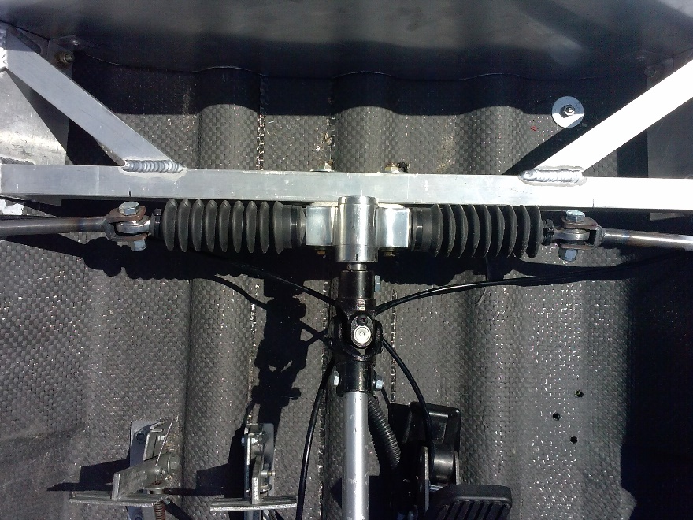
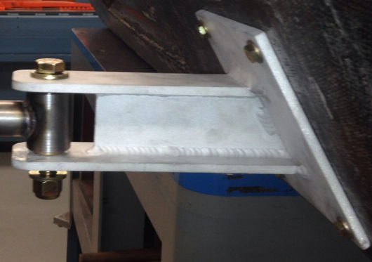
Steering System
James Croasmun
Entire steering system
Requirements:
Capable of withstanding all forces applied during operation
Less than 8 m Turning Radius
Front Mounts
Spindle
Spindle Arm
Rack and Pinion

Slide 10
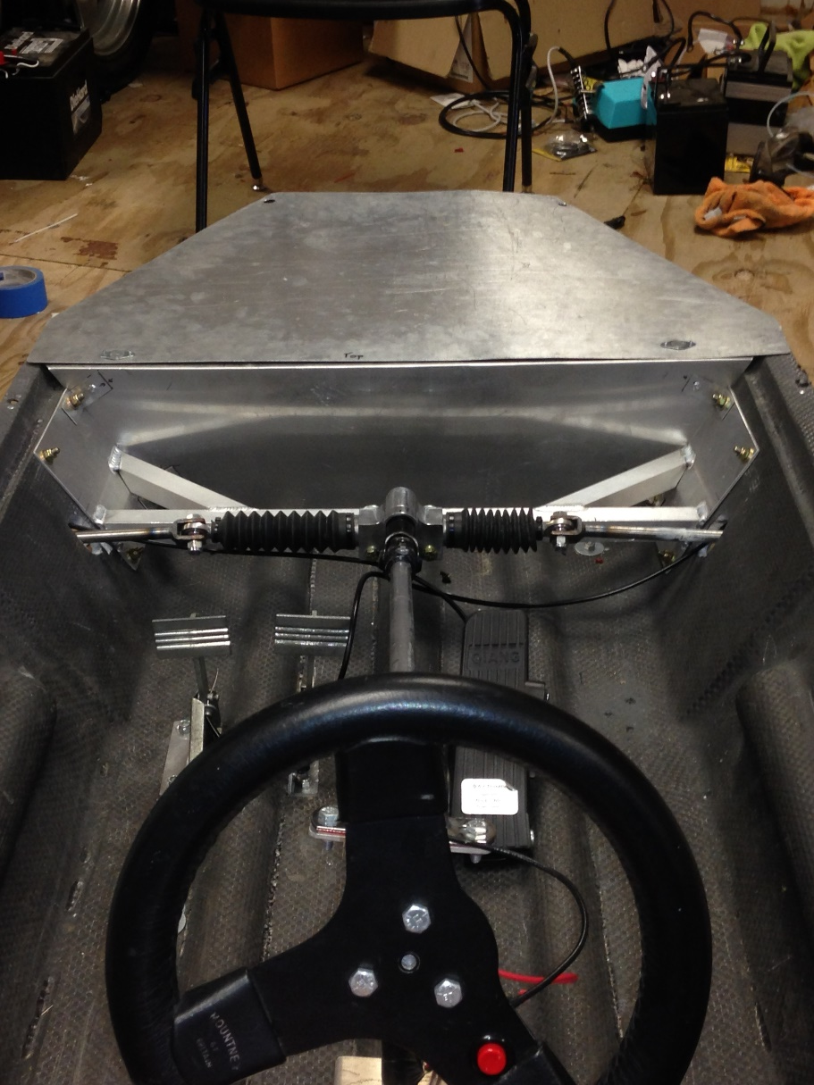
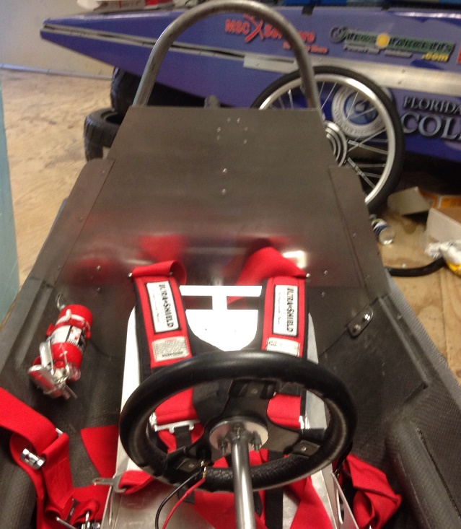
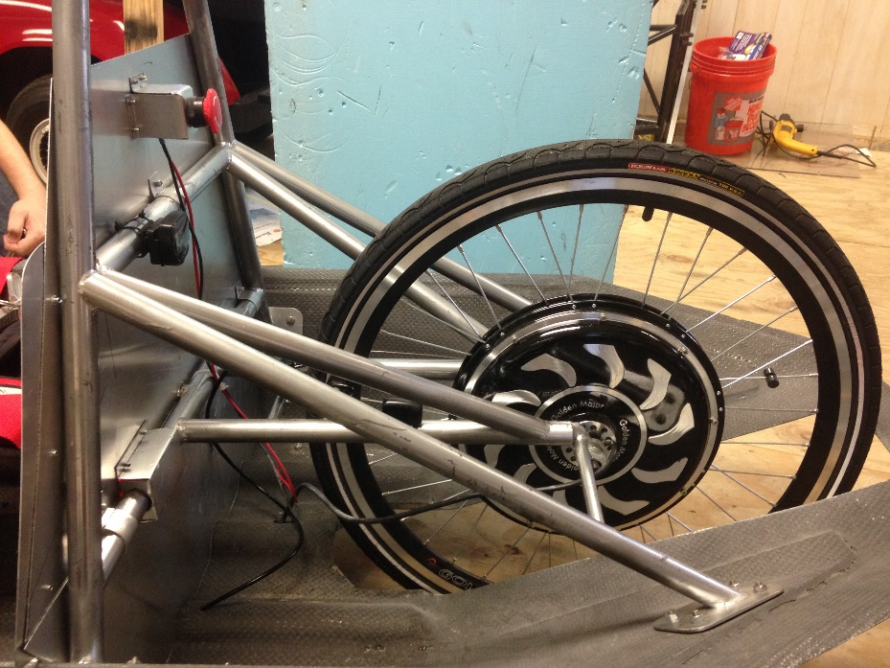
Bulkhead
Jose Cardenal
Requirements:
Fire retardant material
Separate electrical components from driver compartment
2 inches above rear propulsion system (Rear)
Allow for battery inspection (Front)
Front Bulkhead
Rear Bulkhead Front View
Rear Bulkhead Back View

Slide 11
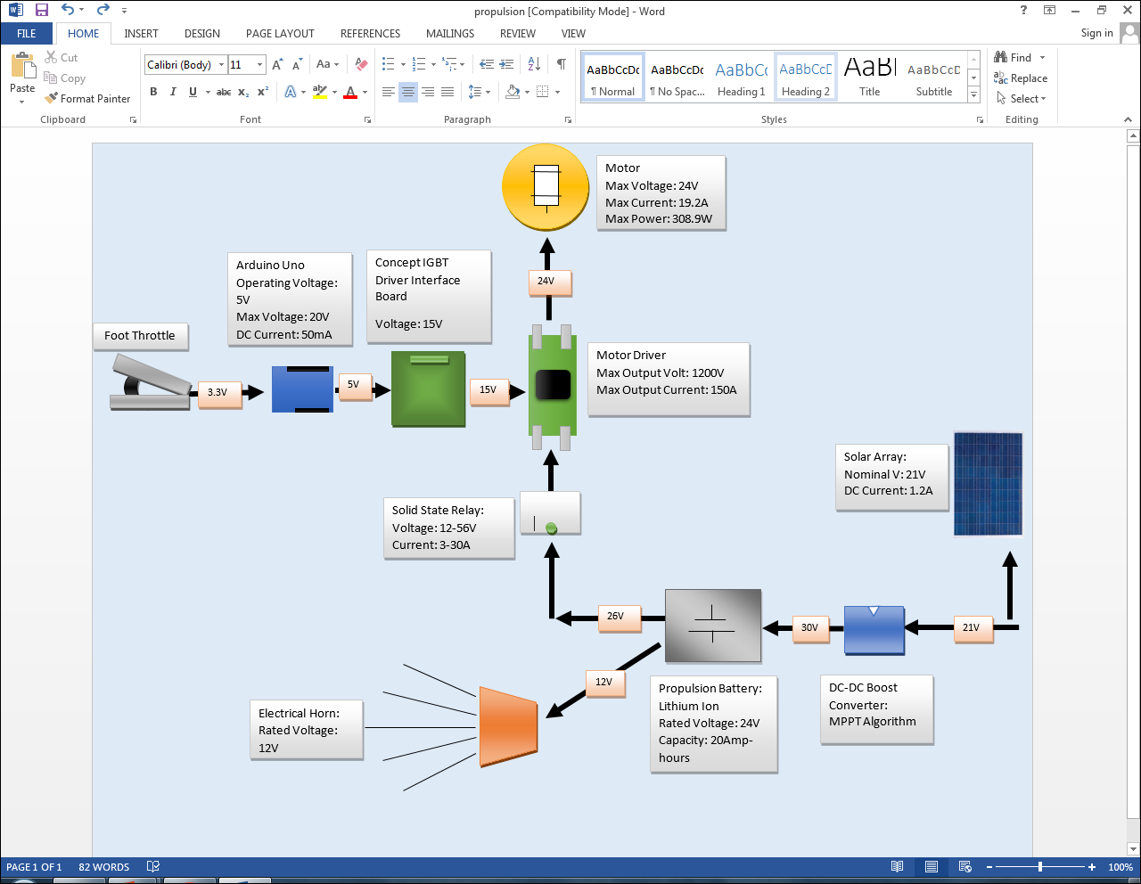
Overview of Electrical System
Francois Wolmarans
Introduction
Scheduling
Concept Generation
ME Overview
EE Overview
Budget

Slide 12
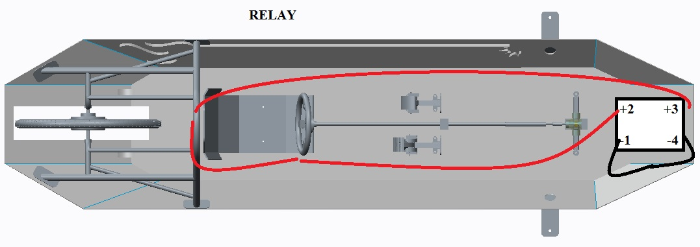
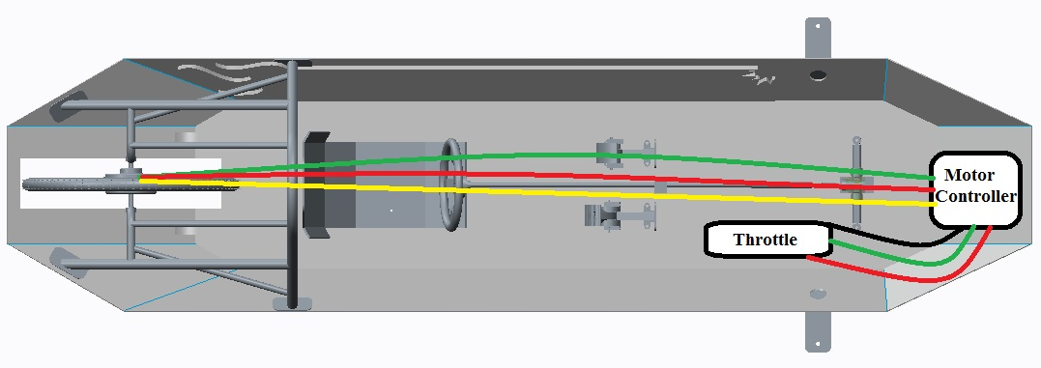
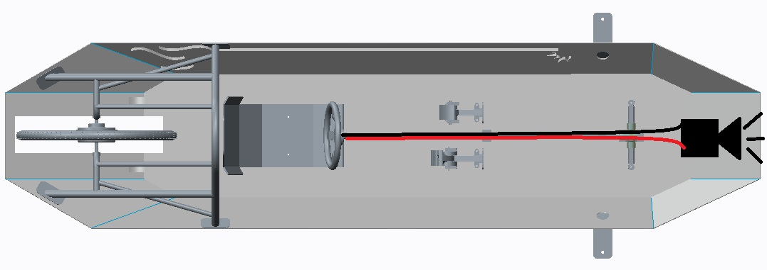
Wiring
Zachary Barr
Requirements:
All wires must be isolated from driver
Positive red wires
Negative black wires
Wiring Diagram

Slide 13
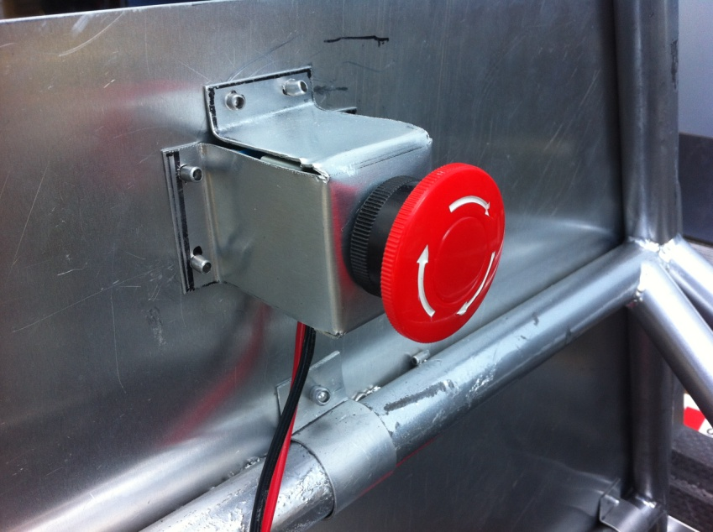
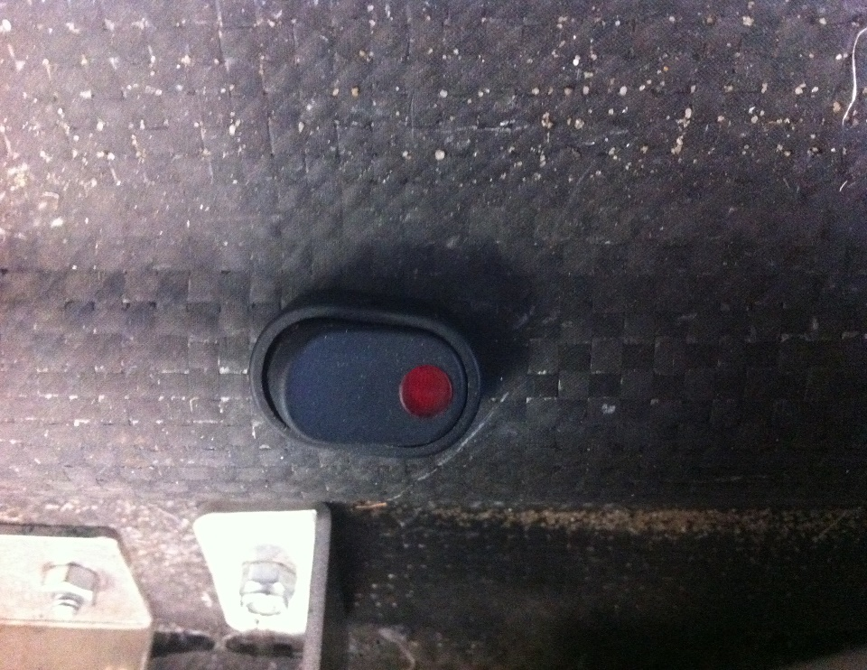
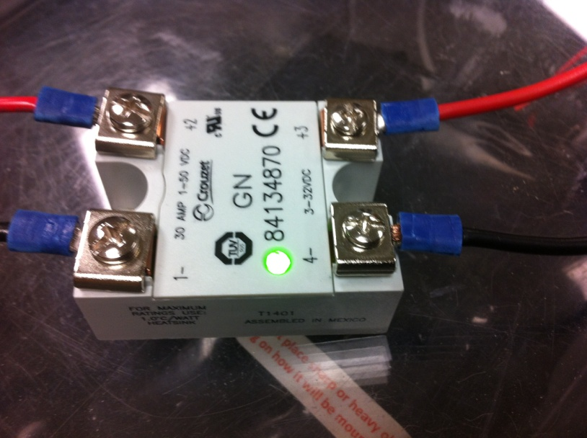
System Shutdown
Zachary Barr
Requirements:
Internal Shutdown Button
External Shutdown Button
Isolated propulsion system
External Shutdown Button
Internal Shutdown Button
Relay

Slide 14
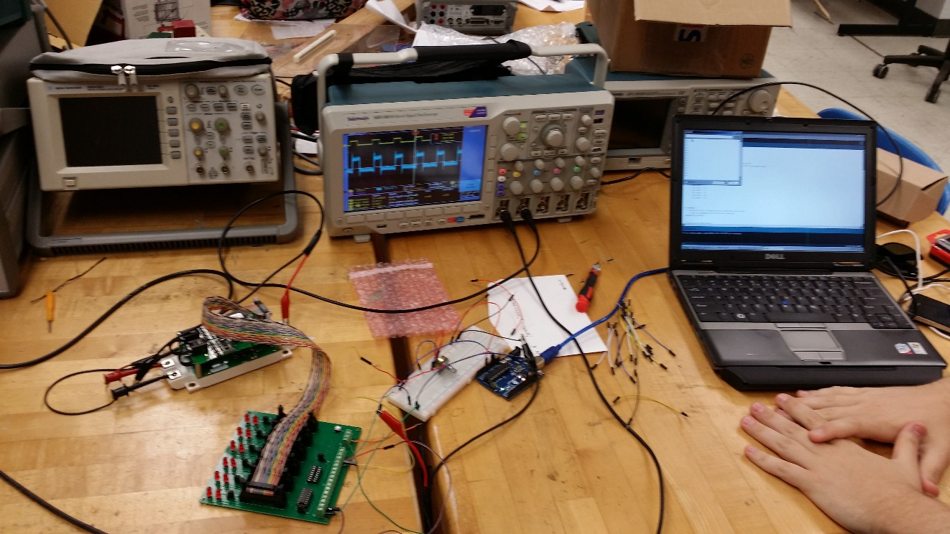
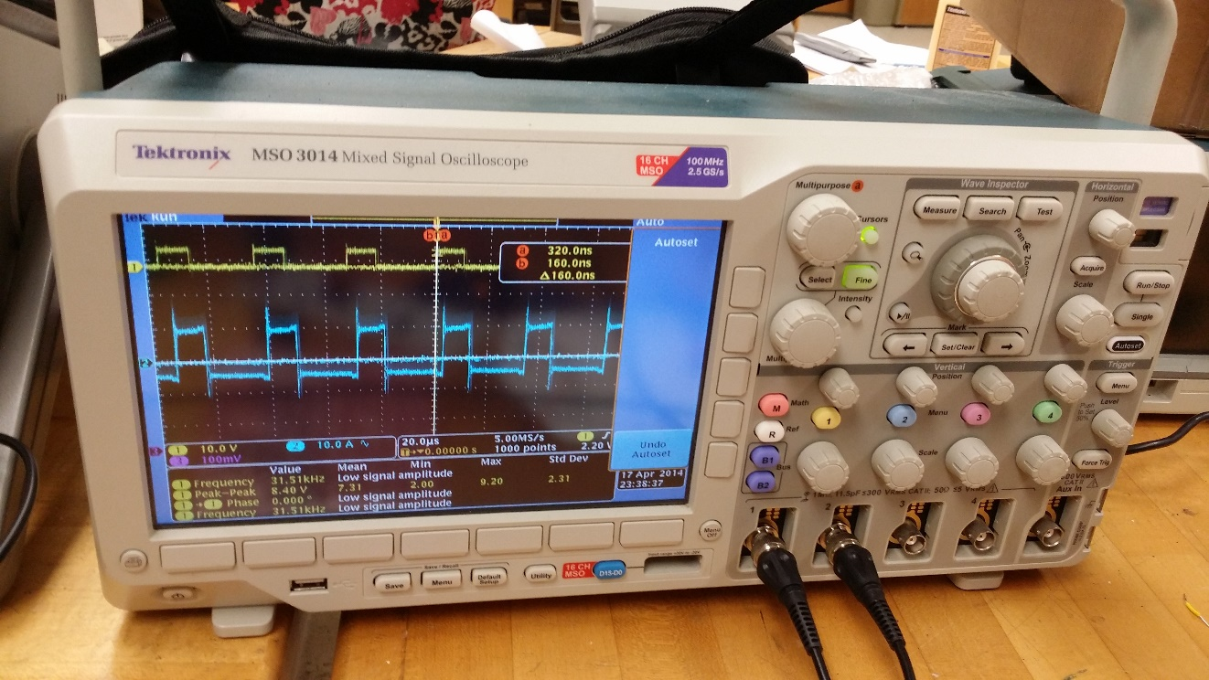
Motor Controller
Fritz Jeanty
Requirements:
Purpose Built
Drive 500W motor with 24V battery
Original Coding
New Motor Controller
Testing

Slide 15
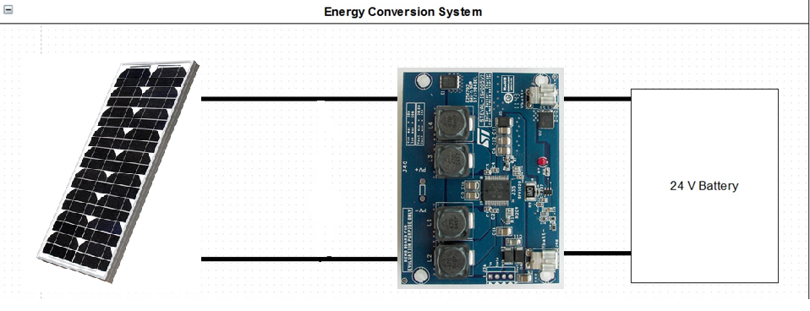
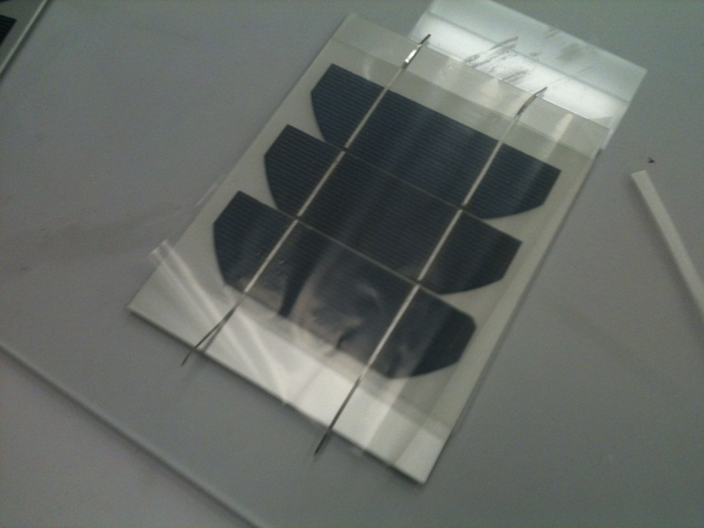
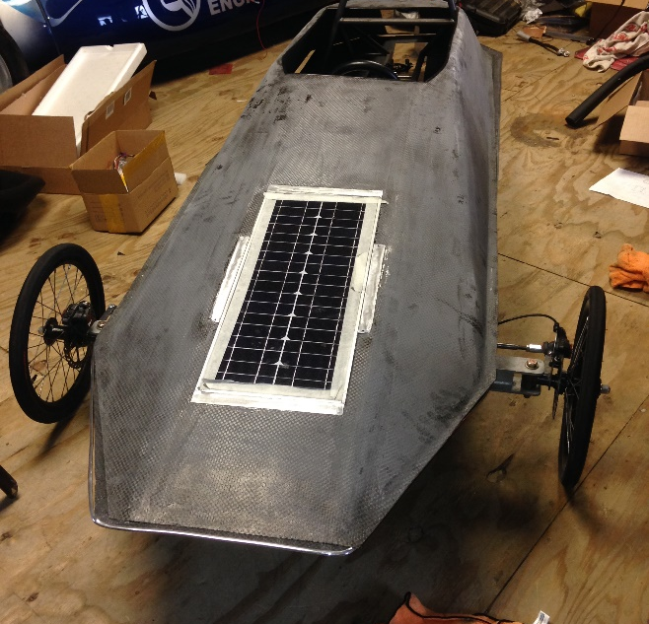
Solar Panels
Francois Wolmarans
Energy Conversion Diagram
Requirements:
Max Area = 0.17m^2
Charge 24V battery
Must be flush with chassis
Original Solar Panel Design
Installation
Final Solar Panels

Slide 16
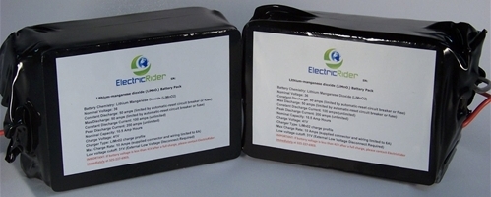
Battery
Julia Clarke
Requirements:
Only lithium ion batteries can be used as an electric storage device
Must contain a BMS system
BMS System
Battery

Slide 17
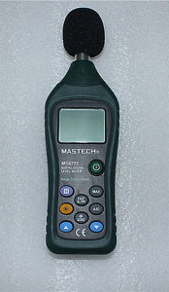
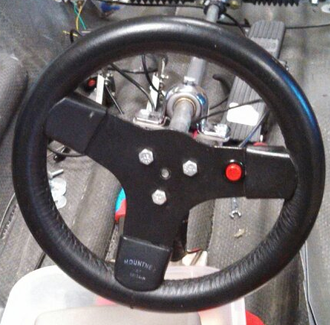
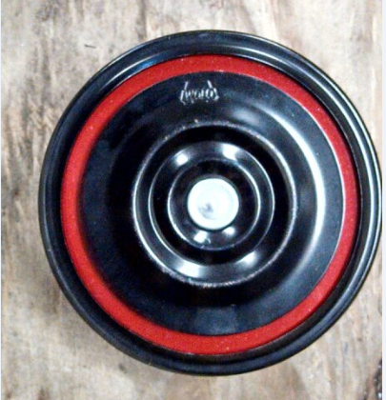
Horn
Julia Clarke
Requirements:
85 decibels from 4 m away
420 Hz frequency
Testing
Horn Button
Horn

Slide 18
Budget Update
Francois Wolmarans
Person | Amount
David | $2322.09
Julia | $672.97
Total: | $2995.06
Description | Amount
Total Fundraised | $5000
Total Expensed | $2995.06
Total Budget Remaining | $2004.94
Introduction
Scheduling
Concept Generation
ME Overview
EE Overview
Budget

Slide 19
Questions

