Slide 1


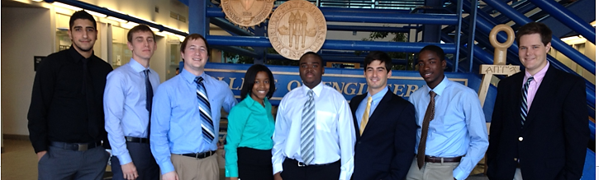
Shell Eco-Marathon
FAMU-FSU 2014 Solar Car
Milestone #2 Presentation
Team #2

Slide 2
Qualifications
Fritz Jeanty- Responsible for the motor controller. Fritz has taken courses related to motor controller including C++ programming, Digital Logic, electronics, and Microprocessor based system design.
Francois Wolmarans- Responsible for finances, and ergonomic design. In addition to his experience in education and research at HPMI, he has founded 3 start ups (of which 2 have been profitable).
Jose Cardenal- Responsible for safety considerations, and ergonomic design, and manufacturing. His previous job in process improvement and analysis and a research assistant at HPMI allow him to qualify for this task.
Julia Clarke- Responsible for accessory battery. Clarke is currently enrolled in courses relating to batteries and has a great interest in batteries.

Slide 3
Qualifications
Zachary Barr- Responsible for the DC-DC convertor. His experience in soldering electronics and Multisim qualify him to work this aspect of the project.
Wael Nabulsi- Installations manager. His employment at the Applied Super Conductivity center, in addition to his previous coursework allow him to do this job effectively.
David Joliceur- Responsible for all mechanical designs. He is currently enrolled in energy conversions for sustainability and vehicle design, which complement the project.
James Croasmun- Responsible for front wheel mount system and steering assemblies. He has completed various courses related to his responsibilities.

Slide 4
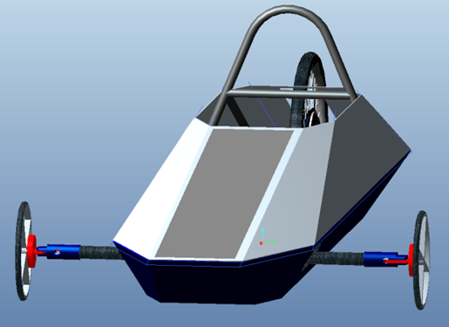
Shell Eco-Challenge Marathon
Urban Concept and Prototype
Divisions
FAMU/FSU Participation
Registration
Francois Wolmarans

Slide 5

Introduction
Acknowledgements
General Problem Statement
General Solution Approach
Operating Environment
Intended Use(s)/User(s)
Assumptions and Limitations
Francois Wolmarans

Slide 6
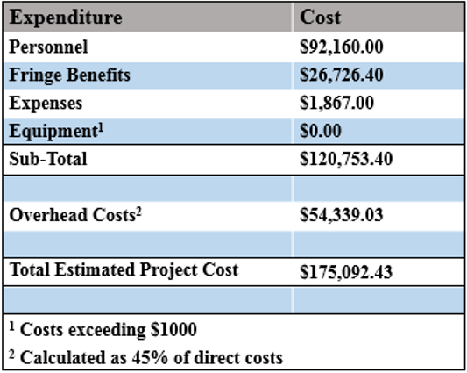
Budget Summary
Francois Wolmarans

Slide 7
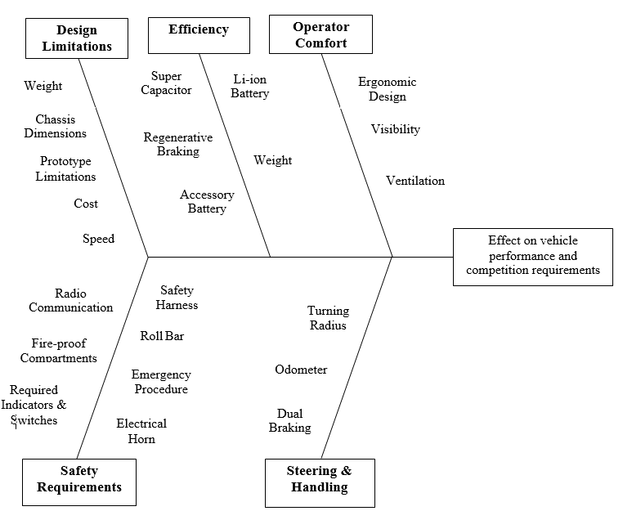
Fish Bone Analysis
What:
Team brainstorming approach to determine the voice of the customer
How:
Using required and desired capabilities
Why:
Allows the team to determine the major vehicle components
Jose Cardenal

Slide 8
House of Quality Results:
What is the HOQ:
Quality Function Deployment tool
  Helps determine VOC
Allows the team to prioritize tasks and vehicle components
Points out positive and negative correlations
How it was created:
HOQ What's:
Customer Requirements
HOQ How's:
Vehicle, components, specifications, and major factors
Results:
Saftey
Cost
Weight
Jose Cardenal

Slide 9
Comparison Matrix
Design Options | Safety (0.432) | Cost (0.208) | Component Weight (0.187) | Implementation (0.173) | Total
Design 1 | 3 | 3 | 3 | 3 | 3
Weight Legend:
Safety = 0.432
Cost = 0.208
Weight = 0.187
Implementation = 0.173
Optimization Legend:
1 least optimal
2 more optimal
3 most optimal
nth more optimal
Jose Cardenal

Slide 10
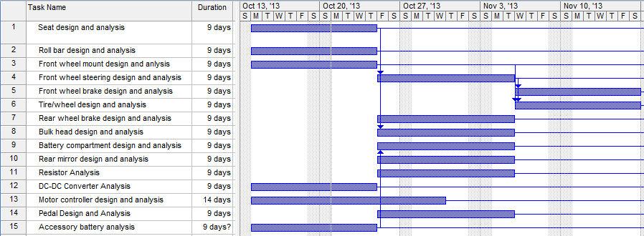
Design Phase Gant Chart
Jose Cardenal

Slide 11
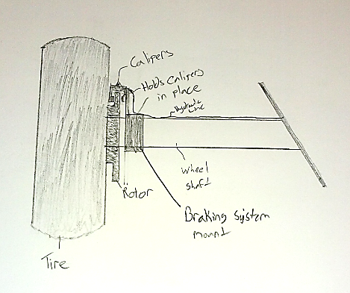
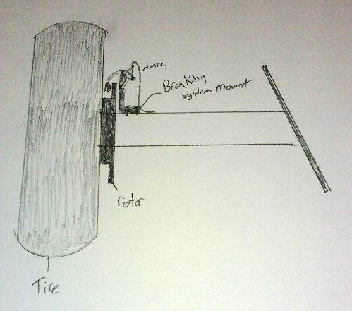
Front Brake Designs
Design 1
Design 2
James Croasmun

Slide 12
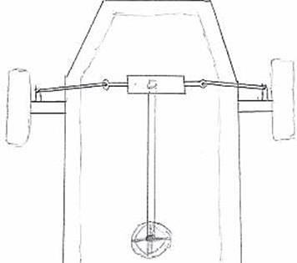
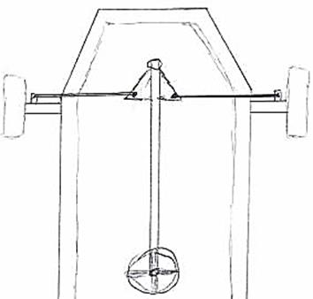
Steering System Design
Design 1
Design 2
James Croasmun

Slide 13
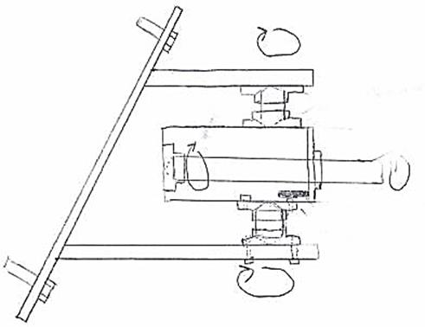
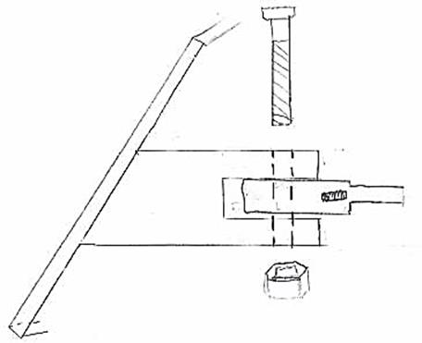
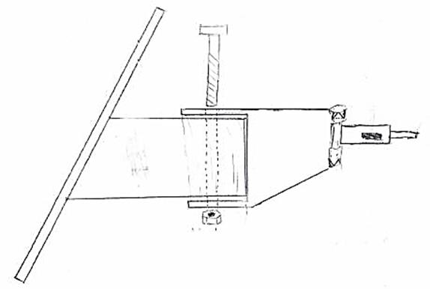
Front Wheel Mount &
Steering Assembly
Design 3
Design 1
Design 2
James Croasmun

Slide 14
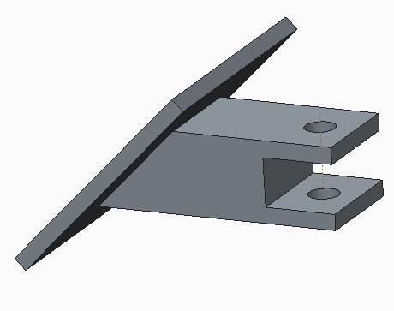
Front Wheel Mount and Steering Assembly
Design Options | Safety (0.432) | Cost (0.208) | Component Weight (0.187) | Implementation (0.173) | Total
Design 1 | 3 | 3 | 3 | 3 | 3
Design 2 | 2 | 1 | 1 | 1 | 1.432
Design 3 | 1 | 2 | 2 | 2 | 1.568
Design 1
Design 1
James Croasmun

Slide 15
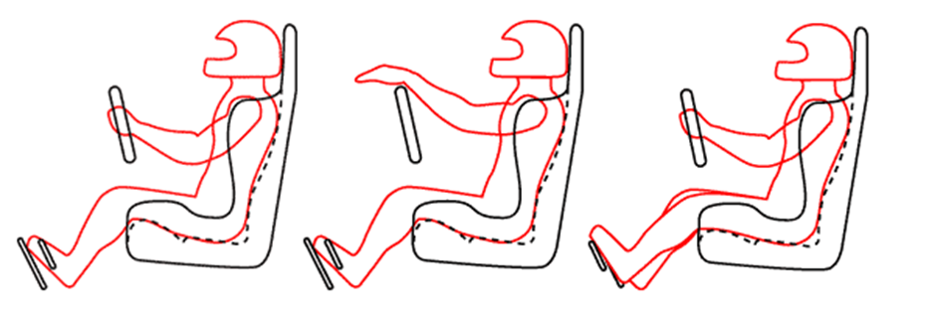
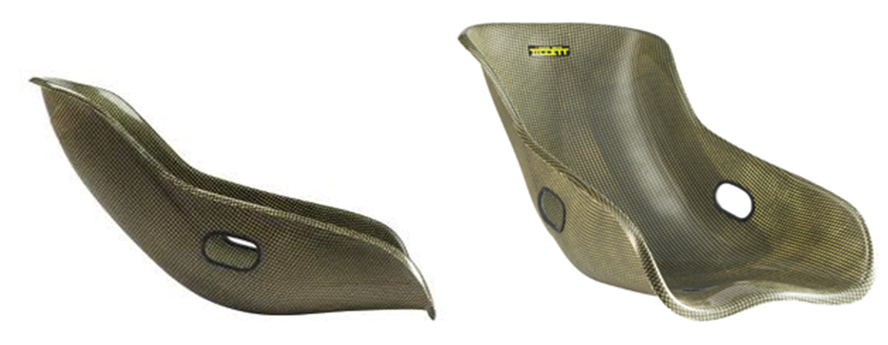
Seat Designs
Design Considerations
Design 1
David Joliceur

Slide 16
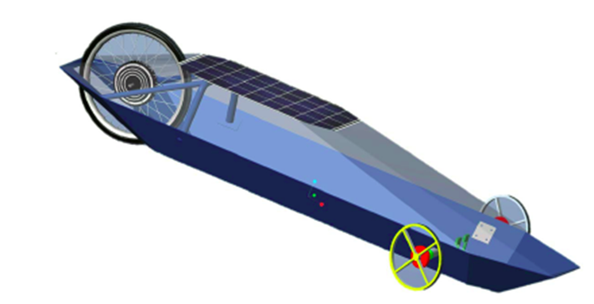
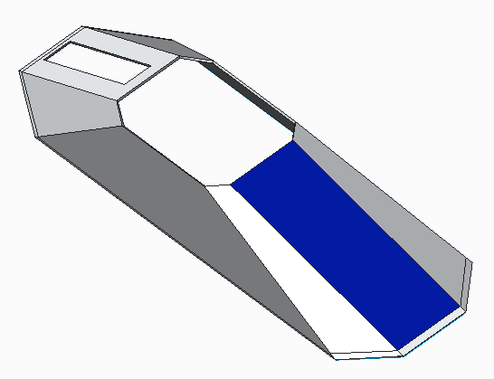
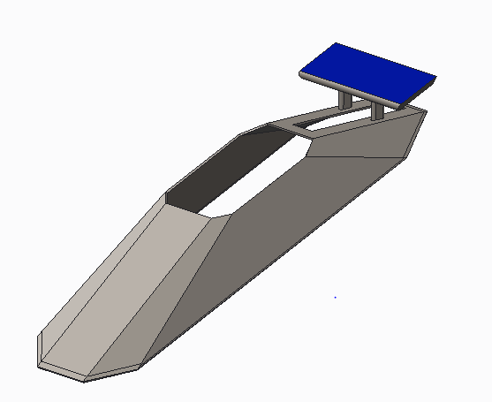
Solar Panel Placement and Implementation
Design 1
Design 2
Design 3
David Joliceur

Slide 17
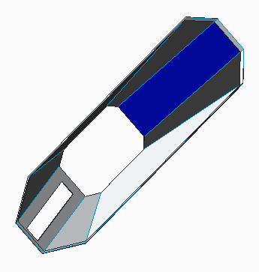
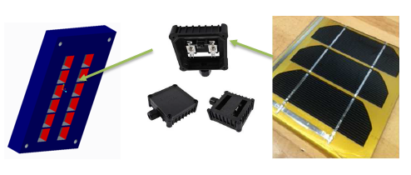
Proposed Design
Design Options | Safety (0.432) | Cost (0.208) | Component Weight (0.187) | Implementation (0.173) | Total
Design 1 | 1 | 2 | 3 | 2 | 1.755
Design 2 | 2 | 3 | 2 | 3 | 2.381
Design 3 | 3 | 1 | 1 | 1 | 1.864
David Joliceur

Slide 18
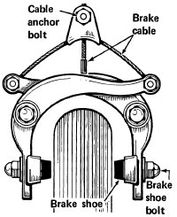
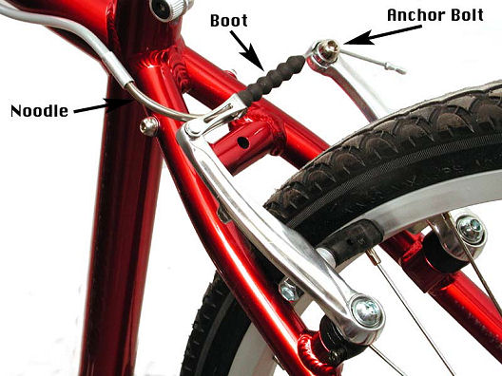
Rear Brakes
Design 1
Design 2
Wael Nabulsi

Slide 19
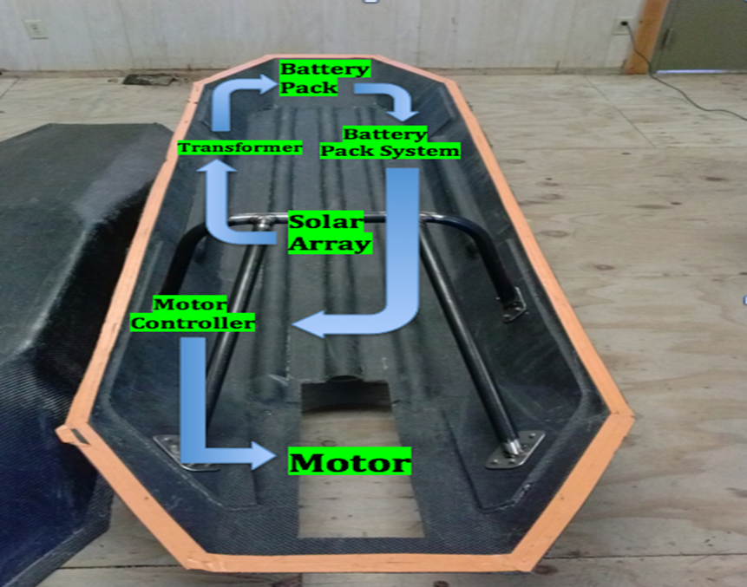
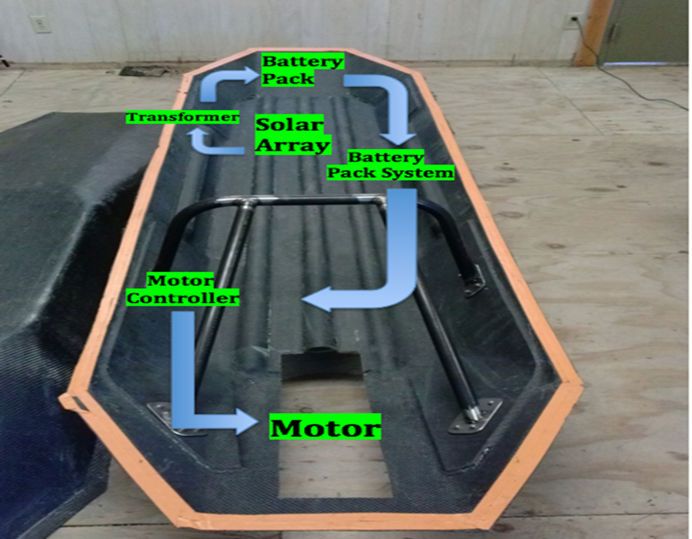
Component Placement
Component Placement 1
Component Placement 2
Wael Nabulsi

Slide 20
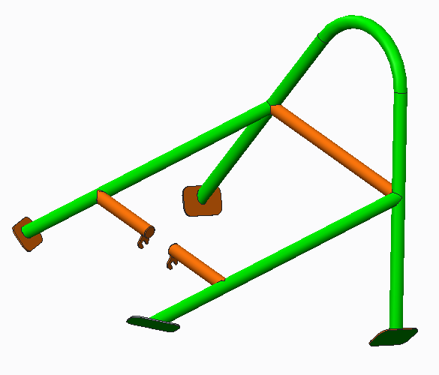
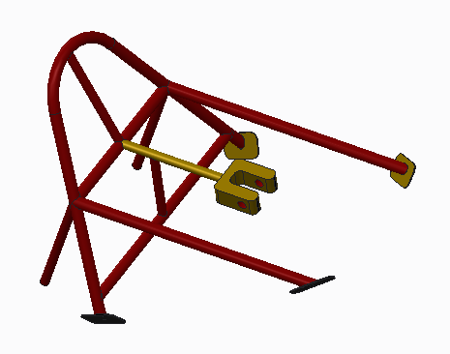
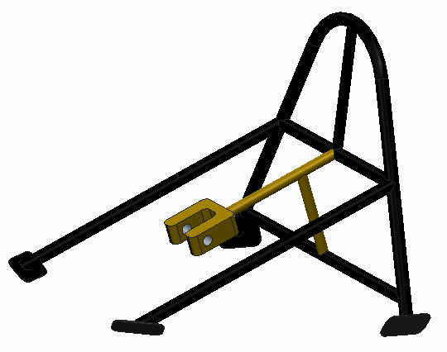
Roll Bar / Wheel Mount Design
Design 1
Design 3
Design 2
Wael Nabulsi

Slide 21
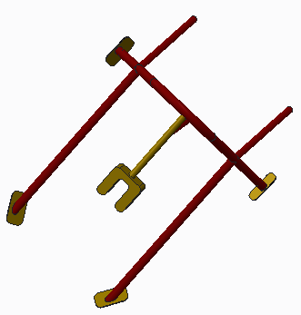
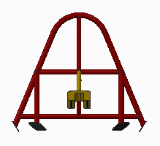
Roll Bar Design 3
Design Options | Safety (0.432) | Cost (0.208) | Component Weight (0.187) | Implementation (0.173) | Total (1.000)
Design 1 | 1 | 3 | 3 | 1 | 1.963
Design 2 | 2 | 2 | 2 | 2 | 2.000
Design 3 | 3 | 1 | 1 | 3 | 2.210
Design 3
Wael Nabulsi

Slide 22
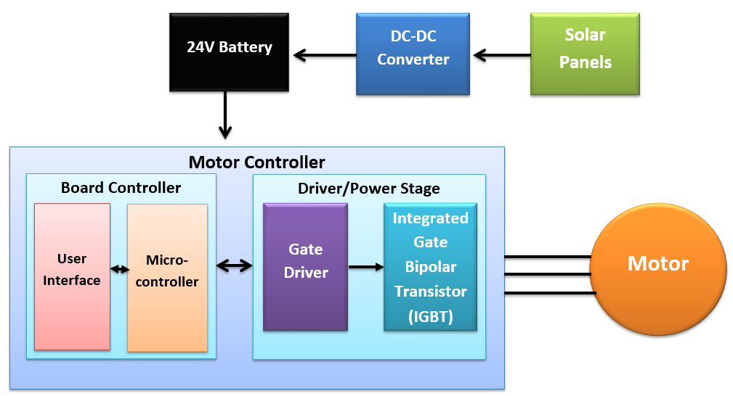
Electrical Component Block Diagram
Electrical Component Placement Diagram
Fritz Jeanty

Slide 23
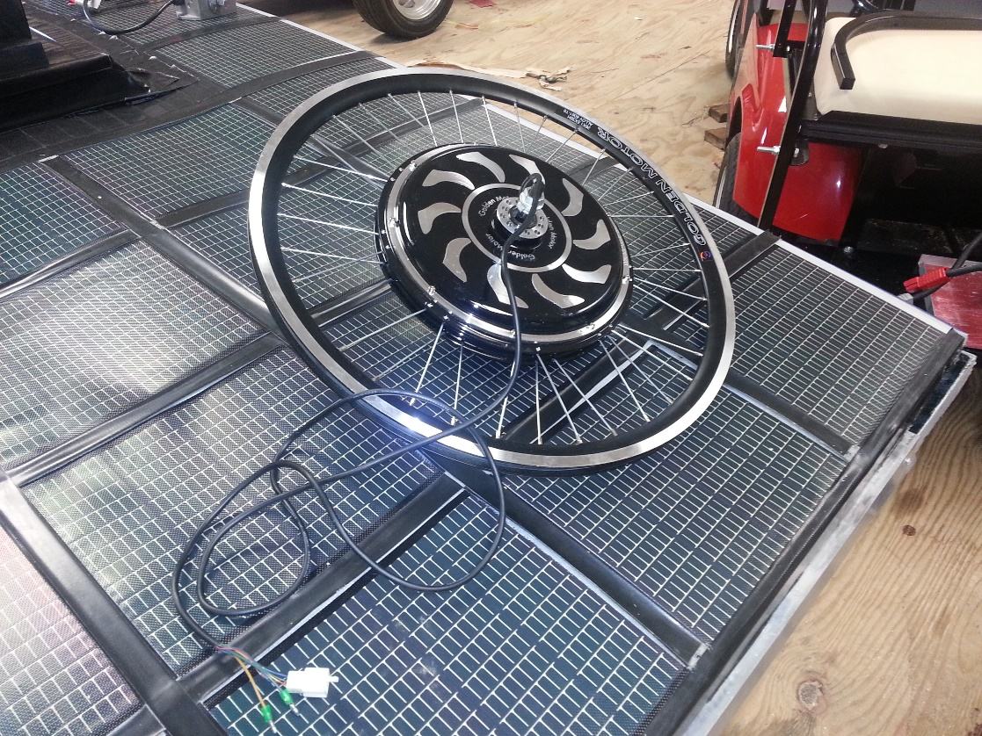
Brushless 3-Phase Motor
Motor Specifications
  24Volts
  250-750W
  30A
Single Board Controller options
  RDK-BLDC
  TI MSP430 LAUNCHPAD
  TI TMS320F28
          ATAVRMC100
Driver Gate Options
  IR3230SPBF
  TI DRV8301DCA
Golden Motor Magic Pie Motor
Fritz Jeanty

Slide 24
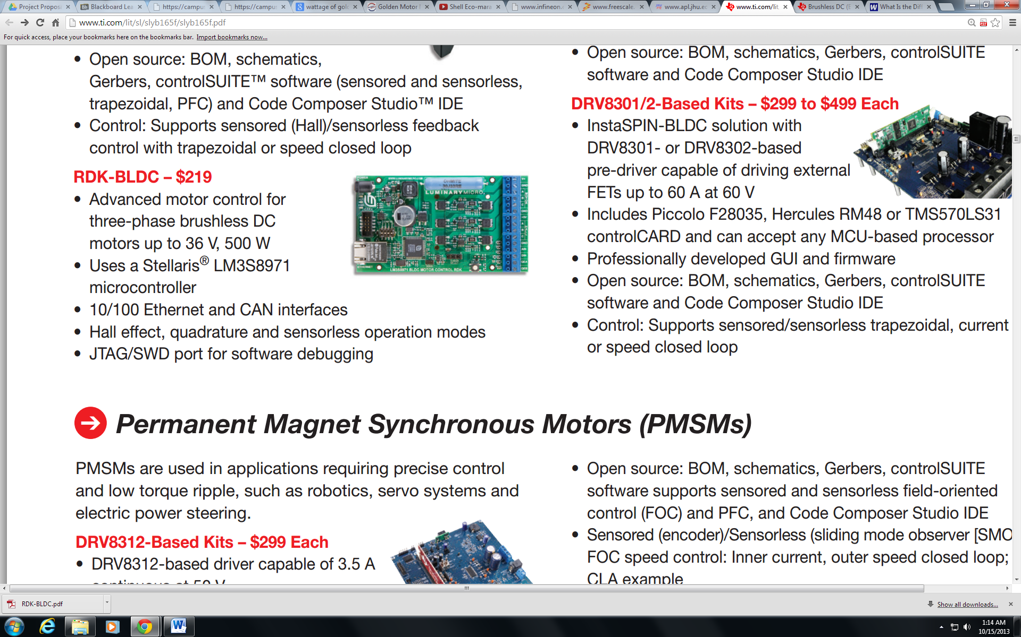
Motor Controller
Single Board Controller Comparison Matrix
Design Options | Safety (0.432) | Cost (0.208) | Efficiency (0.187) | Implementation (0.173) | Total (1.000)
Design 1 | 3 | 3 | 4 | 4 | 3.36
Design 2 | 1 | 4 | 1 | 1 | 2.296
Design 3 | 2 | 1 | 2 | 2 | 1.56
Design 4 | 4 | 2 | 3 | 3 | 2.776
Advantages
Supports and includes a three phase brushless motor
On board breaking circuit for protection against unsafe current levels
Screw Terminals allow direct input source for the propulsion battery
TI RDK-BLDC Motor Controller
Fritz Jeanty

Slide 25

Gate Driver
Gate Driver Comparison Matrix
Design Options | Safety (0.432) | Cost (0.208) | Efficiency (0.187) | Implementation (0.173) | Total
IR 3230SPBF | 1 | 2 | 1 | 1 | 1.208
TI DRV8301DCA | 2 | 1 | 2 | 2 | 1.792
Advantages
Over current protection
Specifically for three phase motor drive applications
Current Shunt amplifiers that support bi-directional current sensing
TI DRV8301DCA
Fritz Jeanty

Slide 26
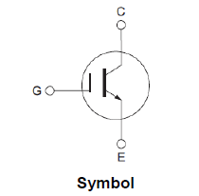
IGBT
Operate more efficiently at higher temperatures
Higher Voltage, Current and Power rating
  Motor operate at minimum 250W
Fritz Jeanty

Slide 27
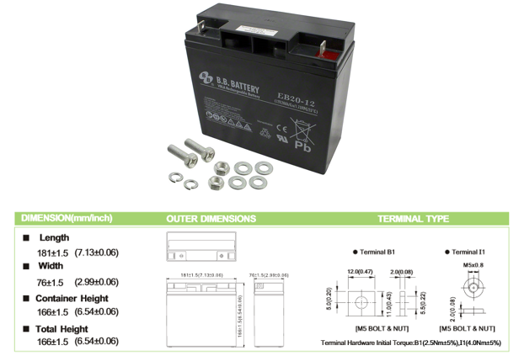
Accessory Battery
Electrical Engineers have considered using a 12V accessory
A 12V lead acid rechargeable battery with a 20Ah capacity
By forgoing the accessory battery the horn and ventilation system would be hooked up to the primary battery
Adding additional components would make the car less efficient
Accessory battery
Julia Clark

Slide 28
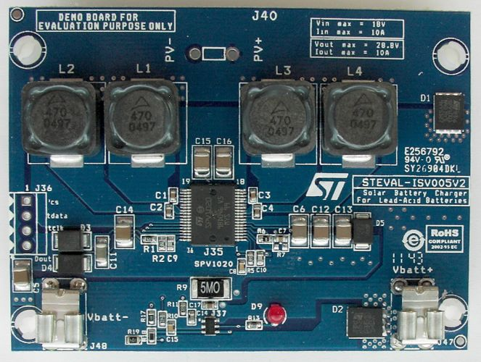
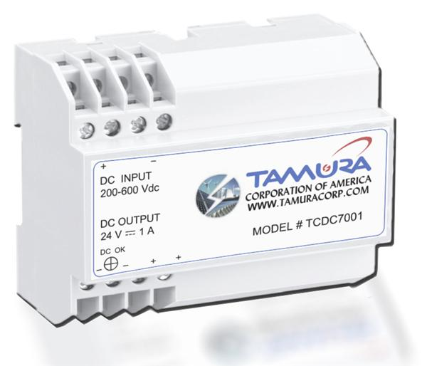
DC-DC Converter
TCDC7001
Cost: $90
80% Efficiency
Over Voltage, Over current Over Temperature, and short circuit recovery
Plastic Insulation
ISV005V2
Cost: Free
98% Efficiency
Overvoltage, Over current, and Over Temperature Protection
ISV005V2
TCDC7001
Zachary Barr

Slide 29
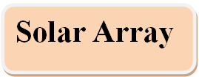



DC-DC Converter Test Summary
  8-9V
  3-3.5A
  Output voltage is 24V
  Output from converter: 20V
    Conclusion: Watt meter absorbs 5V
  Once connected, voltage drops and battery does not charge
Zachary Barr

Slide 30
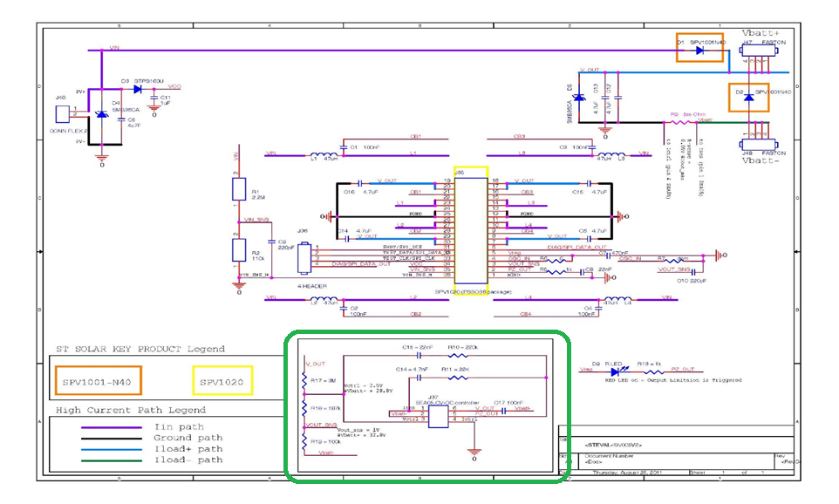
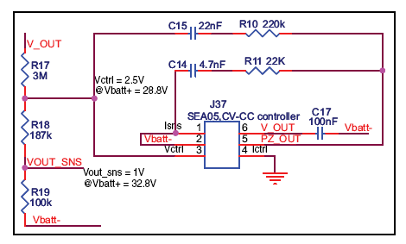
Circuit Schematics
Zachary Barr

Slide 31
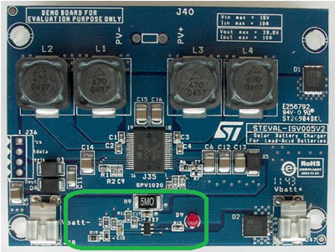
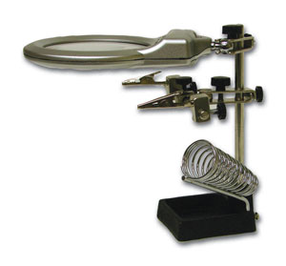
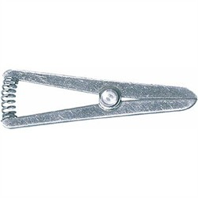
Micro-Soldering
The Safety/integrity of the board is paramount
Tools:
  Heat Sink
  Helping Hands
Risks
  Entire board could be rendered useless
ISV005V2
  Helping Hands
  Heat Sink
Zachary Barr

Slide 32
Acknowledgments

Slide 33

Questions

Slide 34
References

