Slide 1
“Wear It” Impact Baseball Vest
Garth Fletcher
Kyler Hast
Kyle Meredith
Team Members
Maria Miro
Ryne Wickery
Cecilia Wong
Mechanical Engineering Advisor
Dr. Amin
Industrial Engineering Advisor
Dr. Olawale
Project Sponsor
Gavin Boone
Kyle Meredith

Slide 2
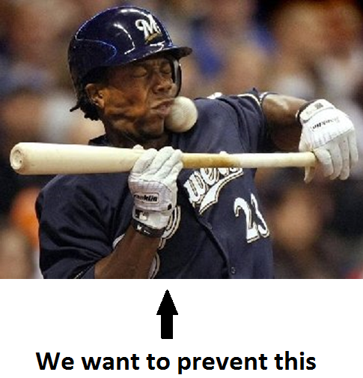
General Overview
Background
Customer Requirements
Project Scope
Project Overview
Design Constraints
Design Considerations
Material Selection
Impact Analysis
Ergonomics
Safety
Proposed Budget
Future Plans
Final Design Selection
Prototype
Manufacturing
Schedule Update
Kyle Meredith

Slide 3
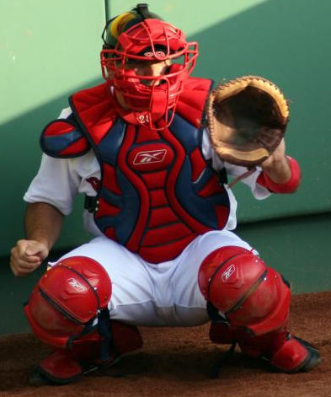
Background
Batter may incur severe or painful injuries often from being hit by a baseball in torso/neck region.
These types of injuries deter younger children from continuing to play the game of baseball.
With an effective design of a protective vest, injuries to areas like the spine and neck can be prevented.
No current protection available.
Kyle Meredith

Slide 4
Customer Requirements
Vest must protect batter from hit by pitch.
Vest must allow for player to retain range of motion.
Vest must be worn over top of the uniform.
Vest should be lightweight.
Vest should be affordable.
Cecilia Wong
Notes:
Safety: the vest must protect the players from being hit by a pitch.
Player Performance: the vest must allow for player to maintain freedom of movement.
Functionality: the vest must be worn over the uniform so its easy to take of after batting, or at first base.
Lightweight: the vest must not add significant weight on the player, so his speed is affected.
Cost: vest should be affordable for mid-class families.

Slide 5
Customer Requirements
Most important:
Vest size.
Vest shape.
Weight
Cecilia Wong
Notes:
Form the analysis in our House of Quality: it was taken into consideration the relationship between our customer requirements and the technical requirements. As well as the correlation of the technical requirements. And we found that the most relevant technical requirements that we will have to look into are, vest size, vest shape and weight. This 3 requirements are the ones that will have a “control” over the others in order to have an optimal design that satisfies our customer requirements.

Slide 6
Scope
Design vest to protect batter when hit by a pitch.
Design a vest that is aesthetically pleasing and therefore marketable.
Design a vest than can be adapted to players of different sizes.
Design a vest that protect without impeding a batter’s motions.
Construct a prototype and develop a manufacturing methodology.
Kyle Meredith

Slide 7
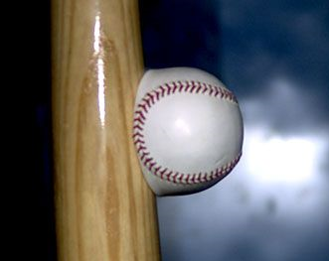
Project Overview
FALL
Define Constraints
Brainstorm Ideas / Design Considerations
Material Selection
Impact Analysis
Ergonomics
Safety
SPRING
Design Selection
Build Prototype
Devise Manufacturing Method
Kyle Meredith

Slide 8
Constraints
Must withstand impact force of 100 mph baseball.
Should weigh under 7 pounds.
Name / Number must be visible while wearing vest.
Should achieve quick application/removal.
Should not impair range of motion.
Maria Miro

Slide 9
Design Considerations
Prevent Damage
Padding in critical areas only [reduce weight]
Hard plate to spread out force
Spring board plates
Inside Padding
Retain Range of Motion
Minimal material in moving areas
Divide padding into small sections
Minimize collar
Use of elastic materials
Maria Miro

Slide 10
Design Considerations
Lightweight
Lightweight materials
Remove unnecessary materials
Minimize thickness
Minimize padding
Worn Over Uniform
Quick securing (Velcro/snaps/etc.)
Transparent material in number area
Interchangeable numbers (Velcro/pouch/etc.)
Aesthetically pleasing
Maria Miro

Slide 11
Material Selection
Kyler Hast

Slide 12
Material Selection
Chose Carbon Fiber for final plate material selection
Manufacturing Carbon Fiber plates is simpler than processing silicon into desired plates
Kyler Hast

Slide 13
Impact Analysis
Calculation Assumptions
1 Dimensional
Elastic region
Uniform force
Constant force
Speed of sound of rubber
About 60 m/s
Assumed to be a solid rubber ball
Used to calculate impact time.
Ryne Wickery

Slide 14
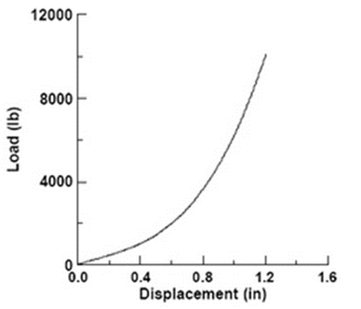
Impact Analysis
Impact time
2.455*10⁻³ sec
Force of ball at 100mph
2.581 kN (580 lbf)
Surface area of ball compressed
0.503 in²
Impact Energy = 141 J
E_{CFRP_absorb.} = 2059 J
F.S = 14.5
Ryne Wickery

Slide 15
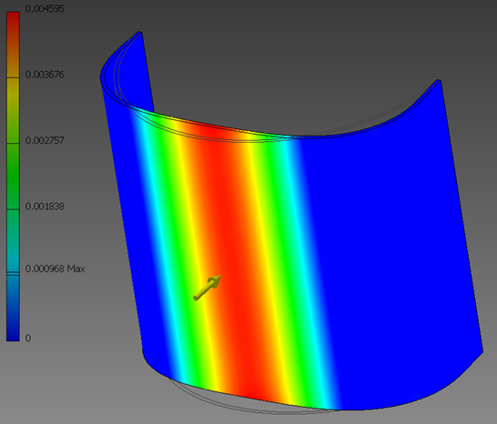
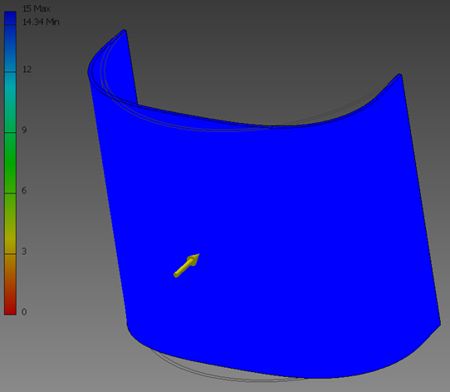
Impact Analysis
Rib Plate: Deflection (inches) [left] & Safety Factor [right]
Ryne Wickery

Slide 16
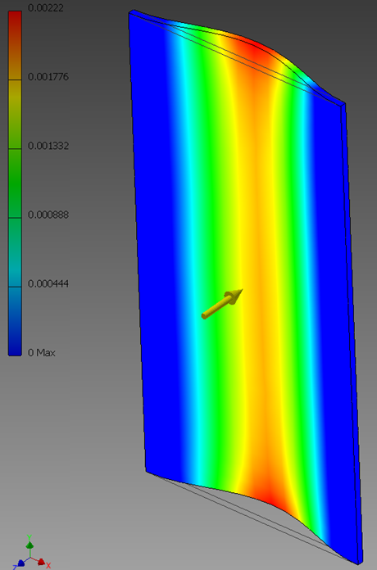
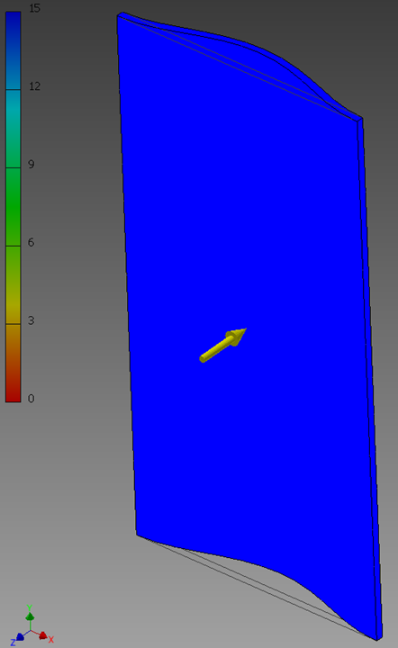
Impact Analysis
Spine Plate: Deflection (inches) [left] & Safety Factor [right]
Ryne Wickery

Slide 17
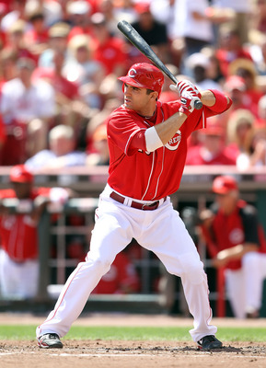
Ergonomics
Collar piece height shouldn’t be the same on the front than at the back of the neck.
The arrangement and size of the padding should follow the form of the muscles underneath.
The arm holes should not cover the shoulder area to allow free range of movement.
The length of the vest shouldn’t exceed the waist of the player.
Cecilia Wong
Notes:
Because we are making a product that is going to be wear by our customers, we have to consider ergonomic analysis.
We have to consider the interaction between the human body and the vest.
Our focus the neck. The collar height has to vary from the back to the front, because on the front, the collar must not impede the rotation of the head, plus the ear protection of the helmet.
For a better acceptance of our product we have to consider that the shape of the padding used to protect the body should mimic or by similar to the form of the muscles underneath.
Also, to allow free arm movement, the armholes shouldn’t cover the shoulder area, the entire semi-sphere of the shoulder is not confined and able to move in every direction. The opening would start closer to the neck, and on the bottom, it should go up to under the pectorals, so when the arms are raised the vest doesn’t cause pressure under the armpits.
Because the players bend forward while in a squatting position, and swing to an almost straight position, the vest length should not go over the waist level. the players wont feel discomfort in its lower abdomen, and also on the upper part of the thighs as its squads.

Slide 18
Safety
Fabric or buffering material should be thick enough to prevent skin injuries from shattered material.
Vest must allow the transfer of body heat to the environment as players performs.
Possible risk analysis.
Cecilia Wong

Slide 19
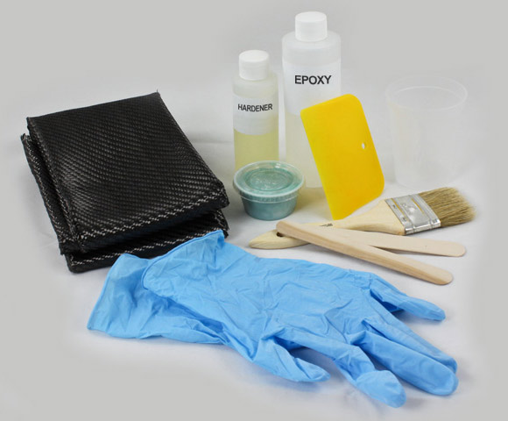
Proposed Budget
Carbon fiber fabric 5.7 oz
$36 per sq. yard
Fiberglass fabric 6 oz
$7 per sq. yard
Polyester resin
$24 per quart
Closed cell foam pad
$12 for 72in x 20in x 3/8in sheet
Kyler Hast

Slide 20
Future – Design Selection
Collar Dimensions
1.5” – 2.5” tall
210º @ 2.5” - 4.5” radius
Spine Plate Dimensions
3” – 4.5” wide
16” – 20” tall
Rib Plate Dimension
6” – 9” tall
85º @ 3” – 6.5” radius
Kyler Hast

Slide 21
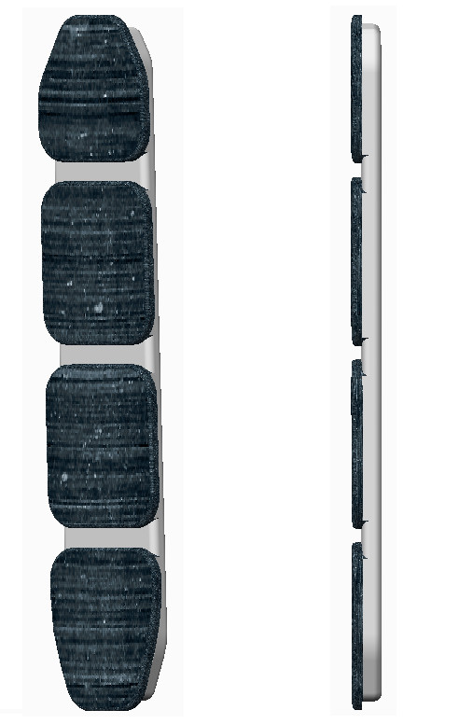
Possible Design Concepts
Kyler Hast

Slide 22
Possible Design Concepts
Kyler Hast

Slide 23
Future – Design Selection
Critical Protection Areas
Neck
Spinal Region
Ribs
Kidney / Liver / Exposed Organs
More Analysis Required
Possibly real-world testing of prototype.
Kyler Hast

Slide 24
Future - Prototype
Prototype will be created for testing next semester
It will allow us to test behavior of carbon fiber plates under impact
We can attched padding material to plates to determine cushioning characteristics
Maria Miro

Slide 25
Competitive Priorities
Cost
Delivery
Selling price
Manufacturing cost
Value-addded cost
Price performance
Ability to keep promises
Quality
Flexibility
Material quality
Output quality
New product
Performance
Aesthetics
Technical durability
Maria Miro

Slide 26
Future - Manufacturing
Process choice: Batch Flow
Manufacturing Strategy: Made-to-Stock (MTS)
Choice of machine: Industrial sewing machine
Operations Strategy:
Order qualifier: Safety
Order Winning: Quality, Performance & Price
Garth Fletcher

Slide 27
Future - Quality
Would like to develop a process to achieve 6-sigma production standards (3 defects per million).
Comply with ISO 9000 requirements.
Introduce aftermarket accessories to protect additional areas if time permitting
Coping with changes in demand.
Garth Fletcher

Slide 28
Updated Schedule
Garth Fletcher

Slide 29
Questions?

Slide 30
References
http://www.acs.psu.edu/drussell/bats/nonlinear-ball.html

