Slide 1
“Wear It” Protective Vest
Sponsor: Gavin Boone
Faculty: Dr. D. Olawale, Dr. K. Amin
Ryne Wickery
Kyle Meredith
Kyler Hast
Cecilia Wong
Maria Miro
Garth Fletcher

Slide 2
Project Scope
Design Vest to protect baseball batter from damage to vital torso regions
Objectives
Withstand impact of 100 mph baseball
Allow batter to retain range of motion/movement
Prevent bruising/fracture/breaking of ribs, spinal cord, and neck
Kyle Meredith

Slide 3
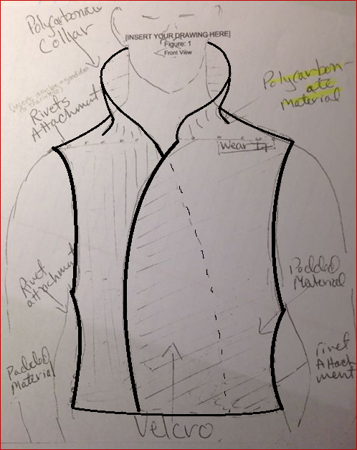
Design
Use of Sponsor’s desired design
Kyle Meredith

Slide 4
Baseball Analysis
m = 5 oz = 0.142 kg
Vmax = 100 mph = 44.7 m/s
E = 0.5*m*Vmax² = 141.638 N*m
Radius = 1.5 in = 3.81 cm
Circumference = 9.42 in = 23.9 cm
Ryne Wickery

Slide 5
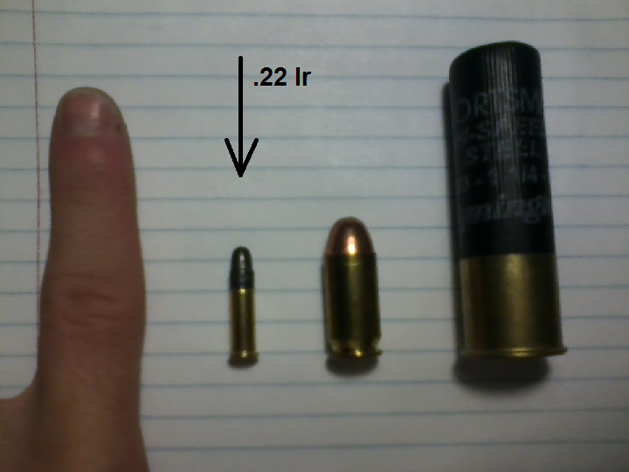
Baseball Analysis
Same energy as 40g .22 lr round
Ryne Wickery

Slide 6
Impact Analysis
Baseball carries 141.638 N*m of energy at 100 mph
Impact occurs over estimated 0.2 sec
F = m*(dv/dt) = (0.142kg)(44.7m/s)/(0.2sec)
The resulting force upon impact is 31.683N
Ryne Wickery

Slide 7
Impact Analysis
Difficult to compare to bullet proof vest
Bullet-proof vest has to absorb impact and also prevent penetration (with emphasis on penetration)
Baseball vest only has to address impact absorption (no penetration factor from baseball)
Ryne Wickery

Slide 8
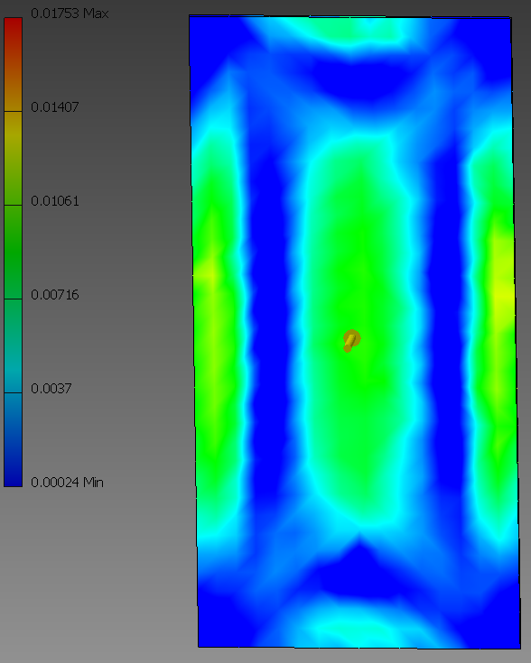
Stress Analysis
Force applied on the flat back plate section
Material tested is polystyrene, high impact
Units: ksi
Ryne Wickery

Slide 9
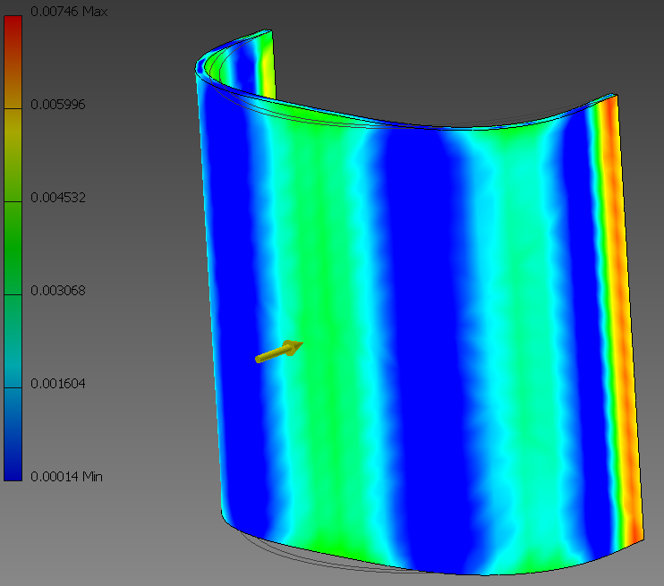
Stress Analysis
Force applied on the curved rib plate section
Material tested is polystyrene, high impact
Units: ksi
Ryne Wickery

Slide 10
Further Research
Difficulty finding force required to fracture rib/ spine or induce bruising.
Simulations can be helpful, but useless if we have no data to compare to.
Need to devise a way to determine what exactly we are trying to protect against.
Kyler Hast

Slide 11
Manufacturing Approach
No funding so theoretical right now.
Automation would be difficult due to complex sewing involved.
Likely use stiff material with padded backing, sewn into thin polymer vest.
Kyler Hast

Slide 12
Project Direction
Disciplines working on project together up until this point
IE and ME need to focus on separate avenues and then collaborate
Leads to better time management and time efficiency
Kyler Hast

Slide 13
IE Dominate Responsibilities
Design for optimization (manufacturability)
Ergonomics (fit)
Quality
Aesthetics
Kyler Hast

Slide 14
ME Dominate Responsibilities
Stress analysis
Impact resistance
Material research
Material selection
Kyler Hast

Slide 15
Current Future Plans
Determine energy required to bruise, fracture rib, fracture spine, and disrupt blood flow in neck artery
Continue Stress analysis on materials, including composites with hard and soft components
Devise geometry of compact surface (flat vs round, etc.)
Kyle Meredith

Slide 16
Current Future Plans
Theorize process for manufacturing of vest
Address ergonomic issues such as comfort, range of motion, extend use wear, etc.
Address quality issues such as viability of sustaining multiple impacts.
Kyle Meredith

Slide 17
Questions?

