Slide 1
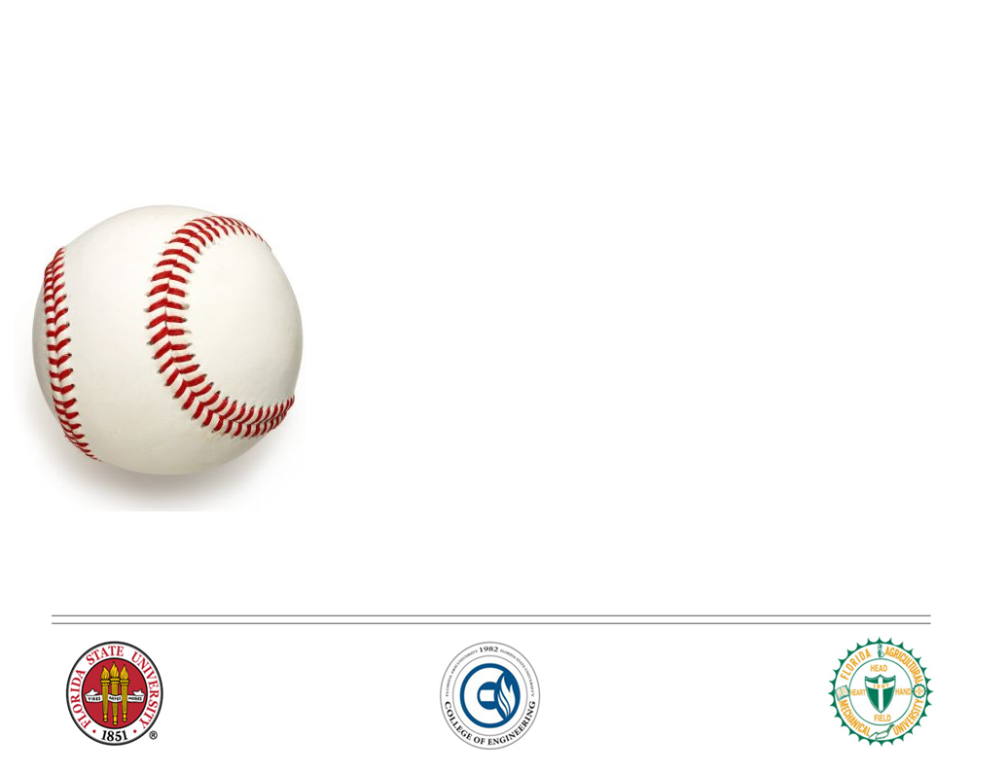
“Wear It” Baseball Vest
Garth Fletcher
Maria Miro
Cecilia Wong
Kyler Hast
Kyle Meredith
Ryne Wickery
Advisors
Dr. K. Amin
Dr. D. Olawale
Sponsor
Gavin Boone

Slide 2


Ages 0-15: 23.9 percent
Ages 16-30: 14.4 percent
Ages 31-45: 6.9 percent
Ages 46-60: 3.8 percent
Ages 61-75: 2.2 percent
Ages 76-98: 0.6 percent
“To enhance a player’s ability on the field, by endorsing confidence through safety”
Kyle Meredith

Slide 3
Overview
Sports equipment development company.
Specialized in athletic protective equipment.
Provision of innovative gear to protect players during sporting events.
Kyle Meredith

Slide 4
Sponsor Overview
Mr. Gavin Boone, candidate for an MBA at Florida State University
Currently works as an executive professional of sales at SANOFI, a leading global health care company
Served as Athletic Director at Holy Comforter Episcopal Middle School for 4 years
Has coached for many years at the high school level, specifically at A.C Flora and Duluth High Schools
Kyle Meredith
Notes:
The inspiration for this project arose from Mr. Boone seeing a player being struck in the back of the neck during a game.
Mr. Boone recognized there was a need for a protective garment that would protect the neck and other vital areas.

Slide 5
Product Need
The inspiration for this project arose from Mr. Boone seeing a batter struck in the back of the neck during a game.
Mr. Boone recognized there was a need for a protective garment that would protect the neck and other vital areas.
Kyle Meredith
Notes:
The inspiration for this project arose from Mr. Boone seeing a player being struck in the back of the neck during a game.
Mr. Boone recognized there was a need for a protective garment that would protect the neck and other vital areas.

Slide 6
Market Opportunity
2009 14,390 neck fractures.
  2,692 were sports related
With an effective protective collar, injuries to the spine and neck can be prevented
No current protection is available for the neck region
Ages 0-15 | 23.9 %
Ages 16-30 | 14.4 %
Ages 31-45 | 6.9 %
Ages 46-60 | 3.8 %
Ages 61-75 | 2.2 %
Ages 76-98 | 0.6 %
Kyle Meredith
Notes:
Batter may incur severe or painful injuries often from being hit by a baseball in torso/neck region.
These types of injuries deter younger children from continuing to play the game of baseball.
With an effective design of a protective vest, injuries to areas like the spine and neck can be prevented.

Slide 7
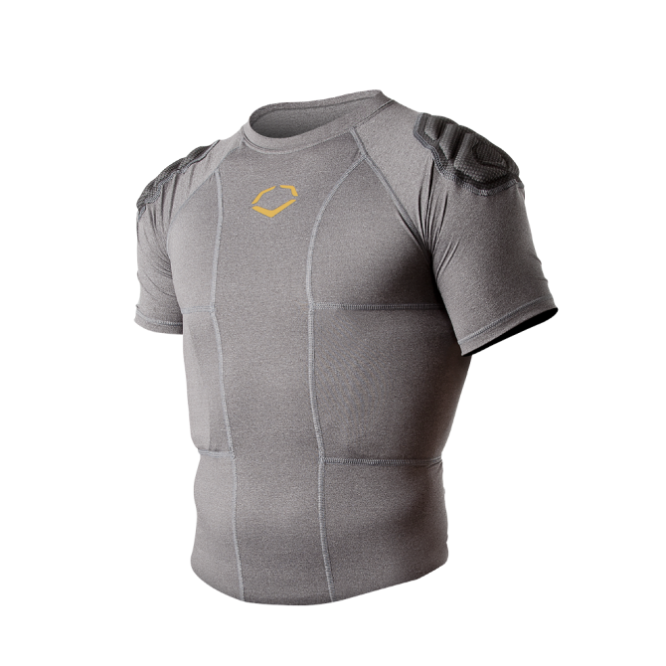
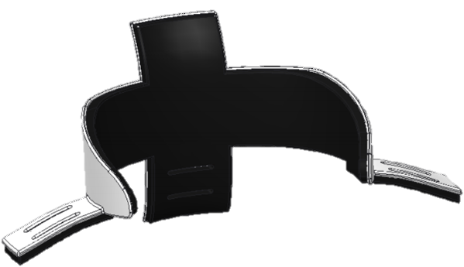
Competition
Direct
None
There is no current market offering of a batting protective collar
Indirect
EvoShield Torso Protection
Cooper Batting Vest
Adams Torso Padding Vest
Garth Fletcher

Slide 8
Project Scope
Design a collar to prevent injury from baseball impact.
Design the collar so it does not hinder motion/performance.
Design collar to be attached to the vest and/or to the body of the player.
Garth Fletcher

Slide 9
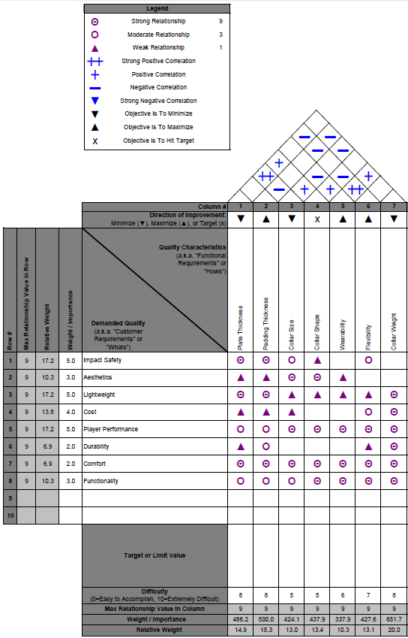
Customer
Requirements
Garth Fletcher

Slide 10
Customer Requirements
Customer Requirements
Impact Safety
Aesthetics
Lightweight
Cost
Player Performance
Durability
Comfort
Functionality
Technical Requirements
Plate Thickness
Padding Thickness
Collar Size
Collar Shape
Wear ability
Flexibility
Collar Weight
  486.2
  500.0
  → 651.7
Garth Fletcher

Slide 11
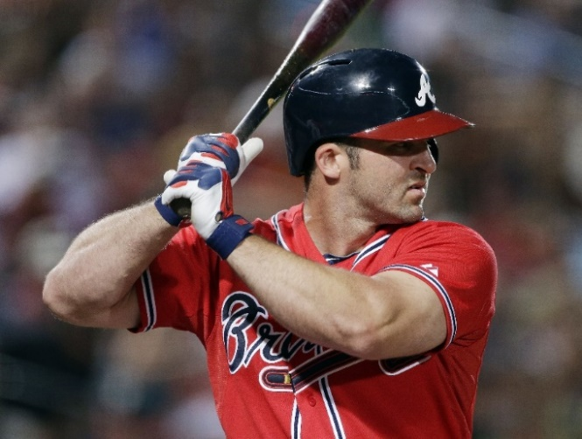
Human Factor
Range of Motion of head and neck
Comfort
    Size
      Based on average dimensions
    Weight
      Maximum of 11 oz. (Half of current helmet)
    Conformance to body shape
Garth Fletcher
Notes:
Comfort
Foam will be comfortable to player
Fit
Thermoplastic, and elastic foam will allow collar to be molded as desired [Retain mobility]
Safety
Collar will protect player from damage caused by impact
Chemical
Polyethylene and EVA will not react with skin of player that would cause rash or disturbance.
Range of motion:
Head:
- flexion, bend the head forwards; 40 to 60 degrees.
- extension, tilting the head backwards (like looking at the ceiling) 45 to 70 degrees
rotation, turning of the head to the sides, 60 to 80 degrees
Lateral bending: 45 degrees.
Shoulders:
Abduction: 150 degrees
Forward flex: 180 degrees
Extension: 45-60 degrees
Rotation: external – 90 degrees, internal – 70 to 90 degrees.
Comfort:
Size – maintain a small collar, to avoid impairing the players view and range of motion, based on the average neck height of 95% males. (6ft) from the baseball almanac.
Weight – based on complains from players having to wear a heavier helmet (rawlings 22 oz). Goal, our collar to be 50% lighter than the helmet.

Slide 12
Sizing
Body Measurements of Mature Men (in.) | Percentiles
 | 1st | 5th | 50th | 95th | 99th
Head Breadth | 5.5 | 5.7 | 6.0 | 6.3 | 6.5
Menton to Back | 6.2 | 6.5 | 7.2 | 7.9 | 8.2
Menton to Top of Head | 8.4 | 8.6 | 9.1 | 9.7 | 10.0
Menton to Sub-Nasal Length | 2.6 | 2.7 | 2.9 | 3.3 | 3.4
Base of Neck to Menton | 3.2 | 3.2 | 3.3 | 3.1 | 3.2
Base of Neck to Hair Line | 5.8 | 5.9 | 6.2 | 6.4 | 6.6
Accurate Fit
  99th percentile of mature male body measurements
Garth Fletcher
Notes:
Body dimensions:

Slide 13
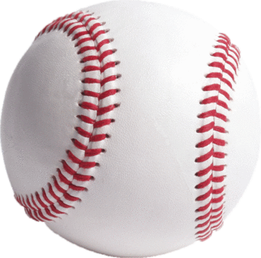
Baseball Dynamics
Force of Impact
    2,500 lbf
Surface area of ball compressed
    - 0.50 in²
Impact Energy
    141 J
Pressure of impact at 100mph
    5,000 psi
Ryne Wickery

Slide 14
Material Selection
Ryne Wickery

Slide 15
Hard Plate Material
Will be used as an impact surface, to disperse impact load
Last semester carbon fiber was chosen as hard plate material
  Rejected due to degrading mechanical properties upon impact
  Polyester matrix extremely brittle
  If failure occurs, the material could crack / splinter
This semester, a material was chosen based on stiffness, toughness, and strength
  Desired ability to minimize deflection (spread impact load)
  Ability to be molded to desired shape (ex. Thermoplastic)
Ryne Wickery
Notes:
Will be used for the hard shell of the collar.
Thermoplastic.
Relatively large strength-to-density ratio.
Currently used in bull riding protection vests, and also in ballistic protection.

Slide 16
Hard Plate Material
Hard Plate Material Comparison
Property | Polyurethane | HDPE | Kevlar
Density (g/cm^3) | 0.9-1.96 | 0.93-0.97 | 1.44
Tensile strength (MPa) | 35-56 | 40.5-48.3 | 3600-4100
Fracture Toughness (MPa*m^{1/2}) | 1.84-4.97 | 1.44.1.75 | -
Price ($/kg) | 4.10-5.60 | 1.20-1.85 | 35-100
High Density Polyethylene (HDPE)
Ryne Wickery
Notes:
Will be used for the hard shell of the collar.
Thermoplastic.
Relatively large strength-to-density ratio.
Currently used in bull riding protection vests, and also in ballistic protection.

Slide 17
Padding Foam
Will Be used as a backing material to the hard plate.
Hard plate will act to spread the impact load over a larger region and the foam will act to absorb the impact energy
Desired Properties
  Closed cell (minimal water absorption)
  Relatively large elastic deformation (energy absorption)
  Capable of full recovery after impact
  Lightweight
Ryne Wickery
Notes:
Padding material for the collar
Used in current protective gear
Water resistant (sweat)
Can be formed to collar shape
Recoverable
Relatively lightweight
Because of the higher tensile strength of the EVA foam, it is stronger than EPE. This is a good thing because
EVA shows a higher elongation @ break. The more it stretches, the more energy it can absorb when the ball hits it.
EVA foam's greater recovery characteristics make it an excellent choice
Stronger
Durable
Lasts longer
Worth the extra money spent
EVA, even it is more expensive, takes the lead in applications where product lifetime and sturdiness is of upmost importance.

Slide 18
Padding Foam
Padding Material Comparison
Property | EVA | PE
Density (kg/m³) | 28-33 | 28-33
Thickness (mm) | 3-40 | 3-40
Tensile strength (kPa) | 450 | 350
Elongation @break (%) | 200-250 | 150-200
Compressive strength (kPa) | 30 | 45
Water absorption (g/cm³) | 0.002 | 0.002
Price ($/sheet) | 35.55 | 28.16
Ethylene-Vinyl Acetate (EVA)
Ryne Wickery
Notes:
Padding material for the collar
Used in current protective gear
Water resistant (sweat)
Can be formed to collar shape
Recoverable
Relatively lightweight
Because of the higher tensile strength of the EVA foam, it is stronger than EPE. This is a good thing because
EVA shows a higher elongation @ break. The more it stretches, the more energy it can absorb when the ball hits it.
EVA foam's greater recovery characteristics make it an excellent choice
Stronger
Durable
Lasts longer
Worth the extra money spent
EVA, even it is more expensive, takes the lead in applications where product lifetime and sturdiness is of upmost importance.

Slide 19
Finite Element Analysis
Kyler Hast

Slide 20
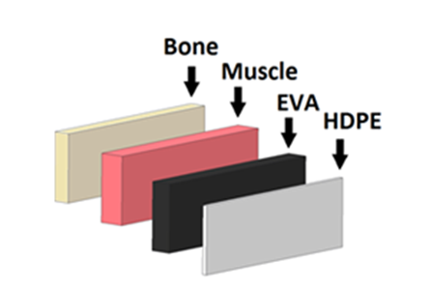
FEA – Assumptions
Modeled under the assumption of a flat plate (2” x 4”)
Material constrained from the bottom to emulate the collar being attached to the shoulder
Modeled under worst case scenario (collar touching skin)
Model constructed as a 4 layer combination (HDPE, EVA, Muscle, and Bone)
Kyler Hast

Slide 21
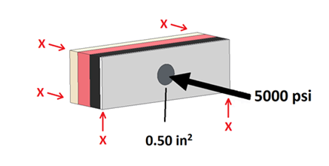
FEA – Modeling
5 material combinations tested
  all combine to equal ¾“ total thickness
  Compared based on maximum deflection and maximum strain
  ½” Material combinations removed due to nature of failure / minimal padding
5000 psi load (ISSBS)
0.50 in² impact surface area
(Russel, Ph.D.)
Kyler Hast

Slide 22
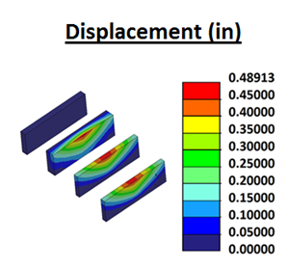
FEA - Deflection
Deflection
Deflection provides a relative measure of a materials ability to spread an impact load over a surface
A material with lower deflection (thicker in our case) spreads out the impact load more efficiently
Kyler Hast

Slide 23
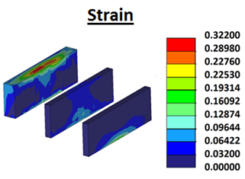
FEA - Strain
Strain
Strain provides a relative measure of a materials ability to absorb impact energy
A sample with a higher strain (of the same material) has stored more impact energy into the molecular structure
Kyler Hast

Slide 24
FEA Results
NIJ standard for bullet proof vests admit a maximum of 1.73” of backface
signature (deflection).
Thickness (in) HDPE EVA |  | Maximum Deflection (in) | % of NIJ Standard | Maximum Strain (in)
1/8 | 5/8 | 1.60 | 92.5 | 94.2
1/4 | 1/2 | 1.10 | 63.6 | 72.3
3/8 | 3/8 | 0.49 | 28.3 | 32.3
1/2 | 1/4 | 0.26 | 15.0 | 17.2
5/8 | 1/8 | 0.15 | 8.7 | 9.8
3/8” HDPE – 3/8” EVA chosen based on the balance of deflection and strain
    Ability to spread impact load over rear surface (lower deflection)
    Ability to absorb impact energy (higher strain)
Other combinations compromise deflection by absorbing more energy, or compromise energy absorption by decreasing deflection
Kyler Hast

Slide 25
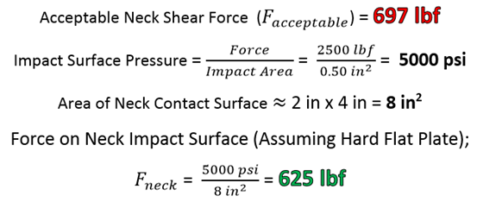
Simple Force Analysis
Hard Plate reduces impact force to acceptable level (89.6% of standard), even before energy absorption of foam and neck muscle is taken into consideration.
Kyler Hast

Slide 26
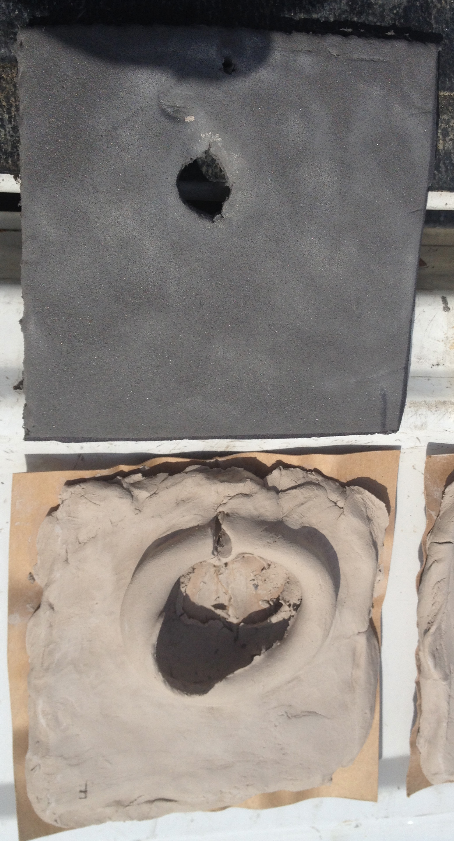
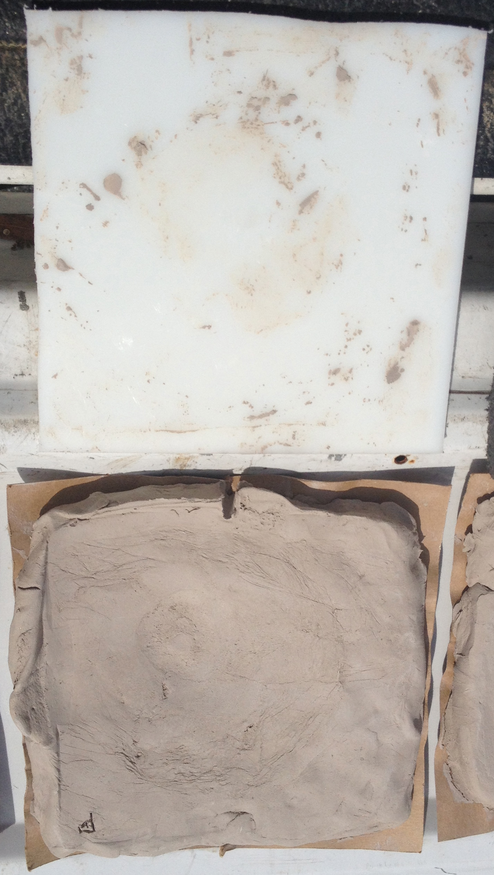
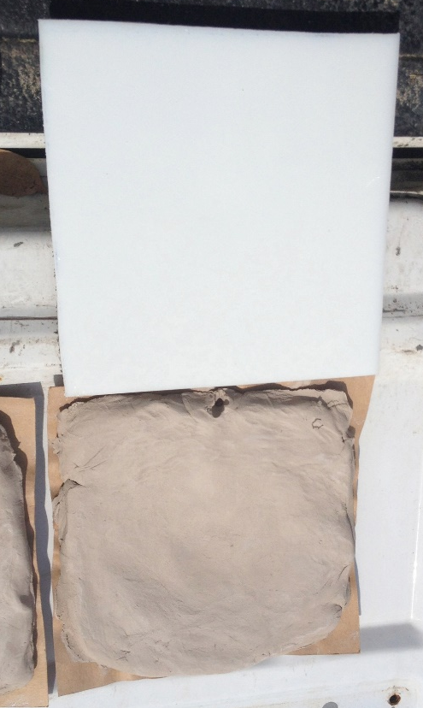
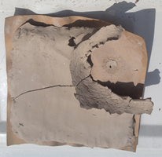
Clay Impact Test
Kyler Hast

Slide 27
Collar Design
Cecilia Wong

Slide 28
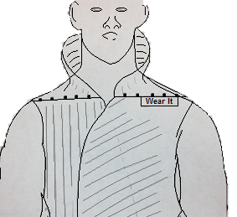
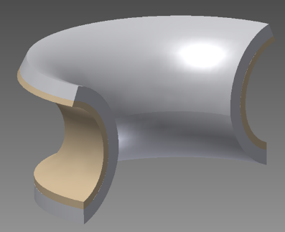
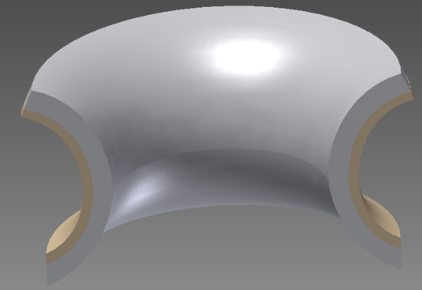
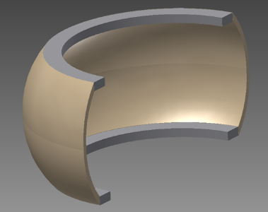
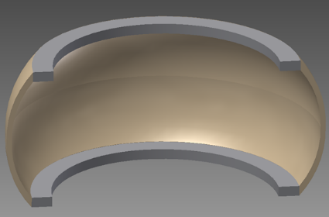
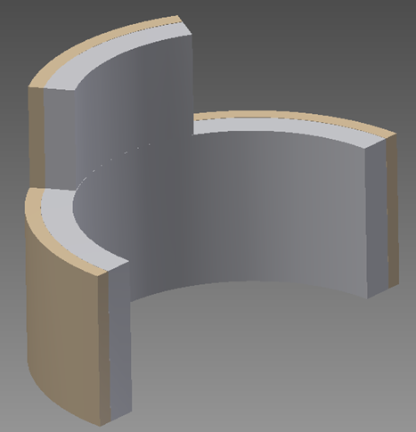
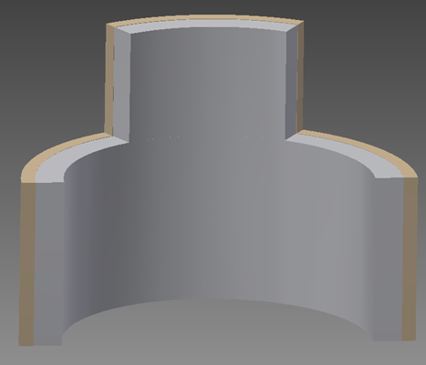
Mr. Boone’s Design
Arched Neck Plate
Crown Plate
Flat Plate
Cecilia Wong

Slide 29
Evaluation Matrix |  | CONCEPTS
CRITERIA | Importance Rating | Mr. Boone's Design | Crown-like shape | Arched shape | Flat neck shape
Cost | 6 | DATUM | S | + | +
Adjustability | 9 |  | S | - | S
Level of Comfort | 7 |  | - | - | -
Ease of Maintenance | 4 |  | + | + | +
Safety | 10 |  | S | - | +
Aesthetics | 7 |  | S | - | -
Lightweight | 9 |  | + | + | +
Durability | 6 |  | S | - | +
Player Performance | 9 |  | + | - | S
Functionality | 8 |  | S | - | +
Sum of Positives |  | DATUM | 3 | 3 | 6
Sum of Negatives |  |  | 1 | 7 | 2
Sum of Sames |  |  | 6 | 0 | 2
Weigthed Sum of Positives |  |  | 22 | 19 | 43
Weigthed Sum of Negatives |  |  | 7 | 56 | 14
 |  |  | 15 | -37 | 29
Flat Plate
Cecilia Wong

Slide 30
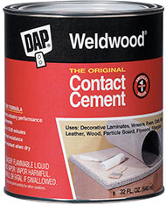
Material Adhesion
Hot Melts
Melding
Double-side tape
Contact cement
Screws & bolts
Contact Cement
  Strong Bonding capabilities
  Waterproof
  Flexible
  Relatively inexpensive
Cecilia Wong

Slide 31
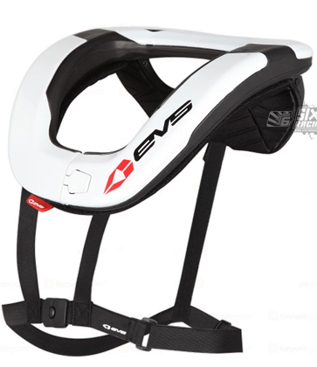
Body Attachment
Straps (nylon)
Lightweight
Strong
Ability to fasten the collar even across front and back
Easily adjustable
Sewing
Velcro
Straps (nylon)
Shoulder padding
Snaps
Cecilia Wong

Slide 32
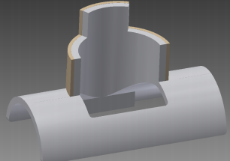
Mr. Boone’s Design
Flat Plate Design
Flat Plate with Shoulder Padding
Final Design
Cecilia Wong

Slide 33
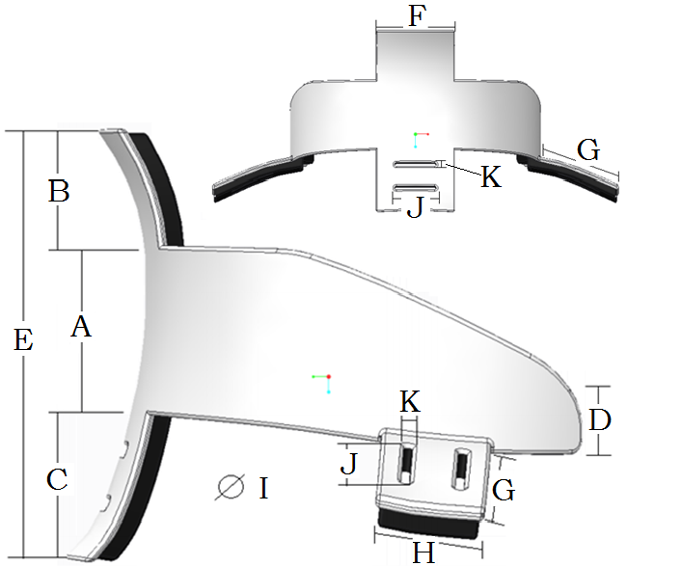
Dimensions
Description |  | Value (in.)
A | Back Height | 2.25
B | Back/Top Height | 1.50
C | Back/From Height | 2.0
D | Front Height | 1.00
E | Total Back Height | 5.75
F | Back Piece Width | 2.50
G | Shoulder Piece Length | 2.50
H | Shoulder Piece Width | 1.50
I | Collar Diameter | 7.50
J | Strap Hole Width | 1.25
K | Strap Hole Height | 0.125
Cecilia Wong

Slide 34
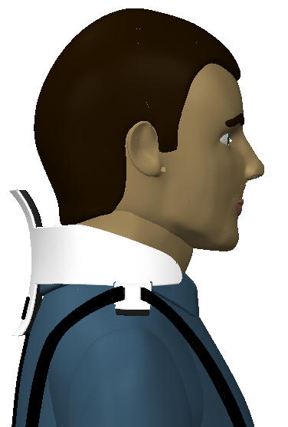
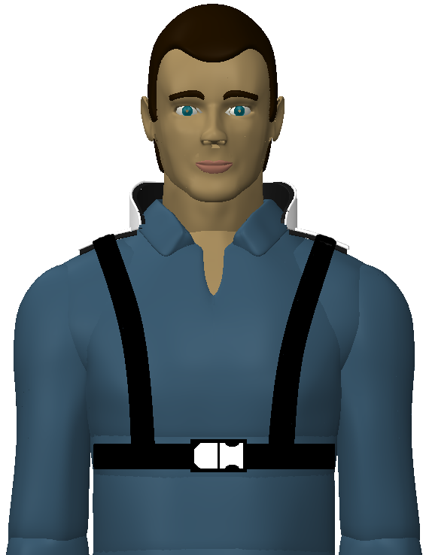
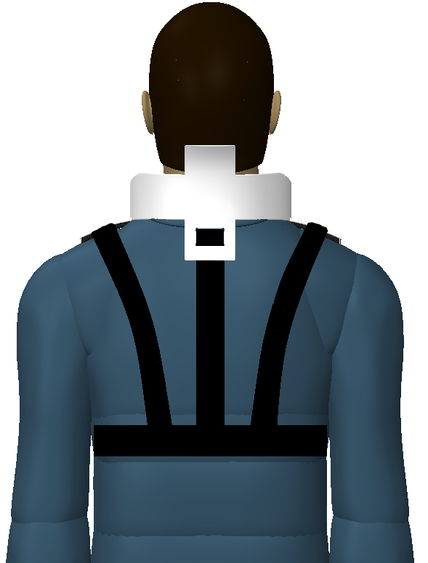
Cecilia Wong

Slide 35
Market Examination
Market Segment
Player Profile
Player Habits
Research and Studies
Maria Miro
Notes:
Nowadays, there is a trend in baseball in which players are being instructed to take a pitch for the team because every time this happens, players are allowed to get to first base; hence, increasing their chance to score. The statistics for NCAA baseball for 2013 are showing that there is a very strong correlation between the number of HBP (hit by pitches) each team had, and the team’s win – loss record. For NCAA divisions 1-3, those teams that had the highest HBP, were also usually the teams that had very high winning percentages, whereas the teams with the lowest number of HBP, had the lowest winning percentages with a few exceptions (see Appendix A).
“Catastrophic injuries are rare; yet, most occur when players are struck in the head or chest with a ball or bat.
On average 3 to 4 players (under the age of 15) die each year from baseball-related injuries. As small as this number is, however, baseball still has the highest fatality rate among all common youth sports”
The sporting goods market as whole and the market for baseball equipment are multi-billion and multi-million dollar markets respectively. CAGR: compound annual growth rate

Slide 36
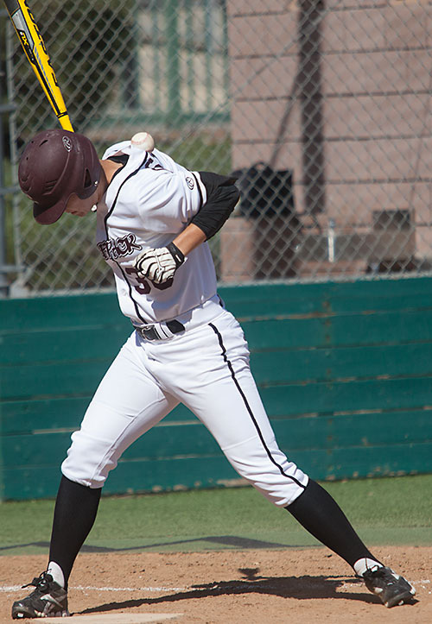
Player Habits
  Take a pitch
Maria Miro

Slide 37
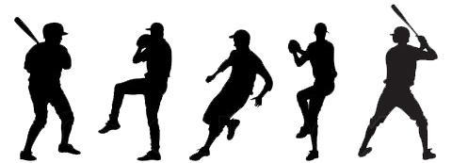
Market Segment
  Approximately 500,000 adult Americans play baseball.
  In high school alone, there are 15,000 teams and 450,000+ participants.
  High school, college, major leagues, and minor leagues.
Maria Miro

Slide 38
Player Profile
  Two Categories
    Youth baseball players
      Teens and high-school players ranging from ages 13-18
    College and major league players
      Adults and ranging from ages 18-45
Player Profile
Market Segment
Maria Miro

Slide 39

  3 to 4 players (under the age of 15) die each year.
  Baseball has the highest fatality rate among all common youth sports.
  “The U.S. market for sports protective equipment was worth $1.8 billion in 2012. The market increased to nearly $1.9 billion in 2013 and expected to increase to $2.1 billion in 2018, a CAGR of 2.6% between 2013 and 2018”. Source: PR Newswire.
Research and Studies
Maria Miro
Notes:
“Catastrophic injuries are rare; yet, most occur when players are struck in the head or chest with a ball or bat. On average 3 to 4 players (under the age of 15) die each year from baseball-related injuries. As small as this number is, however, baseball still has the highest fatality rate among all common youth sports” (Barton). “While the sport may seem safe then, that is little comfort for the parents of children who have been catastrophically injured or died” (R&B Law).
Ages 0-15: 23.9 percent
Ages 16-30: 14.4 percent
Ages 31-45: 6.9 percent
Ages 46-60: 3.8 percent
Ages 61-75: 2.2 percent
Ages 76-98: 0.6 percent

Slide 40
Marketing Strategy
Targeted Media + Public Relations = SUCCESS!
Exhibits, television, newspaper, and magazines
Product’s website
Individual or corporate sponsorships
License product to current manufacturer
Maria Miro
Notes:
This, indeed, is the main mission of this product commercialization.
individual or corporate sponsorships. These will help provide any team or league with the product for no charge to the players.
In addition to individual promotion and sales, there will be an ongoing effort to sell the product to a manufacturer/ marketer of sporting goods, in order to speed the distribution of the collar.
exhibits, television and radio interviews, newspaper and magazine articles, and public speeches will be ongoing parts of the marketing plan for this project. All these will create public awareness of the need to protect youth baseball players from unnecessary pain, suffering, and loss of life (or quality of life).
As an incentive, each contributor to the promotion of “Wear It” will receive a unit for a player of their choice.

Slide 41
Distribution Plan
Find a buyer with an established distribution channel.
    Ex: Atec, Champro, Easton, Rawlings, Schutt, Wilson, Evoshield, and WSI.
This would help speed the introduction of the product.
Maria Miro
Notes:
Find a buyer, with an already established distribution channel, that would be interested in buying the product concept. This would help speed the introduction and access of the product to the baseball community, and potentially save lives and prevent significant injuries sooner. This will be a comparably better alternative than having a Third Party Manufacturer do the work because this will require a capital investor.

Slide 42
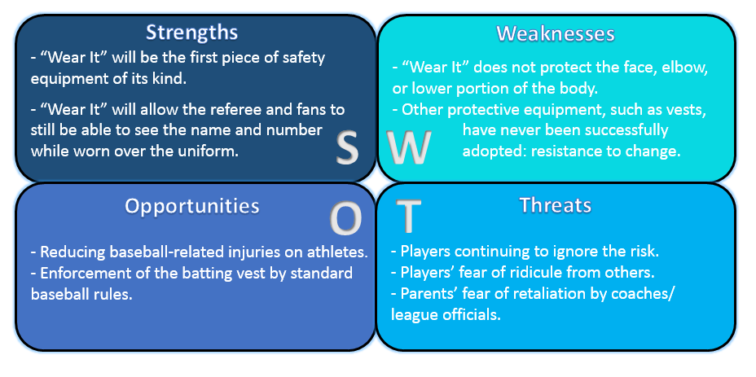
SWOT Analysis
Maria Miro

Slide 43
Initial Sales
Cost of Prototype
6 collars per team
≈ 16,000 teams
93,750 UNITS
EVA foam ………………. $3.50
HDPE …………………….. $9.50
Contact Cement ……. $3.00
Straps & Buckle……… $5.00
TOTAL COST $21.00
Maria Miro

Slide 44
Future Work
More Detailed Finite Element Analysis
Impact Testing
    Measured values of Force on neck
Prototype construction
Test collar fit and player mobility
Kyle Meredith

Slide 45

Conclusion
No current neck protection on the market
    Our product fills this void
Collar exceeds current NIJ deflection standard
Collar effectively reduces shear force applied to neck
3/4” thickness utilized to maximize protection with minimal weight
Kyle Meredith

Slide 46
Questions?

