Slide 1



EML 4551C SENIOR DESIGN
DR. KAMAL AMIN
TEAM 4: ALTERATE MATERIAL SELECTION FOR COMPRESSOR CASING IN TURBOCHARGER
FINAL Design PRESENTATION
Group Members alexander Mankin
HARRISON MCLARTY
Ralph Scott
Abiodun OLUWALOWO
Project sponsor AND FACULTY Adviser
Cummins - Roger England
DR. PETER KALU
5 DECEMBER 2013

Slide 2
Outline
Project Scope
Project Background
Project Objectives
Design Concepts and Evaluation
Analytical Model
Design Analysis
Procurement of Resources
Environmental and Safety and Ethics
Future Work
Final Summary
References
Questions

Slide 3
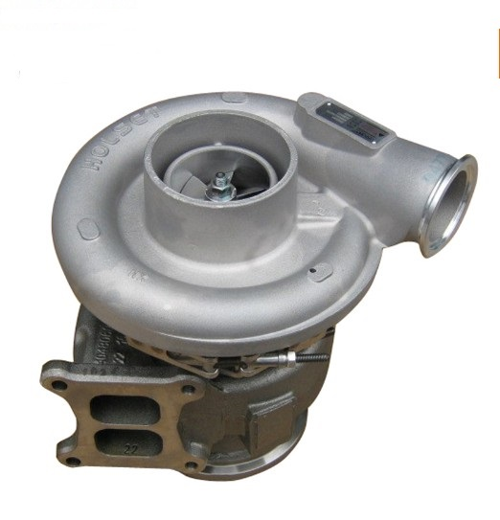
Project Scope
Cummins has an interest in researching and selecting alternate materials to fabricate compressor casings in their B series turbochargers
This alternate material should ultimately be more cost effective than the current one in use, cast aluminum 356, and still satisfy the design and operational parameters set by Cummins
Fig.1: View of turbocharger.[5]
Estimates of manufacturing costs for this alternate material and 3 full scale prototypes are key requirements
Abiodun Oluwalowo

Slide 4
Project Background cont.
A cost efficient material which could replace cast aluminum 356 presents many beneficial opportunities for Cummins
The revenue gained from more cost efficient materials and manufacturing processes present financial advantages for Cummins
Production numbers on compressor casings and turbochargers have the potential to grow allowing the company to meet and exceed the expectations of customers
Abiodun Oluwalowo

Slide 5
Project Objectives
Determine the temperatures, pressures, and stresses experienced by the compressor during operation
Research and compare materials which can operate under these prescribed physical conditions, and are cheaper both as a material and to manufacture
Estimate manufacturing costs with this new material and compare it to cast aluminum 356, which is currently used to fabricate the casings
With the known operational conditions and alternate material known, utilize Finite Element Analysis in conjunction with a CAD model of the casing for analysis
Obtain three prototypes of these casings for testing and experimentation
Abiodun Oluwalowo

Slide 6
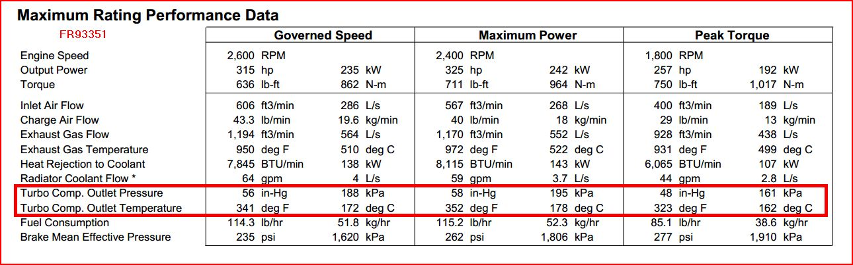
Design Concepts
Operational Conditions for Compressor
Figure 2. Experimental data of turbocharger supplied by sponsor
Abiodun Oluwalowo

Slide 7
Design Concepts cont.
Design Specifications
Casing must possess the same design and geometric tolerances currently in place on the compressor in Cummins turbocharger
Alternate material must be able to safely and continuously operate at temperatures up to 230$℃$
Also, based on the data provided by the sponsor, the casing should be able to withstand pressures up to 215 kPa
Abiodun Oluwalowo

Slide 8
Design Concepts cont.
Performance Specifications
Material must be able to withstand cyclic temperatures including below freezing atmospheric conditions
Compressor casing must be able to withstand and contain a catastrophic failure of the compressor blades caused by over boosting, without fracturing
Corrosion resistance is also an important requirement due to the presence of oil, dirt, water, engine coolant, salt, and other chemicals during the operation of an automobile
Abiodun Oluwalowo

Slide 9
Design Concepts cont.
Why replace the current Aluminum alloy?
Reduce the overall cost of production and manufacturing with an alternative material
Abiodun Oluwalowo

Slide 10
Design Concepts: Materials
Original Materials Researched
Reasons for Applicability
Only PEEK and Extem XH proved to be able to meet the demands and requirements of being a suitable compressor casing material.
Both Fluorsosint 500 and RULON 945 were not suitable do to the fact that they cannot be purchased in a large enough block to properly machine a compressor casing out of. As well as they were not able to withstand the loads associated with the turbocharger compressor casing.
Ralph Scott

Slide 11
Design Concepts; Materials
New Materials Researched
Reasons for Applicability
Of the new material candidates, only TECAPEEK ST and TECATOR T 15013 where deemed suitable for use in the turbocharger compressor casing.
The Material TECASINT 2000, is not applicable for our use do to the fact that it cannot be molded due to the absence of a softening point hence processed via sintering. It is also prone to hydrolysis upon contact with alkaline fluid of high pH.
TECAPEI & FORTUS PPSF cannot withstand the peak temperature of 230°C.
Ralph Scott

Slide 12
Design Concepts; Materials
The complete list of approved materials so far
Ralph Scott

Slide 13
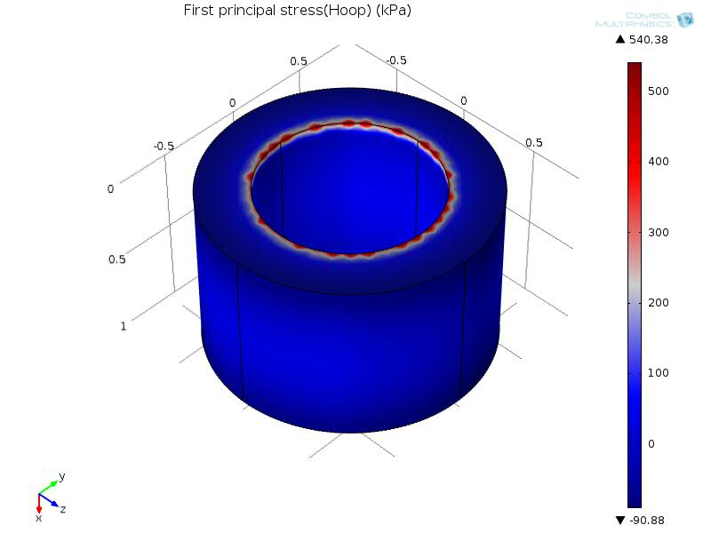
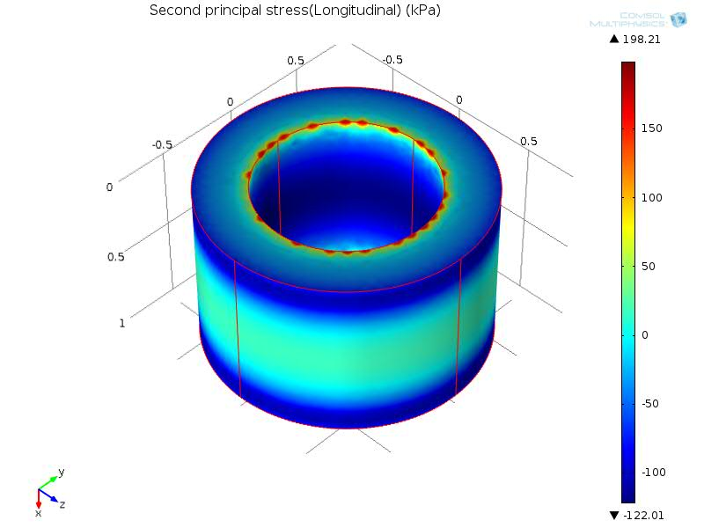
Analytical Model: FEA of Compressor Casing
Figure 3. Hoop Stress
Figure 4. Longitudinal Stress
To gain a better understanding of the stress distribution a 3D simulation was done on a section of the casing
This simulation built off the previous 2D model but now accounts for constrained ends rather than open ends
Alex Mankin

Slide 14
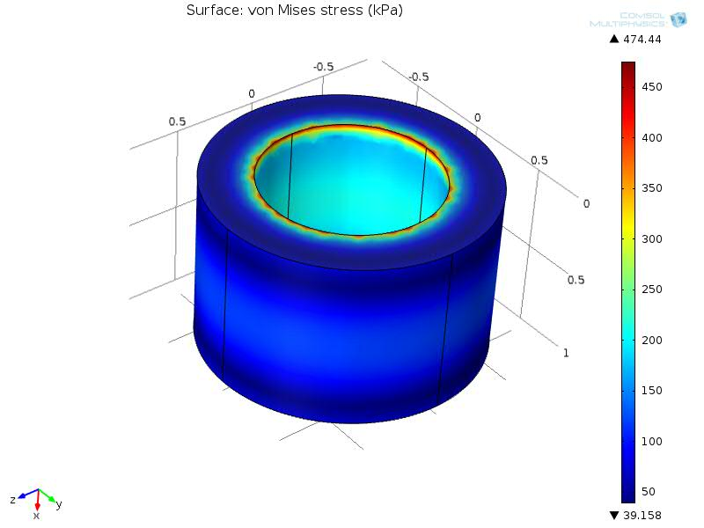
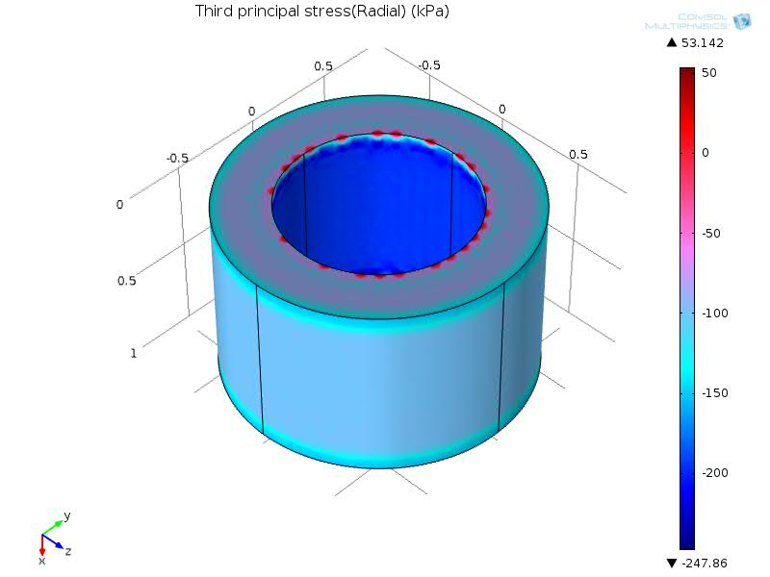
Analytical Model: FEA of Compressor Casing
Figure 5. von Mises stress
Figure 6. Radial Stress
The largest stress was found to the von Mises equivalent stress which was 480 kPa
This stress is much lower than any of the yield stresses of the possible material candidates
Alex Mankin

Slide 15
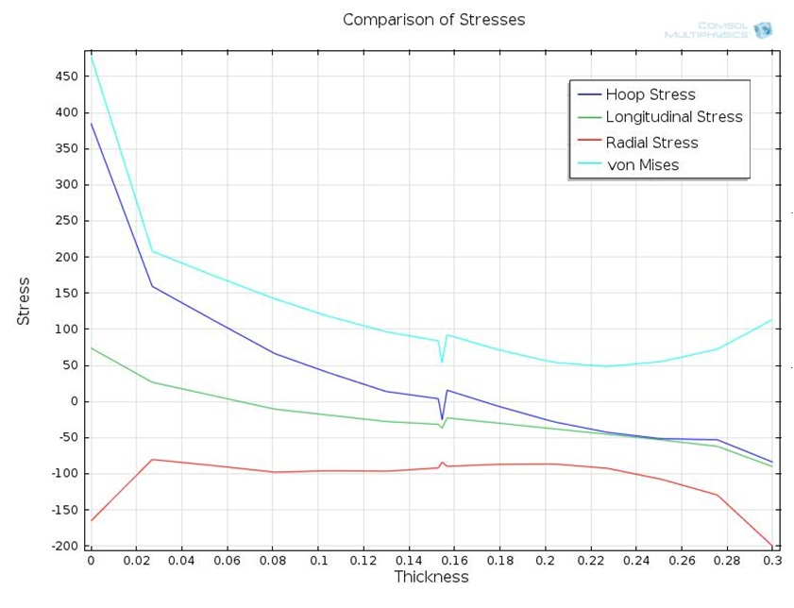
Analytical Model: FEA of Compressor Casing
Figure 7. comparison of stresses
Alex Mankin

Slide 16
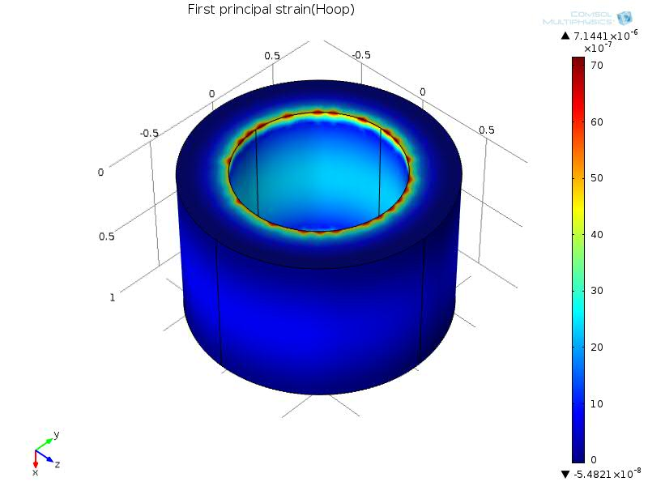
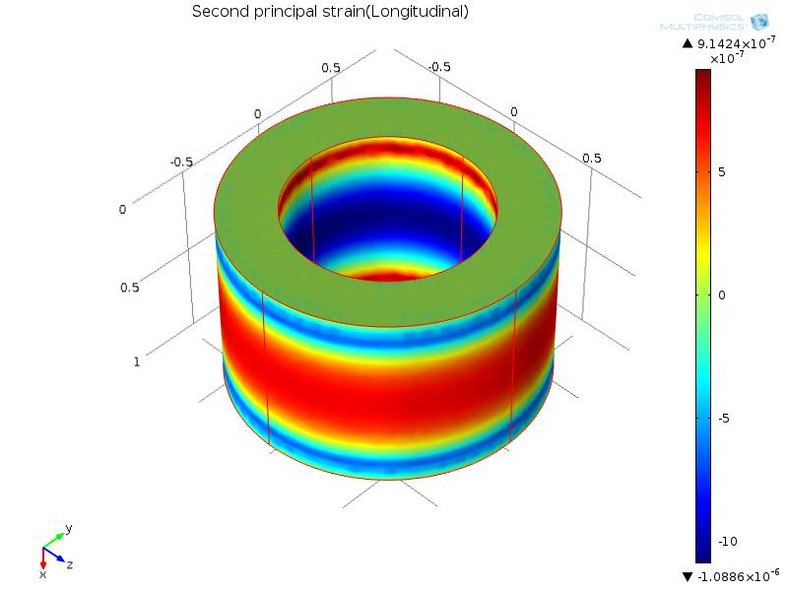
Analytical Model: FEA of Compressor Casing
Figure 8. Hoop Strain
Figure 9. Longitudinal Strain
Alex Mankin

Slide 17
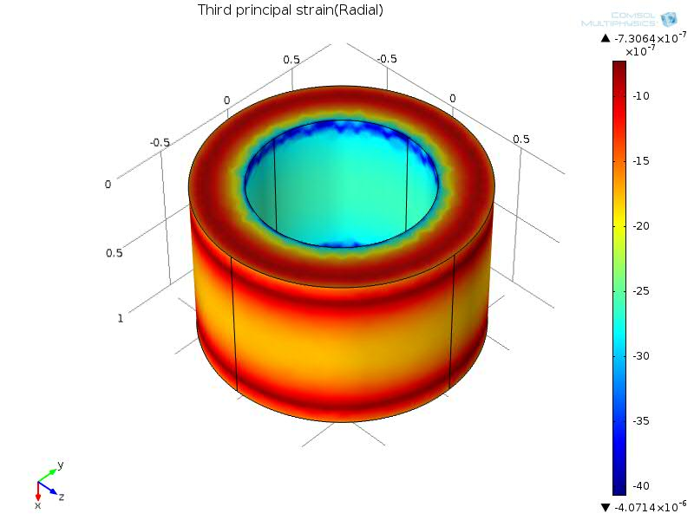
Analytical Model: FEA of Compressor Casing
Figure 11. Radial Strain
Alex Mankin

Slide 18
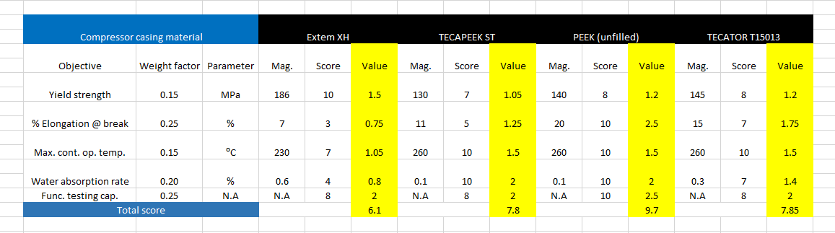
Design Analysis: Decision matrix for prototype
Fig. 5 A weighted decision matrix for selecting the material used for machining a prototype
Harrison McLarty

Slide 19
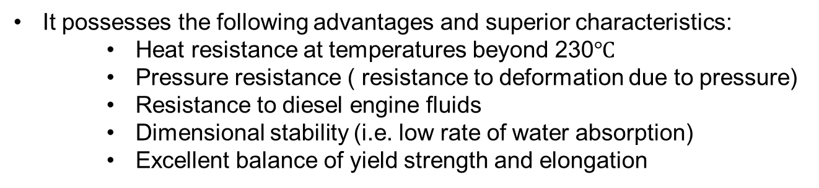
Design Analysis: Material for prototype
With the aid of a weighted decision matrix PEEK (unfilled) was found to be the most effective material for fabricating a compressor casing
It possesses the following advantages and superior characteristics:
    Heat resistance at temperatures beyond 230$℃$
    Pressure resistance ( resistance to deformation due to pressure)
    Resistance to diesel engine fluids
    Dimensional stability (i.e. low rate of water absorption)
    Excellent balance of yield strength and elongation
Harrison McLarty

Slide 20
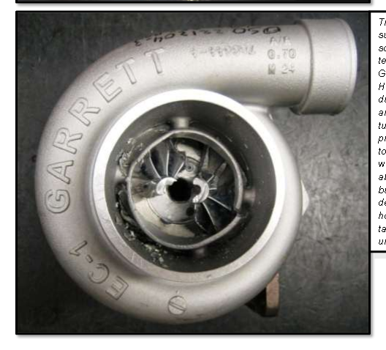
Design Analysis: Need for prototype
“Burst” occurs when the centrifugal force undergone by impeller wheels, due to their rotational speed, overcome the mechanical strength of the wheel.
Causes of a burst event include:
  Reduction of strength due to high internal stresses associated with high temperatures and speeds
  Fatigue failure due to cyclic loading (i.e. stop and go motion of a city bus)
  Foreign object damage (FOD) (i.e. a rock or piece of rubber impacting a wheel
Fig.6 Example of a burst containment test. [5]
Although a rare event, this must be kept in mind when selecting materials for either the compressor or turbine housing due to the safety concern of burst.
Materials with the proper yield strength, % elongation (ductility), and maximum operational temperature must be considered to withstand this event.
Harrison McLarty

Slide 21
Status of procurement and resources
Contact at Cummins is procuring a volume block of PEEK from Victrex. Volume is approximately 10.5 in x 5.25 in x 8.5 in
Victrex specializes in PEEK polymers (polyaryletherketones)
Machining of the material will be completed through use of resources at Cummins.
If deemed suitable, the compressor casings would be manufactured on a large scale through injection molding.
Harrison McLarty

Slide 22
Environmental and Safety and Ethics
There are no environmental concerns associated with the material PEEK
The main safety concern, which must be addressed in the prototype testing, is whether this material can successfully contain a burst event.
Prototype testing will be carried out through Cummins, who are familiar with proper and safe manner in which to test housings through burst events.
Harrison McLarty

Slide 23
Future work
Obtaining manufacturing costs through the use injection molding and comparing this to the cost of the current casting solution of aluminum 356.
FEA Modeling burst containment ,thermal stresses, and more complex geometries comparing the data found to experimental data obtained from prototype testing.
Harrison McLarty

Slide 24
Final summary
Prototype material has been selected and is going to machined to the dimensions and tolerances of the current compressor casings used by Cummins.
Prototype testing will be carried out next semester as well as manufacturing costs associated with the PEEK material used to construct the compressor casings
Harrison McLarty

Slide 25
References
1. "Turbo Torque." Turbo Torque. N.p., n.d. Web. 21 Oct. 2013. <http://www.mazdarotary.net/turbo.htm>.
2. "Online Materials Information Resource - MatWeb." Online Materials Information Resource - MatWeb. N.p., n.d. Web. 21 Oct. 2013. <http://www.matweb.com/>.
3. "Plastic Sheet, Plastic Rod, Plastic Tubing - Buy Online." Plastic Sheet, Plastic Rod, Plastic Tubing - Buy Online. N.p., n.d. Web. 21 Oct. 2013. <http://www.professionalplastics.com/>.
4. "VICTREX® PEEK Polymers." High Performance Polyaryletherketones, High Temperature Advanced PEEK Polymer, Thermoplastic. N.p., n.d. Web. 19 Nov. 2013. <http://www.victrex.com/en/products/victrex-peek-polymers/victrex-peek-polymers.php>.
5. "Burst and Containment: Ensuring Turbocharger Safety." Turbobygarrett.com. N.p., n.d. Web. 19 Nov. 2013. <http://www.turbobygarrett.com/turbobygarrett/sites/default/files/Garrett_White_Paper_02_Burst__Containment.pdf>.
Harrison McLarty

Slide 26
Questions
Harrison McLarty

