Slide 1
Educational Kit for Alkaline Membrane Fuel Cell (AMFC)
Team
------------------------------
Nicole Alvarez
Bryan Anderson
Collin Heiser
Mustafa Nek
James Richardson
Advisor: Juan Ordonez
Sponsor: FSU
Group 10

Slide 2
Why use Fuel Cells?
Bi-Product of use is water
Completely sustainable, assuming a clean source of hydrogen acquisition
Fuel cells accomplish the same result without the environmental issues
Why Alkaline Membrane?
Alkaline Membrane Fuel Cells are the most electrically efficient fuel cell technology
Table 1. Fuel Cell Comparisons
Group 10 Bryan Anderson
Slide 2 of 13 Educational Kit of AMFC

Slide 3
Changes from Fall 2014
Fall 2014
Spring 2015
Communication
Brazil ←→ America
Design
Case Design
Profitability/Marketing
Communication
America
Design
Functioning Fuel Cell
Testing FC with kit components
Cost Benefits
Group 10 Mustafa Nek
Slide 3 of 12 Educational Kit of AMFC

Slide 4
Goal Statement / Objectives
“Deliver a fully functional alkaline membrane fuel cell in a portable case to Florida State University by the end of the spring 2015 semester.”
Develop a functioning fuel cell educational kit
Gather/build components for cell
Test/experiments with built fuel cell
Develop a working fuel cell for AME open house
Obtain necessary materials for kit
Create safety & operations manual for educational kit
Group 10 Mustafa Nek
Slide 6 of 12 Educational Kit of AMFC

Slide 5
Part List and Budget Breakdown
Component | Cost | Notes
Case and padding | $122.84 | May use a cheaper alternative
Membrane | $250.00 | Consumed during process
Tubing/waste container | $8.00
Stainless steel | $52.00 | Needs machining
Compressed gases | $25.00 | Containers are reusable
Power output mechanism | $13.00 | Still in design process
Pressure regulator/guage | $300.00 | Dual stage for steady outlet pressure
Gas leak sensor | $40.00 | Battery operated sensor
Remaining Budget | $189.16
Total | $810.84 | Too high but unpreventable
Group 10 Bryan Anderson
Slide 4 of 12 Educational Kit of AMFC

Slide 6
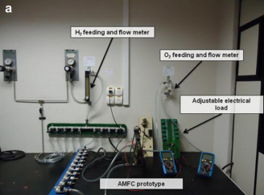
Testing Results
6 hour long test with data recorded every 30 minutes
Run with an approximate 40% KOH electrolyte concentration
Relatively pure H₂ and O₂ fueled the reaction
The power generation was measured using digital multimeters
Figure #. Experimental setup and testing environment in the UFPR LaCelc Lab where the AMFC was tested
Figure #. Sample polarization curves taken from results obtained after 6 hour AMFC test
Group 10 James Richardson
Slide 4 of 12 Educational Kit of AMFC

Slide 7
Future Considerations
Testing the durability of the platinum electrodes
Formation of possible kit demonstrations
Continuing Collaboration between UFPR-FSU
Figure #. A platinum electrode similar to what is being used in the AMFC kit.
Group 10 James Richardson
Slide 4 of 12 Educational Kit of AMFC

Slide 8
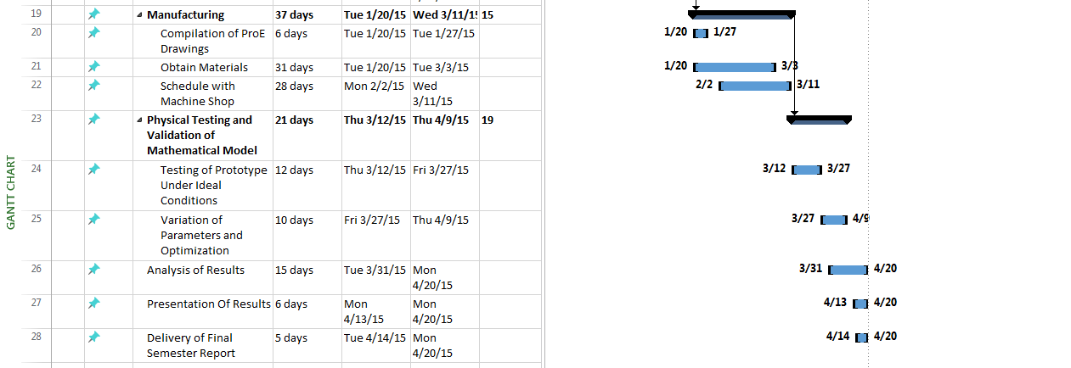
Gantt Chart
Group 10 Bryan Anderson
Slide 2 of 13 Educational Kit of AMFC

Slide 9
References
Vargas, J.V C., and J. C. Ordonez. "Alkaline Membrane Fuel Cell (AMFC) Modeling and Experimental Validation." Journal of Power Sources (2012): 1-15.Www.elsevier.com/locate/jpowsour. Elsevier, 11 Apr. 2012. Web. 15 Sept. 2014.
Ordonez, Juan, and Jose Vargas. Design and Development of an Alkaline Membrane Fuel Cell (AMFC) Educational Kit for High School and College Level Laboratory Demonstration. Tallahassee: Florida State Univeristy, n.d. PDF.
Group 10
Slide 11 of 12 Educational Kit of AMFC

Slide 10
Questions
Group 10
Slide 12 of 12 Educational Kit of AMFC

