Slide 1




Educational Kit for Alkaline Membrane Fuel Cell (AMFC)
Team
------------------------------
Nicole Alvarez
Bryan Anderson
Collin Heiser
Mustafa Nek
James Richardson
Nicolas SchuLtz
Group 10

Slide 2
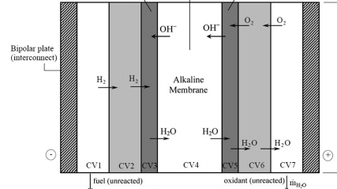
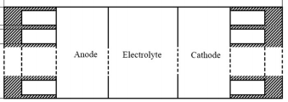
How an AMFC works
Anode
Cathode
Electrolyte
  Potassium Hydroxide (KOH)
Advantages
  No environmental pollutants/waste
  Higher current density
  Low cost for electrolyte solution
Figure 1: Schematic of a typical fuel Cell
Group 10 Mustafa Nek
Slide 2 of 12 Educational Kit of AMFC

Slide 3
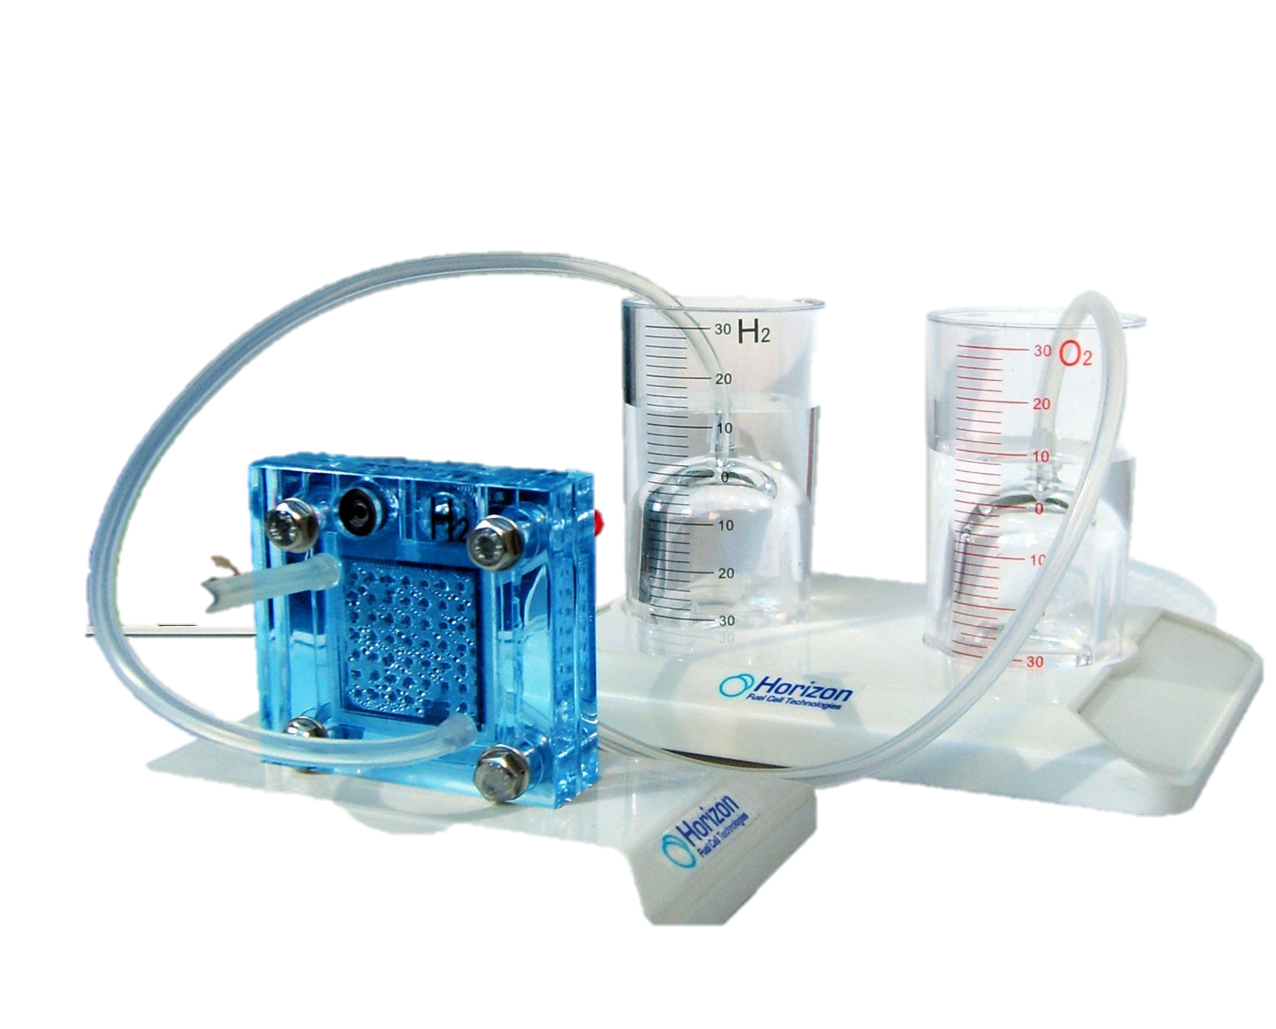
Project Scope
Create and design an AMFC tool kit for educational use
Scaling
“The current AMFC setup is too large and immobile to be a portable educational kit alkaline membrane fuel cell.”
Group 10 Mustafa Nek
Slide 3 of 12 Educational Kit of AMFC

Slide 4
Prototype Specifications
Non-corrosive metal for bi-polar plate
  Stainless steel or Plated Titanium
Vacuum sealed tubing and valves
Pure hydrogen and pure oxygen
Size must maintain portability
Optimized KOH solution
  Testing currently at 40% KOH
Group 10 Bryan Anderson
Slide 4 of 12 Educational Kit of AMFC

Slide 5
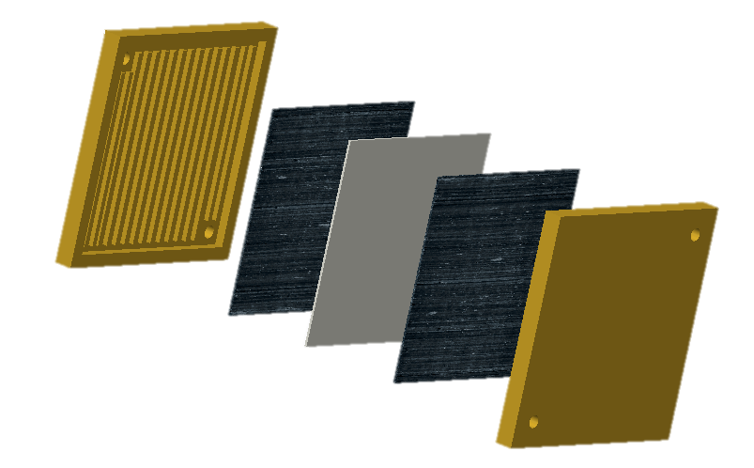

Prototype Design
Anode
AM Electrolyte
Cathode
Bi-polar Plates
Figure 2: Design of AM fuel cell
Group 10 Bryan Anderson
Slide 5 of 12 Educational Kit of AMFC

Slide 6
Challenges & Risks
Power output
Transportation and storage of combustible gases
Excessive heat generation of fuel cell in operation
Corrosion of fuel cell due to liquid potassium hydroxide electrolyte
Possible Contingency Plan
Optimize system or power an object that requires less energy input
Oxygen filter attachment/ supply only containers for H2
Preliminary test (10 min duration) displays no risk of harmful levels of heat generation
Unit meets general safety regulations
Group 10 James Richardson
Slide 6 of 12 Educational Kit of AMFC

Slide 7
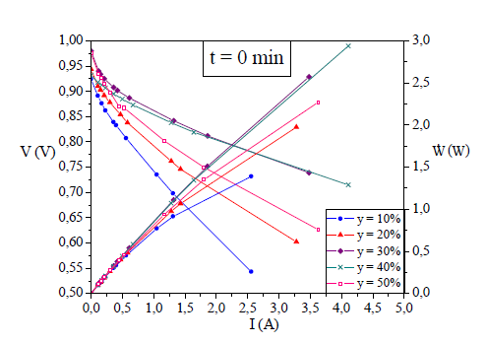
Preliminary Testing
Mathematical modeling
Controlled Parameters:
Aspect ratios of width/length, height/length
Flow rates and molecular concentrations of the working fluids (H2 and O2) were designated
Varied Parameters:
The concentration of the liquid electrolyte (KOH) was varied ( from 10% to 50%)
The duration of time that the AMFC was operated also varied
Figure 3. Theoretical polarization curves for varying potassium hydroxide concentrations of an AMFC prototype (10% - 50%) at t = 0 min
Table 1. Theoretical values for open and short circuit simulations at varying electrolyte concentrations
Group 10 James Richardson
Slide 7 of 12 Educational Kit of AMFC

Slide 8
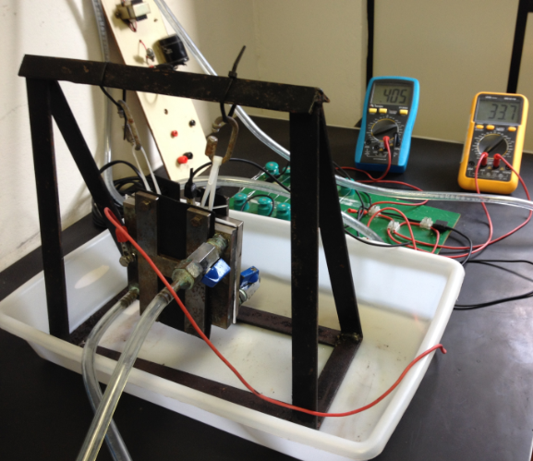
Preliminary Testing
Experimental Validation
Physical testing:
Apparatus assembled and tested with an approximate KOH solution of 40%
Testing was carried out by graduate students of UFPR
Testing lasted 10 minutes, results were only taken at the end of the 10 minute operation period
Figure 4. Experimental setup of Alkaline Membrane Fuel Cell prototype
Table 2. Comparison of the theoretical data obtain from the FORTRAN program compared to the results gathered from physical testing of the prototype
Group 10 James Richardson
Slide 8 of 12 Educational Kit of AMFC

Slide 9
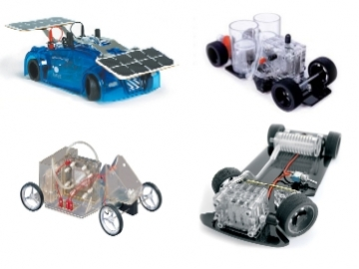
Marketing
Fuel Cell Benefits
Inspiration for the educational kit
Alkaline Membrane Fuel Cell
Group 10 Bryan Anderson
Slide 9 of 12 Educational Kit of AMFC

Slide 10
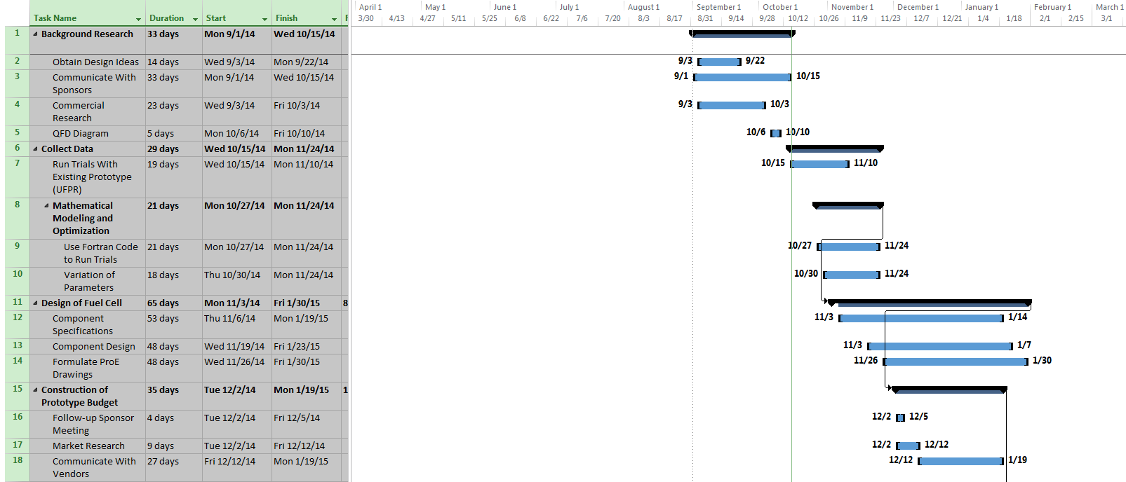
Project Plans
Group 10 Bryan Anderson
Slide 10 of 12 Educational Kit of AMFC

Slide 11
References
Vargas, J.V C., and J. C. Ordonez. "Alkaline Membrane Fuel Cell (AMFC) Modeling and Experimental Validation." Journal of Power Sources (2012): 1-15.Www.elsevier.com/locate/jpowsour. Elsevier, 11 Apr. 2012. Web. 15 Sept. 2014.
Ordonez, Juan, and Jose Vargas. Design and Development of an Alkaline Membrane Fuel Cell (AMFC) Educational Kit for High School and College Level Laboratory Demonstration. Tallahassee: Florida State Univeristy, n.d. PDF.
Group 10
Slide 11 of 12 Educational Kit of AMFC

Slide 12

Questions
Group 10
Slide 12 of 12 Educational Kit of AMFC

