Slide 1
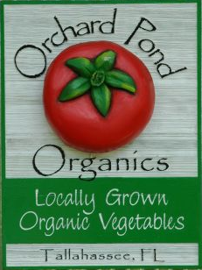

Weeding Robot Team 11
Sponsor: Jeff Phipps
Advisor: Dr. Clark
Student Members:
Ian Nowak (EE)
Coen Purvis (ME)
Amanda Richards (ME)
Grant Richter (ME)
Jeremy Rybicki (EE/CpE)
Nathan Walden (ME)

Slide 2
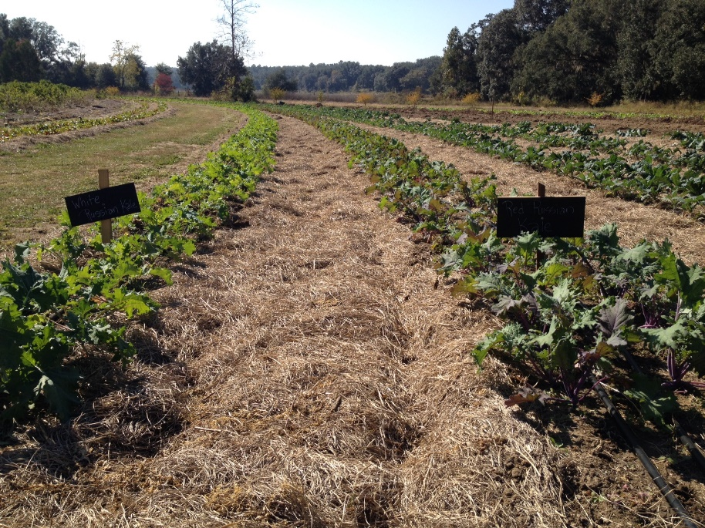
Background Information
Purpose
  To create an autonomous robotic system to remove weeds from a plot
Orchard Pond Organic Farm
  About the farm
  About the sponsor
Constraints
  Affect all weeds in a given area
  Should not disturb below 1 inch of soil
Team 11 Coen Purvis
Slide 2 of 9 Revised Project Plan & Objectives

Slide 3
Motivation
For an organic farm to compete, it must make up for the excessive manpower required
Allow for the farm to expand
Weeding is a menial task that could be automated
Weeding can be physically taxing on an individual

Slide 4
New Project Scope
Old Project Scope
Semi-flat terrain with no beds or furrows
Ground pressure and weight of the robot was a key factor
Remove weeds in entire 36 inch gap between crops
Plot will have beds and furrows
Robot driving in furrow no longer has a weight constraint
Remove weeds from bed within 2 inches of the plant

Slide 5
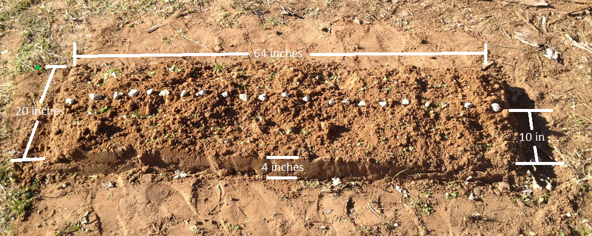

Slide 6
Semester Progress
Finished first prototype and confirmed proof of concept
Finished construction of second prototype
In progress of integrating weeding mechanism and the robot
Electronic design
Team 11 Nathan Walden
Slide 3 of 9 Revised Project Plan & Objectives

Slide 7
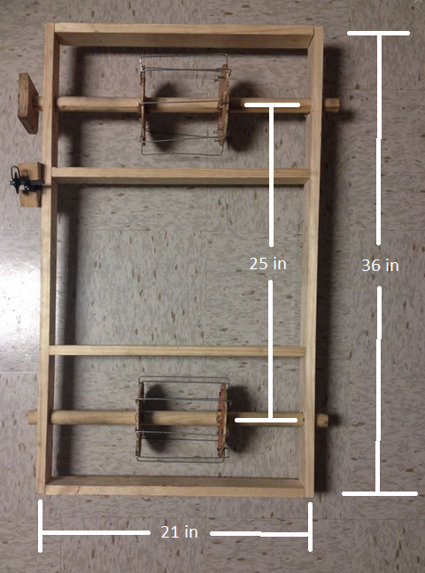
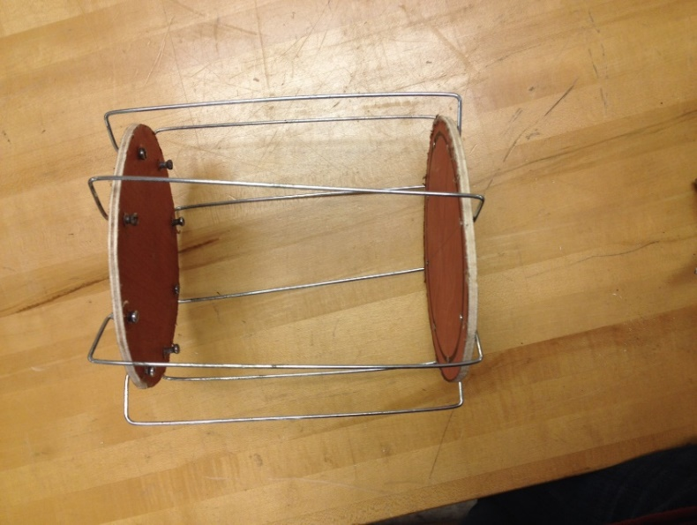
Video of First Prototype

Slide 8
Lessons Learned
More spokes
Better method of fastening spokes
Stronger materials
Influenced frame design of future prototype

Slide 9
Current Mechanical Prototype
Elevated weeding mechanism
Offset distance from robot
Chain driven
Team 11 Coen Purvis
Slide 4 of 9 Revised Project Plan & Objectives

Slide 10
Video Second Prototype
Add video here.

Slide 11
Electrical Project Plan
Get visual system fully operational
Combine the visual system with the motor control for navigation
Testing navigation with the weeding mechanism
Provide documentation
Team 11 Nathan Walden
Slide 8 of 9 Revised Project Plan & Objectives

Slide 12
Challenges
Change of scope
Beagle Bone Black Blowout
Lengthy shipping times

Slide 13
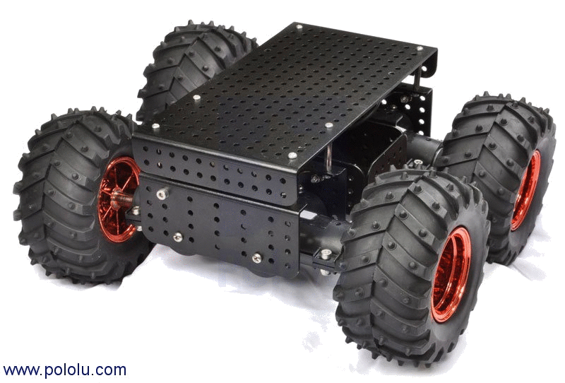
Possible Future Design Modification
Develop height adjusting mechanism
Adding baskets to both sides for navigation and stability
Adjustable basket sizes to improve marketability
Team 11 Grant Richter
Slide 5 of 9 Revised Project Plan & Objectives

Slide 14
Mechanical Project Plan
Fabricate second weeding mechanism, couple with frame
Test weeding mechanism with the Frame
Integrate future design modifications
Provide documentation
Team 11 Nathan Walden
Slide 6 of 9 Revised Project Plan & Objectives

Slide 15
Budget
Team 11 Name
Slide 7 of 9 Midterm II Presentation
Notes:
Dr. Clark, treaded robot for prototyping

Slide 16
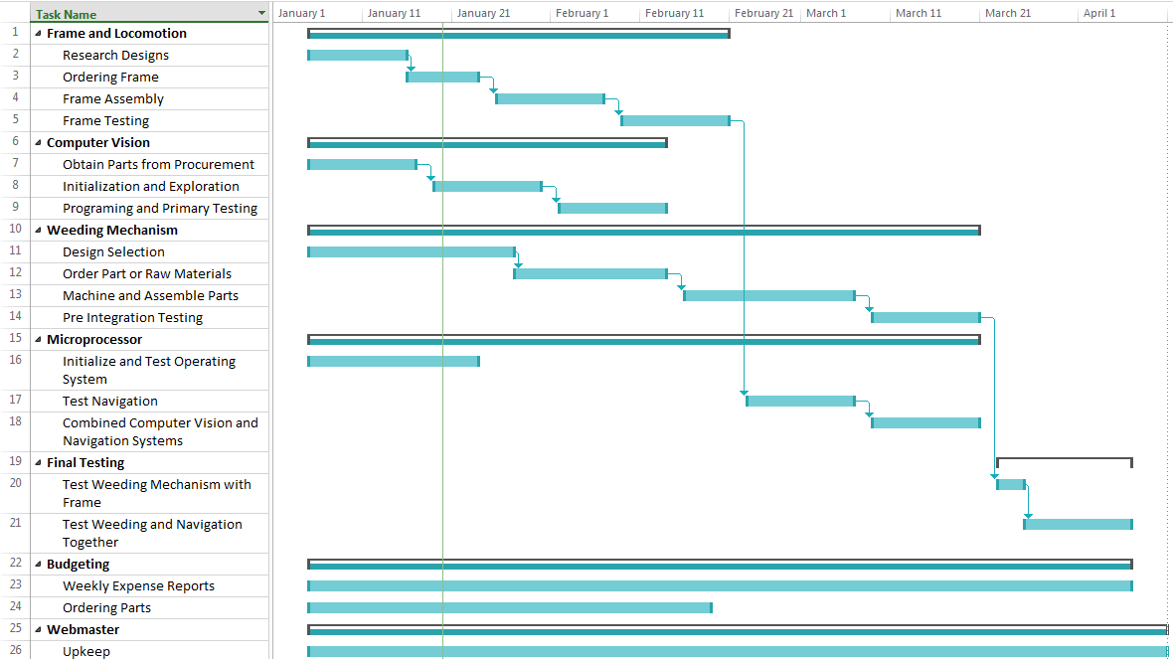
Team 11 Nathan Walden
Slide 9 of 9 Revised Project Plan & Objectives

