Slide 1
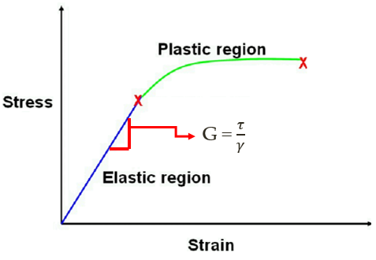
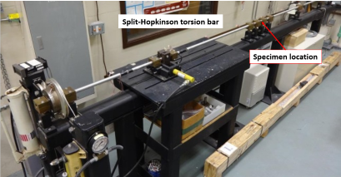
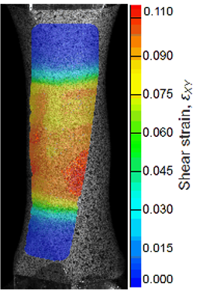
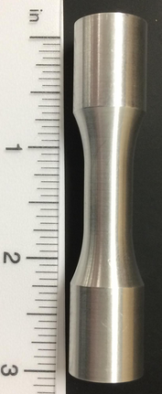
Tabletop Torsion Tester
Team 13
Brendan Keane, Logan McCall, Reginald Scott, Mark Swain
Sponsor: Dr. Philip Flater (AFRL) Advisor: Dr. Simone Hruda
Aim
Develop a device to better characterize small specimens in free end torsion
Our Design
(1) AC Gear motor controlled by Variable Frequency Drive
(VFD)
(2) 4 pillow blocks and linear rail guide system to allow for
free end motion
(3) 4 inch 6 jaw chucks to grip sample
(4) 304 stainless steel inner supports
(5) Low carbon 1015 steel outer frame
(6) Aluminum transmission coupler with strain gages
attached for stress measurement
Data Measurements
Stress
Strain gages placed on transmission coupler with known properties measure elastic strain. Using Hooke’s Law, applied stress can be calculated
Introduction
The Air Force Research Laboratory has a need for a small-scale torsion tester to better characterize small sample geometries
Current 15ft apparatus is inaccurate when testing small specimens
1
6
3
Strain
Digital image correlation (DIC) measures strain field on specimen using high speed cameras and computer software
5
Current torsion testing apparatus at Eglin Air Force Base
4
Customer Requirements
Generate 100 Nm of applied torque
Monotonic, Free end torsion
1 axial DOF on free end
Less than 10 ft² footprint
Compatible with DIC (Digital Image Correlation) at AFRL
Budget of $2000
Customer will supply all measurement equipment
2
Specimen Geometry
Length: 3.2 inches
Inner Diameter: 0.415 inches
Outer Grip Diameter: 0.625 inches
Gauge Wall Thickness: 0.059 inches
Future Work
Utilize time relay to implement cyclic loading
Install wire housing
Install strain gages

