Slide 1
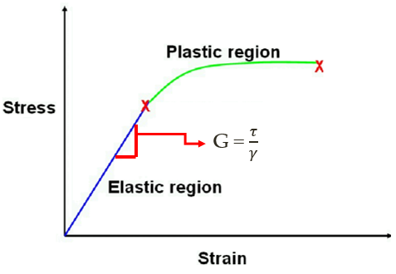
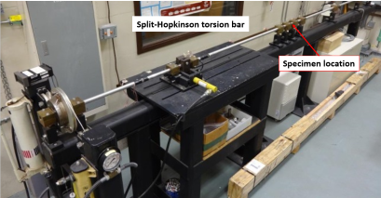
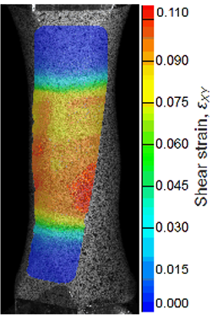
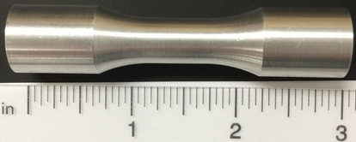
Tabletop Torsion Tester
Brendan Keane, Logan McCall, Reginald Scott, Mark Swain
Aim
Develop a device to better characterize small specimens in free end torsion
Our Design
(1) AC Gear motor controlled by Variable Frequency Drive (VFD)
(2) 4 pillow blocks and linear rail guide system to allow for free end motion
(3) 4 inch 6 jaw chucks to grip sample
(4) 304 stainless steel inner supports
(5) Low carbon 1015 steel outer frame
(6) Aluminum transmission coupler with strain gages attached for stress measurement
Data Measurements
Stress
Strain gages placed on transmission coupler with known properties measure elastic strain. Using Hooke’s Law, applied stress can be calculated
Introduction
The Air Force Research Laboratory has a need for a small-scale torsion tester to better characterize small sample geometries
Samples are approximately 3 inches in length, while the current testing apparatus is 15 feet long
1
6
3
Strain
Digital image correlation (DIC) measures strain field on specimen using high speed cameras and computer software
5
4
2
Specimen Geometry
Future Work
Utilize time relay to implement cyclic loading
Install wire housing
Install strain gages
Current torsion testing apparatus at Eglin Air Force Base
Length: 3.2 inches
Inner Diameter: 0.415 inches
Outer Grip Diameter: 0.625 inches
Gauge Wall Thickness: 0.059 inches

