Slide 1
Tabletop Torsion Device
Final Presentation
By: Brendan Keane, Logan M^{c}Call, Reggie Scott, Mark Swain
Instructor: Dr. Nikhil Gupta
Sponsor: Dr. Philip Flater (Air Force Research Laboratory Eglin AFB)
Advisor: Dr. Simone Hruda

Slide 2
Overview
Introduction
Design and Analysis
Prototype Testing
Project Management
Conclusion
Reginald Scott

Slide 3
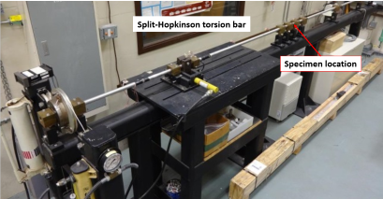
Introduction
Current torsion tester at the Air Force Research Laboratory (AFRL) Munitions Directorate at Eglin AFB is approximately 5 meters in length
Small sample geometries result in inaccuracy and inefficiency
Figure 2.1: Existing Torsion Machine
“DISTRIBUTION A: Approved for public release, distribution unlimited. (96ABW-2014-1649)”
Reginald Scott

Slide 4
Specimen Geometry
Table 3.1: Specimen dimensions
Small specimens are a result of original plate stock dimensions
Specimens tested:
Aluminum 2024
Titanium 64
Dimension | Measurement (mm)
Total Length | 58.4
Gauge Length | 12.7
Width | 14.3
Inner Diameter | 9.09
Fillet Radius | 27.9
Grip Length | 20
Original plate stock
Blank removed
Sample machined
Figure 3.1: Specimen production
“DISTRIBUTION A: Approved for public release, distribution unlimited. (96ABW-2014-1649)”
Reginald Scott

Slide 5
Design Requirements
Maximum torque output: 100Nm
Machine must fit in an area (footprint) of 1m²
Monotonic (one direction) free-end torsion loading
Free end must allow for axial motion
Compatible with measurement equipment used by AFRL
Budget - $2,000
Reginald Scott

Slide 6
Design Requirements
Goal Statement:
Design a more effective way of testing small specimens in free-end torsion
Reginald Scott

Slide 7
DIC (Digital Image Correlation)
Figure 6.1 DIC setup at Eglin AFRL
Figure 6.2 Example DIC use in torsion sample
“DISTRIBUTION A: Approved for public release, distribution unlimited. (96ABW-2014-1649)”
Brendan Keane

Slide 8
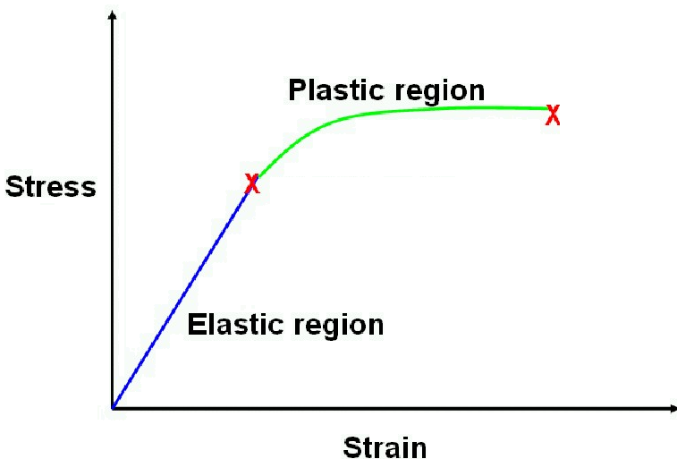
Load Measurement
Current method used by AFRL to measure applied stress:
Strain gage placed on elastic bar
Use shear modulus relationship to output stress
G = $\frac{τ}{γ}$
Figure 7.1: Stress vs. strain plot showing the shear modulus relationship
Brendan Keane

Slide 9
Breakdown of Design
Torsion Tester
Load Generation
Manual Power
Load Measurement
Linear Motion
Compatibility
Gripping Mechanism
Load Application
Friction Reduction
Motor & Transmission
Frame
Material Selection
User Safety
Brendan Keane

Slide 10
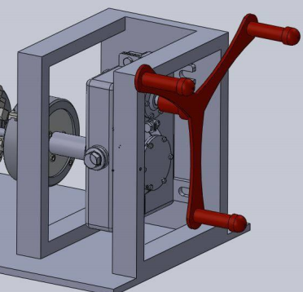
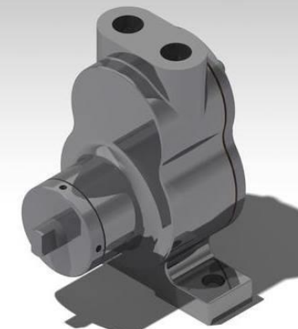
Load Generation
(1)
(2)
(3)
Design | Cost | Weight | Accuracy | Complexity | Maintenance | Variability | Total
Weight Factor | 0.25 | 0.05 | 0.25 | 0.1 | 0.1 | 0.25
(1) Crank System | 5 | 3 | 1 | 5 | 5 | 1 | 2.9
(2) Hydraulic | 1 | 1 | 5 | 1 | 1 | 5 | 3
(3) AC Motor | 3 | 3 | 5 | 3 | 3 | 5 | 4
Brendan Keane

Slide 11
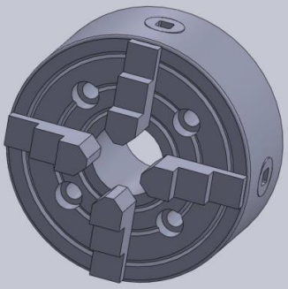
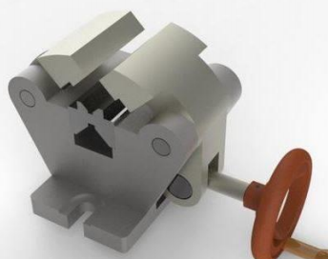
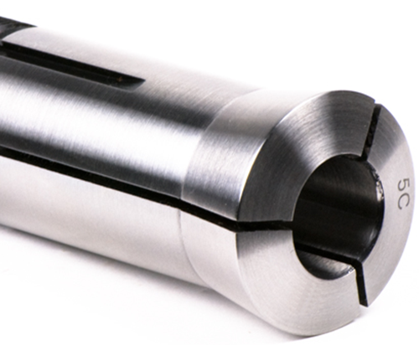
Load Application
(1)
(2)
(3)
(4)
Design | Cost | Weight | Reliability | Complexity | Variability | Total
Weight Factor | 0.25 | 0.15 | 0.3 | 0.1 | 0.2
(1) 3-Jaw Chuck | 5 | 5 | 5 | 3 | 5 | 4.8
(2) 4-Jaw Chuck | 3 | 5 | 5 | 3 | 1 | 3.5
(3) Self-Aligning Vise | 3 | 1 | 3 | 5 | 5 | 3.3
(4) Collet | 5 | 5 | 5 | 3 | 1 | 4
Brendan Keane

Slide 12
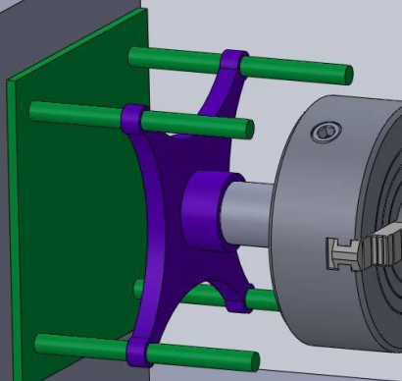
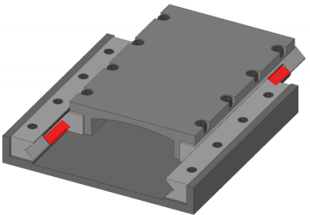
Linear Motion
(1)
(2)
(3)
Design | Cost | Weight | Durability | Complexity | Total
Weight Factor | 0.4 | 0.2 | 0.2 | 0.2
(1) 4 Rail Ball Bearing Guide | 1 | 2 | 1 | 1 | 1.4
(2) 2 Track Roller Bearing Guide | 3 | 5 | 5 | 5 | 4.2
(3) 2 Rail Ball Bearing Guide | 5 | 5 | 3 | 3 | 4.2
Brendan Keane

Slide 13
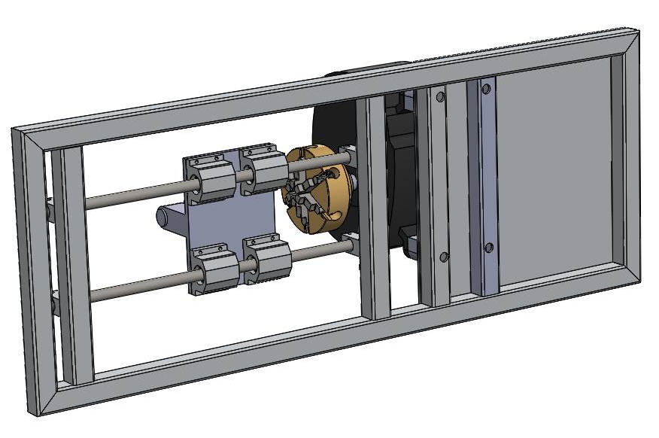
Frame
Design Considerations:
Strength
Machinability
Weight
Cost
Material Selection:
Steel
Figure 12.1: Frame design
Brendan Keane

Slide 14
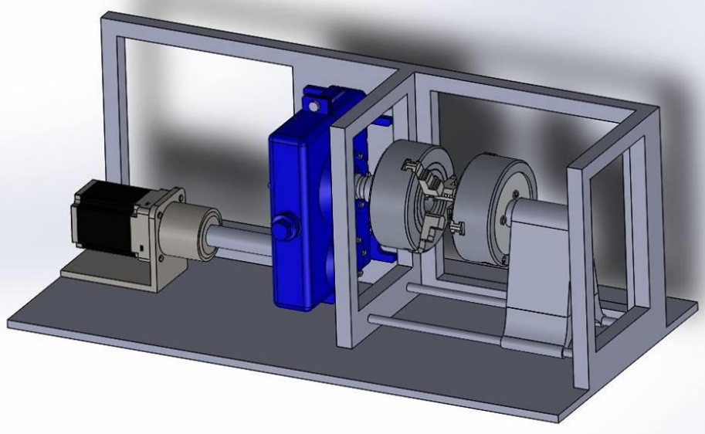
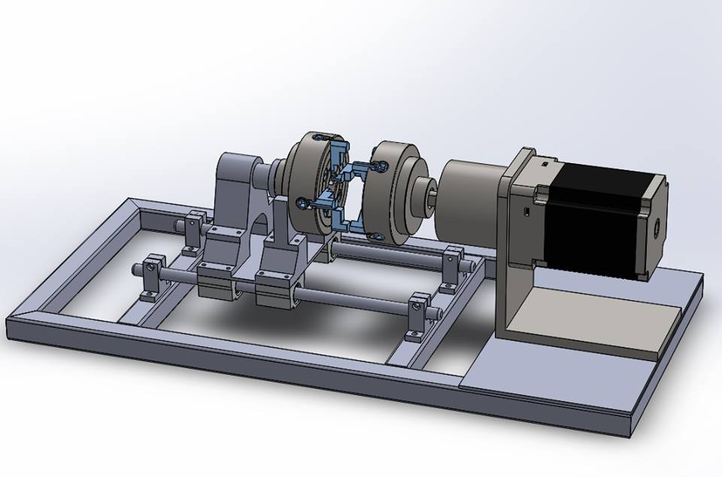
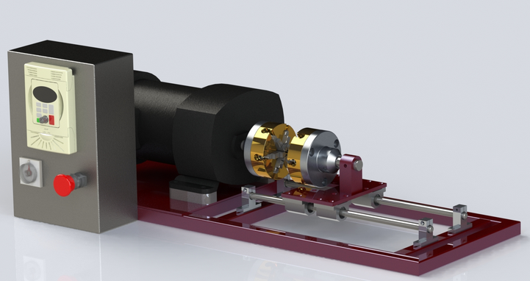
Concept Evolution
Brendan Keane

Slide 15
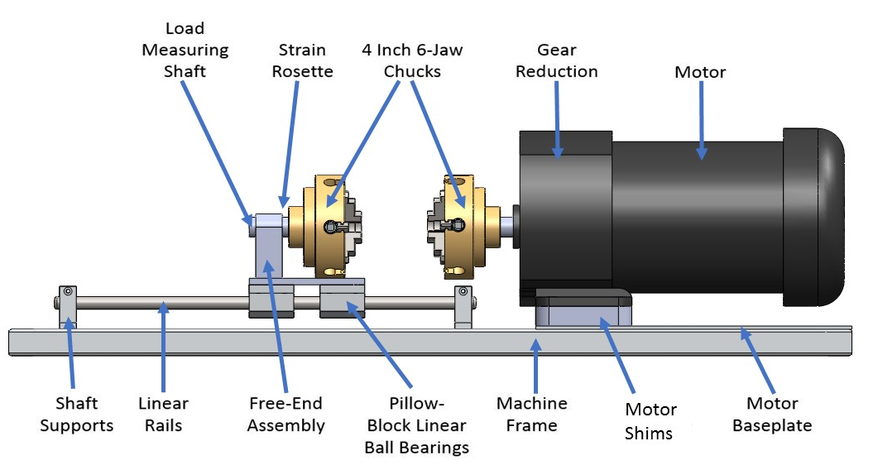
Design Overview
13”
Steel Shaft
Figure 5.1: CAD representation of design
32”
Logan McCall

Slide 16
Load Generation: AC Gearmotor
Vendor: Grainger
Rpm: 18
Gear ratio: 95:1
Max torque: 116 Nm
Weight: 26 lbs
Figure 15.1: AC Gearmotor
Logan McCall

Slide 17
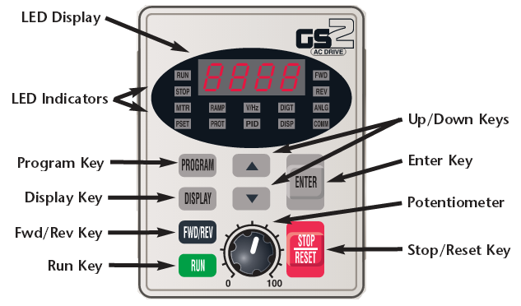
Motor Control: VFD
Variable Frequency Drive (VFD)
Vendor: Automation Direct
Single phase input, three phase output
Digital keypad
Forward and reverse
Expandable
Figure 16.1: VFD keypad
Logan McCall

Slide 18
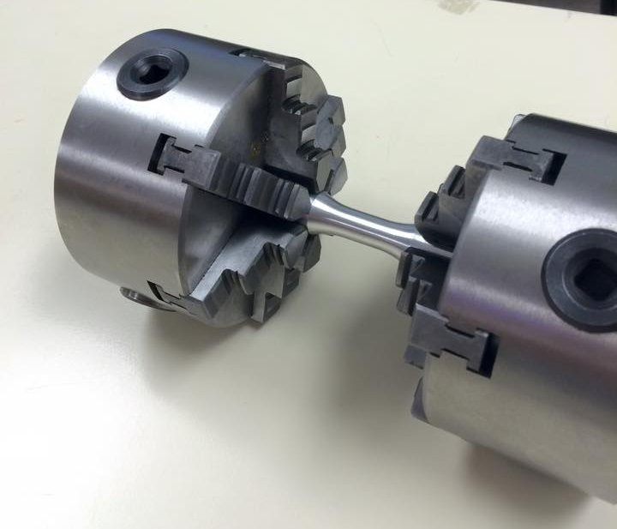
Load Application: 6-Jaw Chuck
Vendor: LittleMachineShop
Weight: 6.4 lbs
Outer diameter: 3.94 in (10 cm)
Inner diameter: 1.02 in (2.59 cm)
Figure 17.1: 6 Jaw Chucks holding specimen
Logan McCall

Slide 19
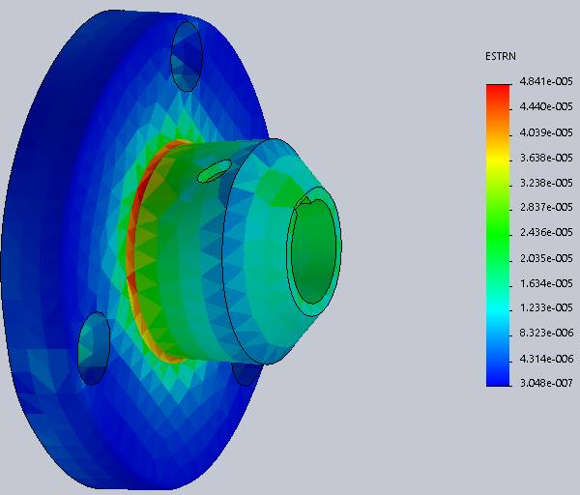
Load Measurement
Coupler material: Al 6061
Coupler properties
Shear modulus: 26 GPa
Shear strength: 76 MPa
Outer diameter: 1.75 in (4.45 cm)
Inner diameter: 0.75 in (1.90 cm)
Figure 18.1: FEA performed on coupler showing strain developed under a simulated load
Logan McCall

Slide 20
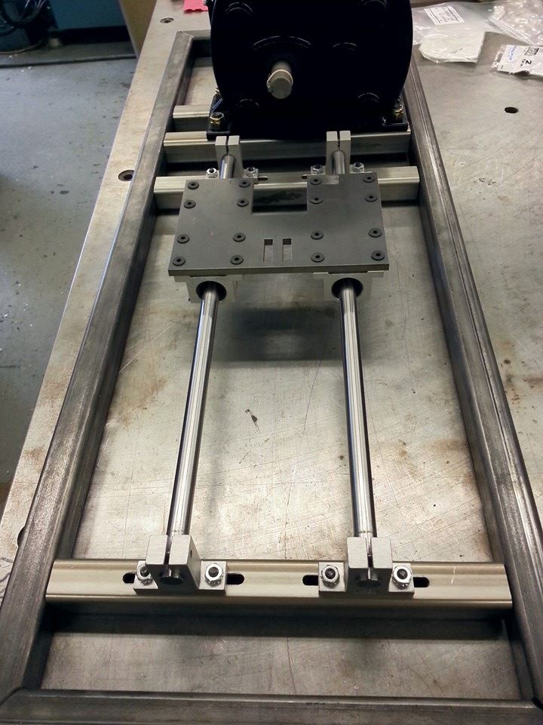
Linear Motion: 2 Rail Ball Bearing Guide
Vendor: Grainger
½ inch steel rails
Slot design to ensure alignment
Figure 19.1: Linear guide system
Logan McCall

Slide 21
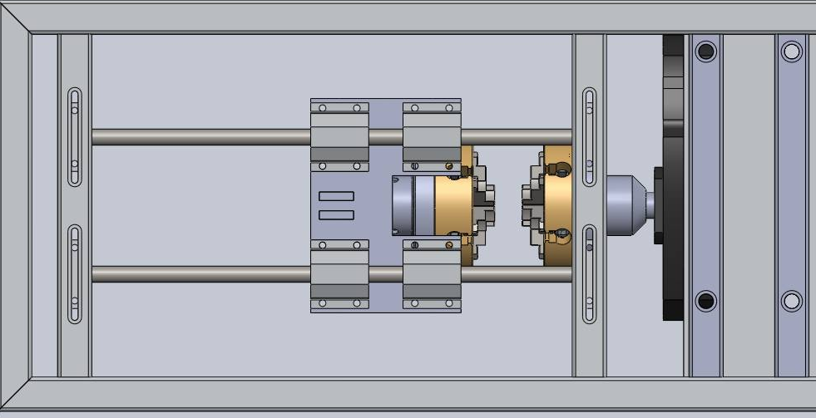
Frame Design
Steel frame
Shape: hollow square shaped cross-section
Dimensions:
1/8 in inner supports – 304 stainless steel
1/8 in outer frame –
low carbon 1015 steel
Figure 20.1: CAD drawing of frame (bottom view)
Logan McCall

Slide 22
Final Design
Logan McCall

Slide 23
Prototype Testing
Mark Swain

Slide 24
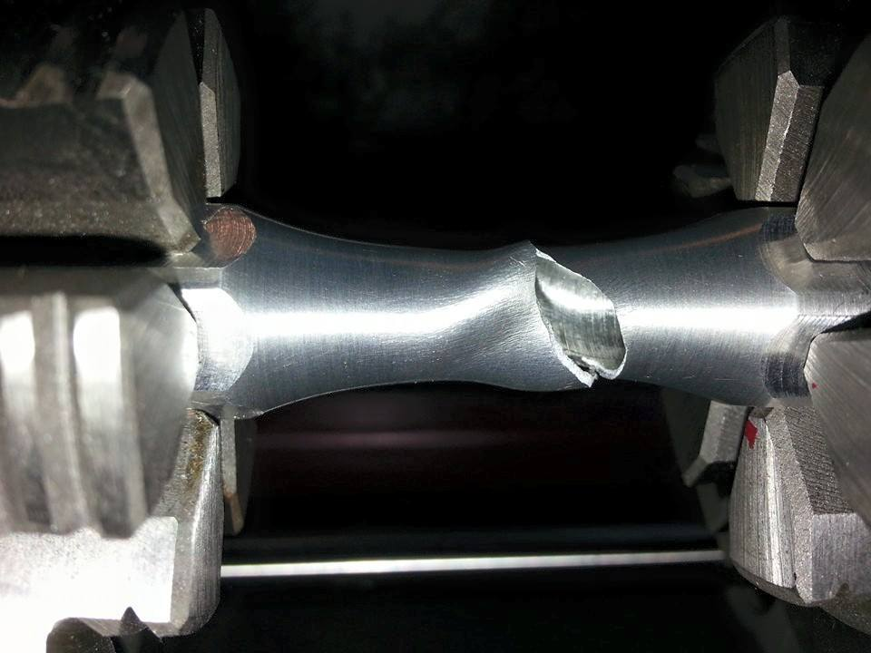
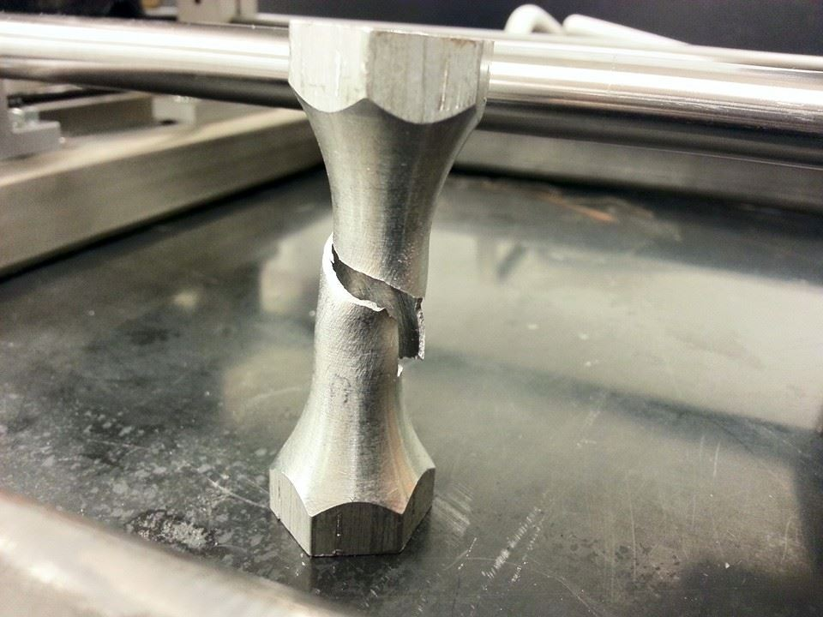
Testing Results
Tester was successful in breaking aluminum specimen
Fracture was at center
During initial testing, free end chuck had slight rotation
Solution: Force fit new connecting rod into free end
Cylindrical grips slipped during initial testing
Solution: Use hex-grip specimen or increase friction on cylindrical specimen
Figure 23.1: Fractured specimens
Mark Swain

Slide 25
Budget
Budget: $2,000
Spent: $1,844
Net: + $156
Mark Swain

Slide 26
Project Progression
Fall
Background research
Design breakdown
Component research
Design analysis
Optimal part selection
Budget breakdown
Purchase orders
Spring
Delivery of parts
Machining
Assembly
Motor/VFD testing
Prototype testing
Troubleshooting
Final assembly
Mark Swain

Slide 27
Conclusion
Maximum torque output: 100Nm
Machine must fit in an area (footprint) of 1m²
Monotonic (one direction)free-end torsion loading
Free end must allow for axial motion
Compatible with measurement equipment used by AFRL
Budget - $2,000
Mark Swain

Slide 28
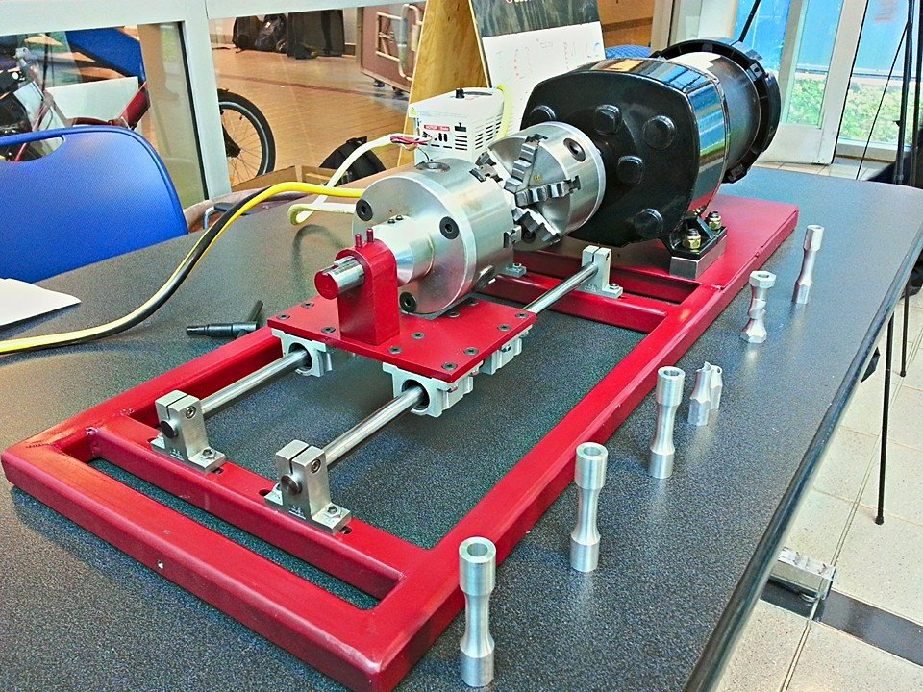
Conclusion
The team was successfully designed and manufactured a tabletop torsion tester for AFRL
What we learned:
Focus on the main customer requirements
Consult as many resources as possible
Teamwork is essential
Unforeseen circumstances
Figure 27.1: Final assembly
Mark Swain

Slide 29
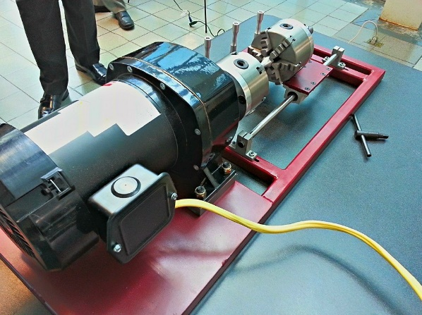
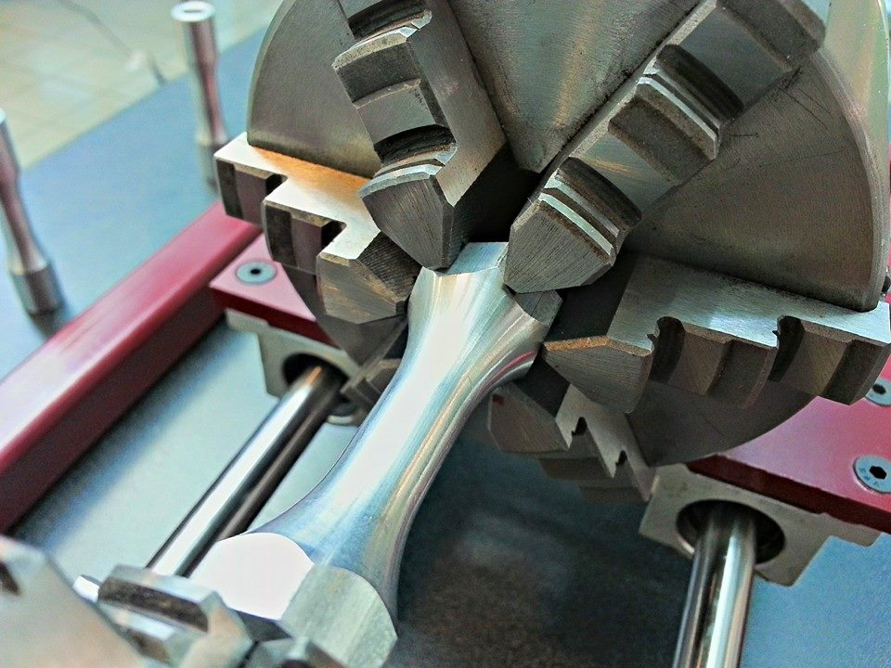
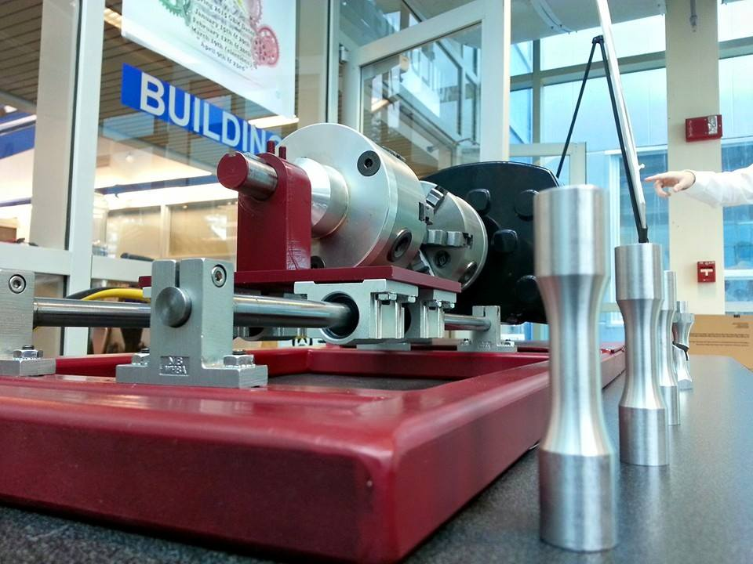
Questions?

Slide 30
References
Carter, B. (2008). Texas Instruments: Op Amp Noise Theory and Applications. Retrieved September 22, 2014
Flater, P. (2014). Tabletop Torsion Test. Eglin, FL: Air Force Research Laboratory.
Ilic, M. (2014, October 11). Clamp for centering. Retrieved from GRABCAD: https://grabcad.com/library/stega-za-centriranje-clamp-for-centering-1
Lathe Chuck. (2014, October 7). Retrieved from GRABCAD: https://grabcad.com/library/lathe-chuck-3
Linear Motion Systems. (2014, September 28). Retrieved from Stock Drive Products: https://sdp-si.com/eStore/coverpg/linearmotion.htm
Mark Swain

Slide 33
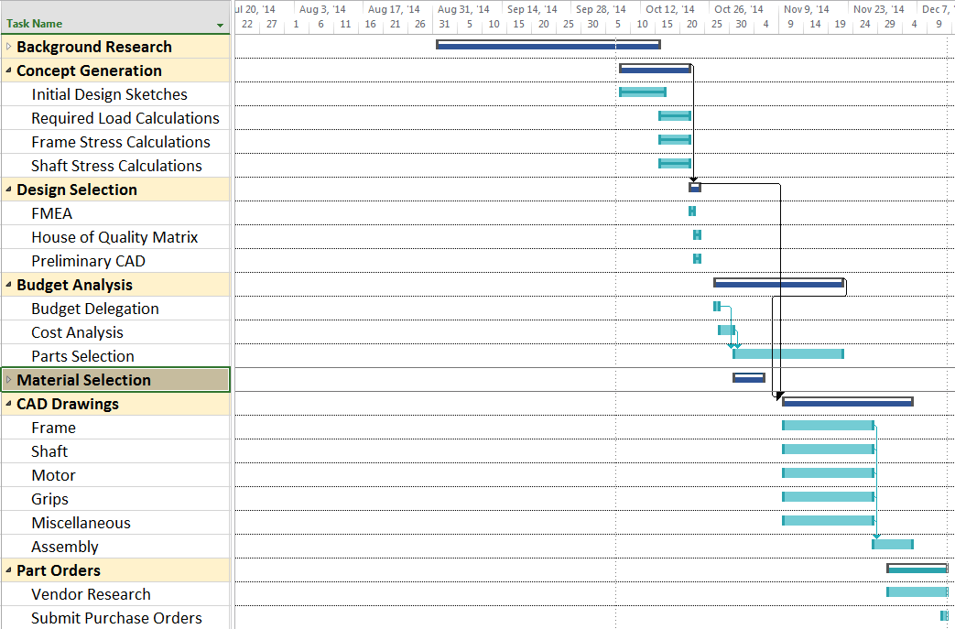
Fall Gantt Chart

Slide 34
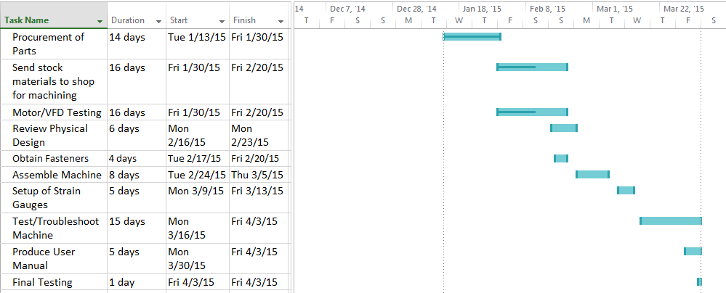
Spring Gantt Chart

Slide 35
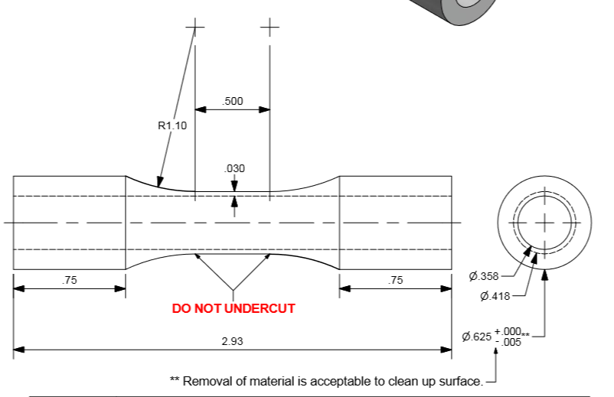
Specimen Dimensions
Units in inches
Brendan Keane

Slide 36
Appendix

Slide 37
