Slide 1
The Gopher Tortoise Scope
Sponsored by
Kim Sash &
The Tall Timbers Research Station and Land Conservancy
In partnership with
Dr. Gupta, Dr. Shih, Dr. Clark, Dr. Harvey, Dr. Frank &
The FAMU-FSU College of Engineering
Presented by
Jane Bartley, ME (team leader)
Bridget Leen, ME
Colin Riley, Lead EE
Also featuring
Jordan Muntain, ME
Lester Nandati, Lead ME
Sina Sharifi-Raini, EE

Slide 2
Overview
Background and objectives
Subsystem breakdown
Specifications
Integration
Prototypes
Project management
Budget overview
Work to be completed
Presented by Jane Bartley

Slide 3
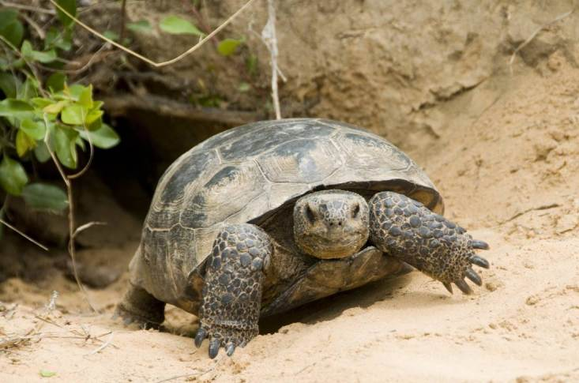
Background
Tall Timbers research focuses on fire dependent ecosystems
One species they study is the gopher tortoise
They are a keystone species
Burrows are a maximum of 15m long
Function of the scope is to take population surveys
Figure 1. Gopher tortoise emerging from his burrow. [1]
Presented by Jane Bartley

Slide 4
Objectives and Goals
Our objective is to create a design that is:
Durable
Capable
Portable
Affordable
“The main goal is to design a mechanism that has testing sensors, better durability, and more advanced video capabilities than the current system in order to enhance the surveying process of gopher tortoises.”
Presented by Jane Bartley

Slide 5
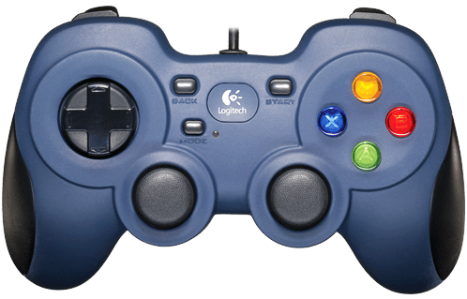
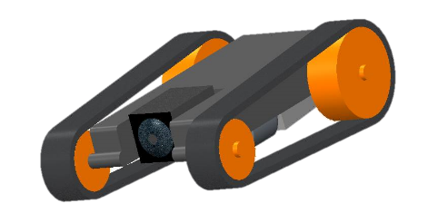
Top Level Design
Rover
Navigates under ground
Carries camera and sensors
User Interface
7 inch screen
Gamepad for controls
Linux based OS
Battery
Tether
Battery
User Interface
RCA Video
Above Ground
Active USB
Below Ground
Rover
Data
Power
Presented by Bridget Leen
Notes:
Tether weight

Slide 6
Rover Body
Chassis
Casing
1/8 inch IR transmitting Plexiglas
Construction
Laser cut
Adhere with silicone sealant
Treads
Lynxmotion Tracks - Polypropylene/rubber
Cut width of 2 inch treads in half
Figure 2. CAD drawing of chassis body.
Presented by Bridget Leen

Slide 7
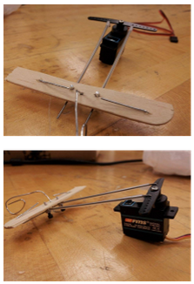
Pan Servo
Simplified design
Aileron system
Panning only
Justifications
Wide angle lens
Simpler mechanism
Less space
Servo motor
Figure 3. Prototype aileron system.
Presented by Bridget Leen

Slide 8
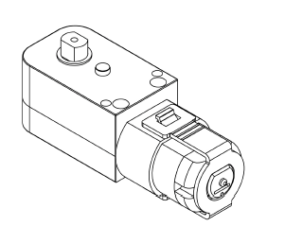
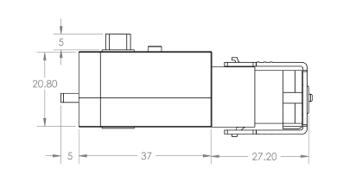
Gearmotors
Gears and motors are fully enclosed
200:1 gear ratio
High torque - 0.706 N·m
90 degree output
Easily positioned in the chassis
Allows shaft to be connected to the axle
Figure 4. 200:1 Plastic gearmotors (dimensions in mm) [2]
Presented by Jane Bartley
Notes:
-Other gearbox was too rudimentary; not enclosed

Slide 9
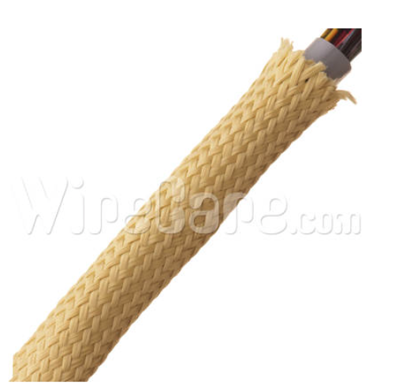
Tether
Decided to use waterproof connections instead of hand-crafted stops.
Features:
Kevlar
50 ft
3/4 in
Tensile strength- 440 ksi
Figure 5. Kevlar expandable braided sheathing. [3]
Presented by Jane Bartley
Notes:
-ksi- killa pounds per square inches

Slide 10
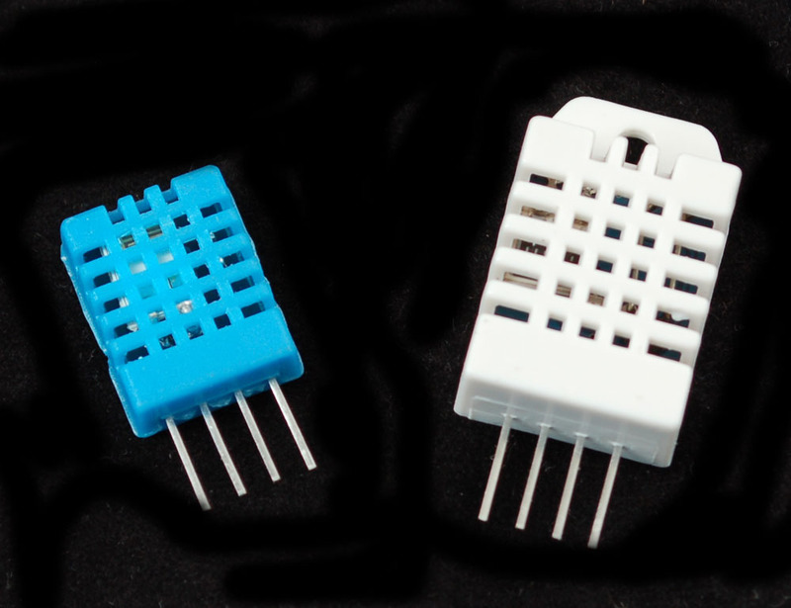
Sensors
DHTxx sensors measure both temperature and humidity
One wire communication
Code written for the DHT11 is compatible with the DHT22
The DHT22 measures:
Relative Humidity from 0% to 100% with ±2% accuracy
Temperatures from -45°C to 125°C with ±0.2°C accuracy
Figure 6. The DHT11 (blue) and DHT22 (white) temperature/humidity sensors. [4]
Presented by Colin Riley
Notes:
Image source: https://learn.adafruit.com/dht/overview
Content source: http://www.adafruit.com/datasheets/DHT22.pdf

Slide 11
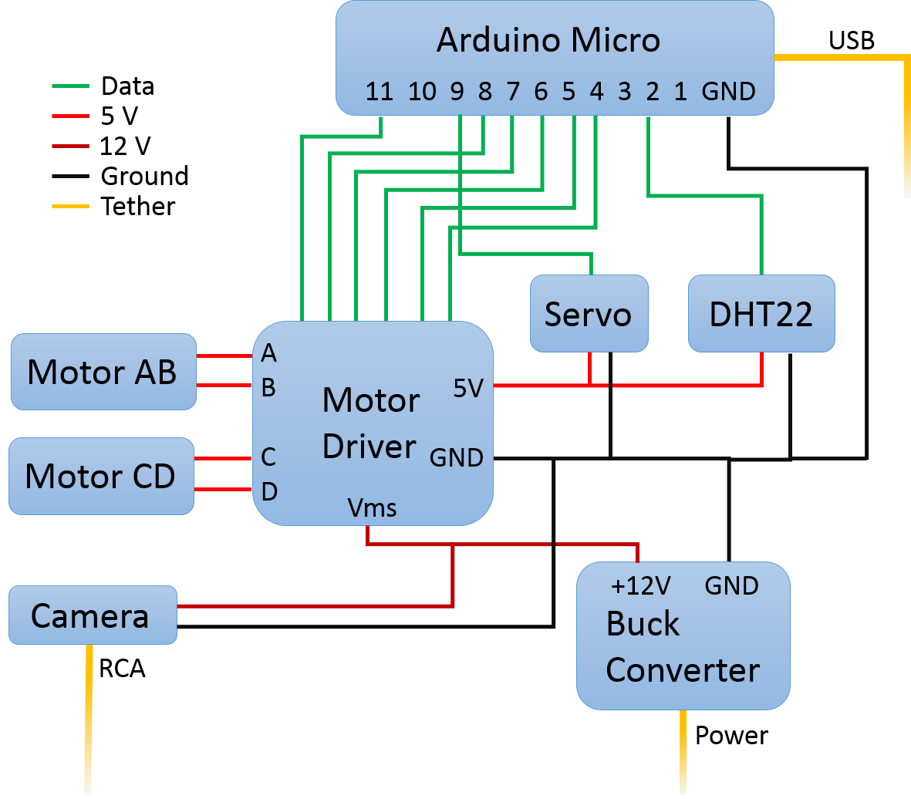
Electrical Schematic
12 V power is supplied by a buck converter connected to the tether
5 V power is supplied by an output pin on the motor driver
All components share a common ground
Arduino Micro controls all data lines
Presented by Colin Riley

Slide 12
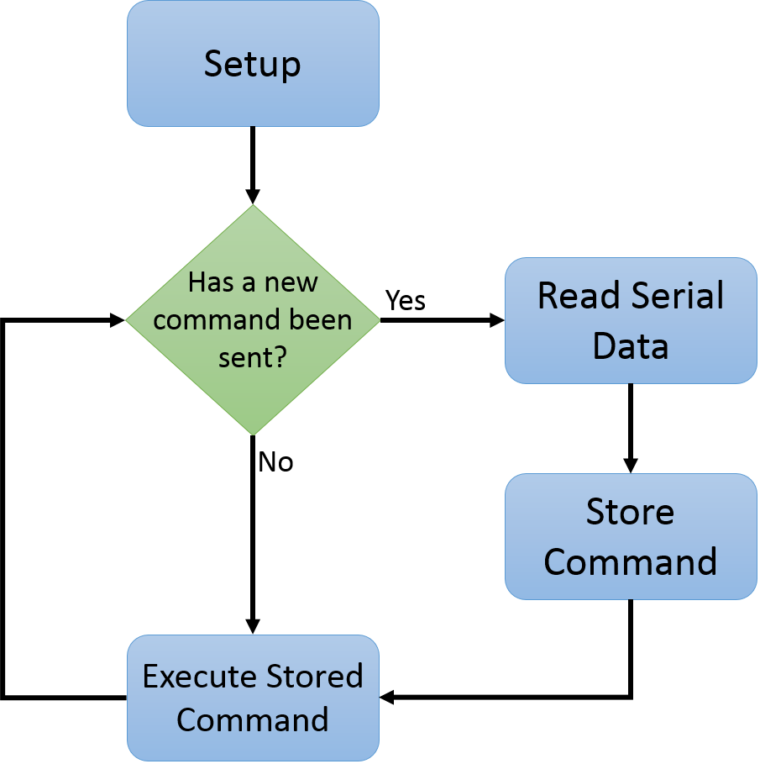
Rover Programming
Main loop of program has been kept as short a possible
Majority of the code is located in functions, which can be called from the main loop
Open-source libraries of code were used instead of custom solutions when possible
Code has been heavily commented to increase readability
Presented by Colin Riley

Slide 13
Rover Electronics Testing
Presented by Colin Riley

Slide 14
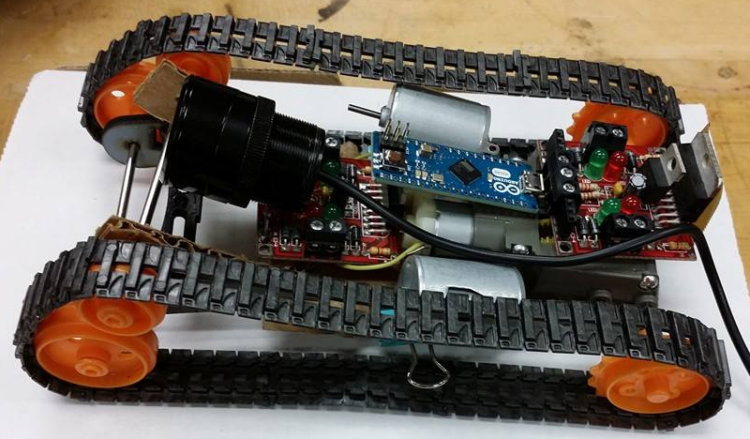
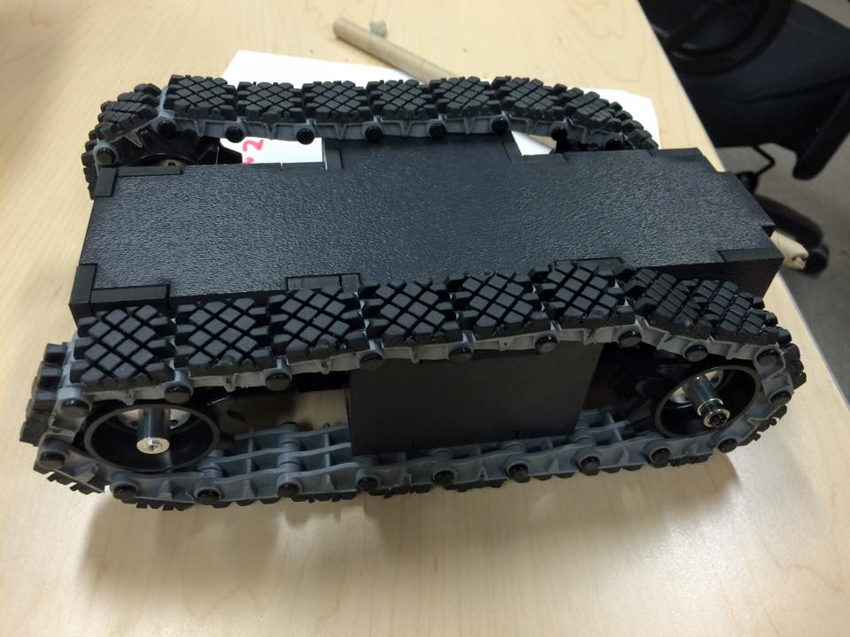
Prototypes
Initial prototype
Built in November
Off-the-shelf hobby kit
Recent progress
Laser-cut ABS chassis body and casing
Custom treads
Simultaneously controlled motor driver, servo and temp/humidity sensor
Figure 7. Initial prototype (top) and recent prototype (bottom).
Presented by Bridget Leen

Slide 15
Budget
Spent about 54% of total budget
Two prototypes
Testing
New components
Still need:
Tether connection
Raw materials
Figure 8. Budget burn chart.
Presented by Bridget Leen

Slide 16
Future Work
Rover
Solder component connections
Outdoor testing
Control testing
Water resistance
Fashion axles
Test durability of the plexiglass
User Interface
Create a program to read commands from the gamepad
Build permanent casing
Presented by Colin Riley
Notes:
Image distortion

Slide 17
Summary
Identified needs and objectives
Integrated components
Began construction of above and below ground subsystems
Completed initial testing
Started construction of a second stage prototype
Presented by Jane Bartley

Slide 18
References
"Gopher Tortoise." Wildlife. Meryman Environmental, n.d. Web. 20 Jan. 2015. <http://merymanenvironmental.com/gopher-tortoise/>.
"Pololu - 200:1 Plastic Gearmotor, 90° Output." Pololu - 200:1 Plastic Gearmotor, 90° Output. Pololu, 2015. Web. 16 Feb. 2015. <https://www.pololu.com/product/1120>.
"Kevlar Expandable Braided Sleeving." Kevlar Expandable Braided Sleeving. Cable Organizer, 2015. Web. 16 Feb. 2015. <http://www.cableorganizer.com/kevlar/#features>.
"DHTxx Sensors." Overview. Adafruit, 29 July 2012. Web. 16 Feb. 2015. <https://learn.adafruit.com/dht/overview>.
Presented by Jane Bartley

Slide 19
Questions?
For more information go to:
eng.fsu.edu/me/senior_design/2015/team21
Presented by Jane Bartley

Slide 20
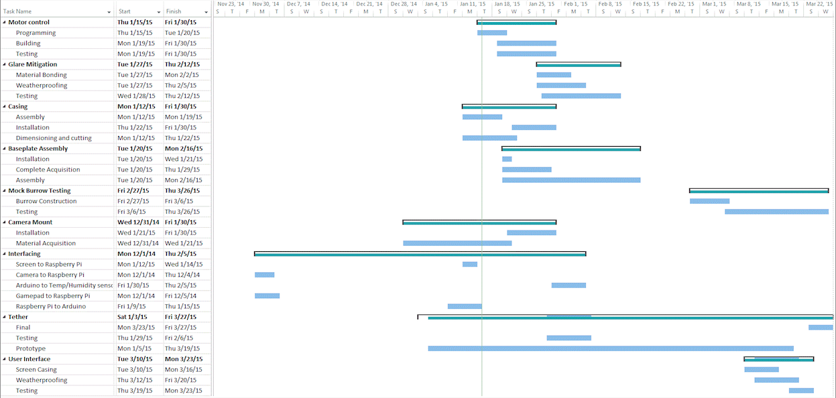
Appendix: Gantt Chart

