Slide 1



The Gopher Tortoise Scope
Sponsored by
Kim Sash &
The Tall Timbers Research and Land Conservancy
In partnership with
Dr. Gupta, Dr. Shih, Dr. Helzer, Dr. Clark, Dr. Harvey, Dr. Frank &
The FAMU-FSU College of Engineering
Presented by
Jane Bartley, ME (Team Leader)
Lester Nandati, Lead ME
Sina Sharifi-Raini, EE
Also featuring
Bridget Leen, ME
Jordan Muntain, ME
Colin Riley, Lead EE

Slide 2
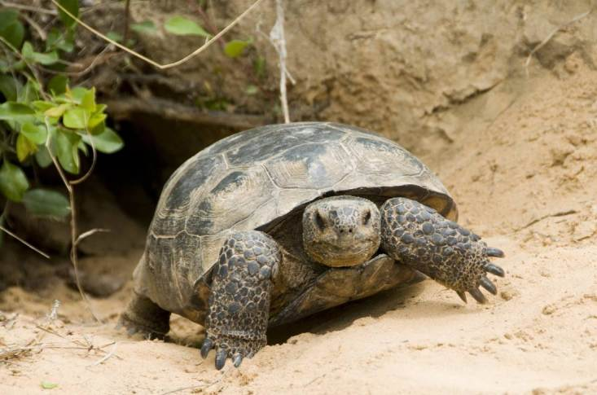
Overview
Background
Needs Analysis and Objective
Component Breakdown
Chassis Determination
and Mobility
Prototype Progress
Budget Analysis
Future Challenges
Scheduling
Summary
Figure 1. Gopher tortoise [1]
Presented by Lester Nandati
Notes:
Plexiglass slide
Picture of tortoise: http://blog.safariltd.com/keystone-species-gopher-tortoise/

Slide 3
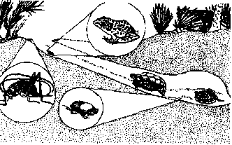
Background
Tall Timbers research focuses on fire-dependent ecosystems
One species they study is the gopher tortoise
  Keystone species
  Burrows are a maximum of 15m long
  Function of the scope is to take population surveys
Figure 2. Gopher tortoise burrow [2]
Presented by Jane Bartley

Slide 4
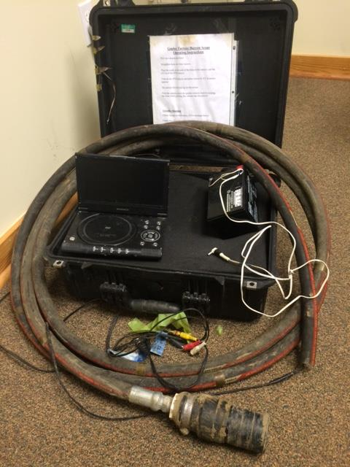
Needs and Objective
Current scope design flaws
  Cumbersome and heavy
  Not waterproof or shockproof
  Lack of data acquisition capability
  Poor visibility from mud and dirt
Our device must be:
  Durable
  Capable
  Portable
  Affordable
Figure 3. Tall Timbers current gopher tortoise scope
Presented by Jane Bartley
Notes:
Scale or description of current scope size

Slide 5
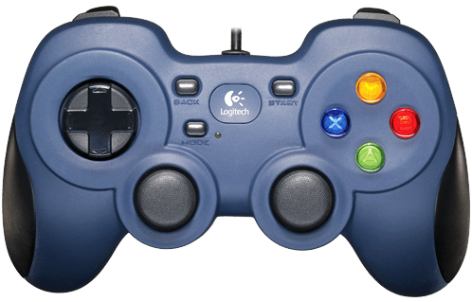
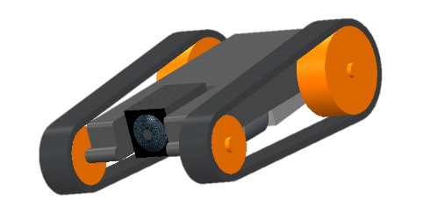
Top Level Design
User Interface
Rover
Battery
  12V 14AH
  5 hour operation
  0.73 kg
Tether
  RCA
  12V power
  Active USB
Battery
User Interface
RCA Video
Above Ground
Active USB
Below Ground
Rover
Data
Power
Presented by Sina Sharifi-Raini
Notes:
Tether weight

Slide 6
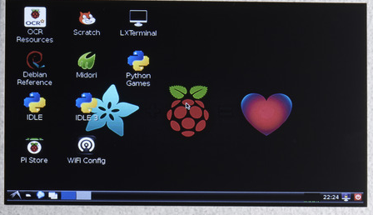
User Interface
Screen
  7 inch diagonal
  800x480 pixels
  Powered by USB
Microprocessor
  Raspberry Pi B+
  Four USB ports
    Screen
    Arduino
    RCA adaptor
    Gamepad
USB
HDMI
RCA from Rover
USB
Microprocessor
USB from Rover
From Battery
Data
Power
Presented by Sina Sharifi-Raini
Notes:
cost

Slide 7
Proposed User Interface
Capture Image
Power Off
Pause Recording
Stop Recording
Start Recording
Rover Motors
Pan/Tilt Motors
Presented by Sina Sharifi-Raini

Slide 8
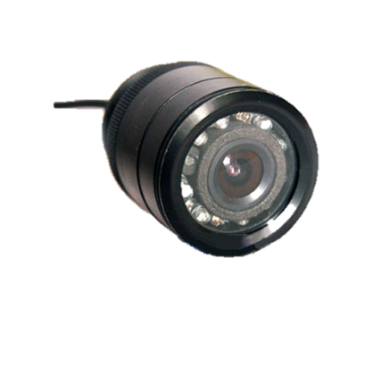
Rover
IR camera with LEDs
  720x480 pixels
  12V power
Two motor drivers
  Four motors
  12V power input
Data acquisition unit
  Temperature by RTD
  Relative humidity
Microcontroller
  Arduino Micro
  Micro USB port
Humidity Sensor
Temperature Sensor
From Battery
USB from UI
Motor Driver
Microcontroller
RCA to UI
Pan/Tilt Motors
From Battery
Chassis Motors
Data
Power
Presented by Sina Sharifi-Raini
Notes:
Label parts to bullet points?

Slide 9

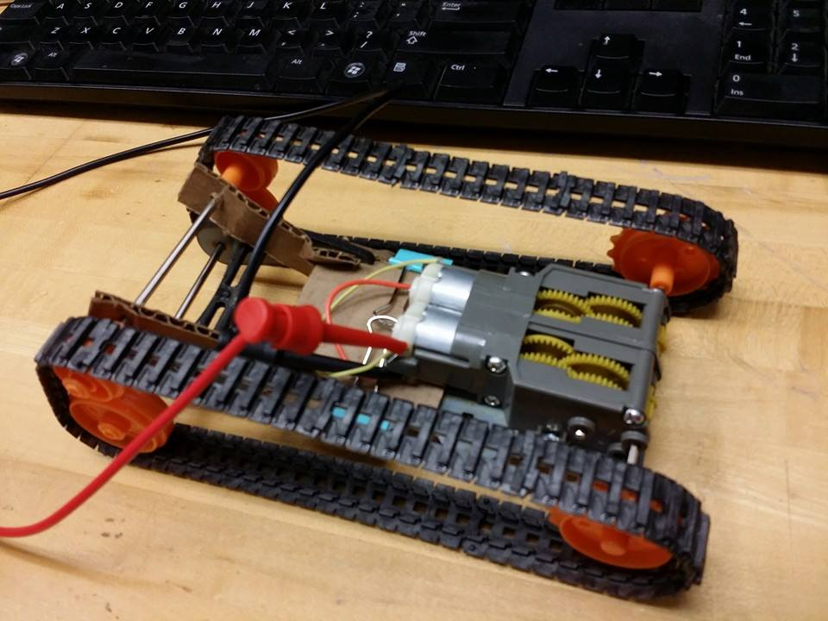
Chassis Determination
Advantage over triangular
  Stability
  Fits in small spaces
  Adjustable height
Advantage over wheeled
  Increased traction
  (51.6 cm² versus 8.4 cm²)
  Less power needed
    (3W versus 6W)
  Less likely to be rendered immobile
Figure 4. CAD assembly and physical prototype [3]
Presented by Lester Nandati
Notes:
Pic of cardboard chassis
Better word than jam

Slide 10
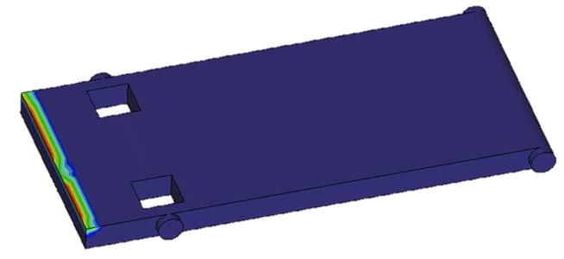
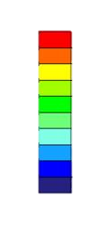
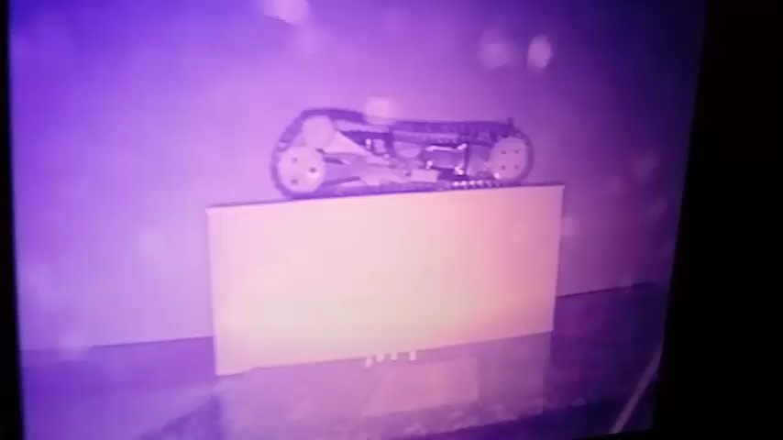
Rover Functionality
177.6 kPa
Material structural integrity
  Maximum stress on body: 177.6 kPa
  Yield strength: 110 MPa
  Flexural strength: 115 MPa [6]
Mobility
  Estimated friction: 5.4 N
  Forward force: 35 N
Casing
  Weight
  IR capable
25.4 kPa
Figure 5. FEM Von Mises stress distribution on body
Figure 6. Plexiglass initial testing
Presented by Lester Nandati
Notes:
Overcome friction resistance from tether
Video from plexiglass
Casing dimensions
Camera field of vision
Curved front glass

Slide 11

Prototype Analysis
Chassis prototype is
  11.4 cm wide
  5.7 cm tall
  0.157 kg
Performed initial tests
  Incline test of 45 degrees
  Confirmed components fit in chassis
Observed obstacles
  Tread durability
  Housing the chassis in plexiglass
Figure 7. Chassis incline test
Presented by Jane Bartley
Notes:
Test angle limits
Average rover speed
Tread durability – at 35 deg, rover starts to slip at top

Slide 12
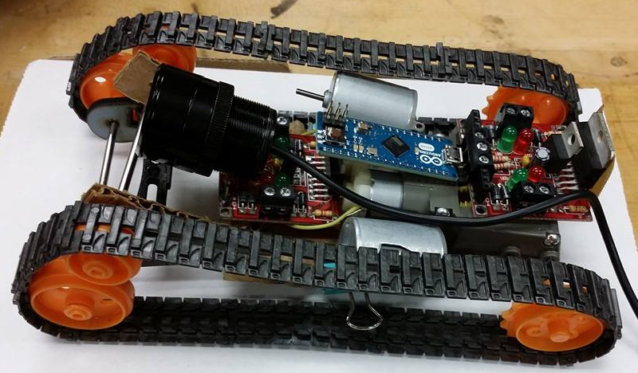
Prototype Analysis
Further improvements
  Complete chassis body
  Plexiglass housing
  Human-computer interaction
Future testing
  Placing camera and pan and tilt system
  Building a mock burrow
  Subterranean mobility
Figure 8. Chassis prototype with components inside the body
Presented by Jane Bartley
Notes:
PIC of fully ‘assembled’ prototype

Slide 13
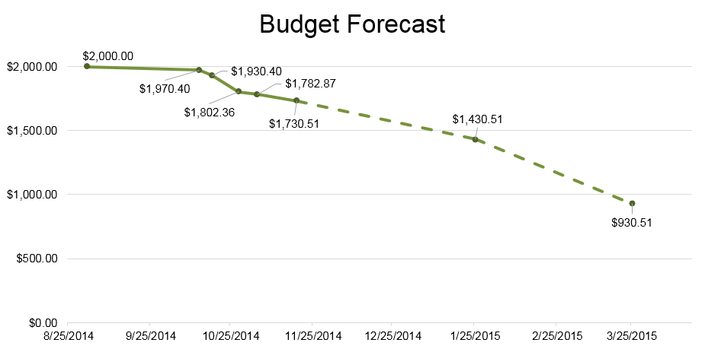
Budget
Spent about 13% of total budget
  First prototype
  Testing
  Permanent
  components
  Spares
Still needed
  Casing
  Treads
  Tether
  Battery
Figure 9. Total budget burn chart
Presented by Jane Bartley

Slide 14
Future Challenges
Controller implementation
Video to Raspberry Pi
Casing
Tether
Weatherproofing
Glare mitigation
Reproducibility
Presented by Lester Nandati
Notes:
Image distortion

Slide 15
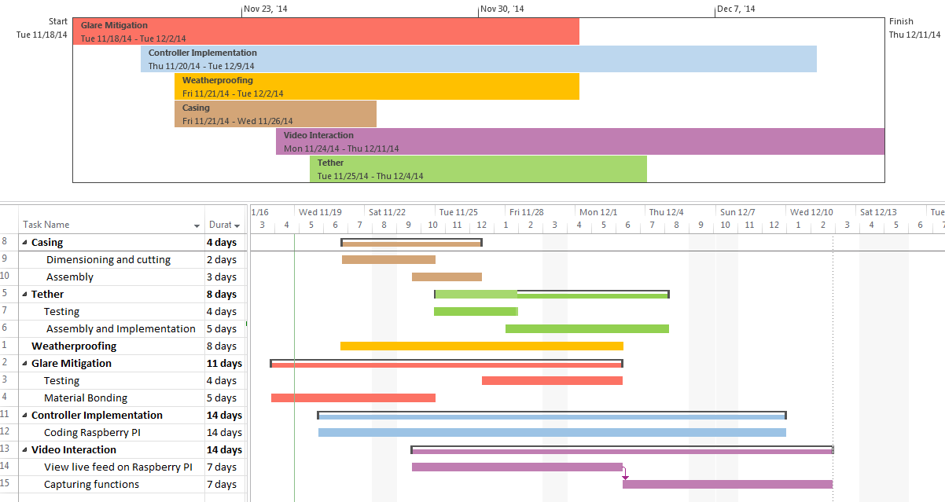
Gantt Chart and Scheduling
Presented by Lester Nandati
Notes:
Project/task based gantt chart for future work

Slide 16
Summary
Identified problems with current scope design
Analyzed component needs
Determined final design concept
Constructed prototype
Began testing
Established a schedule
Presented by Sina Sharifi-Riani

Slide 17
References
Schurr, Jennifer. "Keystone Species: Gopher Tortoise." Safari Ltd. N.p., 25 Aug. 2014. Web. 19 Nov. 2014. <http://blog.safariltd.com/keystone-species-gopher-tortoise/>.
"Florida Scrub Nature Trail." Florida Scrub Nature Trail. N.p., n.d. Web. 10 Nov. 2014.
"Mini RobotShop Rover Chassis Kit." Mini RobotShop Rover Chassis Kit. RobotShop, 2014. Web. 14 Oct. 2014. <http://www.robotshop.com/en/mini-robotshop-rover-chassis-kit.html>.
"6V DC Motor 340mA 14400RPM." Xump Science Supplies, Toys & Gifts. Xump, 2014. Web. 11 Nov. 2014. http://www.xump.com/science/6V-DC-Motor-340mA-14400RPM.cfm.
"Arduino Micro without Headers - 5V 16MHz ATmega32u4." Adafruit. Adafruit, 2014. Web. 11 Nov. 2014. <http://www.adafruit.com/products/1315>.
"Raspberry Pi B+ Broadcom BCM2835 SoC ARM11 700 MHz Low Power ARM1176JZFS Applications Processor Motherboard/CPU/VGA Combo." Newegg. Newegg, 2014. Web. 10 Nov. 2014. <http://www.newegg.com/Product/Product.aspxItem=N82E16813142003>.
"Properties of PLEXIGLAS," Plexiglas. Evonik Industries. 2010. Web 17 Nov. 2014. <http://www.plexiglas.de/product/plexiglas/en/pages/privacy-policy.aspx>
Presented by Sina Sharifi-Riani

Slide 18
Questions?
For more information go to:
www.eng.fsu.edu/me/senior_design/2015/team21/
Presented by Sina Sharifi-Riani

Slide 19
Appendix
Power analysis
 | voltage (V) | current (A) | power (W) | Energy (KJ) per hour
rover motors | 3 | 0.9 | 2.7 | 9.72
camera motors | 6 | 2.68 | 16.08 | 57.888
Raspberry pi b+ | 5 | 0.6 | 3 | 10.8
Arduino Micro | 5 | 1 | 5 | 18
IR camera | 12 | 0.13 | 1.56 | 5.616
Gamepad | 5 | 0.5 | 2.5 | 9
Video display | 5 | 0.5 | 2.5 | 9
Total |  | 6.31 | 33.34 | 120.024
Battery: 168 Wh = 605 kJh

Slide 20
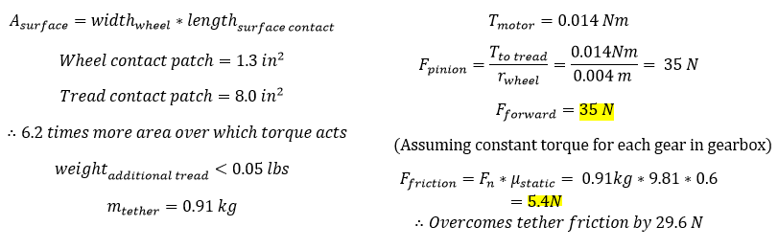
Appendix

