Slide 1
The Gopher Tortoise Scope
Sponsored by
Kim Sash &
The Tall Timbers Research Station & Land Conservancy
In partnership with
Dr. Gupta, Dr. Shih, Dr. Clark, Dr. Harvey, Dr. Frank &
The FAMU-FSU College of Engineering
Presented by
Jordan Muntain, ME
Bridget Leen, ME
Colin Riley, Lead EE
Jane Bartley, ME (Team Leader)
Lester Nandati, Lead ME
Sina Sharifi-Raini, EE

Slide 2
Overview
Background & field research
Design Process
Component selection
Final design details
Initial testing
Project management
Budget overview
Work to be completed
Presented by Jane Bartley

Slide 3
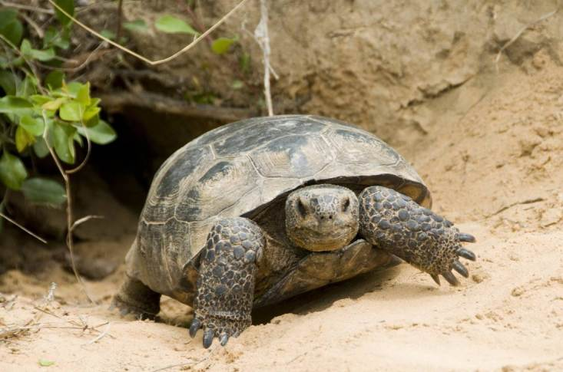
Background
Sponsor of project: Kim Sash, conservation biologist at Tall Timbers
One species she studies is the gopher tortoise
Keystone species
Burrows are an average of 6m long (maximum 15m)
Function of the scope is to take population surveys
Figure 1. Gopher tortoise emerging from his burrow. [1]
Presented by Jane Bartley

Slide 4
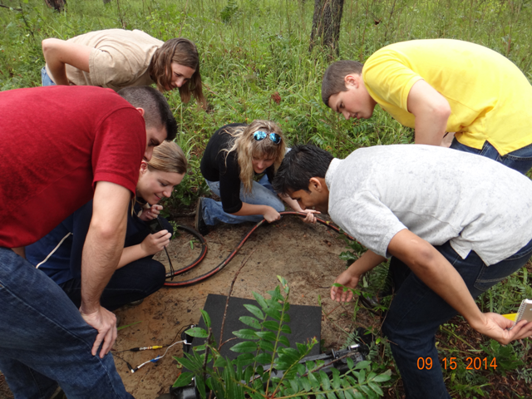
Tall Timbers Expedition
Design team took a trip to Tall Timbers
Scoped several burrows along with Kim
Able to use the current scope to identify issues and items for improvement
Figure 2. Design team scoping a burrow.
Presented by Jane Bartley

Slide 5
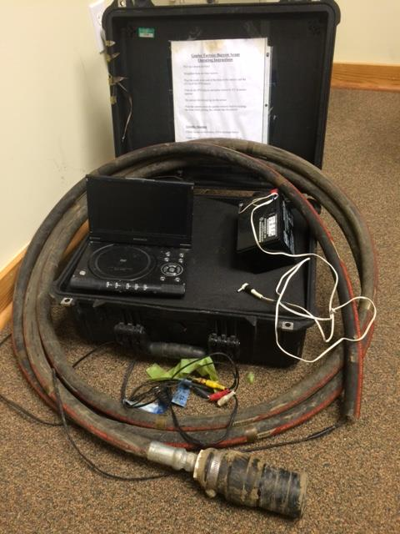
Current Scope
Current scope design flaws:
Cumbersome and heavy
Not waterproof or shockproof
Lack of data acquisition capability
Poor visibility from mud and dirt
Figure 3. Tall Timbers current scope.
Presented by Jane Bartley

Slide 6
Objectives and Goals
Our objective is to create a design that is:
Durable
Capable
Portable
Affordable
“The main goal is to design a mechanism that has testing sensors, better durability, and more advanced video capabilities than the current system in order to enhance the surveying process of gopher tortoises.”
Presented by Bridget Leen

Slide 7
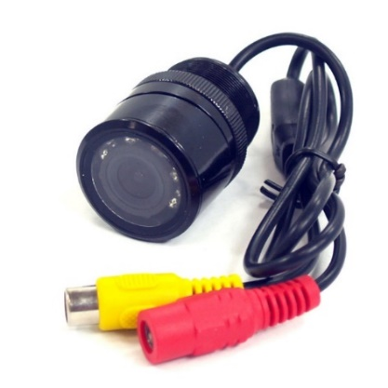
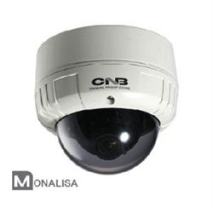
Choosing a Camera
Camera Options
Wide view color infrared camera (top)
7 IR bulbs
Night vision range of 6 meters
All in one security camera (bottom)
Already has weatherproof case
Pan and tilt system built in
Build Pan System
Adding tilt will be excess due to camera’s wide view range
Custom fit to camera and chassis
Smaller than off-the-shelf
Figure 4. Camera designs. [2,3]
Presented by Bridget Leen
Notes:
Compare to the all in one system
Get those notes from Sina

Slide 8
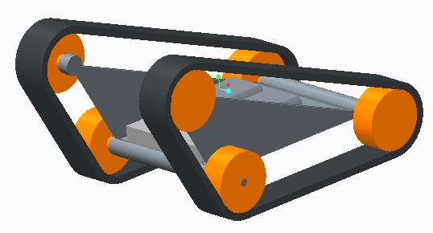
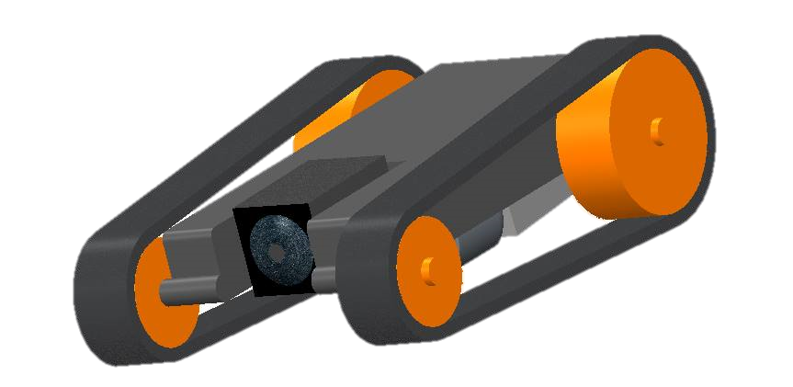
Choosing a Chassis
Linear track
Stability
Fits in small spaces
Adjustable height
Advantage over wheeled
Increased traction
Less likely to be rendered immobile
Figure 4. Triangular tracked and linear tracked chassis.
Presented by Bridget Leen
Notes:
Hoping Jane can add the triangular track CAD to the bottom of this one

Slide 9
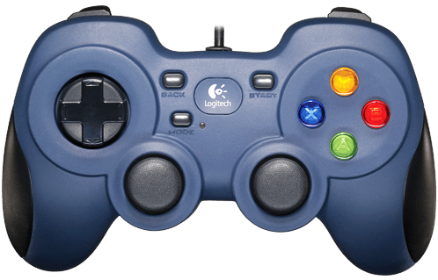
Final Design
User Interface
Rover
Battery
12V
5 hour operation
1.5 lbs
Tether
Video
12V power
Data
Battery
User Interface
RCA Video
Above Ground
Active USB
Below Ground
Rover
Data
Power
Presented by Sina Sharifi-raini

Slide 10
User Interface
Screen
7 inch display
Similar in size to the Ipad Mini
Logitech gamepad
Microprocessor
Raspberry Pi B+
Runs a Linux OS
Functions like a computer
USB
HDMI
RCA from Rover
USB
Microprocessor
USB from Rover
From Battery
Data
Power
Presented by Sina Sharifi-raini
Notes:
cost

Slide 11
User Interface
Capture Image
Power Off
Pause Recording
Pan Motors
Stop Recording
Start Recording
Rover Motors
Presented by Sina Sharifi-raini

Slide 12
Rover
RCA to UI
Infrared camera
Can see in the dark
Limits disturbance
Motors and motor drivers
Temperature and humidity sensor
Microcontroller
Arduino Mircro
Executes simple instructions sent to it by the microprocessor
Pan Servo
Power from Battery
DC Buck Converter
USB from UI
Motor Driver
Microcontroller
Temperature & Humidity Sensor
Chassis Motors
Data
Power
Presented by Colin Riley
Notes:
Label parts to bullet points?

Slide 13
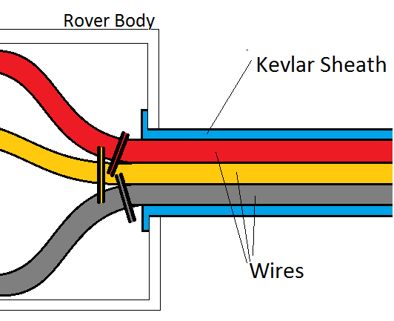
Tether
Electrical wiring
RCA
Active USB
10-gauge speaker wire
Kevlar sheath
Weather/abrasive contact durable
Lightweight (0.21 kg for 15 m) [2]
No steel guide wire
Slack on wires inside body
Stops on wires and sheath
Figure 3: Tether Tension Solution
Presented by Lester Nandati
Notes:
http://www.cableorganizer.com/kevlar/
Diagram of new design

Slide 14
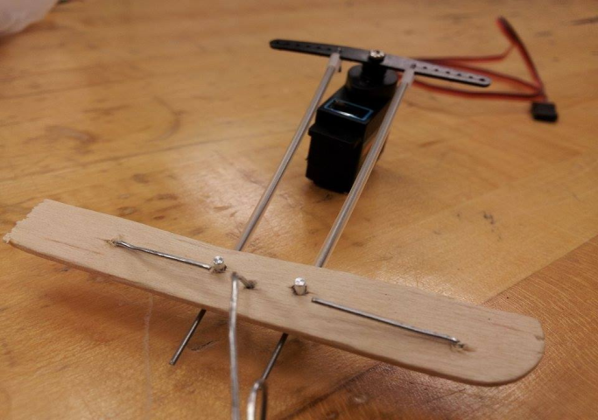
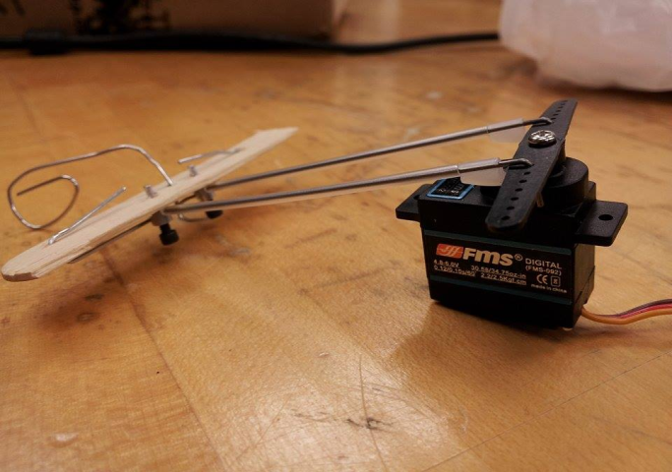
Camera Movement
Simplified design
Aileron system
Panning only
Justifications
Wide angle lens
Simpler mechanism
Less space
Servo motor
Figure 4: Aileron system
Presented by Lester Nandati
Notes:
Pic of aileron

Slide 15
Camera Testing
Materials tested:
Infrared camera
Infrared transmitting plexiglass
Confirmed that the camera works in the dark
Discovered that the orientation of the plexiglass is important
Figure 6. Initial testing of camera and plexiglass
Presented by Colin Riley

Slide 16
Mobility Testing
Materials tested:
Gear box
Motors
Treads
Confirmed that the rover can navigate a variety of terrains
Learned that the final design needs wider, more durable treads
Figure 7. Initial testing of chassis mobility
Presented by Colin Riley

Slide 17
Budget
Still over 70% of budget available
Spending changes
Invest in more expensive parts
Final components
Allocate 20% to prototype testing
Figure 6. Budget burn chart.
Presented by Lester Nandati

Slide 18
Work to be completed
Controller implementation
Video to Raspberry Pi
Casing
Tether
Weatherproofing
Portability
Presented by Jordan Muntain

Slide 19
Conclusion
Conducted field research at Tall Timbers
Determined components
Constructed a final design concept
Tested an initial prototype
Established a schedule for future work
Presented by Jordan Muntain

Slide 20
References
"Gopher Tortoise." Wildlife. Meryman Environmental, n.d. Web. 20 Jan. 2015. <http://merymanenvironmental.com/gopher-tortoise/>.
"Wide View Color Infra Red Camera with 7 IR LEDs." Wide View Color Infra Red Camera with 7 IR LEDs. SuperDroid Robots, n.d. Web. 14 Oct. 2014.
"Wide View Color Infra Red Camera with 7 IR LEDs." Wide View Color Infra Red Camera with 7 IR LEDs. SuperDroid Robots, n.d. Web. 14 Oct. 2014.
Presented by Jordan Muntain

Slide 21
Questions?
For more information go to: http://www.eng.fsu.edu/me/senior_design/2015/team21/index.html

Slide 22
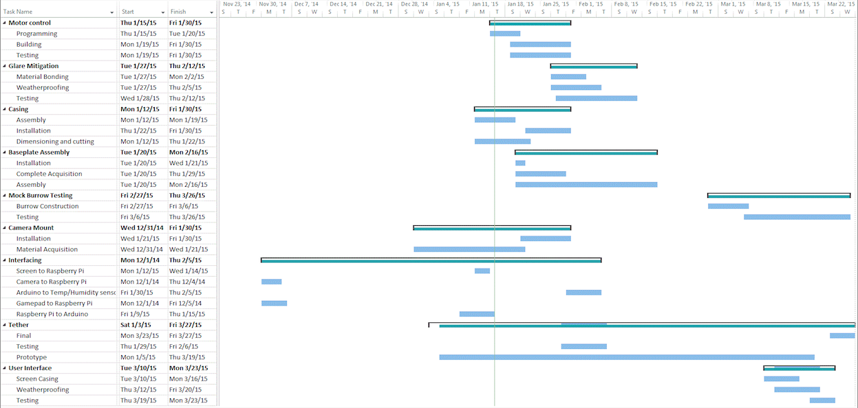
Appendix: Gantt Chart

