Slide 1
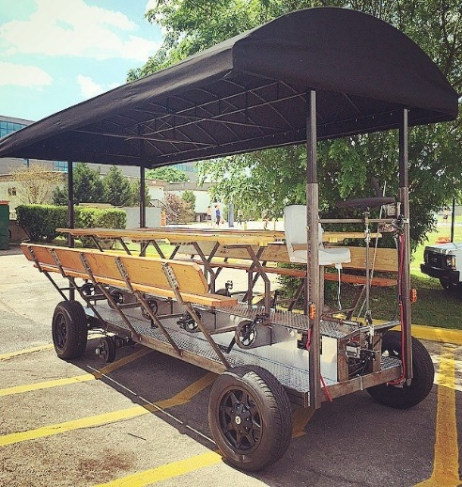
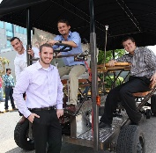
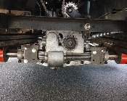
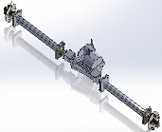
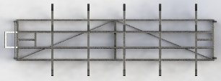
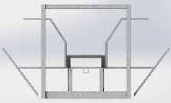
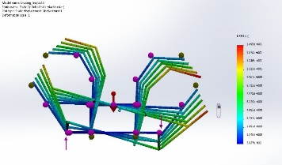
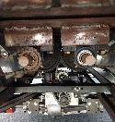
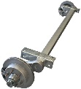
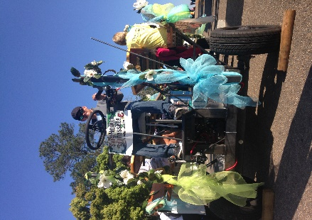
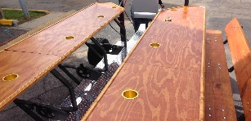
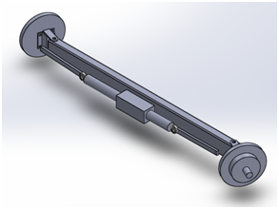
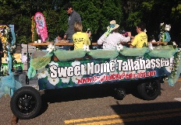
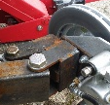
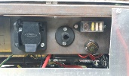
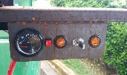
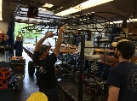
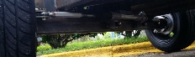
Pedibus 2.0
Team No. 22
Members: Kyle Anderson, Stephen Avery, Alejandro San Segundo, Brett Willenbacher
Background and Purpose
Design and fabricate a fully functional, multi-user, pedal powered vehicle for the purpose of entertainment; Also known as Pedibus, Pub Crawler or Party Bike
Vehicle will join the Capital City Pedicabs current fleet
There are currently no mass productions of this type of vehicle
First full working Pedibus in Tallahassee
Implement new design features not seen before on existing counterparts
The Capital City Pedicabs Pedibus 2.0
A one of a kind, custom built, multi-user, pedal powered, entertainment vehicle. Coming soon to Tallahassee!
The Team
Sponsor:
Ron Goldstein
Team Members:
(Left to Right)
Alejandro San Segundo
Brett Willenbacher
Kyle Anderson
Stephen Avery
Design Requirements & Objectives
Frame and Vehicle Design
10 passenger minimum
Room for extra passengers
Multiple fwd speeds plus reverse gear
Free weight towable
Vehicle Fabrication and Testing
Frame, Powertrain, steering fabrication
Integration of outsourced parts and components
Integration of roof and wooden components
Vehicle Performance Testing (all successful)
Pedaling performance
Max speed
Hill climb
Steering and maneuverability testing
Braking
Advisor:
Keith Larson
Performance Testing and Frame FEA
Performance Test | Result
Pedaling performance (movable by single rider) | Pass
Max speed cadence comfort and vehicle reaction | Pass
Hill Climb (10ᵒ grade climb with 10 passengers) | Pass
Steering testing (ease of steering/curb-to-curb < 45ft) | Pass
Breaking (max speed to full stop < 25ft) | Pass
Final CAD render of Pedibus 2.0
Testing proved a successful and adequate performance for the vehicle under normal operation
Design Specs
Financial Breakdown
The following is a cost breakdown for the parts and material costs associated with the entire fabrication process of the Pedibus 2.0.
Frame FEA Analysis
Torsional Testing | Load Testing
10000lbf applied | 4500lbf on seat posts 500lbf on bar top
Max deformation <10in | Max deformation <0.13in
Structural testing for frame design proved successful showing no failures with a safety factor of 1.3
Frame and Seating
Ladder frame design w/o integrated suspension (8.5ft x 16ft)
Bench seating allows room for extra riders
Powertrain
Dual driveshaft to Peerless 820 transaxle
6 forward speeds plus 1 reverse
Belt friction clutch system for shifting while in motion
Freewheeled driveshaft allow for individual cadence
and no back drivability
Dual drive shaft design eliminates chain crossing
Subcomponent | Cost
Steel | $1155.47
Misc. Materials | $1046.27
Misc. Parts | $6532.58
Transaxle, Brakes & Wheels | $1397.68
Roof | $2945.50
Bar Top | $472.50
Total** | $13,550.00
Rear axle subassembly and rear axle CAD render
**Note- Cost values shown do not include labor costs.
CAD renders of vehicle frame as well as a fabrication progress picture
Future Work Considerations
Fabricate front hitch mount
Fabricate rear bench
Powder Coat frame
Install sound system
Install LED lighting and screens
These future considerations are desired by the project sponsor prior to commercial vehicle operation. These components lie outside of the team’s project scope for the year.
Towing Platform
Torsion axle for towing eliminates need for suspension
Electric drum brakes on towing axle for towing safety
Standard towing hitch mount
Torsional frame FEA analysis
Vertical loading frame FEA analysis
Mounted crank and freewheel hub on drive shaft
The Maiden Voyage
Participated as a float in the Tallahassee Spring Weekend Parade
Recumbent Pedaling Stance
Relaxed stance Reduces Back Stress
Accommodates Wide Range of Rider Heights (5’0”-6’2”) w/o breaking comfort knee bend angle (>25ᵒ)
Rubber torsion axle for towing
Installed torsion axle
Outsourced Fabrication
The roof awning and bar top were locally outsourced in order to achieve a more professional cosmetic finish
Steering
Rack and Pinion design
Curb to curb <45ft
Brass bushings used for smooth rotation
Pedaling stance for riders
Electronics
Modular Lighting (turn signals, hazards)
Remote Charging
Fuse Block with Additional “Hot” Slots
Keyed Battery Shutoff
Rack and pinion steering mechanism on Pedibus and CAD renders
Primary control panel and driver control panel on Pedibus
Finished bar top and roof awning
The proud team captain aboard his ship
The Pedibus 2.0 decorated and ready to begin the parade

