Slide 1
Pedibus Team 22
Team Members:
Kyle Anderson
Stephen Avery
Alejandro San Segundo
Brett Willenbacher
Sponsor:
Ron Goldstein
Advisor:
Keith Larson
Professors:
Dr. Shih
Dr. Helzer
Dr. Gupta
Team No.22
Slide 1 of 20
Alejandro San Segundo
Midterm II

Slide 2
Overview
Design Changes
Component Acquisition
Raw Material
Powertrain Components
Rolling Components
Entering Fabrication Phase
Frame
Powertrain/Steering
Team No.22
Slide 2 of 20
Alejandro San Segundo
Midterm II

Slide 3
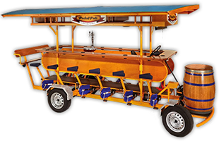
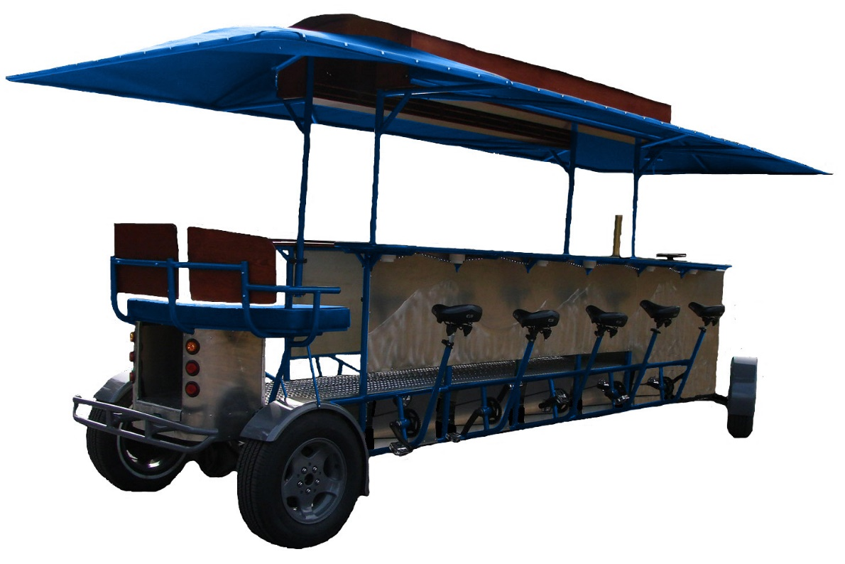
What is the Pedibus?
Team No.22
Slide 3 of 20
Alejandro San Segundo
Midterm II

Slide 4
Design Requirements
Pedibus Requirement | Status
10 pedaling passengers | ✓
Room for extra (non-pedaling) passengers | ✓
Rolling Chassis must be < 1499 lbs (FL law) | ✓
Off the Shelf parts | ✓
Torque output to climb 8° hill grade | ✓
Able to hold 3000 lbs payload | ✓
Free weight transportable | ✓
Reverse gear capability | ✓
Movable on single rider input | ✓
Team No.22
Slide 4 of 20
Alejandro San Segundo
Midterm II
Notes:
Point 1: 10 Peddlers, 1 driver, 1 “bartender”, and 2 non-peddlers
Point 2: Because of Tallahassee’s hills a crawl gear and cruise gears are recomended

Slide 5
Chassis Modifications
Eliminated Suspension (torsion axle for towing)
Recumbent Sitting Style
FEA Analysis Concluded $\frac{1}{8}“$ Tubing Wall Thickness
A500 Structural Box Steel Construction
Manipulated Dimensions and Angles to Reduce Vehicle Width
Team No.22
Slide 5 of 20
Brett Willenbacher
Midterm II

Slide 6
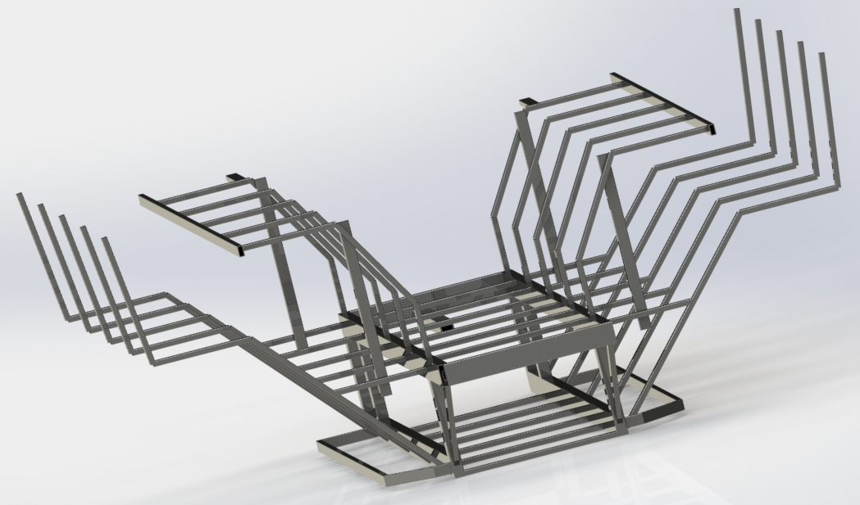
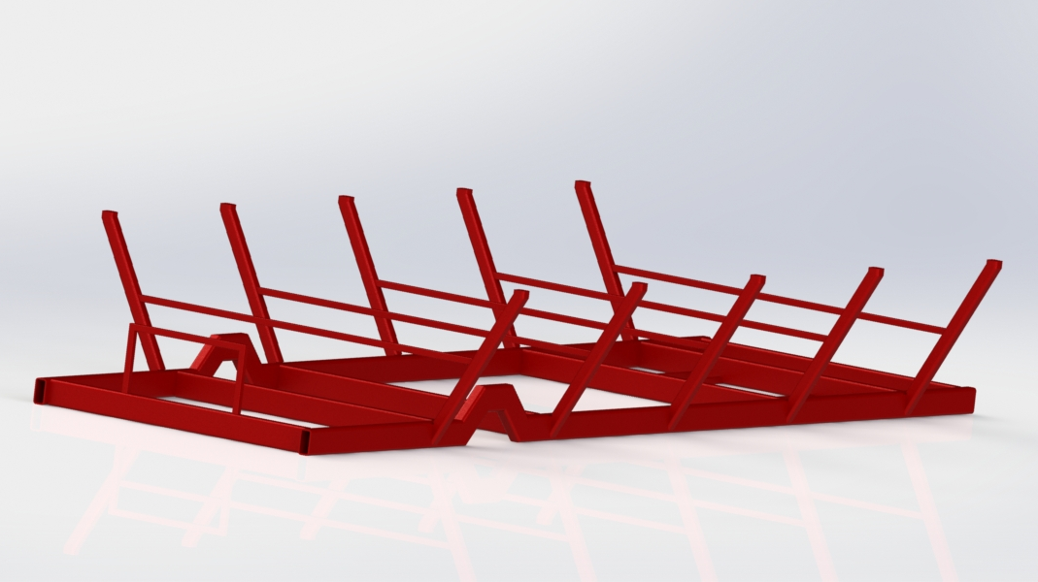
Frame Evolution
Box Design
Ladder Design w/ Suspension
Team No.22
Slide 6 of 20
Brett Willenbacher
Midterm II

Slide 7
Final Frame
Final Ladder Frame Design
w/o Integrated Suspension
Team No.22
Slide 7 of 20
Brett Willenbacher
Midterm II

Slide 8
Torsion Bar Implementation
Eliminates Need for Towing Suspension System
Lockable Steering No Longer Required
Extra Brake Set for Towing Safety
Team No.22
Slide 8 of 20
Brett Willenbacher
Midterm II

Slide 9
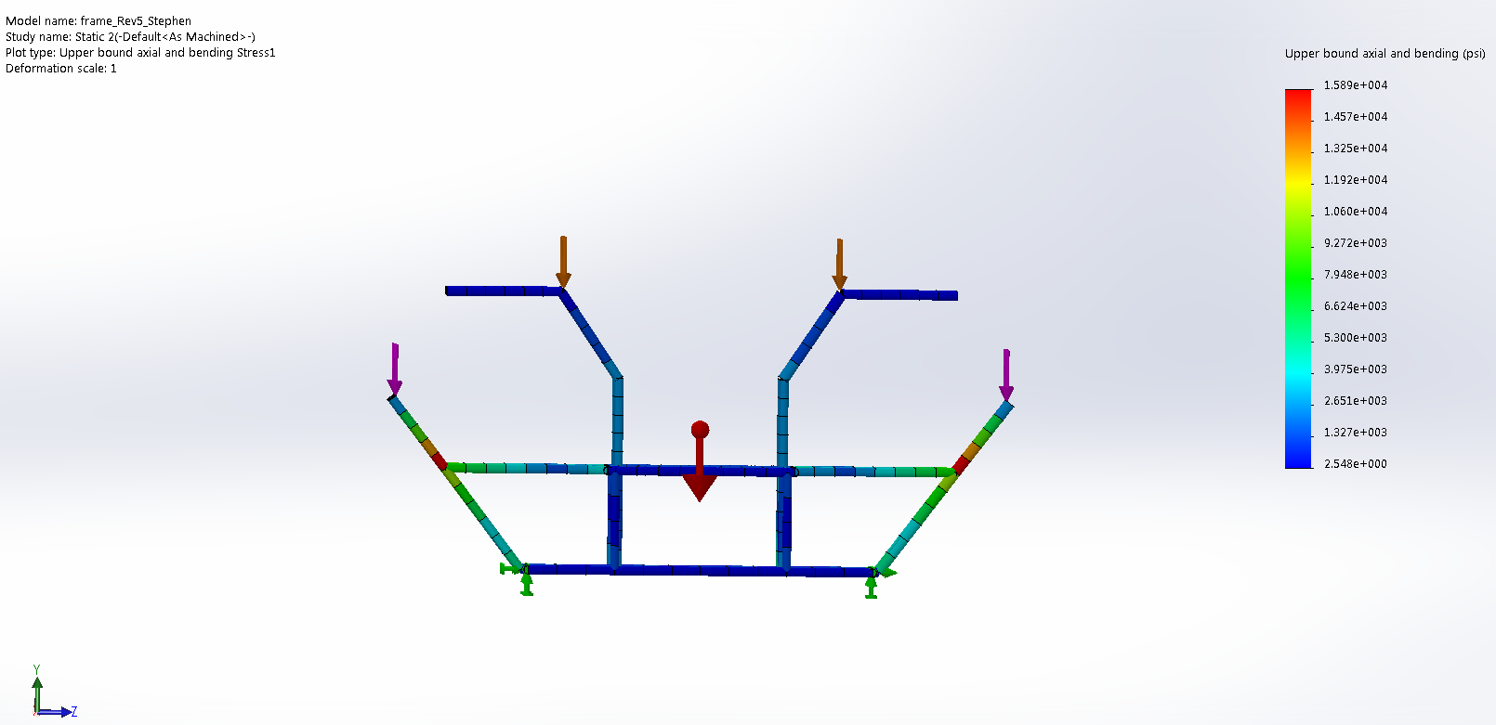
Frame FEA Testing
4500 lb Force on Seat Posts
500 lb Force on Bar Post
1.3 Factor of Safety
Max Deformation of 0.13 in
Team No.22
Slide 9 of 20
Brett Willenbacher
Midterm II

Slide 10
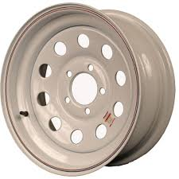
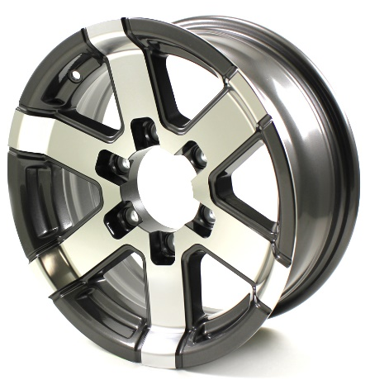
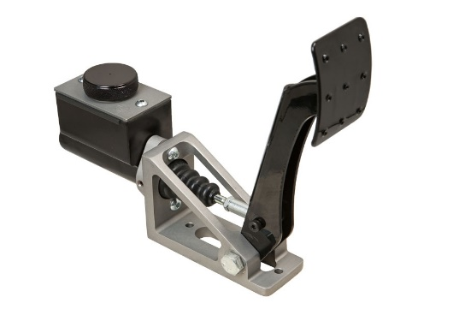
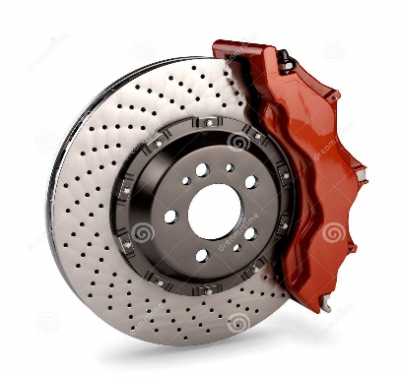
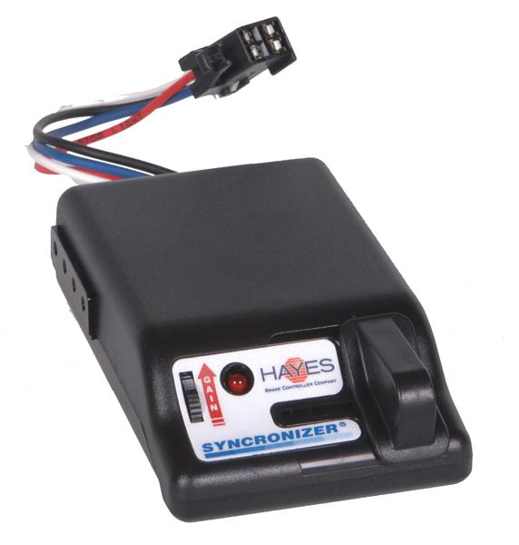
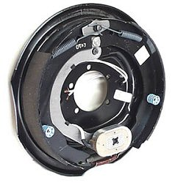
Wheels & Brake System
Axle | Brakes | Wheels | Tires | Bolt Patterns
Rolling | 12” Hydraulic Disc | 16” | 175/50/R16 185/60/R16 | 5 on 4.5”
Towing | 12” Electric Drum
VS.
Team No.22
Slide 10 of 20
Brett Willenbacher
Midterm II

Slide 11
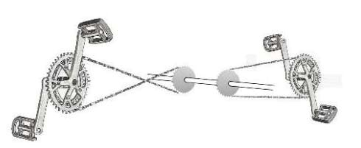
Dual Shaft Design
Eliminates Chain Cross Over
Reduces Torque on Individual Shaft
Reduce Cost and Weight
Simpler Design for Free Coasting
Peddler Input Design Decision Matrix
 | Safety | User Comfort | Complexity | Reliability | Weighted Sums
Cross Chained Linkage | 6 | 6 | 7 | 2 | 132
Dual Drive Shaft Chain Drive | 6 | 7 | 4 | 7 | 161
Pump Motion Crankshaft Linkage | 4 | 4 | 1 | 8 | 120
Crossed Chain System
Double Shaft System
Team No.22
Slide 11 of 20
Alejandro San Segundo
Midterm II

Slide 12
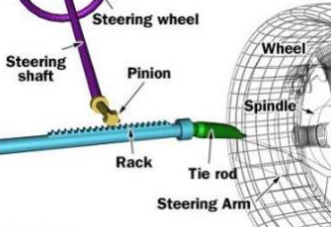
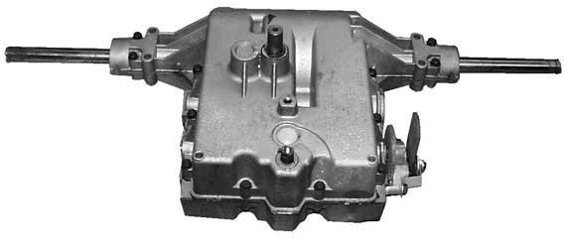
Drivetrain Steering
Peerless 820-040
Manual Transaxle
6 speed Including Reverse
Clutch System
Shift-on-the-Fly
Belt Friction Clutch (adjustability)
Dual Driveshaft to Single Transaxle Design
No Need for Lockable System
Curb to Curb < 45 ft
Reasonable U-Turn Diameter
Rack and Pinion
Easy to Source and Implement
Team No.22
Slide 12 of 20
Alejandro San Segundo
Midterm II

Slide 13
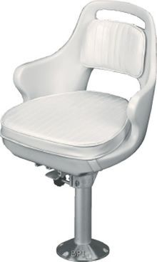
Ergonomics
Driver Chair
Pivoting for Easy Access
Back Support for Reduced Fatigue
Bar Top Positioning
Height and Width Optimized for Comfort
Groove Pattern or Handrail for Rider Support
Free Wheeled Driveshaft
Allows for Individual Cadence
Prevents Rider Back-Driving
Team No.22
Slide 13 of 20
Alejandro San Segundo
Midterm II

Slide 14
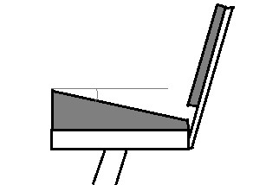
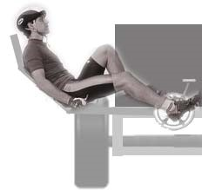
Peddler Ergonomics
Bench Style Seating
Relaxed Stands Reduces Back Stress
Inclined Sitting Ensures 90° Hip Angle
Crank Positioning & Rider Angle
Comfortably Accommodates 5’1” to 6’4” Peddler
Θ ≈ 20°
~20° Incline on bench to ensure proper riding stance
+
=
Compact and Upright Recumbent Stance
Team No.22
Slide 14 of 20
Alejandro San Segundo
Midterm II

Slide 15
Safety and Testing
Large Vehicle Footprint
Increased Stability
Floorboards to Cover Moving Parts✓
Pre-Fabrication Frame Analysis
SolidWorks FEA ✓
MATLAB Speed and Force calculations✓
Post-Fabrication Testing
Road Testing Prior to Release
Team No.22
Slide 15 of 20
Alejandro San Segundo
Midterm II

Slide 16
Sourcing and Ordering
Part | Company/Brand | Estimated Cost | Order Date
Frame (Steel) | Metal Fabrication | $400 | 11/19
Transaxle | Peerless | $700 | 11/19
Bicycle Components | Retrospec and Sunlite | $850 | 11/21
Torsion Bars | Northern Tool | $189 | 11/26
Brake System | Wilwood, Jegs, & Tiedown | $950 | 11/26
Wheels and Tires | TBA | TBA | 11/26
Steering | TBA | TBA | TBA
Miscellaneous | TBA | $450 | TBA
** Prices and sourcing subject to change as per sponsor request
Team No.22
Slide 16 of 20
Alejandro San Segundo
Midterm II

Slide 17
Future Considerations
Adjustable Height Roof
Fiberglass Hardtop or Canvas T-top
Hitch Mounted Modular Accessories
Grill, Cooler, or Additional Seating
Re-evaluation of Electronics
Digital Advertisement
LED Lighting
Sound System
Team No.22
Slide 17 of 20
Brett Willenbacher
Midterm II

Slide 18
Timeline
Team No.22
Slide 18 of 20
Brett Willenbacher
Midterm II

Slide 19
Summary
Frame Finalized
Slight Delay Due to Frame Adjustments
Most Components Sourced and Selected
Ordering Starts Tomorrow!
Team No.22
Slide 19 of 20
Brett Willenbacher
Midterm II

Slide 20
Questions?
Team No.22
Slide 20 of 20
Alejandro San Segundo
Brett Willenbacher
Midterm II

